Slide 1
Corporate Finance
Stock and Bond Valuation: Annuities and Perpetuities
Fall 2024
Prof. Jeffrey Colón

Slide 2
PV Simplifications
Perpetuity
A stream of equal cash flows that lasts forever.
Growing perpetuity
A stream of cash flows that grows at a constant rate forever.
Annuity
A stream of equal cash flows that lasts for a fixed number of periods.
Growing annuity
A stream of cash flows that grows at a constant rate for a fixed number of periods.

Slide 3
Perpetuity
Example
You’ve won a lottery that promises to pay you $100 per year for the rest of time. How much could you sell this promise for if the discount rate is 5%?
Answer: $100 /. 05 = $2,000
C₁
C₂
C₃
…
0
1
2
3

Slide 4
Growing Perpetuity
Growing Perpetuity: A growing stream of cash flows that lasts forever.
C₁
C₁*(1+g)
C₁ *(1+g)²
…
0
1
2
3

Slide 5
Growing Perpetuity
Query: A stock is expected to pay a $1 dividend next year, and the dividend is expected to grow by 5% p.a. forever. What’s the value of the stock if the interest rate is 10%?

Slide 6
Perpetuity and Growing Perpetuity
Growing Perpetuity
Perpetuity

Slide 7
Query
What’s the perpetuity formula?
What’s the growing perpetuity formula?

Slide 8
Annuity
Annuity: A stream of constant cash flows with a fixed maturity.
C₁
C₂
C₃
C_{T}
0
1
2
3
T

Slide 9
An Annuity is Just the Difference Between Two Perpetuities
Consider two perpetuities:
P₀: first payment begins at T₁
P₄: first payment begins at T₅
Subtracting the P₄ payments from the P₀ payments leaves a 4-year annuity, A₄
The PV of P₀ : C/r and the PV of P₄ is C/r * 1/(1+r)⁴
The PV of A₄ : C/r – C/r* 1/(1+r)⁴ or C/r * [1 - 1/(1+r)⁴]
P₀
PV of P₀ = C₁/r
C₃
C₅
. . . .
C₁
C₂
C₄
T
0
1
2
3
4
5
A₄
P₄
PV of A₄ = C₁/r – C₁/r* 1/(1+r)⁴
PV of P₄ = C₁/r * 1/(1+r)⁴

Slide 10
Annuity Example
You can afford a $400 monthly car payment. If the interest rate is 7% APR on a 36-month loan, what’s the maximum amount you can borrow?
Answer:

Slide 11
Growing Annuity
A growing stream of cash flows with a fixed maturity.
C
C*(1+g)
C *(1+g)²
C*(1+g)^{T-1}
0
1
2
3
T

Slide 12
Growing Annuity
Example
At retirement, you have earned a pension (dream on) that will pay you $20,000 per year for 40 years starting in one year and increase the annual payment by 3% per year. What’s the PV of the payments if the discount rate is 10%?
Answer:

Slide 13
Annuity and Growing Annuity
Annuity
Growing Annuity

Slide 14


Future Value of an Annuity
You plan to save $10,000 per year starting 1 year from now for 40 years. If you can earn 7% p.a. on the savings, how much will you have in 40 years?
Three Approaches:
Brute force: Use the FV formula for each of the 40 cash flows and add them together. Ouch.
Use the FV function (Excel or a calculator)
Find the PV of a 40-year $10,000 annuity and then use the FV formula. Clever.
Answer: $1.99M

Slide 15
Query
What’s the formula for an annuity?
What’s the formula for a growing annuity?
What’s the formula for the FV of an annuity?
Give an example of cash flows where you could use the formula for an annuity, growing annuity, and FV of an annuity.

Slide 16
Annuity Application: Pricing a Bond
Your broker calls wants to sell you a bond that promises three annual coupons of $100 (the first paid one year from today) and a principal payment of $1,000 made with the last coupon. If the bond is riskless, what’s its price if the discount rate is 7%?
Using the annuity formula, the PV of the coupons is $262.43: 100/.07(1- 1/(1.07)³)
The PV of the principal is: $816.30.
The price of the bond is: $1,078.73 (PV coupons + PV Principal)

Slide 17
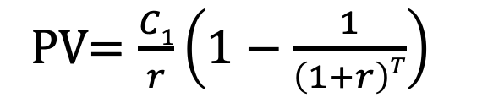
Annuities in Excel
=PV(rate,nper,pmt,[fv],[type])
=NPER(rate,pmt,pv,[fv],[type])
=PMT(rate,nper,pv,[fv],[type])
=FV(rate,nper,pmt,[pv],[type])
=RATE(nper,pmt,pv,[fv],[type],[guess])
PV$=\frac{C1}{r}\left(1−\frac{1}{\left(1+r\right)T}\right)$

Slide 18
How to Value Annuities with Excel
N (NPER) | 40
I (RATE) | 7%
PV | 0
PMT | -10000
FV | $1,996,351 | <-- | =FV(RATE, NPER, PMT, [PV], [type]) =FV(.07,40,-10000,0,0)

Slide 19
Excel Formula: Remaining Principal in Two Steps
You borrow $500,000 for 30 years at 5% APR to purchase a house. How much of the mortgage will you have paid off in 10 years?
Rate | 0.41667% | ← | Why is this the correct input?
NPER | 360
PV₀ | $500,000
PMT | ($2,684.11) |  | =PMT(rate,nper,pv,fv,type)
PV₁₂₀ | $406,710 | ← | =PV(rate,nper,pmt,fv,type), where NPER = 240 and pmt is $2,684.11
PV₀ -PV₁₂₀ | $93,290

Slide 20
Excel Formula: Cumulative Principal
You borrow $500,000 for 30 years at 5% APR to purchase a house. How much of the mortgage will you have paid off in 10 years?
Rate | 0.41667% | ← | Why is this the correct input?
NPER | 360
PV | $500,000
Begin Per | 1
End Per | 120
Cum Prin. | ($93,290) | ← | =CUMPRINC(Rate,Nper,PV, Begin,End,Type) =CUMPRINC(.0041667,360,500000,1,120,0)

Slide 21
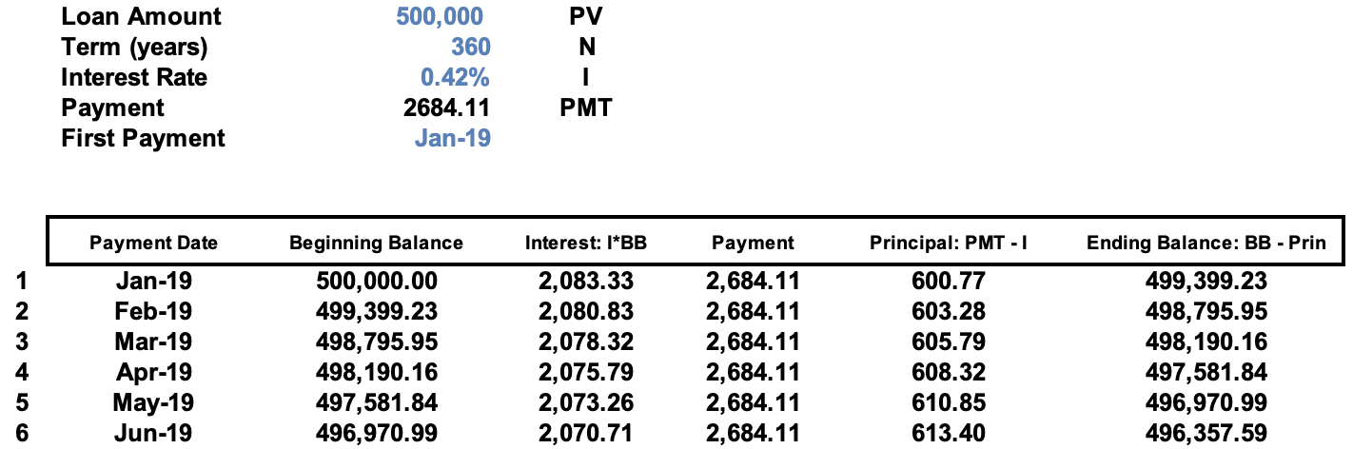
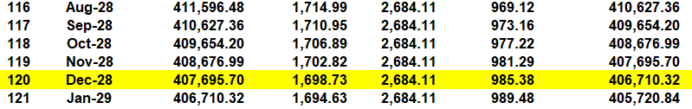
Loan Amortization Example

Slide 22
Stock Valuation and Dividends
If dividends are assumed to remain fixed forever, then the price of stock can be estimated using the perpetuity formula
If dividends are assumed to grow at a constant rate g forever, an estimate of the stock price can be found using the growing perpetuity formula (Gordon Growth model)

Slide 23
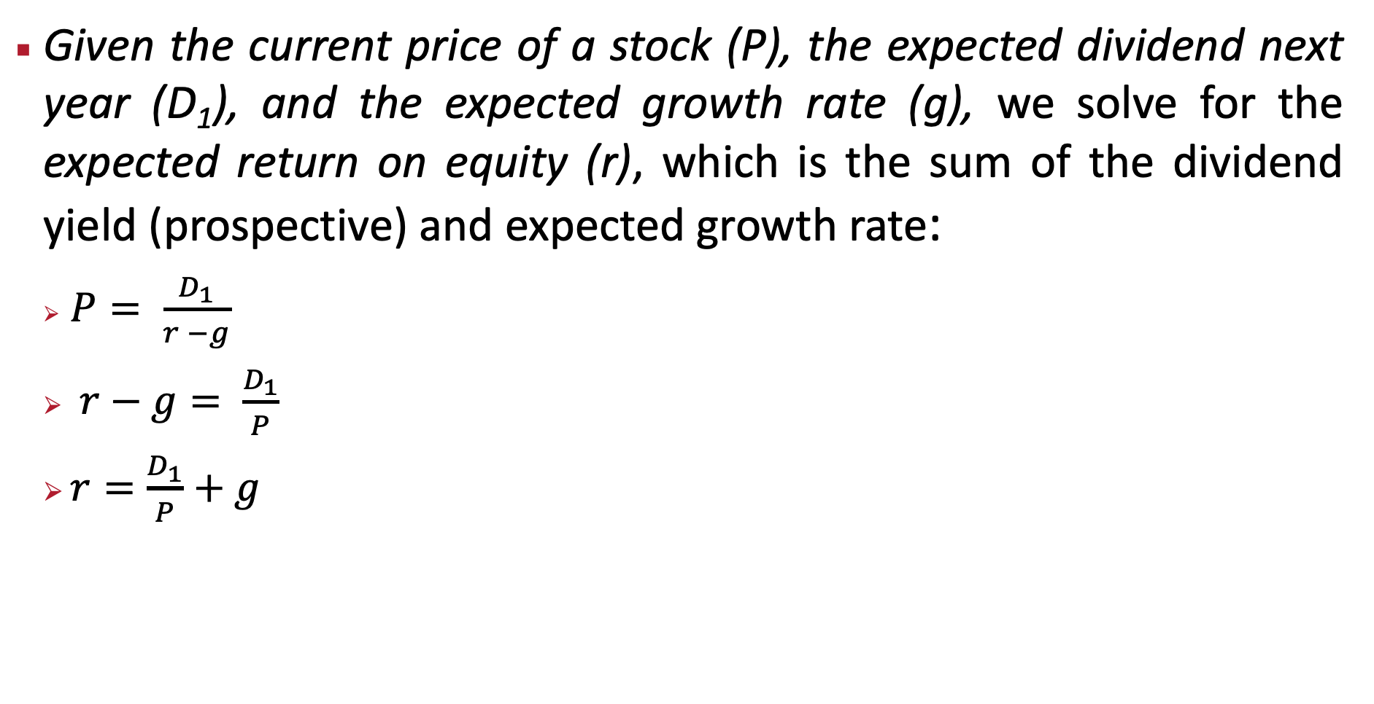
Stock Valuation: Deriving E(r) from Inverting the Constant Dividend Growth Formula
Given the current price of a stock (P), the expected dividend next year (D₁), and the expected growth rate (g), we solve for the expected return on equity (r), which is the sum of the dividend yield (prospective) and expected growth rate:
$P= \frac{D_{1}}{r −g}$
$r−g= \frac{D_{1}}{P}$
$r=\frac{D_{1}}{P}+g$

Slide 24
Estimating the Cost of Capital (r) with the Gordon Growth Model
Microsoft
Dividend Yield (Div1 / Stock Price) | 0.69%
Growth Dividends (past 3 years) | 10.2%
Using Gordon Growth Formula | r = (CF₁/PV) +g
 | r = (Div₁/P) + g
 | r = 0.69% + 10.2%
 | r = 10.89%
Estimated Cost of Capital / E(r) | 10.89%
Source: Yahoo Finance/Gurufocus

Slide 25
Cost of Capital (r) with the Gordon Growth Model and Forward Earnings Yield, 1 / (P/E)
Microsoft
Assume: Earnings Yield (1/(P/E)) equals the Dividend Yield (Div/Price):
Forward P/E = |  | 32.57
Earnings Growth (next 5 yrs) = 15.76% |  | 12.12%
1/Forward P/E = E₁ / P and substitute for Div₁ / Stk Price
Arrange GGM to find E(r) :
r = (CF₁ / PV) + g
r = (E₁ / P) + g
r = (1 / 32.57)+ 15.76% = |  |  | 3.07% + 15.76% = 18.83% | 3.82% + 14.52% = 18.34%
Source: Yahoo Finance/Gurufocus

Slide 26
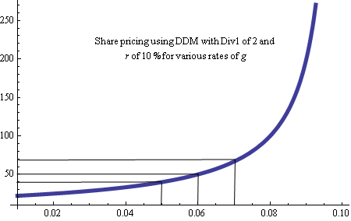
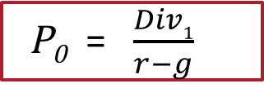
The DDM can be very sensitive to estimates of G (growth rate)
P₀ = $\frac{Div1}{r−g}$
P₀
g

Slide 27
Query: The Importance of Growth: Examples
A share of preferred stock is expected to pay a dividend of $5/year forever. What’s the value of the stock if the discount rate is 10%?
A stock is expected to pay a dividend of $5 next year, and the dividend is expected to grow by 5%/year forever. What’s the value of the stock if the discount rate is 10%?

