Slide 1
Corporate Finance
Uncertainty, Default, & Risk
Fall 2024
Prof. Jeffrey Colón

Slide 2
Uncertainty, Default, & Risk
Same
No differences in opinion
No taxes
No transaction costs.
No big sellers/buyers
Different
Project cash flows are not certain
Cash flows to be discounted are the expected cash flows
Distinction between promised (quoted or stated) returns and expected returns

Slide 3
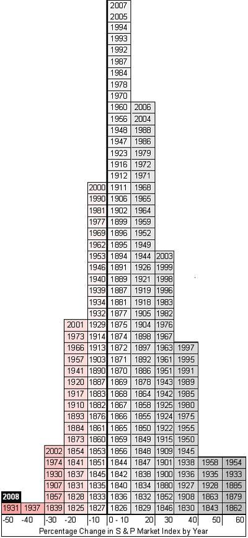
Risk: Percentage Change in SP500 by Year
16
15
11
24
20
14
12
10
18
23
21
17
09
22
19
13

Slide 4
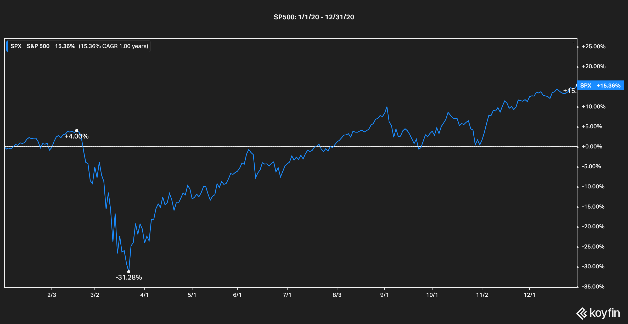
Annual returns can obscure useful information

Slide 5
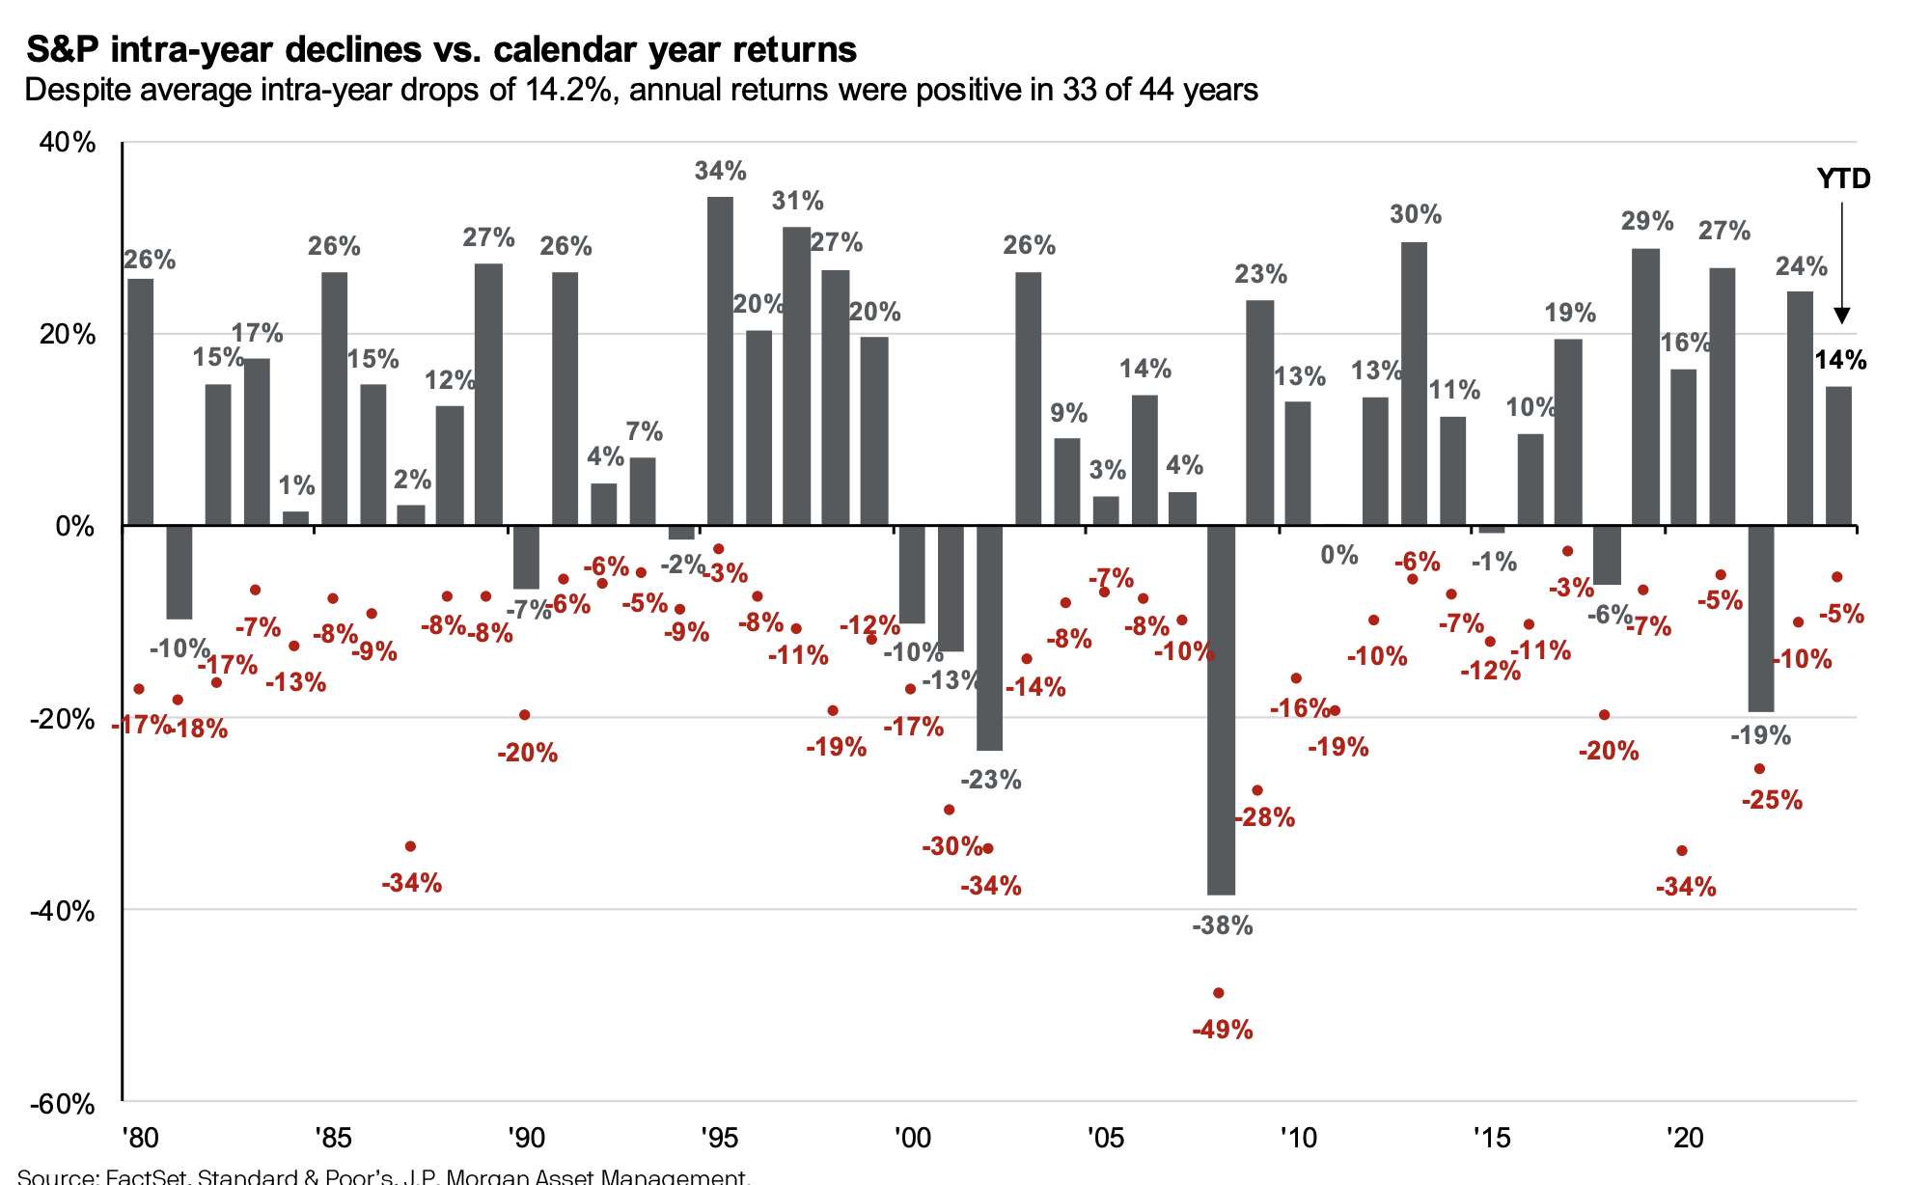
Annual returns can obscure useful information

Slide 6


Random Variables
Random variable:
Examples: Cash flows and Returns

Slide 7
Expectation of a Random Variable
Expectation of a RV:
Examples:
You throw a die. What’s the expected value?
You throw a pair of dice and add the two faces. What’s the expected value?

Slide 8
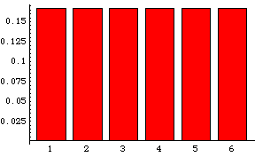
Probability Distribution: Single Die
Probability
Outcomes
EV= 3.5 = 1/6*1 + 1/6*2…+1/6*6

Slide 9
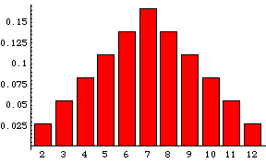
Probability Distribution: Sum of 2 Dice
Probability
Outcomes
EV=7

Slide 10
Risk
Probability weighted dispersion of returns around the expected return
Variance:
Find ,
Subtract each return from and square the result.
Multiply each value by its probability, and
Add
Standard Deviation:

Slide 11
Risk: Example
What are the Var and SD of the throw of dice?
Var:
SD:
Units of SD same as the units of the underlying variable:
SD of annual returns--> %
Var of annual returns--> %²
probability
mean
outcome

Slide 12
SDs and the Normal Distribution
A large enough sample drawn from a normal distribution looks like a bell-shaped curve.
The probability that a yearly return will fall within 20.1 percent of the mean of 13.3 percent will be approximately 2/3.
Probability
– 3s – 49.3%
– 2s – 28.8%
– 1s – 8.3%
0 12.2%
+ 1s 32.7%
+ 2s 53.2%
+ 3s 73.7%
Return on large company common stocks
68.26%
95.44%
99.74%

Slide 13
Risk Adverse, Risk Neutral, and Risk Lover
Fair bet: Cost = E(value)
Risk Averse:
rejects fair bets;
pays premium (more than expected value) for insurance
is indifferent about fair bets (will write or take)
Evaluates outcomes solely on the basis of expected value and not risk
does not pay a premium for insurance
Risk Lover:
accepts all fair (and some unfair) bets;
never purchases insurance
Market vs. Personal Risk Aversion
Risk Neutral

Slide 14

Debt Risk Factors
Interest Rate
Reinvestment Risk
Inflation Risk
Credit (Default) Risk
Liquidity
Contract Risk, e.g., Redemption (Call) Risk
Exchange (FX) Risk

Slide 15
Credit Risk: Example
A bank is considering a loan of $1M to a customer. The r_{f} is 5% and the default risk is 50%, in which case the bank will recover $750,000.
If the bank charges r_{f}, calculate its E(ROR) on the loan?
Assume that the bank is risk neutral. How much does it have to charge on the loan to expect to earn the r_{f}?

Slide 16
Credit Risk: Example
Default/Credit Premium = 30%
Promised/Quoted/Stated Interest = 35%
Time Premium = 5%

Slide 17
Default Premiums in a Risk Neutral World
Promised/Quoted Rate of Return =
Time Premium + Default/Credit Premium
Expected Rate of Return [E(r)] =
E(Time Premium) + E(Default Premium)
E(Time Premium) + 0
From prior example: (.5)*(35%-5%) + (.5)(-25%-5%) = 0
The E(DefaultPremium) is the expected difference between expected outcomes ( + or - ) and the time premium
In risk neutral world, all investments are expected to earn the risk-free rate
Actual Earned (Realized) Rate = Time Premium + Default Realization

Slide 18
Corporate Bond Ratings
What is rated:
The likelihood that the firm will default.
The protection afforded by the loan contract in the event of default.
Who pays for ratings:
Issuers pay to have their bonds rated.
The ratings are constructed from the financial statements supplied by the firm.
Subscriptions
Ratings can change. See, e.g., ratings of CDOs, subprime MBS
Raters can disagree.
Personal: annualcreditreport.com

Slide 19
Corporate Bond Ratings
Credit Rating Agencies (NRSROs)
Federal securities law (mutual funds), financial legislation, state legislation with respect to insurance companies, some foreign legislation, and private contracts
Credit Rating Agency Reform Act of 2006 (§15E of the Exchange Act)
Analysts level conflicts
Rating level conflicts
Expanded record keeping requirements
Disclosure of performance statistics
Transition and default rates
10% Rating Sample
Disclosure of all ratings for all sectors
Dodd-Frank Act, Title IX, Subsection C
SEC Office of Credit Ratings

Slide 20
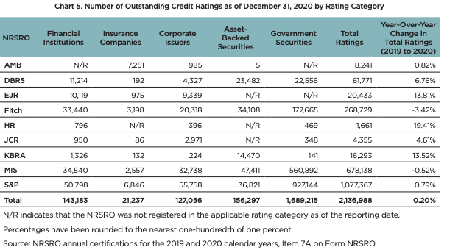
Outstanding Credit Ratings
SEC, Annual Report on NRSRO (Dec. ‘21)

Slide 21
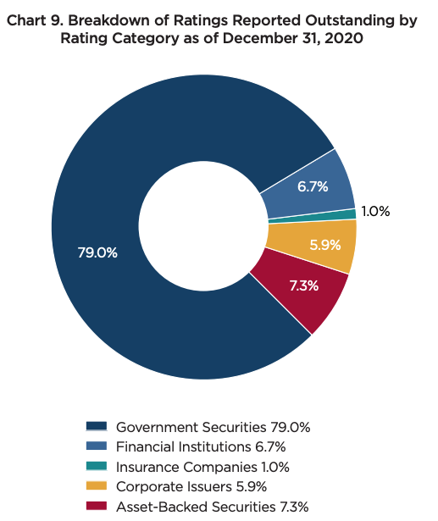
Breakdown of Ratings
SEC, Annual Report on NRSRO (Dec. ‘21)

Slide 22
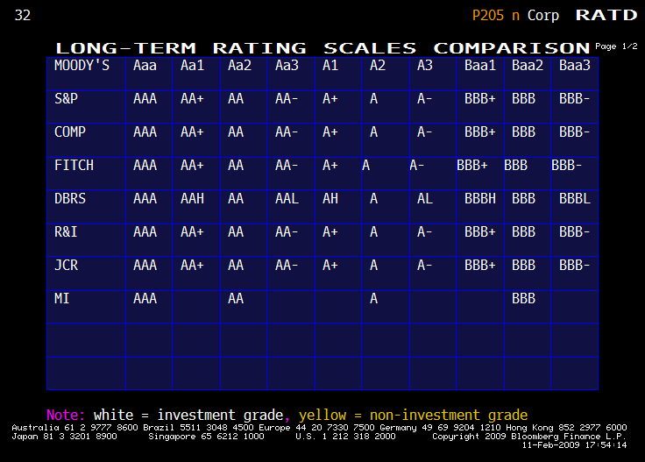
Bond Ratings: Investment Grade

Slide 23
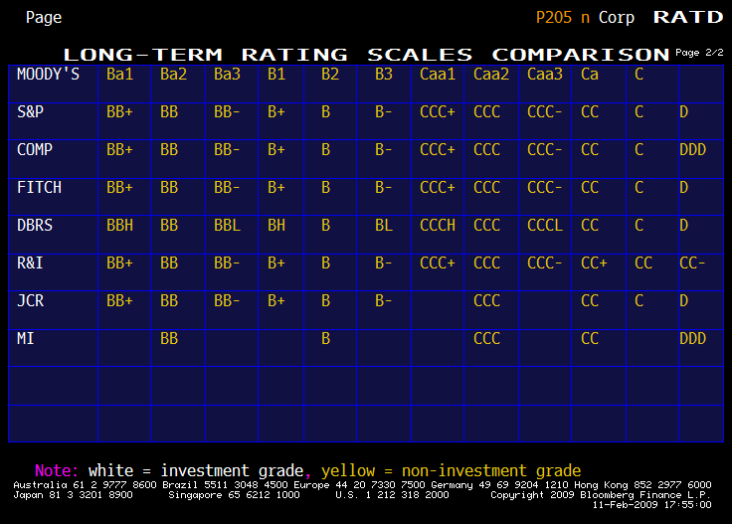
Bond Ratings: Non-Investment Grade (Junk)

Slide 24
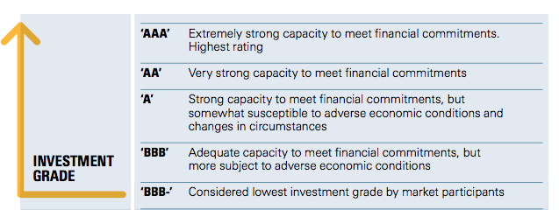
S&P Ratings: Investment
Source: S&P Guide to Credit Ratings Essentials

Slide 25
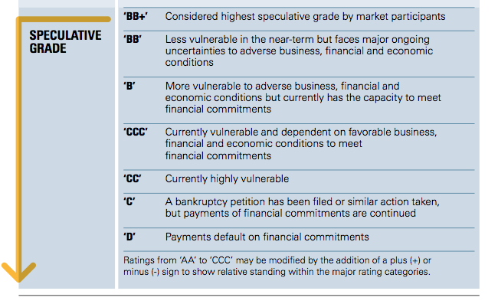
S&P Ratings: Speculative
Source: S&P Guide to Credit Ratings Essentials

Slide 26
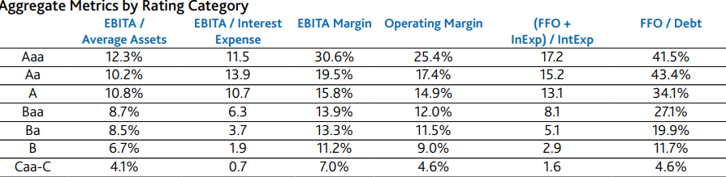
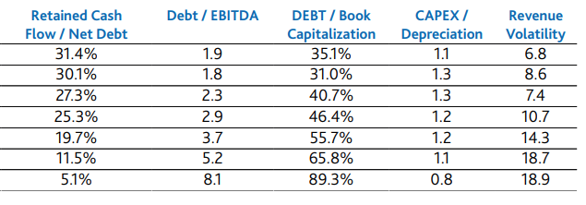
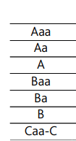
Bond Ratings: Moody’s Financial Metrics Key Ratios (Median 2016)
Source: Moody’s Financial Metrics Key Ratios for Global Non-Financial Corporations: 2016

Slide 27
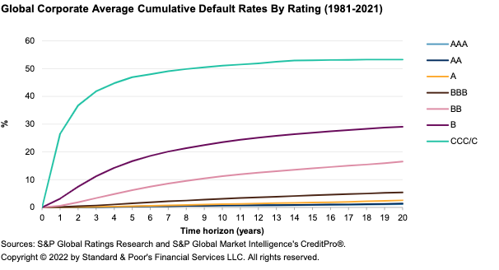
Default rates of corporate bonds 1981-2021 by S&P rating at time of issue
Source: S&P 2021 Annual Global Corporate Default Study And Rating Transitions

Slide 28
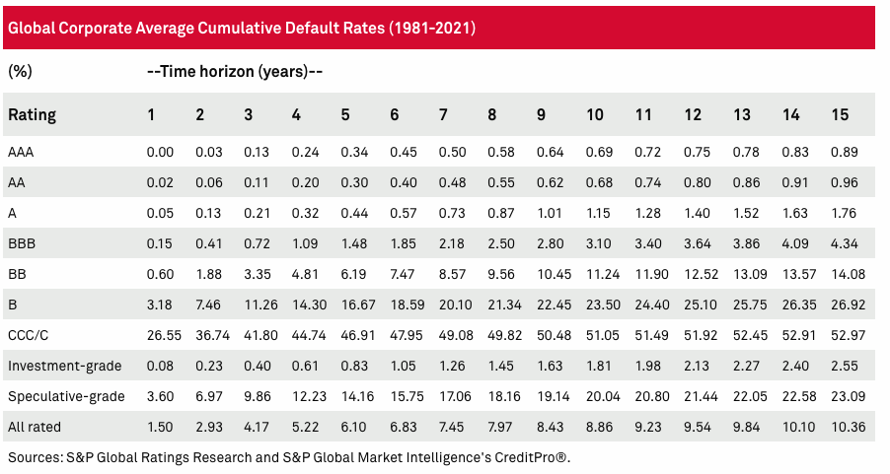
S&P Global Corporate Debt Default Summary
Source: S&P 2021 Annual Global Corporate Default Study And Rating Transitions

Slide 29
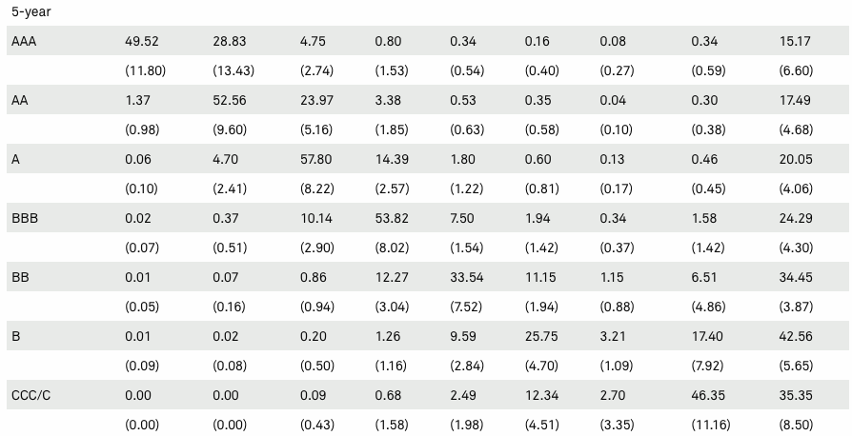
S&P’s 5-Year Transition Rates
Source: S&P 2021 Annual Global Corporate Default Study And Rating Transitions

Slide 30
Moody’s Downgrade of AIG’s Senior Debt (15 July 2021)
Moody's Investors Service has downgraded the senior unsecured debt rating of American International Group, Inc. (NYSE: AIG) to Baa2 from Baa1 following the announcement that AIG has agreed to sell a 9.9% equity stake in its Life and Retirement business (AIG L&R) to Blackstone for cash of $2.2 billion. AIG will also enter into a strategic asset management relationship with Blackstone. The downgrade of the debt ratings reflects AIG's reduced diversification once it completes the separation of AIG L&R.
FACTORS THAT COULD LEAD TO AN UPGRADE OR DOWNGRADE OF THE RATINGS
Upgrade: (i) improvement in underwriting results and profitability (e.g., General Insurance combined ratio below 95%, return on capital consistently above 8%), (ii) favorable/benign development of loss reserves, and (iii) improvement in parent financial flexibility (e.g., total leverage below 25%, pretax interest coverage in the high single digits).
Downgrade: (i) deterioration in underwriting results (e.g., General Insurance combined ratio above 100%, return on capital below 5%), (ii) significant further adverse loss development, or (iii) decline in parent financial flexibility (e.g., total leverage above 35%, pretax interest coverage below 5x.

Slide 31
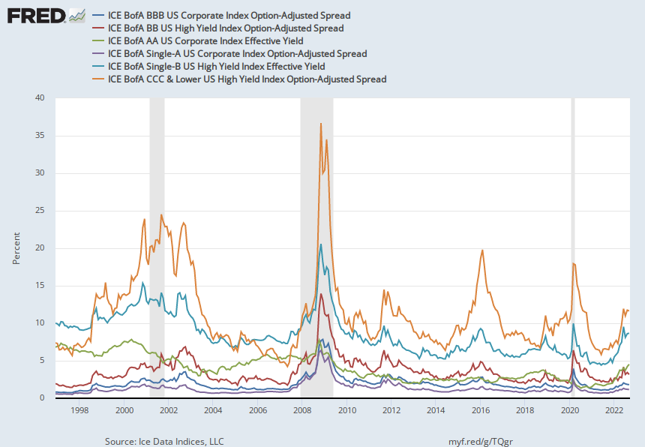
Corporate Spreads: 1996-2022

Slide 32
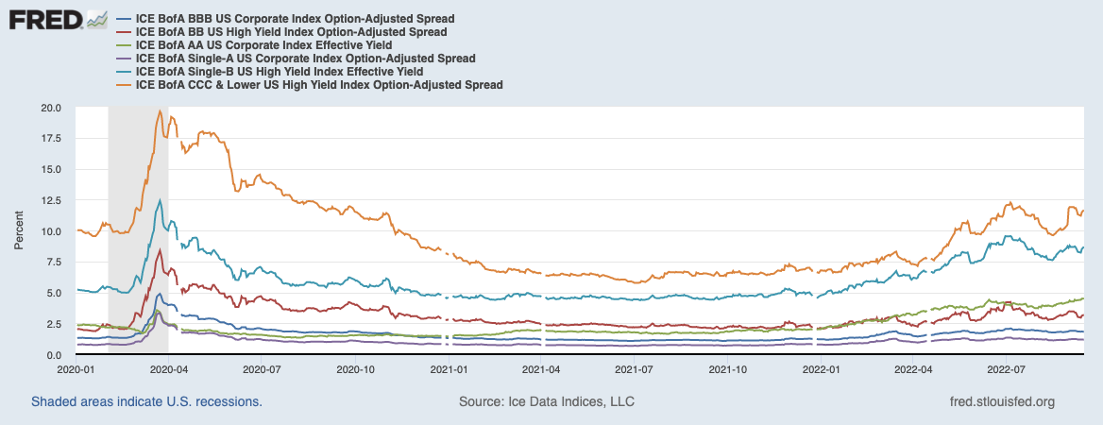
Corporate Spreads: 12/2019 – 9/2022

Slide 33
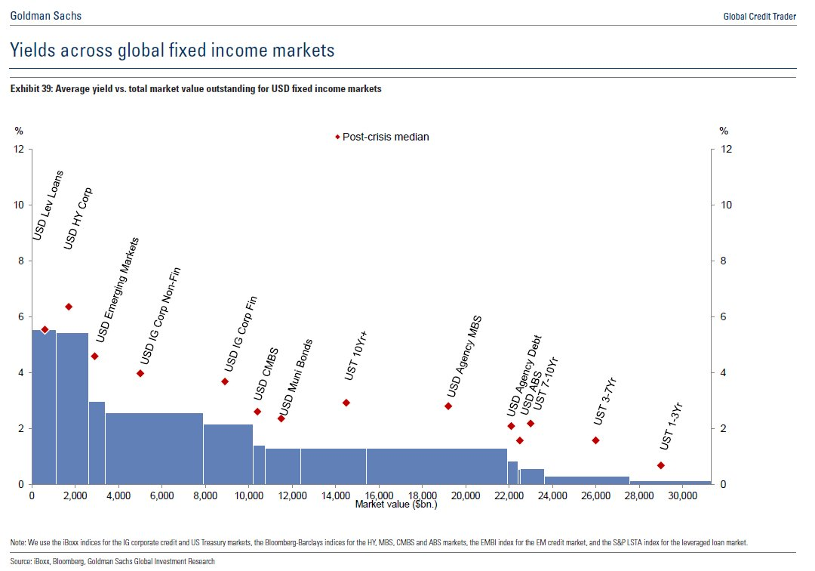
Global Yields Fixed Income Markets

Slide 34
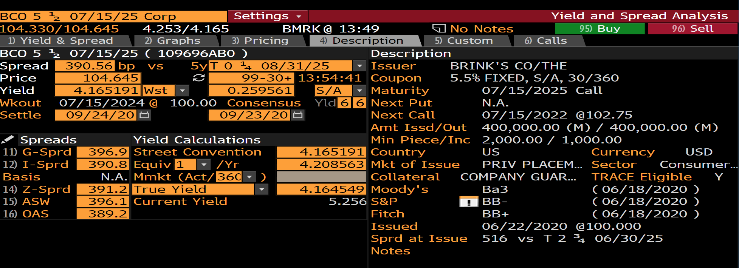
Corporate Spreads (9/22/20): Brink’s 5 ½ maturing on 7/15/25

Slide 35
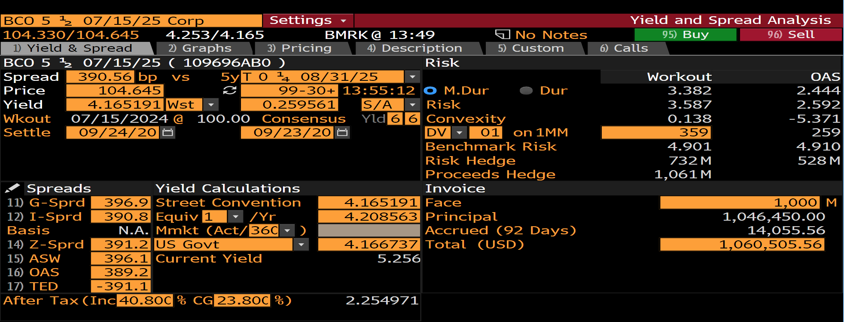
Corporate Spreads (9/22/20): Brink’s 5 ½ maturing on 7/15/25

Slide 36
Debt Risk Premiums
Contract/Risk/Liquidity Premiums
Credit/Default Premium
Promised/Quoted/
Stated Interest
Time Premium

Slide 37
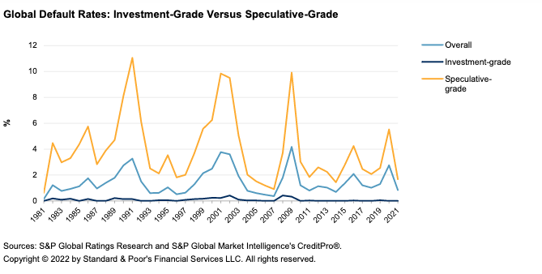
Global Default Rates: 1981-2021
Source: S&P 2021 Annual Global Corporate Default Study And Rating Transitions

Slide 38
Risk and NPV Formula
When future CFs are uncertain, the CFs in the NPV formula are the expected values of the future CFs, E(CFs).
Once the E(CFs) are calculated, discount them at the appropriate, expected risk-adjusted rate of return, E(r) to get the NPV of the investment.
Example
You are offered a 1-yr project that will pay off 100,000 (30% probability), 300,000 (60% probability), or 800,000 (10% probability).
If the appropriate E(r) is 5%, what’s a fair price for the project?
What’s your ROR under each scenario if you pay a fair price?

Slide 39
Risk and NPV Formula: Example

Slide 40
Debt and Equity
The expected value analysis can be applied to value any portion or combination of the future outcomes [“state-contingent claims”] of an investment
General description of Debt and Equity
DHs: paid off first
EHs (SHs): residual claimants after debt paid off.
If project payoffs are insufficient to pay off DHs, SHs generally don’t have to make up the difference (non-recourse).

Slide 41
Valuing Debt and Equity: Sample Problem
You want to buy a building today that you believe will be worth $501,429 (70%) or $300,000 (30%) in one year. The E(r) is 5%. Unfortunately, you only have $100,000 and will have to borrow the difference from a bank. Assume that any borrowing in non-recourse to the borrower.
What’s the PV of the building?
How much will you have to borrow to acquire it?
What rate will you have to offer the bank if it’s risk neutral?
What’s the ROR on your equity under each scenario?
Create a payoff table like Table 6.7 in Welch.

Slide 42

Leverage

Slide 43
Leverage

Slide 44
Leverage

Slide 45
X% ASSET and (100-X)% CASH: P/L Diagram
100% Asset
S = 100
t = 1
1+r = 1.15
D = 0
Profit
25
50
75
125
150
Future Asset Price
50% Asset, 50% Cash
(Lending)
150% Asset, -50% Cash
(Borrowing)
-25
Loss
Notes:
2. Forwards and Futures → 2.1 Asset and Cash

Slide 46
Prejudgment Interest
What is prejudgment interest?
What is post-judgment interest?
State rules on PJ Interest
Federal Rules
“Prejudgment interest is an element of complete compensation.”
How to view PJI
PV of judgment = PV of harm
Coerced Loan Theory
Risk: risk of DEFENDANT’S default
ROR: Defendant’s interest rate on similar loan
Floating, short-term rate

Slide 47
Amoco Cadiz
District court: T-bill rate at time of judgment
7th Cir.:
“complete compensation”
involuntary creditor
“market rate for money”—defendant’s borrowing rate
Use Prime rate if court doesn’t want to engage in “refined rate setting”
11.9%: average prime rate
What’s the Delaware rule for prejudgment interest? See Merion Capital.

