Slide 1
Corporate Finance
Time Varying Rates of Return and the Yield Curve
Fall 2026
Prof. Jeffrey Colón

Slide 2
Time Varying Rates of Return & the Yield Curve
Same
  No differences in opinion
  No taxes
  No transaction costs.
  No big sellers/buyers
Different
  Rates of return for each period are not necessarily equal (Term Structure of Interest Rates)
  $1 buys less in the future than it does today (Inflation and negative rates)

Slide 3
Annualized Rates of Return
A fund manager earns the following returns:
Calculate the manager’s holding period return (r_{0,3}) and the 3-year annualized ROR, or
  HPR = ?
  Annualized ROR/Compound Annual Growth Rate (CAGR) = ?
Year | Rate | Rate
1 | r_{0,1} | 100%
2 | r_{1,2} | <50%>
3 | r_{2,3} | <2%>

Slide 4
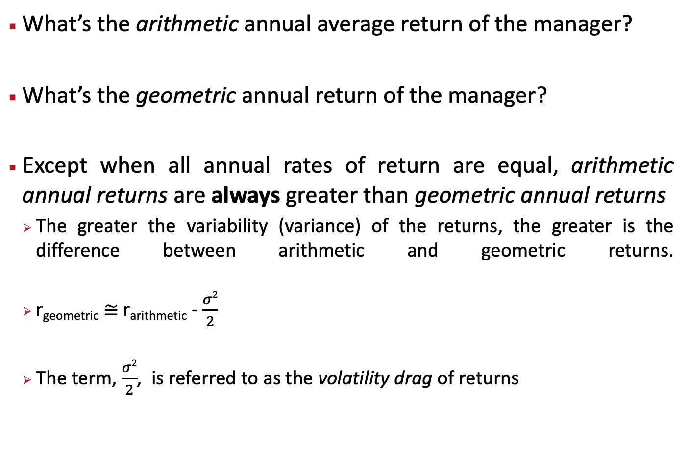
Annualized Rates of Returns: Be careful when you are quoted “average” returns
What’s the arithmetic annual average return of the manager?
What’s the geometric annual return of the manager?
Except when all annual rates of return are equal, arithmetic annual returns are always greater than geometric annual returns
  The greater the variability (variance) of the returns, the greater is the difference between arithmetic and geometric returns.
  r_{geometric} ≅ r_{arithmetic} - $\frac{σ2}{2}$
  The term, $\frac{σ2}{2}$, is referred to as the volatility drag of returns

Slide 5
Inflation
Inflation: Loss of purchasing power caused by price increases.
Inflation generally measured by the CPI
  bls.gov/cpi
  Base Rate 1983 = 100; Current 2026_{July} = 323.048
  CPI_{(July/25)} = 333.918 and CPI_{(July/25)} = 323.048
  Inflation Rate_{(July-July)}: (333.918 – 323.048) / 323.048 = 3.4%
If R_{INF} is 3.4% for 2026, $100 in 2026 is worth in 2025: $100/1.034 = $96.7
  https://data.bls.gov/cgi-bin/cpicalc.pl (CPI calculator)

Slide 6
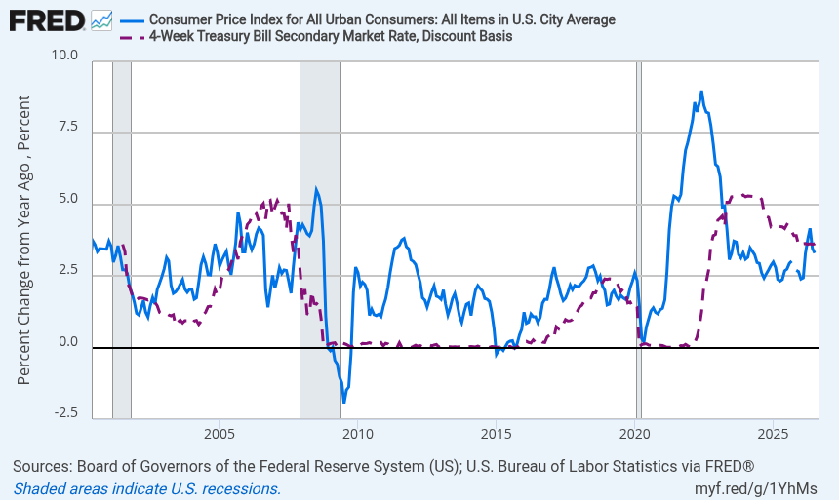
4-Week T-Bill & CPI

Slide 7
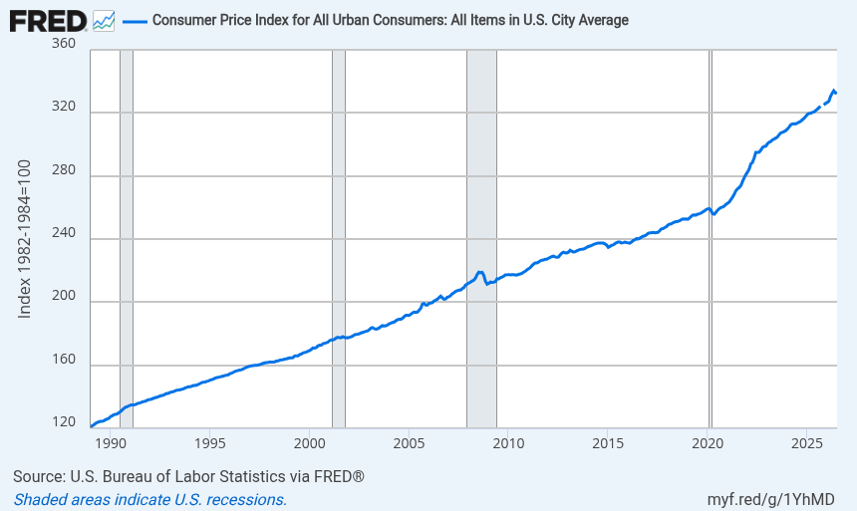
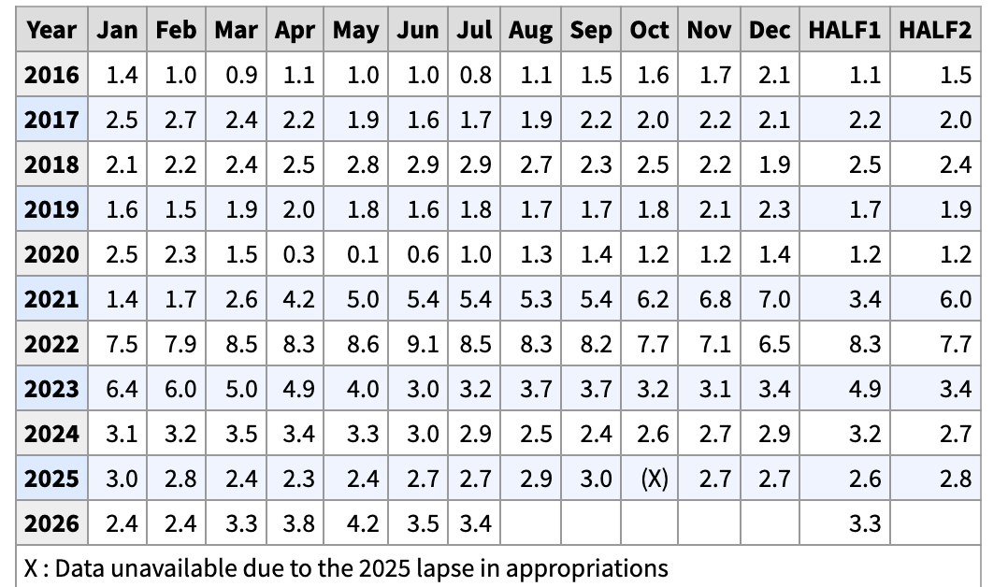
CPI: Index Change 36 Years and 12-Month Inflation

Slide 8
Real and Nominal Interest Rates
Nominal Interest Rate
  The stated, quoted, or promised interest rate
  Bank promises to pay you $110 in one year if you purchase a CD for $100.
  R_{NOM} is 10%: (110 – 100) / 100
Real Interest Rate
  R_{REAL} is the increase in purchasing power (after inflation) from an investment

Slide 9
Real and Nominal Interest Rates: Example
R_{f} is 6%, and the CPI is 300 today. Assume that the CPI will be 309 next year (a 3% increase). If you invest $100 at R_{f}, what are the nominal and real rates of return on this investment?
R_{NOM:} ?
R_{REAL}: ?
For small interest and inflation rates
  R_{REAL} ≈ R_{NOM} - R_{INF}

Slide 10
Inflation: Capital Budgeting Rules
Use nominal discount rates to discount nominal cash flows
Use real discount rates to discount real cash flows
Example
You are offered an investment that pays 1,000/yr for 2 years. What’s the PV in real and nominal dollars if inflation is 3%/yr and the nominal 1-yr and 2-yr rates are 5%?
Nominal: ?
Real: ?

Slide 11
Legal Application: Rental Inflation Escalation Clause Example
McCormick & Schmicks Seafood Restaurants Inc.
Base Rent. Lessee covenants and agrees to pay to Lessor rentals for the leased Premises in the amount of $10,080.00 for each and every month during the term of the Lease on or before the first day of each month
Rent for First Renewal Term. The Base Rent for the first year of the First Renewal Term shall equal the dollar amount specified above increased by the percentage change in the Consumer Price Index comparing the Consumer Price Index figure for the calendar month immediately preceding the commencement of the Original Term and the Consumer Price Index for the calendar month preceding the commencement of the first lease year of the First Renewal Term; provided, however, that such fraction shall not in any event result in a decrease in Base Rent. The Consumer Price Index shall mean the “All Urban Consumers--All Items--U.S. city average (1982-1984=100) published by the United States Department of Labor

Slide 12
Bond Definition
A bond is a legally binding agreement between a borrower and a lender:
  Specifies the principal amount of the loan.
  Specifies the size and timing of the cash flows:
    In dollar terms (fixed-rate borrowing), or
    As a formula (adjustable-rate borrowing, e.g., SOFR +2% LIBOR)
Treasuries:
  Bills: Term of 13-52 weeks and no coupon
  Notes: Term of 1-10 years and semi-annual coupon
  Bonds: Term of 10-30 years and semi-annual coupon
Basis Point: 1% of 1%, or .0001: 100 bps = 1%

Slide 13
Example of a U.S. Bond
U.S. government bond listed as 6-3/8 of December 2018.
  The Par or Face Value of the bond is $1,000.
  Coupon payments are made semi-annually (June 30 and December 31 for this particular bond).
  Since the coupon rate is 6 3/8, the s.a. payment is $31.875.
  On January 1, 2019, the size and timing of cash flows are:
1/1/19
6/30/19
12/31/19
6/30/24
12/31/24

Slide 14
Treasury Price Quotes:
Treasury Price Quotes:
  100:01 [% of face + n/32] Sometimes
  Gov't Securities Quotes (link)

Slide 15
Bond Valuation
Value = PV of E(CFs) = Price
Bond valuation:
  Estimate the size and timing of future cash flows
  Discount future cash flows at an appropriate, risk-adjusted rate
If the price and cash flows of a bond are known, the yield to maturity (YTM) is the single discount rate that makes the sum of the PVs of the cash flows equal to the price. (YTM = IRR)

Slide 16
Zero Coupon Bond
Information needed to value a zero-coupon bond:
  Time to maturity (T) = Maturity date – Today’s date
  Face value (F)
  Discount rate (r)
Present value of a pure discount bond at time 0:

Slide 17
Zero Coupon Bond Example
Find the value of a 30-year, zero-coupon bond with a $1,000 par value and a YTM of 6%.

Slide 18
Zero-Coupon Bond Example

Slide 19
Coupon Bonds
Information needed to value coupon bonds:
  Coupon payment dates and time to maturity (T)
  Coupon payment (C) per period and Face value (F)
  Appropriate Discount rate
P = PV of coupon bond= PV of coupons + PV of face value

Slide 20
Coupon Bond Example
Find the price (as of January 1, 2019) of a 6-3/8 coupon T-Note with semi-annual payments, and a maturity date of December 31, 2024, if the annual YTM is 5%.
On January 1, 2019, the size and timing of cash flows are:
1/1/19
6/30/19
12/31/19
6/30/24
12/31/24

Slide 21
Coupon Bond Example with Excel

Slide 22
Quotes, Conventions, and Confusion
Convention is to quote annual as 2x’s the semi-annual and not (1+s.a.)²
  If the annual YTM is 6%, then the semi-annual rate is 3% (6%/2), not (1.06)^{0.5}
The rate obtained by doubling the semi-annual yield is called the Bond-Equivalent Yield (think of it as a bond’s “APR”)
The effective annual yield (rate), with m payments per year, is computed as follows:

Slide 23
Term Structure of Interest Rates or Yield Curve
Term structure of interest rates
  The relationship between the maturity (term) of treasuries and their annualized rates ( ) or YTMs.
  As the maturity of a treasury bond increases, so too generally does the YTM.
Spot Rates: The YTM today for bonds of different maturities
Forward Rates: The future YTM on bonds of different maturities. Forward rates are derived from the spot yield curve.

Slide 24
Timing Varying Rates of Return
6%
4%
2%
0%
r_{0,3}
t =
0
1
2
3
T
r_{0,1}
r_{1,2}
r_{2,3}
r_{1,3}
(1+r_{0,3}) = (1+ r_{0,1}) * (1+r_{1,2}) * (1+r_{2,3}) or (1+ )³
r_{1,2} , r_{2,3} , and r_{1,3} are reinvestment or forward rates (an interest rate that begins in the future) and r_{0,1} is a spot rate

Slide 25
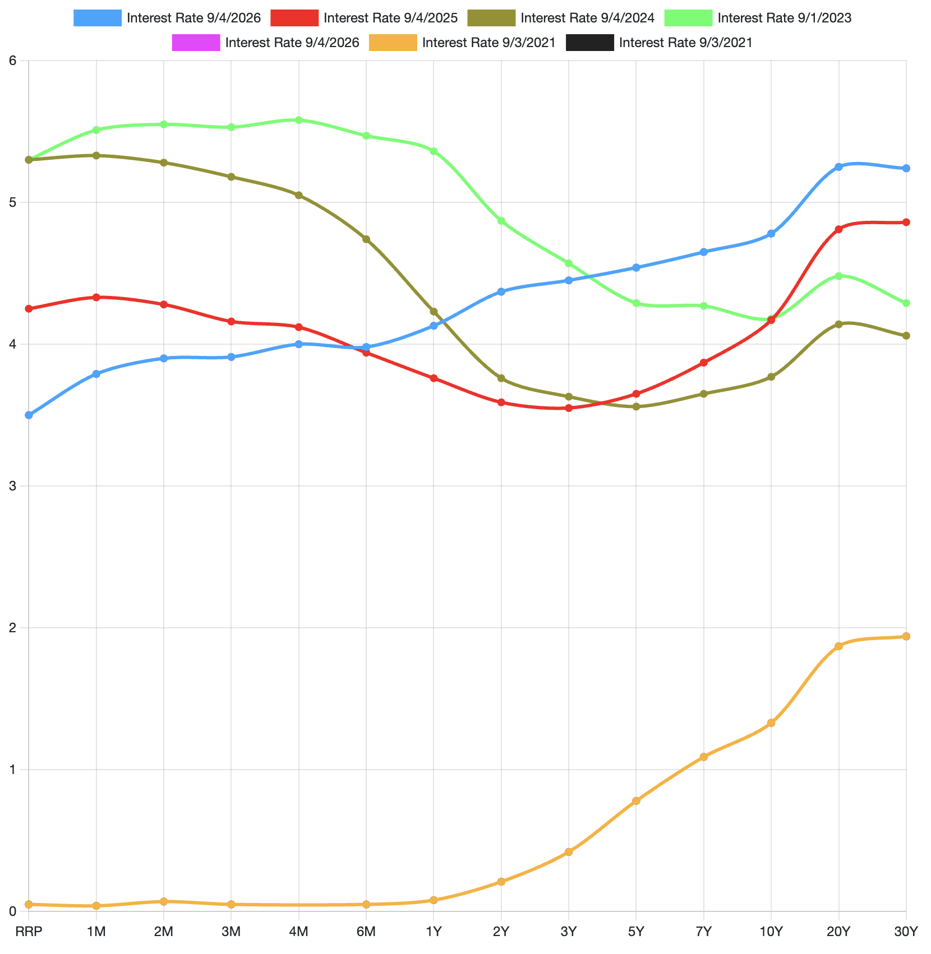
Treasury Yield Curve: 2021-2026 (Sept)
https://www.ustreasuryyieldcurve.com/

Slide 26
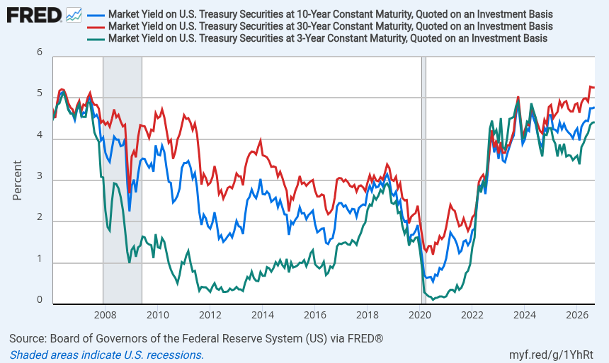
Treasury Yield Curve: 3-month, 10-year, and 30-year

Slide 27
Using the Yield Curve to Calculate Holding Period Returns and Future Values
CFs should be grown using the appropriate annualized spot rates ( ) from the Yield Curve
You invest $10,000 today for 2 years. What’s the final value and HPR of the investment?
  Final Value = ?
  HPR = ?
Period | YTM
1 Year | 4.35%
2 Years | 3.88%
5 Years | 3.65%
10 Years | 3.84%

Slide 28
Using the Yield Curve to Calculate Forward Rates
Forward rates can be extracted from the spot rate yield curve.
If we know the 1-yr and 2-yr spot rates, the 1-yr forward rate, r_{1,2}, is implied by the following relationship:
  (1+r₂)² = (1+ r_{0,1})*(1+ r_{1,2})
  (1+ r_{1,2}) = (1+r₂)² / (1+ r_{0,1})
  r_{1,2} = (1.0388)² / (1.0435) -1 = 3.41%
Period | YTM | Forward Rates | Forward Rates
1 Year | 4.35% | 4.35% | r_{0,1}
2 Years | 3.88% | 3.41% | r_{1,2}

Slide 29
Using the Yield Curve to Calculate Present Values
The future CFs from projects are discounted using the appropriate annualized spot rates ( ) from the Yield Curve.
Example: A 2-yr bond offers annual coupons of 15 and a face of 1,000. What’s its price (PV)?
Period | YTM | Forward Rates
1 Year | 4.35% | 4.35%
2 Years | 3.88% | 3.41%
3 Years | 3.73% | 3.71%
5 Years | 3.65%

Slide 30
YTM and Bond Value
$1400
1300
When the YTM < Coupon, the bond trades at a premium: Price > Face.
Bond Value
1200
When the YTM = Coupon, the bond trades at par: Price = Face.
1100
1000
6 3/8
800
0
0.01
0.02
0.03
0.04
0.05
0.06
0.07
0.08
0.09
0.1
Discount Rate
When the YTM > Coupon, the bond trades at a discount: Price < Face.

Slide 31
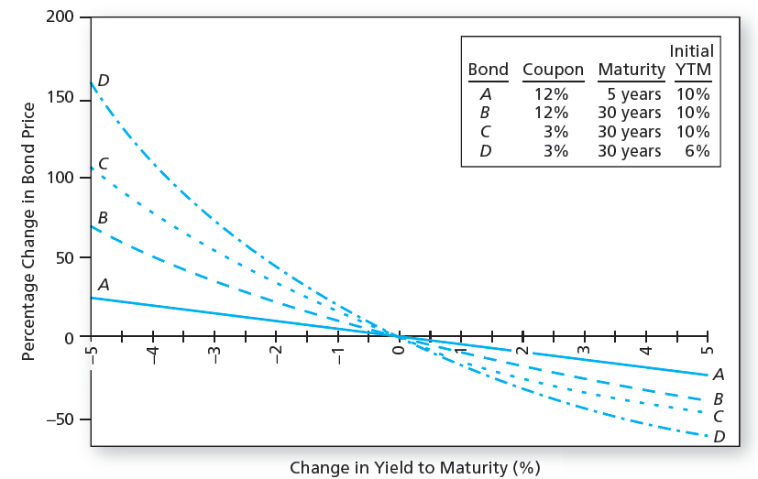
Changes in Bond Price when YTM Changes

Slide 32
Interest Rate Risk
Bond 1 CFs: 1090
Bond 2 CFs: 90, 90, 90, 90, and 1090
 | YTM
Bond | 5% (T₀) | 7% (T₁) | Price Change | % Price Change
1-year, 9% Ann. Coupon | 1038 | 1018 | -19.30 | -1.86%
5-year, 9% Ann. Coupon | 1173 | 1082 | -90.99 | -7.76%

Slide 33
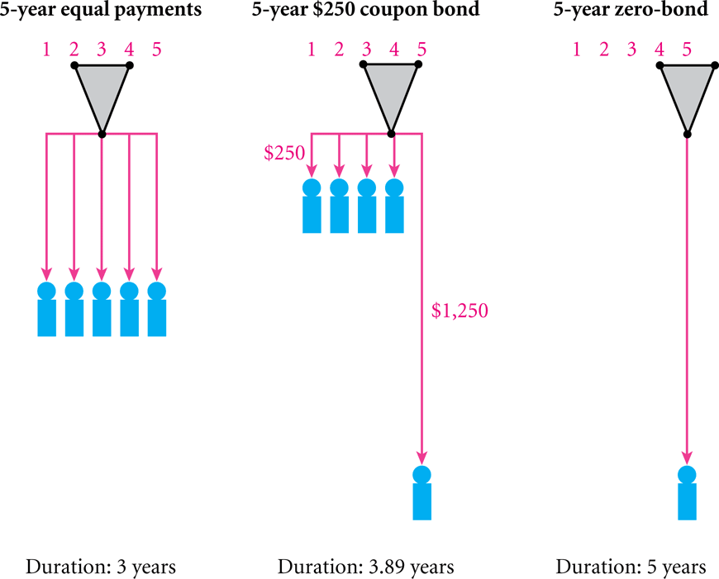
Interest Rate Risk: Duration

Slide 34
Interest Rate Risk: Duration
Macaulay Duration: weighted average term to maturity using the present values of a bond’s CFs

Slide 35
Macaulay and Modified Duration Example

Slide 36
Modified Duration: Duration and Price Changes
Modified Duration (volatility):
  Modified Duration = Mac. Duration/(1+YTM)
  ∆ Bond Price ≈ -Modified Duration *Bond Price* ∆YTM
  % ∆ Bond Price ≈ -Modified Duration * ∆YTM
Example
By how much does our 9%, 5-year bond change in price if the YTM rises or falls 50 bps? How accurate is the modified duration formula?
Bond YTM | Price | Price Change | % Actual Price Change | Predicted Price Change using Mod. Duration | Mod. Duration Predicted % Change
5% | 1173.17
4.5% | 1197.55 | 24.38 | 2.078% | 24.04 | 2.049%
5.5% | 1149.45 | -23.72 | -2.022% | -24.04 | -2.049%

Slide 37
Changes in Bond Price when YTM Changes

Slide 38
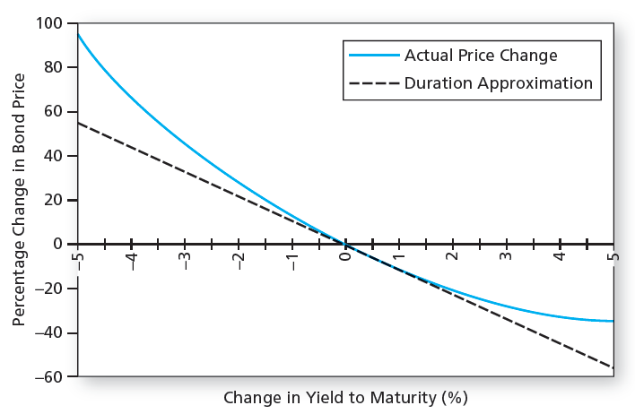
Bond Price Convexity: 30YR, 8% Coupon, YTM = 8%

Slide 39
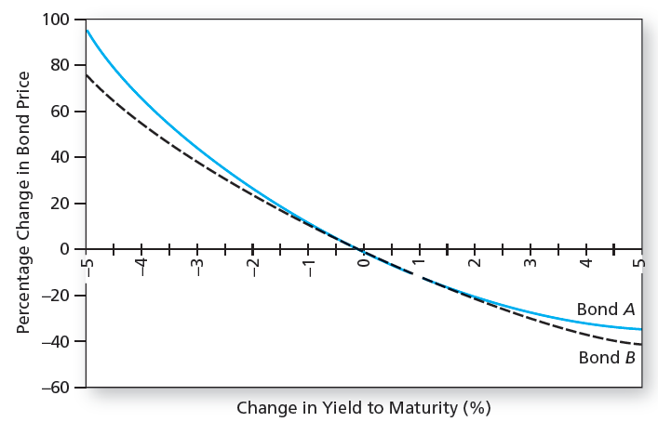
Convexity

Slide 40
Maturity and Bond Price Volatility
Consider two otherwise identical bonds.
The long-maturity bond will have much more volatility with respect to changes in the discount rate
Bond Value
Par
Short Maturity Bond
C
Discount Rate
Long Maturity Bond

Slide 41
Coupon Rate and Bond Price Volatility
Consider two otherwise identical bonds.
The low-coupon bond will have much more volatility with respect to changes in the discount rate
Bond Value
High Coupon Bond
Discount Rate
Low Coupon Bond

Slide 42
Summary of Bond Concepts
Bond prices and market interest rates move in opposite directions.
When coupon rate = YTM, price = par value.
When coupon rate > YTM, price > par value (premium bond)
When coupon rate < YTM, price < par value (discount bond)
A bond with longer maturity has higher relative (%) price change than one with shorter maturity when YTM changes, all other features identical.
A lower coupon bond has a higher relative price change than a higher coupon bond when YTM changes, all other features identical.

Slide 43
Treasury Inflation Protected Securities: TIPS and I Bonds
 | Year 1 | Year 2
Principal | 1,000 | 1,020
Inflation | 2% | 3%
Inflation Adjustment: P*(1+INF) | 1,020 | 1,050.60
Fixed Coupon 3% * (P + Inf) | 30.60 | 31.52
Tot. Return: Infl Adj + Fixed Coupon | 50.60 | 62.12

Slide 44
Real YTM: Treasuries and TIPS (Sept 2026)
Term | Treasury | TIPS | Implied Inflation
5 YR | 4.54% | 2.17% | 2.37%
7 YR | 4.65% | 2.29% | 2.36%
10 YR | 4.78% | 2.43% | 2.35%
20 YR | 5.25% | 2.77% | 2.48%
30 YR | 5.24% | 2.96% | 2.28%

Slide 45
Real YTM: Treasuries and TIPS (Sept 2020)
Term | Treasury | TIPS | Implied Inflation
5 YR | 0.24% | -1.29% | 1.55%
7 YR | 0.43% | -1.18% | 1.63%
10 YR | 0.63% | -1.02% | 1.67%
20 YR | 1.13% | -0.65% | 1.79%
30 YR | 1.34% | -0.39% | 1.74%

