Slide 1
Corporate Acquisition Alternatives: Merger v. Stock Acquisition
Merger
Stock Acquisition

Slide 2
Valuation in Delaware
After the Court determines the stockholders entitled to an appraisal, the appraisal proceeding shall be conducted in accordance with the rules of the Court of Chancery, including any rules specifically governing appraisal proceedings. Through such proceeding the Court shall determine the fair value of the shares exclusive of any element of value arising from the accomplishment or expectation of the merger or consolidation, conversion, transfer, domestication or continuance together with interest, if any, to be paid upon the amount determined to be the fair value. In determining such fair value, the Court shall take into account all relevant factors. DGCL § 262(h)

Slide 3
Delaware: Appraisal Rights
Market Out Exception (appraisal not available):
Shares listed on national securities exchange, or
Shares held by more than 2,000 holders
No appraisal for shareholders of surviving corporation in a merger if shareholders of surviving did not have to vote for approval. DGCL § 262(b)(1).
Exceptions to Market Out Exception (appraisal is available) if shareholders receive anything except:
Stock of surviving in merger (or shares of converted entity or entity resulting from transfer, domestication, or continuance if such entity is a corporation)
Stock of any other corporation whose shares will be listed on a national securities exchange or held by more than 2,000 holders. DGCL § 262(b)(2).
Par-Sub mergers under § 253. DGCL § 262(b)(3).

Slide 4
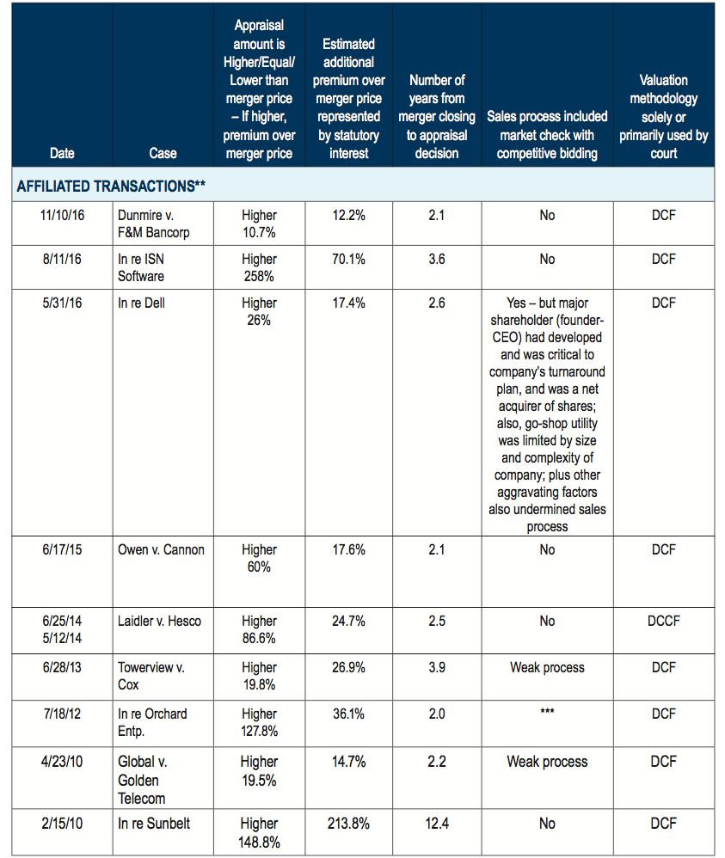
Some Appraisal Decisions (‘10-’17)

Slide 5
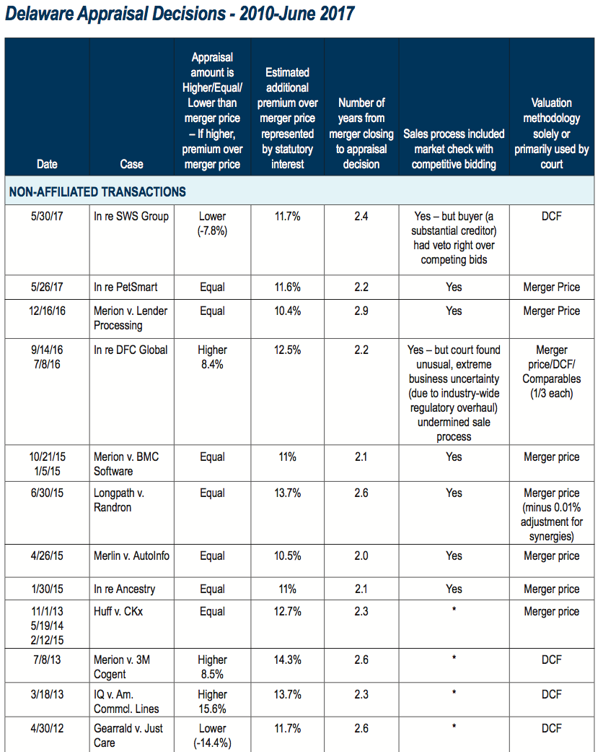
Some Appraisal Decisions (‘10-’17)

Slide 6
Delaware Appraisal
Contrary to the critics of appraisal, we find no evidence that bidders lower their up-front price so they can afford to pay off dissenting shareholders post-sale. Furthermore, threat of appraisal does not appear to impact method of payment, likelihood of closing, or limit the amount of takeover activity. Instead, we find that shareholders of Delaware targets receive marginally higher acquisition premiums following events that strengthen the appraisal remedy in Delaware. In general, our results are consistent with appraisal providing ex-ante protection in settings where public investors are most at risk.
Boone, Mergers Negotiations in the Shadow of Judicial Appraisal (2017)

Slide 7
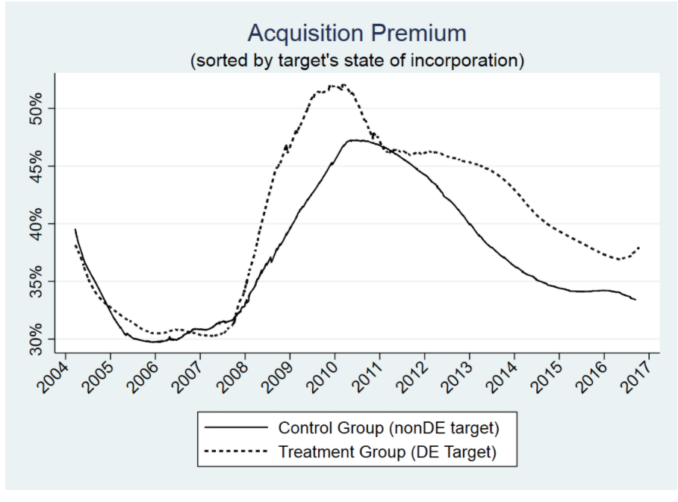
Delaware Appraisal
Boone, Mergers Negotiations in the Shadow of Judicial Appraisal (2017)

Slide 8
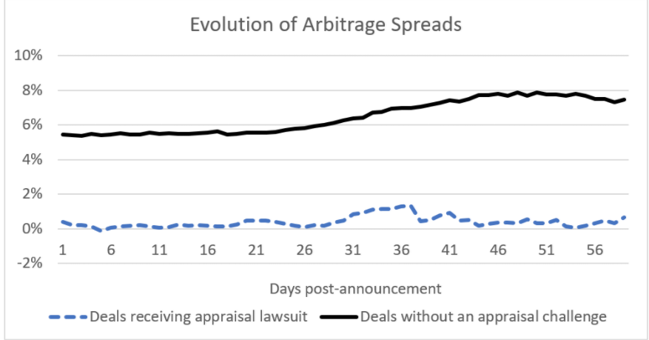
Delaware Appraisal
Boone, Mergers Negotiations in the Shadow of Judicial Appraisal (2017)

Slide 9
Delaware Appraisal: 2016 Changes
If the target shares were publicly traded, there is no appraisal remedy unless:
(1) The total number of shares entitled to appraisal exceeds 1% of the outstanding shares of the class or series eligible for appraisal,
(2) the value of the consideration provided in the merger, consolidation conversion, transfer, domestication or continuance for such total number of shares exceeds $1 million, or
(3) the merger was approved pursuant to § 253 or § 267. DGCL § 262(g).
A surviving corporation can pay cash to the dissenting shareholders before judgment, thus stopping the accrual of interest on the amount paid. Interest will only accrue on the sum of (a) the difference, if any, between the amount so paid and the fair value of the shares as determined by the Court of Chancery, and (b) interest already accrued at the time of the payment. DGCL § 262(h).

Slide 10
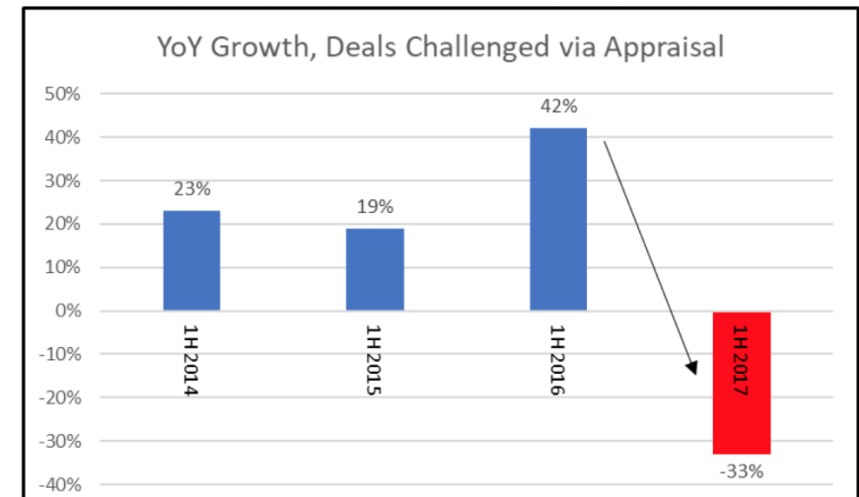
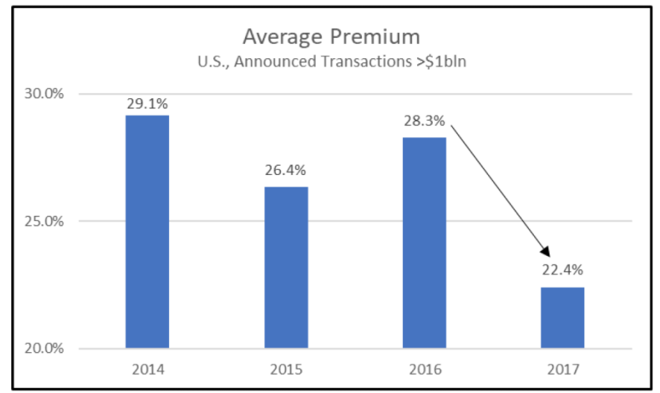
Delaware Appraisal: 2016 Changes
Schoenfeld, High Cost of Fewer Appraisal Claims in 2017

Slide 11
Delaware Appraisal: 2022 and 2023 Changes
Allow a beneficial owner of stock to demand appraisal directly instead of relying on the record holder, e.g., Cede & Co.
No longer require that a copy of the appraisal statute be attached to the notice that appraisal rights are available; company can provide directions to access the statutory text (“without subscription or cost”) at a “publicly available electronic resource”
Make appraisal rights available in connection with any conversion of a corporation to another entity, e.g., LLC
Extend appraisal rights to domestications, transfers, and continuations

Slide 12
Valuation in Delaware
“Accordingly, the standard `Delaware block` or weighted average method of valuation, formerly employed in appraisal and other stock valuation cases, shall no longer exclusively control such proceedings. We believe that a more liberal approach must include proof of value by any techniques or methods which are generally considered acceptable in the financial community.” Weinberger v. UOP, Inc. 457 A.2d 701, 713 (1983)
“Only the speculative elements of value that may arise from the ‘accomplishment or expectation’ of the merger are excluded. We take this to be a very narrow exception to the appraisal process, designed to eliminate use of pro forma data and projections of a speculative variety relating to the completion of a merger. But elements of future value, including the nature of the enterprise, which are known or susceptible of proof as of the date of the merger and not the product of speculation, may be considered .” Id.

Slide 13
Valuation in Delaware
Closely-held corporations
Does CAPM work well here?
Cash-out mergers
What are the concerns about determining FV if there is a controlling SH?
Poorly performing managers?
Short-form mergers DGCL § 262(b)(3).
Balancing tensions between minority and controlling SHs
Average time from transaction to award: 5 years
Some recent cases are decided in 2 years

Slide 14
Measure of Fair Value in Delaware
Market value
What if there is a controlling SH?
Minority discount?
Close corporation?
EMH?
Market out exception?
Third-party sale value
“What’s the best price a single buyer could reasonably be expected to pay for the firm as an entirety?” McLoon Oil Co. (1989)
Always value enhancing?
Going concern value

Slide 15
Valuation Techniques in Delaware
Delaware Block Method: weighted average of
Asset value
Earnings Value
Market Value
Discounted Cash Flow (DCF)
Net CFs over a period
Terminal/residual value
CoC
Comparable Company & Comparable Transactions
Market value
Third-party Sales
Net asset value
Earnings and book
Merger Price

Slide 16
Merion Capital v. 3M Cogent
P’s DCF Valuation
Ct. rejected cash deployment scenarios/industry growth scenarios
SBC—non-cash expense
WC adjustment
WACC: 12.55%: 20-yr Treas; 1-yr raw weekly Beta w/ cash adjustment & smoothing; SERP=5.0% + Size Premium (1.73%)
CT: 2.96 + (1.397 * 5.2) + 1.73 = 11.954%
Terminal value: Gordon GM: 4.5% (3 stage model)
D’s DCF & Comparable Companies & Comparable Trans.
Com. Company: LTM & Forward Revenue and EBITDA
Rejected—Why?
Com. Transaction: LTM & Forward Revenue and EBITDA
Rejected—Why?
SBC—cash expense
WC adjustment
WACC: 10.04%: 10-yr Treas; 2-yr weekly adjusted Beta w/ cash adjustment & smoothing; HERP= 5.2% + Size Premium (2%)
Terminal value: EBITDA multiples
Pub
3M
Cogent
MergeCo
Transaction
TO for 73% of Cogent’s shares
Short-form merger into MergeCo with Cogent surviving
$10.50/share

Slide 17
Dell v. Magnetar (Del. S. Ct. 2017)
Facts
What’s an MBO?
What was the basis for the Ch. Ct.’s holding that deal price was not fair value?
When is a market efficient/semi-strong efficient?
What’s a financial acquirer? Strategic?
What was the Ct’s view of DCF analyses?
Why did the S. Ct. opt for deal price?

Slide 18
Dell v. Magnetar (Del. S. Ct. 2017)
The transaction process exemplifies many of the qualities that Delaware courts have found favor affording substantial, if not exclusive, weight to deal price in the fair value analysis. Even the Court of Chancery’s own summary remarks suggest the deal price deserves weight as the court characterized the sale process as one that “easily would sail through if reviewed under enhanced scrutiny” and observed that “[t]he Committee and its advisors did many praiseworthy things,” too numerous to catalog in its opinion, as the trial court noted. Given the objective indicia of the deal price’s reliability and our rejection of the notion of a private equity carve out, to the extent that the Court of Chancery chose to disregard Dell’s deal price based on the presence of only private equity bidders, its reasoning is not grounded in accepted financial principles, and this assessment weighs in favor of finding an overall abuse of discretion. [p.51]
In so holding, we are not saying that the market is always the best indicator of value, or that it should always be granted some weight. We only note that, when the evidence of market efficiency, fair play, low barriers to entry, outreach to all logical buyers, and the chance for any topping bidder to have the support of Mr. Dell’s own votes is so compelling, then failure to give the resulting price heavy weight because the trial judge believes there was mispricing missed by all the Dell stockholders, analysts, and potential buyers abuses even the wide discretion afforded the Court of Chancery in these difficult cases. [p. 60]

Slide 19
DFC Global v. Muirfield (Del. S. Ct. 2017)
What was DFC’s business?
What was the underlying transaction?
What was DFC’s argument?
Ct’s response?
What was the Ct’s view of the EMH? DCF?
When are appraisal actions most useful?
Why did the Ch. Ct. not use deal price?
What was the Ct’s response to the “regulatory risk” concern?
What was the Ct’s response to the “specific rate of return” concern for PE purchasers?

Slide 20
Verition v. Aruba (Del. S. Ct. 2019)
Facts
Is HP a strategic or financial buyer?
Why did Ch. Ct. reject deal price less synergies?
Response of S. Ct.?
Why did S. Ct. reject unaffected market price?
Any bad blood between the courts?

Slide 21
Fir Tree v. Jarden (Del. S. Ct. 2020)
Facts
Ch. Ct.’s basis for using unaffected market price?
What was concerning about the sales process?
Why did the Ch. Ct. reject DCF? Comparable companies?
Why did the S. Ct. uphold the Ch. Ct.’s decision?
Why did it reject deal price?

Slide 22
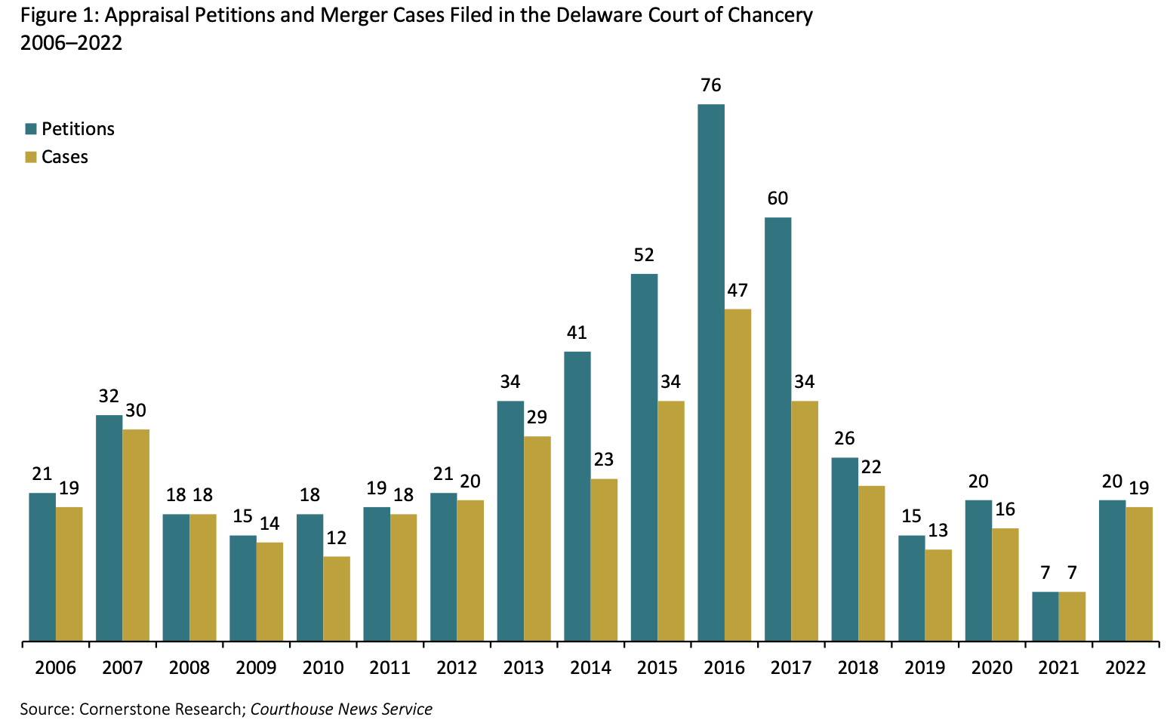
Appraisal Petitions: 2006-2022

Slide 23
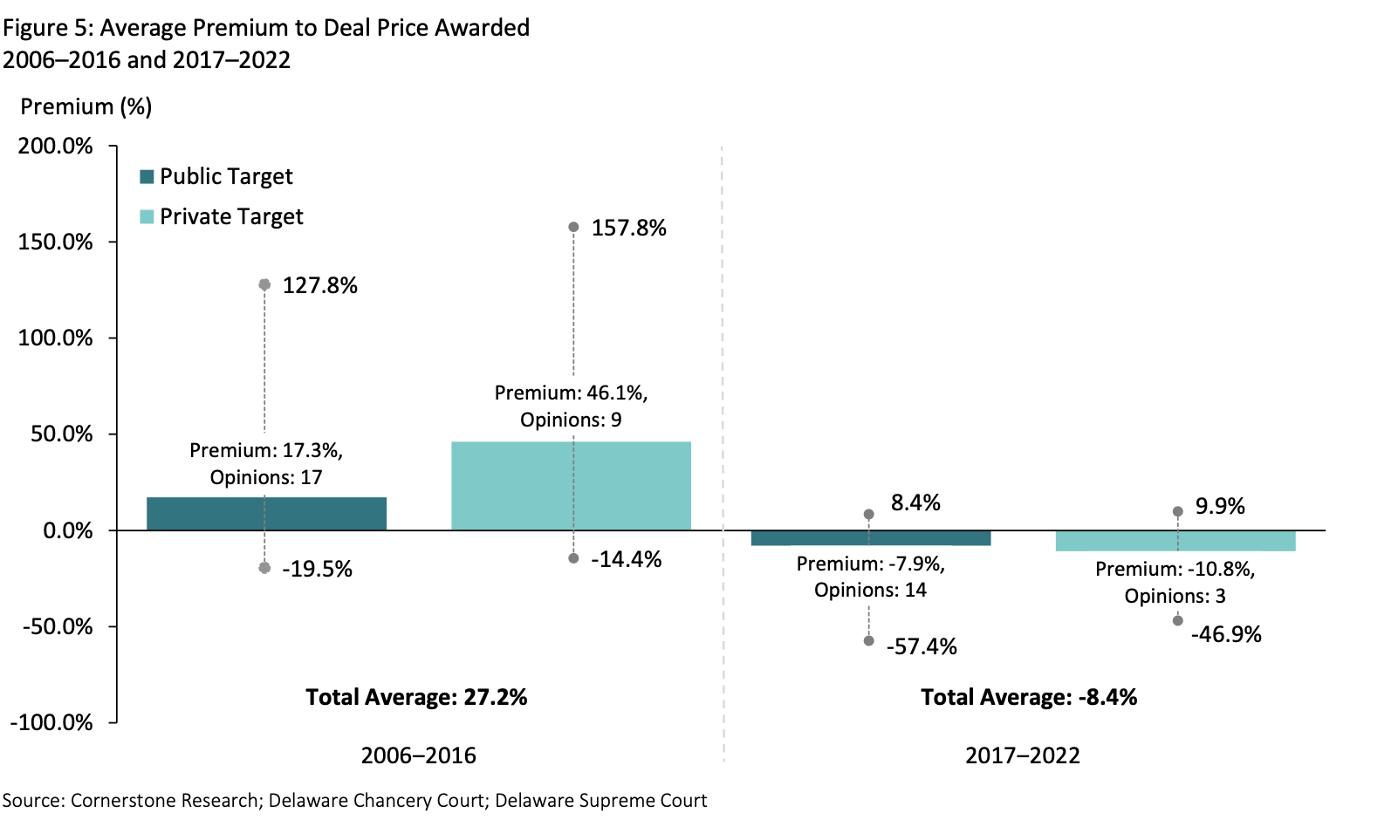
Average Premium to Deal Price

Slide 24
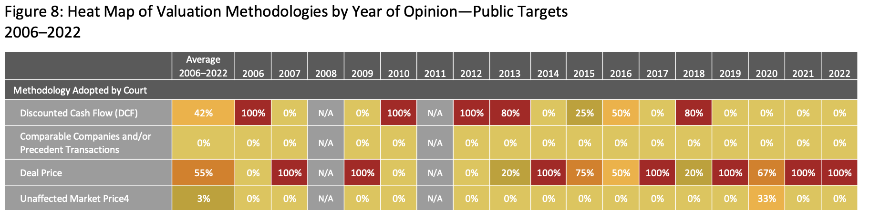
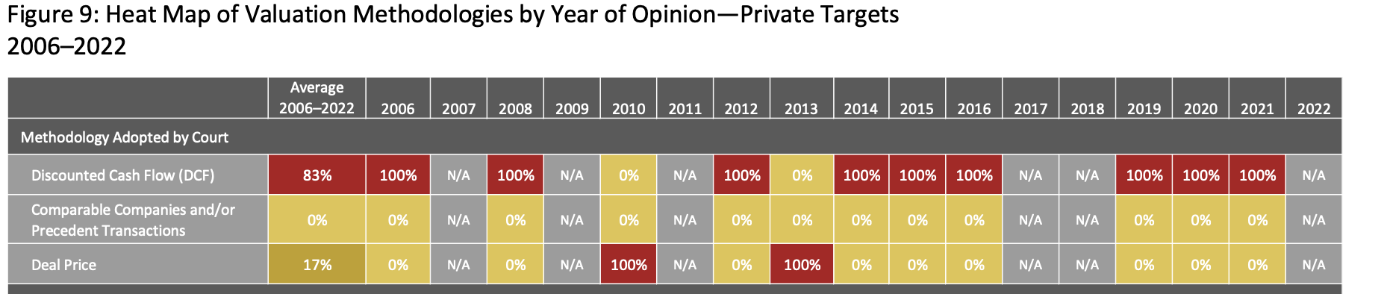
Valuation Methodologies (2006-2022)

Slide 25
Waiver of Appraisal Rights: Manti Holdings
Manti Holdings, LLC v. Authentix Acq. Co. (Del. St. Ct. 2021)
Ct. upheld waiver of appraisal rights in shareholder drag along agreement:
Neither public policy nor DGCL § 262 prohibits “sophisticated and informed stockholders, who were represented by counsel and had bargaining power, from voluntarily agreeing to waive their appraisal rights in exchange for valuable consideration.”

Slide 26
Some Other Recent Appraisal Cases
Hyde Park v. FairXchange (2024)
Deal price “least bad” methodology
Cellular Telephone Partnership Litigation (2022)
Freeze out transaction; unfair process; used DCF (3xs firm’s valuation!)
In re Appraisal of Regal Entertainment Grp (Del. Ch. Ct. 2021)
Deal price ($23) less synergies ($23.60) best indicator or fair value
Regal publicly traded and widely held; Arm’s length transaction; Post-signing market check
Subtracted synergies of $3.77, but adjusted for post-signing change in corporate rate rate ($4.37); discussion of synergies (oper & fin)
BCIM Strategic Value Master Fund (Del. Ch. 2022)
Deal price less synergies and post signing change in value
Kruse v. Synapse Wireless (Del. Ch. Ct. 2020)
DCF used to value private company-–resulting value about 50% less than deal price
Manichaen Capital v. Sourchehov (2020)
DCF used for value private company—respondent disagreed w/ own expert!
Panera Bread (2020)
Deal price less synergies, but Panera had prepaid deal price; no refund!!

