Slide 1
Time Varying Rates of Return & the Yield Curve
Same
No differences in opinion
No taxes
No transaction costs.
No big sellers/buyers
Different
Rates of return for each period are not necessarily equal (Term Structure of Interest Rates)
$1 buys less in the future than it does today (Inflation and negative rates)

Slide 2
Query: Annualized Rates of Return
What is a holding period return?
What is the notation for a 3-year holding period return?
What’s the formula to compute a 3-year holding period return?
What is an annualized rate of return?
What is the notation for a 3-year annualized rate of return?
What’s the formula to compute a 3-year annualized rate of return?

Slide 3
Annualized Rates of Return
A fund manager earns the following returns:
Calculate the manager’s holding period return (r_{0,3}) and the 3-year annualized ROR, or
HPR = ?
Annualized ROR = ?
Year | Rate | Rate
1 | r_{0,1} | 100%
2 | r_{1,2} | <50%>
3 | r_{2,3} | <2%>

Slide 4
Annualized Rates of Returns
Be careful when you are quoted “average” returns.
What’s the arithmetic annual average return of the manager?
What’s the geometric annual return of the manager?
Except when all annual rates of return are equal, arithmetic annual returns are always greater than geometric annual returns
The greater the variability of the returns, the greater is the difference between arithmetic and geometric returns.

Slide 5
NPV Calculations with Annualized RORs or Holding Periods Returns
Computing NPVs with either holding period returns, (1+r_{0,2}) or (1+r_{0,1})*(1+r_{1,2}), or annualized rates of returns (1+r₂)² is equivalent.

Slide 6
Inflation
Inflation: Loss of purchasing power caused by price increases.
Inflation generally measured by the CPI
www.bls.gov/cpi
Base Rate 1983 = 100; Current 2022_{July} = 296.276
CPI_{(July/22)} = 296.276 and CPI_{(July/21)} = 273.003
Inflation Rate_{(July-July)}: (296.276– 273.003) / 273.003 = 8.5%
If R_{INF} is 9% for 2022, $100 in 2022 is worth in 2021: $100/1.09 = $91.74
https://data.bls.gov/cgi-bin/cpicalc.pl (CPI calculator)

Slide 7
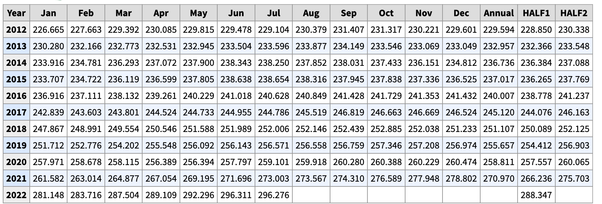
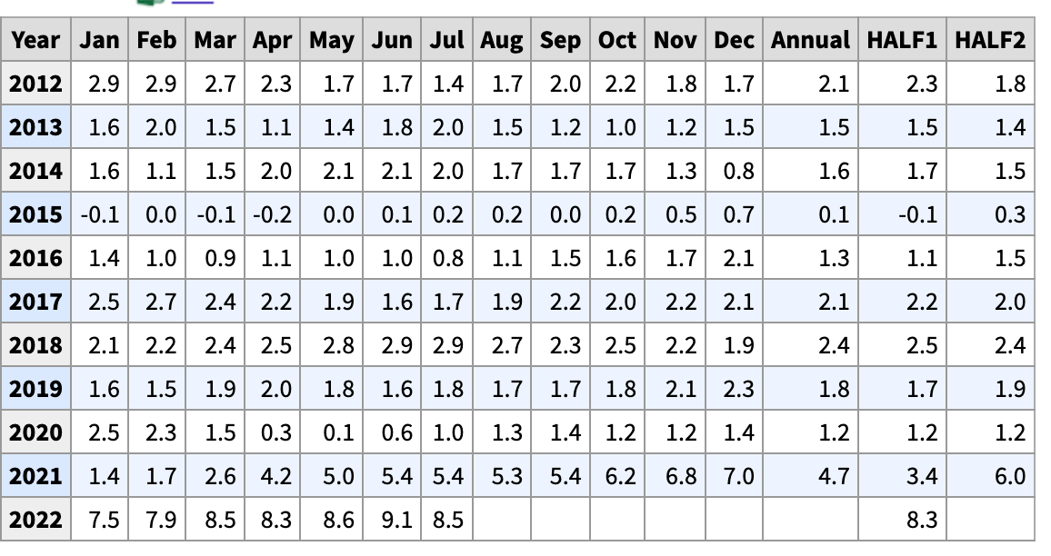
CPI-All Urban Consumers (Not Seasonally adjusted) and 12-Month Percent Change
Source: www.bls.gov/cpi

Slide 8
Term Structure and Yields
The Return on US Treasury Bills and the Inflation rate (1953-2021)

Slide 9
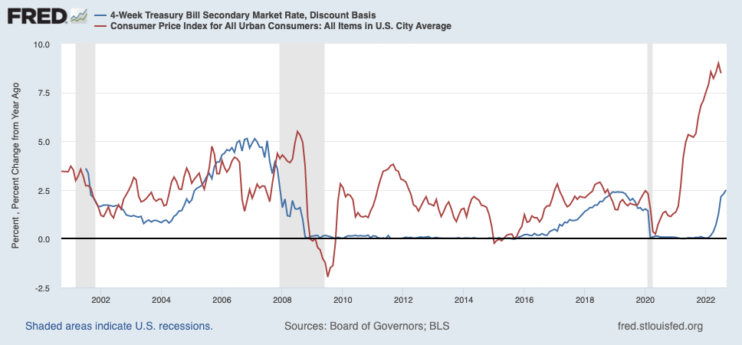
4-Week T-Bill & CPI

Slide 10
Real and Nominal Interest Rates
Nominal Interest Rate
The stated, quoted, or promised interest rate
Bank promises to pay you $110 in one year if you purchase a CD for $100.
R_{NOM} is 10%: (110 – 100) / 100
Real Interest Rate
R_{REAL} is the increase in purchasing power (after inflation) from an investment

Slide 11
Real and Nominal Interest Rates: Example
R_{f} is 6%, and the CPI is 200 today. Assume that the CPI will be 206 next year (a 3% increase). If you invest $200 at R_{f}, what are the nominal and real rates of return on this investment?
R_{NOM:} ?
R_{REAL}: ?
For small interest and inflation rates
R_{REAL} ≈ R_{NOM} - R_{INF}

Slide 12
Inflation: Capital Budgeting Rules
Use nominal discount rates to discount nominal cash flows
Use real discount rates to discount real cash flows
Example
You are offered an investment that pays 1,000/yr for 2 years. What’s the PV in real and nominal dollars if inflation is 3%/yr and the nominal 1yr and 2yr rates are 5%?
Nominal: ?
Real: ?

Slide 13
Inflation Escalation Clause
McCormick & Schmicks Seafood Restaurants Inc.
Base Rent. Lessee covenants and agrees to pay to Lessor rentals for the leased Premises in the amount of $10,080.00 for each and every month during the term of the Lease on or before the first day of each month
Rent for First Renewal Term. The Base Rent for the first year of the First Renewal Term shall equal the dollar amount specified above increased by the percentage change in the Consumer Price Index comparing the Consumer Price Index figure for the calendar month immediately preceding the commencement of the Original Term and the Consumer Price Index for the calendar month preceding the commencement of the first lease year of the First Renewal Term; provided, however, that such fraction shall not in any event result in a decrease in Base Rent. The Consumer Price Index shall mean the “All Urban Consumers--All Items--U.S. city average (1982-1984=100) published by the United States Department of Labor

Slide 14
Bond Definition
A bond is a legally binding agreement between a borrower and a lender:
Specifies the principal amount of the loan.
Specifies the size and timing of the cash flows:
In dollar terms (fixed-rate borrowing), or
As a formula (adjustable-rate borrowing, e.g., SOFR LIBOR)
Treasuries:
Bills: Term of 13-52 weeks and no coupon
Notes: Term of 1-10 years and semi-annual coupon
Bonds: Term of 10-30 years and semi-annual coupon
Basis Point: 1% of 1%, or .0001: 100 Bps = 1%

Slide 15
Example of a U.S. Bond
U.S. government bond listed as 6 3/8 of December 2018.
The Par or Face Value of the bond is $1,000.
Coupon payments are made semi-annually (June 30 and December 31 for this particular bond).
Since the coupon rate is 6 3/8 the s.a. payment is $31.875.
Treasury Price Quotes: 100:01 [% of face + n/32]
Gov't Securities Quotes (link)
On January 1, 2019 the size and timing of cash flows are:
1/1/19
6/30/19
12/31/19
6/30/24
12/31/24

Slide 16
Bond Valuation
Value = PV of E(CFs) = Price
Bond valuation:
Estimate the size and timing of future cash flows
Discount future cash flows at an appropriate, risk-adjusted rate
If the price and cash flows of a bond are known, the yield to maturity (YTM) is the single discount rate that makes the sum of the PVs of the cash flows equal to the price. (YTM = IRR)

Slide 17
Zero Coupon Bond
Information needed to value a zero coupon bond:
Time to maturity (T) = Maturity date – Today’s date
Face value (F)
Discount rate (r)
Present value of a pure discount bond at time 0:

Slide 18
Zero Coupon Bond Example
Find the value of a 30-year, zero-coupon bond with a $1,000 par value and a YTM of 6%.

Slide 19
Zero Coupon Bond Example

Slide 20
Coupon Bonds
Information needed to value coupon bonds:
Coupon payment dates and time to maturity (T)
Coupon payment (C) per period and Face value (F)
Appropriate Discount rate
P = PV of coupon bond= PV of coupons + PV of face value

Slide 21
Coupon Bond Example
Find the price (as of January 1, 2019) of a 6-3/8 coupon T-Note with semi-annual payments, and a maturity date of December 31, 2024 if the annual YTM is 5%.
On January 1, 2019 the size and timing of cash flows are:
1/1/19
6/30/19
12/31/19
6/30/24
12/31/24

Slide 22
Coupon Bond Example with Excel

Slide 23
Quotes, Conventions, and Confusion
Convention is to quote annual as 2x’s the semi-annual and not (1+s.a.)²
If the annual YTM is 6%, then the semi-annual rate is 3% (6%/2), not (1.06)^{0.5}
The rate obtained by doubling the semi-annual yield is called the Bond-Equivalent Yield (think of it as a bond’s “APR”)
The effective annual yield (rate), with m payments per year, is computed as follows:

Slide 24
Term Structure of Interest Rates or Yield Curve
Term structure of interest rates
The relationship between the maturity (term) of treasuries and their annualized rates ( ) or YTMs.
As the maturity of a treasury bond increases, so too generally does the YTM.
Spot Rates: The YTM today for bonds of different maturities
Forward Rates: The future YTM on bonds of different maturities. Forward rates are derived from the spot yield curve.

Slide 25
Timing Varying Rates of Return
6%
4%
2%
0%
r_{0,3}
t =
0
1
2
3
T
r_{0,1}
r_{1,2}
r_{2,3}
r_{1,3}
(1+r_{0,3}) = (1+ r_{0,1}) * (1+r_{1,2}) * (1+r_{2,3}) or (1+ )³
r_{1,2} , r_{2,3} , and r_{1,3} are reinvestment or forward rates (an interest rate that begins in the future) and r_{0,1} is a spot rate

Slide 26
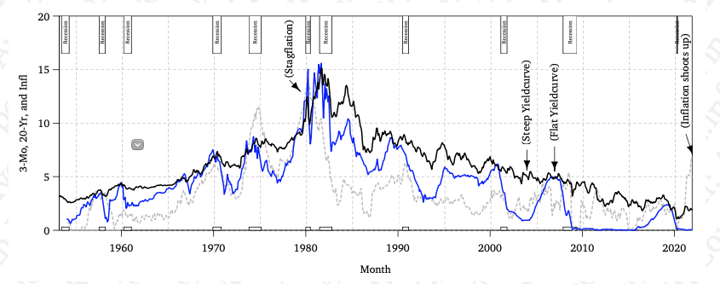
3-Mo, 20-Yr, and Inflation

Slide 27
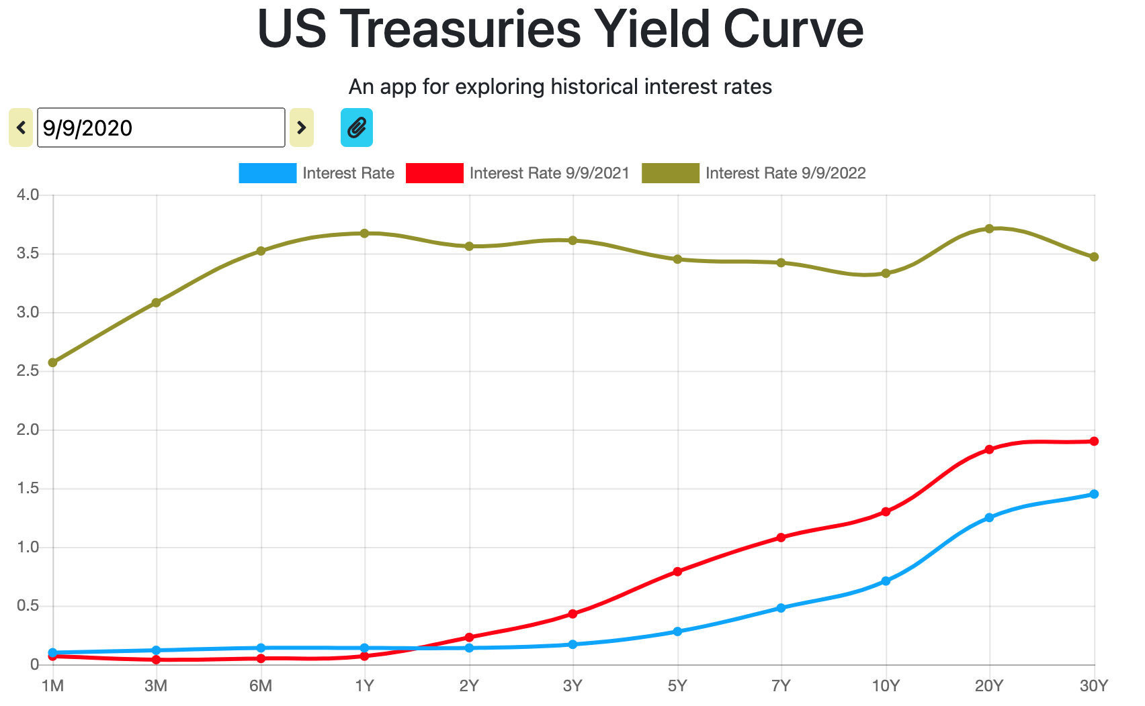
Treasury Yield Curve: Sept 2022, 2021, and 2020

Slide 28
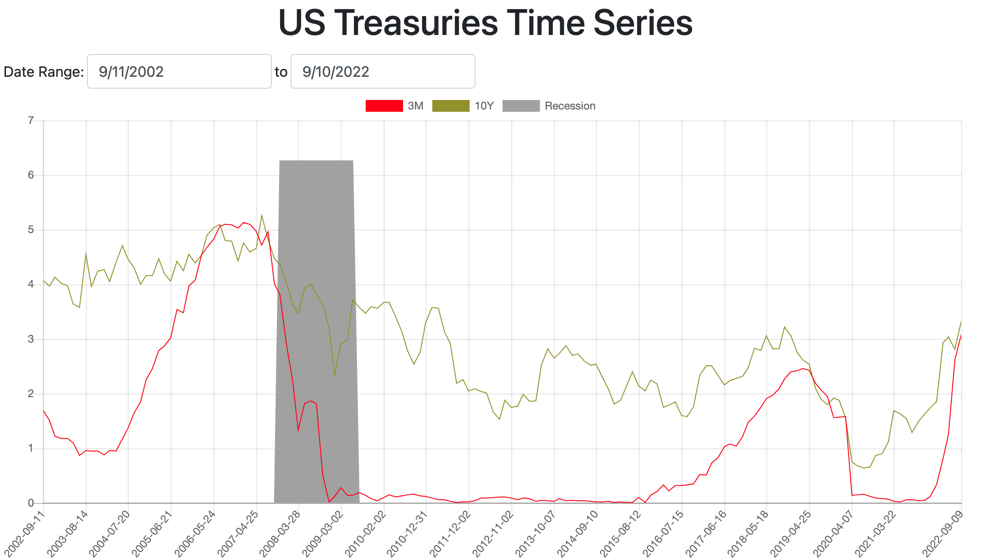
Treasury Yield Curve: 3-month, 10-year

Slide 29
Using the Yield Curve to Calculate Holding Period Returns and Future Values
CFs should be grown using the appropriate annualized spot rates ( ) from the Yield Curve
You invest $10,000 today for 2 years. What’s the final value and HPR of the investment?
Final Value = ?
HPR = ?
Period | YTM
1 Year | 3.67%
2 Years | 3.56%
5 Years | 3.45%
10 Years | 3.42%

Slide 30
Using the Yield Curve to Calculate Forward Rates
Forward rates can be extracted from the spot rate yield curve.
If we know the 1-yr and 2-yr spot rates, the 1-yr forward rate, r_{1,2}, is implied by the following relationship:
(1+r₂)² = (1+ r_{0,1})*(1+ r_{1,2})
(1+ r_{1,2}) = (1+r₂)² / (1+ r_{0,1})
r_{1,2} = (1.0356)² / (1.0367) -1 = 3.45%
Period | YTM | Forward Rates | Forward Rates
1 Year | 3.67% | 3.67% | r_{0,1}
2 Years | 3.56% | 3.45% | r_{1,2}

Slide 31
Using the Yield Curve to Calculate Present Values
The future CFs from projects are discounted using the appropriate annualized spot rates ( ) from the Yield Curve.
Example: A 2-yr bond offers annual coupons of 15 and a face of 1,000. What’s its price (PV)?
Period | YTM | Forward Rates
1 Year | 3.67% | 3.67%
2 Years | 3.56% | 3.45%
3 Years | 3.61% | 3.71%
5 Years | 3.45%

Slide 32
YTM and Bond Value
$1400
1300
When the YTM < Coupon, the bond trades at a premium: Price > Face.
Bond Value
1200
When the YTM = Coupon, the bond trades at par: Price = Face.
1100
1000
6 3/8
800
0
0.01
0.02
0.03
0.04
0.05
0.06
0.07
0.08
0.09
0.1
Discount Rate
When the YTM > Coupon, the bond trades at a discount: Price < Face.

Slide 33
Query: Are U.S. Treasuries Risk-Free?
In what way are U.S. treasuries risk-free?
In what way are U.S. treasuries not risk-free?

Slide 34
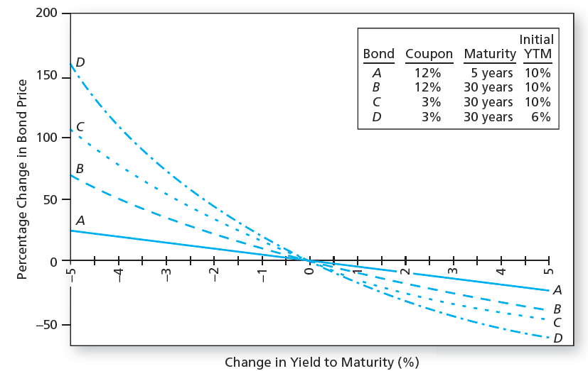
Changes in Bond Price when YTM Changes

Slide 35
Interest Rate Risk
Bond 1 CFs: 1090
Bond 2 CFs: 90, 90, 90, 90, and 1090
 | YTM
Bond | 5% (T₀) | 7% (T₁) | Price Change | % Price Change
1-year, 9% Ann. Coupon | 1038 | 1018 | -19.30 | -1.86%
5-year, 9% Ann. Coupon | 1173 | 1082 | -90.99 | -7.76%

Slide 36
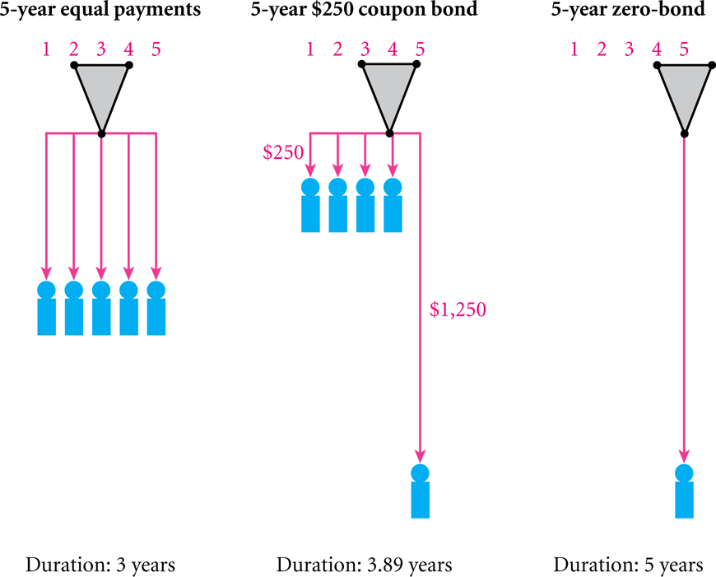
Interest Rate Risk: Duration

Slide 37
Interest Rate Risk: Duration
Macaulay Duration: weighted average term to maturity using the present values of a bond’s CFs

Slide 38
Macaulay and Modified Duration Example

Slide 39
Modified Duration: Duration and Price Changes
Modified Duration (volatility):
Modified Duration = Duration/(1+YTM)
∆ Bond Price ≈ -Modified Duration *Bond Price* ∆YTM
% ∆ Bond Price ≈ -Modified Duration * ∆YTM
Example
By how much does our 9%, 5-year bond change in price if the YTM rises or falls 50 bps? How accurate is the modified duration formula?
Bond YTM | Price | Price Change | % Actual Price Change | Predicted Price Change using Mod. Duration | Mod. Duration Predicted % Change
5% | 1173.17
4.5% | 1197.55 | 24.38 | 2.078% | 24.04 | 2.049%
5.5% | 1149.45 | -23.72 | -2.022% | -24.04 | -2.049%

Slide 40
Changes in Bond Price when YTM Changes

Slide 41
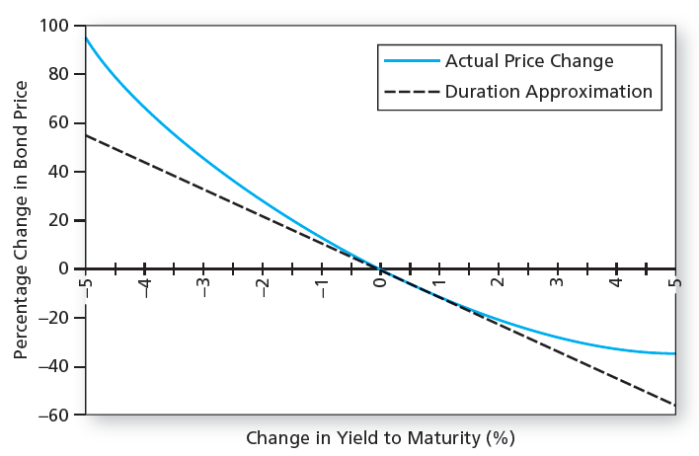
Bond Price Convexity: 30YR, 8% Coupon, YTM = 0

Slide 42
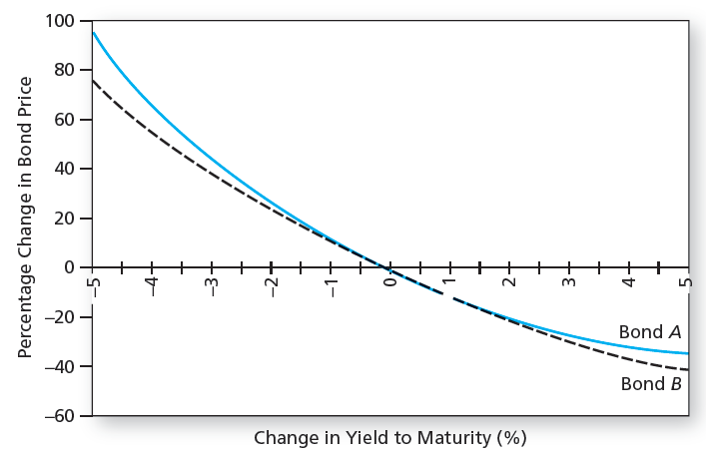
Convexity

Slide 43
Maturity and Bond Price Volatility
Consider two otherwise identical bonds.
The long-maturity bond will have much more volatility with respect to changes in the discount rate
Bond Value
Par
Short Maturity Bond
C
Discount Rate
Long Maturity Bond

Slide 44
Coupon Rate and Bond Price Volatility
Consider two otherwise identical bonds.
The low-coupon bond will have much more volatility with respect to changes in the discount rate
Bond Value
High Coupon Bond
Discount Rate
Low Coupon Bond

Slide 45
Summary of Bond Concepts
Bond prices and market interest rates move in opposite directions.
When coupon rate = YTM, price = par value.
When coupon rate > YTM, price > par value (premium bond)
When coupon rate < YTM, price < par value (discount bond)
A bond with longer maturity has higher relative (%) price change than one with shorter maturity when YTM changes, all other features identical.
A lower coupon bond has a higher relative price change than a higher coupon bond when YTM changes, all other features identical.
Current Yield (CY) ≠ YTM
Current Yield = Annual Coupon Amount/Current Price

Slide 46
Treasury Inflation Protected Securities: TIPS and I Bonds
 | Year 1 | Year 2
Principal | 1,000 | 1,020
Inflation | 2% | 3%
Inflation Adjustment: P*(1+INF) | 1,020 | 1,050.60
Fixed Coupon 3% * (P + Inf) | 30.60 | 31.52
Tot. Return: Infl Adj + Fixed Coupon | 50.60 | 62.12

Slide 47
Real YTM: Treasuries and TIPS (Sept 2022)
Term | Treasury | TIPS | Implied Inflation
5 YR | 3.45% | 0.94% | 2.51%
7 YR | 3.42% | 0.92% | 2.50%
10 YR | 3.33% | 0.91% | 2.42%
20 YR | 3.71% | 1.03% | 2.68%
30 YR | 3.47% | 1.14% | 2.33%

Slide 48
Real YTM: Treasuries and TIPS (Sept 2021)
Term | Treasury | TIPS | Implied Inflation
5 YR | 0.81% | -1.72% | 2.53%
7 YR | 1.11% | -1.36% | 2.47%
10 YR | 1.35% | -1.03% | 2.38%
20 YR | 1.88% | -0.53% | 2.42%
30 YR | 1.95% | -0.29% | 2.24%

Slide 49
Real YTM: Treasuries and TIPS (Sept 2020)
Term | Treasury | TIPS | Implied Inflation
5 YR | 0.24% | -1.29% | 1.55%
7 YR | 0.43% | -1.18% | 1.63%
10 YR | 0.63% | -1.02% | 1.67%
20 YR | 1.13% | -0.65% | 1.79%
30 YR | 1.34% | -0.39% | 1.74%

Slide 50
Real YTM: Treasuries and TIPS (Sept, 2019)
Term | Treasuries | TIPS | Implied Inflation
5 YR | 1.75% | 0.29% | 1.46%
7 YR | 1.83% | 0.25% | 1.58%
10 YR | 1.90% | 0.23% | 1.67%
20 YR | 2.17% | 0.45% | 1.72%
30 YR | 2.37% | 0.65% | 1.72%

