Slide 1
Corporate Finance
Investor Choice: Risk and Reward
Fall 2026
Prof. Jeffrey Colón

Slide 2
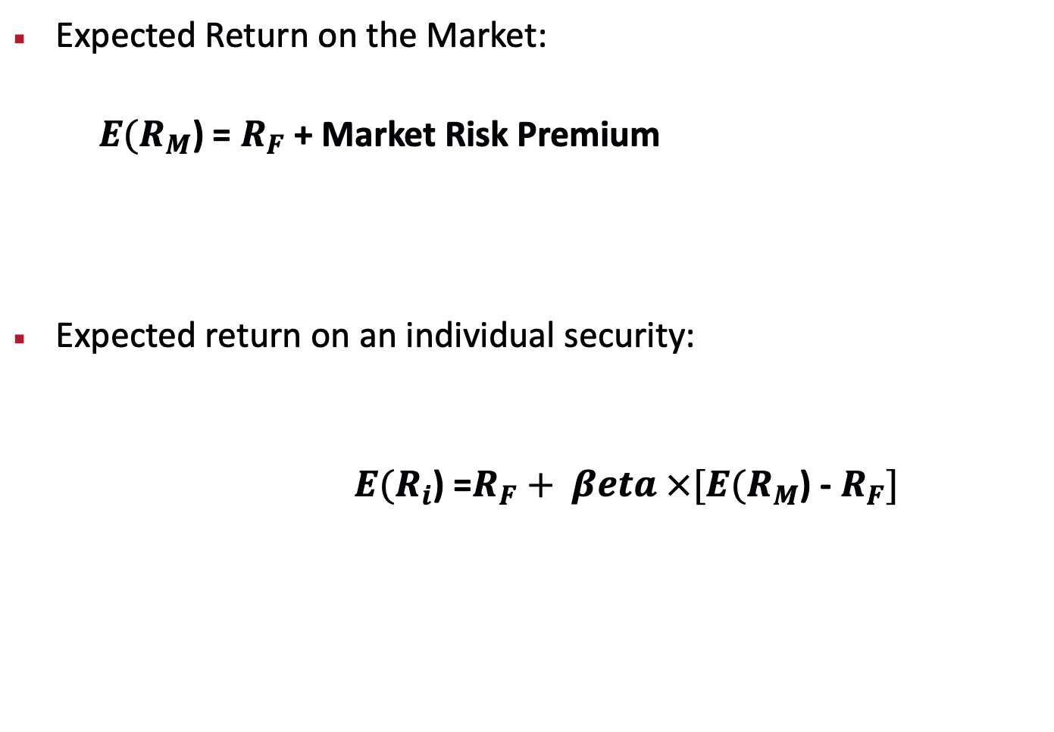
Relationship between Risk and Expected Return (CAPM)
Expected Return on the Market:
$E(R_{M}$) = $R_{F}$ + Market Risk Premium
Expected return on an individual security:
$E(R_{i}$) =$R_{F}+ βeta ×[E(R_{M}$) - $R_{F}]$
Market Risk Premium
This applies to individual securities held within well-diversified portfolios.

Slide 3
Diversification
What happens to expected returns (reward) when assets are combined to form portfolios?
  Is the expected return of a portfolio of stocks equal to the weighted average of the expected returns of individual stocks?
What happens to standard deviation (risk) when assets are combined to form portfolios?
  Is the SD of a portfolio of stocks equal to the weighted average of the SDs of the individual stocks?
If a firm’s shareholders are well diversified, what kinds of projects should managers choose?

Slide 4
Diversification: Results
To the extent that assets don’t move together (nonsynchronous), diversification reduces risk
Since most investors probably hold very diversified portfolios, corporate managers should pursue projects that offer high returns and lower risk
A project’s idiosyncratic risk is not important
A project with a high SD may lower an investor’s portfolio risk
Market risk is measured using beta

Slide 5
Portfolio Expected Returns
Expected rate of return (reward) on a portfolio of assets depends on:
  Portfolio weights, and
  Individual asset returns
Expected Return on a portfolio of assets is the weighted average of expected returns of assets:
  The sum of all the weights must equal 1
  W can be negative in the case of short sales

Slide 6
Portfolio Variance: 2 Assets
Variance (Single asset j):
Variance (Two assets, x and y):
Variance or standard deviation (risk) of a portfolio of assets is generally not the weighted average of VAR or SD (risk) of the portfolio’s assets

Slide 7
Sample Investment Opportunities
Now, for each of the investment opportunities, M, A, B, C, and F, calculate the E(r), VAR, and SD.

Slide 8
Sample Investment Opportunities
Now, calculate the E(r) and SD of a Portfolio of 50% M and 50% A.

Slide 9
Investment Opportunities and Diversification
Now, calculate the E(r) and SD of a Portfolio of 90% M and 10% A, and 90% M and 10% C.

Slide 10
Investment Opportunities and Diversification

Slide 11
Efficient Frontier
M, A, & B
M&A
M, A, B, & C
M, A, B, & F

Slide 12
Investment Opportunities and Diversification

Slide 13
Investing Insights
Individuals should focus on the risk of their overall portfolio and not the risk of the individual investments.
Diversification generally lowers overall portfolio risk.
Because investors are risk-adverse they will hold diversified portfolios.
A manager should evaluate a project based on its risk/reward contribution for investors holding diversified portfolios.
Investors like projects whose returns are non-synchronous with their portfolio returns.

Slide 14
Asset Beta & Portfolio Risk Contribution

Slide 15
Measuring Risk Contribution
There are 3 choices for measuring an asset’s risk contribution to a portfolio:
  Covariance
  Correlation
  Beta

Slide 16
BETA (β)
Unitless
Slope of best fitting line through (Y,X): (y = α + βx)
Order of variables matters: β_{y,x} = β_{x,y}
Tells how much Y will change for given change in X
Time period and frequency matter
In CAPM, beta refers to the beta of stock Y (asset, project) generally with the market return, M
Higher beta means more comovement and less diversification

Slide 17
The Formula for Beta of Stock i with the Market Portfolio
Your estimate of beta will depend upon your choice of a proxy for the market portfolio.

Slide 18
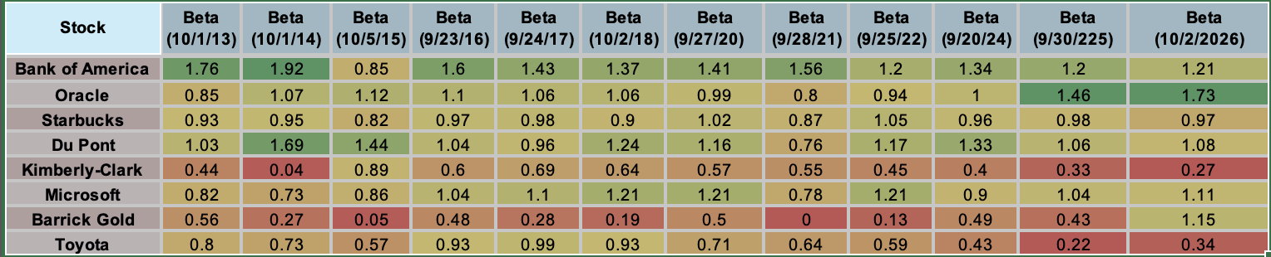
Estimates of β for Selected Stocks

Slide 19
Measuring Risk Contribution
The formula for covariance is:
A major drawback to covariance is its units, %². If the covariance is divided by the product of the standard deviation of the assets, the units cancel out. The result is correlation.

Slide 20
Correlation and Covariance
Correlation
  Unitless
  Always between +1 and -1
  Same sign (+ or - ) as Covariance
  Drawback: correlation measures reliability, not slope
The formula for correlation is:

Slide 21
Scaling Problem with Correlation

Slide 22
Correlation, Covariance, and Beta

Slide 23
Covariance, Correlation, and Beta

Slide 24
Portfolio Variance: N Assets
Assets | 1 | 2 | 3 | ---- | N
1 | w₁²Var(1) | w₁w₂Cov(1,2) | w₁w₃Cov(1,3) | -- | w₁w_{N}Cov(1,N)
2 | w₂w₁Cov(2,1) | W₂²*Var(2) | w₂w₃Cov(2,3) | -- | w₂w_{N}Cov(2,N)
3 | w₃w₁Cov(3,1) | w₃w₂Cov(3,2) | w₃²*Var(3) | -- | w₃w_{N}Cov(3,N)
----- | ----- | ----- | ----- | -- | ------
N | w_{N}w₁Cov(N,1) | w_{N}w₂Cov(N,2) | w_{N}w₁Cov(N,3) | -- | w_{N}²*Var(N)

Slide 25
Diversification: The Role of Covariance
Assume a portfolio: n assets, each with a variance of AveVar, investment of 1/n in each asset, and each asset has a covariance with every other asset of AveCov
What’s the portfolio’s variance?
Using the box, add all of the variances (+weights)
  (1/n)^{2 *} (n) * AveVar, or ----> (1/n) * AveVar
Now, add all of the covariances
  (1/n)² * (n²-n) * AveCov, or ------> (n-1)/n * AveCov
Var Port = (1/n) * AveVar + (n-1)/n * AveCov

Slide 26
Portfolio Risk as a Function of the Number of Stocks in the Portfolio
σ
In a large portfolio the variance terms are effectively diversified away, but the covariance terms are not.
Diversifiable Risk; Nonsystematic Risk; Firm Specific Risk; Unique Risk
Portfolio risk
Nondiversifiable risk; Systematic Risk; Market Risk
n
Thus, diversification can eliminate some, but not all of the risk of individual securities.

Slide 27


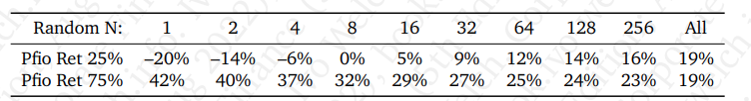
Random Diversification (Million Samples drawn from 2020 Returns, Eq. Weighted)

Slide 28
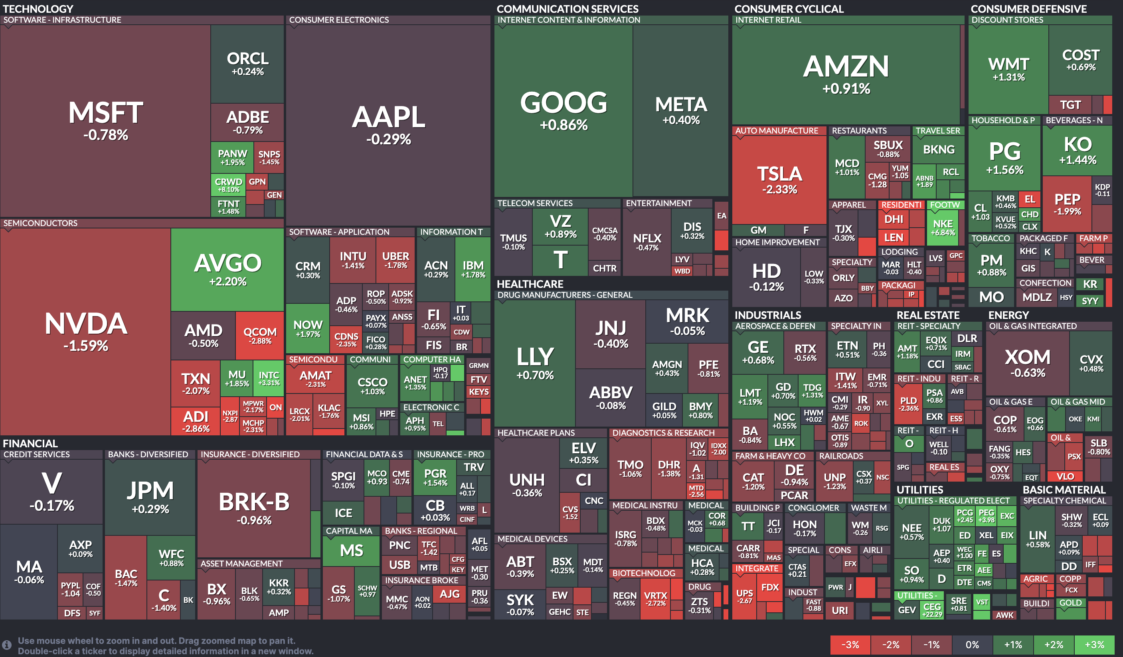
On any given day, there is a range of return outcomes: Returns SP500 (Sept 20, 2024)

Slide 29
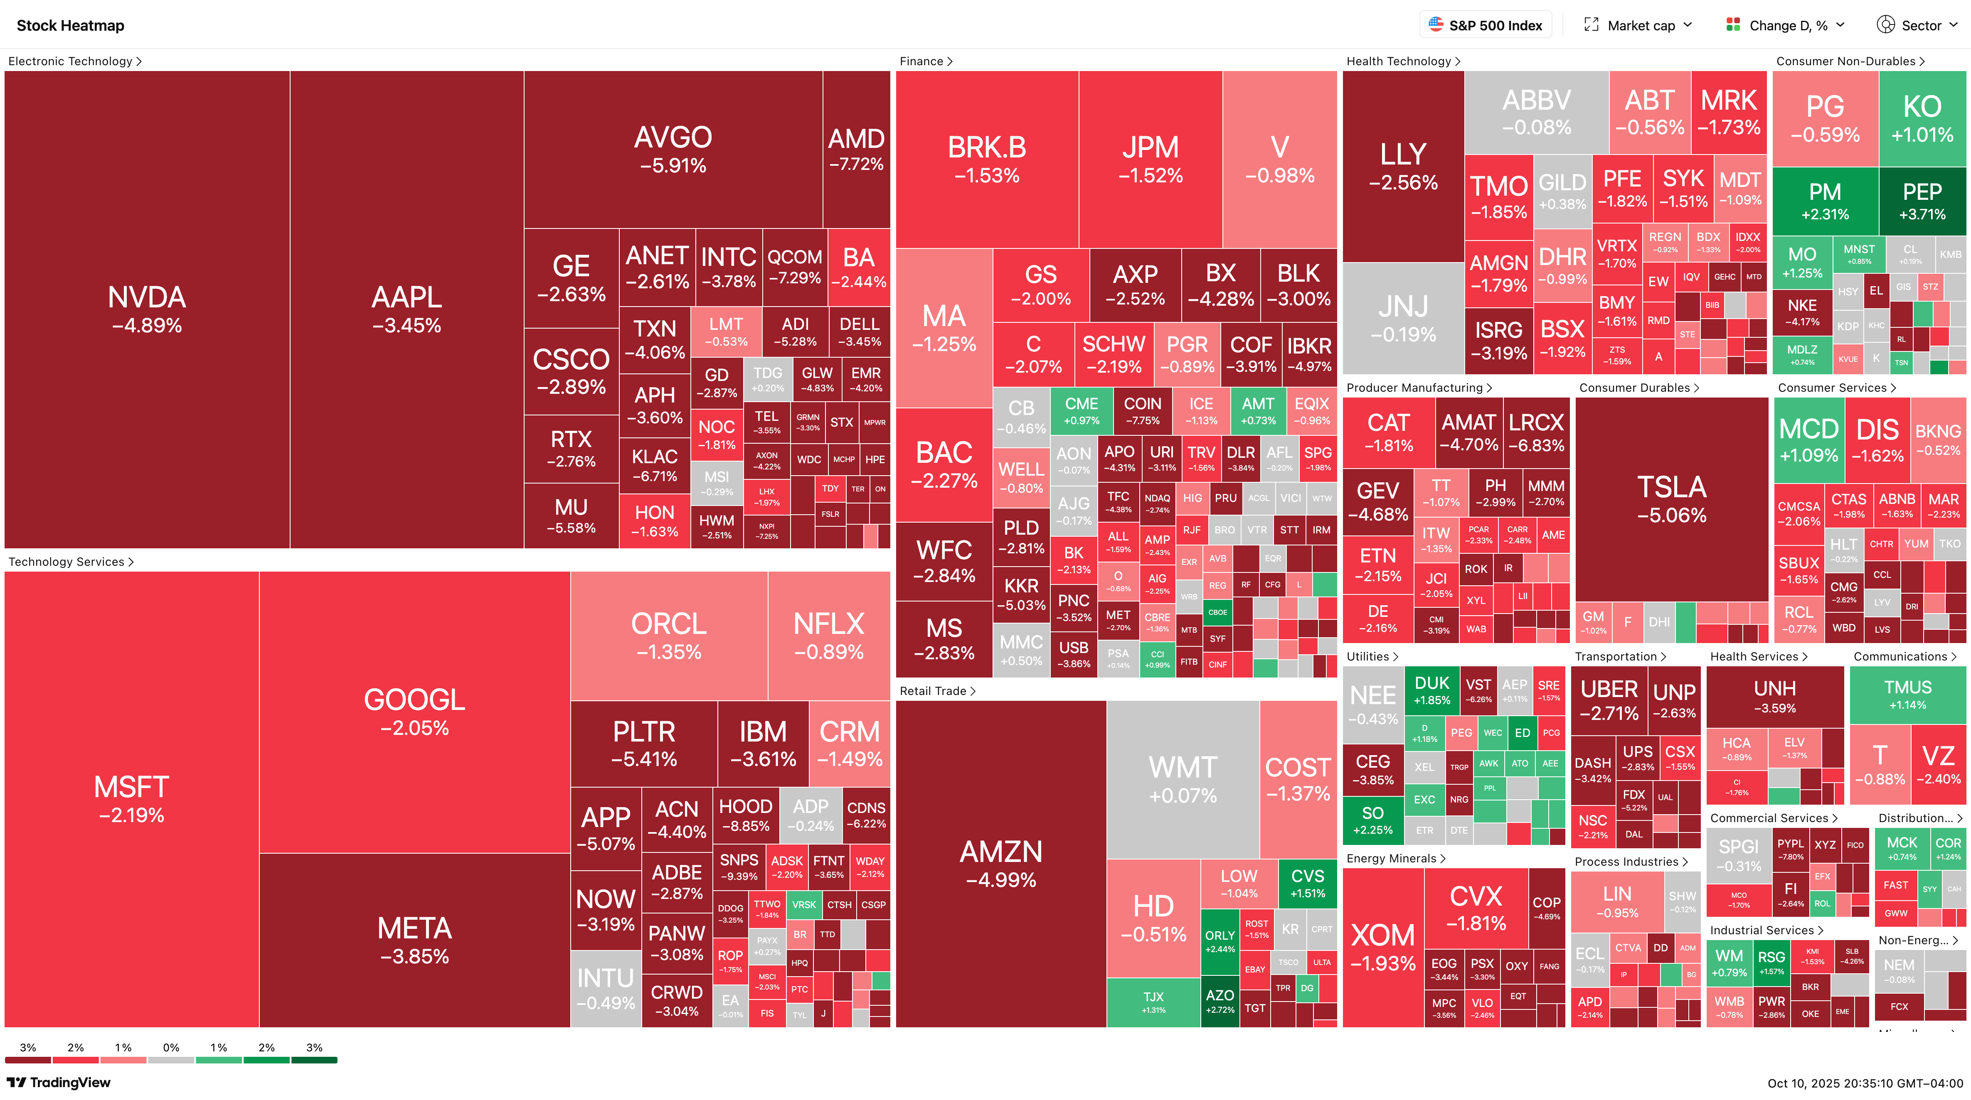
But in times of stress, all correlations go to 1 (Oct 10, 2025, Returns SP500)

Slide 30
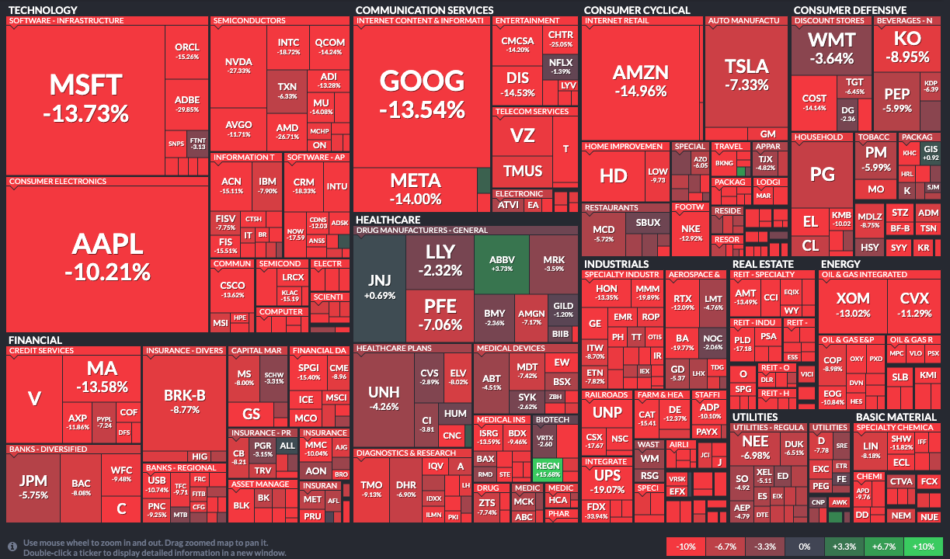
But in times of stress, all correlations go to 1 (Sept. 2022, Returns SP500)

Slide 31
Diversification
Diversification is a free lunch, up to a point
For a well-diversified investor, an investment’s variance (SD) doesn’t generally give us information about the effect that adding the investment has on the investor’s overall portfolio risk--what matters is its covariance (or beta).
Lower betas help reduce portfolio risk
Investments with lower betas have higher prices (and lower expected returns)
In moments of stress, however, correlations can go to 1

Slide 32
The OG on Diversification
Cast thy bread upon the waters, for thou shalt find it after many days. Give a portion to seven and also to eight, for thou knowest not what evil shall be upon the earth. Ecclesiastes 11:1-2

Slide 33
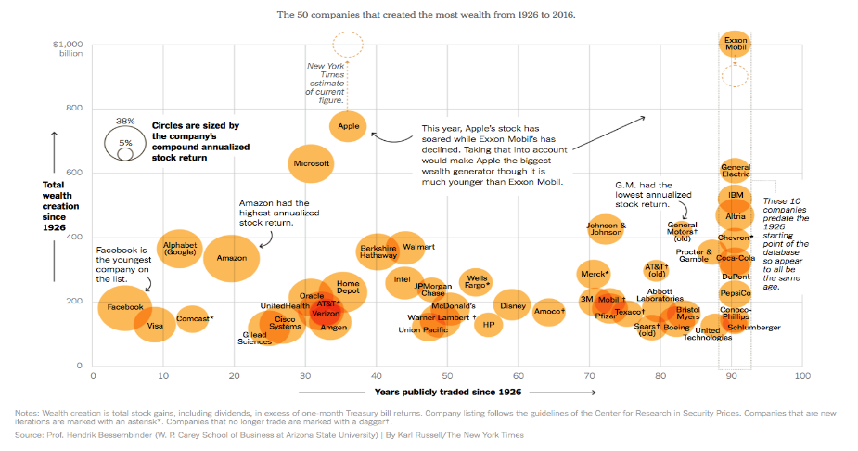
Diversification: IMPORTANT
Fifty eight percent of CRSP common stocks have lifetime holding period returns less than those on one-month Treasuries. The modal lifetime return is -100%. When stated in terms of lifetime dollar wealth creation, the entire net gain in the U.S. stock market since 1926 is attributable to the best-performing four percent of listed stocks, as the other ninety six percent collectively matched one-month Treasury bills. Bessembinder, Do Stocks Outperform Treasury Bills (2017)

Slide 34
Diversification: IMPORTANT
Of the 29,081 firms, a total of 11,884 (40.87%) improved shareholder wealth, while 17,197 (59.13%) reduced shareholder wealth, as compared to the Treasury-bill benchmark. For comparison, I also assess the proportion of firms for which buy-and-hold returns are greater or less than buy-and-hold returns to Treasury bills during the same months that the firm was included in the sample. The outcome is that a total of 11,924 firms (41%) provided returns that exceed Treasury bills, while 17,157 (590%) fell short of Treasury bills…the CRSP data contains returns for a total of 29,081 firms. Among these, 2 firms accounted for 10% of net wealth creation, 8 firms accounted for 25% of net wealth creation, 46 firms accounted for 50% of net wealth creation, 208 firms accounted for 75% of wealth creation, and 1,082 (3.7%) firms accounted for 100% of net wealth creation [of $91 Trillion].
Bessembinder, One Hundred Years in the U.S. Stock Markets 1926-2025 (2026)

Slide 35
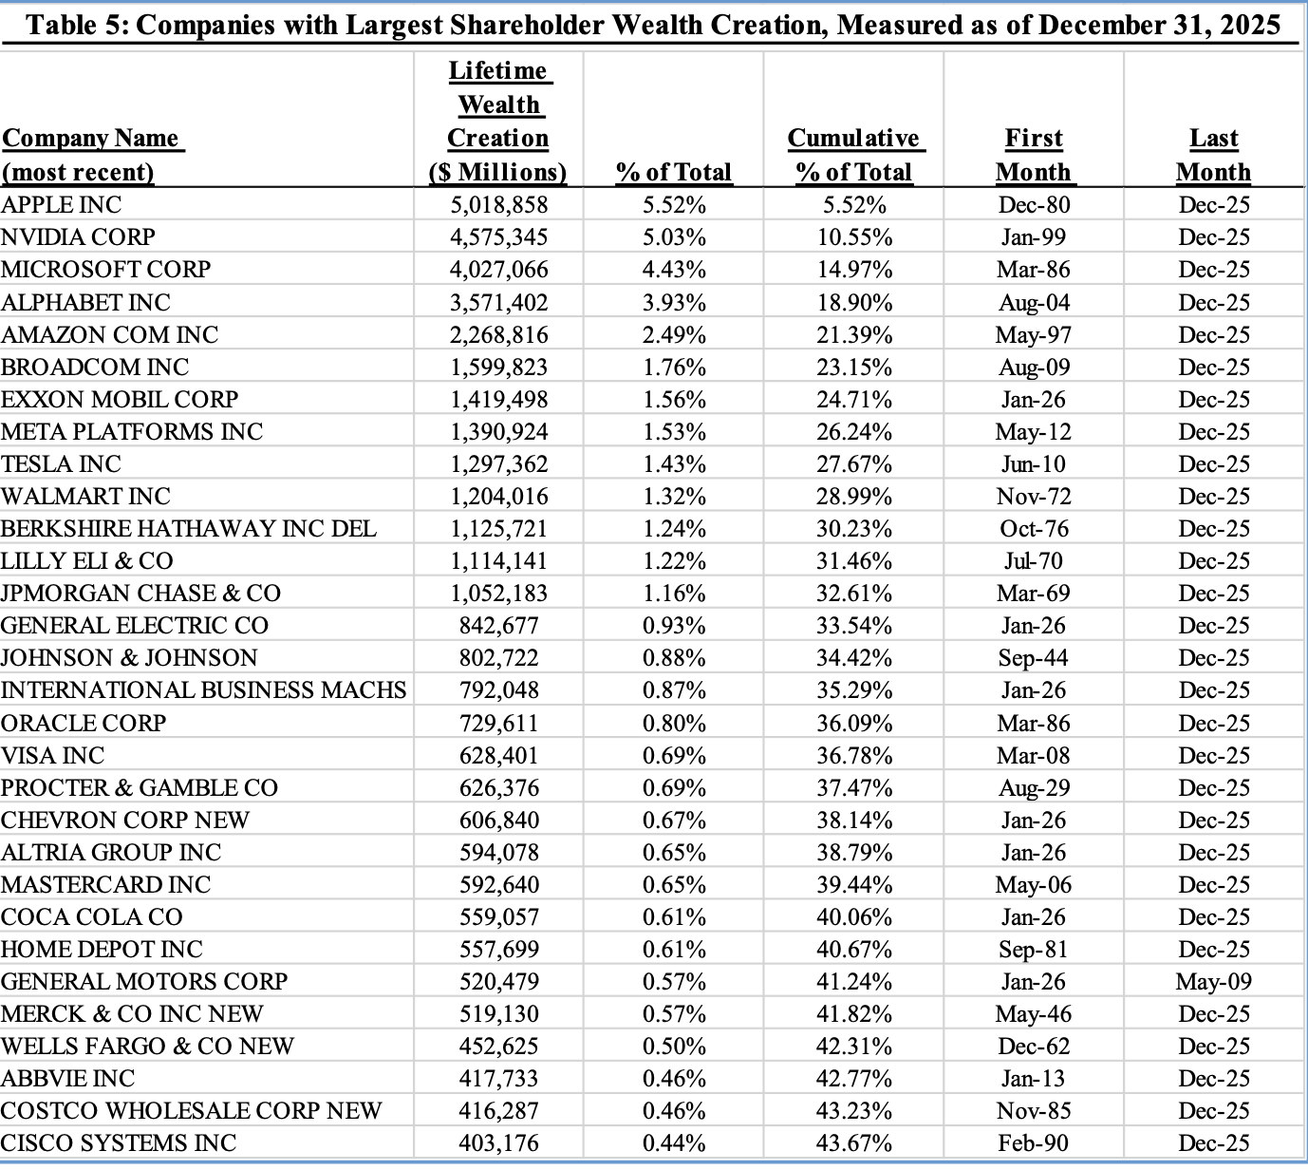
Diversification: IMPORTANT
Bessembinder, One Hundred Years in the U.S. Stock Markets 1926-2025 (2026)

Slide 36
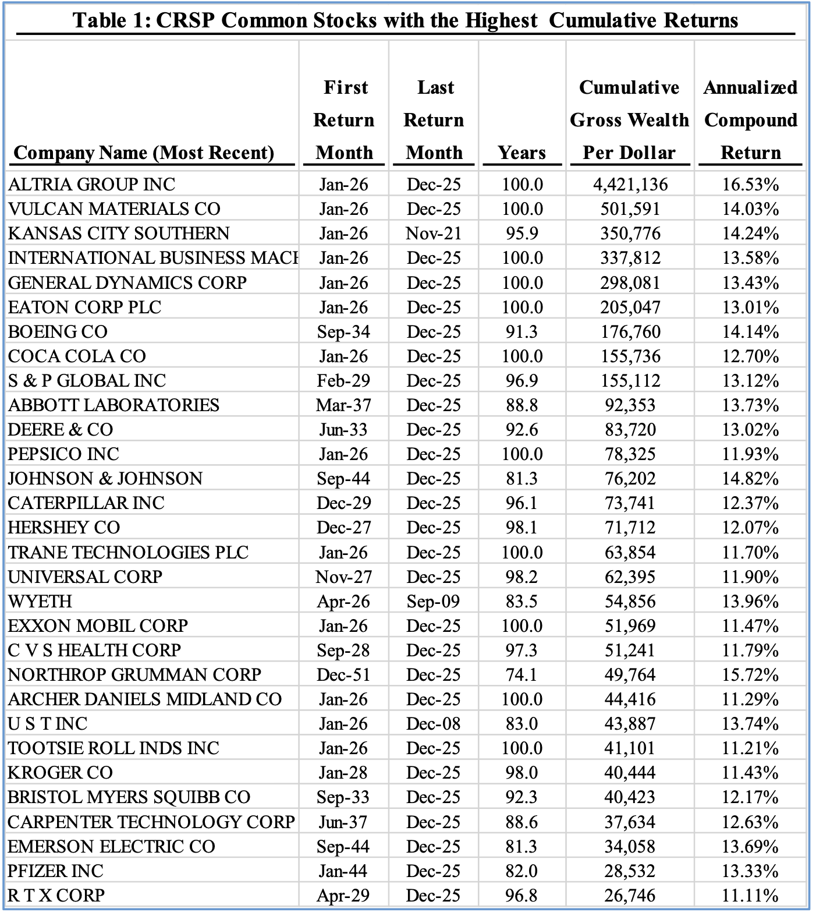
Stocks with Highest Cumulative Returns
Bessembinder, One Hundred Years in the U.S. Stock Markets 1926-2025 (2026)

Slide 37
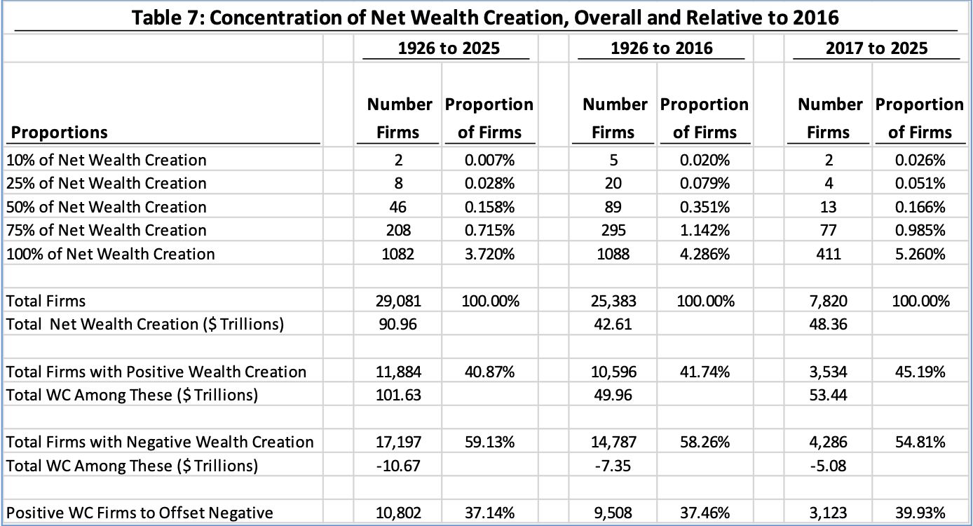
Concentration of Net Wealth Creation, Overall and Relative to 2016
Bessembinder, One Hundred Years in the U.S. Stock Markets 1926-2025 (2026)

Slide 38
Market Betas for Portfolios (Firms)
Expected return of a portfolio (firm) is weighted average of expected returns of the portfolio’s assets (firm’s divisions).
The beta of a portfolio (firm) is the weighted average of the betas of the portfolio’s assets (firm’s divisions).
  Weighted averaging doesn’t work with Sdev and Var.
Firm can be viewed not only as consisting of different projects/divisions but also as debt and equity.
  Beta of a firm’s assets is weighted average of its debt and equity:

