Slide 1
Equity Payouts: Dividends and Share Repurchases
What can a company do with its earnings?
Retain them and then either spend or reinvest
Pay off liabilities
Pay dividends in cash or (very rarely) in property
Repurchase shares from shareholders

Slide 2
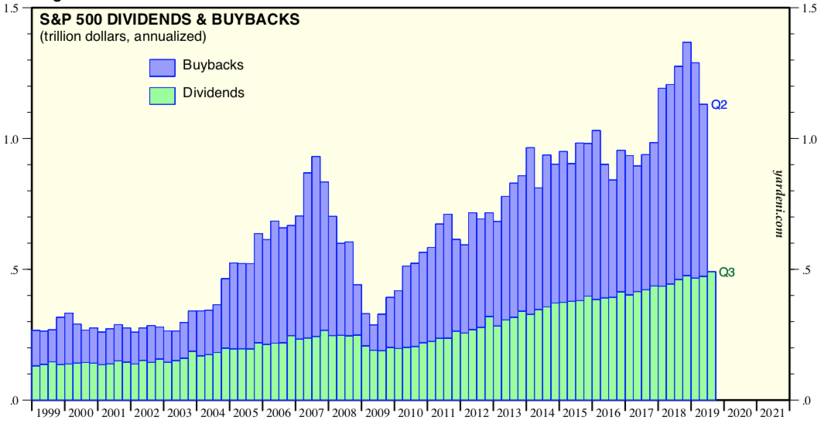
S&P 500 Dividends & Buybacks
Source: Yardeni & Abbott

Slide 3
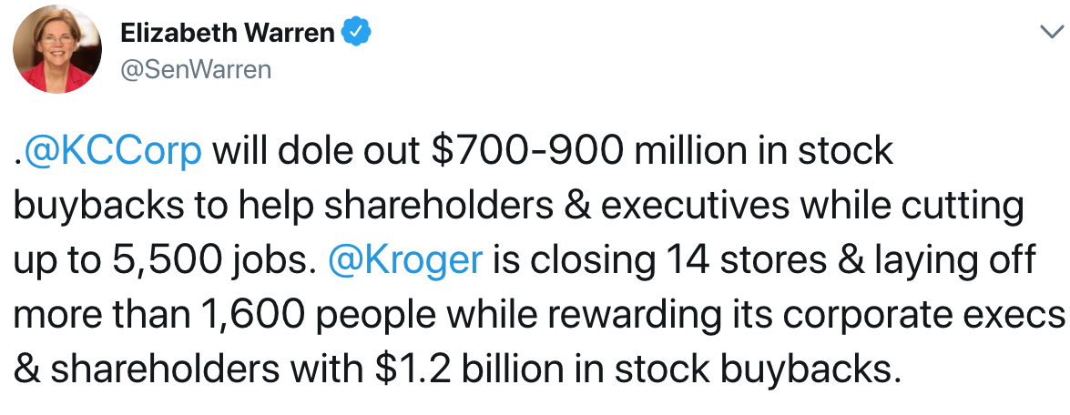
Political Concerns with Buybacks

Slide 4
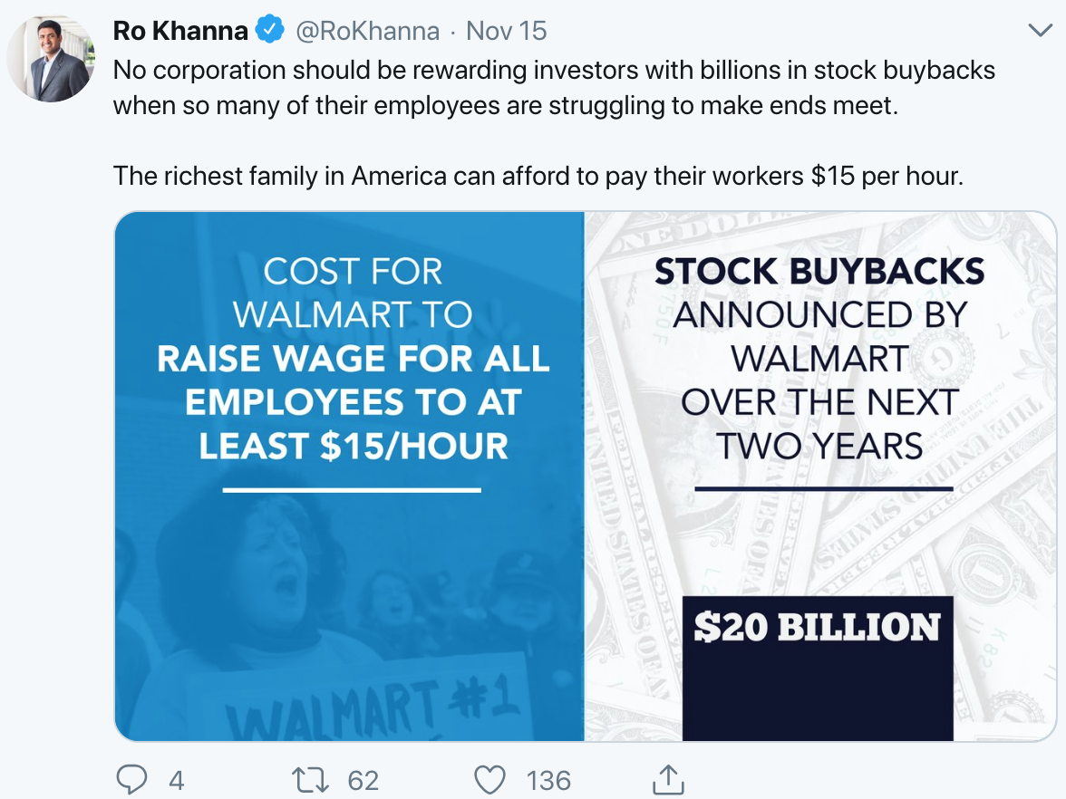
Political Concerns with Buybacks

Slide 5
Dividend
Pro rata distribution to shareholders (but preferred dividends)
Cash or (rarely) property
On October 23, 2017, we announced an increase in the dividend amount to $0.16 per share, payable on November 15, 2017, to stockholders of record as of the close of business on November 6, 2017. Dolby Laboratories
Declaration (announcement) date [10/23]
Cum-dividend date [11/2]
Ex-dividend date [11/3]
Record date [11/6]
Payment date [11/15]
T+2
Stock split and reverse stock split
Price effects?

Slide 6
Stock Repurchases
Auction-based repurchase
Private negotiations
Open-market Repurchase (most common)
The company announces a new $20 billion share repurchase program to replace its existing authorization and expects to utilize the new authorization over an approximate two-year period. Walmart (Oct. 2017)
Rule 10b-18 Safe Harbor (very abbreviated)
Must purchase all shares from single broker on any single day
Limits on when during the day purchases can be made
Limits on the purchase price
Can’t exceed 25% of ADTV over prior 4 weeks
Where can you find information about share buybacks on the financials?

Slide 7
Apple Announcement (March 30, 2019)
As of March 30, 2019 , the [Apple] had an authorized program to repurchase up to $100 billion of the Company’s common stock, of which $61.3 billion had been utilized. During the six months ended March 30, 2019, the Company repurchased 164.7 million shares of its common stock for $32.2 billion, including 55.1 million shares initially delivered under a $12.0 billion accelerated share repurchase arrangement dated February 2019. On April 30, 2019 , the Company announced the Board of Directors increased the share repurchase program authorization from $100 billion to $175 billion . The Company’s share repurchase program does not obligate it to acquire any specific number of shares. Under this program, shares may be repurchased in privately negotiated and/or open market transactions, including under plans complying with Rule 10b5-1 under the Securities Exchange Act of 1934, as amended (the “Exchange Act”).

Slide 8
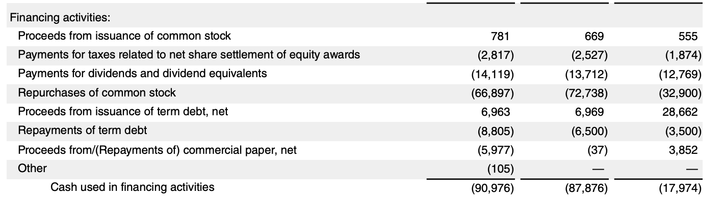
Apple SOCF 2019 10-K
2019 2018 2017

Slide 9
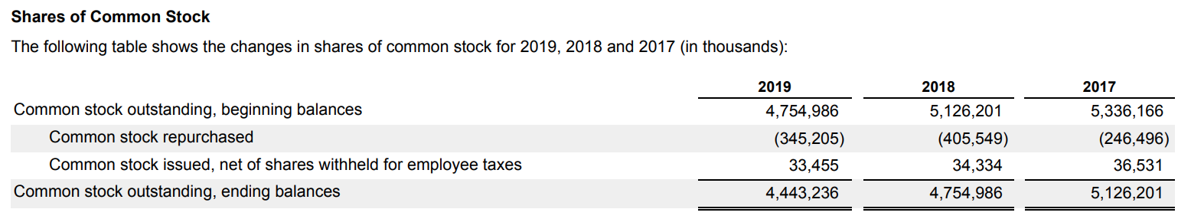
Apple 10-K

Slide 10
Buybacks going up, up, up?
Source: Asness (2018)

Slide 11
Companies are selling assets to fund buybacks
Source: Asness (2018)

Slide 12
Companies are forgoing investments to fund buybacks

Slide 13
Dividends & Repurchases
In a perfect market, payout policy doesn’t matter. M&M II
Q: Would you pay more for a stock that promised a 2% dividend vs. a stock that promised a 1% dividend? What if you wanted more $ each year?
But, market Imperfections…
Corporate taxes
Personal taxes
Dividend rate vs. CG rate: 23.8%
Dividend vs. Repurchase
Clienteles (tax-exempt and taxable investors)
CGs still offer significant flexibility
Financial distress
Agency and Signaling
Reduce possibility of investment in bad project (like debt)

Slide 14
Naive Conceptions
Buybacks help remaining SHs because there are now fewer shares outstanding.
Only tendering SHs gain from share repurchases because they get the cash.
Consider the value of the firm and value of the remaining shares after a redemption:
(A) Firm is worth $100 with 10 shareholders each owning 1 share. The company repurchases 1 share for $10. Results to exiting SH and remaining SHs?
(B) Firm is worth $100 with 10 shareholders each owning 1 share. The company repurchases 1 share for $11. Results to exiting SH and remaining SHs?
(C) Firm is worth $100 with 10 shareholders each owning 1 share. The company repurchases 1 share for $9. Results to exiting SH and remaining SHs?

Slide 15
Naive Conceptions
Dividends don’t eat “investment substance” but selling shares does.
10 shares @ $10/share: Compare (1) $1 dividend/share & (2) sale of 1 share
Share repurchases increase EPS
Keep earnings constant, buy back shares, and voila, EPS up, up, up and price up, up, up

Slide 16
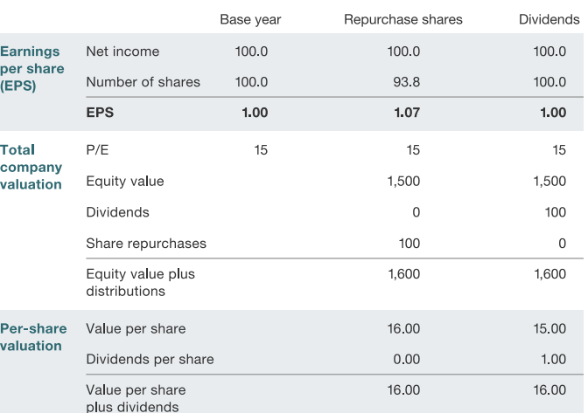
Buybacks and EPS

Slide 17
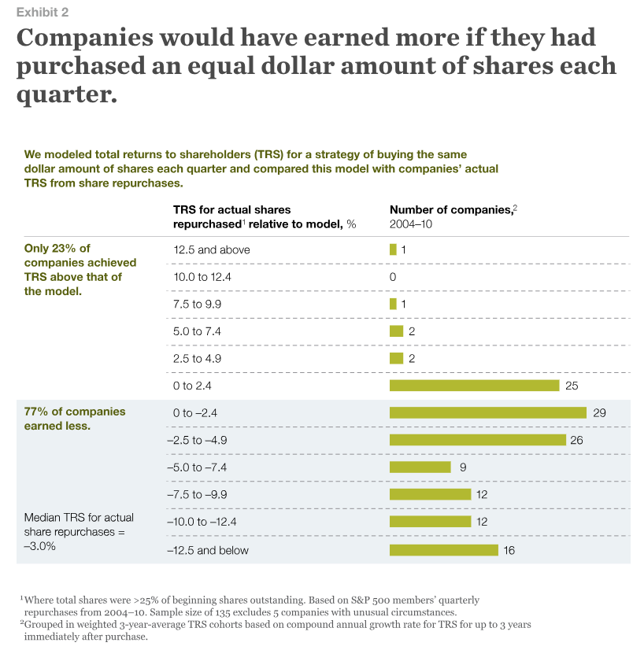
Buybacks: Can Managers Time the Market?
Source: Jiang & Koller, 2011

Slide 18
Buybacks: Can Managers Time the Market?
Little is known about the price firms pay for stock repurchases. Using a data set of all U.S. repurchases from 2004 to 2011, we compare the actual average price paid monthly in a repurchase with the average market price for the same stock over various horizons. We find that firms repurchase stock at a significantly lower price than the average market price in all sample years. Less frequent repurchasers, firms that repurchase when insiders buy on their own account, and firms that experience low stock returns prior to the repurchase obtain significantly lower prices. After controlling for risk factors, repurchasing firms earn positive returns. Infrequent repurchasers earn a significantly higher return up to three years following the actual repurchase. Dittmar & Field (2015)

Slide 19
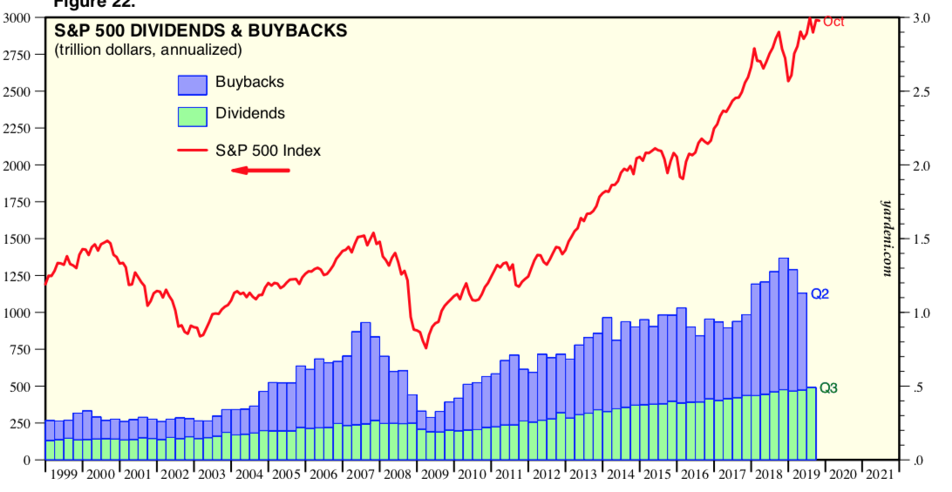
S&P 500 Dividends & Buybacks
Source: Yardeni & Abbott

Slide 20
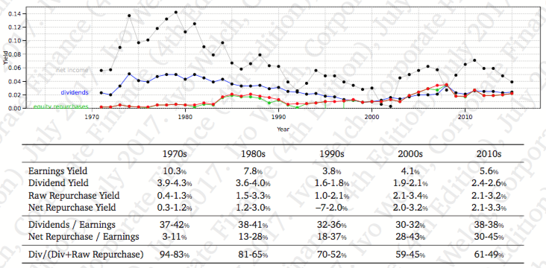
Historical S&P 500 Dividend/Repurchase Payout Patterns

Slide 21
Dividends & Repurchases Issues
Signaling: Why might stock rise after a repurchase announcement?
Dividend smoothing
Firms are reluctant to cut dividends so they prefer to slowly increase them over time
Earnings shocks are transitory and firms would rather do a repurchase with these shocks
Executive stock options
Call options lose value after dividend payout so executives/owners prefer repurchases
Executive ownership
Restricted stocks do not participate in repurchase offers so they get more of the company after a repurchase, but may not get dividends
Increased leverage to fund repurchases
Investor preferences
Behavioral finance demonstrates than unsophisticated small investors prefer dividends when it would have been more beneficial (tax shield) if they sold shares instead
Fund charter exclusion clauses
Institutional charters may restrict them to holding ONLY dividend paying stocks

