Slide 1
Corporate Finance
Introduction
Fall 2025
Prof. Jeffrey Colón

Slide 2
Course Materials and Requirements
Website
Lecture Slides
Supplemental materials and readings
Updates
In-class problems (formerly known as homeworks)
Math requirements 😁
Miscellaneous:
Attendance
Recording of Lectures: All class recordings are the property of instructor, and students may not download or capture the recording in any manner, share the recording, or use it for non-class purposes.
Final Exam

Slide 3
Course Materials and Requirements
Primary Textbook:
Ivo Welch, Corporate Finance (5th ed. 2022) [“CF”], available online at: Welch Finance Text
Alternatives (concordance):
Brealey, Myers, and Allen, Principles of Corporate Finance; Berk and DeMarzo, Corporate Finance
Damordan (NYU Finance Professor)
Potentially Useful: Desai, How Finance Works: The HBR Guide to Thinking Smart About the Numbers.
Required: Excel
Old School: Financial Calculator (FV, PV, and PMT keys), e.g., HP10B, 12C, or 17BII
New School: LLMs (Chat, Claude, Grok).
S/what interesting (July & Aug ‘25): ChatGPT, Study & Learn; Gemini Guided Learning
Recommended Daily Reading:
Matt Levine Bloomberg Columnist (please subscribe to his daily emails)
WSJ and FT
Reddit & Twitter (not TikTokInvestors!) sometimes useful

Slide 4
Overview of Class
Valuation
$X Promised Tomorrow
$? Today

Slide 5
Valuation
Law of One Price
Identical goods should sell for the same price
Similar goods should sell for similar prices
How similar is similar?
1oz gold in NY and Dubai
Adjacent 1-BR apartments on the 25th floor of the same NYC building
1 share of Google vs. 1 share of Apple
Ives Klein painting vs. Picasso

Slide 6
(Just Some) Legal Applications of Valuation
Appraisal rights (DGCL sec. 262)
Interest on judgement awards and settlements
Reorganizations in Bankruptcy
Investing in legal claims (recent podcast w/ Eva Shang of legalist.com)
Regulatory proceedings
Security Issuances and Repurchases
Venture Capital and Private Equity
Property transfers for gift and estate tax purposes
Mergers and Acquisitions
Buy/Sell Agreements

Slide 7
Overview of Class
Time Value of Money and Capital Budgeting
Current dollars vs. future dollars
Net Present Value
Riskless cash flows (CFs), e.g., U.S. Treasury Bond
Varying rates of returns
Uncertain returns, e.g., bonds of risky corporations (aka, deadbeat debtors)
Inflation—OMG, it’s back!

Slide 8
Overview of Class
Investments and Risk-Adverse Investors
Portfolio Analysis and Diversification
Variance and Beta
Asset Pricing Models
Capital Asset Pricing Model (CAPM)
Fama-French and other factor models
Efficient Capital Market Hypothesis and Market Imperfections
Alpha
Behavioral limitations
Meme stocks

Slide 9
Overview of Class
Valuation Alternatives
Cash Flows
Accounting Ratios and Metrics, e.g., ROIC, ROE, ROA, EBITDA
Comparables (Companies and Transactions)
Delaware appraisal remedy: How is Fair Value determined?
Capital Structure
Debt, Leverage and the structure of risky debt contracts
Preferred Stock
Payout Policy (dividends vs. repurchases)
*Derivatives (Forwards, Futures, Swaps, and Options) and Hedging
* If time and desire

Slide 10
Valuation Ties Together Many Law School Classes
Trusts & Estates
Commercial
Drafting
Corp. Tax
Secured Transactions
Accounting
Valuation
M&A
Intro. to the Deal
Corp. Reorganizations
Venture Capital & Private Equity
Securities Regulation

Slide 11
Valuation Hypothetical: Law School
Query: When you were considering going to law school, what were the financial and non-financial flows that were relevant to you? Please list!

Slide 12
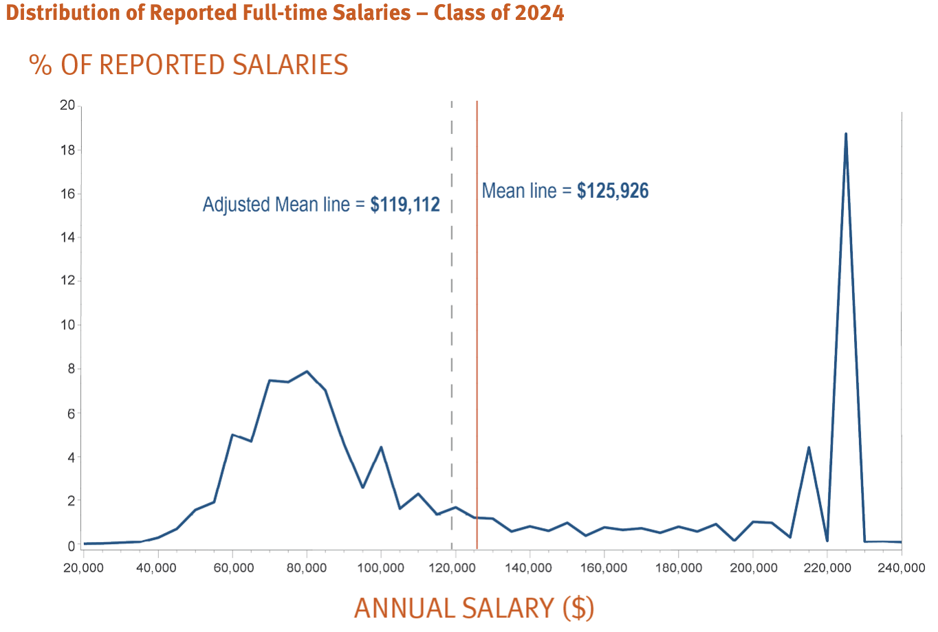
Distribution of US Legal Salaries (Class of ‘24 )
Class | Mean | Median | Median (Law Firm)
2024 | 125,926 | 95,000 | 160,000
2023 | 122,112 | 90,000 | 165,000
2022 | 116,398 | 85,000 | 150,000
2021 | 109,469 | 80,000 | 131,500
2020 | 102,858 | 75,000 | 130,000
2019 | 100,540 | 72,500 | 125,000
2018 | 98,150 | 70,000 | 120,000
2017 | 95,320 | 70,000 | 117,000
2016 | 90,035 | 65,000 | 104,000
2015 | 83,979 | 64,800 | 100,000
2014 | 82,292 | 63,000 | 95,000
2013 | 82,408 | 62,467 | 95,000
2012 | 80,798 | 61,245 | 90,000
2011 | 78,653 | 60,000 | 85,000
2010 | 84,111 | 63,000 | 104,000
2009 | 93,454 | 72,000 | 130,000
2008 | 92,999* | 72,000 | 125,000
Source: nalp.org

Slide 13
Valuation Hypothetical: Law School
Simkovic & McIntyre, The Economic Value of a Law Degree (2013)
Legal academics and journalists have marshaled statistics purporting to show that enrolling in law school is irrational. We investigate the economic value of a law degree and find the opposite: given current tuition levels, the median and even 25th percentile annual earnings premiums justify enrollment. For most law school graduates, the net present value of a law degree typically exceeds its cost by hundreds of thousands of dollars.
After controlling for observable ability sorting, we find that a law degree is associated with a 60 percent median increase in monthly earnings and 50 percent increase in median hourly wages. The mean annual earnings premium of a law degree is approximately $53,300 in 2012 dollars. The law degree earnings premium is cyclical and recent years are within historic norms.
We estimate the mean pre-tax lifetime value of a law degree as approximately $1,000,000.

Slide 14
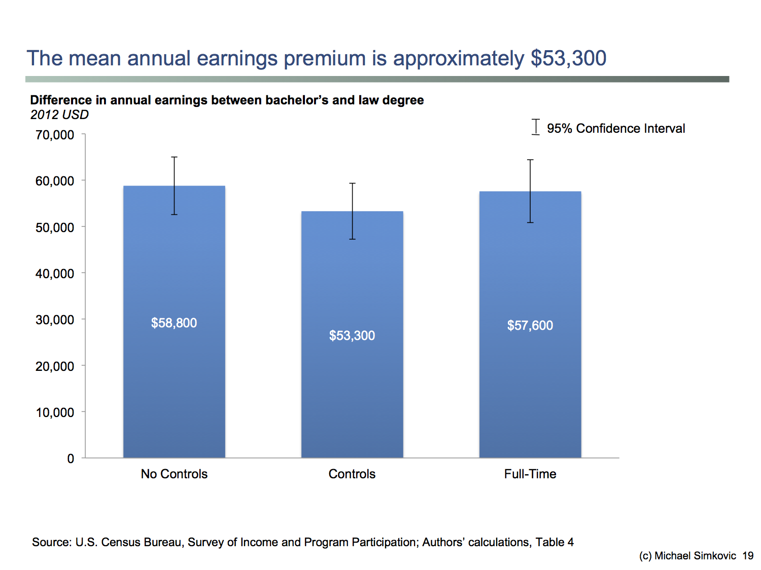
Valuation Hypothetical: Law School

Slide 15
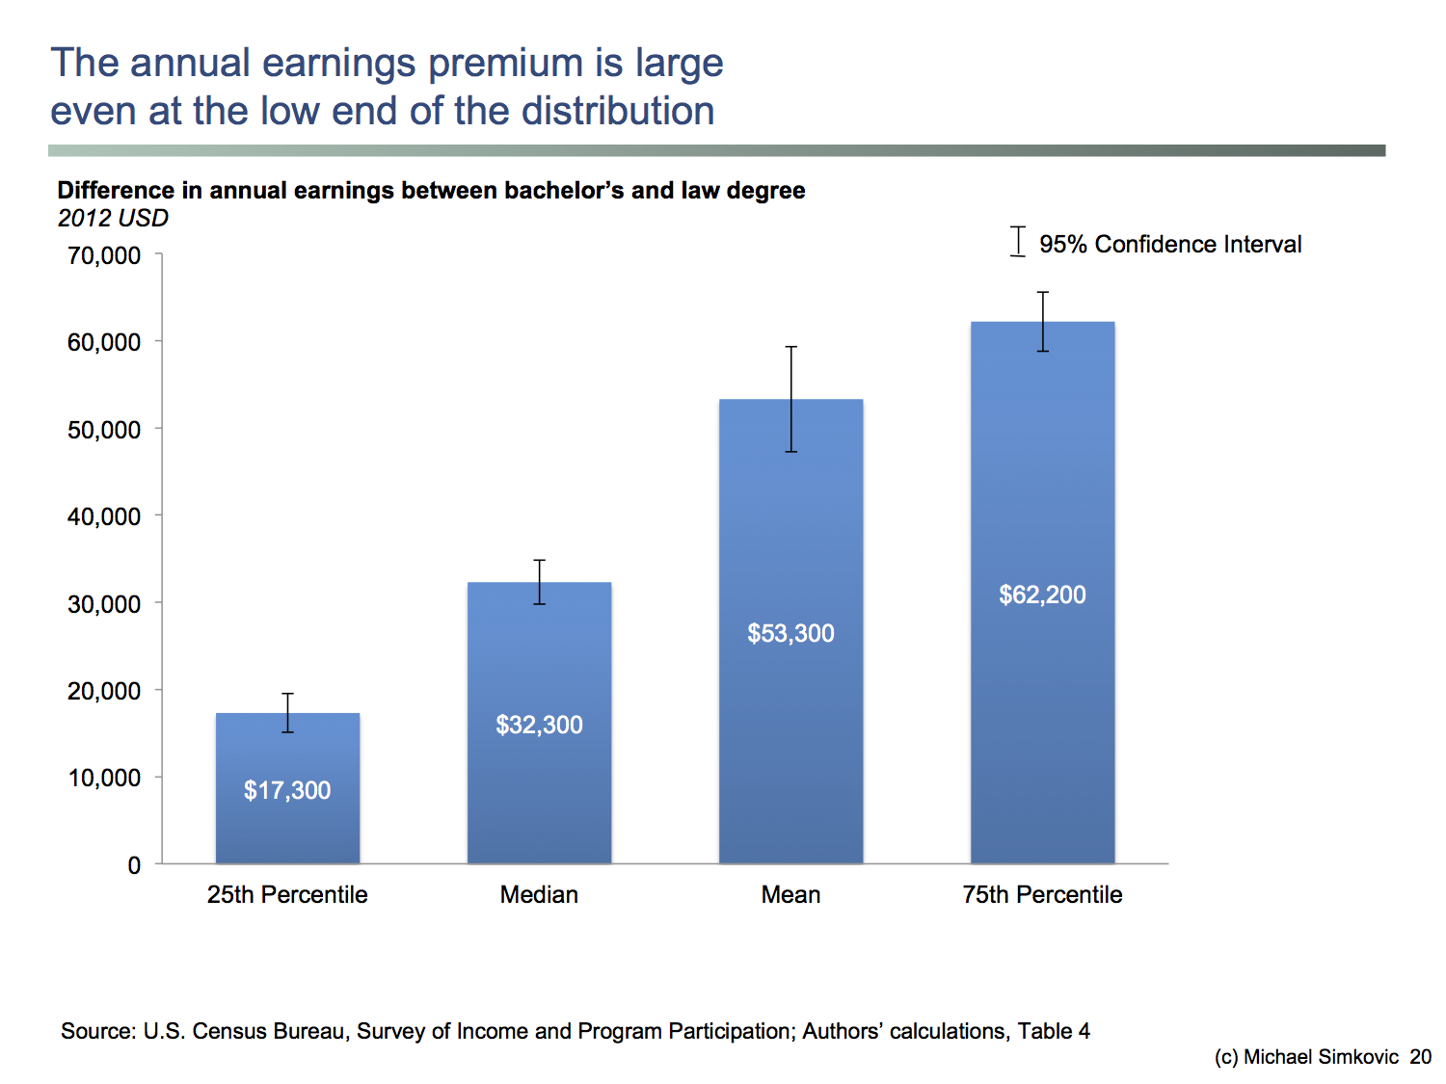
Valuation Hypothetical: Law School

Slide 16
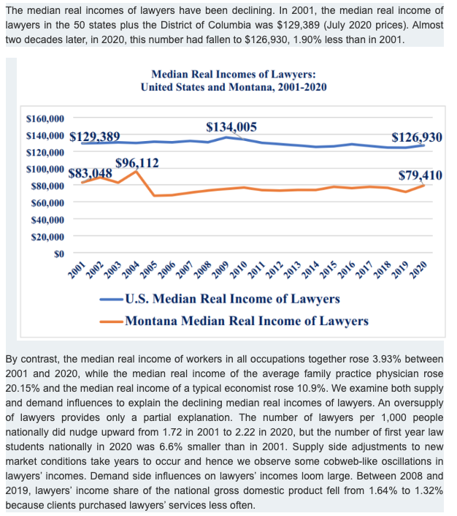
But…Median Real Income of Lawyers: 2001-2020
Source: Koch & Blake-Gonzalez, 46 J. Econ. & Fin _(2022)

Slide 17
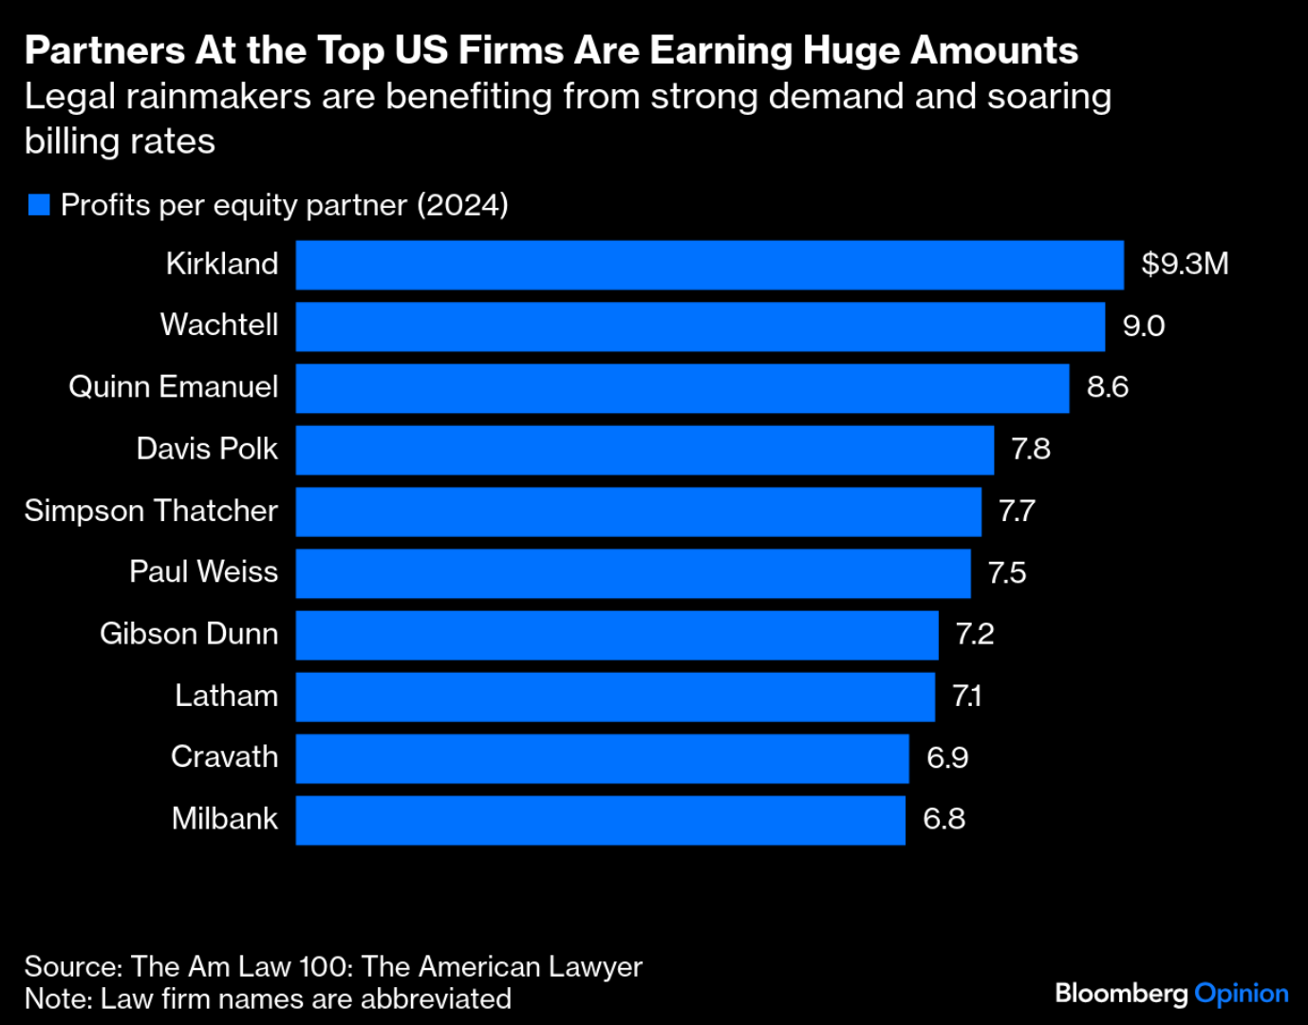
But…
Pay for Lawyers is So High
People Are Comparing It to the N.B.A.
(NYT, July 1, 2024)
Bloomberg, Aug. 2025

Slide 18
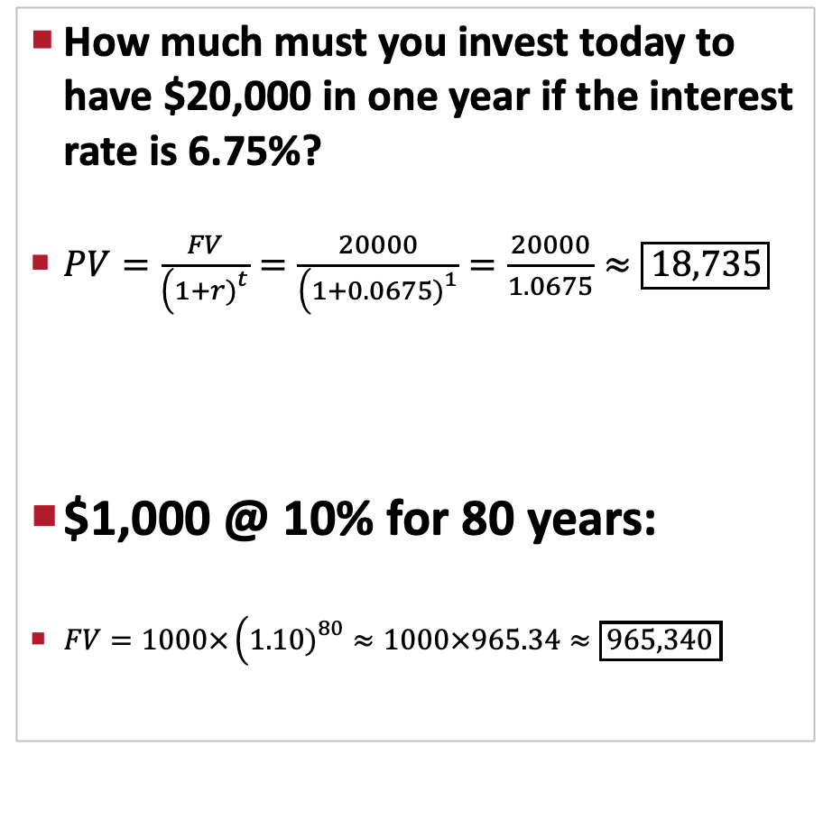
LLMs: Potentially very useful, but proceed with caution
Chat
Claude
How much must you invest today to have $20,000 in one year if the interest rate is 6.75%?
$PV=\frac{FV}{\left(1+r{\left.)\right.}^{t}\right.}=\frac{20000}{\left(1+0.0675{\left.)\right.}^{1}\right.}=\frac{20000}{1.0675}≈\boxed{18,735}$
$1,000 @ 10% for 80 years:
$FV=1000×\left(1.10{\left.)\right.}^{80}≈1000×965.34≈\boxed{965,340}\right.$
Present Value to have $20,000 in one year
Formula: PV = FV / (1 + r)^n
PV = $20,000 / (1.0675)^1
PV = $20,000 / 1.0675
PV = $18,739
FV = $1,000 × (1.10)^80
FV = $1,000 × 2,048.40
FV = $2,048,400

