Slide 1
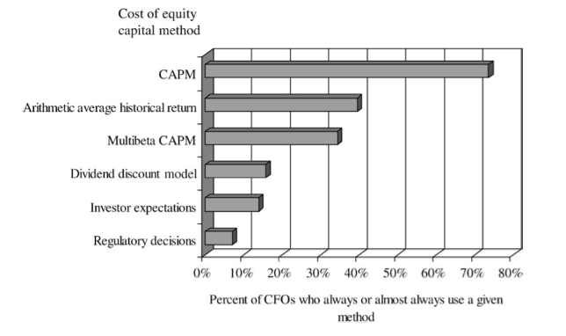
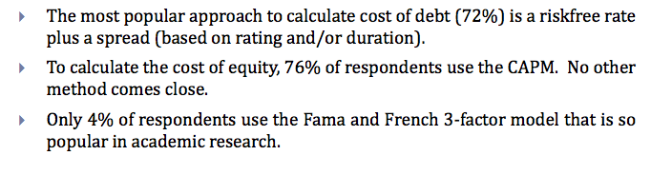
Use of CAPM
Source: Graham & Harvey, 60 J. of Fin. Econ. 187 (2001)
Source: Nyborg & Mukhlynina, 2016

Slide 2
CAPM Assumptions
Investors care only about means and variances (SDs)
Markets are frictionless
No Taxes
No Transaction costs
Same investment choices for everyone
Markets are efficient
Same risk-free rates for borrowing and lending
All model parameters are perfectly known
E(r) of every stock, bond, etc.
All expected covariances (betas) are known
Implication: Under the CAPM assumptions, if a risk-free asset exists, every investor should hold a combination of the market portfolio and risk-free asset

Slide 3
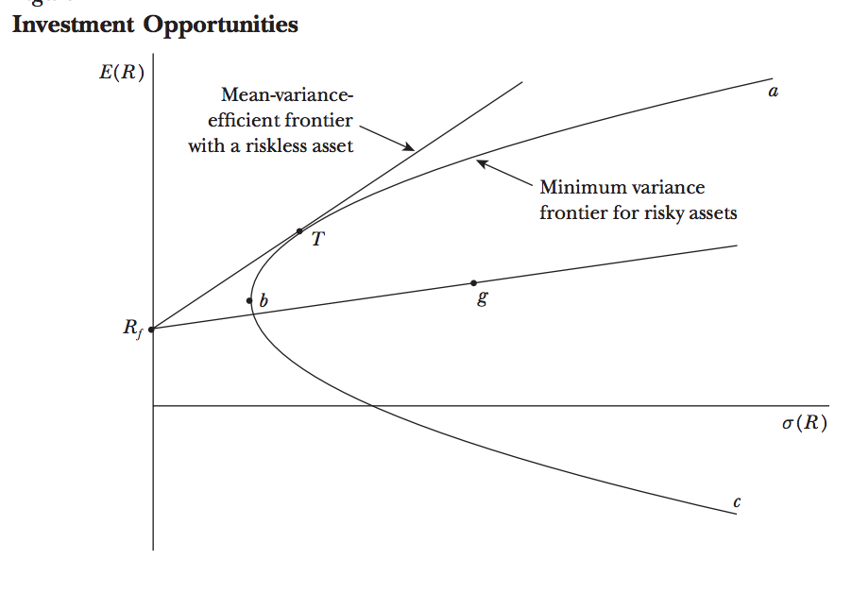
CAPM

Slide 4
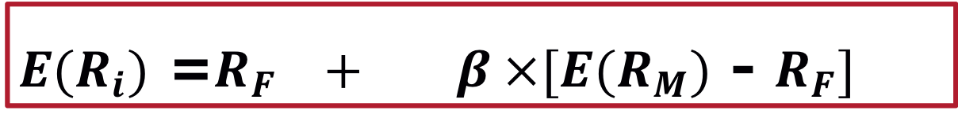

Expected Return on an Individual Security
The Capital Asset Pricing Model (CAPM)
Assume β_{i} = 0, then the E(r) is R_{F}
Assume β_{i} = 1, then $E(R_{i})$ = $E(R_{M})$
Assume β_{i} = -1, then R_{i} is negative if mrkt premium less than R_{f}
Note: SDev_{i} is irrelevant
$E(R_{i})$ =$R_{F} + β ×[E(R_{M})$ - $R_{F}]$
Expected return on a security
Beta of the security
Market risk premium
=
Risk-free rate
+
x

Slide 5
CAPM
CAPM gives us the expected return, , which is used (in the denominator) in calculating NPV.
CAPM inputs:
Risk-free rate
Market premium
Project beta (with market)
E(r) is a linear function of beta
Higher beta, higher expected return
Lower beta, lower expected return
What does that imply about price?

Slide 6
Relationship Between Risk & Expected Return: Security Market Line
R_{F} = 3%; Equity Premium = 5%

Slide 7
Security Market Line

Slide 8

Relationship Between Risk & Expected Return
$E(R_{i}$) =$R_{F} + β × [E(R_{M}$) - $R_{F}]$
Asset B
●
Expected return
Security Market Line
●
Asset A
1.0

Slide 9
Rate of Returns: Risk Premiums
Promised/Quoted/Stated Return
Expected Rate of Return:
In CAPM, different assets have different E(r)
Contract/Risk/
Liquidity Premiums
Credit/Default Premium
Risk,
Contract, and
Liquidity Premiums
Time Premium
Time Premium

Slide 10
Using CAPM in the NPV Formula
CAPM gives expected return, E(r), not promised return.
CAPM E(r) doesn’t incorporate default risk.
Default risk is incorporated in the numerator, E(CF), of the NPV formula.
Default risk affects the price today but not through the expected return, E(r).
Example
A corporate zero-bond promises $1,000 in 1 year.
Its market-beta is 0.5.
The equity premium is 4%.
The risk-free rate is 3%.
What is the appropriate bond price today?

Slide 11
Expected Return Example: Supplying Default Risk
A corporate bond promises 1,000 one year from today. You estimate that it will pay 1,000 with a p=95% and will default entirely with a p=5%. If the bond has a beta of 0.25, the risk-free rate is 2% and the E(r_{m}) is 6%, find the price of the bond.
E(r_{bond}) = 2% + 0.25( 6% - 2%) = 3% [CAPM]
E(cf) = 950 [probability * outcome]
PV = 950/(1+.03) = 922.33 [PV formula]
Promised ROR = 8.4% [(1000-922.33)/922.33]
Risk Premium = 1% [3% – r_{f} of 2%]
Default Premium =5.4% (on average, will be zero)
Time Premium = 2%
Default Risk -> numerator; risk aversion -> denominator

Slide 12
Financial Leverage and Beta
The relationship between the betas of the firm’s debt, equity, and assets is:
Financial leverage always increases the equity beta relative to the asset beta (assume β_{Debt}=0) :
β_{Asset} x (1+D/E) = β_{Equity}
Debt
Equity
β_{Asset} =
x β_{Debt} +
x β_{Equity}
Debt + Equity
Debt + Equity

Slide 13
Financial Leverage and Beta: Example
Consider a firm that is currently all-equity and has an equity and asset beta of 0.90. The firm has decided to lever up to a capital structure of 1 part debt to 1 part equity.
Since the firm will remain in the same industry, its asset beta should remain 0.90.
Assuming a zero beta for its debt, its equity beta would become twice as large:
1
β_{Asset} = 0.90 =
x β_{Equity}
1 + 1
β_{Equity} =
2 x 0.90 = 1.80

Slide 14
Combining Betas in Portfolios
Corp A, which is worth $900mm and has a beta of 2 and a SD of 20%, is considering combining with Corp B, which is worth $100mm and has a beta of 1 and a SD of 20%. Assume that risk-free rate is 3% and the equity premium is 5%.
Very generally, will the risk of the combined company be greater or less than 20%?
What is the expected return of each company if the CAPM applies?
What will be the expected return (cost of capital) of the combined company?
If the beta of a portfolio is the weighted average of the portfolio betas, what is the beta of the combined company?
What will be the expected return of the combined company under CAPM?

Slide 15
CAPM Inputs: Equity Risk Premium
Historical averages for r_{m}:
Time period?
LT or ST bonds for r_{f}?
Geometric v. arithmetic?
Peso problem
Adjustment for bubbles and busts?

Slide 16
Estimating CAPM Inputs: Beta
Project (not necessarily firm) specific
Estimation issue
Historical rates of return for specific firm vs. historical rates of return for industry
Beta shrinkage towards 1
Daily, monthly, number of years?
Equity Beta, which is reported on finance sites, depends on a firm’s leverage
Equity beta helps find E(r_{Equity}), but you should use β_{Asset} to finding the appropriate hurdle/discount rate for a project

Slide 17
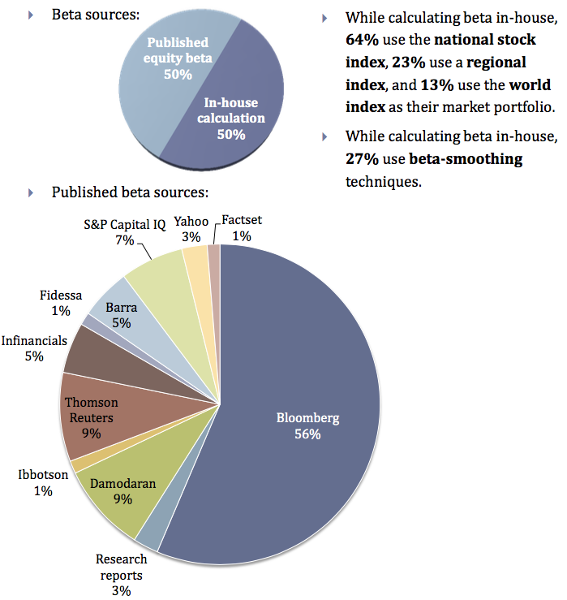
CAPM Beta
Source: Nyborg & Mukhlynina, 2016

Slide 18
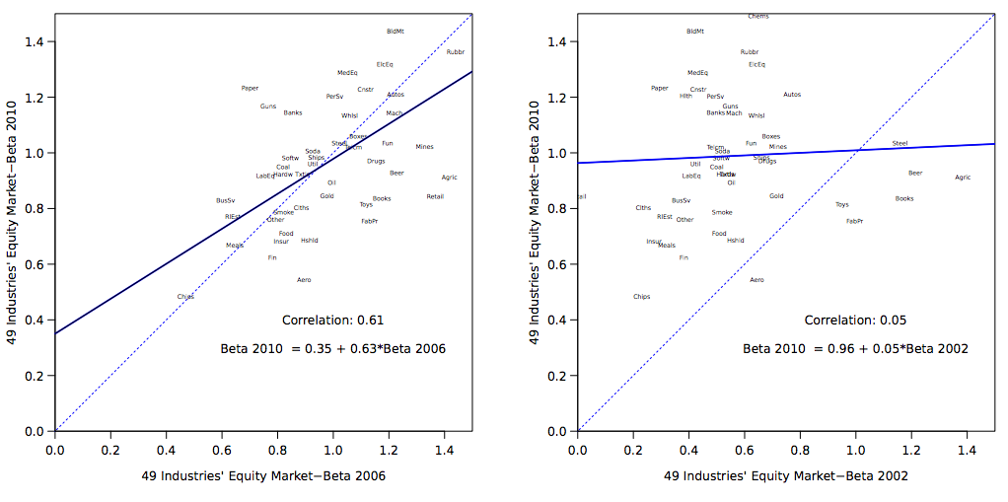
Estimating CAPM Inputs: Beta

Slide 19
The Firm versus the Project
If a project has the same risk as the company as a whole and the company has debt, the equity beta is used to calculate the E(r) on equity and the WACC is used to discount the E(CFs) of the project.
Any project’s cost of capital depends on the use to which the capital is being put—not the source.
Therefore, it depends on the risk of the project and not the risk of the company.
Notes:
16

Slide 20
The Cost of Capital with Debt
The Weighted Average Cost of Capital (WACC) is given by:
Because interest expense is tax deductible, we multiply the last term by (1 – T_{C})
r_{WACC} =
Equity
* r_{Equity} +
Debt
* r_{Debt} * (1 – T_{C})
Equity + Debt
Equity + Debt
E
D
r_{WACC} =
* r_{E} +
* r_{D} * (1 – T_{C})
E + D
E + D

Slide 21
Capital Budgeting & Project Risk
A firm that uses one discount rate for all projects may over time increase the risk of the firm while decreasing its value.
Project IRR
The SML can tell us why:
Incorrectly accepted negative NPV projects
Hurdle rate
Incorrectly rejected positive NPV projects
r_{f}
Firm’s risk (beta)
β_{FIRM}

Slide 22
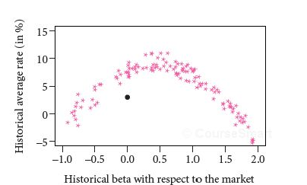
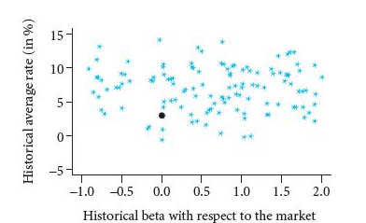
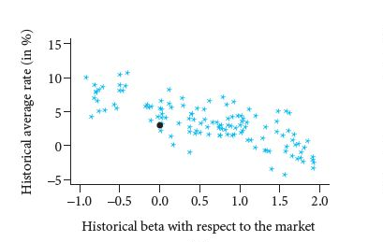
SML in Non-CAPM Worlds

Slide 23
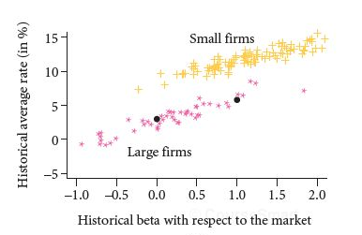
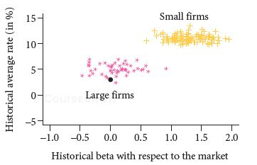
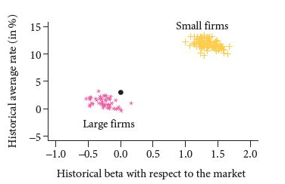
SML in Non-CAPM Worlds

Slide 24
Testing the CAPM
Expected values vs. realized values for R_{m}, β, and R_{m}- R_{f}
Right theory, wrong ruler; right ruler, wrong theory
Results
Relationship between estimated β and R is weaker than CAPM suggests (slope of SML is flatter than predicted by theory)

Slide 25
Testing the CAPM
Beta vs. Average Risk Premium
Avg Risk Premium 1931-2002
30
20
10
0
SML
Investors
Market Portfolio
Portfolio Beta
1.0

Slide 26
Testing the CAPM
Beta vs. Average Risk Premium
Avg Risk Premium 1931-65
SML
30
20
10
0
Investors
Market Portfolio
Portfolio Beta
1.0

Slide 27
Testing the CAPM
Beta vs. Average Risk Premium
Avg Risk Premium 1966-2002
30
20
10
0
SML
Investors
Market Portfolio
Portfolio Beta
1.0

Slide 28
Rates of Return and Market Betas (’70-’03)

Slide 29
Fama and French
FF (1992) have found:
The market capitalization or size of a firm is a predictor of its average historical return
Stocks with low market-to-book ratios tend to have higher returns than stock with high market-to-book ratios.
Differences in beta do NOT explain these differences
FF have proposed a three factor model for expected returns based on:
the difference between the returns of small stocks and big stocks [R_{SMALL}-R_{BIG}];
the market premium [R_{M}-R_{f}]; and
the difference between the returns of high and low B/M stocks [R_{HIGHBM}-R_{LOWBM}].
FF:

Slide 30
Fama and French
Company Size versus Average Return
Return
Company Size
Largest
Smallest

Slide 31
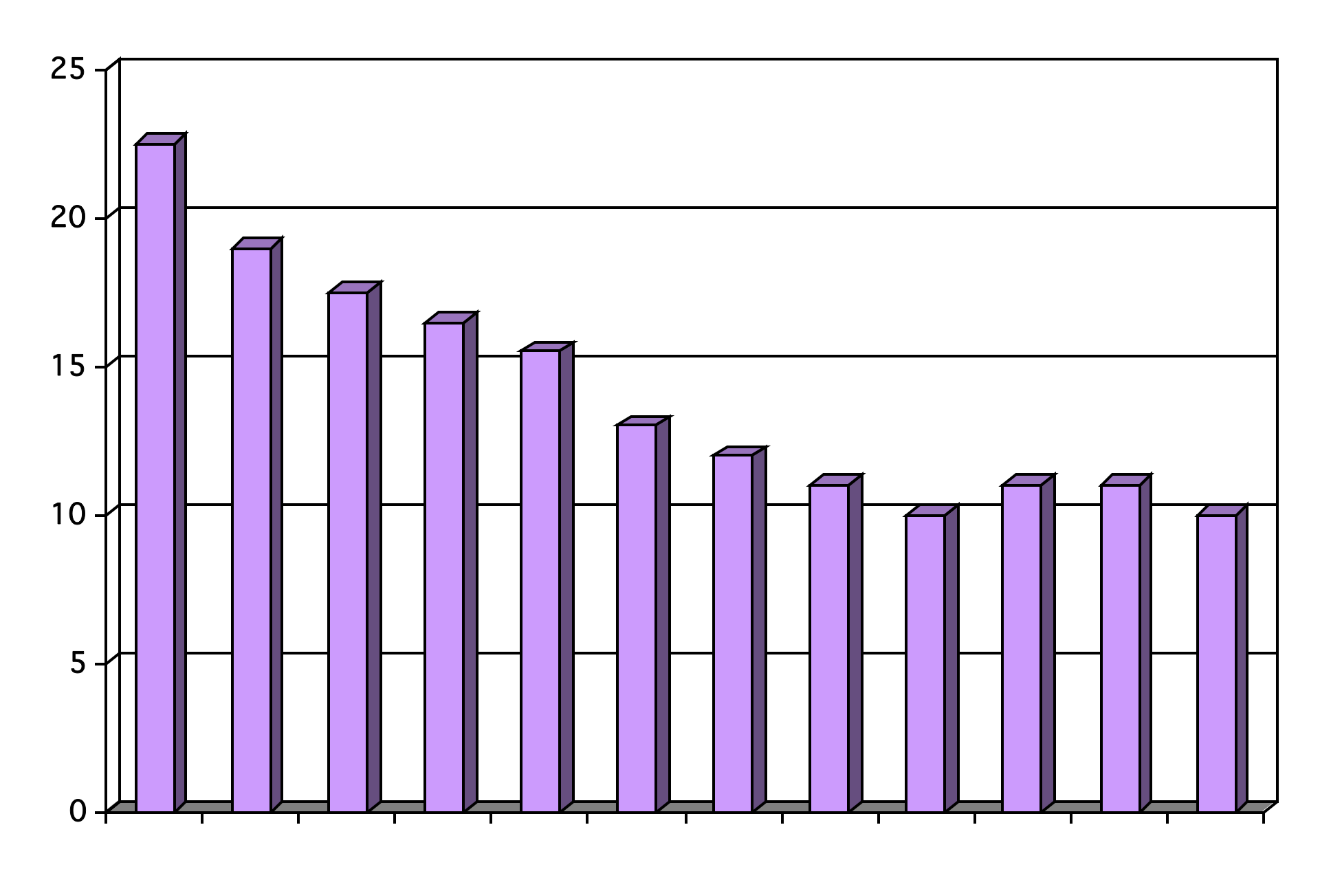
Fama and French
Book-Market versus Average Return
Return
Highest
Book-Market Ratio
Lowest

Slide 32
Fama and French
 | All Firms (%) | Low Betas (%) | High Betas (%)
All Firms | 15 | 16.1 | 13.7
Small Cap | 18.2 | 20.5 | 17
Large Cap | 10.7 | 12.1 | 6.7
 | All Firms | High ME/BE | Low ME/BE
All Firms | 14.8 | 7.7 | 19.6
Small Cap | 17.6 | 8.4 | 23
Large Cap | 10.7 | 11.2 | 14.2
Fama and French (1992). Data from ’63-’90

Slide 33
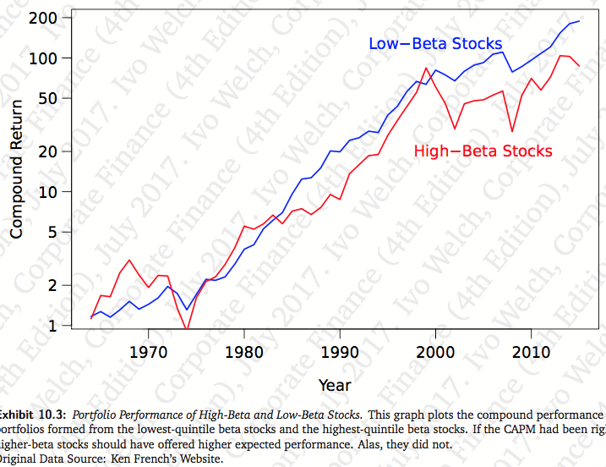
Low Beta vs. High Beta Stock Returns

Slide 34
Size Effect: Illusion?
In the earliest days of empirical work in academic finance, the size effect was the first market anomaly to challenge the standard asset pricing model and prompt debates about market efficiency. The notion that small stocks have higher average returns than large stocks, even after risk-adjustment, was a pathbreaking discovery, and for decades it has been taken as an unwavering fact of financial markets. In practice, the discovery of the size effect fueled a crowd of small cap indices and active funds to a point where the investment landscape is now segmented into large and small stock universes. However, despite its long and illustrious history in academia and its commonplace acceptance in practice, there is still confusion and debate about the size effect. We examine many claims about the size effect and aim to clarify some of the misunderstanding surrounding it by performing simple tests using publicly available data. For one, using 90+ years of U.S. data, there is no evidence of a pure size effect, and moreover, it may not have existed in the first place, if not for data errors and insufficient adjustments for risk and liquidity.
Fact, Fiction, and the Size Effect, Alquist, Israel, Moskowitz (June 2018)

Slide 35
Fama-French
 | Three-factor Model |  |  |  | CAPM
 | B(Market) | B(Size) (Sm - Large) | B(HBk-LBk) | E(r)-r_{f} | E(r)-r_{f}
Computers | .90 | .17 | -.49 | 2.49 | 5.29
Petroleum & Gas | .96 | -.35 | .21 | 4.93 | 4.32
Factor Risk Premiums (’63-’94):
Market: 5.2%
Size: 3.2%
HBM-LBM: 5.4%
Source: Fama & French (‘97)

Slide 36
Arbitrage Pricing Theory (APT)
R = R_{F} + (R₁-R_{F})β₁+ (R₂-R_{F})β₂ +…. (R_{K}-R_{F})β_{K}
To implement the model, one must:
(1) identify factors;
(2) estimate the risk premium for each factor; and
(3) estimate the beta for each factor

Slide 37
APT
One 1994 APT study used the following factors and risk premiums

Slide 38
Interpreting the Multifactor Model
Each “B_{i}(R₁-R_{F})” can be interpreted roughly as follows: The number inside the parenthesis is the expected additional return of a stock with “average” exposure (B = 1) to a particular factor over a stock that had no exposure to that factor.
For example, a stock that had average exposure to changes in GNP earned .49% more than a stock with no exposure to change in GNP. Investors appear to require a greater return from cyclical stocks.
For stocks with average exposure to inflation, investors earned .83% less than stocks with no exposure to inflation. Investors appear to like stocks that are exposed to inflation (do well when inflation increases) and are willing to accept a lower return.

