Slide 1
Corporate Finance
TVM: Present and Future Value
Fall 2024
Prof. Jeffrey Colón

Slide 2
Introduction to Time Value of Money
You have filed suit against IBM and have been offered:
$1,000 today, or
$1,100 one year from now.
You are quoted returns on two equally risky investments:
Investment 1 pays 6%, compounded quarterly,
Investment 2 pays 6.1%, compounded annually.
Query: For each example, which option is better, and why?

Slide 3
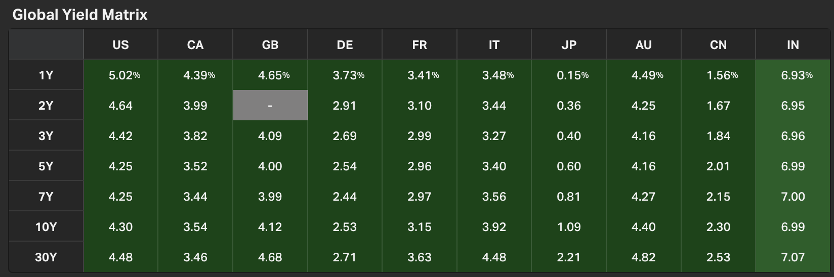
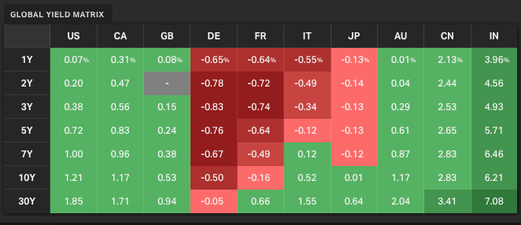
Time Value of Money: Fundamental Principles
A safe dollar is worth more than a risky dollar.
A dollar today is worth more than a dollar tomorrow (but not always)
8 July 2024
August 2021

Slide 4
Perfect Market (and other) Assumptions
No transaction costs
No taxes
Information freely available and no difference of opinions among investors (there can be risk)
Many buyers and sellers
No risk or uncertainty
No inflation
Level interest rates

Slide 5
Future Value: One Period
Future Value (FV): Amount an investment today grows to in the future.
Example
You purchase for $1,000 a certificate of deposit (CD) that promises to pay in one year $1,000 plus 5% interest. One year later, the FV of the CD will be $1,050, consisting of the original investment of $1,000 and $50 of interest (return) (5%*1,000)
$1,050 = $1,000 + $1,000*5%, or
C₁ = C₀ + C₀ * r
C₁ = C₀ * (1+r)

Slide 6
Future Value: One Period
Future Value (FV) = C₀*(1 + r)^{T}
where C₀ is the original investment or cash flow and r the rate of return.
In the one-period example, T is 1.

Slide 7
Time Conventions
Examples:
CF₀ r₂ r_{1,3} and CF₃
End of Period 1
1 Period
From Today (CF₁)
Today
t =
0
1
2
3
T or t
Period 1
Beginning of Period 2

Slide 8
Rate of Return: One Period
Rate of Return (r or ROR): The percentage gain (or loss) earned on an investment.
Distinguish between Rate of Return and Return and Net Return
Example
You invest $1,000 today, and one year from now your investment is worth $1,070. Your r is 7%:
r = ($1,070 - $1,000) / $1,000
r = (Net Return) / Initial Investment
r = (Ending–Beginning) / Beginning

Slide 9
Rate of Return: One Period
One Period RoR = r₁ = (C₁ - C₀) / C₀
where C₁ is the future value and C₀ the original investment.
r is also called the cost of capital, opportunity cost, discount rate, or hurdle rate.

Slide 10
Basis Points
A friend tells you that the interest rate yesterday was 6.5% and increased by 1%.
Is it now 7.5% or 6.5% + .01*6.5%?
To prevent confusion, specify changes in percentages (interest rates, yields) by using basis points
One Basis Point (bip or bp) is .01%, or .0001
Example
Assume r = 6.86% = 0.0686
100 bps = 1% = .01
10 bps = 0.1% = .001
1 bp = .01% = .0001
If r increases by 25 bps, it will increase to 6.86% + 0.25% or 7.11%

Slide 11
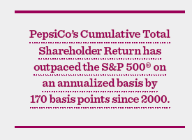
Basis Points Example
Query: What is 170 basis points in percentage (%)? Why didn’t
PEP use percentage?
Source: Pepsico 2013 Annual Report

Slide 12
Query
What’s the formula for the FV of a $100 CF today that earns a rate of return of 8% for one year?
What’s the rate of return, return, and net return in the previous example?
You invest $100 and sometime later the investment is worth $120. What’s the rate of return?
You buy a bond yielding 6.25%. A few days later, it’s yielding 6.35%. By how many bps did the yield increase?

Slide 13
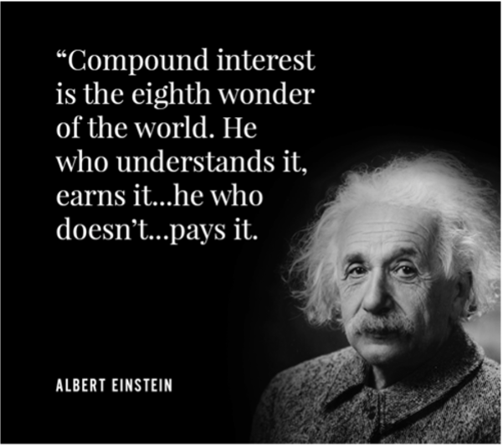
Future Value for Multiple Periods: Compounding

Slide 14
Future Value for Multiple Periods: Compounding
Example
You purchase a CD for $1,000 that earns 5% interest per annum. Two years later, the FV of the CD will be $1,102.50, consisting of the original investment of $1,000 and two years’ total interest of $102.50.
$1,102.50 = $1,000*(1.05)², or
C₂ = C₁ + C₁ * r
C₂ = C₁ * (1+r)
C₂ = (C₀+ C₀*r) * (1+r)
C₂ = C₀*(1+r)*(1+r)
C₂ = C₀ * (1+r)²

Slide 15
Future Value for Multiple Periods: Compounding
Future Value = FV = C₀*(1 + r)^{T}
where C₀ is the original investment or cash flow, r the relevant rate of return, and T the number of periods.
Query: You invest $1,000 for 10 years at a return of 7% p.a. What’s the FV of the investment?

Slide 16
Holding Period Returns for Multiple Periods
An investment of C₀ earning the same r per period for T periods grows to:
C_{T} = C₀* (1+ r)^{T}, or
C_{T} = C₀*(1+r_{0,1})*(1+r_{1,2})*(1+r_{2,3})…(1+ r_{T-1,T}), if r varies each period.
The (1+r) terms can be represented by (1+ r_{0,T}), where r_{0,T} is the T period holding rate of return--the total percentage return you earn by investing T periods at r%.
Given C_{T} , C₀ , and T, we can solve for r_{0,T}
C₀* (1+ r_{0,T}) = C_{T} ==> r_{0,T} = C_{T}/ C₀ - 1 = (C_{T} - C₀) / C₀
Query: You are comparing your HPR with your friend’s. What are important things to keep in mind when comparing HPRs?

Slide 17
Holding Period Returns for Multiple Periods
(1+ r_{0,T}) = (1+ r_{0,1}) *(1+ r_{1,2})* (1+ r_{2,3})… (1+ r_{T-1,T})
(1+ r_{0,T}) = (1+ r)^{T}
r_{0,T} = (1+ r)^{T} - 1
r_{0,T} = C_{T}/ C₀ - 1 or (C_{T} - C₀) / C₀
Example
You invest $1,000 for 10 years and the FV of the investment is $1,967.14. What’s the HPR?
r_{0,10} = (1,967.14 – 1,000) / 1,000
= 96.71%
Notes:
17

Slide 18

Future Value for Multiple Periods: Compounding
r_{0,10} ≠ (r_{0,1} + r_{1,2} +…+ r_{9,10})

Slide 19
Compound and Simple Interest
FV = C₀*(1 + r)^{T} reflects compound interest
Example
The FV of 1,000 that earns 7% p.a. is 1000*(1+.07)³ , or 1,225.04
FV = C₀ + (C₀ * r) *T reflects simple interest
Example
The FV of 1,000 that earns 7% p.a. simple interest is 1000 + 1000*.07*3 , or 1,210
Simple interest is for simps and simpletons!

Slide 20
Compound and Simple Interest

Slide 21
Future Value of $10,000 in 150 Years

Slide 22
Future Value: Other Applications
The FV formula can be manipulated to solve for either T or r.
Example
You buy a CD for $1,000 that promises a return of 7% interest, p.a. How many years before its value grows to $2,000?
FV = C₀*(1 + r)^{T}
2000 = 1000*(1+.07)^{T}
(1.07)^{T} = 2000 / 1000
T Ln 1.07 = Ln 2 [Note: Ln X^{T} = T Ln X]
T = Ln 2 / Ln 1.07
T = 10.244 years

Slide 23
Future Value: Other Applications
The FV formula can be manipulated to solve for either T or r.
Example
If law school will cost $200,000 in 15 years, and you have $20,000 today, what rate of return do you have to earn to cover the cost?
FV = C₀*(1 + r)^{T}
200,000 = 20,000*(1+ r)¹⁵
(1+r)¹⁵ = 200,000 / 20,000
(1+r) = 10^{1/15}
r = 16.59 %

Slide 24
Query
What’s the formula for the FV of a $100 CF today that earns a rate of return of 8% for 10 years?
You invest $100 and sometime later the investment is worth $200. What’s the holding rate of return?
What’s the rule of 72?
You invest $10,000 today. How many years until you have $1,000,000 if you earn 8% p.a.?

Slide 25
Compounding Periods
Interest is generally quoted as an annual rate, but it may be compounded more frequently.
The FV formula must be adjusted to account for the effect of intra-year compounding.
Compounding an investment m times a year at an annual rate of r for T years provides for future value of wealth of:

Slide 26
Compounding Periods
Example
If you invest $50 for 3 years at 12%, compounded semi-annually, what the FV?

Slide 27
Compounding Periods
Stated Annual Rate (SAR) or Nominal Rate or Annual Interest Rate
Annual Percentage Rate (APR)
(Rate per period) x (# periods per year)
Effective Annual Rate (EAR) or Annual Percentage Yield (APY)

Slide 28
Effective Annual Rates
The Effective Annual Interest Rate (EAR) is the annual rate that would give the same end-of-investment wealth as the nominal rate.
In the above example (12%, compounded semi-annually), what’s the EAR?

Slide 29

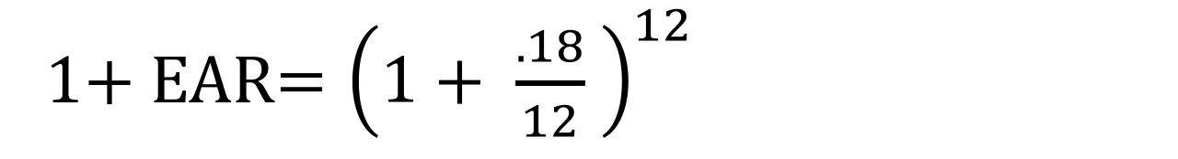
Effective Annual Rates
Example
Find the EAR of an 18% APR loan that is compounded monthly.
This is a loan with a monthly interest rate rate of 1.5% [18%/12]
This is equivalent to a loan with an annual interest rate of 19.56%.
1+ EAR$={\left(1+ \frac{.18}{12} \right)}^{12}$
$$1+EAR=1.1956$$
$EAR=19.56$%

Slide 30
Effective Annual Rates
APR | Freq. Of Compounding | EAR %
18 | 1 | 18
18 | 2 | 18.81
18 | 4 | 19.25
18 | 12 | 19.56
18 | 52 | 19.68
18 | 365 | 19.72

Slide 31

Converting a Nominal Rate to an EAR
EARs can be converted into nominal rates and vice versa by the following formulas:
=NOM(Eff Rate, Num Periods)
=EFFECT(Nom Rate, Num Periods)

Slide 32
Continuous Compounding
The general formula for the future value of an investment compounded continuously over many periods can be written as:
FV = C₀ x e^{rT}
Where:
C₀ is cash flow at time 0,
r is the stated annual interest rate,
T is the number of periods over which the cash is invested, and
e is a transcendental number approximately equal to 2.718. e^{x} is a key on your calculator. In Excel, use exp(x) for e^{x}.
Why?
Black-Scholes Formula for option pricing
Notes:
e is a transcendental number because it transcends the real numbers.

Slide 33
Long Periods to Short Periods
If the EAR is 10%, what are the 6-month and 3-month rates?
10/2 = 5% and 10/4 = 2.5% ??
Wrong! Why?
Need to find:
(1+ r)*(1+ r) = (1+.10), and
(1+ r)*(1+ r)*(1+ r)*(1+ r) = (1+.10)
Notes:
e is a transcendental number because it transcends the real numbers.

Slide 34
Query
What’s the formula for the FV of a $100 CF today that earns a rate of return of 8%, compounded semi-annually, for 10 years?
Your student loans have an APR of 6%. What’s the EAR?

Slide 35
Present Value: One Period
Present Value (PV):
The value today of a future cash flow, or
The amount of money you would have to set aside today to have a certain amount in the future.
Example
You need to have $1,050 one year from now to pay your law school tuition. What’s the PV of the $1,050 if the rate of return is 5%?
PV * (1+r) = $1,050
PV = $1,050/(1+.05)
PV = $1,000

Slide 36
Present Value: One Period
Present Value = PV = FV / (1 + r)^{T}
where FV is the future value or future cash flow and r the rate of return. In the one-period example, T is 1.
In the PV formula, 1/(1 + r), is referred to as the discount factor (DF) and r the discount rate or opportunity cost of capital.
As r increases, DF and PV decrease, and vice versa
Movement of Bond Prices and Yield

Slide 37
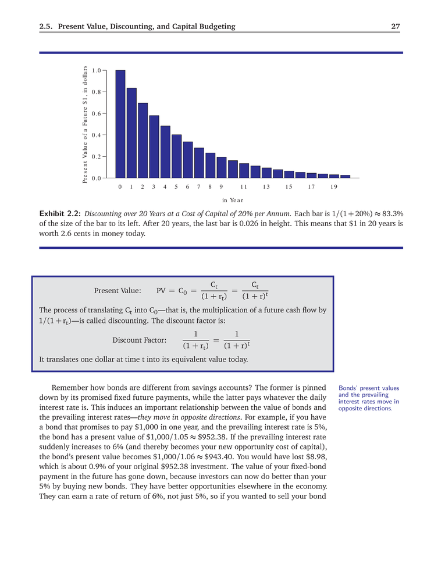
Present Values of Future CFs

Slide 38
Net Present Value: One Period
Net Present Value (NPV): The sum of the PVs of all of the CFs of an investment.
Net Present Value = NPV = -C₀ + C₁/(1+r)^{T}
where -C₀ and C₁ are the cash flows in periods 0 and 1, and r the relevant interest rate. In the one-period example, T is 1 and the first CF is negative.
Cash inflows are positive (+) and outflows negative (-).

Slide 39
NPV and Valuation: One Period
Net Present Value
Translate all future cash flows into today’s dollars
Add them up (find total present value)
Subtract the initial investment
NPV RULE:
If NPV>0, invest;
If NPV<0, put your money in the bank

Slide 40
NPV and Valuation: One Period
Example
You are offered an apartment for $1M, but it requires immediate repairs of $100k. You can sell it for sure in 1 year for $1.21M, and the riskless 1-year rate is 5%.
Should you buy it?
What’s the project’s NPV and ROR?
CFs: <1.1M> and 1.21M
r = 5%
NPV of CFs: <1.1M> + 1.21M/(1+.05) = 52.38k
ROR = (1.21M-1.1M)/1.1M = 10%
Note: <10> means negative 10 or a cash outflow of 10

Slide 41
Net Present Value: Multiple Periods
The multi-period formula for PV is:
NPV = -C₀ + C₁/(1+r) + C₂/(1+r)² +…+ C_{T}/(1+r)^{T}, or
Cash inflows are positive and cash outflows negative
In the PV formula, each 1/(1 + r)^{t} term is referred to as the period t discount factor (DF).

Slide 42
NPV Example
A building is for sale for $170,000. It will require $100,000 of repairs in one year, and one year after the repairs are made, its value will be $320,000. What’s the NPV of the building project if the discount rate is 5%?

Slide 43
Query
What’s the formula for the PV of $10,000 to be received 10 years from today if the discount rate is 8%, compounded annually?
A bond issued by Intel promises to pay $1,000 in principal and $50 in interest one year from today. What’s the price of the bond today (PV) if the yield (discount rate) is 3% p.a.?
What’s the relationship between bond prices and bond yields? Explain why.
What is NPV?

Slide 44
NPV Example
Example
A project costs 15 and promises a CF of 10 one year from today and a CF of 10 two years from today. If r = 10%, is this a good deal?
NPV = -15 + 10/(1.1) + 10/(1.1)² = 2.36

Slide 45
Three Different Ways to Understand NPV
Difference between market value of future CFs and project’s cost
Cost = 15; MV of CFs (9.091 + 8.28) or 17.36. Value added is 2.36
Difference between cost of replicating portfolio and project’s cost
To replicate project CFs buy 2 zero-coupon bonds—a 1-year and 2-year bond--each with a face value of 10. FMV = 17.36 (9.09 + 8.26). Replicating portfolio costs 17.36 but project costs 15. Buy project.
Value of project over alternatives in the capital market
Invest 15 in market. At T₁, you will have 16.5 (15*1.1). To match the CF of the project take 10, leaving 6.5 to reinvest. This would grow to 7.15 at the end of T₂, but the project would give 10, a difference of 2.85.
Note: FV of 2.36 is 2.85→ 2.36*(1+.1)² = 2.85.
In finance we can work with PVs or FVs but shouldn’t mix the two.

Slide 46

Net Present Value
Finance Prime Directives
Accept only positive NPV projects.
In deciding among projects, accept the project with the highest NPV
Why?

