Slide 1
Corporate Finance
Annuities and Perpetuities
Basic Stock and Bond Valuation
Fall 2025
Prof. Jeffrey Colón

Slide 2
PV Simplifications
Perpetuity
A stream of equal cash flows that lasts forever.
Growing perpetuity
A stream of cash flows that grows at a constant rate forever.
Annuity
A stream of equal cash flows that lasts for a fixed number of periods.
Growing annuity
A stream of cash flows that grows at a constant rate for a fixed number of periods.

Slide 3
Perpetuity
Example
You’ve won a lottery that promises to pay you $100 per year for the rest of time. How much could you sell this promise for if the discount rate is 5%?
Answer: $100 /. 05 = $2,000
C₁
C₂
C₃
…
0
1
2
3

Slide 4
Growing Perpetuity
Growing Perpetuity: A growing stream of cash flows that lasts forever.
C₁
C₁*(1+g)
C₁ *(1+g)²
…
0
1
2
3

Slide 5
Perpetuity and Growing Perpetuity
Growing Perpetuity
Perpetuity

Slide 6
Annuity
Annuity: A stream of constant cash flows with a fixed maturity.
C₁
C₂
C₃
C_{T}
0
1
2
3
T

Slide 7
An Annuity is Just the Difference Between Two Perpetuities
Consider two perpetuities:
P₀: first payment begins at T₁
P₄: first payment begins at T₅
Subtracting the P₄ payments from the P₀ payments leaves a 4-year annuity, A₄
The PV of P₀ : C/r and the PV of P₄ is C/r * 1/(1+r)⁴
The PV of A₄ : C/r – C/r* 1/(1+r)⁴ or C/r * [1 - 1/(1+r)⁴]
P₀
PV of P₀ = C₁/r
C₃
C₅
. . . .
C₁
C₂
C₄
T
0
1
2
3
4
5
A₄
P₄
PV of A₄ = C₁/r – C₁/r* 1/(1+r)⁴
PV of P₄ = C₁/r * 1/(1+r)⁴

Slide 8
Annuity Example
You can afford a $400 monthly car payment. If the interest rate is 7% APR on a 36-month loan, what’s the maximum amount you can borrow?
Answer:

Slide 9
Growing Annuity
A growing stream of cash flows with a fixed maturity.
C
C*(1+g)
C *(1+g)²
C*(1+g)^{T-1}
0
1
2
3
T

Slide 10
Growing Annuity
Example
At retirement, you have earned a pension (dream on) that will pay you $20,000 per year for 40 years starting in one year and increase the annual payment by 3% per year. What’s the PV of the payments if the discount rate is 10%?
Answer:

Slide 11
Annuity and Growing Annuity
Annuity
Growing Annuity

Slide 12


Future Value of an Annuity
You plan to save $10,000 per year starting 1 year from now for 40 years. If you can earn 7% p.a. on the savings, how much will you have in 40 years?
Three Approaches:
Brute force: Use the FV formula for each of the 40 cash flows and add them together. Ouch.
Use the FV function (Excel or a calculator)
Find the PV of a 40-year $10,000 annuity and then use the FV formula. Clever.
Answer: $1.99M

Slide 13
Annuity Application: Pricing a Bond
Your broker calls wants to sell you a bond that promises three annual coupons of $100 (the first paid one year from today) and a principal payment of $1,000 made with the last coupon. If the bond is riskless, what’s its price if the discount rate is 7%?
Using the annuity formula, the PV of the coupons is $262.43: 100/.07(1- 1/(1.07)³)
The PV of the principal is: $816.30.
The price of the bond is: $1,078.73 (PV coupons + PV Principal)

Slide 14
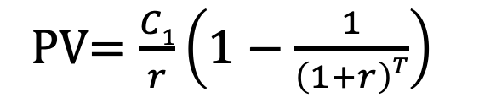
Annuities in Excel
=PV(rate,nper,pmt,[fv],[type])
=NPER(rate,pmt,pv,[fv],[type])
=PMT(rate,nper,pv,[fv],[type])
=FV(rate,nper,pmt,[pv],[type])
=RATE(nper,pmt,pv,[fv],[type],[guess])
PV$=\frac{C1}{r}\left(1−\frac{1}{\left(1+r\right)T}\right)$

Slide 15
How to Value Annuities with Excel
N (NPER) | 40
I (RATE) | 7%
PV | 0
PMT | -10000
FV | $1,996,351 | <-- | =FV(RATE, NPER, PMT, [PV], [type]) =FV(.07,40,-10000,0,0)

Slide 16
Excel Formula: Remaining Principal in Two Steps
You borrow $500,000 for 30 years at 5% APR to purchase a house. How much of the mortgage will you have paid off in 10 years?
Rate | 0.41667% | ← | Why is this the correct input?
NPER | 360
PV₀ | $500,000
PMT | ($2,684.11) |  | =PMT(rate,nper,pv,fv,type)
PV₁₂₀ | $406,710 | ← | =PV(rate,nper,pmt,fv,type), where NPER = 240 and pmt is $2,684.11
PV₀ -PV₁₂₀ | $93,290

Slide 17
Excel Formula: Cumulative Principal
You borrow $500,000 for 30 years at 5% APR to purchase a house. How much of the mortgage will you have paid off in 10 years?
Rate | 0.41667% | ← | Why is this the correct input?
NPER | 360
PV | $500,000
Begin Per | 1
End Per | 120
Cum Prin. | ($93,290) | ← | =CUMPRINC(Rate,Nper,PV, Begin,End,Type) =CUMPRINC(.0041667,360,500000,1,120,0)

Slide 18
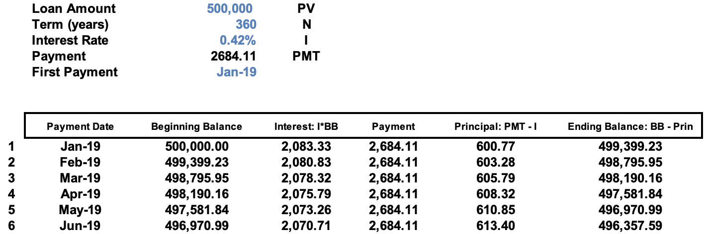
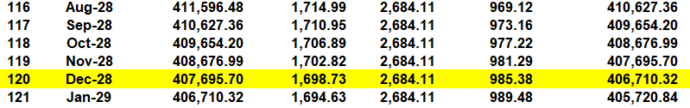
Loan Amortization Example

Slide 19
Stock Valuation and Dividends
If dividends are assumed to remain fixed forever, then the price of stock can be estimated using the perpetuity formula
If dividends are assumed to grow at a constant rate g forever, an estimate of the stock price can be found using the growing perpetuity formula (Gordon Growth model)

Slide 20
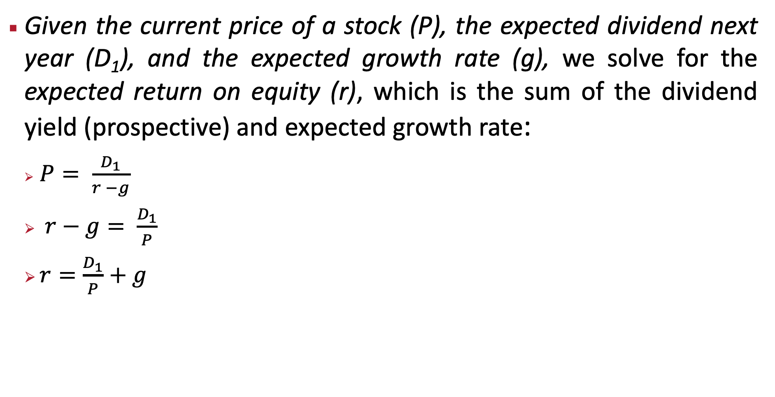
Stock Valuation: Deriving E(r) from Inverting the Constant Dividend Growth Formula
Given the current price of a stock (P), the expected dividend next year (D₁), and the expected growth rate (g), we solve for the expected return on equity (r), which is the sum of the dividend yield (prospective) and expected growth rate:
$P= \frac{D_{1}}{r −g}$
$r−g= \frac{D_{1}}{P}$
$r=\frac{D_{1}}{P}+g$

Slide 21
Estimating the Cost of Capital (r) with the Gordon Growth Model
Microsoft
Dividend Yield (Div1 / Stock Price) | 0.62%
Growth Dividends (past 3 years) | 10.2%
Using Gordon Growth Formula | r = (CF₁/PV) +g
 | r = (Div₁/P) + g
 | r = 0.62% + 10.2%
 | r = 10.84%
Estimated Cost of Capital / E(r) | 10.84%
Source: Yahoo Finance/Gurufocus

Slide 22
Cost of Capital (r) with the Gordon Growth Model and Forward Earnings Yield, 1 / (P/E)
Microsoft
Assume: Earnings Yield (1/(P/E)) equals the Dividend Yield (Div/Price):
Forward P/E = |  | 33.7
Earnings Growth (next 3 yrs) = 14.23% |  | 12.12%
1/Forward P/E = E₁ / P and substitute for Div₁ / Stk Price
Arrange GGM to find E(r) :
r = (CF₁ / PV) + g
r = (E₁ / P) + g
r = (1 / 33.7)+ 14.23% = |  |  | 2.97% + 14.23% = 17.19% | 3.82% + 14.52% = 18.34%
Source: Yahoo Finance/Gurufocus

Slide 23
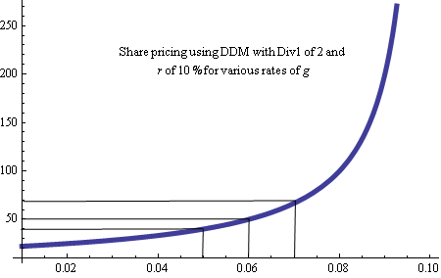
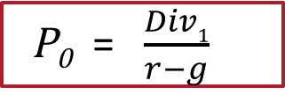
The DDM can be very sensitive to estimates of G (growth rate)
P₀ = $\frac{Div1}{r−g}$
P₀
g

