Slide 1
Redemptions Through Related Corporations: Section 304 and Brother-Sister Acquisitions
BEFORE
AFTER
A
A
A sells X
stock to Y for cash
Cash
Y
(Acq.)
X
(Issuing)
Y
(Acquiring)
X
(Issuing)

Slide 2
Section 304: Big Picture
If §304 applies, the payment for stock is treated as a redemption of acquiring; the payment is therefore either a:
S/X, or
an ordinary distribution (dividend, ROC, S/X)

Slide 3
Review of Differing Consequences of Redemption
Redemption treated as S/X
Recovery of basis
CG rates (individuals) on gain
Proportionate E&Ps pulled out (§312(n)(7))
Tax-free for foreigners
No DRD for US corporate shareholders
Redemption treated as ordinary distribution
No recovery of basis
CG rates for qualified dividend
E&Ps (current, accumulated, recovery of basis, S/X) pulled out
Dividend taxable to foreigners
DRD for US corporate shareholders if dividend, but possibly an extraordinary dividend (§1059(e)(1)(A)(iii)(II)
Issue: Allocation of basis of redeemed shares

Slide 4
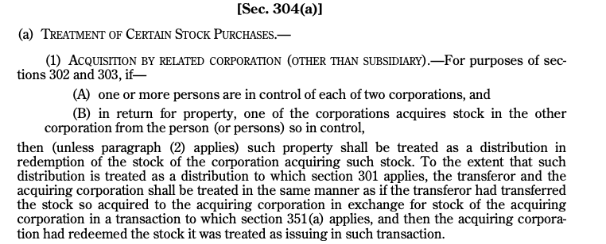
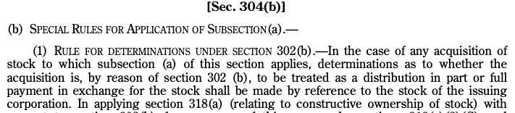
Section 304(a)

Slide 5
Section 304(a)(1): Does it Apply?
Section 304(a)(1) potentially applies if one or more persons are in control of each of two corporations and in return for property, one of the corporations acquires stock of the other corporation from the person(s) in control.
Control:
≥ 50% of total combined voting power of all classes of stock entitled to vote, or
≥ 50% of total value of shares of all classes of stock.
If the corporation has more than 1 class of stock, voting power is tested on an aggregate basis. Rev. Rul. 89-57.
If Corp A is controlled by a person(s), and Corp A owns ≥ 50% of vote or value of Corp B, then Corp B is controlled by that person(s). §304(c)(1).
318 attribution rules apply to determine control, but with modifications:
Corporation-to-SH (SH owns what Corp owns) attribution threshold lowered from 50% to 5%; and
SH-to-Corporation (Corp owns what SH owns) attribution threshold lowered from 50% to 5%, but if share ownership is between 5% and 50%, the Corporation only owns a proportionate amount of the SH’s shares. §304(c)(3)(A) and (B).

Slide 6
Section 304(a)(1): Redemption or Distribution
In the case of a brother-sister acquisition, the property received by the transferor (the selling shareholder) is treated as a distribution in redemption of acquiring (Y Corp) stock.
The deemed redemption in §304(a)(1) is then tested under §302 to determine if the deemed redemption is treated as a current distribution (dividend to the extent of E&Ps) or a sale/exchange.
Note: The redemption analysis is determined by reference to the stock ownership of the the issuing [acquired] (X Corp) corporation. §304(b)(1).
In testing whether the redemption is a S/X or ordinary distribution, the §318 attribution rules apply, but are (again!) modified:
Corporation-to-SH attribution threshold (50%) is disregarded; and
SH-to-Corporation attribution threshold (50%) is disregarded. §304(b)(1).

Slide 7
Section 304(a)(1): Redemption or Distribution
If the redemption is treated as an ordinary distribution (not a S/X), then the transaction is recast (deemed transactions) as follows:
(1) Transferor (seller, A) is treated as if it transferred the stock acquired by the acquiring corporation [Y] to the acquiring corporation in exchange for stock of the acquiring corporation in a deemed tax-free §351 transaction, and then
(2) Acquiring corporation had redeemed the stock it is treated as issuing in the deemed §351 transaction. §304(a)(1).
If the redemption is treated as an ordinary distribution, it will be treated as a dividend to the extent of the E&Ps of first acquiring and then issuing [acquired]. §304(b)(2).

Slide 8
Section 304: Rev. Rul. 71-563
Transaction
Analysis
Does §304(a) apply?
Is A in control of both X and Y? See §318.
Does Y acquire stock of X in exchange for property?
Is the redemption an ordinary distribution or sale/X?
Are any of the tests in §302(b) satisfied with respect to X (issuing), e.g.:
disproportionate, complete termination, or not essentially equivalent to a dividend?
A doesn’t own any shares in Y so basis goes to A’s X shares.
A
B (A’s son)
25 shares
100 shares
$
X
(Issuing)
Y
(Acquiring)
B (A’s son)
A
Y
(Acquiring)
75 shares
X
(Issuing)
25 shares

Slide 9
Section 304: Basis Adjustments in the case of a Section 301 Distribution
Shareholder
If sale is treated as a current distribution, the SH’s basis in the transferred shares of issuing [aquired] carries over to the basis of the shares of acquiring deemed received—remember, the controlling shareholder is treated as transferring the shares of issuing to acquired in a §351 transfer. §358(a).
If there are sufficient E&Ps so that the redemption proceeds are treated as a dividend in their entirety, the basis of the shares that are treated as redeemed are transferred to any shares of acquiring. Reg. §1.302-2(c), Ex. 1.
If no shares of acquiring are owned, the SH may have a loss that is deferred until the inclusion date, Prop. Reg. §1.302-5(a)(3) (withdrawn), or the basis may be lost. Rev. Rul. 70-496.
If no shares of acquiring are owned, it may be possible to allocate the basis of the redeemed shares to shares of issuing [acquired]. Rev. Rul. 71-563.
If the redemption proceeds exceed the E&Ps of acquiring and issuing, the basis of all shares of acquiring are reduced pro-rata. Prop. Reg. §1.301-2(a), Ex. (withdrawn). If the redemption proceeds exceed the basis of any of the acquiring shares, the SH will have gain.
If transferor is C Corp, any amount treated as dividend is an extraordinary dividend under section 1059(e)(1)(iii)(II), and transferor must reduce basis in redeemed stock by the untaxed portion (probably 65%).
Acquiring Corporation
Acquiring takes a carryover basis in the shares of issuing. §362(a).

Slide 10
Proposed Stock Basis Withdrawal Notice (Mar. 28, 2019)
The [Gov’t] continue[s] to believe that under current law, the results of a section 301 distribution should derive from the consideration received by a shareholder in respect of each share of stock, notwithstanding designations otherwise. See Johnson v. United States, 435 F.2d 1257 (4th Cir. 1971).
The [Gov’t] also continues to believe that, under current law, with respect to redemptions governed by section 302(d), any unrecovered basis in the redeemed stock of a shareholder may be shifted to other stock only if such an adjustment is a proper adjustment within the meaning of §1.302-2(c). Not all shifts of a redeemed shareholder's unrecovered basis result in proper adjustments, and certain basis adjustments can lead to inappropriate results. See, e.g., Notice 2001-45, 2001-33 I.R.B. 129.

Slide 11
304 Transaction Treated as S/X
If transaction treated as S/Ex, shareholder recognizes capital gain/loss, subject to §267, and acquiring will take a cost basis in the shares.

Slide 12
Redemptions Through Related Corporations: Section 304 and Parent-Subsidiary Acquisitions
BEFORE
AFTER
A
A
100 shares
50 shares
X
(Issuing)
X
(Issuing)
X Stock
$
50 X shares
100 shares
100 Y shares
50 X shares
Y
(Acquiring)
Y
(Acq.)

Slide 13
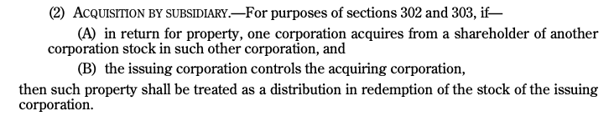
Section 304(a)(2)

Slide 14
Section 304 and Parent-Subsidiary Acquisitions
In the case of a parent-subsidiary acquisition, the property received by the shareholder (the seller) is treated as a distribution in redemption of issuing [acquired] stock.
In testing whether the redemption is a S/X or an ordinary distribution, the tests under §302(b) are applied to the stock of issuing [acquired]. §304(b)(1).
The same modifications of the §318 rules discussed above apply in determining the SH’s ownership of issuing before and after.

Slide 15
Section 304 and Parent-Subsidiary Acquisitions
If the transfer is treated as an ordinary distribution and there are sufficient E&Ps so that the redemption proceeds are treated as a dividend in their entirety, the basis of the transferred shares is transferred to any shares of issuing (parent/acquired). Reg. § 1.302-2(c), Ex. 1.
If the transfer is treated as an ordinary distribution and amount received is more than the total E&Ps, the SH’s AB basis in all of issuing’s shares, including those redeemed, are reduced on a share-by-share basis. Withdrawn Prop. Reg. § 1.301-2(a), Ex. Any remaining basis of the transferred shares is allocated to the remaining issuing shares. Prop. Reg. §1.302-5(e), Ex. 1 (withdrawn); 1.304-3(a).
If the SH doesn’t own any issuing shares, the loss may be taken later (when, for example, the SH doesn’t own constructively any issuing shares). Prop. Reg. §1.302-5(a)(3) (withdrawn).
The acquiring corporation’s basis in the parent’s (issuing) shares is equal to the amount paid, regardless whether the transfer is treated as a S/X or ordinary distribution. Rev. Rul. 80-189.

Slide 16
Section 304 and Parent-Subsidiary Acquisitions
Overlap of parent-subsidiary and brother-sister transactions
Statute gives priority to parent-subsidiary transactions. §304(a)(1) (…”unless paragraph 2 applies...”). But if transaction qualifies as a P-S transfer solely because of constructive ownership rules, then the transaction will be covered by the brother-sister rules.

Slide 17
Overlap with Section 351
Overlap with section 351
SH transfers shares of wholly-owned brother corp to wholly-owned sister corp in exchange for: (1) $100 and (2) shares of sister corp.
SH borrows against brother shares and transfers brother shares subject to the liability to sister corp.
In the case of overlap, §304 takes precedence for the non-stock consideration, and §351 applies to the stock consideration. §304(b)(3)(A). Why? See §317.
If acquiring assumes liabilities, generally treated as property for purposes of §304, but doesn’t apply to acquisition indebtedness. §304(b)(3)(B).

