Slide 1
Corporate Taxation
Prof. Colon
Spring 2023
Introduction

Slide 2
Administrative Details
Class Web Page: https://jmc877.github.io/Corporate-Tax/index.html
Textbook & Code
Class textbook
Block, Examples & Explanations: Corporate Taxation, 5th ed. (2022).
Supplemental (not required) Materials
Yin & Burke, Corporate Taxation (2nd 2015) and Yin & Burke, Supplement (2018)
Burke, Fed. Income Taxation of Corporations and Shareholders in a Nutshell, 8th ed. (2019)
Schwarz & Lathrope, Corporate Taxation (Black Letter)
Code & Regs (any one with 2018 changes)
Tax Analysts Tax Research Database (a great free resource)
Exam: Yes; 3 hours, short answer
Recording: Yes

Slide 3
Course Goals
Understand and be able to apply to problems the fundamental provisions of the US tax rules applicable to C and S corporations and their shareholders:
Subchapters C (90%) and S (10%) of the IRC and accompanying Treasury Regulations
IRS administrative guidance (revenue rulings, revenue procedures, notices, and PLRs)
Judicial decisions interpreting the Code and Regs, and especially the application of common law and statutory substance-over-form principles
Be able to do competently undertake basic corporate tax research

Slide 4
Promulgating, Interpreting, and Administering U.S. Tax Law
Executive Branch
Judicial Branch
Legislative Branch

Slide 5
Legislative Branch
Bill Introduced in the House of Representatives and Senate
Bill Referred to and Public Hearings by House Committee on Ways and Means and Senate Committee on Finance
Executive Branch
Executive Sessions of Ways and Means and Senate Finance
Bill Referred to House and Senate Floors
Reconciliation Conference
Bill Returned to Full House and Senate

Slide 6
Legislative History Example: New Section 163(j)
Conference Committee Report (H.R. CONF. REP. NO. 115-466)
House Bill
The deduction for business interest is limited to the sum of (1) business interest income; (2) 30% of the adjusted taxable income of the taxpayer for the taxable year; … The amount of any business interest not allowed as a deduction for any taxable year may be carried forward for up to five years beyond the year in which the business interest was paid or accrued, treating business interest as allowed as a deduction on a first-in, first-out basis…
Adjusted taxable income means the taxable income of the taxpayer computed without regard to (1) any item of income, gain, deduction, or loss which is not properly allocable to a trade or business; (2) any business interest or business interest income; (3) the amount of any net operating loss deduction; and (4) any deduction allowable for depreciation, amortization, or depletion….
Senate Amendment
The Senate amendment makes several changes to the definition of adjusted taxable income. Specifically, the Senate amendment does not add back deductions allowable for depreciation, amortization, or depletion, but does add back any deduction under section 199, and any deduction under section 199A with respect to qualified business income of a passthrough entity….
The Senate amendment permits interest deductions to be carried forward indefinitely, subject to certain restrictions applicable to partnership….
Conference Agreement
The conference agreement generally follows the Senate amendment, with the following modifications. Under the conference agreement, for taxable years beginning after December 31, 2017 and before January 1, 2022, adjusted taxable income is computed without regard to deductions allowable for depreciation, amortization, or depletion….

Slide 7
Executive Branch
President
Treasury
Legislative
Proposals
Assistant Secretary for Tax Policy
IRS
Regulations
Audit
Revenue Rulings
Priv. Letter Rul.
Tech. Adv. Mem.
Gen Legal Advice Mem.
30-Day Letter
90-Day Letter
Tax Court

Slide 8
Judicial Branch
Refund Suits
90 day
Letter
Tax Court
Claims Court
District Court
Appellate Courts
Supreme Court

Slide 9
Internal Revenue Code and Regulations
IRC: Title 26 of the U.S. Code
Subtitles (A-K)
A (Income Taxes) and (B) Estate and Gift Taxes
Chapters and Subchapters
Chapter 1 (Normal Taxes) [§§1-1400L]
Subchapter C: Corporate Distributions and Adjustments [§§301-385]
Subchapter K: Partners and Partnerships [§§701-777]
Subchapter S: S Corporations and Their Shareholders [§§1361-1379]
Parts [I], Sections [61], Subsections [c], Paragraphs [1], Subparagraphs [A], Clauses [i], and Subclauses [II]
Treasury Regulations: Title 26 of the CFR
Chapter, Parts, Sections [§§1.1 and 301.7701], Subsections [-1], Paragraphs[-1(d)]; Subparagraphs [-1(d)(1)]; and Subdivisions [-1(d)(1)(ii)]

Slide 10
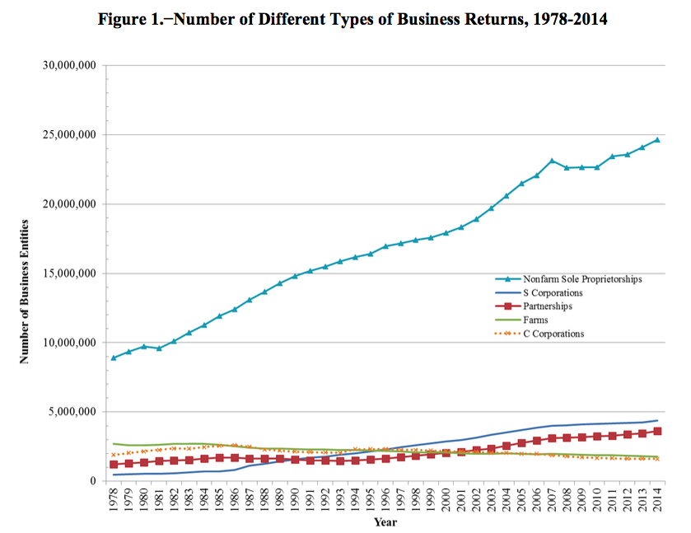
Business Entity Returns
Source: JCX-35-16
Source: JCX-42-17

Slide 11
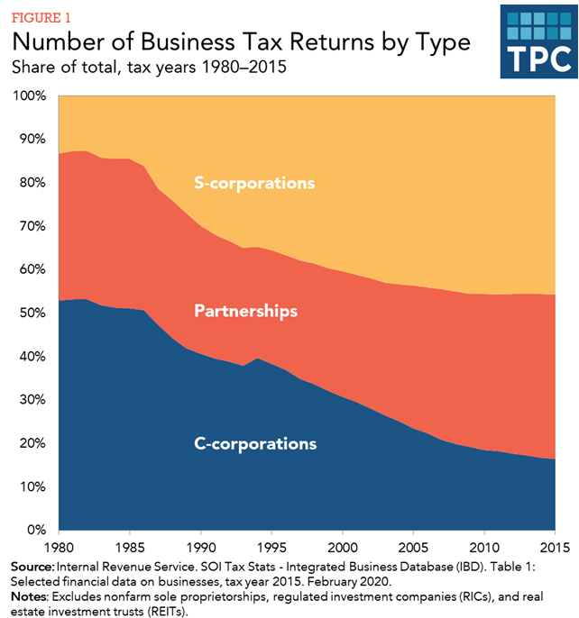
Number of Business Tax Returns by Type
Source: TPC, Key Elements of US Tax System

Slide 12


Business Entity Returns: Update through 2019
Source: JCT, X-14-22

Slide 13
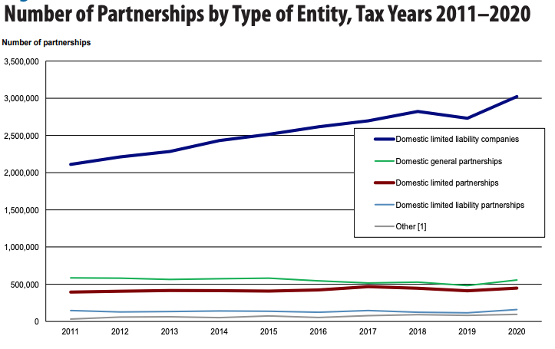
Partnership Returns
Source: SOI, PSH Returns, 2020

Slide 14
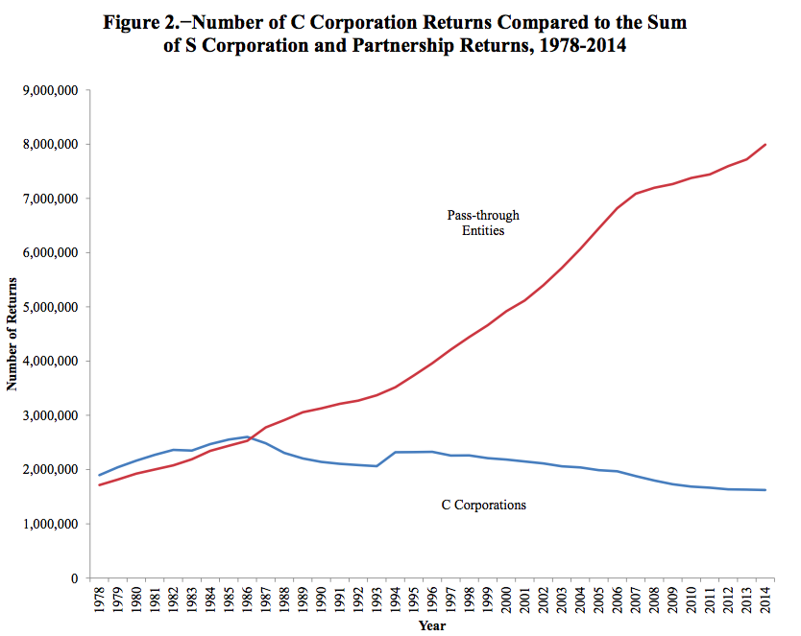
C Corp and S Corp Returns
Source: JCX-42-17

Slide 15
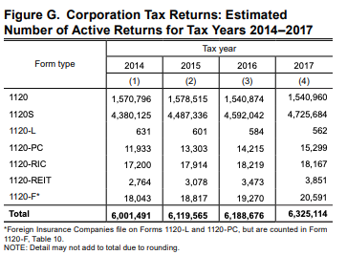
Number and Types of Corporate Returns
Source: IRS, SOI, Corp Inc. Tax Ret (2017)

Slide 16
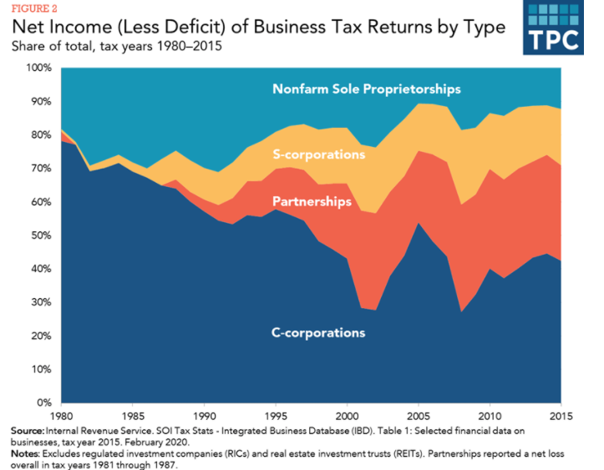
Net Income of Business Tax Returns by Types by Percent of Total (1980-2015)
Source: TPC, Key Elements of US Tax System

Slide 17
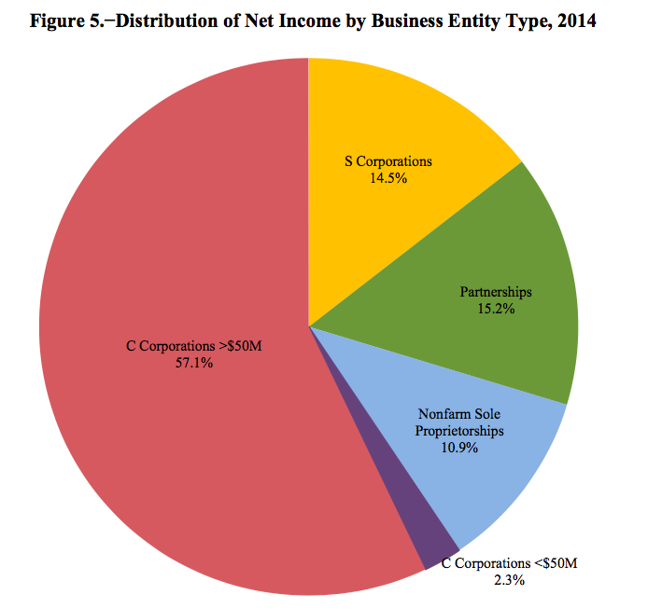
Net Income by Business Entity
Source: JCX-42-17

Slide 18
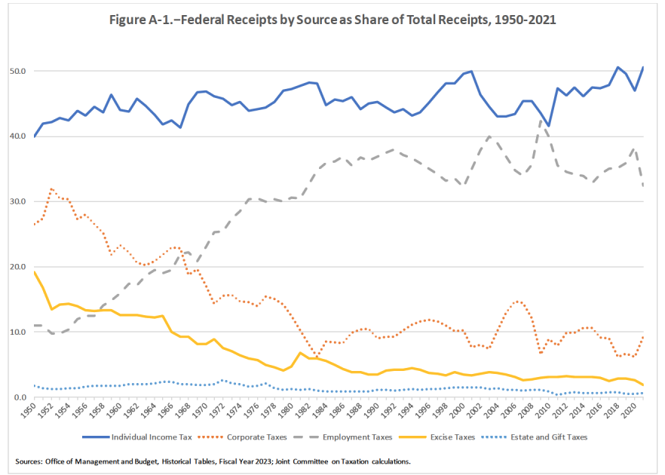
Federal Receipts as Share of Total Receipts: 1950-2021

Slide 19
Overview of Class
Choice of Entity considerations
Tax classification of business entities
Operation and taxation of corporations and shareholders
Rates
Special Treatment of: Losses, Capital Gains, Depreciation, and Interest
Double Tax (and techniques to avoid double tax)
Formation and ongoing transfers of property to controlled corporations
Distributions to shareholders
Ordinary distributions and redemptions (buybacks)
Liquidating distributions
Redemptions involving related corporations
Distributions of stock or stock rights
Taxable sales of shares and assets
Non-taxable exchanges of shares and assets (reorganizations)
Tax-free division of corporate assets
Spin-offs, split-ups, split-offs

Slide 20
Overview of Federal Taxation of Business Income
Separate Owner and Entity Taxation [Sub. C] (aka: double taxation)
Income Earned by Entity Taxed Separately from Owners’ Income
Income Earned by Entity Taxed Again to Owners when Distributed
Passthrough Taxation [Sub. K and Sub. S]
Income Earned by Entity is Taxed Directly to Entity’s Owners (whether or not actually received)
Income Earned by Entity not Taxed Again to Owners When Actually Received

Slide 21
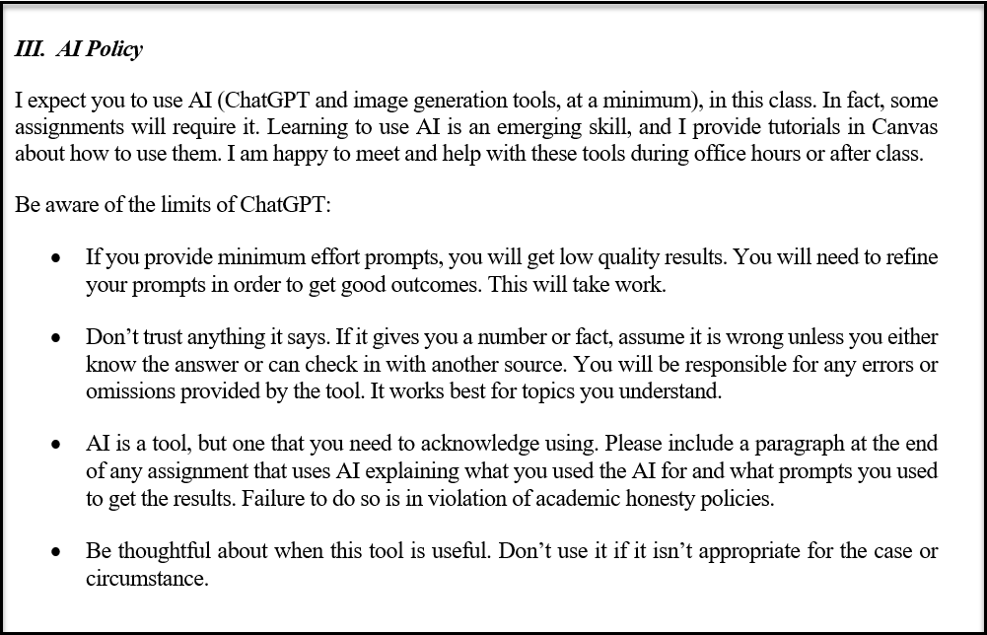
GPT

Slide 22
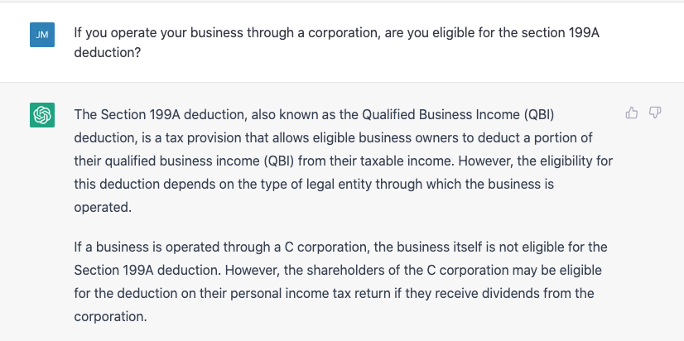
ChatGPT: Not quite ready for tax prime time
So very, very wrong!

