Slide 1
Ordinary Distributions
Ordinary distributions of property (§301)
  Dividend
  ROC
  S/X
Redemptions (§302)
  Ordinary distribution
  S/X
  S/X treated as redemptions (§304)
Liquidating distributions (§§331 and 332)
  S/X

Slide 2
Ordinary Distributions: Shareholder Consequences
Ordinary distributions of property:
  (a) Dividend to the extent of accumulated or current earnings & profits (E&Ps), then
  (b) Recovery of basis, and then
  (c) Capital gain. §301(c).
SH receives FMV basis in property received. §301(d).
Property
  Money, securities, other property except stock (or warrants) of the distributing corporation. §317(a).

Slide 3
Ordinary Distributions: E&Ps
E&Ps
  Start w/ taxable income
  Add back tax-free income, such as municipal bond interest, life insurance proceeds
  Add back certain deductions that reduce TI, e.g., DRD and NOL
  Subtract certain disallowed losses, e.g., §1211 CLs
  Subtract certain nondeductible payments, e.g., income taxes
  Subtract distributions ($, face value of debt, adjusted basis of property).
    Note: When an appreciated asset is distributed, E&Ps are first increased by amount of gain and then decreased by the amount of the distribution
      Ex: Corp distributes property (FMV=100; AB=75): E&Ps increased by 25 and then decreased by 100
  Realized gain/losses affect E&Ps only to the extent they are recognized (§312(a), (f); Reg. §1.312-7(b)(1)).
    Ex: Losses realized but not recognized because of the wash sales rules don’t affect E&Ps

Slide 4
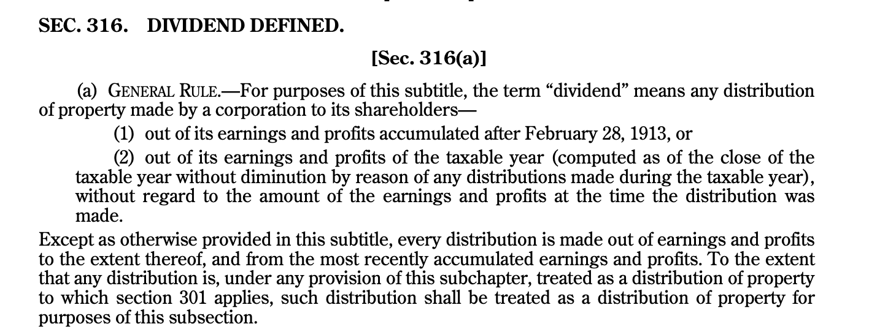
Dividend: §316

Slide 5
Ordinary Distributions: Rev. Rul. 74-164
Accumulated and Current E&Ps
Distribution
Sit. 1 (X)
  Accum. E&Ps ‘71: 40K
  Oper. loss 1/1–6/30: <50K>
  ‘71 E&Ps: 5K
Sit. 2 (Y)
  Accum. E&Ps ‘71: <60K>
  Profits 1/1-6/30: 75K
  ‘71 E&Ps: 5K
Sit. 3 (X)
  Accum. E&Ps ’71: 40k
  Oper. loss 1/1-6/30: <50K>
  ‘71 E&Ps: <5K>
Sit. 4 (X)
  Accum. E&Ps ’71: 40k
  Oper. loss 1/1-6/30: <50K>
  ‘71 E&Ps: <55K>
SH
15k on 7/1/71
X & Y

Slide 6
Ordinary Distributions: Additional Rules
If the total distributions exceed current year E&Ps, each distribution takes with it a proportionate amount of current year E&Ps.
  Assume Corp has current E&Ps of 20k and accumulated E&Ps of 5k. Corp makes four distributions of 10k each.
    5k (10k/40k * 20k) of each distribution will come from current E&Ps (and hence be a dividend).
    The 5k of accumulated E&Ps will also make an additional 5k of the first distribution a dividend.
    The remaining amounts of each distribution (5k * 3) will not be dividends. Reg. §1.316-2(b).
In case of distributions on different classes of shares, the E&Ps go first to the distributions to the most senior, e.g., preferred shares, and then to junior shares, e.g., common shares. Rev. Rul. 69-440.
  Corp has current E&Ps of 10k and distributes 8k to the preferred and 4k to the common.
  All distributions to preferred are from current E&Ps, but only 2k of distributions to common are from current E&Ps.

Slide 7
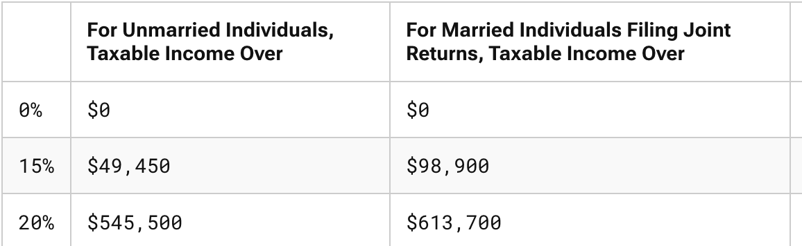
Ordinary Distributions to Individuals
Dividends: Ordinary and Qualified
  Ordinary dividends are taxed as ordinary income.
  Qualified dividends are taxed at the same rates as LTCGs (for TY 2026):
  Both are subject to the NII tax of 3.8% (AGI > $200,000(S); $250,000 (MFJ))
Qualified dividends are dividends from a:
  US Corporation
  Foreign corporation if incorporated in a possession, tax treaty eligible, or publicly traded in the US. §1(h)(11)(B) & (C).
  Holding Period Requirement:
    >60 days for common and >90 days for preferred. §§1(h)(11); 246(c).

Slide 8
Ordinary Distributions: Liabilities and Different Blocks of Shares
A corporation can distribute $ or other property, both of which are treated as dividends to the extent of current or accumulated E&Ps. §301(a) and (c).
In the case of property, the amount distributed is the property’s FMV, not its book value. §301(b)(1).
The FMV of property distributed is reduced (but not below 0) by liabilities:
  Assumed by a shareholder in connection with the distribution, and
  To which the property is subject to both before and after the distribution. §301(b)(2).
For distribution in excess of E&Ps, basis is recovered on a share-by-share basis within the same class of shares.
  SH owns 2 shares of Corp X, one with a basis of $25 and the other with a basis of $100. Corp X has E&Ps of $100 and distributes $100 per share (or $200 total).
    Share with basis of $25: $50 dividend; $25 ROC; and $25 CG
    Share with basis of $100: $50 dividend; $50 ROC. Prop. Reg. §1.301-2, withdrawn on 3/28/19 and Johnson v. US (4th Cir. 1971)

Slide 9
Ordinary Distributions: Corporate Shareholders
Corp X
Corp X
Corp X
> or =80%
> or =20%
<20%
Corp Y
Corp Y
Corp Y
100% DRD
§243(b)
65% DRD
§243(c)
50% DRD
§243(a)(1)
Tax Benefit of the 50% DRD
Corp X, which is subject to TR of 21%, receives $100 dividend from Corp Y. If the dividend is eligible for the 50% DRD, Corp X will pay a $10.5 tax on dividend [21%* ($100-$50)]. This represents a tax rate of 10.5% ($10.5/$100). Double tax is reduced but not eliminated.

Slide 10

Ordinary Distributions: Dividend Terminology
Payor Corporation
  Declaration Date
  Record Date
  Payment Date
Trading Terminology
  Ex-dividend
  Cum-dividend
  Record Date
  Trade Date
  Settlement Date
  Payment Date
Costco Wholesale Corporation (“Costco” or the “Company”) (Nasdaq: COST) announced that its Board of Directors has declared on Jan 15, 2026, a quarterly cash dividend on Costco common stock of $1.30 per share. The quarterly dividend is payable February 13, 2026, to shareholders of record at the close of business on January 30, 2026.
Cum
Ex
Jan. 15, 2026
Jan 30, 2026
Jan 30, 2026
Feb. 13, 2026
Trade Date:
Buy on 1/29
T + 1
Settlement Date:
Receive on 1/30

Slide 11
Ordinary Distributions: Corporate Shareholders and Dividend Stripping
Corporations can use the DRD to generate tax refunds in the absence of economic income
Example
Corp A, which has 100 of CGs, purchases a stock cum-dividend just prior to the ex-dividend date for 1,000 that will pay a dividend of 100. On the ex-date, the stock is sold for 900, generating a loss of 100.
  Economic Income: Buy stock for <1,000> + sell for 900 + receive 100 dividend = 0
  Tax Consequences
    CG 100 (from other property on which 21 of taxes are owed)
    CL <100> (on sale of share)
    Tax Div 50 (100 -50 DRD)
    Tax Inc 50
    Taxes 10.5 (21% * 50)
    Tax Savings 10.5 (21 taxes on CGs saved – 10.5 on dividends paid)

Slide 12
Ordinary Distributions and Dividend Stripping: Corporate Shareholders and Limits on the DRD
    To claim the DRD, a corporation must hold the stock for at least 46 days during 91-day period beginning 45 days before ex-dividend date (>90 days/181-day period for certain preferred dividends). §246(c)(1)(A), (c)(2).
If a corporation engages in certain types of hedging with respect to the stock to reduce its risk of loss, either the DRD is disallowed or the days are not counted for purposes of calculating the 46-day holding period. §246(c)(1)(B), (c)(4).
  Buys a put
  Enters into a short forward contract
  Sells a call, except a qualified covered call (§1092(c)(4))
  Shorts the underlying stock
  Risk of loss is diminished by holding 1 or position with respect to substantially similar or related property

Slide 13
Ordinary Distributions: Special Rules for Corporate Shareholders
The DRD is generally only available for dividends paid by US corporations. §243(a).
Certain dividends from foreign corporations are eligible for the DRD:
  Dividends from 10%-owned foreign corporations to the extent that the E&Ps were subject to US tax. §245(a)(1).
  Dividends from a wholly owned foreign subsidiary if all of the subsidiary’s gross income was effectively connected with a US trade/business. §245(b)(2).
  Dividends from a foreign corporation that succeeds to E&Ps accumulated by a US corporation. §243(e).
  New for ‘18: 100% DRD for dividends (E&Ps that haven’t yet been taxed to US owners) received from a foreign corporation if the US corporate recipient owns 10% or more of the vote or value of the foreign corporation. §245A.
For a 20% corporate shareholder, E&Ps of the payor corporation have to be computed as if §312(k) and (n) didn’t apply:
  Accelerated depreciation applies
  Installment sales rules apply. §301(e)(1).
  Result: More likely or less likely that the distribution will be a dividend?

Slide 14
Ordinary Distributions: Dividend Stripping and Extraordinary Dividends
A corporation that receives an extraordinary dividend and hasn’t held the stock for more than 2 years before the dividend announcement date:
  Must reduce its basis in the shares by the nontaxed portion of the dividend
  Must recognize gain if the nontaxed portion exceeds the basis. §1059(a) and (b).
Extraordinary dividend
  Dividend equals or exceeds 10% (5% for preferred stock dividends) of the recipient’s basis in the shares. §1059(c)(1) and (2). SH can use FMV instead of AB. §1059(c)(4).
  Can be distributions in kind as well. §1059(d)(2).
  Qualifying dividends excluded (received from member of same affiliated group). §1059(e)(2).
  Aggregation rules
    All dividends received that have ex-dividend dates within 85 days
    All dividends received within 1 year if dividend exceeds 20% of adjusted basis. §1059(c)(3).
    Dividends from a corporation that the SH has owned since the paying corporation’s inception are excluded. §1059(d)(6).
Individuals: Losses from the sale of shares are LTCLs if SH receives extraordinary dividend. §1(h)(11)(D)(ii). Enforcement?

Slide 15
Ordinary Distributions: Dividend Stripping and Debt Financed Stock
In the case of debt-financed portfolio stock, the DRD percentage is the product of:
  50% (65% from 20% owned corporation), and
  100% - the average indebtedness percentage. §246A(a).
  Debt-financed portfolio stock: portfolio stock subject to portfolio indebtedness, which is indebtedness directly attributable to investment in the stock. §246A(c)(1), (2), and (d)(3)(A).
    Portfolio Stock: any stock unless SH owns >=50% of vote & value or > = 20% if owned by 5 or fewer corporate shareholders. §246A(c)(2)

Slide 16
Ordinary Distributions: Dividend Stripping and Debt Financed Stock
Example
C Corp borrows $1,000X @ 5% to purchase a dividend paying stock yielding 4.75%.
  Is this generally a wise investment without consideration of taxes?
  After taxes?

Slide 17
Ordinary Distributions: Dividend Stripping and Debt Financed Stock
Rev. Rul. 88-66
Sit. 1
Corp X owns portfolio stock (sec. §246A(c)(2)) and has cash to meet business needs. X borrows to buy new facility as was customary but doesn’t liquidate the portfolio stock. No other factors indicating loan obtained to facilitate the carrying of portfolio.
Sit. 2
Corp X borrows money to construct plant within 18 months and temporarily invests the loan proceeds in portfolio stock
Sit. 3
Z bank, which can’t purchase stock, receives deposits from customers. Z bank loans $ to Parent, which invests in portfolio stock.

Slide 18
Ordinary Distributions: General Utilities Operating Co. v. Helvering (1935)
Sale to Southern
of Islands Stock
Southern
SH
Dividend of
Islands Stock
GU
What were the IRS’s 2 arguments?
20K shares
Basis= $.10/share
FMV = $56/share
Islands

Slide 19
Ordinary Distribution: Corporate-Level Consequences
General Rule (GU): No G/L recognized by the corporation on the current distribution of stock or property. §311(a).
  Liquidations and reorganizations are not covered by this rule (“distributions to which subpart A applies”).
Special Rule for Appreciated Property (GU Repeal): Distributing corporation recognizes gain (but not loss) on current distributions of appreciated property (other than obligations). §311(b). Why didn’t Congress allow losses to be recognized?
Liabilities:
  General Rule: In deemed sale under §311(b), liabilities are generally treated as part of amount realized if the property distributed is subject to a liability or the SH assumes a corporate liability in connection with the distribution. Reg. §1.1001-2(a)(1) and (4)(ii).
  Special Rule: In a distribution of appreciated property subject to a liability, the FMV of the property is not treated as less than the amount of the liability (or in other words, Corp must recognize gain to the extent that the liability > the AB of the property). §§311(b)(2); 336(b); 7701(g).

Slide 20
Ordinary Distribution: Corporate-Level Consequences
E&Ps generally decreased by:
  amount of money;
  principal amount of obligation;
  AB of other distributed property. §312(a)(3).
If gain recognized under §311(b), E&Ps are first increased by gain and then decreased by FMV of property (instead of the AB of the property). §312(b).
If distributed property is subject to liabilities, E&Ps are increased by liabilities assumed. Reg. §1.312-3.
  Why?

Slide 21
Disguised Dividends and Dividend Strips
Non-market transactions between shareholders and corporations can be reclassified as disguised dividends
  Unreasonable compensation (Aspro v. CIR, TC 2021; 8th Cir 2022)
  Non-arm’s length sales/leases between corporation and shareholders
  Personal use of corporate property by shareholders
C Corp owns 90% of Sub Corp (SC) and has received an offer to sell its shares for $100MM. C Corp has a very low basis in its SC stock, and SC has significant E&Ps. In negotiating the sale, C Corp’s tax advisors have suggested distributing SC’s excess cash, let’s say, $30MM ($27MM to C Corp), before selling the stock for $70MM.
  What’s the benefit to C Corp of the proposed structure?
  What are the risks? See TSN Liquidating Corp (5th Cir. 1980).

Slide 22
S Corp Distributions
The rules for C Corps generally otherwise apply to S Corps, e.g., contributions, certain distributions, acquisitions, and reorganizations. §1371(a).
For an S Corp with no E&Ps:
  Distribution of $ first reduces basis of stock, i.e., no income inclusion
  Amounts in excess of basis are treated as gain from the sale/exchange of property. §1368(b).
  Distributions of appreciated property:
    gain recognized at S Corp level, which is included in the SH’s income and increases basis, and
    basis then lowered by value of distributed property
Effect on SH’s basis:
  Decreases basis. §1367(a)(2)(A)
Priority rule in the case of distributions and losses--why do we need such a rule?
  Basis increased by income/gain. §1367(a)(1).
  Basis decreased by distributions. §§1367(a)(2)(A); 1368(d)
  Basis decreased by nondeductible expenses.
  Basis decreased by losses/deduction. Reg. §1.1367-1(f). The last two can be switched.

Slide 23
S Corps with E&Ps
If an S Corp was formally a C Corp and had accumulated E&Ps, distributions will generally come first from:
  S Corp earnings (AAA), and then from
  C Corp E&Ps.
Accumulated Adjustments Account
  The S Corp’s earnings computed following the basis adjustment rules in §1367(a)—increase for income and gains, and decrease for losses, deductions and distributions.
If a distribution comes from AAA, the S Corp rules apply (tax-free to SH and reduction of basis). §1368(c)(1).
If a distribution comes from C Corp E&Ps, the C Corp rules apply (dividend to the extent of E&Ps; and any excess is treated under the S Corp rules). §1368(c)(2) and (3).
An annual election can be made to distribute C Corp E&Ps first. §1368(e)(3).

