Slide 1
C Corporations: Commissioner v. Bollinger
Moline Properties v. CIR, 319 U.S. 436 (1943)
Whether the purpose be to gain an advantage under the law of the state of incorporation or to avoid or to comply with the demands of creditors or to serve the creator's personal or undisclosed convenience, so long as that purpose is the equivalent of business activity or is followed by the carrying on of business by the corporation, the corporation remains a separate taxable entity…The choice of the advantages of incorporation to do business, it was held, required the acceptance of the tax disadvantages.
National Carbide Corp. v. CIR, 336 US 442 (1949)
[1] Whether the corporation operates in the name and for the account of the principal, [2] binds the principal, by its actions, [3] transmits money received to the principal, and [4] whether receipt of income is attributable to the services of employees of the principal and to assets belonging to the principal are some of the relevant considerations in determining whether a true agency exists. [5] If the corporation is a true agent, its relations with its principal must not be dependent upon the fact that it is owned by the principal, if such is the case. [6] Its business purpose must be the carrying on of the normal duties of an agent.
Bollinger
Agreement between B & C
Hold title to apart as agent
No obligation to maintain
B agrees to indemnify for liabilities
PSH
Creekside
$ (Loan + Bollinger guarantee)
MMLIC

Slide 2
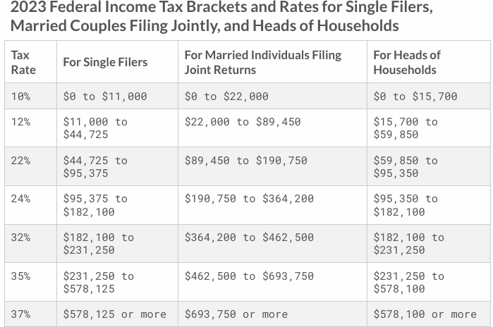
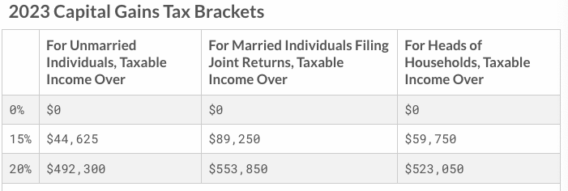
C Corporations: Individual and Tax Rates for 2023
C Corporations | MTR
Any income | 21%

Slide 3
C Corporations: Miscellanea
All C corporations taxed at the same 21% rate.
Capital losses
Deducted only to extent of capital gains;
Excess CLs can be carried back 3 years and forward 5 years. §§1211(a); 1212(a)(1)(C).
Dividends received deduction: 50%, 65%, and 100%. §243(a)-(c)
Is an S Corp entitled to the DRD?
Charitable deduction: 10% of TI (specially computed). §170(b)(2)
Net Operating Losses:
Excess of deductions over GI (computed with special modifications). §172(c)
NOLs can be carried forward indefinitely and can offset up to 80% of TI. §§172(a)(2) and 172(b)(1)(A)(ii)(II).
Compare treatment of losses in S Corp (and PSH) with C Corp.

Slide 4
C Corporations: Affiliated Groups & Controlled Groups
Section 1501
Affiliated group of US corporations can file a consolidated return
Affiliated group: 80% vote & value (§1504), excluding tax-exempts & foreign corporations
Section 1561
Treats all corporations that are members of a “controlled group of corporations” as one for purposes of the accumulated earnings tax.
Controlled Group of Corporations
Parent-Subsidiary
Brother-Sister (§1563(a))
Excluded Corporations and Stock
Tax-exempts
Foreign Corporations
Non-voting Preferred Stock (§1563(b) and (c))
Constructive Ownership Rules (§1563(e))

Slide 5
C Corporations: Section 163(j)
Section 163(j)
Applies to taxpayers, including all tax shelters, with average 3-yr, annual gross receipts > 29mm in 2023. §§163(j)(3); 448(c)(1)
Business interest deduction limited to the sum of:
Business interest income, and
30% of Adjusted Taxable Income. §163(j)(1)
ATI (close to EBIT): TI computed without regard to:
business interest income and business interest expense,
Non-business income, gain, deduction, or loss, and
NOLs
For pre-Jan 1, ‘22 TY, depreciation was added back. §163(j)(8)
Any disallowed interest is treated as business interest paid/accrued in the succeeding taxable year. §163(j)(2)

Slide 6
C Corporation Taxation: Sections 168(k) and 179
Qualified Property placed in service in 2023 is 80% (and scheduled to decline 20% points for each subsequent year).
Qualified property eligible for 100% depreciation if acquired before 2023. §168(k).
Qualified Property
Tangible Property with recovery period of 20 years or less. What type of property is excluded?
Qualified film or TV production, qualified live theatrical production
Original use or acquisition by taxpayer, provided that the acquisition isn’t from a related person or received on an exchanged basis.
Section 179 expensing amount for QP increased to 1.16mm (phaseout threshold: 2.89mm)
QP: tangible personal property, SW, and qualified real property (qualified improvement property and (for nonresidential RP) roofs, heating, ventilation, and AC, fire property, and alarm & security system. § 179(f).
What is the economic effect of a 100% deduction for the purchase of a capital asset?

Slide 7
Benefits of 100% Expensing
For an asset whose purchase price would otherwise have to be capitalized, a 100% deduction is equivalent to exempting the income produced by the asset from tax. The first column assumes that you earn $100 (pre-tax) and you purchase stock for $63, which is the amount you can invest after tax. The gains--$6.30--we assume are exempt. The second column assumes that you deduct the purchase price of the stock and thereby eliminate tax on your $100 of income, but all of the gains (both the investment and return) are taxed. You’ll see that the final amounts are equal. In your basic tax class, this is similar to the equivalence of accumulations in a Roth IRA (no deduction/no tax) and regular IRA (deduction/tax), given similar tax rates at the time of contribution and distribution.

Slide 8
C Corporations: Taxation of C Corp Investors
Individuals:
Maximum rate on dividends: 23.8%.
Maximum rate on CGs: 23.8%.
20% rate on CGs and dividends kicks in when TI > 459,750 (or 517,200 for joint returns) §§1(h)(1)(D) and(11)
Note: Dividend rate applies to entire dividend; CGs rate applies only to gains and not to gross receipts (taxpayers recover basis first)
3.8% rate on net investment income (divs, CGs) kicks in when AGI > 200,000 (individuals) or 250,000 (joint return). §1411.
Corporations:
CGs taxed at same rate as business income
Can deduct between 50% and 100% of dividends received from other corporations
Ex. 100 div minus 50 deduction = 50 TI; 50 * 21% = 10.5%

Slide 9
C Corporations: Special Rules for Qualified Small Business Stock (§1202)
Noncorporate taxpayers can exclude 100% of the gain from the S/E of qualified small business stock (QSBS) acquired after 9/27/10 (50% or 75% if acquired before) and held for more than 5 years. §1202(a)(1) and (4).
For stock eligible for the 100% exclusion, there is no AMT add back and the 3.8% tax doesn’t apply.
Limit: Greater of: (1) $10MM per issuer; or (2) 10 x adjusted basis of the stock issued and disposed of by taxpayer during the year. §1202(b)(1).
QSBS is C corporation stock of a qualified small business (QSB) acquired at original issue in exchange for $, property, or services. §1202(c)(1)
QSB: Aggregate gross assets don’t exceed $50mm after issuance, and 80% of assets are used in the conduct of 1 or more businesses other than health, law, banking, investing, a t/b where the principal asset of the the t/b is the reputation or skill of 1 or more its employees, farming, operating a hotel, motel, holiday inn, or restaurant. §§1202(d)(1)(B); 1202(e)(3).

Slide 10
C Corporations: Section 1244 and Small Business Corporations
Up to 50k/yr (100k for MFJ) on S/X of section 1244 stock is treated as ordinary loss; any excess is treated as capital loss
Benefit?
Sec. 1244 stock
Corporation (including S Corp) was small business corporation;
Stock issued for money or property (not services); and
For 5-yr period ending before the date of loss, the corporation derived more than 50% of its aggregate gross receipts from non-passive sources (i.e., not dividends, interest, rents, and royalties). §1244(c)(1).
Small Business Corporation
Aggregate money and other property received by the corporation for stock, contribution to capital, and paid-in surplus does not exceed $1MM. §1244(c)(3)(A).

Slide 11
C Corporations: Section 1045 and Sales of Small Business Stock
In the case of a sale by a noncorporate taxpayer of qualified small business stock held for more than 6 months, gain is recognized only to the extent that the amount realized exceeds the cost of QSBS purchased within 60 days of the sale. §1045(a)(1).
QSBS is defined by reference to §1202(c).
Any gain not recognized because of this provision reduces the basis of the purchased QSBS stock. §1045(b)(3).
Why?

Slide 12
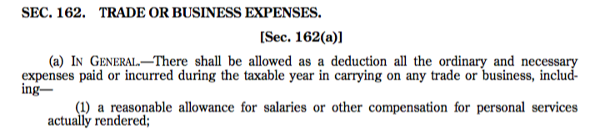
C Corporations: Avoiding Corporate Tax with Compensation
What are the tax consequences to the corporation and shareholder when the corporation pays a salary to the shareholder?
When is it beneficial for a corporation to pay the shareholder a salary vs. paying a dividend?
Reg. §1.162-7

Slide 13
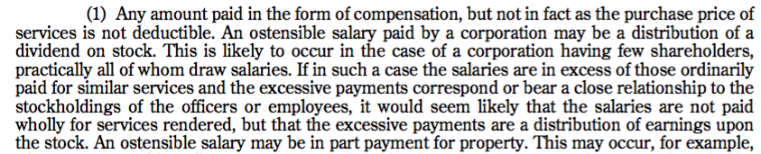
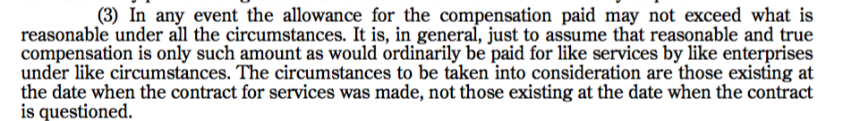
C Corporations: Avoiding Corporate Tax with Compensation
Reg. §1.162-7(b)(1), (3)

Slide 14
Compensation
Federal Income
Compensation is generally taxed as ordinary income
But note special rules of §199A
Investment income: 3.8% tax on investment income, e.g., dividends, interest, rents, royalties. §1411.
> $200,000 (single), $250,000 (joint)
Social Security
7.65% [6.2% (OASDI) + 1.45% (Medicare)] to $160,200 (2023) (employers & employees, each). §§3101(a)and (b)(1); 3111(a) and (b).
1.45% (employer & employee) on earned income > $160,200 (2023). §§3101(b)(1) and 3111(b).
0.9% Medicare tax (employee) on earned income > $200,000 (single); 250,000 (joint). §3101(b)(2)

Slide 15
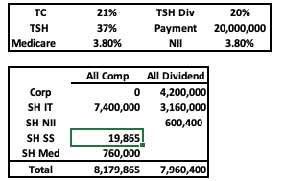

C Corporations: Menard (Avoiding Corporate Tax with Compensation)
What was the 5% bonus?
When was it adopted?
What were some of the factors that the IRS and TC argued that the 5% bonus should be treated as a dividend?
According to J. Posner, was it relevant that Menard’s didn’t pay a dividend?
The TC focused on the compensation paid to comparable companies, e.g., Home Depot and Lowe’s. Why didn’t J. Posner put much weight on this?
What test does the 7th Cir use to determine whether compensation is reasonable?
Menard
1998
Salary: 157k
Profit Sharing: 3mm
5% Bonus: 17.5mm
100% VS
56% NVS
Menard, Inc
The Tax Stakes Today

Slide 16

C Corporations: Avoiding Corporate Tax with Compensation
Public Companies
No deduction for applicable employee remuneration for covered employee of publicly held corporation (including foreign corporations with US traded equity) or U.S. corporations that issue publicly traded debt in excess of $1MM. §162(m)(1).
Covered Employee
CEO and CFO
Top 3 highest compensated officers (other than CEO or CFO). §162(m)(3).
Once covered, always covered
Applicable Employee Remuneration
Aggregate amount allowed as a deduction for remuneration for services
Final Regs issued on 12/30/20
Grandfathered for pre-Nov. 2, ‘17 contracts:
Deductible remuneration for services, except:
remuneration payable solely on account of the attainment of one or more performance goals, if:
Performance goals determined by a compensation committee of the BOD comprised solely of 2 or more outside directors
Material terms disclosed to SHs and approved by a majority of the vote
Compensation committee certifies that the performance goals satisfied. Former §162(m)(4)(C).

Slide 17
C Corporations: Avoiding Corporate Tax with Compensation
There is little evidence that the deductibility cap has had significant effects on overall executive compensation levels or growth rates at firms likely to be affected by the deductibility cap, however, nor is there evidence that it has increased the performance sensitivity of CEO pay at these firms. We conclude that corporate pay decisions seem to be relatively insulated from this type of blunt policy intervention.
Rose & Wolfram, Regulation Executive Pay: Using the Tax Code to Influence Chief Executive Officer Compensation, J. of Labor Econ. (2002)

Slide 18
C Corporations: Avoiding Corporate Tax with Compensation
Tax Considerations. Section 162(m) of the Internal Revenue Code limits the Company’s ability to deduct compensation in excess of $1,000,000 paid in any year to the Company’s named executive officers. The HR Committee adopted performance goals so that awards made pursuant to such goals that contributed to a named executive officer earning more than $1 million in annual compensation may qualify as tax deductible to the Company for U.S. federal income tax purposes under Section 162(m). In December 2017, the U.S. federal government enacted the Tax Cuts and Jobs Act, which …eliminated the performance-based compensation exception under Section 162(m). As a result, the Company expects that, except to the extent an exception applies, any compensation over $1 million paid to any current or future named executive officer in a fiscal year will not be tax deductible. The HR Committee certified certain performance measures in December 2017 to protect a portion of the tax deduction for performance-based compensation that would be paid in February and March 2018 to the Company’s named executive officers.
American Electric Power, Proxy Statement (2018)

Slide 19
C Corporations: Avoiding Corporate Tax with Compensation
Nonqualified Stock Options (options without a readily ascertainable FMV)
Bargain element (difference btwn exercise price and share value) is taxed upon exercise. §83; Reg. §1.83-7(a).
Corporation receives deduction in the same amount as employee inclusion when the employee reports the income. §83(h).
Incentive Stock Options (ISOs)
Bargain element taxed when employee disposes of shares at capital gains rates
No deduction for corporation
Upon exercise, bargain element is AMT add back. §56(b)(3).
100k annual limit. §§421 and 422.
Financial accounting treatment
Recognized as expense (FMV) when granted. If not vested at grant, FMV recognized over the vesting period.

Slide 20
C Corporations: Avoiding Corporate Tax with Compensation
Stock granted in exchange for services
Includible in income (and deductible by issuing corporation) when “vested”:
stock is transferable, or
not subject to substantial risk of forfeiture, e.g., future performance of servicies
Section 83(b) election for nonvested stock, but generally not for nonqualified options
FMV currently included in income (and deductible by employer), and
Any subsequent gain recognized is capital gain
Qualified Equity Grants (new §83(i))
Qualified stock: received in connection with the exercise of an option or settlement of a RSU from an eligible corporation
Eligible Corporation: Non-publicly traded and 80% or more of all employees are granted stock options/RSU
Deferral Option: e/ee can elect to defer QS until the earliest of: it becomes transferable; the stock becomes tradable on an exchange; or 5 years after vesting
Any increase in value after the election date is taxed at capital gains rate

Slide 21
C Corporations: Capital Structure
Interest paid by a corporation on indebtedness is generally deductible, subject to certain limitations, such as section 163(j), by a corporation in computing its taxable income. §163
Is leverage always beneficial to a firm?
Consider the profitability of firm
Is leverage always beneficial to a firm’s shareholders?
Taxation of dividends vs. taxation of interest
What are some of non-tax burdens of leverage?
Covenants?

Slide 22
C Corporations: Section 163(j)
Section 163(j)
Applies to taxpayers, including all tax shelters, with average 3-yr, annual gross receipts > 29mm in 2023. §§163(j)(3); 448(c)(1)
Business interest deduction limited to the sum of:
Business interest income, and
30% of Adjusted Taxable Income. §163(j)(1)
ATI (close to EBIT): TI computed without regard to:
business interest income and business interest expense,
Non-business income, gain, deduction, or loss, and
NOLs
For pre-Jan 1, ‘22 TY, depreciation was added back. §163(j)(8)
Any disallowed interest is treated as business interest paid/accrued in the succeeding taxable year. §163(j)(2)

Slide 23
C Corporations: Capital Structure (Pre-TCJA Example)
Corp X needs to raise $100mm of capital and must decide between issuing debt or preferred stock @ 5% to its shareholders
How does this example change after the TCJA? See https://goo.gl/dMcWmw
Source: JCX-45-16, Overview of Corp Debt & Equity

Slide 24
C Corporations: Capital Structure

Slide 25
C Corporations: Capital Structure
Notice 94-47
Unconditional promise of issuer to pay a sum certain on demand or at a fixed maturity date that is in the reasonably foreseeable future
Holders possess the right to enforce the payment of principal and interest
Holders’s rights are subordinate to creditors’s rights
Holders’s right to participate in the management of the issuer
Issuer is thinly capitalized
Identity between holders and stockholders
Label placed upon the instruments by the parties
Intent to be treated as debt or equity for non-tax purposes, including regulatory, rating agency, or financial accounting purposes

Slide 26
C Corporations: Capital Structure
Final Section 385 Regulations (May 2020)
Implement the authority to treat instrument as part debt and part stock
Debt instrument treated as stock:
Distribution of debt obligations to related party
Issuance of debt in exchange for affiliate stock
Debt issued pursuant to internal asset reorganization
Won’t apply if immediately after issuance of the debt, the issue price of debt instruments held by expanded group <50mm

Slide 27
C Corporations: Earnings Accumulation
When is it beneficial for a C Corp to retain (and invest) its earnings rather than paying them out? Consider various combinations of the following parameters:
C Corp tax on earnings
SH tax on current and future distributions of earnings
SH tax on sale of shares
Investment opportunities of SHs and C Corps
See https://goo.gl/dMcWmw

Slide 28
C Corporations: Earnings Accumulation
Accumulated Earnings Tax (AET)
Applies to corporation formed or availed of for the purpose of avoiding tax by permitting E&Ps to be accumulated instead of being distributed. §532(a).
If E&Ps accumulate “beyond the reasonable need of the business”, tax avoidance is presumed, unless corporation can prove to the contrary by a preponderance of the evidence. §533(a).
20% corporate tax on accumulated taxable income (ATI). §531.
ATI= TI (with adjustments) - Dividends Paid – accumulated earnings credit (AEC)
Adjustments:
Less: taxes, unlimited charitable contributions, capital losses
Plus: NOLs, DRD. §535(a) and (b)
AEC: amount in excess of E&Ps retained for reasonable needs of business
Minimum Credit: $250,000 ($150,000 for service corporations). §535(c).

Slide 29
C Corporations: Earnings Accumulation
Personal Holding Company (PHC) Tax
20% tax on undistributed person holding company income of PHC. §541
PHC
60% of AOGI is personal holding company income (PHCI); and
More than 50% of value of stock is owned by 5 or fewer individuals (with constructive ownership rules). §§542(a)(1) and (2); 544.
PHCI
Dividends, interest, royalties, certain rents, certain computer software royalties, certain film rents, rent from the use of corporate property by certain shareholders, income from personal service contracts. §543.
Undistributed PHCI
TI minus dividends paid, taxes, charitable contributions
Deduction for deficiency dividends. §547.
When this provision was enacted, what do you think was the corporate-individual tax rate differential?

Slide 30
Different Goals of Tax and Accounting
GAAP: Communicate financial performance of a company to outside stakeholders in a manner that is accurate, transparent, and consistent from one organization to another
Principle of conservatism (reduce risk of overstating NI)
FASB/SEC
Tax: Collect revenue in proportion to ability to pay, encourage certain activities and industries, limit certain behavior
Minimize risk of understating income
Schedules M-1 & M-3, Form 1120, reconcile book-tax.

Slide 31
Some Examples of Book-Tax Differences
Item | Book | Tax
Contingency reserves (litigation) | If probable and can be estimated | When all-events test made
Depreciation | SL over asset’s useful life | Accelerated
Bad Debts | If probably and can be estimated | When written off
COD | Recognized | Exempt if certain conditions satisfied
Deferred Comp | When earned (services provided) | When included in E/ee’s income
Advance payments | When earned | When received
Fines, penalties | Fully expensed | Not deductible
Non-recognition transactions (reorgs, transferred to controlled corps, spin offs, liquidations) | G/L for book purposes | Full or partial deferral
Interest Expense | Full deduction for interest expense | Limited by §163(j): 30% of EBIT
Income of foreign subsidiaries | Included | Can’t be part of a consolidated return, but Subpart F, GILTI
Dividends from other corporations | Fully included | Under the DRD rules, some or all can be deducted

Slide 32
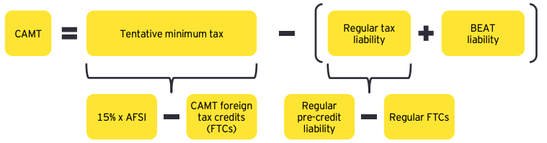
New (and not improved) Minimum Tax on Book Income (CAMT) of Applicable Corporations
For post-’22 TYs, an applicable corporation is subject to a 15% CAMT on:
Adjusted financial statement income (AFSI) above the CAMT FTC minus the corporation’s regular tax and any base erosion anti-abuse tax. §§55(b)(2)(A); 56A(a)
15% * (AFSI – CAMT FTC) – (Regular tax after FTC + BEAT)
AFSI: net income or loss shown on the corporation’s financial statements (books). §56A(b)

Slide 33
Different Goals of Tax and Accounting
GAAP: Communicate financial performance of a company to outside stakeholders in a manner that is accurate, transparent, and consistent from one organization to another
Principle of conservatism (reduce risk of overstating NI)
FASB/SEC
Tax: Collect revenue in proportion to ability to pay, encourage certain activities and industries, limit certain behavior
Minimize risk of understating income
Schedules M-1 & M-3, Form 1120, reconcile book-tax.

Slide 34
CAMT: Applicable Corporation
Applicable Corporation
Any corporation if average AFSI (over last 3 yrs) > $1Billion (determined w/out any deduction for financial statement NOL). §59(k)(1)(A)
S Corp, RICs (mutual funds/ETFs), and REITs are excluded. §59(k)(1)(A)
Once an applicable corporation, always an applicable corporation, with some to be determined regulatory exceptions (change of ownership and failure to satisfy the $1Billion test). §59(k)(1)(C)
A corporation that is part of a foreign-parented multinational group that satisfies the average AFSI test and the U.S. corporation’s AFSI is $100MM or more. §59(k)(1)(B), (k)(2)(A) and (B)
AFSI determined w/out certain adjustments, e.g., for CFCs, ECI
A US branch of a foreign corporation is treated as a separate US corporation. §59(k)(2)(C)
SAFE harbor: Unadjusted AFSI is <$500MM or $50MM for members of foreign group. Notice 2023-7, §5.03

Slide 35
New (and not improved) Minimum Tax on Book Income (CAMT) of Applicable Corporations
Some of many, many adjustments to arrive at AFSI
AFSI is computed using tax depreciation. §56A(c)(13)
AFSI of a P in a PSH takes into account the distributive shares of the PSH’s AFSI. §56A(c)(2)(D)
For shareholders of CFCs, AFSI takes into account the SH’s pro rata shares of each CFC’s NI or NL. §56A(c)(3)(A)
Special rules for tax nonrecognition transactions (reorgs, spin-offs, 351 & 721 contributions, liquidations)
Book G/L of covered nonrecognition transactions not taken into account for AFSI. Notice 2023-7, §3.03 (Qs remaining regarding partially taxable transactions).
Any book income recognized on COD transactions is excluded if excluded for tax purposes. Notice 2023-7, §2.02

