Slide 1
Corporate Taxation: Redemptions

Slide 2
Equity Payouts: Dividends and Share Repurchases
What can a company do with its earnings?
Retain them and then either spend or reinvest
Pay off liabilities
Pay dividends in cash or (very rarely) in property
Repurchase shares from shareholders

Slide 3
Redemptions
Ordinary Distribution
Redemption
SH
SH
$ or Property
$ or Property
Shares
Corp X
Corp x
§
Tax Treatment
Dividend to the extent of E&Ps
Recovery of Basis
Capital Gains
Tax Treatment
Dividend or Sale/X depending on whether SH’s interest in the corporation is significantly reduced
Difference less important since tax rates on NCGs and Dividends are identical, but recovery of basis in S/X
Foreign v. U.S. shareholders

Slide 4
Redemptions: Shareholder Consequences
Redemptions treated as S/X:
Not essentially equivalent to a dividend (§302(b)(1))—hazy
Substantially disproportionate (§302(b)(2))—bright line
Termination of SH’s interest (§302(b)(3))—bright line & hazy
Redemption from noncorporate SH in partial liquidation (§302(b)(4))
Redemptions to pay estate taxes (§303)

Slide 5
Constructive Ownership Rules
Constructive ownership rules of §318 apply to determine ownership changes. §302(c)(1).
Attribution among Members of Family (§318(a)(1))
Attribution from Partnerships and Corporations (§318(a)(2))
Attribution to Partnership and Corporations (§318(a)(3))
Options (§318(a)(4))
Important Operating Rules
Reattribution in general (§318(a)(5)(A))
Reattribution among family members (§318(a)(5)(B))
Reattribution from Partnerships and Corporations (§318(a)(5)(C))

Slide 6
Substantially Disproportionate Redemptions: §302(b)(2)
Immediately after redemption SH owns <50% of total combined voting power of all classes entitled to vote
SH’s ownership of common stock (voting and nonvoting) after and before redemption also satisfies the 80% requirement.
Reduction is tested on an aggregate and not class-by-class basis. Rev. Rul. 87-88

Slide 7
Substantially Disproportionate Redemptions: Rev. Rul. 81-41
Before
After
OtherSHs
A
OtherSHs
A
4,900 V Prd
5,100 VS
2,900 V Prd
5,100 VS
Corp X
Corp x
X redeems 2,000 of SH A’s V prd stock
Why doesn’t this qualify as a substantially disproportionate redemption under section 302(b)(2)(C)?

Slide 8
Substantially Disproportionate Redemptions and §302(b)(2)(D): Rev. Rul. 85-14
Tax Consequences
Ownership Structure
Repurchase agreement between X and B, C, and D:
If any SH ceases to work in the business, he must tender shares to X for book value
B announced on 1/1/83 his intention to resign on 3/22/83.
A caused X to redeem 902 shares from A on 3/15/83 for 700X, which reduced A’s ownership to 49.96% from 72.18%
On 3/22/83, B resigned, and X redeemed B’s shares over the next 6 months.
After the dust settles, A owns >50% of X, and A’s ownership was reduced from 72.18% to 61.37%
A
B
C
D
X
SHs | Jan 1 | Mar 15 | Sept 22
A | 1466 | 564 | 564
B | 210 | 210 | 0
C | 200 | 200 | 200
D | 155 | 155 | 155

Slide 9
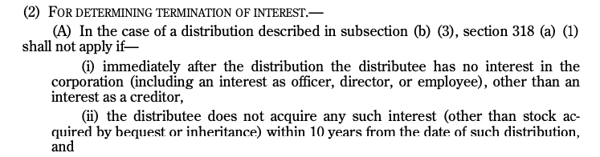
Redemptions that Completely Terminate a Shareholder’s Interest: §302(b)(3) and (c)(2)
Redemptions that completely terminate a shareholder’s interest are treated as S/X. §302(b)(2)
Issues:
Redemptions of a family member in a family-held corporation and the constructive ownership rules

Slide 10
Redemptions: Lynch v. CIR, 801 F.2d 1176 (9th Cir. 1986)
Before
Sale to Gilbert
Complete Redemption of William
William
Gilbert
William
Gilbert
William
Sale of
50 shares
2,350 shares
50 shares
Complete redemption for 17,900 and Note
2,300 shares
Lynch Co.
Lynch Co.
Lynch Co.
Does the transaction qualify as a complete redemption under §302(b)(3)? Why not? See §302(c)(2)(A)(i).
What was William’s relationship to the company after the redemption?

Slide 11
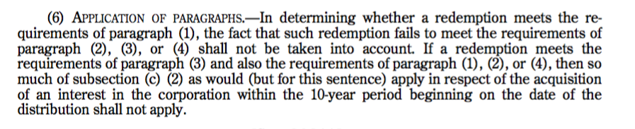
Redemptions: Section 302(b)(6)
In English, what does this mean?

Slide 12
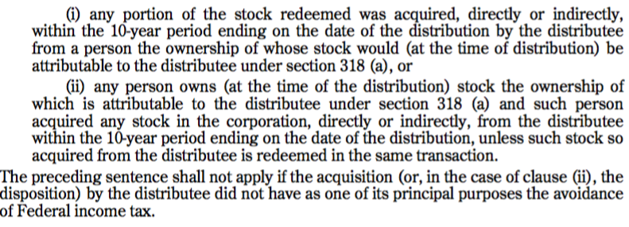
Redemptions: Section 302(c)(2)(B)(i) and (ii)
In English, what does this mean?

Slide 13
Redemptions: Rev. Rul. 77-293
Before
Gift to B
Complete Redemption of A
A
B
(A’s son)
B
A
A
120 shares
Gift of 60 shares
60 shares
Complete redemption
60 shares
X
X
X
Does the transaction qualify as a complete redemption under section 302(b)(3)?
But see §302(c)(2)(A)(i)
But see 302(c)(2)(B)(ii)
But see 302(c)(2)(B)(ii) flush language.

Slide 14
Redemptions: US v. Davis, 397 US 301 (1970)
Davis
Wife
Son
Daughter
250 CS
1000 prd
250 CS
250 CS
250 CS
1
X redeems prd shares for 25k
X
Why did Davis argue that the redemption was not essentially equivalent to a dividend?
“To qualify for preferred treatment under [302(b)(1)], a redemption must result in a meaningful reduction of the shareholder’s proportionate interest in the corporation.”

Slide 15
Redemptions: Rev. Rul. 76-385
Corp X
Corp X
few shares
Corp Y
Corp Y
Corp Z
few shares
few shares
Corp Z
28mm shares
outstanding
Z redeems Corp Y’s shares
1
Why isn’t the redemption of Corp Y’s shares treated as a complete termination?
See §318(a)(3)(C)
What was Corp Y’s ownership interest before and after the redemption?

Slide 16
Redemptions: Rev. Rul. 81-289
Other SHs
A
1
Other SHs
A
2,000x
A tenders 40x shares (2%)
1,960x
Corp X
1,000,000x
outstanding
Corp X
980,000x
outstanding
1
X redeems 20,000x shares (2%)
What was A’s ownership interest in X before and after the redemption?

Slide 17
Redemptions: Partial Liquidations--Section 302(e)
Applies to noncorporate shareholder
Can be non pro-rata
Partial liquidation of corporation
Distribution not essentially equivalent to a dividend (determined at the corporate level)
Pursuant to a plan and occurs w/in the TY the plan is adopted or succeeding TY. §302(e)(1).
Distribution is attributable to corporation’s ceasing to conduct (or consists of the assets of) a Qualified T/B; and immediately after distribution, distributing corporation is actively engaged in a Qualified T/B
Qualified T/B: actively conducted throughout 5-year period ending on date of redemption; and not acquired in taxable transaction w/5 previous 5 years. §302(e)(3).
Corporate SH: any amount treated as dividend in a partial liquidation is an extraordinary dividend. §1059(e)(1)(A)(i).
For ruling purposes, the distribution must result in at least a 20% reduction in gross revenues, net fair market value of assets, and employees. Rev. Proc. 2008-3.

Slide 18
Redemptions: Rev. Rul. 60-322
Leather trade no longer profitable
Losses
Excess inventory (5,000X)
Liquidation of inventory
Redeem portion of stock with cash from sale of G bonds and liquidation of inventory
Genuine contraction of the business?
SHs
SHs
Corp X
3,800 shares
outstanding
Accumulated E&Ps: 1,500X

Slide 19
Redemptions: Section 303
Redemption of an amount to pay estate, inheritance, legacy, and succession taxes and the amount of funeral and administration expenses treated as a sale/X.
Applies only if the value of the stock which is included in determining the value of the decedent’s gross estates exceeds 35% of the value of the gross estate over allowable deductions.

Slide 20
Redemptions: Corporate-Level Consequences
Current Distribution:
E&Ps reduced by the amount of money;
E&Ps reduced by adjusted basis of property (if greater than FMV); or
E&Ps reduced by FMV of property if greater than AB of property (after first increasing E&Ps for gain recognized). §312(a) and (b).
Sale/Exchange:
E&Ps reduced by ratable share of E&Ps attributable to stock redeemed but capped at the actual amount of the distribution. §312(n)(7).
Is there another approach?

Slide 21
Redemptions and Tax Planning: Zenz v. Quinlivan, (6th Cir. 1954)
1
$
Zenz
3rd
Party
What did the IRS argue?
47 Shares
2
Redemption
of 61 shares
Corp

Slide 22
Redemptions and Tax Planning: Rev. Rul. 75-447
A
B
A
B
C
1
2
1
A
B
C
X
X
2
X
Situation 1
A and B cause X to:
Issue 25 shares to C, and
Redeem 25 shares of stock from each of them
A and B each
owns 50 shares of X
Situation 2
A and B each sells 15 of X to C, and
X redeems 5 shares from both A and B
Since the Zenz holding requires that effect be given only to the overall result and proscribes the fragmenting of the whole transaction into its component parts, the computation of the voting stock of the corporation owned by the shareholder immediately before the redemption for purposes of section 302(b) (2) (C) (ii) of the Code should be made before any part of the transaction occurs. Likewise, the computation of the voting stock of the corporation owned by the shareholder immediately after the redemption for purposes of section 302(b) (2) (C) (i) should be made after the whole transaction is consummated… Furthermore, in each situation, the result would be the same if the redemption had preceded the issuance, or sale, of stock.

Slide 23
Redemptions and Buy-Sell Agreements: Rev. Rul. 69-608
Sit. 1 & 2: SH-level buy-sell agreement btwn A & B assigned to X after departure and death of B. X redeemed B’s shares.
Sit 3: Trust owns shares of X terminates in ‘69. A purchases B’s interest in trust for 25x and deferred payment of 20x in ’66. In ‘69, X reimburses A for 25x and redeems B’s shares for 20x.
Sit 4: A agreed to purchase (or cause to be purchased) B’s shares. B was free to sell to 3rd party. A causes X to redeem B’s shares when A had no obligation to purchase stock.
Sit 5: Agreement btwn A & B provided that X would redeem their shares upon death, with either shareholder being liable to satisfy the obligation if X didn’t redeem.
Sit 6: A owns 100% of X. B agreed to purchase A’s shares, but PA permitted B to fully assign purchase obligation to Corp. B assigned PA to Y, which purchased X shares. Y subsequently merged into X.
Sit 7: Original buy-sell agreement btwn A & B to repurchase upon death was rescinded; new agreement provided that X would redeem.

Slide 24
Redemptions: Shareholder-Level Consequences
Redemption treated as sale/X
G/L (value minus AB of shares)
Any loss recognized may be limited by section 267 (50%-or-more owned corporation)
Basis Issues in the case of Ordinary Distributions
Basis probably reduced on a share-by-share basis (instead of aggregate basis). Prop. Reg. §1.301-2(a).
Basis Issues in the case of Redemption Treated as a Dividend
Where does the basis of the redeemed shares go?
“Proper adjustment of basis of remaining stock will be made with respect to stock redeemed…” Reg. §1.302-2(c).
If SH retains any other shares, basis goes to those shares. Reg. §1.302-2(c), Exs. 1 and 3.
If no other shares, basis transferred to shares of related person if those shares attributed to the redeemed SH. Reg. §1.302-2(c), Ex. 2.

Slide 25
Redemptions: Notice 2001-45 (Basis Shifting Shelters)
Corp X and unrelated Corp Y each purchase 1,000X shares of Corp Z.
Corp Y is a tax-indifferent party (maybe tax-exempt or foreign corporation).
Corp Y purchases from Corp X an option to purchase 2,000X shares of Corp Z stock.
Corp Z redeems Corp Y’s shares in a transaction that is treated as a dividend. Why? Hint: Option attribution rules.
Corp Y’s basis in the redeemed shares go to Corp X’s shares of Corp Z under Reg. §1.302-2, Ex. 2.
Corp X now sells the shares for a loss. What was Corp X’s economic loss?

Slide 26
Redemptions: H.J. Heinz Co. v. US (Fed. Cl. 2007)
Transaction
Structuring Points
Cash flows
-131mm stock purchase price
+137.5mm from sale of stock to AT&T (7mm) and Note (130.5mm)
+1.7mm dividends
Net: 6.5mm (less interest cost) + 1.7mm (Div)
Tax
Basis of shares sold to Heinz (124.2mm)
Treatment of redemption? (Div or sale/X?)
If dividend, where does the basis go?
Basis of remaining 175k shares (124.2mm + 7mm, or 131mm); FMV = 7mm
Heinz
Sell 3.325mm shares to Heinz for $197mm ZC convertible note (into 3.51mm shares)
3
4
Sell remaining 175k shares to AT&T
HCC
2
Purchase 3.5mm Heinz shares for 131mm
1
Borrow $129mm

Slide 27
Redemptions: Shareholder-Level Consequences (Proposed Regulations, withdrawn 3/2019)
Proposed Regulations:
Generally, no reallocation of basis to either retained shares or shares held by another through attribution rules
For redemptions treated as a dividend distribution, once there are no additional E&Ps, basis of shares is reduced on a share-by-share basis. Thus, you can have gain on some shares but not on others. Prop. Reg. §1.302-5(a)(1).
If some shares are retained after the redemption, the proposed regulations create a deemed exchange (aka: recapitalization) of all of the shares owned immediately before the redemption for all of the shares owned immediately after the redemption. The basis of the redeemed shares is retained in the remaining shares under a tracing approach. Prop. Reg. §1.302-5(a)(2). Basic idea: same result in this case and the case in which no shares are cancelled.
If no shares are retained after the redemption, under the proposed regulations, the unrecovered basis of the redeemed shares (after taking into account the above adjustments) is a deferred loss that can only be recognized when, for example, the redeemed SH would satisfy §302(b)(1), (2), or (3), if the facts and circumstances existing at the end of such day existed immediately after the redemption. Prop. Reg. §1.302-5(a)(3), (b)(4)(A).

Slide 28
Equity Payouts: Dividends and Share Repurchases
What can a company do with its earnings?
Retain them and then either spend or reinvest
Pay off liabilities
Pay dividends in cash or (very rarely) in property
Repurchase shares from shareholders

Slide 29
New (and not improved) §4501: 1% Excise Tax on Redemptions
1% excise tax on the FMV of repurchased stock of US, publicly traded corporations (covered corporation) reduced by the FMV of any stock issued by a covered corporation.
Repurchase
Redemption (§317(b)) or economically similar transaction
Purchase by specified affiliates (>50% owned corporations or partnerships) treated as repurchase by covered corporation
Exceptions
repurchases part of reorganization
total value of stock repurchased doesn’t exceed 1MM
repurchases by ETFs, MFs, or REITs
repurchases treated as a dividend

Slide 30
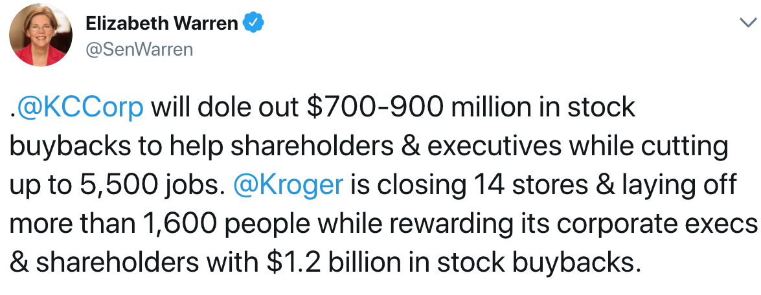
Political Concerns with Buybacks

Slide 31
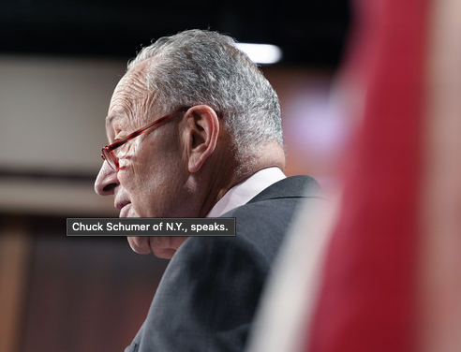
Political Concerns with Buybacks
“I hate stock buybacks,” Senate Majority Leader Chuck Schumer (D-N.Y.) said Friday. “I think they’re one of the most self-serving things that corporate America does. Instead of investing in workers and in training and in research and in equipment, they simply — they don’t do a thing to make their company better and they artificially raise the stock price by just reducing the number of shares.”
Politico (8/5/22)

Slide 32
Warren Buffet: 2022 Letter to Shareholders
A very minor gain in per-share intrinsic value took place in 2022 through Berkshire share repurchases as well as similar moves at Apple and American Express, both significant investees of ours. At Berkshire, we directly increased your interest in our unique collection of businesses by repurchasing 1.2% of the company’s outstanding shares. At Apple and Amex, repurchases increased Berkshire’s ownership a bit without any cost to us.
The math isn’t complicated: When the share count goes down, your interest in our many businesses goes up. Every small bit helps if repurchases are made at value-accretive prices. Just as surely, when a company overpays for repurchases, the continuing shareholders lose. At such times, gains flow only to the selling shareholders and to the friendly, but expensive, investment banker who recommended the foolish purchases. Gains from value-accretive repurchases, it should be emphasized, benefit all owners – in every respect. Imagine, if you will, three fully-informed shareholders of a local auto dealership, one of whom manages the business. Imagine, further, that one of the passive owners wishes to sell his interest back to the company at a price attractive to the two continuing shareholders. When completed, has this transaction harmed anyone? Is the manager somehow favored over the continuing passive owners? Has the public been hurt?
When you are told that all repurchases are harmful to shareholders or to the country, or particularly beneficial to CEOs, you are listening to either an economic illiterate or a silver-tongued demagogue (characters that are not mutually exclusive).

Slide 33
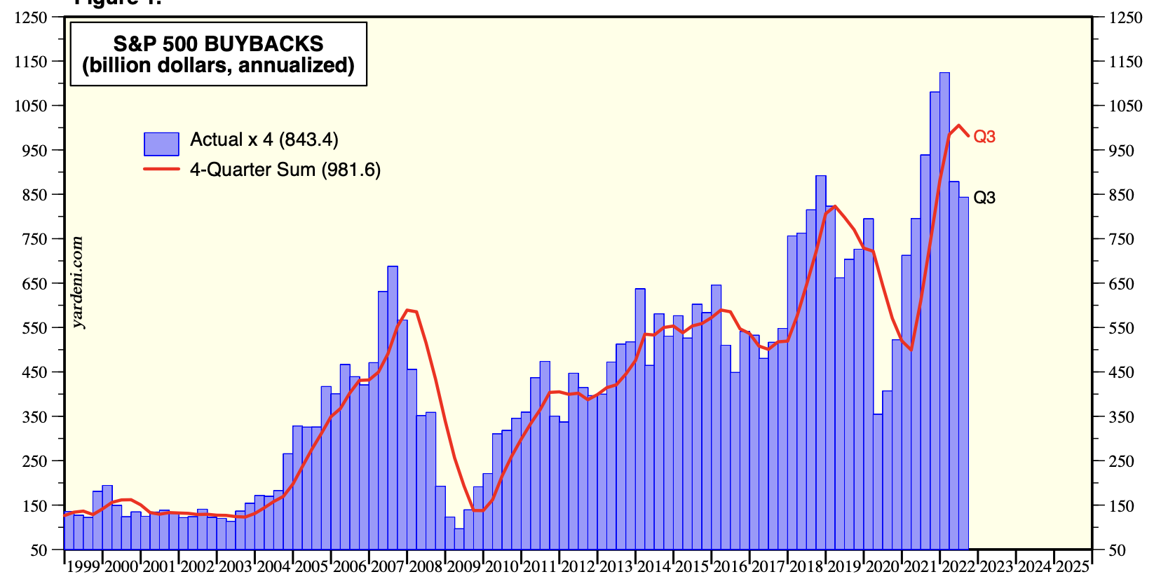
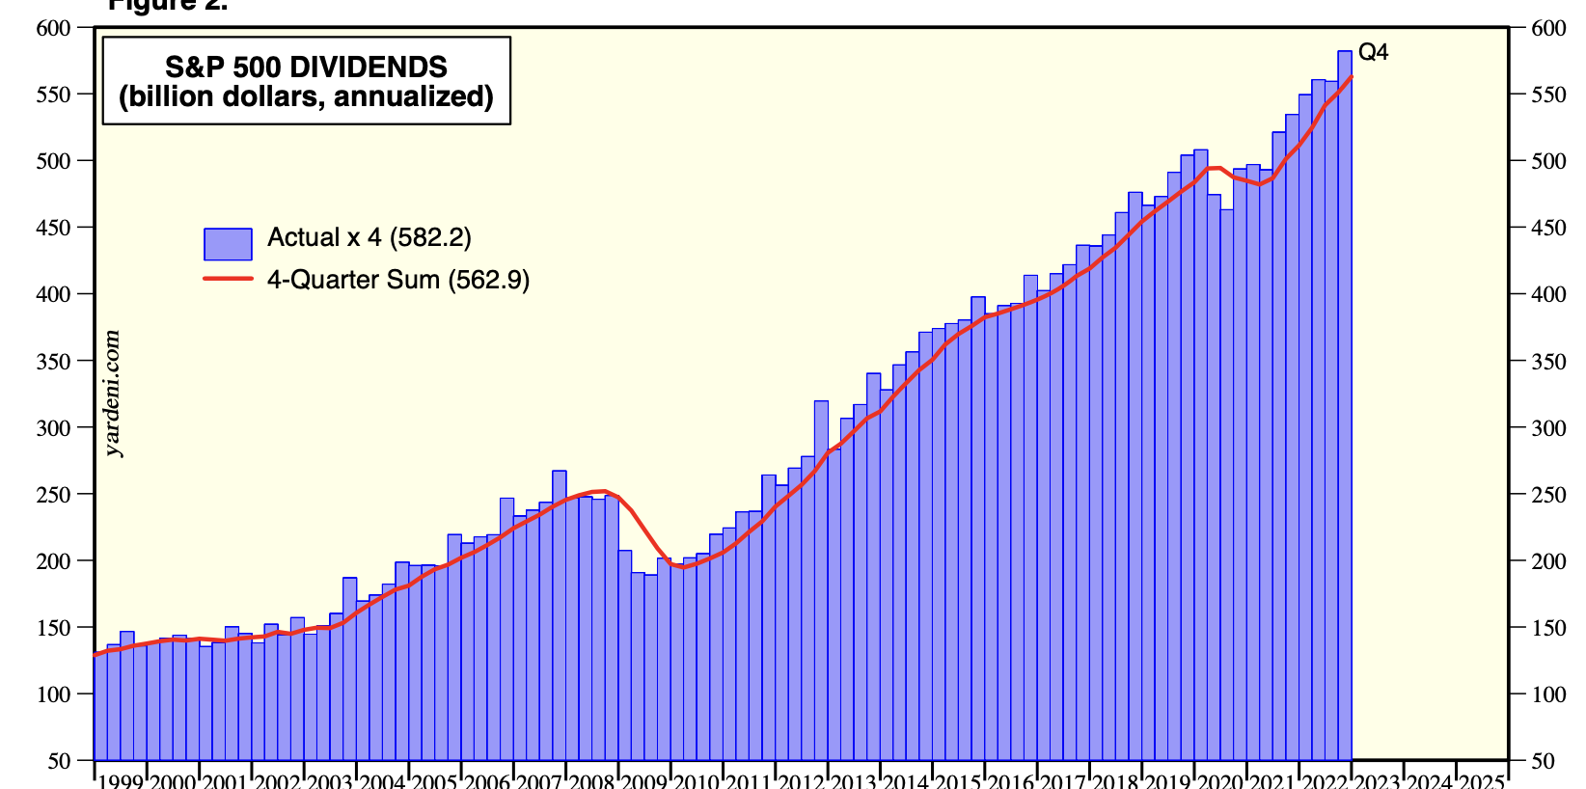
Buybacks and Dividends (1999-2025)
Buybacks
Dividends
Source: Yardeni, SP500 BBs and Divs (2/23/23)

Slide 34
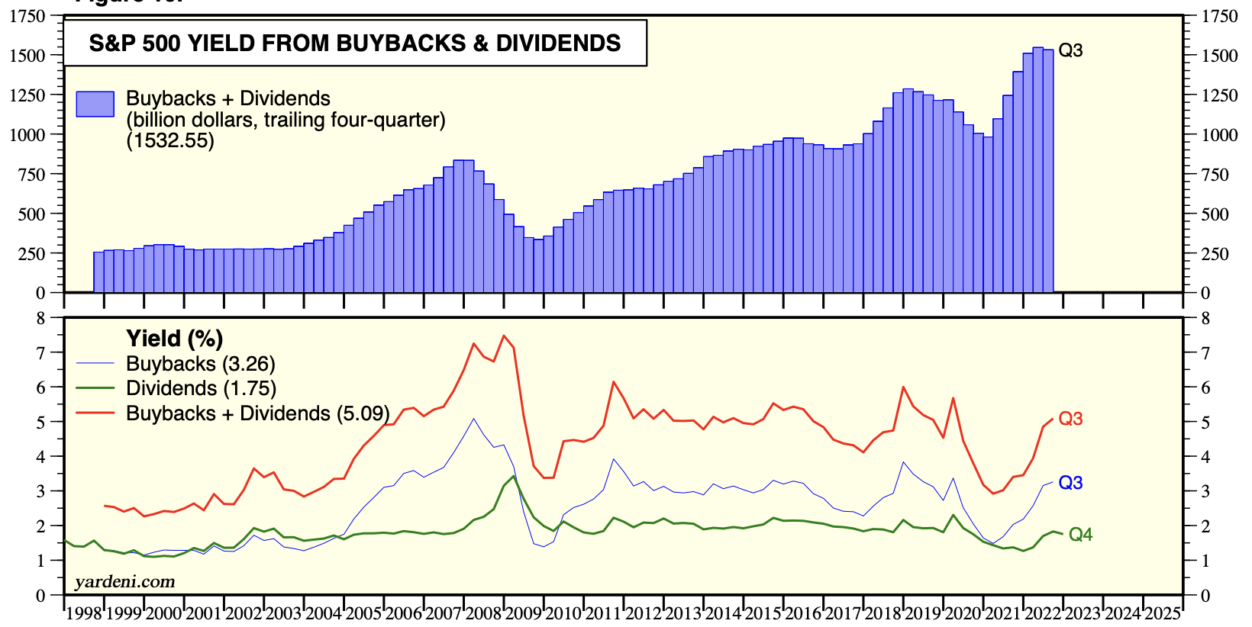
S&P 500 Yield from Buyback and Dividends
Source: Yardeni, SP500 BBs and Divs (2/23/23)

Slide 35
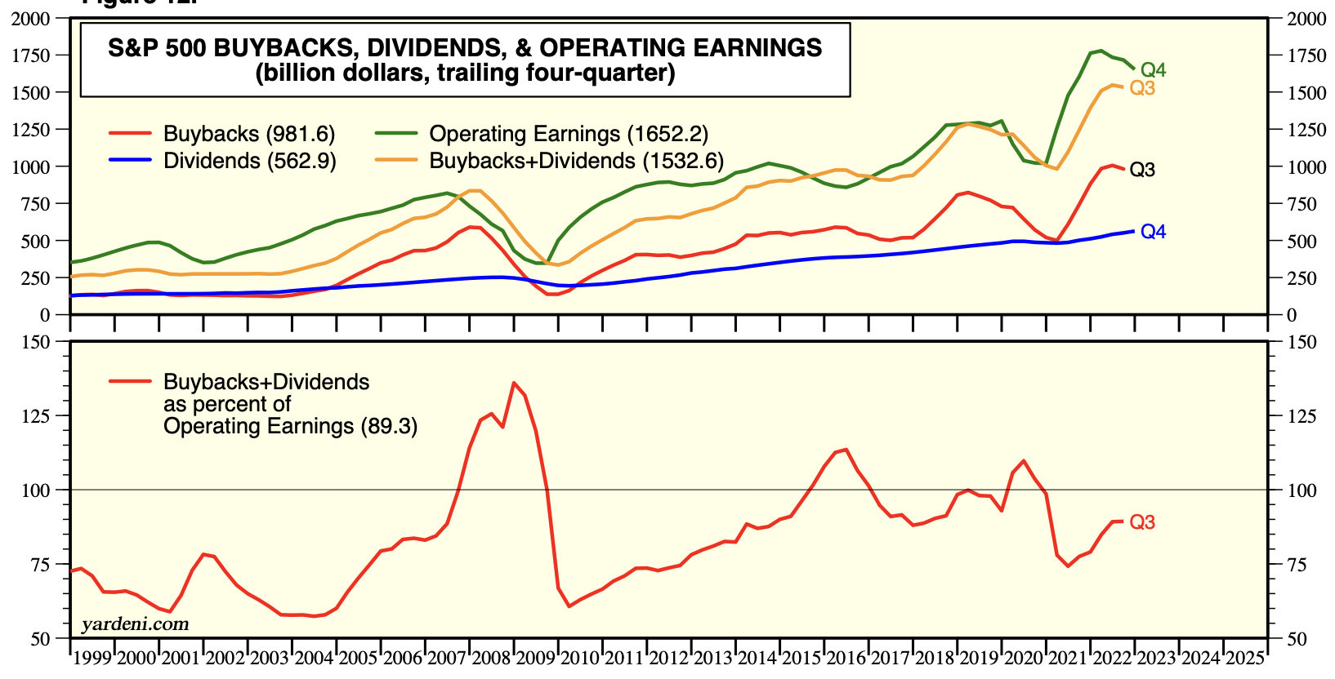
Buybacks and Dividends as a % of Operating Earnings
Source: Yardeni, SP500 BBs and Divs (2/23/23)

Slide 36
Stock Repurchases
Auction-based repurchase
Private negotiations
Open-market Repurchase (most common)
The company announces a new $20 billion share repurchase program to replace its existing authorization and expects to utilize the new authorization over an approximate two-year period. Walmart (Oct. 2017)
Rule 10b-18 Safe Harbor (very, very abbreviated)
Must purchase all shares from single broker on any single day
Limits on when during the day purchases can be made
Limits on the purchase price
Can’t exceed 25% of ADTV over prior 4 weeks
Where can you find information about share buybacks on the financials?

Slide 37
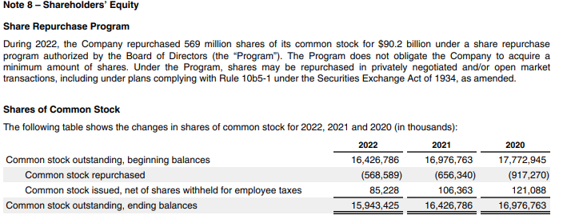
Apple FY 2022 10-K

Slide 38
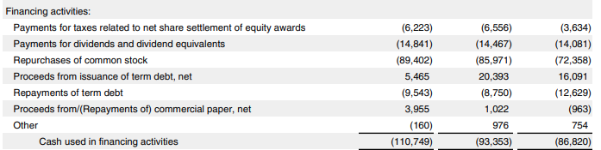
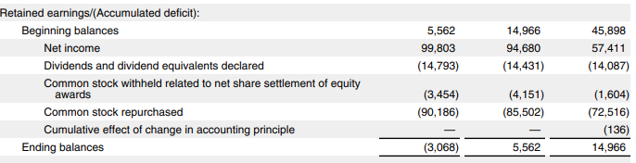
Apple FY 2022 10-K
Cash Flow Statement
Balance Sheet

Slide 39
Buybacks going up, up, up?
Source: Asness (2018)

Slide 40
Companies are selling assets to fund buybacks
Source: Asness (2018)

Slide 41
Companies are forgoing investments to fund buybacks

Slide 42
Naive Conceptions
Buybacks help remaining SHs because there are now fewer shares outstanding.
Only tendering SHs gain from share repurchases because they get the cash.
Consider the value of the firm and value of the remaining shares after a redemption:
(A) Firm is worth $100 with 10 shareholders each owning 1 share. The company repurchases 1 share for $10. Results to exiting SH and remaining SHs?
(B) Firm is worth $100 with 10 shareholders each owning 1 share. The company repurchases 1 share for $11. Results to exiting SH and remaining SHs?
(C) Firm is worth $100 with 10 shareholders each owning 1 share. The company repurchases 1 share for $9. Results to exiting SH and remaining SHs?

Slide 43
Naive Conceptions
Dividends don’t eat “investment substance” but selling shares does.
10 shares @ $10/share: Compare (1) $1 dividend/share & (2) sale of 1 share
Share repurchases increase EPS
Keep earnings constant, buy back shares, and voila, EPS up, up, up and price up, up, up

Slide 44
Dividends & Repurchases Issues
Signaling: Why might stock rise after a repurchase announcement?
Dividend smoothing
Firms are reluctant to cut dividends, so they prefer to slowly increase them over time
Earnings shocks are transitory, and firms would rather do a repurchase with these shocks
Executive stock options
Call options lose value after dividend payout, so executives/owners prefer repurchases
Executive ownership
Restricted stocks do not participate in repurchase offers so they get more of the company after a repurchase, but may not get dividends
Increased leverage to fund repurchases
Investor preferences
Behavioral finance demonstrates than unsophisticated small investors prefer dividends when it would have been more beneficial (tax shield) if they sold shares instead
Fund charter exclusion clauses
Institutional charters may restrict them to holding ONLY dividend paying stocks

