Slide 1
Corporate Taxation
Choice of Entity

Slide 2
LLC
C Corp
?
PSH
S Corp

Slide 3
Choice of Business Entity
Sole Proprietorship/Branch/Division
Partnership
  GP, LP, LLP, and LLLP
  LLC
Corporation
  Association
  Business Trust
Analysis:
  Is there a separate entity for federal tax purposes?
  Is the entity a SP/B/D, PSH, or Corp?

Slide 4
C Corp vs. Pass-through
Rate Comparison
  C Corp
    C Corp: 21% Corporate rate + 23.8% (CGs or dividends + 3.8% NII)
    New (post-2022 tax years): 15% Corporate Minimum Alternative Tax (CMAT) on large corporations based on financial statement income (book)
  Pass-through
    37% for operating income (individuals), but 29.6% for QBI (note, this rate doesn’t apply to CGs)
    3.8% for NII
    20% for qualified dividends and NCGs
Other considerations
  Deferral of SH-level tax
  Step-up basis at death of shares
  Investment of passive earnings by C Corp or SH
  Use of losses
  Qualified Small Business Stock exclusion (§1202)

Slide 5
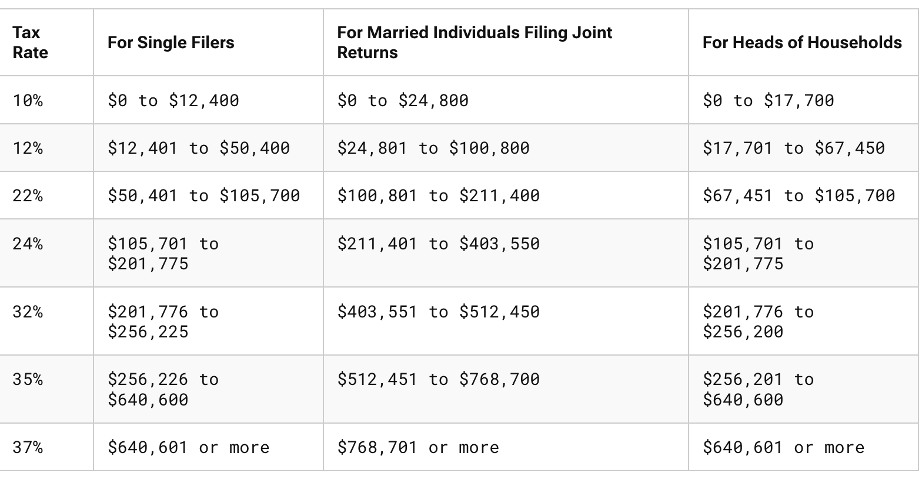
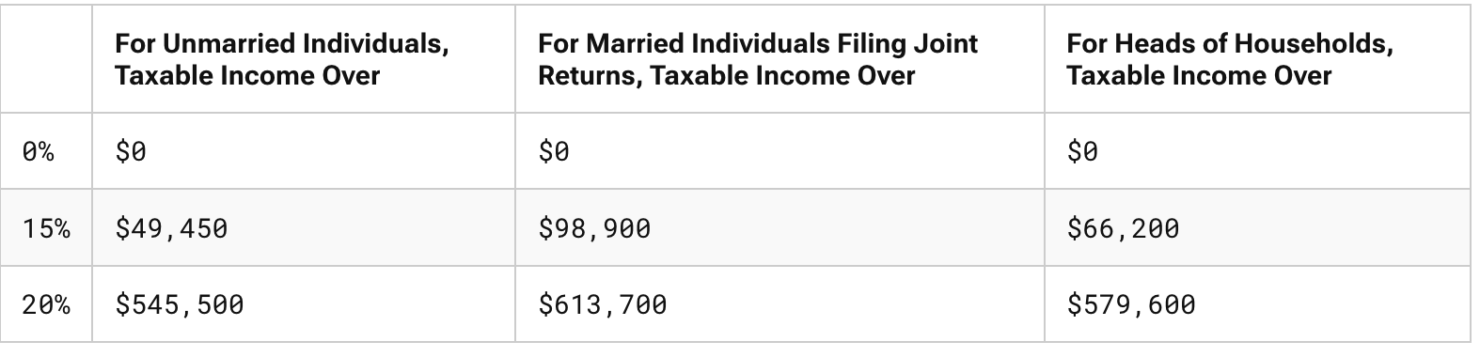

Rates for 2026
Capital Gains
QBI

Slide 6
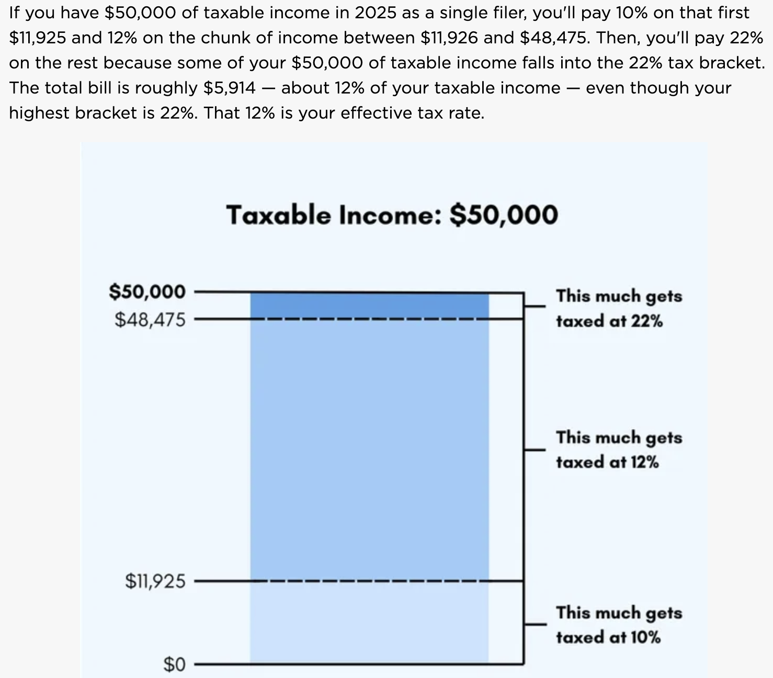
Marginal vs. Effective (Average) Tax Rates

Slide 7
Tax Differences: C, S, and K
 | C Corporations | S Corporations | Partnerships (GPs, LPs, LLCs)
Entity’s Income | Taxed to entity (21% max. rate) | Taxed to owners with basis adjustment (37% max rate; 29.6% if QBI) | Taxed to owners with basis adjustment (37% max rate; 29.6% if QBI)
Entity’s Losses | Deductible against corporate income; NOLs can offset 80% of TI and be carried forward indefinitely | Deductible by owners, limited by basis in stock; individual excess business loss subject to 250k/yr limitation | Deductible by owners; limited by basis in PSH; excess business loss subject to 250k/yr limitation
Distributions of $ | Taxed to SHs to extent of E&Ps, return of basis, and then gain; Qualified dividends taxed at 20% max + 3.8% NII | No taxation; reduction of basis and then gain | No taxation; reduction of basis and then gain
Distributions of Property | Gain but not loss recognized; taxed to SHs as dividend to extent of FMV | Gain but not loss recognized | No G/L to PSH; CO basis to Ps
Transfer of Equity Interests | Capital G/L | Capital G/L | Capital G/L with look-through to extent of OI assets; can elect to adjust basis of PSH property

Slide 8
Tax Differences: C, S, and K
 | C Corporations | S Corporations | Partnerships (GPs, LPs, LLCs)
Mergers with Corporations | Tax-free | Tax-free | Can’t undertake tax-free reorg with corporation
Classes of Equity Interests and Maximum # of Owners | No limitation; no maximum | One class of stock; 100 maximum | No limitation; no max, but minimum of 2
Foreign Owners | Eligible | Not Eligible | Eligible
Tax-exempt Owners | Eligible; dividends not subject to UBIT | Generally not eligible except charitable organizations and retirement plans; income is UBIT | Eligible, but subject to UBIT
Source: JCT-71-15

Slide 9
Comparison of AT-Returns for C Corporation and S Corp/PSH
 |  | Choice of Entity Examples Assumptions
Ret PSH | 10% |  | Tax SH/P OI | 37.0%
Ret Corp | 10% |  | Tax SH/P Div | 23.8%
Tax Corp | 21% |  | Tax SH/P CG | 23.8%
Amount Invested | 10,000 |  | Tax SH/P 199A | 29.6%
 | Pass-through vs. C Corporation: One Period
 |  |  |  | C Corporation | S Corp/ PSH w/ 199A | S Corp/ PSH w/out 199A
1 | Pre-Tax Income |  |  | 1,000.00 | 1,000.00 | 1,000.00
2 | Corp / (SH or P) Tax |  |  | (210.00) | (296.00) | (370.00)
3 | After-Tax Income |  |  | 790.00 | 704.00 | 630.00
4 | Tax on Distribution of AT Earnings |  |  | (188.02) | 0.00 | 0.00
5 | Net Amount to C or P: [1+2+4] |  |  | 601.98 | 704.00 | 630.00
6 | Effective Tax Rate [(PT Inc - AT Inc) / PT Inc] |  |  | 39.80% | 29.60% | 37.00%
https://bit.ly/2F2KsbX

Slide 10
Partnership vs. Corporation
If T_{C}=T_{P} and T_{CG}=0, neither dominates
If T_{C}=T_{P} and T_{CG}>0, PSH dominates
If T_{C}<T_{P} and T_{CG}=0, Corporation dominates
If T_{C}<T_{P} and T_{CG}>0, no clear preference

Slide 11
Comparison of AT-Returns for C Corp and S Corp/PSH: The Benefits of Deferral
Investment at T₀ of 10K generating a pre-tax return of 10%, which is reinvested
Pass-through vs. C Corporation: Benefits of Deferral (AT Returns are Reinvested and then Liquidated)
 |  |  | C Corporation | S Corp/PSH w/ 199A | S Corp/PSH w/out 199A
 |  | 5 | 13,525 | 14,052 | 13,573
 |  | 10 | 18,679 | 19,745 | 18,422
 | Year of | 15 | 26,218 | 27,745 | 25,003
 | Liquidation | 25 | 53,371 | 54,784 | 46,061
 |  | 35 | 111,450 | 108,172 | 84,852
 |  | 45 | 235,683 | 213,587 | 156,314
 |  | 50 | 343,594 | 300,127 | 212,160
https://bit.ly/2F2KsbX

Slide 12
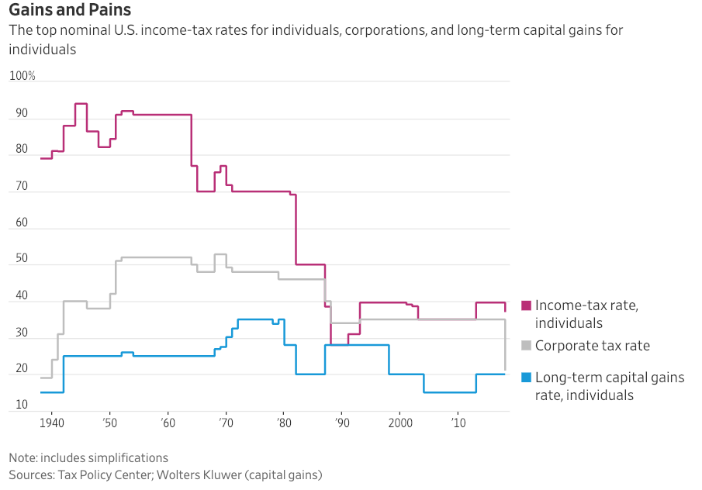
Marginal Tax Rates

Slide 13
Section 199A: Ugh
20% deduction of a non-corporate taxpayer’s Qualified Business Income Amount (QBIA)
QBIA: the lesser of:
  (A) 20% of QBI with respect to the QT/B, or
  the greater of
  (B)(i) 50% of the W-2 wages of the QT/B, or
  (B)(ii) Sum of 25% W-2 wages PLUS 2.5% of the unadjusted basis immediately after acquisition of all qualified property. §199A(b)(2).
  The (B) limit doesn’t apply if the taxpayer’s income is less than $201,775 ($403,500) (inflation adjusted for 2026 with phaseouts of 75K and 150K)
QT/B: Any business except the T/B of being an employee, and: health, law, accounting, actuarial science, performing arts, consulting, athletics, financial service, brokerage services, or any T/b where the principal assets of the T/B is the reputation or skill of 1 or more of its employees;
  Scope of “principal assets of the T/B is the reputation or skill…”? See Reg. §1.199A-5(b)(2)(xiv)
  Exception for specified service business: If the taxpayer’s income is less than $182,100 ($364,200) (2026), a specified service, e.g., law, will be treated as a QT/B. §199A(d)(3)(A).

Slide 14
Choice of Business Entity
Sole Proprietorship/Branch/Division
Partnership
  GP, LP, LLP, and LLLP
  LLC
Corporation
  Association
  Business Trust
Analysis:
  Is there a separate entity for federal tax purposes?
  Is the entity a SP/B/D, PSH, or Corp?

Slide 15
CTB Regs: Business Entity
Any entity recognized for federal tax purposes (including a single member entity (“SME”)) that is not a trust or subject to special treatment under the IRC
Business Entity with 2 or more members
  Corporation, or
  Partnership
Business Entity with 1 member (SME)
  Disregarded Entity (“tax nothing”), or
  Corporation. Reg. §301.7701-2(a).

Slide 16
CTB Regs: Eligible Entity
Business entity not classified as a corporation—an Eligible Entity (“EE”)—can choose its tax status √
  EE with two or more members is either an association or a PSH
  EE with one member (“SME”) is either:
    Association, or
    disregarded entity (sole proprietorship, branch, division) (-2(a))
Default classification for domestic EE:
  PSH if 2 or more members
  Disregarded entity if single owner (-3(b))

Slide 17
CTB Regs: Corporation Defined
Federal law controls, but legal relations governed by state law
  Entity organized pursuant to state corporate statutes
  Certain foreign entities are per se corporations:
    Sociedad Anónima (SA)
    Societe Anonyme (SA)
    Public Limited Company
    Aktiengesellschaft (AG)
    Gufen Youxian Gongsi
    Societas Europaea (-2(b)(8))
  Insurance companies
  Associations. §7701(a)(3); Reg. §301.7701-2(b)

Slide 18
CTB Regs: Election
EE can elect √ alternate tax status:
  EE with 2 or more members can elect to be taxed as an association (corporation)
  SME can elect to be taxed as an association
  Form 8832 (-3(c))

Slide 19
CTB Regs: Default Classification of Foreign Eligible Entities
PSH if two or more members and at least one member doesn’t have limited liability
Association if all members have limited liability
DRE if single owner who does not have limited liability
Liability determined under foreign law or organizational documents (-3(b)(2))

Slide 20
CTB Regs: Election
Effective date: dated listed on Form 8832 or filing date, but
  Not more than 75 days prior to filing date, or
  Not more than 12 months after filing date. (-3(c)(1)(iii))
Relief for Late Filing: Rev. Proc. 2013-30
  New entity can request relief for late filing if election filed by return due date
An EE that changes its classification cannot change its classification again during the next 60 months, except if there is a >50% change in ownership and CIR consents.
  An initial election is not considered a change. (-3(c)(1)(iv))

Slide 21
CTB Regs: Classification Changes
PHS->Association: PSH contributes A&L to Assoc. in exchange for stock and the PSH liquidates
Association->PSH: Association distributes assets to SHs, and SHs contribute A&L to new PSH
Association->DRE: Association liquidates and distributes A&L to single owner
DRE->Association: Owner of DRE contributes all A&L to the Assoc. in exchange for stock (-3(g))
Rev. Rul. 2004-59: Conversion of PSH into Corp pursuant to state law not requiring transfer of A&L—formless conversion—treated as contribution of assets to new Corp, liquidation of PSH, and distribution of stock by PSH to Ps.
Change in Number of Members (-3(f))
  PSH->DRE: Rev. Rul. 99-6
  DRE->PSH: Rev. Rul. 99-5

Slide 22
Graphical Representations of Entities
Corp
DRE
Corp
Branch
LLC
Hybrid
PSH
Reverse
Hybrid
Hybrid: Passthrough under US law; corp under foreign law
Reverse Hybrid: Corp under US law; passthrough under foreign law

Slide 23
Publicly Traded Partnerships (PTPs/MLPs)
Some publicly traded Corporations switched to PSH status in the early ‘80s.
  Why? See Historical marginal tax rate chart.
  After 2017, how does the analysis change?
What was the concern of Congress?
Under §7704, PTPs generally taxed as corporations (§7704(a))
Publicly Traded Partnership:
  Traded on established securities market
  Readily tradable on a secondary market (or substantial equivalent)
  Various Exceptions (Safe harbors)
    Private transfers (family transfers, death)
    Certain redemptions/repurchases
    Private placements. Reg. §1.7704-1

Slide 24
Publicly Traded Partnerships (PTPs/MLPs)
Passive Income Exception
  PTP not taxed as Corp if ≥ 90% of its gross income is “qualifying income”, such as
    Dividends, Interest, Gains from Stock and Bond Sales, Swap Income (NPC)
    Real Property Rents and Gains
    Income from the production of natural resources (§7704(c))
    Interest derived from conduct of financial or insurance business excluded (§7704(c)(2))
    QI does NOT include income from services
  QI exception does not apply to any PSH that would be subject to the ‘40 Act if it were a corporation (§7704(c)(3))
A list of current MLPs
Why are some MLPs converting to C Corps after the TCJA? See article on class web site.

