Slide 1
Federal Income Taxation Capital Expenditures and Expenses
Prof. Colon
Spring 2025

Slide 2
Capital Expenditures vs Expenses
Capital expenditures are generally not currently deductible (§263(a))
May be recovered through depreciation if the property is a wasting asset, e.g., building
Expenses (T/B or investment) are generally currently deductible (§§162(a) and 212, but §212 is suspended through 2025)
Importance of the distinction:
Timing (TVM): cash outlay today, deduction benefit tomorrow, etc.
Pillar distinction between income tax (investment and return taxed) and consumption tax (return not taxed)
Tax arbitrage looms large, especially when debt (interest deduction) is considered

Slide 3
Intangibles
Indopco, Inc. v. CIR, 503 U.S. 79 (1992)
In connection with a partially taxable acquisition of National Starch (renamed Indopco), National Starch paid:
Morgan Stanley $2.2MM (fee, fairness opinion, out-of-pocket expenses, and legal fees)
Debevoise $505K (legal fees and out-of-pocket expenses)
Misc. fees of $150K (accounting, printing, SEC fees)
Issue: were payments deductible under §162(a) as ordinary and necessary expenses or required to be capitalized under §263(a)(1)?
CIR v. Lincoln Savings (1971): FSLIC premiums, which created or enhanced a separate and distinct asset, had to be capitalized.
Query: according to the court, what were the substantial future benefits to National Starch of the acquisition?
Under Indopco, how should advertising costs be treated? See Rev. Rul. 92-80

Slide 4
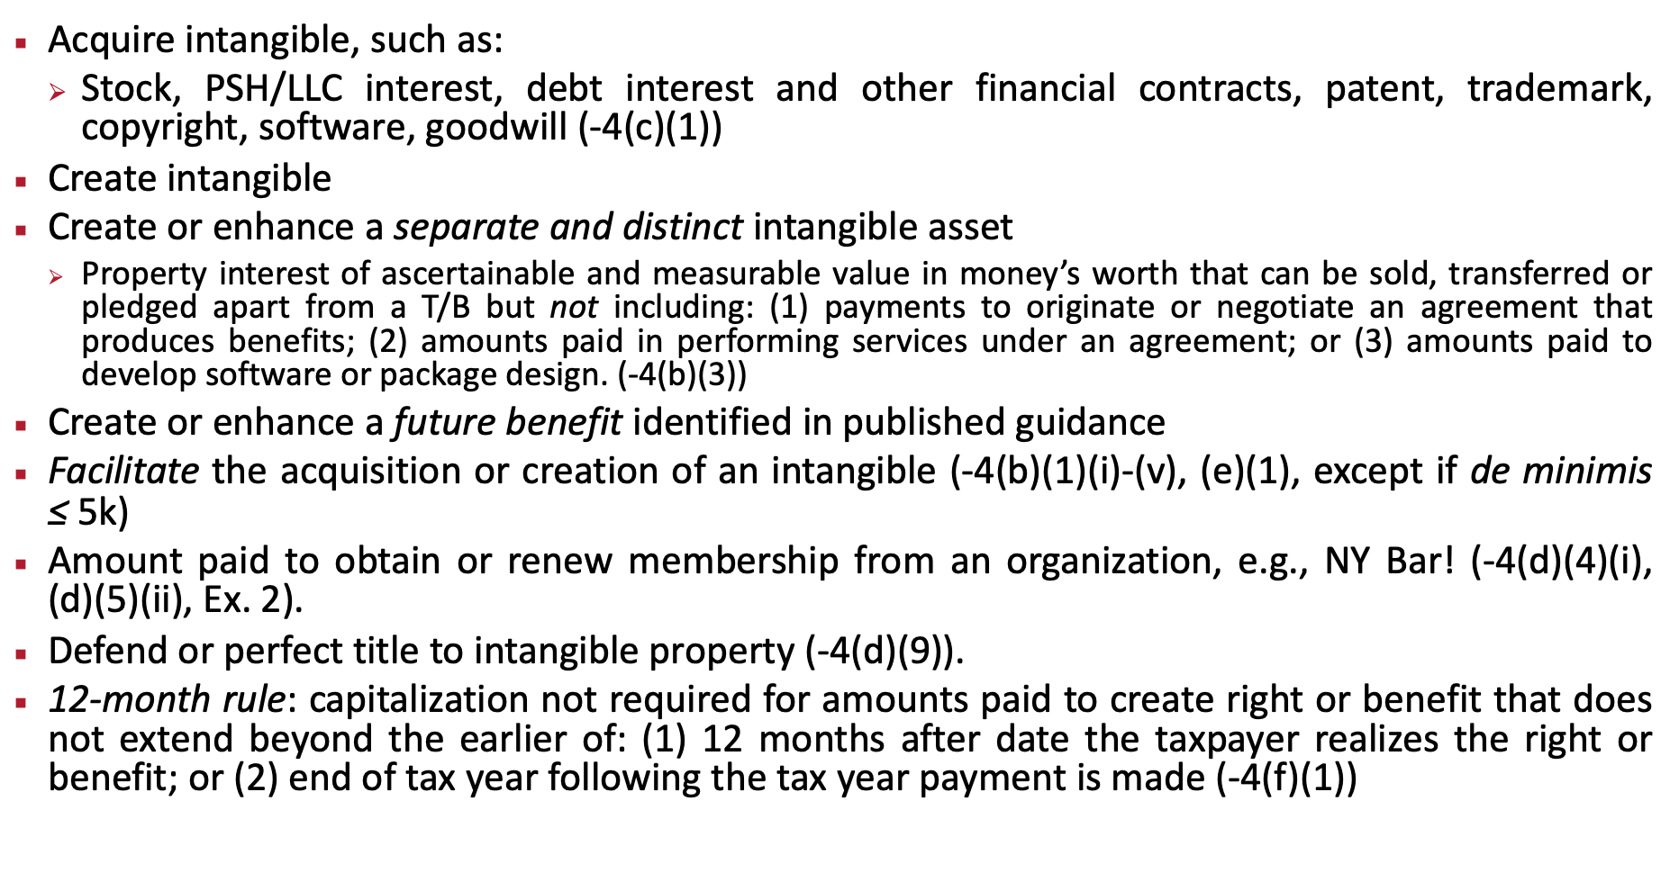
Capitalization of Intangibles: Reg. §1.263(a)-4
Acquire intangible, such as:
Stock, PSH/LLC interest, debt interest and other financial contracts, patent, trademark, copyright, software, goodwill (-4(c)(1))
Create intangible
Create or enhance a separate and distinct intangible asset
Property interest of ascertainable and measurable value in money’s worth that can be sold, transferred or pledged apart from a T/B but not including: (1) payments to originate or negotiate an agreement that produces benefits; (2) amounts paid in performing services under an agreement; or (3) amounts paid to develop software or package design. (-4(b)(3))
Create or enhance a future benefit identified in published guidance
Facilitate the acquisition or creation of an intangible (-4(b)(1)(i)-(v), (e)(1), except if de minimis ≤ 5k)
Amount paid to obtain or renew membership from an organization, e.g., NY Bar! (-4(d)(4)(i), (d)(5)(ii), Ex. 2).
Defend or perfect title to intangible property (-4(d)(9)).
12-month rule: capitalization not required for amounts paid to create right or benefit that does not extend beyond the earlier of: (1) 12 months after date the taxpayer realizes the right or benefit; or (2) end of tax year following the tax year payment is made (-4(f)(1))

Slide 5
Capitalization of Intangibles: Reg. §1.263(a)-5
Capitalization required for amounts paid to facilitate:
Acquisition of a T/B (whether acquiror or target)
Restructuring, recapitalization, or reorganization
Acquisition of ownership interest in the taxpayer
A capital contribution to a corporation or partnership/LLC
Formation or organization of disregarded entity
Stock issuance
A borrowing (-5(a)(1)-(10))
Facilitate: amount paid in the process of investigating or otherwise pursuing the transaction. (-5(b)(1))

Slide 6
Capitalization of Tangible Assets: Reg. §1.263(a)-2
Amounts paid to purchase buildings, permanently improve, or restore real estate (-2(d)(1))
Amounts paid to acquire personal tangible property, such as equipment, machinery (-2(d)(1))
Amounts paid to facilitate the acquisition of real/personal property if paid to investigate or otherwise pursue the acquisition, such as appraisal, application fees, finders’ or brokers’ commissions, and architectural services (-2(f)(1) and (2)), but not employee compensation, unless an election is made. (-2(f)(2)(iv)(A) and (B))
Doesn’t include costs incurred in deciding whether to purchases real property & which real property to purchase (whether and which rule) (-2(f)(2)(iii))
Defense or perfection of title to property (-2(e)(1))

Slide 7
De Minimis Amounts for Tangible Property: Reg. §1.263(a)-1(f)
Taxpayers with an applicable financial statement can elect to deduct amounts to acquire, produce, or improve tangible property if:
Taxpayer has accounting procedures treating outlays (1) costing less than a stipulated amount; or (2) have economic useful life of 12 month or less for nontax purposes;
Outlays is treated as expense on its AFS; and
Amount does not exceed $5K per invoice or per item. (-1(f)(1)(i))
AFS: required to be submitted to SEC; audited financial statement used to report to SHs or Ps; or required to be submitted to state or Federal government (-1(f)(4))
If no AFS, amount is limited to $2.5K per item or invoice, and taxpayer must record as current expense on nontax books and records. (-1(f)(1)(ii))
If TP doesn’t elect de minimis safe harbor, TP can deduct materials and supplies under Reg. §1.162-3(c).

Slide 8
The Big Battle: Repairs vs. Improvements of Tangible Property (Reg. § 1.263(a)-3))
Amounts paid to:
Improve a unit of property must be capitalized §263
Repair property—necessitated by normal wear and tear--can be deducted under §162
Improvements
Betterment to the property:
Ameliorates material condition/defect that existed prior to acquisition of the property
Material addition (enlargement, expansion, extension, capacity)
Expected to materially increase productivity, efficiency, strength, output of unit of property (-3(j)(1))
Restore the property
Replacement of component of property that TP deducted for a loss (also casualty loss)
Replacement of component that TP has properly taken into account the AB in realizing G/L
Returns property to ordinarily efficient operating condition if property no longer functional for intended use
Rebuilding property to like-new condition after end of its class life.
Replacement of part that comprises a major component or substantial structural part. (-3(k)(1))
Adapt the property to a new or different use if adaptation is not consistent with TP’s ordinary use of the property when placed in service. (-3(l)(1).

Slide 9
The Big Battle: Repairs vs. Improvements of Tangible Property (Reg. §1.263(a)-3))
Routine maintenance safe harbor
Recurring activities to keep building structure (building system) in ordinarily efficient operating condition. (-3(i)(1)(i)).
Small business safe harbor for building:
TP can elect to deduct improvements if total amount paid for repairs, maintenance, improvement doesn’t exceed the lesser of ($10K) or 2% of the AB of the building.
Eligible building property must have unadjusted basis of $1MM or less. (-3(h)(1) and (4))

Slide 10
CIR v. Idaho Power Co., 418 U.S. 1 (1974)
Idaho Power owned automotive transportation equipment used to operate, maintain and construct capital facilities.
Idaho Power claimed separate depreciation of the equipment based on a useful life 10 years, which is much less than the useful life of a power line and related facilities.
Issue: “Issue comes down to a question of timing”
Asset used to further TP’s day-to-day business operations (deduction), or
Consumption of asset takes place in the construction of other assets that will produce income (capitalized as part of cost of acquiring income producing asset)
Section 263A
Applies to all real or tangible personal property produced by the TP.
Generally requires direct costs and allocable shares of indirect costs to be capitalized into produced property, with some exceptions, e.g. qualified creative expense incurred by writers, photographers, and artists.
Indirect costs: interest, labor costs, storage costs, depreciation, rents, sales & property taxes, with some exceptions, e.g., R&E expenses and amounts deductible under §179.

Slide 11
Section 263A

