Slide 1
Federal Income Taxation Capital Gains and Losses
Prof. Colon
Spring 2025

Slide 2
Gains and Losses
Analyzing S/X of Property
Realized G/L = amount realized (AR) minus adjusted basis (AB)
Is realized gain recognized and included in GI under §61(a)(3) or does a nonrecognition provision (e.g., §§1031, 1033) apply?
Is realized loss recognized and does it reduce GI under §§62(a)(3) and 165(c)?
What is the character, capital, ordinary or §1231 G/L, of the recognized gains or losses?

Slide 3
Gains and Losses: Overview
If a TP has a net capital gain (NCG), it is taxed at preferential rates under §1(h).🌟
If a TP has a capital loss, it may be limited under §1211(b)
Capital gains and losses generally arise from the S/X of a capital asset. §1222(1)-(4).
Short-term CG/L: asset held from one year or less
Long-term CG/L: asset held for more than one year

Slide 4
Capital Losses
If CLs exceed CGs (Net Capital Loss), under §1211(b), the CLs (ST or LT) are deductible only to the extent of the CGs (ST or LT) plus $3,000.
This deduction is above the line.
Any excess CLs can be carried and used in a subsequent year under §1212(b) or until the TP dies.
Why is there a limitation on the use of CLs?
Consider (1) the realization requirement; and (2) the favorable taxation of NCGs
Section 1212(b) provides rules for the nature of the losses (ST or LT) that can be carried over to subsequent years. Not on the exam.

Slide 5
Economic Depreciation in a Realization-based Income Tax
CFCT: cost of business/investment property deductible in the year purchased
Income Tax: No deduction because no decrease in wealth (merely changed form) but basis is created.
Different strands of a property’s value
Change in supply/demand
Interest rates
One strand of value produces a loss: If the asset wastes away over time from use in an income producing activity. Note, value of asset may change (increase) because of the change in the other strands of value.

Slide 6
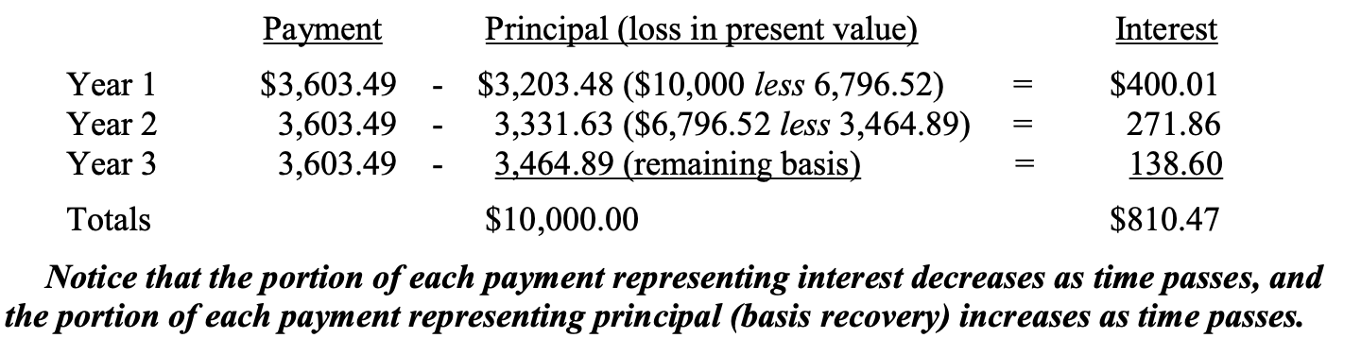
Economic Depreciation in a Realization-based Income Tax
Example (p. 366): TP purchases machine for 10K and expects to earn back the cost of the machine plus 4% profit. TP believes that the machine will be worthless after 3 years, and TP expects to earn about 3.606 in gross receipts annually from use of the machine.
How should TP recover the 10K cost of the machine?
Recall our examination of the repayment of 10K of debt at 4% with 3 annual payments of 3.6K in Ch. 9, where we determined how much of each payment is principal & int.
Note: For debt, only interest is taxable; for machine, all GI taxable w/ a deduction for depreciation.

Slide 7
Economic Depreciation vs. Depreciation under §§167, 168, 179, and 197
Economic depreciation is generally much slow than depreciation allowed under §§167, 168, 179, and 197.
Accelerated depreciation is a CFCT feature of our income tax system, because it allows the deduction of basis before economic loss, thus permitting a portion of the investment’s return to be earned on pre-tax dollars.
Query: who captures this benefit? Buyers of investment property or sellers?
The JCT consider accelerated depreciation to be a tax expenditure:
The Joint Committee staff generally classifies as tax expenditures cost recovery allowances that are more favorable than those provided under the alternative depreciation system (sec. 168(g)), which provides for straight-line recovery over tax lives that are longer than those permitted under the accelerated system.

Slide 8

Section 167 and “Wear and Tear”
Under §167(a), a depreciation deduction is allowed for “exhaustion, wear and tear” of property used in the T/B or held for the production of income.
Inventory, personal residences, personal cars, and land, for example, are not depreciable
Section 167 permits depreciation, but the specific rules for the timing and amount are found in:
§168 (tangible property)
§§167 & 197 (intangible property)
§179 (certain business property)
Simon v. CIR, 103 T.C. 247 (1994), aff’d, F.3d 41 (2d Cir. 1995)
Is a 200-year bow subject to wear & tear?

Slide 9
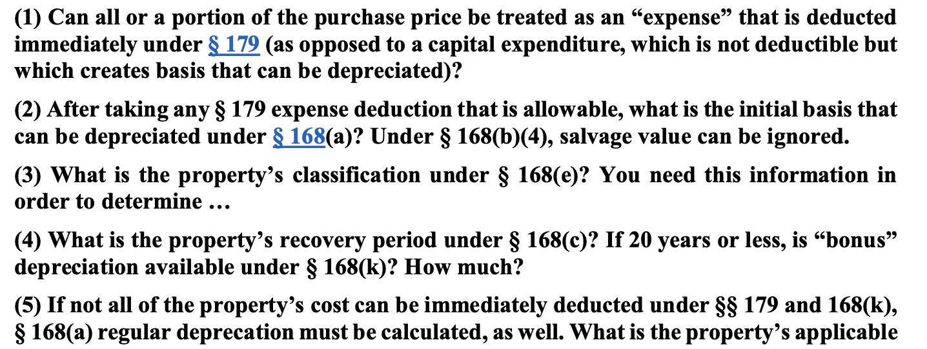
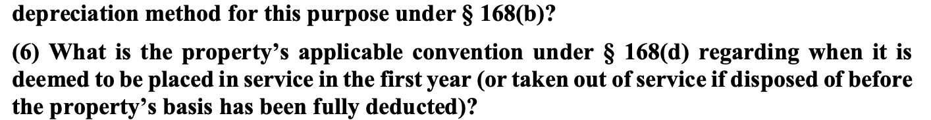
Depreciation of Tangible Assets

Slide 10
Depreciation of Tangible Assets: Section 179
Section 179 allows a TP to elect to immediately expense §179 property placed in service. §179(a).
Limits:
For 2025, the total cost that can be expensed under §179 is 1.25MM
The 1.25MM limit is reduced by the excess of §179 property placed into service over 3.13MM.
The §179 deduction is limited to the taxable income of the TP’s trade or business. §179(b)(1), (2) and (3).
§179 property:
Tangible property, computer software, section 1245 property (personal property), and certain improvements to nonresidential real property, such as roofs, AC, heating, and ventilation. §179(d)(1) and (e).

Slide 11
Section 168 Depreciation: Recovery Period
To the extent that a TP either does not elect §179 or has additional remaining basis of purchased property after the application of §179, the remaining basis (capital expenditure) can be depreciated under §168.
The first step is to determine the property’s classification under §168(e), such as 3-year property, 20-year property, residential rental property or nonresidential property, etc.
Certain property is classified under the statute, but for property that’s not listed, the IRS provides class life classification.
Residential rental property 27.5 years; Nonresidential rental property: 39 years
If a property doesn’t have a class life, it is treated as 7-year property. §168(e)(3)(C)(v).
Once the property’s classification (class life) is determined, then the TP must determine its recovery period under §168(c). For example, 5-year property is depreciable over 5 years.

Slide 12
Section 168(k): Bonus Depreciation
If the depreciable property has a recovery period of 20 years or less, is computer software, water utility property, qualified firm or television production, or qualified live theatrical production, additional bonus depreciation can be taken in the year in which the property is placed into service. §168(k)(1) and (2).
The property’s basis reduced by the bonus depreciation before computing any allowable depreciation. §168(g)(1)(B).
Bonus depreciation for 2025 is 40% (from 2017 through 2022, it was 100%!). §168(k)(6).

Slide 13
Bonus Depreciation is Coming Back!
President Trump meant to call for 100 percent bonus depreciation when discussing a return to “100 percent expensing” during a speech to Congress, a White House official has told Tax Notes.
The official, speaking on the condition of anonymity, said Trump’s allusion to cutting taxes on “domestic production and all manufacturing” in his March 4 address to a joint session of Congress was an indication he was referring to bonus depreciation on property rather than expensing on investments in areas such as research and development.
“I interpreted the statement in the address last night to be 100 percent bonus depreciation . . . the focus was on equipment cost recovery,” the official said.

Slide 14
Section 168(b): Depreciation Methods
200% declining balance method
generally applies to 3, 5, 7, 10-year property
150% declining balance method
generally applies to 15, 20-year property
Straight-line method
generally applies to nonresidential real property and residential rental property
Under both the 200% and 150% DBMs, the TP switches to SL when it is greater than the accelerated methods.

Slide 15
Section 168(b): Applicable Conventions
The applicable convention ignores the exact date the property is placed into service and treats property as being played into service:
At the mid-point of the year (half-year convention)
At the mid-point of the month (mid-month convention)
At the mid-point of the quarter (mid-quarter convention). §168(d)(1)-(4)
The applicable convention for most property is the half-year convention, but nonresidential RP and residential rental property is mid-month. §168(d)(1) and (2).
For example: For half-year convention property, the TP’s depreciation deduction for Y1 is ½ of the year’s depreciation. Note, this rule also applies for the year of sale or disposition.

Slide 16
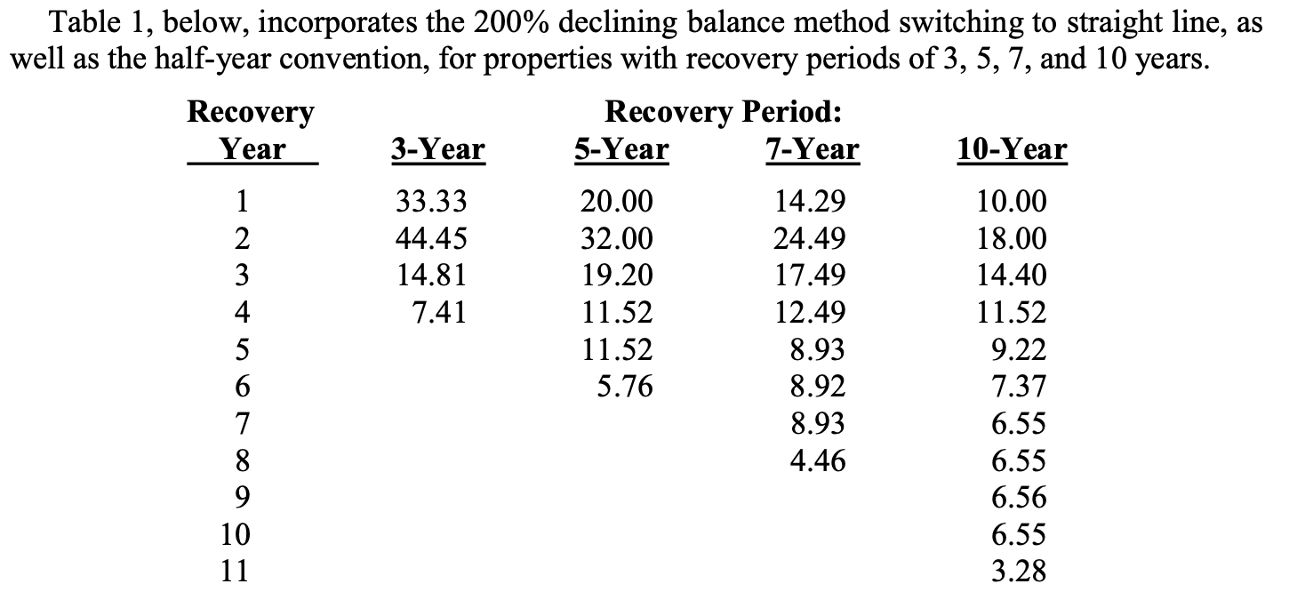
Section 168(b): Depreciation Tables

Slide 17
Depreciation and Basis
Section 179 is elective, but §168 is not
TP is presumed to take bonus depreciation, unless TP elects out. §168(k)(7)
§1016(a)(2) requires a TP to reduce to the basis of property by depreciation allowed…but not less than the depreciation allowable.1
Allowed: depreciation actually taken
Allowable: deprecation that could have been taken but wasn’t
Why would a TP want to delay a depreciation deduction?

Slide 18
Depreciation: Real Estate
RE is not eligible for §179 (not §1245 property) or bonus depreciation under §168(k) (recovery period exceeds 20 years)
Residential real property: building structure if 80% or more of gross rental income is rental income from dwelling units. §168(e)(2)(A). Doesn’t include a hotel, motel, or Holiday Inn
Recovery period is 27.5 years with a mid-month convention
Nonresidential real property: RP that is not residential RP or property w/ a class life less than 27.5 years.
Recovery period is 39 years with a mid-month convention

Slide 19
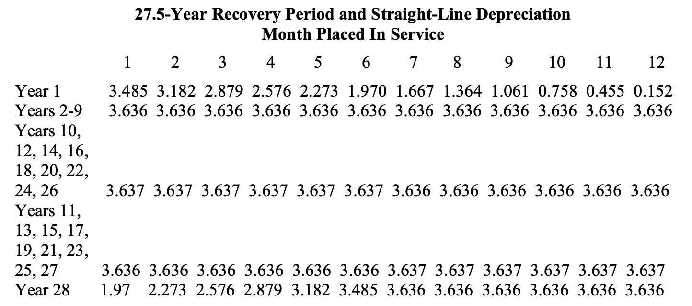
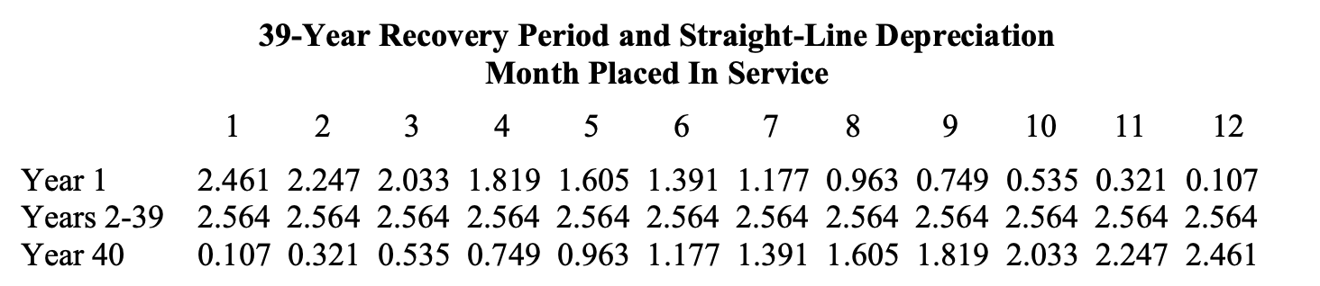
Depreciation: Real Estate

Slide 20
Section 280F Limitations
Goal: limit §§179 and 168 in the case of luxury automobiles, but it applies to passenger automobiles, which is defined to be any 4-wheeled vehicle for public street use weighing 6,000 pounds or less. §280F(a)(1) and (d)(5).
The limits in §280F for passenger automobiles is increased by 8,000 for bonus depreciation. 168(k)(2)(B)
In addition, §280F also applies to listed property, which is passenger automobiles, any other property used for transportation, property used for entertainment, recreation, or amusement. §280F(d)(4)(A).
If an automobile is used partially for personal use and partially for business use, the depreciation deduction is proportionately reduced. §280F(a)(2).
If business usage does not exceed 50%, the §168 depreciation schedule is straight line and thus no bonus depreciation. §280F(b)(1).
Under §179(b)(5), for purposes of §179, the cost of any SUV that can be taken into account under §179 is $31,300 for 2025, provided that it is not subject to §280F and weighs less than 14,000 pounds.

Slide 21
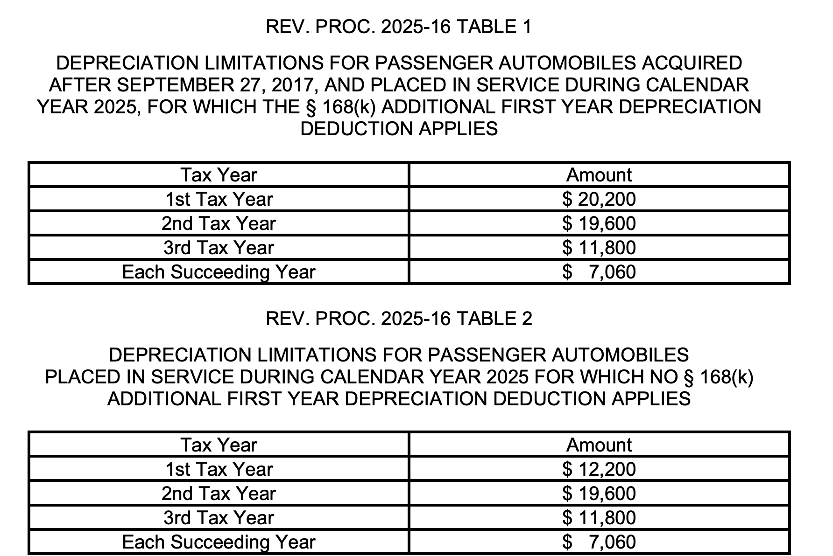
Section 280F Limitations for 2025: Rev. Proc. 2025-16

Slide 22
Amortization of Intangible Assets: §§ 167 and 197; Start-Up Costs
Section 197 intangibles are amortizable over 15 years (SL).
Goodwill, going concern value, workforce in place, business books and records, operating systems
Patent, CR, TM, TN, franchise, formula
Customer-based and supplier-based intangibles. §197(d)(1)
Doesn’t include land, financial interests, any CR or patent not acquired as part of the acquisition of a T/B, lease, indebtedness. §197(e)(1), (2), (4), and (5).
Start-up Expenditures: Currently deductible under to 5K; remainder deductible over the 180-month (15 yrs) period beginning w/ the month the T/B begins. §195(b)(1).

Slide 23
Tax Arbitrage
Income Tax: Borrowed principal is excluded from income, repaid principal is not deductible, but business interest is deductible.
CFCT: Borrowed principal included in tax base, but interest and repaid principal deductible (non-consumption outlay)
Wage Tax: Borrowed principal not included and repaid not deductible and but business interest is not deductible.
Tax Arbitrage: CFCT treatment of investment (deduction) and interest deduction for purchase of that investment can result in better treatment than consumption tax treatment
§179 plus §163(a) business interest deduction
§168(k) bonus depreciation plus §163(j) deduction for interest (limited to 30% of adjusted taxable income: GI – business expenses less depreciation (after 2022).
Some RE business are not subject to §163(j) if they agree to lengthen deprecation to 30 yrs (RRE) and 40 yrs (Non-RRE). §163(j)(7)

