Slide 1
Federal Income Taxation
Borrowing and Lending
Prof. Colon
Fall 2026

Slide 2
Borrowing and Lending
Chapter 9: Basic rules of borrowing and lending, including receipt and payment of principal, receipt and payment of interest, identifying principal and interest, and timing of interest and deduction.
Chapter 10: Consequences of not repaying principal or interest
Chapter 11: Applying debt rules in the context of purchase, ownership, and disposition of property.

Slide 3
Benefits and Possible Detriments of Debt
Debt/leverage can magnify both gains and losses
Example:
Amy buys land for 100K in 2025 and sells it one year later for 150K. Her return on her investment of 100K is: (150 – 100)/100 or 50%.
Zandro has 20K and borrows 80K at 10% to buy land for 100K, which he sells one year later for 150K. He repays the bank 88K (80K + 8K of interest), and he has 62K left. His return on his investment of 20K is: (62-20)/20 or 210%

Slide 4
Benefits and Possible Detriments of Debt
Debt/leverage can magnify both gains and losses
Example:
Amy buys land for 100K in 2025 and sells it one year later for 90K. Her return on her investment of 100K is: (90– 100)/100 or -10%.
Zandro has 20K and borrows 80K at 10% to buy land for 100K, which he sells one year later for 90K. He repays the bank 88K (80K + 8K of interest), and he has 2K left. His return on his investment of 20K is: (2-20)/20 or -90%

Slide 5
Debt Basics
Amy borrows 100K from Banker
  Accession to wealth under HS for Amy?
  Decrease in wealth under HS for banker?
Banker: No current deduction for loan (Reg. §1.263(a)-4(d)(2)(i)(B) and (d)(2)(vi), Ex. 1; cost to create intangible—debt instrument—must be capitalized)
  What’s banker’s basis in the loan?
  When Amy repays the loan principal, income for Banker?
Amy: What are the result to Amy? Gross income under §61? Why?
  When Amy repays the loan principal, deduction for Amy?
  Original exclusion for debt proceeds in Y1 depends on estimating future repayment in YX
  Tension w/ the annual accounting principle

Slide 6
Debt Basics
Amy borrows 100K and pays 10K of interest to Banker
  Decrease in wealth under HS for Amy for interest paid?
  Increase in wealth under HS for Banker for interest received?
Banker: Gross income under §61(a)(4)
Amy: Possibly deductible under §163 if it constitutes business interest, investment interest, qualified residence interest, or qualified passenger vehicle loan interest (OBBBA), all subject to certain limitations.

Slide 7
Debt Basics: Present Value and Future Value
Future Value: an amount that represents how much an investment made today (PV) will grow to in the future over a certain period at a certain rate.
  Example: The future value of 100K invested for one year at 10% is 110K.
  FV = PV * (1 + rate)^{T}, where T is the number of periods in the future.
Present Value: the current value today of an amount to be received in the future discounted at a certain rate.
  Example: The PV of 110K to be received one year from now invested for one year at 10% is 110K.
  PV = FV / (1 + rate) ^{T}

Slide 8
Debt Basics: Using the Loan Exclusion to Play Games
Bank makes a 1-year loan to Amy of 100K. In one year, she’ll have to repay 110K, the original 100K plus interest of 10K.
Should Amy be able to exclude the entire 100K under the borrowing exception?
What is the PV the loan if the discount rate is 10%?
  PV = FV / (1 + rate) T
  100K = 110K / (1 + 10%) ¹
Does Amy have an accession to wealth when she receives the 100K in PV terms?

Slide 9
Debt Basics: Using the Loan Exclusion to Play Some No-Interest Games
Corp makes a 5-year, no-interest loan to its CEO of 100K.
  Should CEO be able to exclude the entire 100K under the borrowing exception?
  What is the PV the loan if the discount rate is 10%?
    PV = FV / (1 + rate) ^{T}
    62K = 100K / (1 + 10%) ⁵
  How should the remaining 38K be classified?
Mom makes a no-interest loan to daughter of 200K. Mom’s MTR is 37% and daughter’s is 10%. Mom can request repayment at any time.
  What’s going on?

Slide 10
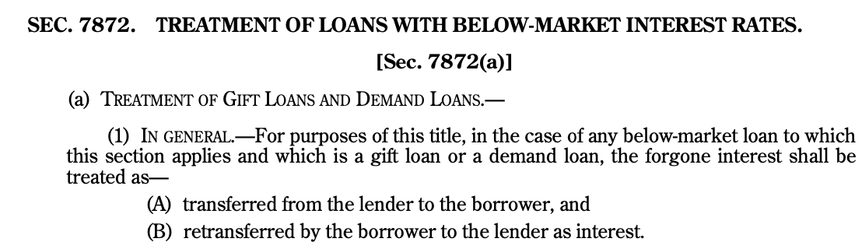
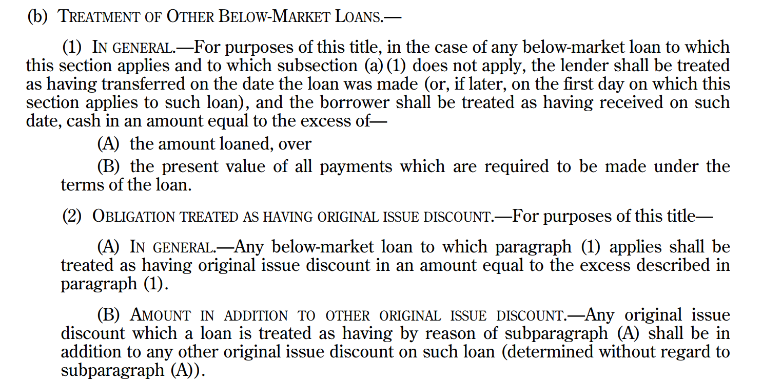
Section 7872

Slide 11
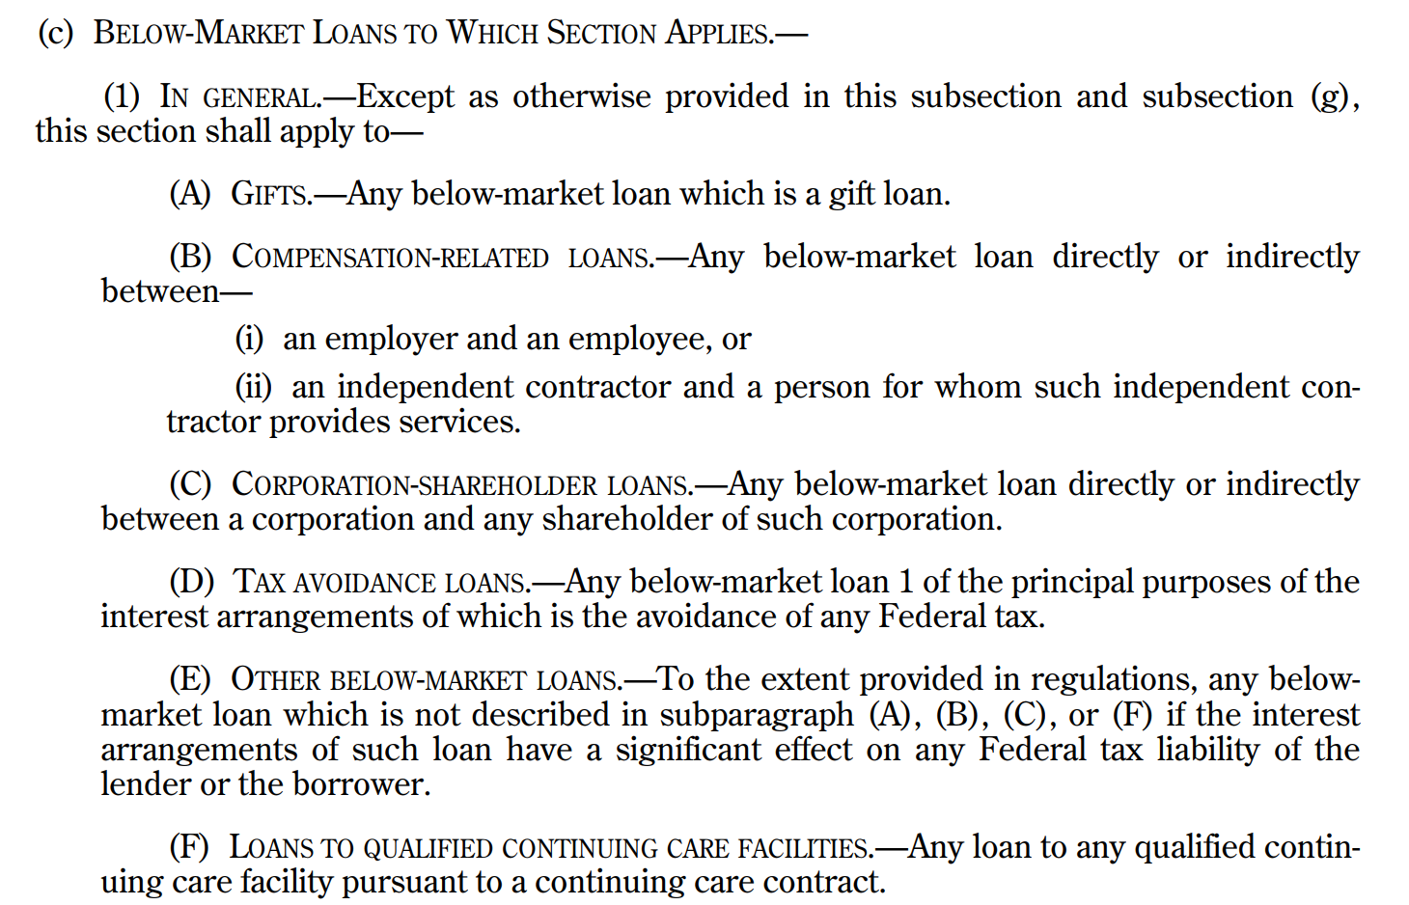
Section 7872

Slide 12
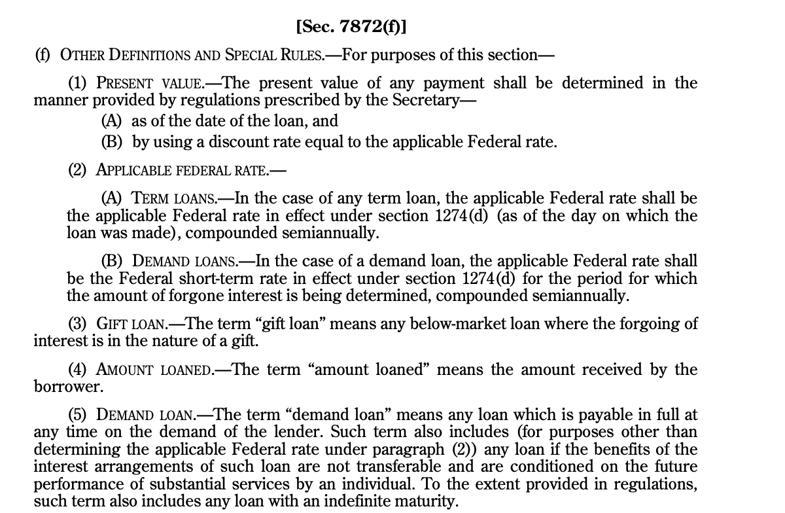
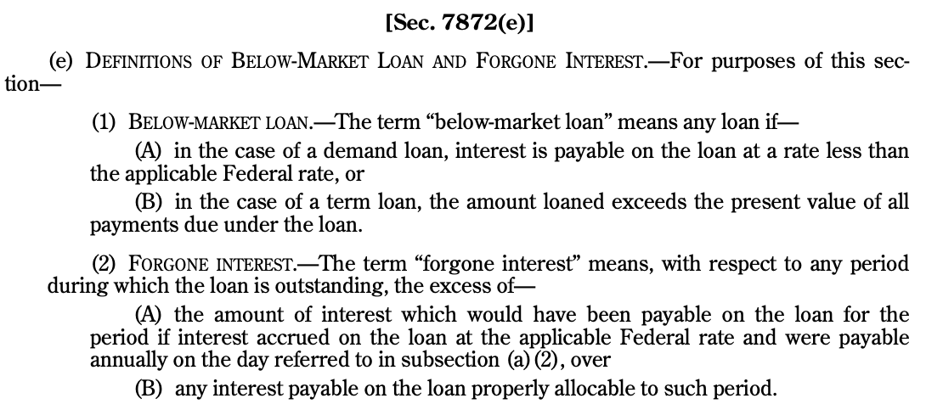
Section 7872

Slide 13
Section 7872: Below Market Demand Loan
Mom makes a no-interest loan to daughter of 200K. Mom’s MTR is 37% and daughter’s is 10%. Mom can request repayment at any time.
Is the loan subject to §7872?
  Yes: It is a below market loan (§7872(e)(1)—no interest is payable) that is a gift loan. §7872(f)(3) and (c)(1)(A).
What are the consequences?
  Foregone interest is treated as transferred from mom to daughter and daughter retransfers it as interest to mom on the last day of each year. §7872(a)(1) and (2)
    Consequences to Mom and daughter?
  Foregone interest = Short-term AFR

Slide 14
Section 7872: Below Market Term Loan
Corporation makes a 1MM, 3-year, no-interest loan to its CEO. If the AFR is 5%, what are the consequences to Corp and CEO?
Is this loan subject to §7872?
  Yes, it would probably be a compensation-related loan under §7872(c)(1)(B).
  It is a below-market loan under §7872(e)(1)(B) because the amount loaned (1MM) exceeds the PV of the all payments 863.8K (1MM/(1+.05)^3)

Slide 15
Section 7872: Below Market Term Loan
How is it taxed to Corporation and CEO?
Under §7872(b)(1), Corp would be treated as transferring to CEO the excess of the amount loaned (1MM) over the PV of the payment (863.8K), or 136K. This would mostly like be treated as compensation (deductible by Corp/taxable to CEO).
Remember, the CEO still owes 1MM in 3 years. Under §7872(b)(2), the loan is treated as having original issue discount (OID) equal to 136K, which would have be accrued annually (even though NOT received) under the rules of §1272:
  The issue price would be 863.8K
  For Y1, the OID accrual would be 863.8K * .05 or 43.2K, which would increase the adjusted issue price of the loan to 907K. The 43.2K would be taxed to Corp as interest and potentially deductible by CEO.
  For Y2, the OID accrual would be 907K * .05 or 45.4K (deductible by CEO/taxed to Corp), and the AIP would increase to 952K.
  For Y3, the OID accrual would be 952K * .05 or 47.6 (deductible by CEO/taxed to Corp), and the AIP would be 1MM, which is repaid with no G/L.
  Note: the numbers are slightly rounded.

Slide 16
Section 7872
Role of §7872 is simply to identify the principal and interest for certain loans with below-market interest rates.
Below-market rate is determined by reference to the applicable federal rate (AFR)
The treatment of the portions of the payments in a loan covered by §7872 that do not constitute interest or principal is covered by other code sections, e.g., gift, compensation, dividend.

Slide 17
Identifying Principal and Interest
For the timing of interest paid and received, we first need to identify in a loan payment how much of a payment is interest and how much is principal.
In a loan transaction that requires interest to be paid annually and the principal to be paid when the term of the loan ends, the interest will be includible/deductible generally when paid. Remember, different rules may apply to below market rate loans. See §7872.
Example: you borrow 50K for 3 years to pay your tuition with an annual interest rate of 10%. At the end of Y1, Y2, and Y3, you will pay 5K of interest, and at the end of Y3, you will pay 50K of principal.

Slide 18
Identifying Principal and Interest
You borrow 50K for the student loan, but the payment schedule is 3 annual payments of 20.1K. At the end of 3 years the loan balance will be zero. How much of each payment is interest?
Year | Amount | PV at beginning of Y1
Y1 | 20,106 | 18,278
Y2 | 20,106 | 16,616
Y3 | 20,106 | 15,106
 |  | 50,000
Year | Amount | PV at beginning of Y2
Y2 | 20,106 | 18,278
Y3 | 20,106 | 16,616
 |  | 34,894
Difference = 15,106
Year | Payment | Principal (Loss PV) |  | Interest
Year 1 | 20,106 -- | 15.1K (50K - 34.8K) | = | 5,000
Year 2 | 20,106 -- | 16.6K (34.8K – 18.2K) | = | 3,489
Year 3 | 20,106 -- | 18.2K (18.2K – 0) | = | 1,827
Totals |  | 50,000 |  | 10,316

Slide 19
Identifying Principal and Interest

Slide 20
Methods of Accounting: Economic Accrual of Interest
Methods of Accounting—affect the timing inclusions/deductible, but not whether an amount is interest, principal, capital expenditure, etc.
  Cash method
    When paid or received
  Accrual method
    All events test—right to receive; establish fact of liability
    Accrual of interest: include/deduct as times passes under economical accrual of interest

Slide 21
Original Issue Discount
Corp A wants to issue a bond that offers a 10% return for 3 years.
Corp A wants to save cash, so it says that it won’t pay any interest before the maturity of the bond.
Amy likes the promised return and talks to her broker who says that the bond will be sold (issued) for $751.31 today and will pay off $1,000 three years from now.
Can Amy defer including the interest in income until Y3 when she received the $1,000?

Slide 22
Original Issue Discount
A holder of a debt instrument with OID must include each year the OID that accrues on the debt instrument. §1272(a)(1).
The issuer deducts the same amount. §163(e)
OID: Stated Redemption Price at Maturity (SRPM) over the Issue Price (IP)
  In prior example: SRPM = 1,000 and IP = 751.31
OID Accrual: Adjusted IP times yield to maturity
  Adjusted IP = IP plus any OID adjustment

Slide 23
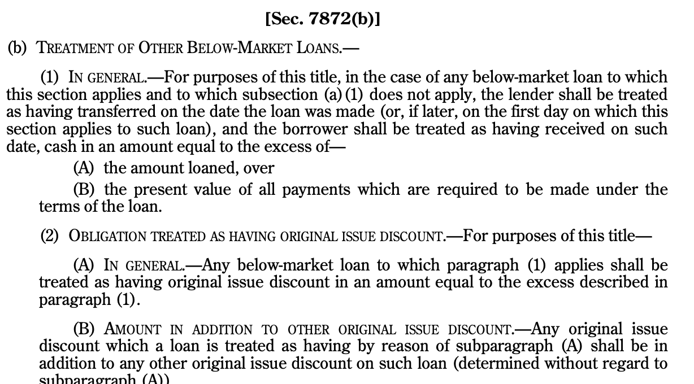
Section 7872: OID

Slide 24
Section 72—Recovery of Annuity Basis
Amy buys an annuity that pays her $60,000 per year for the rest of her life. She is 65 years old, and the cost of the annuity is $900,000. How much, if any, of each payment can she exclude?
Gross income includes any amount received as an annuity. §72(a)(1)
But under §72(b)(1), annuity holder can exclude from each payment:
  Payment * (Contract Investment / Expected Return Under the Contract)
Contract Expected Return: computed to reference to mortality tables. Reg. §1.72-9 [20 years]
  60K * (900K / 1.2MM) or 45K is recovered tax-free
What happens if Amy lives past 85?
What happens if Amy dies early and there is unrecovered basis? §72(b)(3)(A)
Loans under annuity treated as distributions of inside buildup (taxable) and not as a loan. §72(e)(4)(A)
10% penalty (of taxable amount) for withdrawals before reaching 59^{½} years old. §72(q)(1) and (2); §72(t)(1)(2)

Slide 25

James v. US, 366 U.S. 213 (1961)
James embezzled >738K [8.4MM in 2025] from 1951 through 1954 from employer union and insurance company w/ which union was doing business. 3 years in prison for willful evasion of income tax.
Why did James argue that the embezzled funds were not income in the year of embezzlement?
  Wilcox: held embezzled money without any semblance of a bona fide claim of right and was therefore at all times under an unqualified duty and obligation to repay money to employer
  When a taxpayer acquires earnings, lawfully or unlawfully, without the consensual recognition, express or implied, of an obligation to repay and without restriction as to their disposition, “he has received income which he is required to return, even though it may still be claimed that he is not entitled to retain the money, and even though he may still be adjudged liable to restore its equivalent.”

Slide 26

North American Oil Consolidated v. Burnet, 286 U.S. 417 (1932)
NA operated oil land, legal title of which was held by the US. US gov’t instituted a suit to oust NA, and in 1916, a receiver was appointed to operate the property and hold the net income.
171K was paid to NA by receiver in 1917. The gov’t appealed, and the suit was finally dismissed by the S. Ct. in 1922.
Issue: When were the profits taxable to NA? 1916, 1917, or 1922?
  If a taxpayer receives earnings under a claim of right and without restriction as to their disposition, he has received income which he is required to return, even though it may still be claimed that he is not entitled to retain the money, and even though he may still be adjudged liable to restore its equivalent.

Slide 27
Section 1341
What are the tax consequences to James or NA if either must return the funds on which they were taxed?
If the TP is entitled to a deduction, what if the rates have changed between the time the income was included and deducted? What if, for example, the income was originally taxed at 50% but only generated a deduction of 20%, or vice versa?
Under §1341, if:
  (1) TP has GI in a prior year because it appeared that the TP had an unrestricted right to the income, and (2) a deduction is allowable in the current year because the TP did not have an unrestricted right to the GI, then the TP can:
    (1) take the deduction; or (2) not take a deduction an instead take a credit for the additional tax paid in the prior year because of the GI inclusion.

Slide 28
CIR v. Indianapolis Power & Light
IPL receives deposits for certain customers to assure payment of future bills for electric service.
  Customers selected based on formula, and IPL paid interest on the deposits only if held for more than 12 months.
  Deposits refunded if customer made timely payments for a certain number of months.
  A customer could receive a refund by satisfying a credit test or terminating service.
  Customer could use deposit to pay for electricity.
IPL treated deposits as liabilities and recognized income when it mailed monthly bill.
  If deposit was used to offset a bill, accounting adjustments were made.
Deposits not physically segregated; commingled with other receipts and subject to IPL’s unfettered use and control.
Issue: Loan or advance payments for electricity?

