Slide 1
Federal Income Taxation Home, Health, and Charity
Prof. Colon
Spring 2025

Slide 2
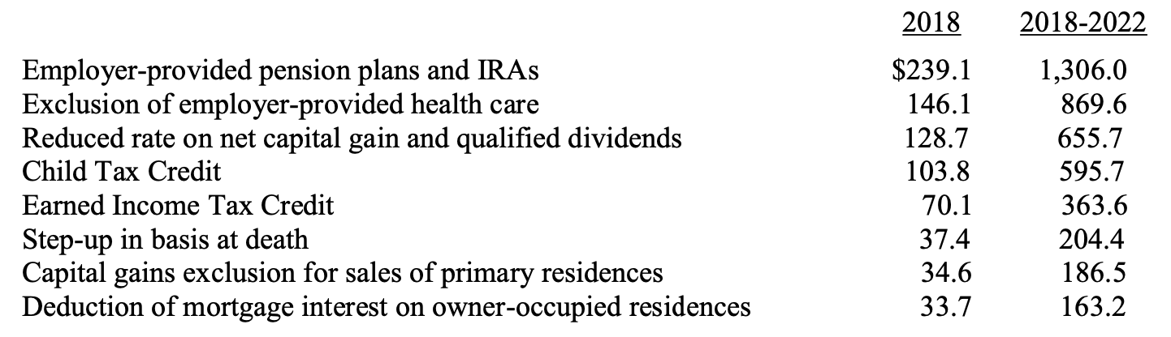
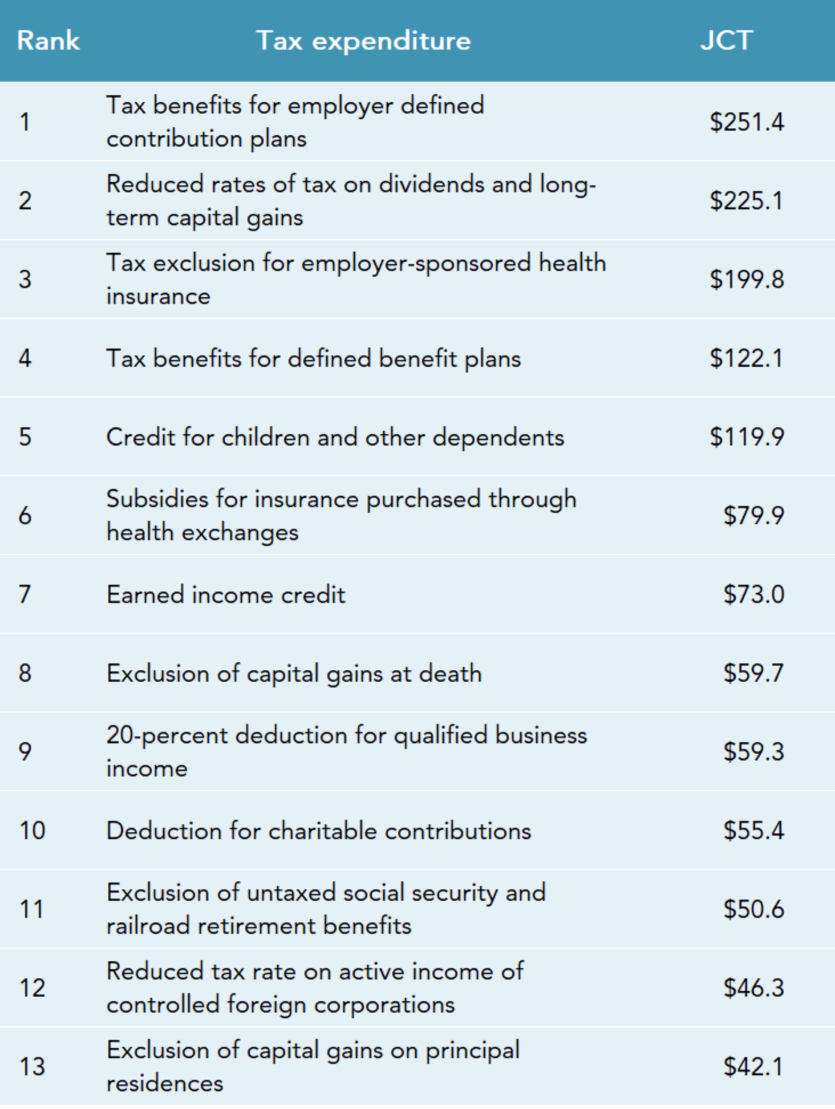
Personal Consumption Tax Expenditures
JCT 2024

Slide 3
Owner Occupied Housing Tax Benefits
Exclusion of imputed income
§163(h)(3) itemized deduction for qualified residence interest
§121 exclusion of gain on principal residence sale
§164(a)(1) itemized deduction for property taxes
§108(a)(1)(E) and (h) exclusion of certain debt-discharge income

Slide 4
Exclusion of Imputed Income
What is imputed rental income?
Value of housing services owner receives from residing in their own home
Effectively receiving same rental income as if renting to a tenant, but don’t have to pay tax on imputed income.
We derive imputed income from many personal assets, e.g., cars, washing machines
Net imputed income = gross rental value less expenses, interest, taxes, and depreciation
Most countries do not tax imputed income (though some European countries historically did)

Slide 5
Tax Policy Critiques of Home Ownership Tax Expenditures
Housing is one of the most tax-preferred investments in U.S. economy
Creates major economic inefficiency and distortion by channeling capital into housing instead of business investment
Results in "bigger houses" rather than improved economic productivity
2005 CBO study: Average tax rate on owner-occupied housing is <5.1%> vs. 13.8% for all capital returns

Slide 6


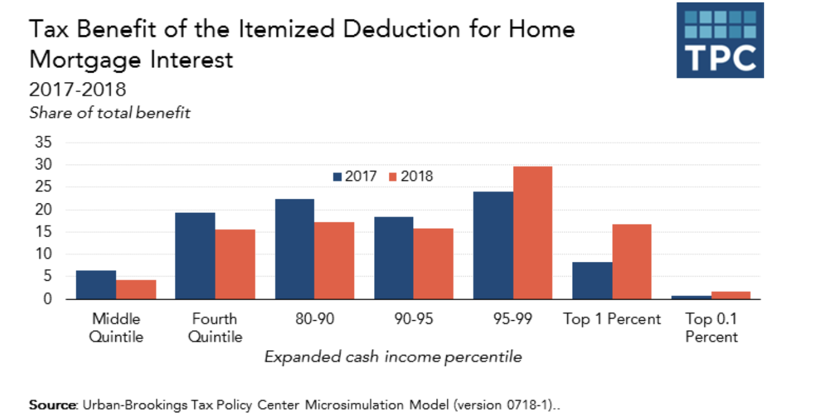
Who benefits from the housing tax subsidies?
Benefits of mortgage interest and property tax deductions disproportionately go to higher-income taxpayers
80% of the benefits from mortgage interest and property tax deductions go to the top 20% of taxpayers; only 5% go to bottom 60% of income scale
TCJA: higher standard deduction means fewer itemizers, so top 5% captures even more benefit than before the TCJA, but this may change after 2025
Homeownership rates similar in countries without these subsidies (Canada, Australia)

Slide 7

Possible Effects of Repeal of TCJA (reduction of standard deduction)
JCT: Tax Expenditures, 2024

Slide 8
Qualified Residence Interest: §163(h)(3)
Originally all interest deductible, but not too important before WWII because only high income earners paid income tax.
As income tax expanded to include middle class after WWII, the deduction for home mortgage interest became a much more valuable subsidy for middle and upper-middle-income taxpayers.
Before 1986, all interest, including personal interest, was deductible. After 1986, only business, investment, and home mortgage interest remain deductible. Note, the interest deduction for student loan interest.
§163
§ 163(a): all interest paid or accrued is deductible
§163(h)(1): no deduction for personal interest
§163(h)(2)(D): Personal interest includes any interest except…qualified residence interest defined in §163(h)(3)
Qualified residence interest is an itemized deduction (not listed in §62) but NOT a miscellaneous itemized deduction (listed in §67(b)(1)).

Slide 9
Qualified Residence Interest: §163(h)(3)
QRI:
(1) acquisition indebtedness; or
(2) home equity indebtedness (only after 2025)
HEI: any indebtedness other than QRI secured by qualified residence. Limited to 100K and can’t exceed FMV of property less any acquisition indebtedness. §163(h)(3)(C).
Acquisition Indebtedness
Debt, including refinanced debt, used to construct, acquire, or substantially improve a qualified residence and is secured by the residence. §163(h)(3)(B)(i)
Qualified residence: Principal residence plus one other personal residence. §163(h)(4)(A)
Substantial improvement: Must significantly add to value, prolong useful life, or adapt to new use
Ceiling: $750,000 ($375,000 if married filing separately) after TCJA. §163(h)(3)(B)(ii)
Reduced from $1 million pre-TCJA - $1 million limit still applies to grandfathered debt incurred before 2018

