Slide 1
Federal Income Taxation Bad Debt Deduction and COD
Prof. Colon
Spring 2025

Slide 2
Borrowing and Lending
Chapter 10: Consequences of not repaying principal or interest
Chapter 11: Applying debt rules in the context of purchase, ownership, and disposition of property.

Slide 3
Lender’s Deduction for Bad Debt (or Worthless Security)
Bank make a loan to Amy of 100K. What’s the bank basis in the loan?
When Amy repays principal, what happens to the loan’s basis?
Lending is generally either a trade or business (e.g., bank or a store selling on credit) or an investment activity (Amy buys a bond of Apple)
What should happen to Bank when Amy doesn’t pay back some or all of the loan principal?

Slide 4
Section 165(g): Deduction for Worthless Security
If a security that is a capital asset becomes worthless during the taxable year, loss treated as loss from S/X on last day of year. §165(g)(1).
Security: Corporate stock or bond. §165(g)(2).
Character of loss?

Slide 5
Section 166: Bad debt deduction
In 2023, Amy loans Biff 100K (at market rates, with appropriate documentation) to help him start a business. In 2025, Biff tells Amy that he can only pay 70K.
After Biff pays Amy 70K, what’s Amy’s basis in the loan?
Can Amy deduct her remaining basis in the loan?
Business bad debt
Deduction for wholly or partially worthless debt. §166(a)(1) and (2).
Character?
Non-business debt
Non-business: debt not created or acquired in connection with a trade/business
Must be worthless, and loss is short-term capital loss. §166(d)(1) and (2).
Debt must be bona fide debt.

Slide 6
Rev. Rul. 93-27
Can a parent deduct funds spent for child support for arrearage in child support payments from a former spouse under §166?
What’s the paying parent’s basis in the former spouse’s obligation to pay child support?

Slide 7
Income from the Discharge of Indebtedness (COD): §61(a)(12)
What is the rationale for the borrowing inclusion (no GI upon the receipt of borrowed funds)?
Explain how under our current system, borrower isn’t taxed upon receipt but upon repayment.
What should be the result if the borrower doesn’t satisfy its repayment obligation?
What happens if borrower isn’t taxed when it fails to satisfy its repayment obligation?

Slide 8
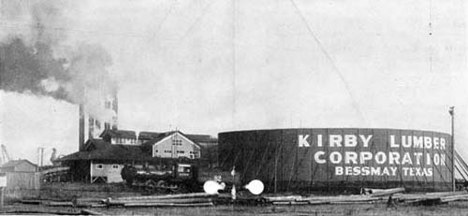
US v. Kirby Lumber, 284 U.S. 1 (1931)
Kirby Lumber issued bonds for 12.1MM (at par/face value). Later that year, when the price of the bonds had dropped, Kirby repurchased some of them at 137K less than par.
Issue: Is the difference between the purchase price and the issue price income to Kirby?
What are some of the reasons that Kirby may have been able to repurchase its bonds for less than they were sold for?
Discuss Holmes’ rationale for taxing Kirby:
Here there was no shrinkage of assets and the taxpayer made a clear gain. As a result of its dealings it made available $137,521.30 assets previously offset by the obligation of bonds now extinct.

Slide 9
Modern View of Debt-Discharge Income: §61(a)(12)
The economic value received in Year 1 is not an “accession to wealth” under Glenshaw Glass principles solely because of the obligation to repay with after-tax dollars.
The obligation to repay disappears.
Because the exclusion justification is gone, the value received in Year 1 is now an accession to wealth (in the year the repayment obligation disappears) under §61(a)(12).

Slide 10
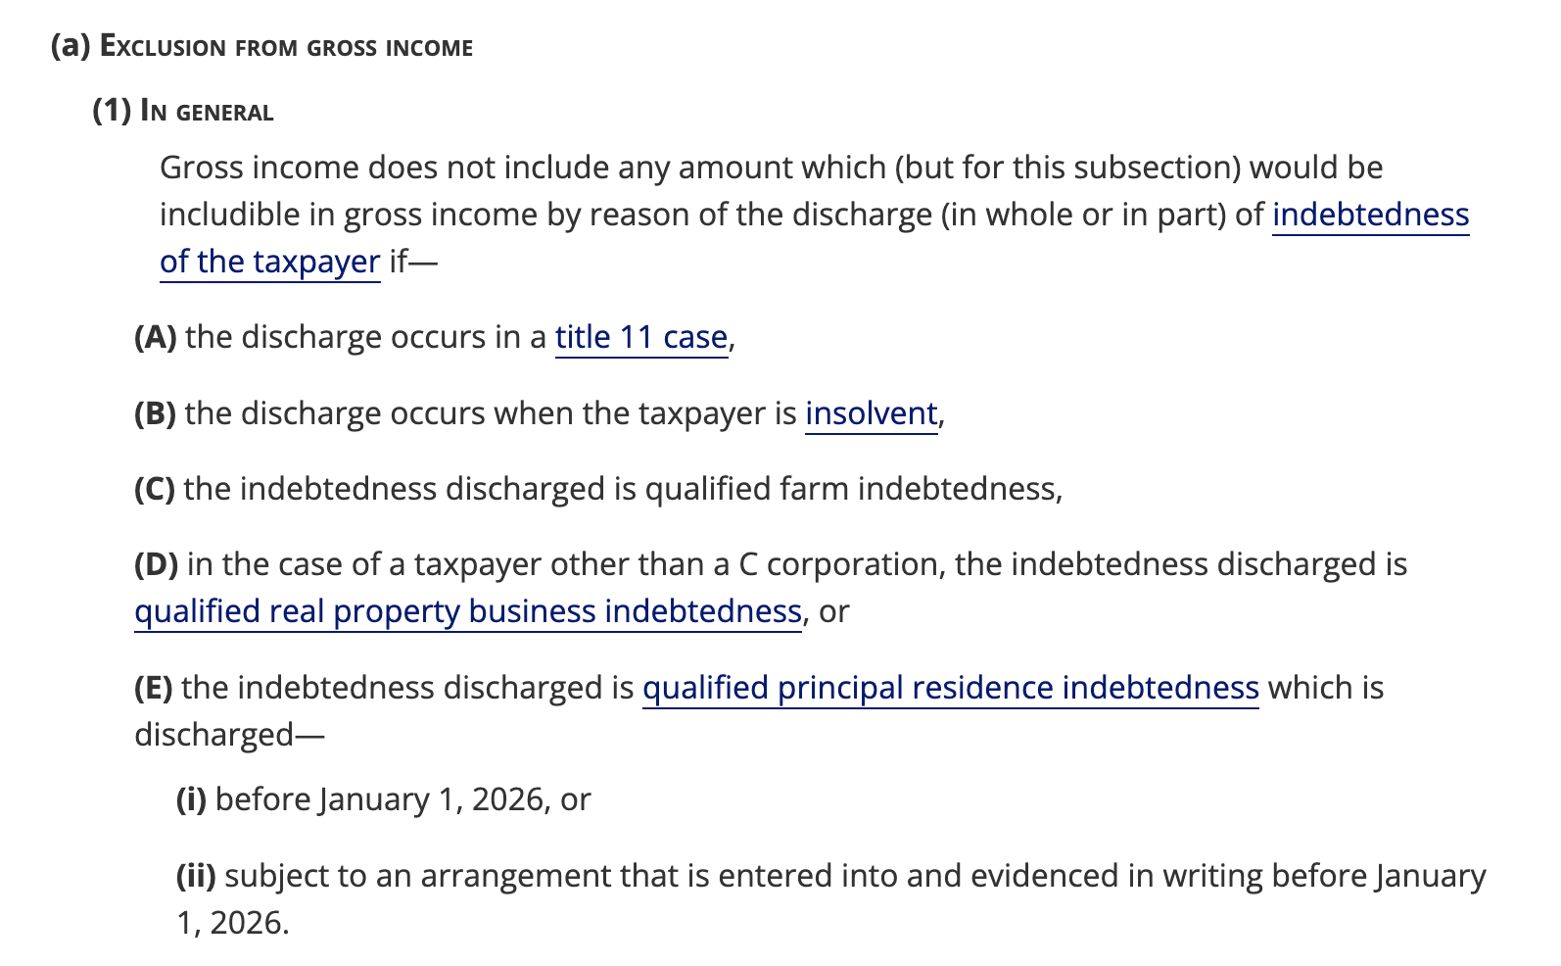
Deferral of COD: §108

Slide 11
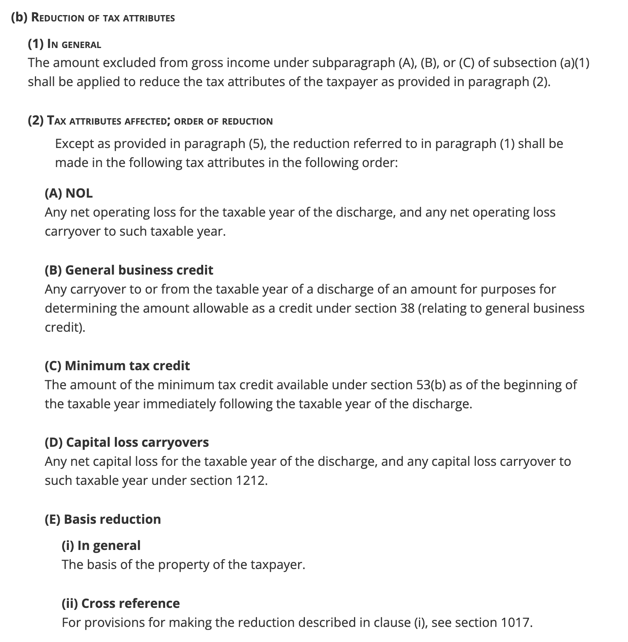
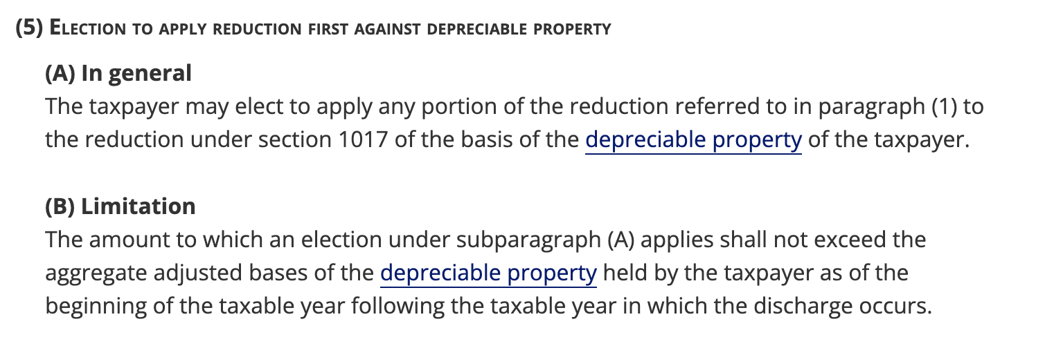
Deferral of COD: §108

Slide 12
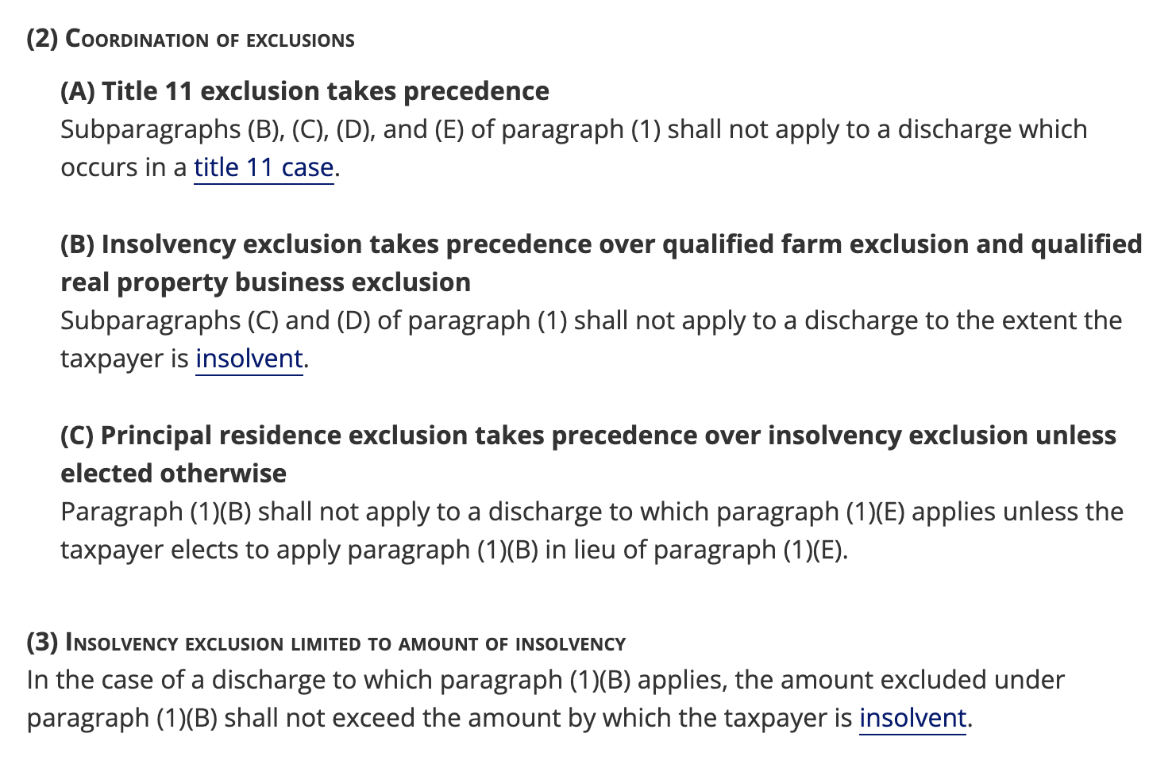
Deferral of COD: §108

Slide 13

Payne v. CIR, TC Mem 2008-66 (2008), aff’d 8th Cir.
Payne charges 21K on MBNA credit card to pay hospital bills and receive cash advances during unemployment.
In 2004, pursuant to settlement between MBNA and Payne, Payne agreed to pay 4.5K in full settlement of the 21K balance. MBNA sent Payne a Form 1099-C (Cancellation of Debt) reporting 16.6 COD.
Payne wasn’t insolvent and didn’t file for bankruptcy.
What were Payne’s arguments?

Slide 14


Zarin v. CIR, 92 T.C. 1084 (1989) and 916 F.2d 110 (3rd Cir. 1990)
Compulsive gambler Zarin is extended 3.4MM in credit by Resorts in Atlantic City as evidenced by markers and personal checks.
In Sept. 1981, Zarin settles with Resorts for 500K.
IRS argues Zarin has 2.9MM of COD.

