Slide 1
Federal Income Taxation Essential Structure of the Income Tax Ch. 1
Prof. Colon
Fall 2026

Slide 2
Federal Income Taxation
Course Goal: Understand the basic structure of the U.S. federal income tax system and how theory translates into positive law (the Internal Revenue Code).
Key Question: How do we and how should we allocate the economic burden of government costs ($X) across the population?

Slide 3
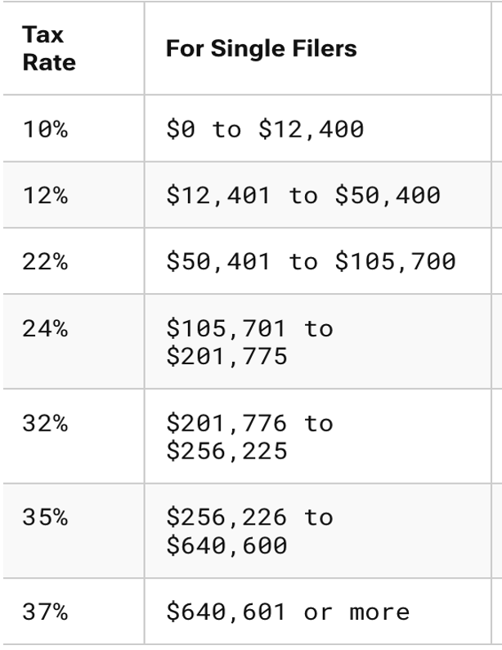


Tax Base and Tax Rates (Single, 2026)
X
=
$Tax Revenue$
Tax Base
Income
Consumption/Wages
Wealth
Tariffs (New for ‘25 ) and other excise taxes

Slide 4
HS Definition of Income
Market value of rights exercised in consumption,
plus
(2) Change in value of property during period (e.g., annually).
Simplified Formula:
Income = Wealth increases – Wealth decreases,
but only if wealth reduction does not represent personal consumption

Slide 5
Core Structure of a Tax on Income
Gross Income (inflows—wealth accessions, if not excluded) [§61]
minus
Allowable Deductions (certain outflows—wealth reductions) [§161]
= Taxable Income (tax base) [§1]

Slide 6
Deviations from HS (Theory)
The Rule: §61 applies "Unless as otherwise provided in this subtitle".
Example – Gifts (§102)
HS theory: receiving a cash gift is a clear wealth increase and should be taxed.
Positive Law: §102(a) specifically excludes "gifts, bequests, devises, and inheritances" from Gross Income.
Exclusion vs. Deduction:
Exclusions are wealth inflows that never enter Gross Income
Deductions are outflows that reduce Gross Income.

Slide 7
Analysis of Wealth Reductions
 | Analysis of Wealth Reductions
 | Personal | Business | Investment
Capital Expenditures | No wealth reduction; mere change in form of wealth
 | Not deductible [§263] | Not deductible [§263] | Not deductible [§263]
 | Creates basis [§1012] | Creates basis [§1012] | Creates basis [§1012]
Capital Expenditures are generally made after-tax dollars because they are not deductible.

Slide 8
Role of Basis
Two Precepts of a Tax on Income
Same $ should not be taxed to the same taxpayer more than once; and
Same $ should not provide a double tax benefit to the same taxpayer
Basis
Record of previously taxed $
$ that have not yet been deducted
Basis (§1012)
Created by nondeductible capital expenditures (most common), or
Income inclusion—your employer grants you stock as additional compensation; by including it in income, basis is created.

Slide 9
Realization
Under HS, increases (decreases) in wealth, e.g., increases (decreases) in the value of an asset, would be taxable events.
Gains/losses are not recognized (enter into the tax base) generally until there is a realization event (sale or exchange).
Gain/Loss: Amount realized minus adjusted basis (AR – AB). §1001(a)
AR: Cash or FMV of other property. §1001(b)
AB: Cost basis with adjustments, e.g., depreciation. §1011(a)
Subtracting the AB ensures that the same dollars are not taxed more than once to the same taxpayer.
Realization is a valuable option for taxpayers. Why?
What is one justification for the realization requirement? One critique?

Slide 10
Analysis of Wealth Reductions
 | Analysis of Wealth Reductions
 | Personal | Business |  | Investment
Capital Expenditures | No wealth reduction; mere change in form of wealth
 | Not deductible [§263] | Not deductible [§263] | Not deductible [§263] | Not deductible [§263]
 | Creates basis [§1012] | Creates basis [§1012] | Creates basis [§1012] | Creates basis
Expenses | Outlays that reduce wealth
 | Not deductible [§262] | Deductible [§162(a)] | Deductible [But not §212(1) and (2) expenses] | Deductible [§212(1) and (2)]

Slide 11
Analysis of Wealth Reductions
 | Analysis of Wealth Reductions
 | Personal | Business |  | Investment
Capital Expenditures | No wealth reduction; mere change in form of wealth
 | Not deductible [§263] | Not deductible [§263] | Not deductible [§263] | Not deductible [§263]
 | Creates basis [§1012] | Creates basis [§1012] | Creates basis [§1012] | Creates basis
Expenses | Outlays that reduce wealth
 | Not deductible [§262] | Deductible [§162(a)] | Deductible [But not §212(1) and (2) expenses] | Deductible [§212(1) and (2)]
Losses | Not deductible [§165(c)(3)] | Deductible [§165(c)(1)] | Deductible [§165(c)(2)]

Slide 12
Analysis of Wealth Reductions
 | Analysis of Wealth Reductions
 | Personal | Business |  | Investment
Capital Expenditures | No wealth reduction; mere change in form of wealth
 | Not deductible [§263] | Not deductible [§263] | Not deductible [§263] | Not deductible [§263]
 | Creates basis [§1012] | Creates basis [§1012] | Creates basis [§1012] | Creates basis
Expenses | Outlays that reduce wealth
 | Not deductible [§262] | Deductible [§162(a)] | Deductible [But not §212(1) and (2) expenses] | Deductible [§212(1) and (2)]
Losses | Not deductible [§165(c)(3)] | Deductible [§165(c)(1)] | Deductible [§165(c)(2)]
Depreciation | None | Deductible [§167(a)] if wasting asset | Deductible [§167(a)] if wasting asset

Slide 13
Character of Income
Important: "Capital expenditure" ≠ "capital gain/loss" — different concepts
Three Requirements for "Capital" Treatment:
Gain includable or loss deductible (personal losses generally not deductible)
Asset is a "capital asset" (§ 1221)
From "sale or exchange"
Example:
Gold necklace purchased by Ellen for personal adornment → Capital asset for Ellen
Same necklace held by Steve (retail shop) as inventory → Not a capital asset
If the property sold is a capital asset and is held for more than one year, any gains are potentially subject to a rate of 0%, 15%, 20%. §1(h) (CG rates).
Capital losses are limited under §1211(b) (amt of CGs plus 3K)
If the property is held for less than one year, any gains are generally subject to the same rates as wage income.

Slide 14
Subsistence Consumption, Tax Rates, etc.

Slide 15
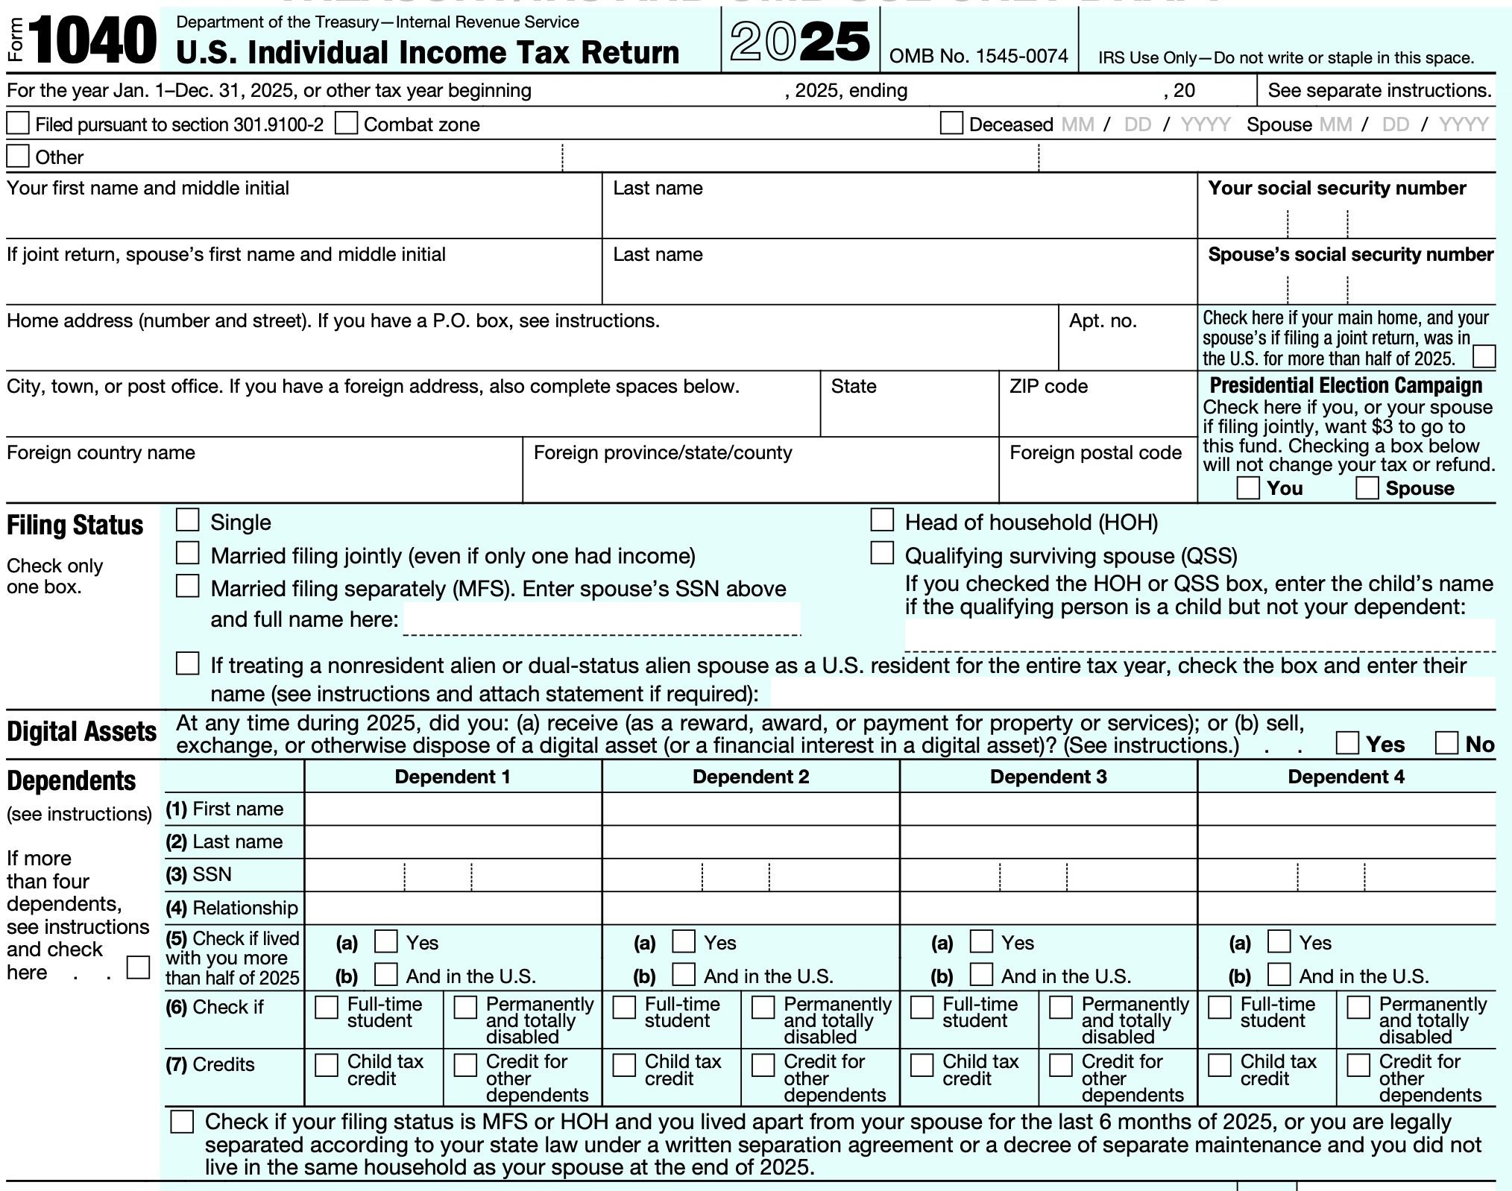
Form 1040

Slide 16
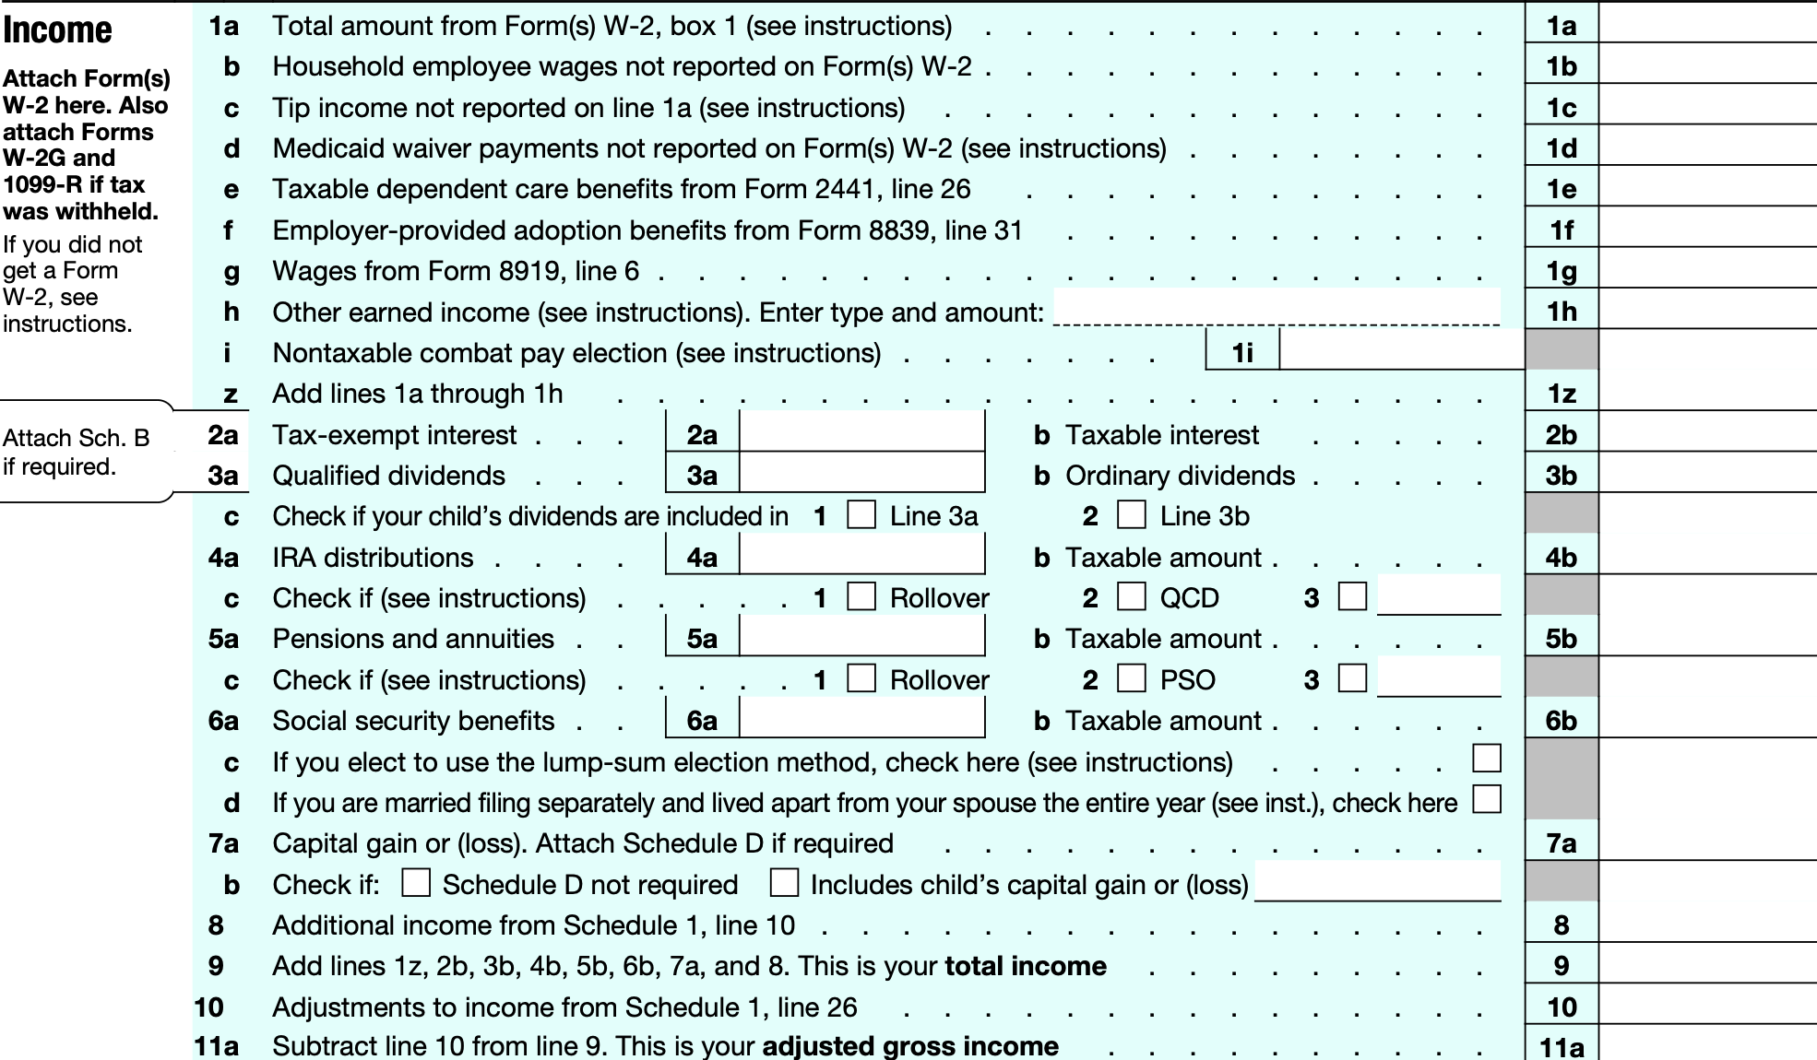
Form 1040: From Gross Income (GI §61) to Adjusted Gross Income (AGI §63)

Slide 17
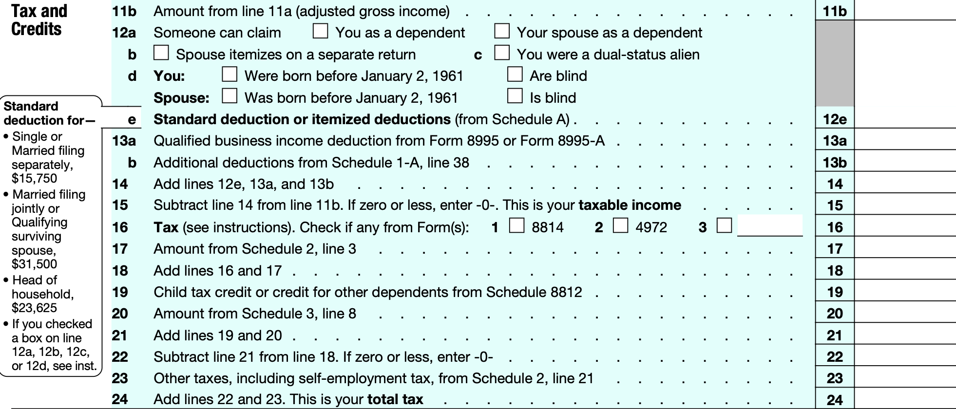
AGI to Taxable Income, Tax, and Credits

Slide 18
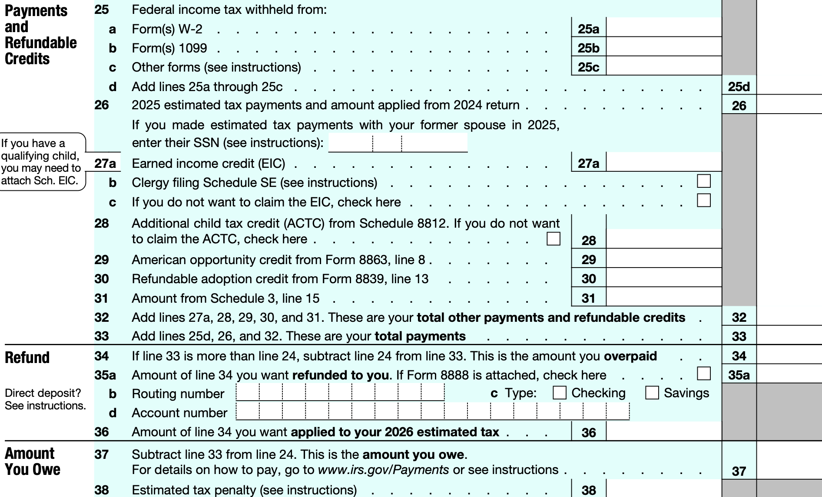
Payments, Refunds, and Amounts Owed

Slide 19
Going from the Code to the 1040
After taking FIT, you realize that you are eligible for a tax credit for a portion of your education expenses under §25A (Lifetime Learning Credit). Where does it go on your 1040 and what other forms do you need to file?
Step 1
Form 8863: Education Credits (American Opportunity and Lifetime Learning Credits), Line 19
Step 2
Schedule 3 (Form 1040): Additional Credits and Payments, Line 3
Step 3
Form 1040, Line 20

Slide 20
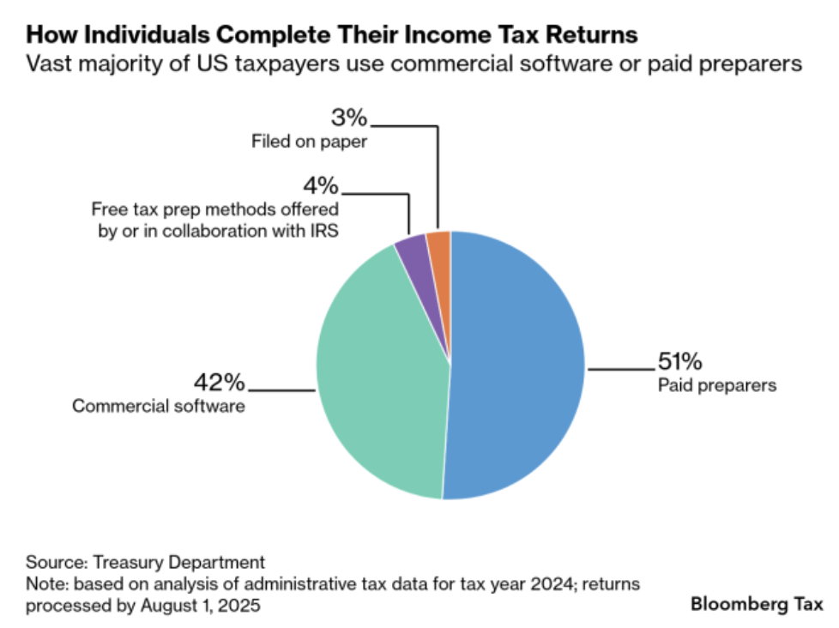
Thinking of Completing Your Return with Pencil and Paper?

Slide 21
Gross Income to AGI
Deductions from GI to arrive at AGI are referred to as “above the line” deductions.
Examples: T/B deductions; losses from S/X of property; deductions attributable to rents & royalties; IRA deduction; interest on student loans. §62(a).
Above the line deductions are generally not limited (more beneficial than itemized deductions)

Slide 22
AGI to Taxable Income
AGI to Taxable Income (TI): To itemize or not to itemize
Non-itemizer
Stan. deduct. (16.1k S, 32.2k MFJ) + senior deduction (6K/12K) + §199A deduction + lim. cash char. cont. + qual. tips + qual. overtime + qual. vehicle loan int. §63(b)(1).
Itemizer
Any other allowable deductions except above-the-line deductions and non-itemizer deductions. §63(d).
Examples: Home interest deduction, state and local tax deduction (up to 40.4k), char. contrib. §67(b).
Miscellaneous itemized deductions (MIDs), e.g., non-reimbursed employee business expenses, investment expenses, are suspended through 2025.
Prior to TCJA, MIDs deductible only to extent of excess of 2% of AGI. §67(a) and (d).
Above-the-line deductions > Itemized deductions; Itemized deduction only valuable to the extent that they exceed the stand. deduction.

Slide 23
Zero Bracket (Subsistence) Amount
Zero Bracket Amount: Standard deduction + Child Tax Credit + Earned Income Tax Credit + Senior deduction
Standard deduction in 2026: 16.1k (Single); 32.2k (MFJ)
CTC: 2.2K/child under 17
EITC: 8.231k (max, 3 or more children)
Senior deduction: 6K (12K)
Personal Exemption & Dependent Deduction (suspended through 2025)

Slide 24
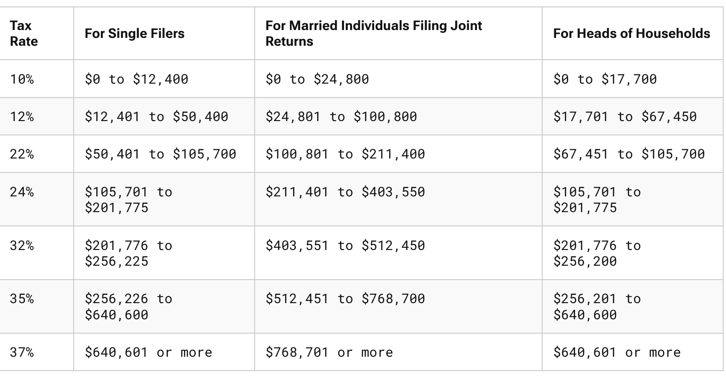
Taxable Income Tables (2026)

Slide 25
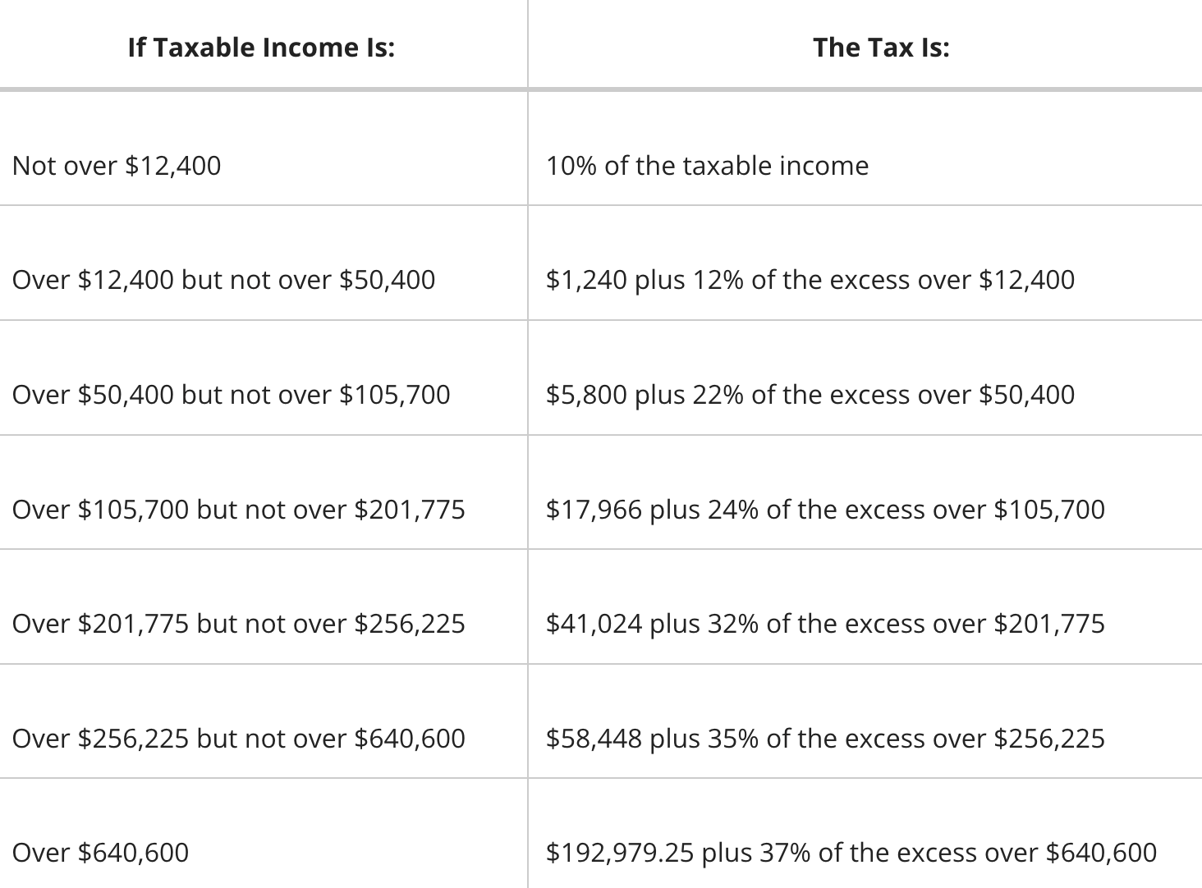
Tax Income Table (2026)

Slide 26
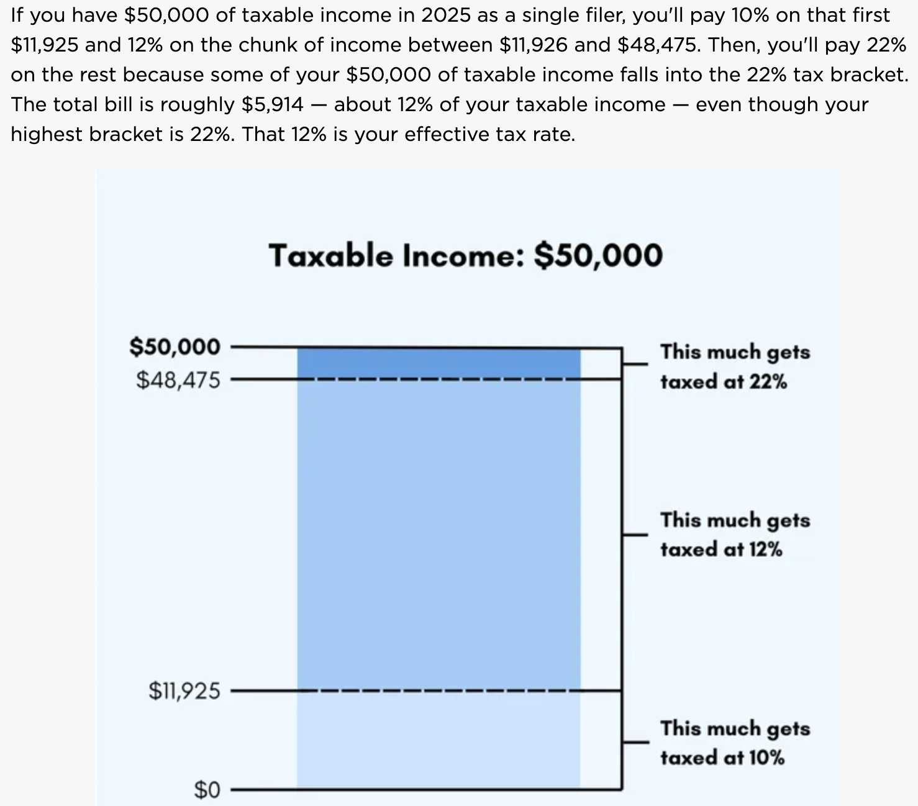
Marginal v. Effective Tax Rates

Slide 27
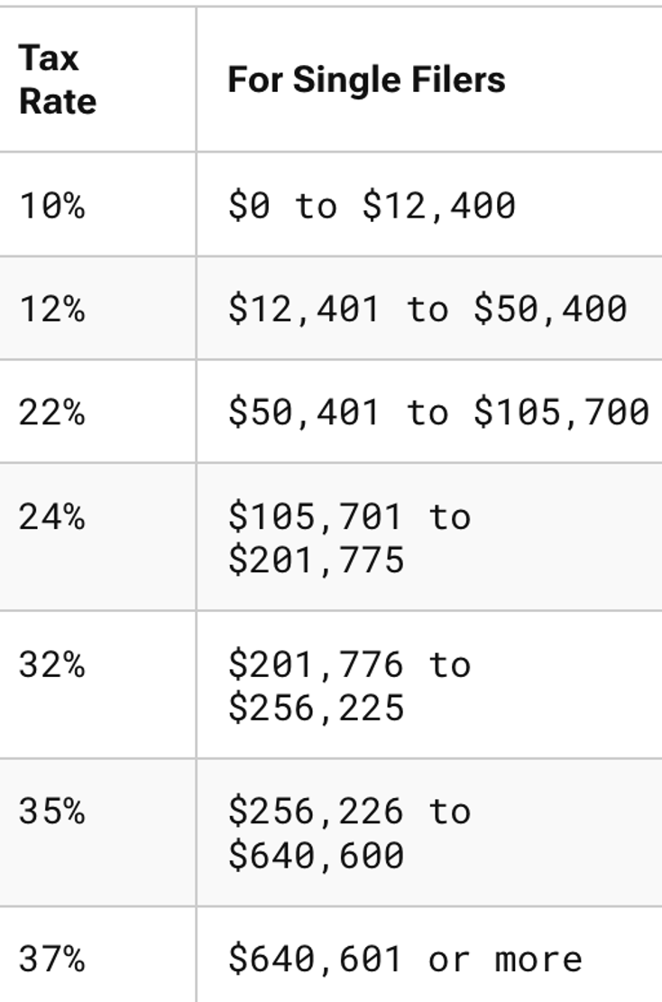
Marginal vs. Effective (Average) Tax Rates
Tax Calculation
Tax Table (Single, 2026)
Mary is single and has taxable income of $100K
Her marginal tax rate is 22%
Her effective tax rate is:
1,240 [12,400 X 10%],
plus
4,560 [12% X (50,400 -12,401)], plus
10,912 [22% * (100,000 – 50,401)]
Total Tax: 16,712
ETR = 16,712 / 100,000 = 16.71%

Slide 28
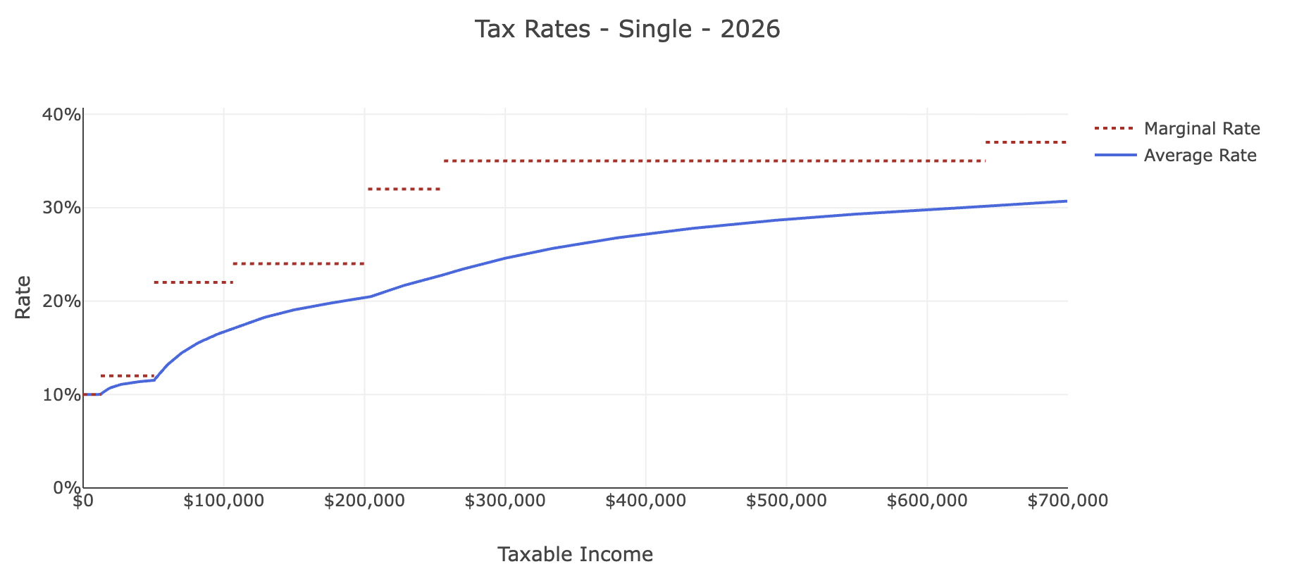
Marginal vs. Effective (Average) Tax Rates

Slide 29
Tax Credit vs. Tax Deduction
A tax credit is a dollar-for-dollar reduction in tax liability.
Each dollar of a deduction reduces tax liability by the taxpayer’s marginal tax rate.
Some possible credits:
Child Tax Credit: 2.2K/child. §24(a). Up to 1.7K is refundable.
EITC: 8.046K (max, 3 or more children). §32(a)
Foreign Tax Credit. §27
Lifetime Learning Credit. §25A
Credit for taxes withheld on wages. §31(a)

Slide 30
Alternative Minimum Tax (AMT)
Taxpayer pays the greater of regular tax liability or AMT
AMT rate is 28% vs. highest individual rate of 37%
AMT base is wider than regular tax base
Add back state and local taxes
Add back property taxes
But not capital gains!
TCJA (2017) increased the AMT exemption amount, so it catches far fewer TPs than before the TCJA.

Slide 31
§199A: New in the TCJA of 2017 and Unfortunately Expanded in OBBBA of 2025.
*Note: many details omitted
20% deduction of a non-corporate taxpayer’s Qualified Business Income Amount (QBIA)
QBI: Roughly income from a QT/B, but excluding CGs, CLs, dividend income
QT/B: Any business except the T/B of being an employee, and: health, law, accounting, actuarial science, performing arts, consulting, athletics, financial service, brokerage services, or any T/b where the principal assets of the T/B is the reputation or skill of 1 or more of its employees;
Exception for specified service business: If the taxpayer’s income is less than $201,775 ($403,500) (2026), a specified service, e.g., law, will be treated as a QT/B. §199A(d)(3)(A).
Exception doesn’t apply to attorneys who are employees.

