Slide 1
Federal Income Taxation Gifts and Bequests
Prof. Colon
Spring 2025

Slide 2

Gifts
Inter vivos Gifts & Bequests
Issues
Income tax consequences
Gift/Estate tax consequences

Slide 3
Gifts
Income Tax
Same dollars should not be taxed to the same person.
Implemented through the concept of basis
I buy a stock for 100 and sell for 150.
Since stock purchase is not deductible, 100 purchase is made with after-tax dollars, and become the basis of the stock.
When the stock is sold, only 50 of 150 sales price is taxed as gain. The 100 of basis has already been taxed isn’t taxed again.
But in an income tax, the same dollars can be taxed to different persons
I earn 1K and pay 200 of taxes. I use 100 of those 800 after-tax dollars to pay for a personal dinner at a restaurant.
But the same dollars can be taxed to the same person under separate tax systems
I earn 10K at my job as salary, but those same 10K are subject to payroll taxes

Slide 4
Unified G&E taxation
G&E Exclusion amounts for 2025:
$13.99MM (S)
$27.98MM (M)
$19K/yr per done
Rates begin at 18% and reach 40%
Gift tax imposed on the donor; estate tax imposed on the transfer of an estate
Gifts do not include direct payments for health and education (§2503(e))
Gifts do not include transfers to spouses (§2523(a))

Slide 5
Income Taxation of Gifts and Bequests
Gross income doesn’t include property acquired by gift or bequest. §102(a)
The basis of property acquired by gift is generally a carry over basis, except if the basis is greater than the FMV at the time of the gift, for the purposes of determining loss the basis is FMV. §1015(a)
What happens to any unrealized gain at the time of the gift?
The holding period of property acquired by gift includes the period the property was held by the donor. §1223(2)
The basis of property acquired from a decedent by bequest is the FMV of the property at the decedent’s death. §1014(a)(1) and (b)(1).
What happens to any unrealized gain at death?
The holding period of property acquired by bequest is long term. §1223(9)

Slide 6
Income Taxation of Gifts and Bequests
Alternatives:
Include gifts as income
Include bequests as income
Make gifting a realization event
Treat bequests as a realization event

Slide 7
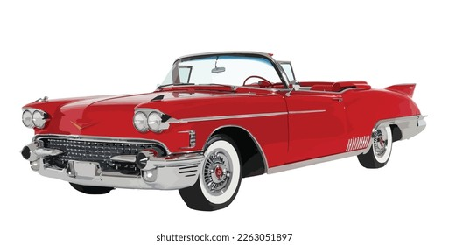

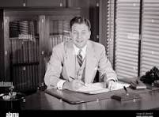



CIR v. Duberstein, 363 U.S. 278 (1960)
Duberstein (Duberstein Iron)
Berman (Mohawk)
Thanks for sending leads my way. A small token of our appreciation.
Thanks for service as comptroller of our RE sub. Here’s a gratuity of 20K.

Slide 8
CIR v. Duberstein, 363 U.S. 278 (1960)
What did the court say was the most important consideration?
Did the court follow the common-law definition of gift?
Is the mere absence of a legal or moral obligation sufficient to make a transfer a gift?
How relevant is the donor’s characterization of the transfer?
What was the government’s proposed test?
How are these cases to be decided in the future?
What happened to Duberstein? Stanton?

Slide 9
CIR v. Duberstein, 363 U.S. 278 (1960)
This Court has indicated that a voluntary executed transfer of his property by one to another, without any consideration or compensation therefor, though a common-law gift, is not necessarily a “gift” within the meaning of the statute. For the Court has shown that the mere absence of a legal or moral obligation to make such a payment does not establish that it is a gift. And, importantly, if the payment proceeds primarily from “the constraining force of any moral or legal duty,” or from “the incentive of anticipated benefit” of an economic nature, it is not a gift. And, conversely, “where the payment is in return for services rendered, it is irrelevant that the donor derives no economic benefit from it.” A gift in the statutory sense, on the other hand, proceeds from a “detached and disinterested generosity,” “out of affection, respect, admiration, charity or like impulses.” And in this regard, the most critical consideration, as the Court was agreed in the leading case here, is the transferor’s “intention.”

Slide 10
Consequences of Duberstein
Section 274(b)(1): no deduction under §162 or §212 for gift (under §102) that exceed $25/year.
Excludes items costing less than $4 on which the TP’s name is imprinted, or
Excludes sign, display rack or other promotional materials used on the business premises of recipient.
Section 102(c): amounts transferred from employer to employee can’t be excluded as gifts, unless it constitutes:
(1) an employee achievement award under §74(c), or
(2) an excludible fringe under §132(e)

Slide 11


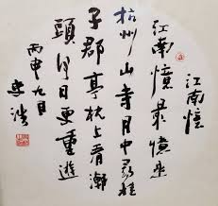
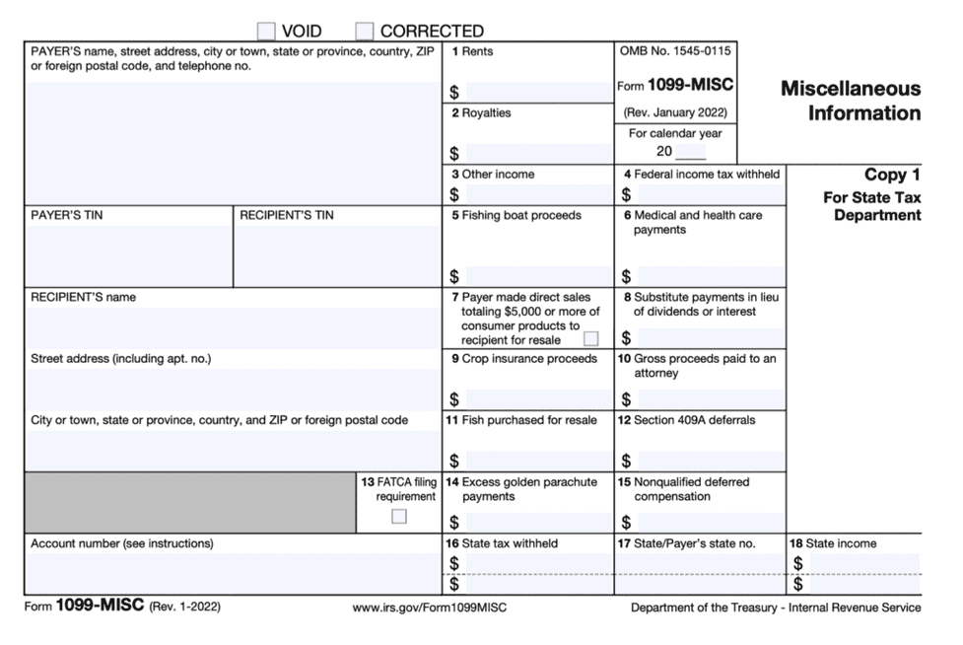

Jue-Ya Yang v. CIR, TC Sum. Op. 2008-156

Slide 12



Olk v. US, 536 F.2d 876 (9th Cir. 1976)

Slide 13
Life Insurance Proceeds
Amounts received under a life insurance contract are exempt from gross income if such amounts are paid by reason of the death of the insured. §101(a)(1).
If a life insurance contract is transferred for valuable consideration, the transferee can exclude only the amounts paid plus any premiums paid by the transferee. §101(a)(2).

