Slide 1
Federal Income Taxation Home, Health, and Charity
Prof. Colon
Spring 2025

Slide 2
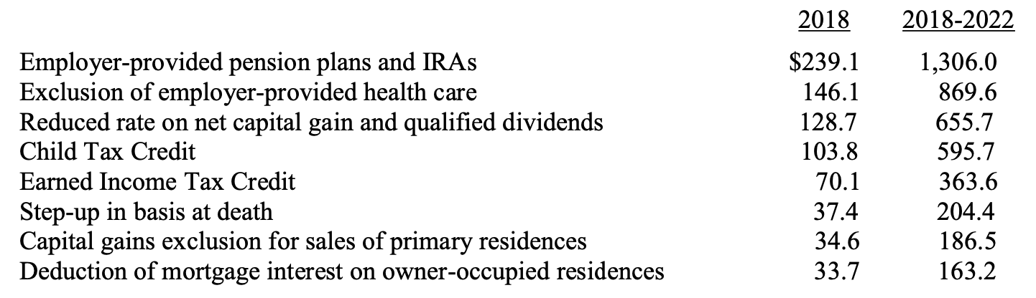
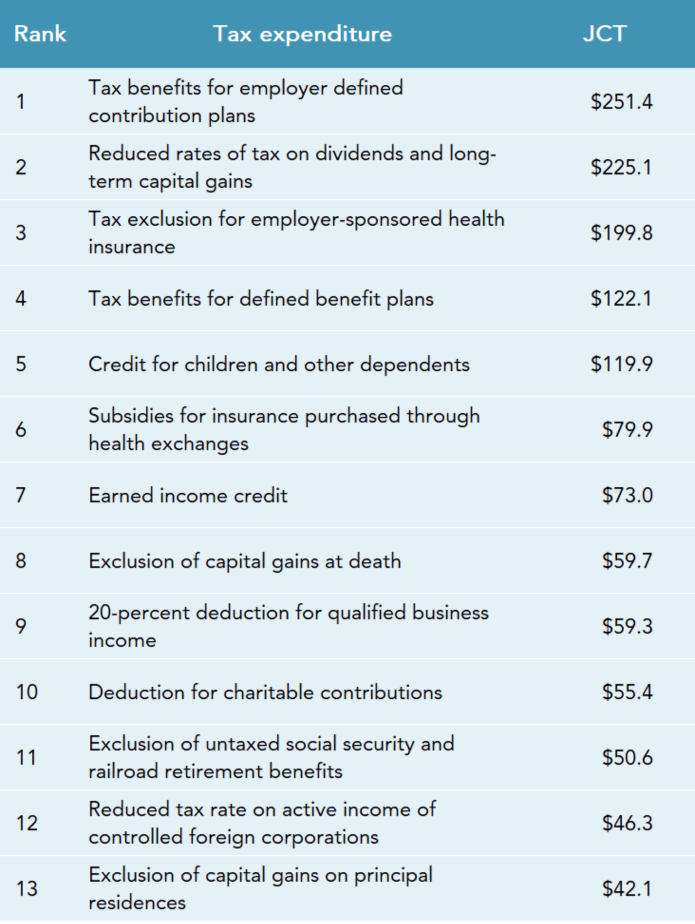
Personal Consumption Tax Expenditures
JCT 2024

Slide 3
Owner Occupied Housing Tax Benefits
Exclusion of imputed income
§163(h)(3) itemized deduction for qualified residence interest
§121 exclusion of gain on principal residence sale
§164(a)(1) itemized deduction for property taxes
§108(a)(1)(E) and (h) exclusion of certain debt-discharge income

Slide 4
Exclusion of Imputed Income
What is imputed rental income?
Value of housing services owner receives from residing in their own home
Effectively receiving same rental income as if renting to a tenant, but don’t have to pay tax on imputed income.
We derive imputed income from many personal assets, e.g., cars, washing machines
Net imputed income = gross rental value less expenses, interest, taxes, and depreciation
Most countries do not tax imputed income (though some European countries historically did)

Slide 5
Tax Policy Critiques of Home Ownership Tax Expenditures
Housing is one of the most tax-preferred investments in U.S. economy
Creates major economic inefficiency and distortion by channeling capital into housing instead of business investment
Results in "bigger houses" rather than improved economic productivity
2005 CBO study: Average tax rate on owner-occupied housing is <5.1%> vs. 13.8% for all capital returns

Slide 6
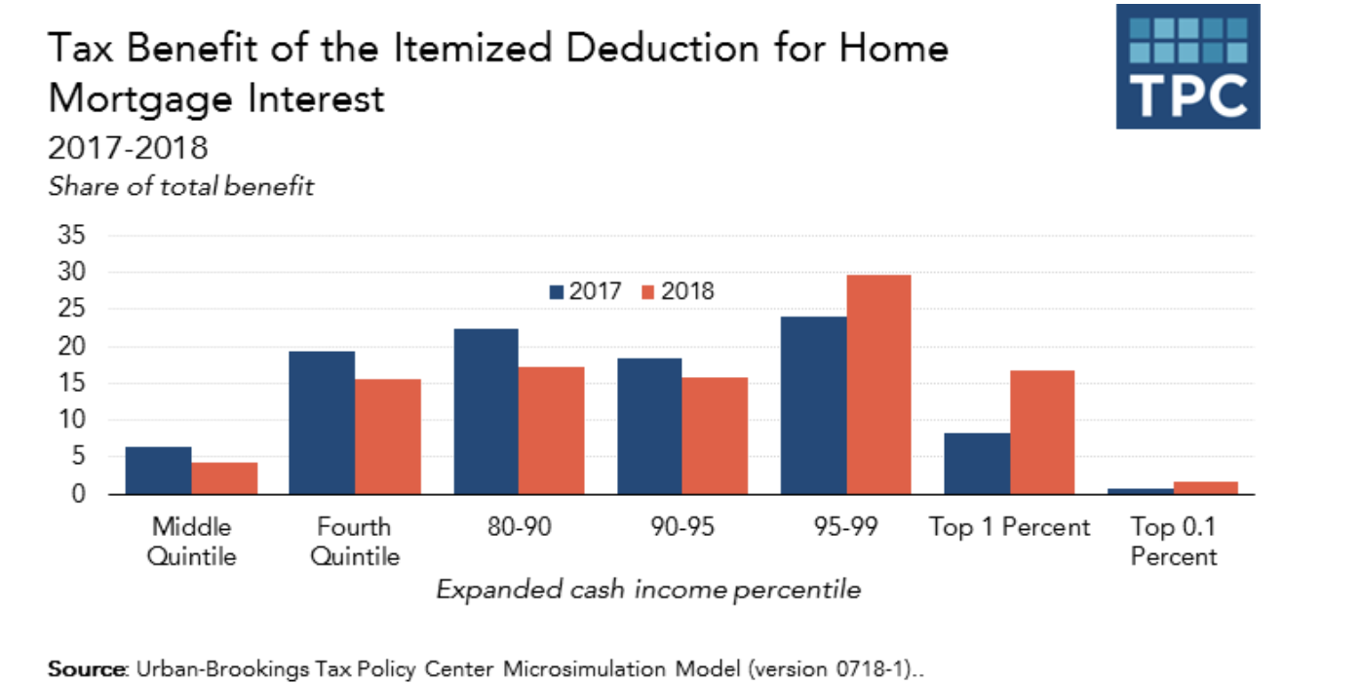
Who benefits from the housing tax subsidies?
Benefits of mortgage interest and property tax deductions disproportionately go to higher-income taxpayers
80% of the benefits from mortgage interest and property tax deductions go to the top 20% of taxpayers; only 5% go to bottom 60% of income scale
TCJA: higher standard deduction means fewer itemizers, so top 5% captures even more benefit than before the TCJA, but this may change after 2025
Homeownership rates similar in countries without these subsidies (Canada, Australia)

Slide 7



Possible Effects of Repeal of TCJA (reduction of standard deduction)
JCT: Tax Expenditures, 2024

Slide 8
Qualified Residence Interest: §163(h)(3)
Originally all interest deductible, but not too important before WWII because only high- income earners paid income tax.
As income tax expanded to include middle class after WWII, the deduction for home mortgage interest became a much more valuable subsidy for middle and upper-middle-income taxpayers.
Before 1986, all interest, including personal interest, was deductible. After 1986, only business, investment, and home mortgage interest remain deductible. Note, the interest deduction for student loan interest.
§163
§ 163(a): all interest paid or accrued is deductible
§163(h)(1): no deduction for personal interest
§163(h)(2)(D): Personal interest includes any interest except…qualified residence interest defined in §163(h)(3)
Qualified residence interest is an itemized deduction (not listed in §62) but NOT a miscellaneous itemized deduction (listed in §67(b)(1)).

Slide 9
Qualified Residence Interest: §163(h)(3)
QRI:
(1) acquisition indebtedness; or
(2) home equity indebtedness (only after 2025)
HEI: any indebtedness other than acquisition indebtedness secured by qualified residence. Limited to 100K and can’t exceed FMV of property less any acquisition indebtedness. §163(h)(3)(C).
Acquisition Indebtedness
Debt, including refinanced debt, used to construct, acquire, or substantially improve a qualified residence and is secured by the residence. §163(h)(3)(B)(i)
Qualified residence: Principal residence plus one other personal residence. §163(h)(4)(A)
Substantial improvement: Must significantly add to value, prolong useful life, or adapt to new use
Ceiling: $750,000 ($375,000 if married filing separately) after TCJA. §163(h)(3)(B)(ii)
Reduced from $1 million pre-TCJA - $1 million limit still applies to grandfathered debt incurred before 2018

Slide 10
Exclusion of Gain on Home Sale: §121
Pre-1997: Complex rollover provisions (old §1034) and one-time exclusion of 125K for those 55+ (old §121). Consumption tax (CF variety)
Current §121: More generous exclusion: $250,000/$500,000 (MFJ) gain exclusion. §121(b)(1). Consumption tax (wage variety)
To qualify, the TP must have owned and used as principal residence for 2 of previous 5 years. §121(a).
Unlike pre-’97 rules, there is no requirement to purchase another home, but a TP can generally only use §121 once every 2 years. §121(b)(3).

Slide 11
Exclusion of Gain on Home Sale: §121
Reduced exclusion if sale due to:
Change in employment
Health reasons
Certain "unforeseen circumstances"
Calculated as fraction of 2-year period: # months of qualified use / 24 months. §121(c)(1) and (2).
Nonqualified use (post-2008 provision)
Limits exclusion for property converted from rental/second home to principal residence
Gain allocated to "nonqualified use" periods is not eligible for exclusion. §121(b)(5).

Slide 12
Debt Discharge: §108(a)(1)(E) and (h)
Under §108, debt forgiveness generally creates taxable income, subject to certain exceptions, e.g., insolvency
Review rules for transfer of property to lender subject to recourse debt! Crane, Rev. Rul. 90-16, and §1.1001-2(a)
Special provision for principal residence debt discharge
First enacted in 2007 (housing crisis), repeatedly extended through 2025
Allows exclusion up to $750,000 of debt forgiveness on qualified principal residence debt, but at a cost of a reduction in basis

Slide 13
Personal Casualty Loss: §165(c)(3) and (h)
Under §165(c)(3), a TP can deduct losses of property from "fire, storm, shipwreck, or other casualty, or from theft”
Note: TCJA limitation (through 2025): deduction limited only to those losses in federally declared disaster areas, but it is generally a below-the-line deduction. §67(b)(3). Not a MID.
Floors:
Any loss is allowed only to the extent that the amount of the loss from each casualty or theft exceeds $100
Net casualty losses (casualty losses minus casualty gains) allowed only to the extent they exceed 10% of AGI.
Amount of loss = Lesser of:
(1) decrease in FMV due to casualty, or
(2) property's adjusted basis. Reg. §1.165-7(b)(1).
Proof requirements: TP must show, the nature of casualty/theft, the property was actually lost, it was the owner, and the amount of loss (usually requires appraisals)

Slide 14
Health Care
U.S. spends significantly more on healthcare than other developed nations--approximately 5% more of GDP with half in private sector and half in public sector
Higher costs without better outcomes
Tax treatment creates market distortions
Key tax provisions:
§213 medical expense deduction
§§105(b) and 106 exclusions for employer-provided care; and
HSAs and high-deductible plans
FSA

Slide 15
Medical/Dental Expense Deduction: §213
A TP can deduct uncompensated amounts paid for medical care to the extent that the medical care expenses exceed 7.5% of AGI.
Note: §213 is an itemized deduction (not a §67 MID)
Medical care is defined in §213(d)(1):
Diagnosis, cure, mitigation, treatment, or prevention of disease or for the purpose of affecting any structure or function of the body
Includes mental health care
Explicitly covers health insurance premiums, qualified long-term care insurance
Transportation/lodging for medical care
Covers drugs and medicine but only if it prescribed or is insulin. §213(b).

Slide 16
Medical Expense Deduction: §213
Cosmetic surgery not deductible unless:
Correcting congenital abnormality
Treating injury from accident/trauma
Treating disfiguring disease. §213(d)(9)
Capital expenditures are deductible if for medical care (eyeglasses, prosthetics, wheelchair)
Home improvements deductible only to extent cost exceeds increase in home value—must directly relate to medical care. Reg. §1.213-1(e)(1)(iii). Maintenance/repair costs generally 100% deductible

Slide 17
Employer Provided Health Care: §§105(b) and 106
Employees exclude 100% of employer-provided health care: No floor or ceiling
Estimated $1 trillion tax expenditure (‘24-’28)
Self-employed: Can deduct 100% as business expense under §162(l)
Historical accident dating to WWII wage controls
Tax policy critique: Creates major market distortions:
Artificially lowers cost to employee
Encourages overconsumption of healthcare
Contributes to healthcare inflation

Slide 18
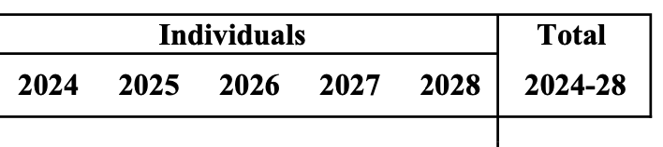
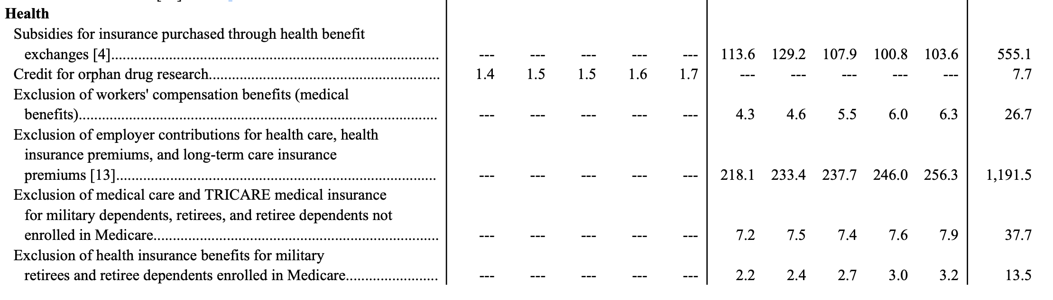
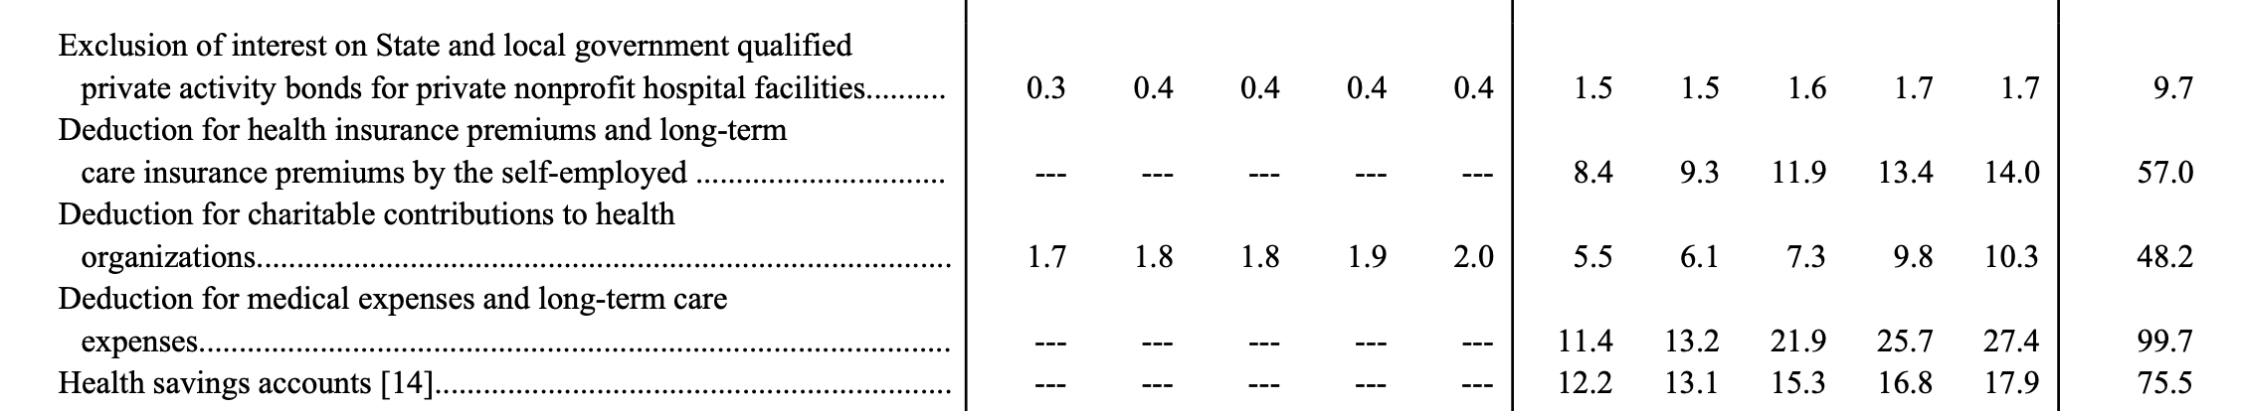
Employer Provided Health Care: §§105(b) and 106

Slide 19
Employer Provided Health Care: §§105(b) and 106
Employer captures some benefit through reduced wages
Healthcare providers capture benefit through higher prices
Similar after-tax position for employee with/without health insurance
Economists across spectrum agree exclusion contributes to healthcare cost problems
Widely viewed as economically inefficient tax expenditure
Political difficulty in reforming due to perception of who benefits

Slide 20
Employer Capture Example

Slide 21
Employer Provided Health Care: §§105(b) and 106
Amounts received by employee through accident or health insurance for personal injuries or sickness are taxable to the extent they are attributable to employer contribution not includible in income or are paid by the employer. §105(a)
But…under §105(b), amounts attributable to medical expenses are excludible if paid directly to taxpayer to reimburse for medical care expenses of himself, dependents, spouses, and any child under the age of 27.
Gross income does not include employer-provided coverage under an accident or health plan. §106(a).

Slide 22
Health Savings Accounts (HSAs) : §223
Extraordinary tax treatment:
Contributions are deductible—above the line (§62(a)(19))
Earnings not taxed as they accrue
Withdrawals for qualified medical expenses are tax-free
Requirements:
Must have high-deductible health plan under §223(c)(2)(A): annual deductible not less than 1.65K (3.3K family) and out of pocket expenses can’t exceed 8.3K (16.6K)
Annual contribution limits under §223(b)(2)(A): 4.3K (8.85K family) for 2025
Non-medical withdrawals: Includable in income plus 20% penalty (but no penalty after 65)

Slide 23
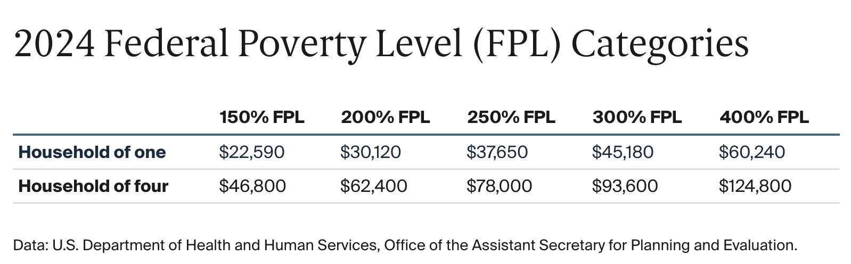
Premium Tax Credit: §36B
Refundable credit created by Affordable Care Act
Available to taxpayers with income between 100-400% of federal poverty level
Credit amount:
Lesser of actual premium or benchmark plan cost
Reduced by expected contribution based on income
Enhanced subsidies through 2025

Slide 24
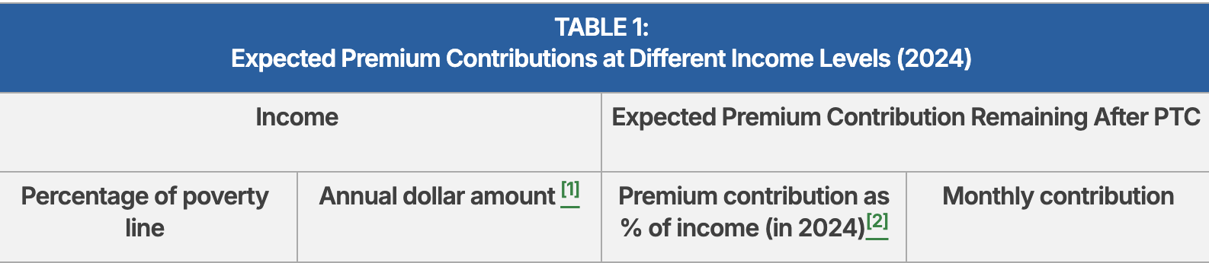
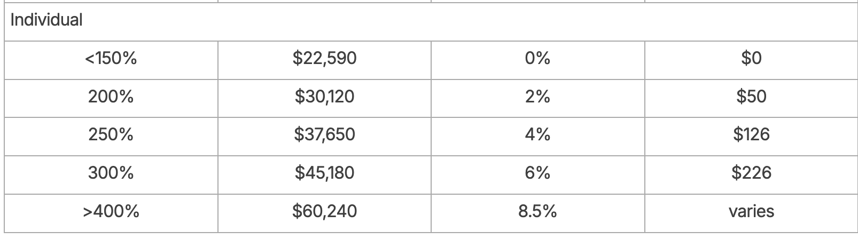
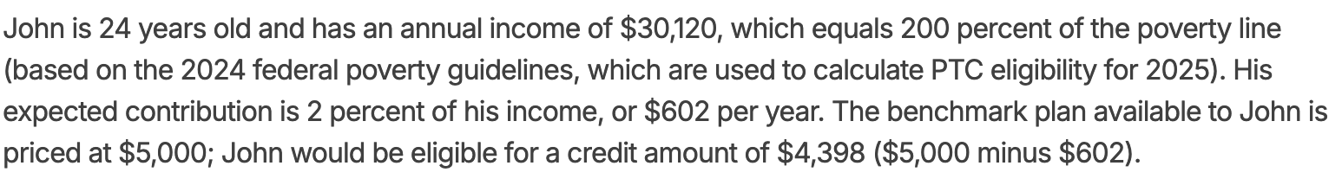
Premium Tax Credit: §36B

Slide 25
Flexible Spending Accounts (FSAs): §125
A type of cafeteria plan under which an employee can choose between a benefit or cash. §125(d)(1).
TPs can use contributions to an FSA to pay on a pre-tax basis medical expenses not covered by their health plan. §125(i)
Covers certain OTC items
Limit for 2025: 3.3K
Other types of cafeteria plans:
Premium only plan (allows employees to pay their share of employer sponsored health insurance using pre-tax dollars).
Dependent care assistance plan (pay costs on pre-tax basis of caring for qualified dependents).

Slide 26
Charitable Deductions
§170 deduction first enacted in 1917
Deduction for "contribution or gift" to qualified organizations:
Governments for public purposes
Religious organizations
Educational organizations (FLS!)
§501(c)(3) organizations
Private foundations (with additional restrictions)

Slide 27
Who Benefits from Charitable Deductions?
Limited to itemizers (dramatically reduced after TCJA)
Benefits flow primarily to high-income taxpayers
Top 1% captures more benefit after TCJA
Charitable giving consistently around 2% of GDP regardless of tax rates
2014 distribution of charitable giving:
Religion: 32%
Education: 15%
Human services: 12%
Gifts to foundations: 12%
Health: 8%

Slide 28
What Constitutes a “Contribution or Gift”?
Duberstein definition: Transfer made out of "detached and disinterested generosity"
Two-part test from United States v. American Bar Endowment:
1. Payment must exceed fair market value of benefits received
2. Excess must be paid with intent to make a gift
Hernandez v. Commissioner: Quid pro quo test
Payments to Church of Scientology for "auditing and training" not deductible
"External features" of transaction showed exchange, not gift

Slide 29
Dual Payments (Part Gift/Part Purchase)
When payment exceeds value of benefit received
Burden on taxpayer to prove:
1. Intent to make a gift
2. Payment exceeds fair market value of benefit
§6115(a) disclosure requirements:
Charities must provide "good faith estimate" of benefits provided for quid pro quo contributions in excess of $75
Must inform donor of deductible portion
Exception for "solely intangible religious benefits"

Slide 30
Contributions of Property
Cash contributions: Amount of cash
Property contributions: FMV at time of contribution but reduced under §170(e)(1) in certain cases. Reg. §1.170A-1(c)(1)
Threshold Question: What would be the character of gain if property were sold instead of donated?
Long-term capital gain
Short-term capital gain
§1231 gain
Ordinary gain

Slide 31
§170(e)(1) Reduction Rules
§170(e)(1)(A): Reduces deduction by amount that would not be long-term capital gain
Inventory: Reduced to basis
Depreciable business property: Reduced by depreciation recapture under §1245
Short-term capital assets: Reduced to basis
§170(e)(1)(B): May reduce long-term capital gain property deduction in certain circumstances:
Tangible personal property with unrelated use
Intellectual property
Taxidermy property
Certain vehicles. §§170(f)(12) and 6720

Slide 32
Property Contribution Examples
Corporate stock held >1 year: Full FMV deduction (most tax-efficient donation)
Corporate stock held <1 year: Basis only
Artwork donated by collector to museum for display: Full FMV
Artwork donated by dealer (inventory): Basis only
Artwork donated where museum will sell it: Basis only
Real estate held >1 year: Full FMV

Slide 33
Substantiation Requirements
Record of donation required for any deduction
Donations $250+: "Contemporaneous written acknowledgment" stating whether goods/services received. §170(f)(8)
Property worth $500+: Form 8283 with description
Property worth $5,000+: Qualified appraisal plus Form 8283
Vehicles: Special requirements under §170(f)(12)

Slide 34
AGI Percentage Contribution Limits
Overall limit: 60% of AGI (increased from 50% by TCJA)
Different limits based on type of property:
Cash to public charities: 60% of AGI. §170(b)(1)(A) and (G).
Property with §170(e)(1) reduction: 50% of AGI (reduced by cash gifts)
Property at FMV (no reduction): Lesser of 30% of AGI or 50% of AGI reduced by other contributions. §170(b)(1)(C).
5-year carryforward for excess contributions. §170(d)(1)

