Slide 1
Federal Income Taxation Essential Structure of the Income Tax
Prof. Colon
Spring 2025

Slide 2
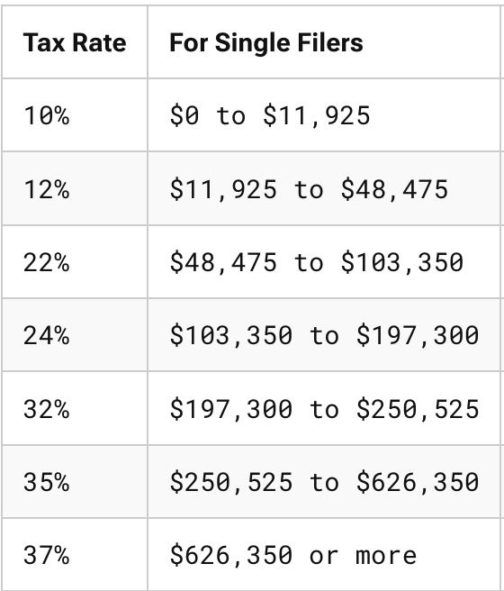

Tax Base and Tax Rates
X
=
$Tax Revenue$
Tax Base
Income
Consumption/Wages
Wealth

Slide 3
HS Definition of Income
HS Definition of Income
Market value of rights exercised in consumption, plus
(2) Change in value of property during period (e.g., annually).
Income = Wealth increases – Wealth decreases, but only if wealth reduction does not represent personal consumption

Slide 4
Core Structure of a Tax on Income
Core Structure of a Tax on Income
Gross Income (inflows—wealth accessions, if not excluded) [§61] minus
Allowable Deductions (certain outflows—wealth reductions) [§161]
Taxable Income (tax base) [§1]

Slide 5
Analysis of Wealth Reductions
 | Analysis of Wealth Reductions
 | Personal | Business | Investment
Capital Expenditures | No wealth reduction; mere change in form of wealth
 | Not deductible [§263] | Not deductible [§263] | Not deductible [§263]
 | Creates basis [§1012] | Creates basis [§1012] | Creates basis [§1012]

Slide 6
Role of Basis
Two Precepts of a Tax on Income
Same $ should not be taxed to the same taxpayer more than once; and
Same $ should not provide a double tax benefit to the same taxpayer
Basis
Record of previously taxed $
$ that have not yet been deducted
Basis (§1012)
Created by nondeductible capital expenditures (most common), or
Income inclusion

Slide 7
Realization & Character
Under HS, increases (decreases) in wealth, e.g., increases (decreases) in the value of an asset, would be taxable events.
Under our tax system, gains/losses are not recognized (enter into the tax base) generally until there is a realization event (sale or exchange).
Gain/Loss: Amount realized minus adjusted basis (AR – AB). §1001(a)
AR: Cash or FMV of other property. §1001(b)
AB: Cost basis with adjustments, e.g., depreciation. §1011(a)
Subtracting the AB ensures that the same dollars are not taxed more than once to the same taxpayer.
What is one justification for the realization requirement? One critique?
If the property sold is a capital asset, any gains are potentially subject to a lower rate (0%, 15%, 20%) than wage income. §1221 (def. of capital asset); §1(h) (CG rates).

Slide 8
Analysis of Wealth Reductions
 | Analysis of Wealth Reductions
 | Personal | Business |  | Investment
Capital Expenditures | No wealth reduction; mere change in form of wealth
 | Not deductible [§263] | Not deductible [§263] | Not deductible [§263] | Not deductible [§263]
 | Creates basis [§1012] | Creates basis [§1012] | Creates basis [§1012] | Creates basis
Expenses | Outlays that reduce wealth
 | Not deductible [§262] | Deductible [§162(a)] | Deductible [§212(1) and (2)]* | Deductible [§212(1) and (2)]

Slide 9
Analysis of Wealth Reductions
 | Analysis of Wealth Reductions
 | Personal | Business |  | Investment
Capital Expenditures | No wealth reduction; mere change in form of wealth
 | Not deductible [§263] | Not deductible [§263] | Not deductible [§263] | Not deductible [§263]
 | Creates basis [§1012] | Creates basis [§1012] | Creates basis [§1012] | Creates basis
Expenses | Outlays that reduce wealth
 | Not deductible [§262] | Deductible [§162(a)] | Deductible [§212(1) and (2)]* | Deductible [§212(1) and (2)]
Losses | Not deductible [§165(c)(3)] | Deductible [§165(c)(1)] | Deductible [§165(c)(2)]

Slide 10
Analysis of Wealth Reductions
 | Analysis of Wealth Reductions
 | Personal | Business |  | Investment
Capital Expenditures | No wealth reduction; mere change in form of wealth
 | Not deductible [§263] | Not deductible [§263] | Not deductible [§263] | Not deductible [§263]
 | Creates basis [§1012] | Creates basis [§1012] | Creates basis [§1012] | Creates basis
Expenses | Outlays that reduce wealth
 | Not deductible [§262] | Deductible [§162(a)] | Deductible [§212(1) and (2)]* | Deductible [§212(1) and (2)]
Losses | Not deductible [§165(c)(3)] | Deductible [§165(c)(1)] | Deductible [§165(c)(2)]
Depreciation | None | Deductible [§167(a)] if wasting asset | Deductible [§167(a)] if wasting asset

Slide 11
Subsistence Consumption, Tax Rates, etc.

Slide 12
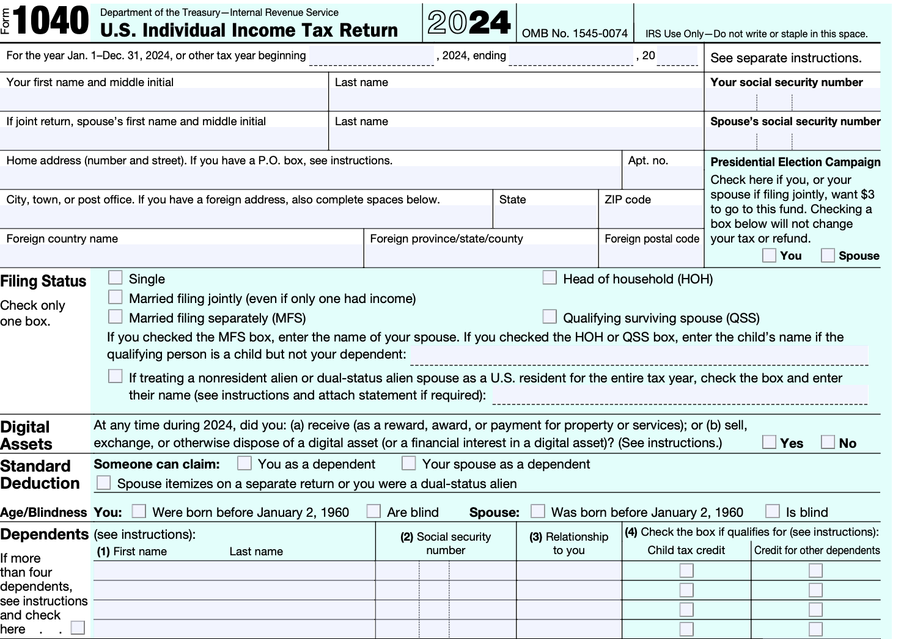
Form 1040

Slide 13
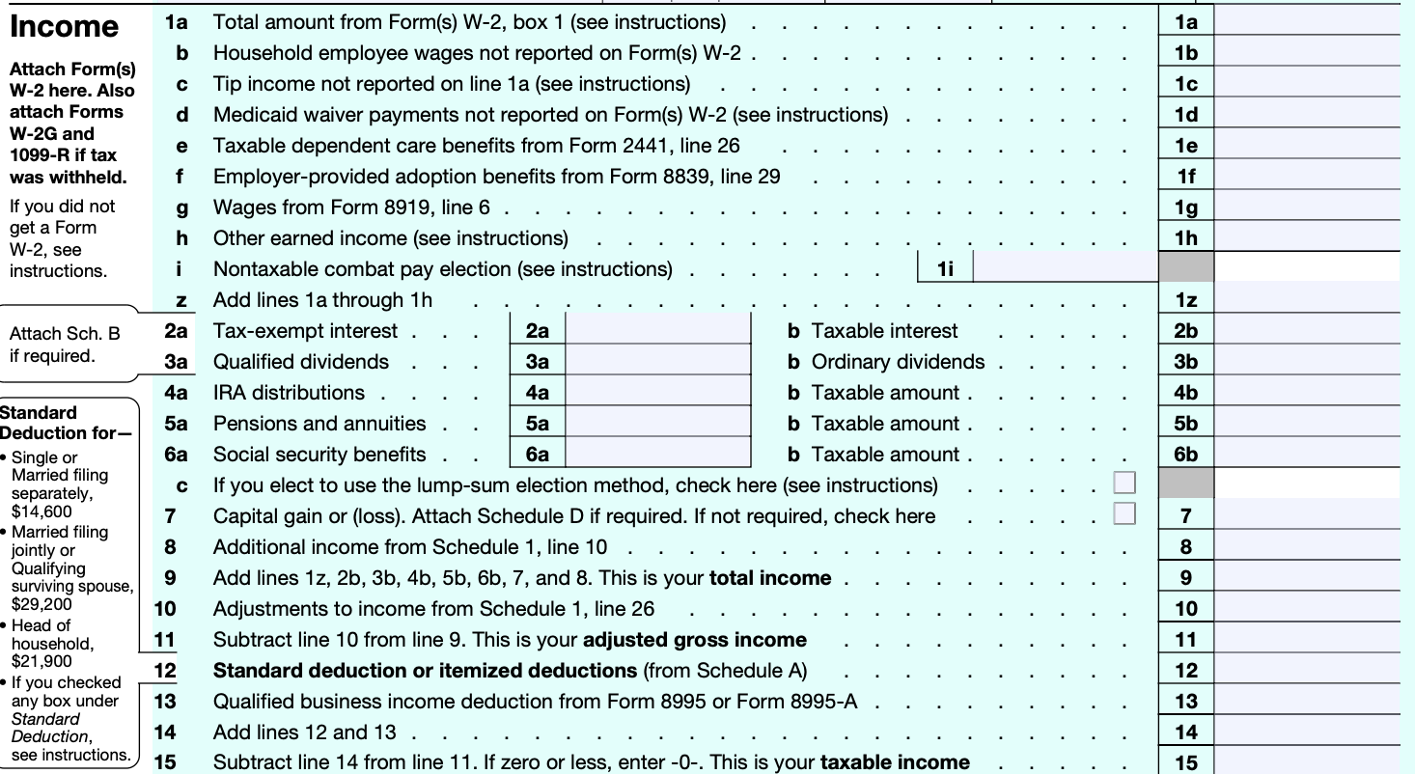
Form 1040: From Gross Income (GI) to Adjusted Gross Income (AGI) to Taxable Income (TI)

Slide 14
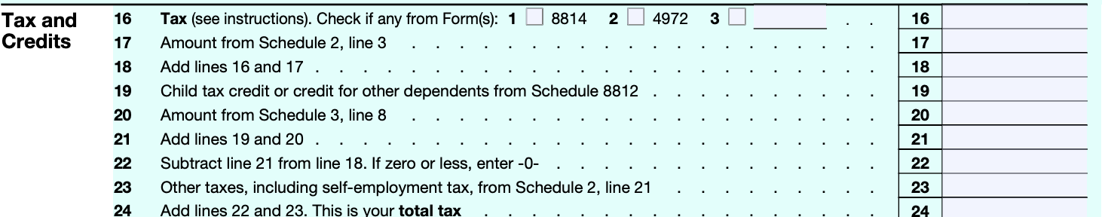
Tax and Credits

Slide 15
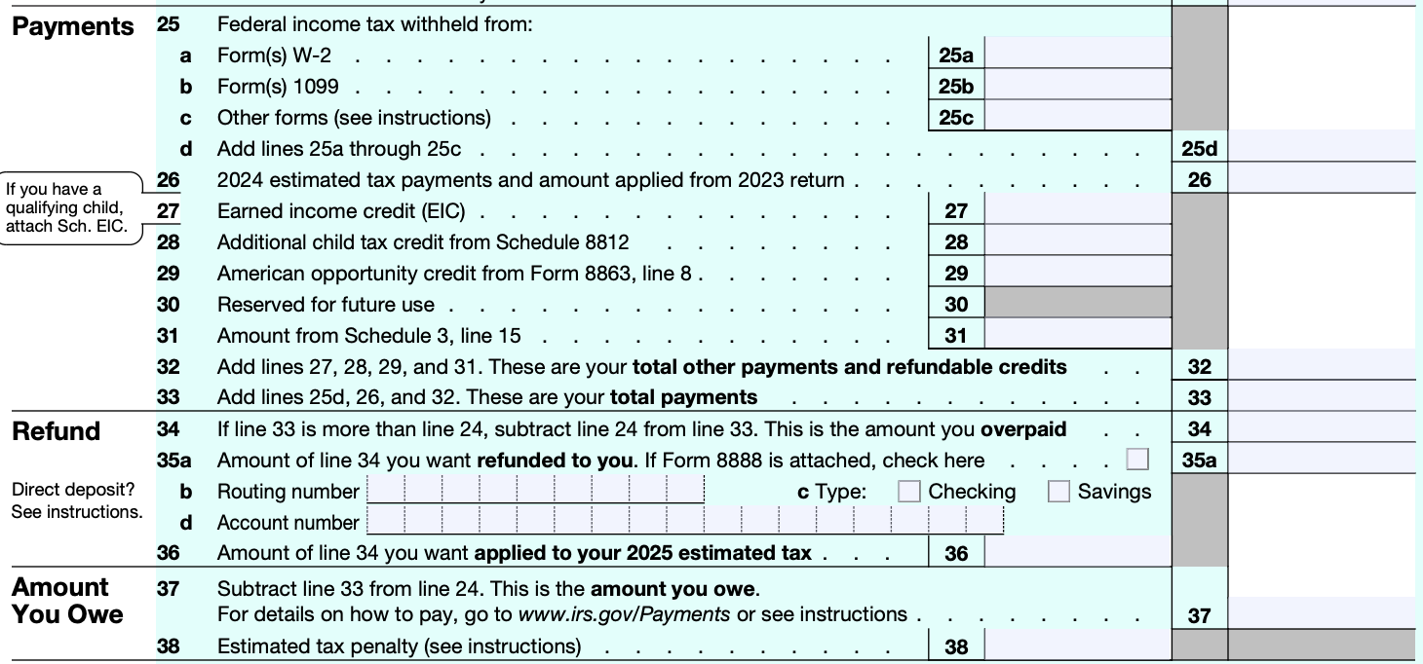
Payments, Refunds, and Amounts Owed

Slide 16
Gross Income to AGI
Deductions from GI to arrive at AGI are referred to as “above the line” deductions.
Examples: T/B deductions; losses from S/X of property; deductions attributable to rents & royalties; IRA deduction; interest on student loans. §62(a).
Above the line deductions are generally not limited (more beneficial than itemized deductions)

Slide 17
AGI to Taxable Income
AGI to Taxable Income (TI): To itemize or not to itemize
Non-itemizer
Standard deduction (15K S, 30K MFJ) + personal exemptions ($0 through 2025) + § 199A deduction. §63(b).
Itemizer
Any other allowable deductions except above-the-line deductions and non-itemizer deductions. §63(d).
Examples: Home interest deduction, state and local tax deduction, charitable contributions. §67(b).
Miscellaneous itemized deductions (MIDs), e.g., non-reimbursed employee business expenses, investment expenses, are suspended through 2025.
Prior to TCJA, deductible only to extent of excess of 2% of AGI. §67(a) and (d).
Above-the-line deductions > Itemized deductions > MIDs

Slide 18
Zero Bracket (Subsistence) Amount
Zero Bracket Amount: Standard deduction + Child Tax Credit + Earned Income Tax Credit
Standard deduction in 2025: 15K (Single); 30K (MFJ)
CTC: 2K/child
EITC: 8.046K (max, 3 or more children)
Personal Exemption & Dependent Deduction (suspended through 2025)

Slide 19
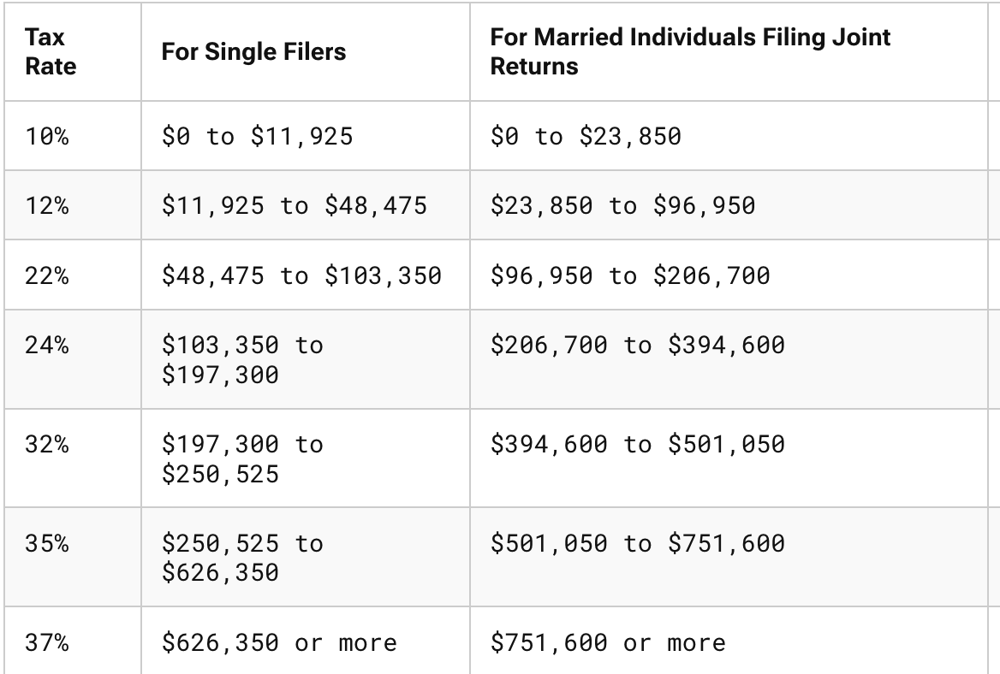
Taxable Tables (2025)

Slide 20
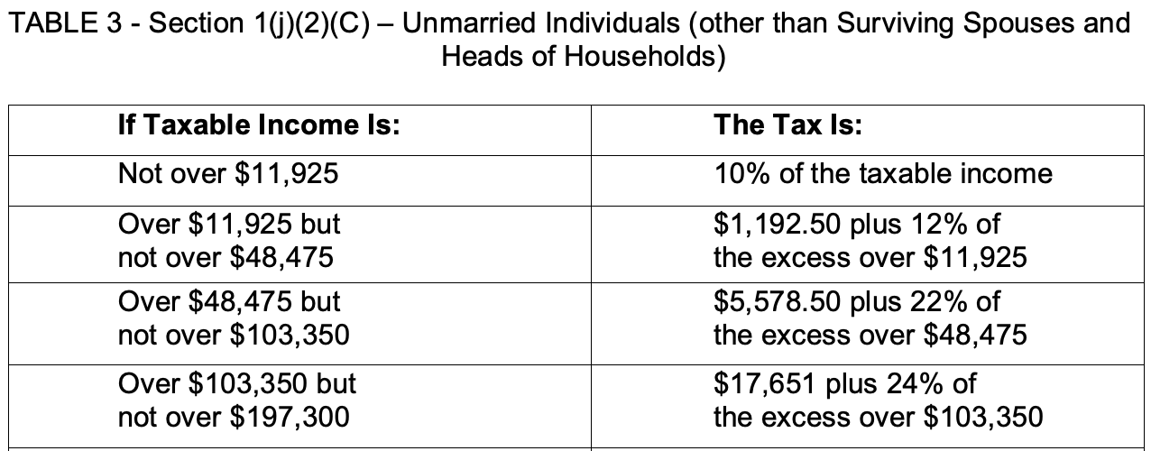
Marginal vs. Effective (Average) Tax Rates
Tax Calculation
Tax Table (Single, 2025)
Mary is single and has taxable income of $100K
Her marginal tax rate is 22%
Her effective tax rate is:
1,1192.50 [11,925 X 10%], plus
4,386 [12% X (48,475 -11,925)], plus
11,335.50 [22% * (100,000 – 48,475)]
Total Tax: 16,914
ETR = 16.914 / 100,000 = 16.91%

Slide 21
Tax Credit vs. Tax Deduction
A tax credit is a dollar-for-dollar reduction in tax liability.
Each dollar of a deduction reduces tax liability by the taxpayer’s marginal tax rate.
Some possible credits:
Child Tax Credit: 2K/child. §63(b)
EITC: 8.046K (max, 3 or more children). §32(a)
Foreign Tax Credit. §27
Lifetime Learning Credit. §25A.
Credit for taxes withheld on wages. §31(a)

Slide 22
Alternative Minimum Tax (AMT)
Taxpayer pays the greater of regular tax liability or AMT
AMT rate is 28% vs. highest individual rate of 37%
AMT base is wider than regular tax base
Add back state and local taxes
Add back property taxes
Add back personal exemptions and dependent deductions (suspended through 2025)
TCJA increased the AMT exemption amount, so it catches fewer taxpayers.

Slide 23
§199A (New in the TCJA of 2017).
*Note: many details omitted
20% deduction of a non-corporate taxpayer’s Qualified Business Income Amount (QBIA)
QBI: Roughly income from a QT/B, but excluding CGs, CLs, dividend income
QT/B: Any business except the T/B of being an employee, and: health, law, accounting, actuarial science, performing arts, consulting, athletics, financial service, brokerage services, or any T/b where the principal assets of the T/B is the reputation or skill of 1 or more of its employees;
Exception for specified service business: If the taxpayer’s income is less than $197,300 ($394,600) (2025), a specified service, e.g., law, will be treated as a QT/B. §199A(d)(3)(A).
Exception doesn’t apply to attorneys who are employees.

