Slide 1
Federal Income Taxation
Depreciation and Business Interest
Prof. Colon
Fall 2026

Slide 2
Depreciation—Financial Accounting
Depreciation—the financial accounting approach
  Matching the cost of income-producing assets with the income that they generate
  Goal is to improve the accuracy of the financial health of a business
  Depreciation: tangible assets; Amortization: intangible assets
Is allowing depreciation before a sale of the asset consistent with a realization-based income tax system?

Slide 3
Economic Depreciation in a Realization-based Income Tax
CFCT: cost of business/investment property deductible in the year purchased
Income Tax: No deduction because no decrease in wealth (merely changed form) but basis is created.
Different strands of a property’s value
  Change in supply/demand
  Interest rates
One strand of value produces a loss: if the asset wastes away over time from use in an income-producing activity.
  Note, value of asset may change (increase) because of the change in the other strands of value, e.g., interest rate, oil price shocks, demand/supply for output

Slide 4
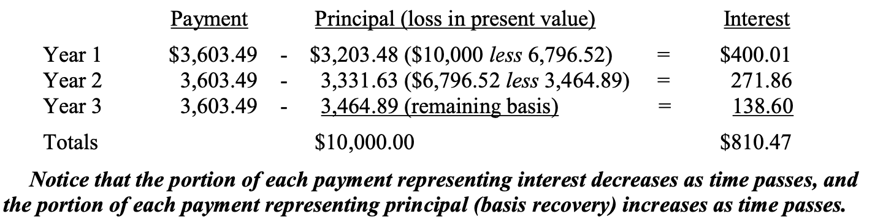
Economic Depreciation in a Realization-based Income Tax
Example (p. 377): TP purchases machine for 10K and expects to earn back the cost of the machine plus 4% profit. TP believes that the machine will be worthless after 3 years, and TP expects to earn about 3.603K in gross receipts annually from use of the machine.
How should TP recover the 10K cost of the machine?
Recall our examination of the repayment of 10K of debt at 4% with 3 annual payments of 3.6K in Ch. 9, where we determined how much of each payment is principal & int.
Note: For debt, only interest is taxable; for machine, all GI taxable w/ a deduction for depreciation.

Slide 5
Economic Depreciation vs. Tax Depreciation under §§167, 168, 179, and 197
Economic depreciation is generally much slow than depreciation allowed under §§167, 168, 179, and 197.
Accelerated depreciation is a CFCT feature of our income tax system, because it allows the deduction of basis before economic loss, thus permitting a portion of an investment’s return to be earned on pre-tax dollars.
Query: who captures this benefit? Buyers of investment property or sellers?
The JCT considers accelerated depreciation to be a tax expenditure:
  The Joint Committee staff generally classifies as tax expenditures cost recovery allowances that are more favorable than those provided under the alternative depreciation system (sec. 168(g)), which provides for straight-line recovery over tax lives that are longer than those permitted under the accelerated system.
  For 2025-2029: 296Bi (equipment); 27Bi (rental housing); 80Bi (non-rental housing buildings). JCT-45-25.

Slide 6

Section 167 and “Wear and Tear”
Under §167(a), a depreciation deduction is allowed for “exhaustion, wear and tear” of property used in the T/B or held for the production of income.
Inventory, personal residences, personal cars, and land, for example, are not depreciable
Section 167 permits depreciation, but the specific rules for the timing and amount are found in:
  §168 (tangible property)
  §§167 & 197 (intangible property)
  §179 (certain business property)
Simon v. CIR, 103 T.C. 247 (1994), aff’d, F.3d 41 (2d Cir. 1995)
Is a 200-year bow subject to wear & tear?

Slide 7
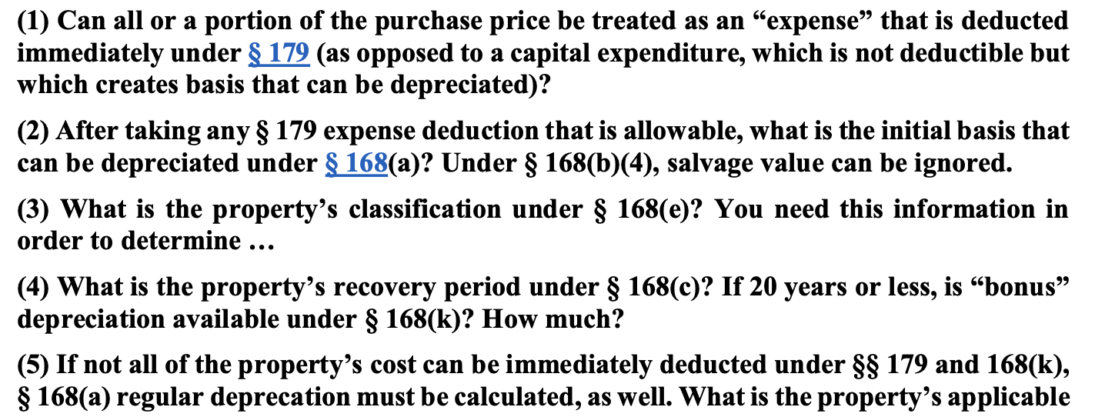
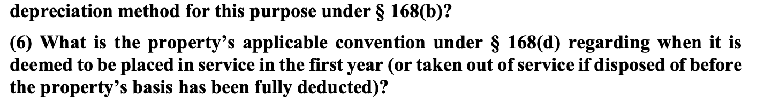
Depreciation of Tangible Assets

Slide 8
Depreciation of Tangible Assets: Section 179
Section 179 allows a TP to elect to immediately expense §179 property placed in service. §179(a).
Limits:
  For 2026, the total cost that can be expensed under §179 is 2.56MM (2.5MM stat. + inf. adjust)
  The 2.56MM limit is reduced by the excess of §179 property placed into service over 4.09MM (full phase out at 6.65MM). (4MM stat. + inf. adjust)
  The §179 deduction is limited to the taxable income of the TP’s T/B. §179(b)(1), (2) and (3).
§179 property:
Tangible property, computer software, §1245 property (personal property), business vehicles, and certain improvements to nonresidential real property, such as roofs, AC, heating, and ventilation. §179(d)(1) and (e).

Slide 9
Section 168 Depreciation: Recovery Period
To the extent that a TP either does not elect §179 or has additional remaining basis of purchased property after the application of §179, the remaining basis (capital expenditure) can be depreciated under §168.
Step 1: to determine the property’s classification under §168(e) based on its class life, such as 3-year property, 20-year property, residential rental property or nonresidential property, etc.
  Certain property is classified under the statute, e.g., Alaska natural gas pipeline is 7-year property, but for property that’s not listed, the IRS provides class life classification.
  Residential rental property: 27.5 years; Nonresidential rental property: 39 years
  If a property doesn’t have a class life, it is treated as 7-year property. §168(e)(3)(C)(v).
Step 2: once the property’s class life/classification is determined, the TP must determine its recovery period under §168(c), e.g., 5-year property is depreciable over 5 years.

Slide 10
Section 168(k): Bonus Depreciation for Qualified Property
Qualified property depreciable property has a recovery period of 20 years or less, is computer software, water utility property, qualified firm or television production, or qualified live theatrical production, additional bonus depreciation can be taken in the year in which the property is placed into service. §168(k)(1) and (2).
The property’s basis is reduced by the bonus depreciation before computing any allowable depreciation. §168(k)(1)(B).
Bonus depreciation for property acquired aft 1/29/2025 is 100%. §168(k)(1)(A).

Slide 11
Section 168(b): Depreciation Methods
200% declining balance method
  generally applies to 3, 5, 7, 10-year property
150% declining balance method
  generally applies to 15, 20-year property
Straight-line method
  generally applies to nonresidential real property and residential rental property
Under both the 200% and 150% DBMs, the TP switches to SL when it is greater than the accelerated methods.

Slide 12
Section 168(b): Applicable Conventions
The applicable convention ignores the exact date the property is placed into service and treats property as being played into service:
  At the mid-point of the year (half-year convention)
  At the mid-point of the month (mid-month convention)
  At the mid-point of the quarter (mid-quarter convention). §168(d)(1)-(4)
The applicable convention for most property is the half-year convention, but nonresidential RP and residential rental property is mid-month. §168(d)(1) and (2).
For example: For half-year convention property, the TP’s depreciation deduction for Y1 is ½ of the year’s depreciation. Note, this rule also applies for the year of sale or disposition.

Slide 13
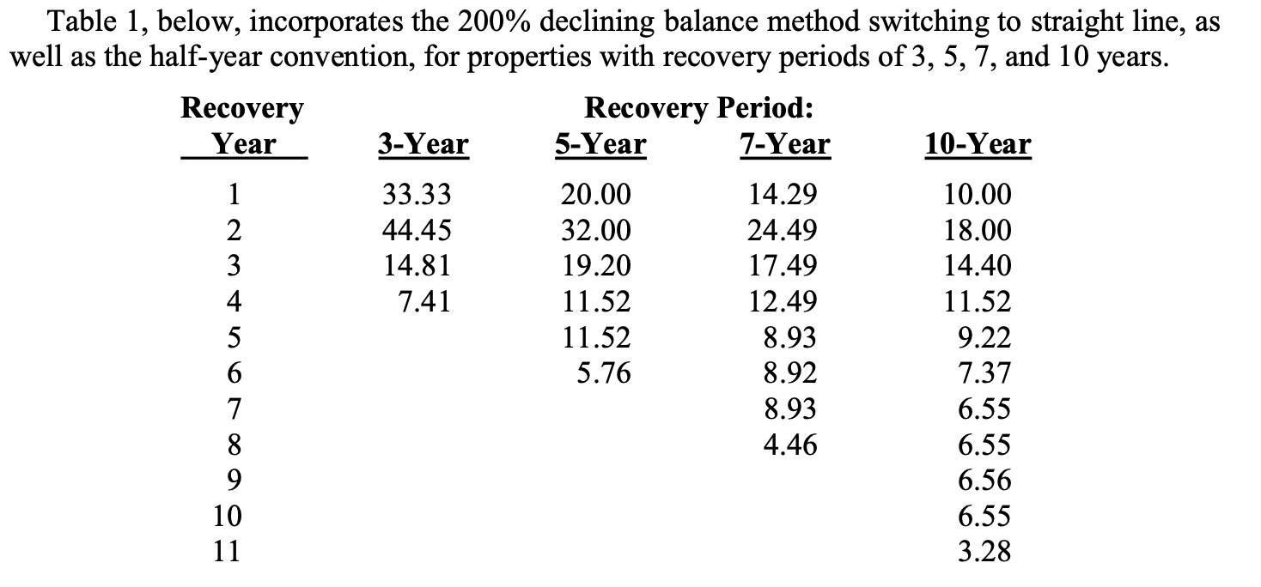
Section 168(b): Depreciation Tables

Slide 14
Depreciation and Basis
Section 179 is elective, but §168 is not
TP is presumed to take bonus depreciation, unless TP elects out. §168(k)(7)
§1016(a)(2) requires a TP to reduce to the basis of property by depreciation allowed…but not less than the depreciation allowable.
  Allowed: depreciation actually taken
  Allowable: depreciation that could have been taken but wasn’t
  Why would a TP want to delay a depreciation deduction?

Slide 15
Depreciation: Real Estate
RE is generally not eligible for §179 (not §1245 property, but see §179(e) (qual. real property) or bonus depreciation under §168(k) (recovery period exceeds 20 years)
Residential real property: building structure if 80% or more of gross rental income is rental income from dwelling units. §168(e)(2)(A). Doesn’t include a hotel, motel, or Holiday Inn
  Recovery period is 27.5 years with a mid-month convention
Nonresidential real property: RP that is not residential RP or property w/ a class life less than 27.5 years.
  Recovery period is 39 years with a mid-month convention

Slide 16
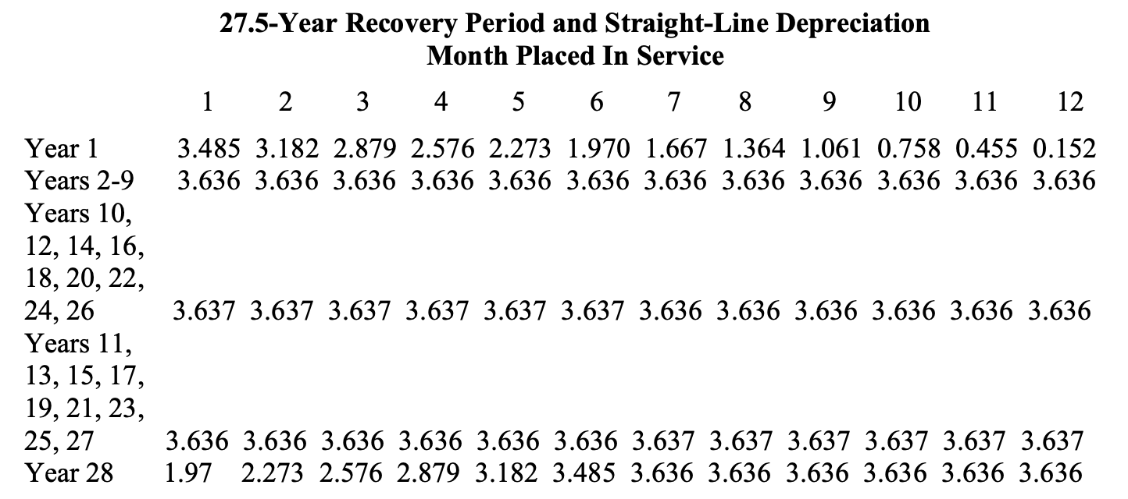
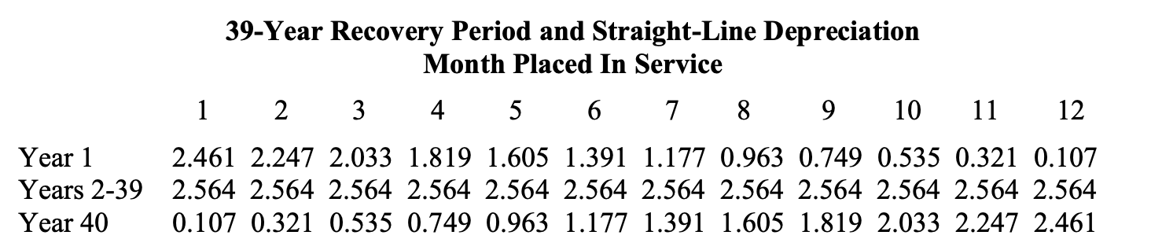
Depreciation: Real Estate

Slide 17
Section 280F Limitations
Goal: limit §§179 and 168 in the case of luxury automobiles, but it applies to passenger automobiles, which is defined to be any 4-wheeled vehicle for public street use weighing 6,000 pounds or less. §280F(a)(1) and (d)(5).
The limits in §280F for passenger automobiles is increased by 8,000 for bonus depreciation. §168(k)(2)(F)(i)
§280F also applies to listed property, which is passenger automobiles, any other property used for transportation, property used for entertainment, recreation, or amusement. §280F(d)(4)(A).
If an automobile is used partially for personal use and partially for business use, the depreciation deduction is proportionately reduced. §280F(a)(2).
If business usage does not exceed 50%, the §168 depreciation schedule is straight line and thus no bonus depreciation. §280F(b)(1).
Under §179(b)(5), for purposes of §179, the cost of any SUV that can be taken into account under §179 is $32,000 for 2026, provided that it is not subject to §280F and weighs less than 14,000 pounds.

Slide 18
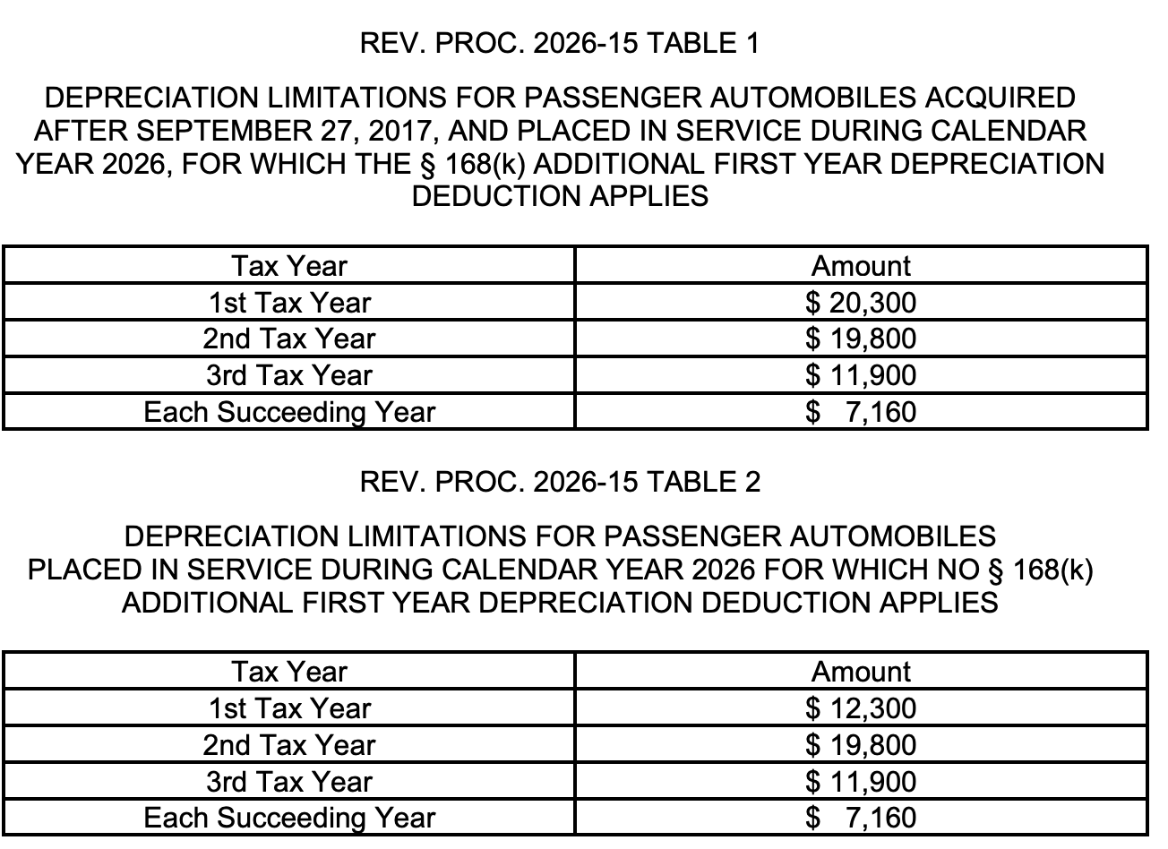
Section 280F Limitations for 2026: Rev. Proc. 2026-16

Slide 19
Amortization of Intangible Assets: §§ 167 and 197; Start-Up Costs
Section 197 intangibles are amortizable over 15 years (SL).
  Goodwill, going concern value, workforce in place, business books and records, operating systems
  Patent, CR, TM, TN, franchise, formula
  Customer-based and supplier-based intangibles. §197(d)(1)
Doesn’t include land, financial interests, any CR or patent not acquired as part of the acquisition of a T/B, lease, indebtedness. §197(e)(1), (2), (4), and (5).
Start-up Expenditures: Currently deductible under to 5K; remainder deductible over the 180-month (15 yrs) period beginning w/ the month the T/B begins. §195(b)(1).

Slide 20
Tax Arbitrage
Income Tax: Borrowed principal is excluded from income, repaid principal is not deductible, but business interest is deductible.
CFCT: Borrowed principal included in tax base, but interest and repaid principal deductible (non-consumption outlay)
Wage Tax: Borrowed principal not included and repayments not deductible, but business interest is not deductible.
Tax Arbitrage: CFCT treatment of investment (deduction) and interest deduction for purchase of that investment can result in better treatment than consumption tax treatment
  §179 plus §163(a) business interest deduction
  §168(k) bonus depreciation plus §163(j) deduction for interest (limited to 30% of adjusted taxable income: EBITDA (after 2024).
  Some RE businesses are not subject to §163(j) if they agree to lengthen deprecation to 30 yrs (RRE) and 40 yrs (Non-RRE). §163(j)(7)

