Slide 1
Federal Income Taxation Essential Structure of the Income Tax
Prof. Colon
Spring 2025

Slide 2
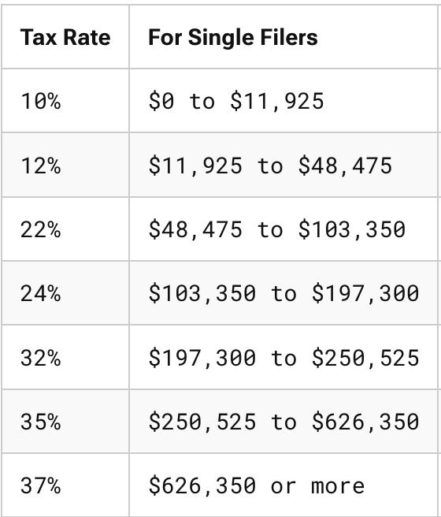

Tax Base and Tax Rates
X
=
$Tax Revenue$
Tax Base
Income
Consumption
Wealth

Slide 3
HS Definition of Income
HS Definition of Income
Market value of rights exercised in consumption, plus
(2) Change in value of property during period (e.g., annually).
Income = Wealth increases – Wealth decreases, but only if wealth reduction does not represent personal consumption

Slide 4
Core Structure of a Tax on Income
Core Structure of a Tax on Income
Gross Income (inflows—wealth accessions, if not excluded) [§61] minus
Allowable Deductions (certain outflows—wealth reductions) [§161]
Taxable Income (tax base) [§1]

Slide 5
Analysis of Wealth Reductions
 | Analysis of Wealth Reductions
 | Personal | Business | Investment
Capital Expenditures | No wealth reduction; mere change in form of wealth
 | Not deductible [§263] | Not deductible [§263] | Not deductible [§263]
 | Creates basis [§1012] | Creates basis [§1012] | Creates basis [§1012]

Slide 6
Role of Basis
Two Precepts of a Tax on Income
Same $ should not be taxed to the same taxpayer more than once; and
Same $ should not provide a double tax benefit to the same taxpayer
Basis
Record of previously taxed $
$ that have not yet been deducted
Basis (§1012)
Created by nondeductible capital expenditures (most common), or
Income inclusion

Slide 7
Realization & Character
Under HS, increases (decreases) in wealth, e.g., increases (decreases) in the value of an asset, would be taxable events.
Under our tax system, gains/losses are not recognized (enter into the tax base) generally until there is a realization event (sale or exchange).
Gain/Loss: Amount realized minus adjusted basis (AR – AB). §1001(a)
AR: cash or FMV of other property. §1001(b)
AB: Cost basis with adjustments, e.g., depreciation. §1011(a)
Subtracting the AB ensures that the same dollars are not taxed more than once to the same taxpayer.
What is one justification for the realization requirement? One critique?
If the property sold is a capital asset, any gains are potentially subject to a lower rate (0%, 15%, 20%) than wage income. §1221 (def. of capital asset); §1(h) (CG rates).

Slide 8
Analysis of Wealth Reductions
 | Analysis of Wealth Reductions
 | Personal | Business |  | Investment
Capital Expenditures | No wealth reduction; mere change in form of wealth
 | Not deductible [§263] | Not deductible [§263] | Not deductible [§263] | Not deductible [§263]
 | Creates basis [§1012] | Creates basis [§1012] | Creates basis [§1012] | Creates basis
Expenses | Outlays that reduce wealth
 | Not deductible [§262] | Deductible [§162(a)] | Deductible [§212(1) and (2)]* | Deductible [§212(1) and (2)]

Slide 9
Analysis of Wealth Reductions
 | Analysis of Wealth Reductions
 | Personal | Business |  | Investment
Capital Expenditures | No wealth reduction; mere change in form of wealth
 | Not deductible [§263] | Not deductible [§263] | Not deductible [§263] | Not deductible [§263]
 | Creates basis [§1012] | Creates basis [§1012] | Creates basis [§1012] | Creates basis
Expenses | Outlays that reduce wealth
 | Not deductible [§262] | Deductible [§162(a)] | Deductible [§212(1) and (2)]* | Deductible [§212(1) and (2)]
Losses | Not deductible [§165(c)(3)] | Deductible [§165(c)(1)] | Deductible [§165(c)(2)]

Slide 10
Analysis of Wealth Reductions
 | Analysis of Wealth Reductions
 | Personal | Business |  | Investment
Capital Expenditures | No wealth reduction; mere change in form of wealth
 | Not deductible [§263] | Not deductible [§263] | Not deductible [§263] | Not deductible [§263]
 | Creates basis [§1012] | Creates basis [§1012] | Creates basis [§1012] | Creates basis
Expenses | Outlays that reduce wealth
 | Not deductible [§262] | Deductible [§162(a)] | Deductible [§212(1) and (2)]* | Deductible [§212(1) and (2)]
Losses | Not deductible [§165(c)(3)] | Deductible [§165(c)(1)] | Deductible [§165(c)(2)]
Depreciation | None | Deductible [§167(a)] if wasting asset | Deductible [§167(a)] if wasting asset

Slide 11
Subsistence consumption, tax rates, etc.

Slide 12
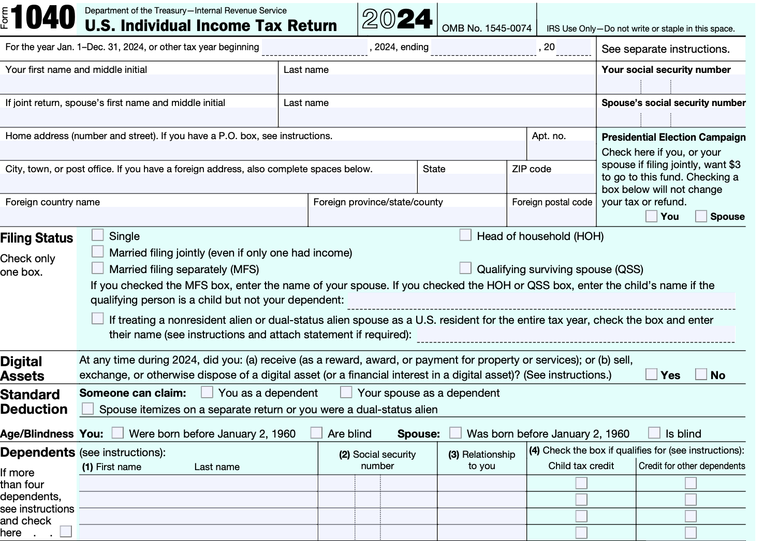
Form 1040

Slide 13
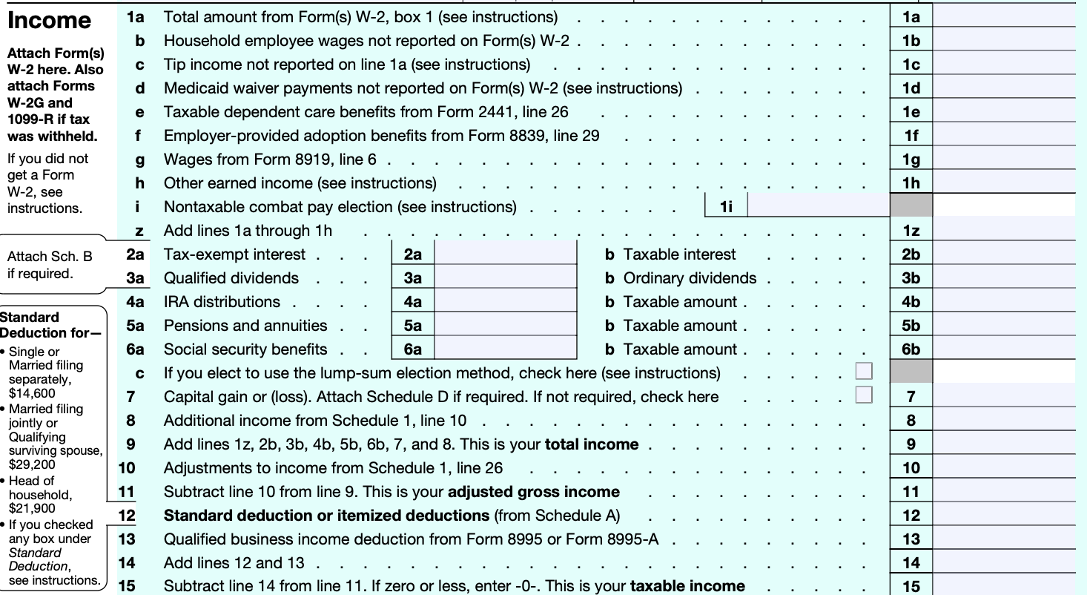
Form 1040: From Gross Income (GI) to Adjusted Gross Income (AGI) to Taxable Income (TI)

Slide 14
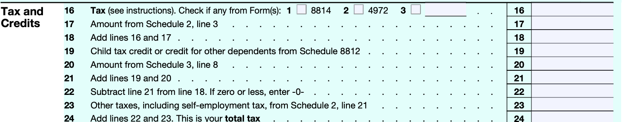
Tax and Credits

Slide 15
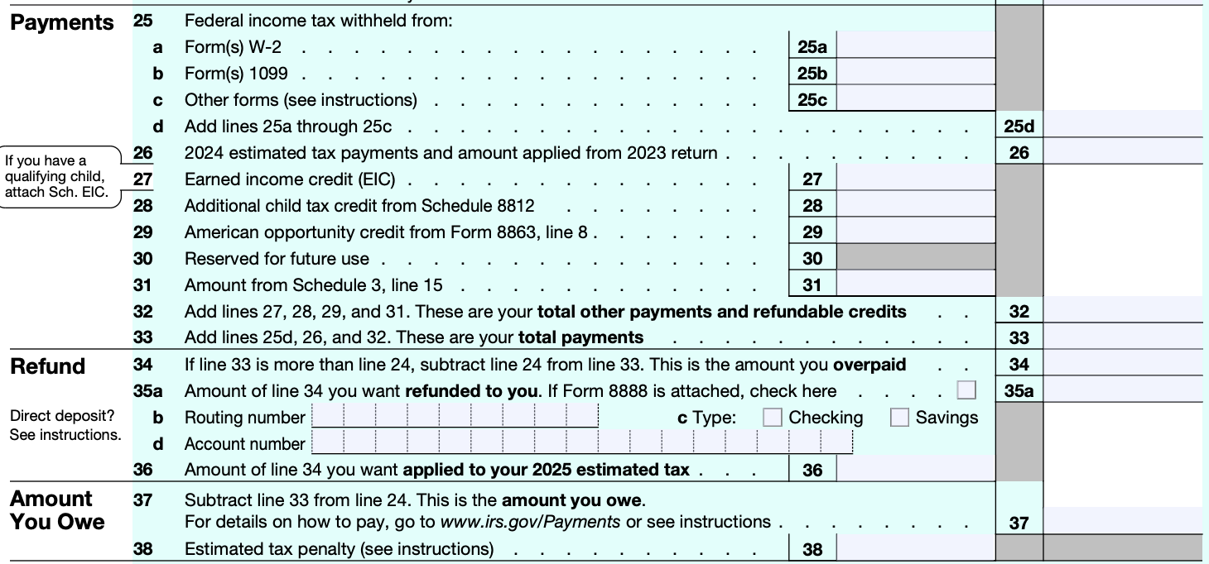
Payments, Refunds, and Amounts Owed

Slide 16
Some additional comments
Deductions from GI to arrive at AGI are referred to as “above the line” deductions.
Above the line deductions are generally not limited
Itemized Deductions

Slide 17
Zero Bracket Amount: Standard deduction + Child Tax Credit + Earned Income Tax Credit
Standard deduction in 2025: 15K (Single); 30K (MFJ)
CTC: 2K/child
EITC: 8.046K (max, 3 or more children)
Personal Exemption & Dependent Deduction (suspended through 2025)

