Slide 1
Federal Income Taxation Human Capital
Prof. Colon
Spring 2025

Slide 2
Human Capital
Human capital vs. Financial capital vs. Physical/Tangible capital
Ability to sell human capital or things created w/ human capital
Treatment of education costs under an HS income tax
Distinction between income producing activities and personal producing activities
Wealth accessions and wealth reductions
Education tax zoo: Credits, deductions, exclusions, exemptions
Justifiable tax expenditures? Cost: 130Bi over the last 4 years.
Who captures the benefits: Society? Students? Administrators? Professors?

Slide 3
Scholarships and Tuition Reductions: §117
Qualified scholarships are excludable
QS: amount received used for qualified tuition and related expenses
Must be a candidate for a degree at a higher education institution.
Qualified Tuition: Tuition, fees, books supplies, and equipment required for course of instruction. §117(a)(1)
Excludes amounts that represent payments for teaching, research, or other service. §117(c)(1). This includes payments for past, present, or future employment services.
Qualified Tuition Reduction is excludable
Tuition reduction for employee (spouse or dependent child) of educational organization
Subject to non-discrimination rules. §117(d)(1)-(3)

Slide 4
Employer Provided Educational Assistance: §127
Exclusion of up to $5,250 annually of educational assistance to an employee provided pursuant to a program. §127(a)
Educational assistance program
For exclusive benefit of employees
Non-discriminatory
Limits of benefits to SHs/owners owning 5% or more of the stock/capital of employer
Can’t provide for choice between educational assistance or remuneration. §127(b)(1)-(4)
Educational Assistance
Payment for education, including tuition, fees, books, supplies, and equipment
Payment by employer to employee or lender of principal or interest on qualified education loan
Provision by employer of courses of instruction
Not including any payment for provision of benefits to course or education involving sports, games, or hobbies. §127(c)(1)
No deduction or credit to employee for any amount excluded under §127(c)(7).

Slide 5
American Opportunity Tax Credit and Lifetime Learning Credit: §25A
AOTC
100% of qualified tuition and related expenses up to $2,000 plus
25% of expenses that exceed $2,000 but not $4,0000.
For $4,000 (or more) of expenses, total credit would be $2,500. §25A(a) and (b).
As law students know, the AOTC is allowed for only 4 taxable years and for the first 4 years of postsecondary education. §25A(b)(2)(A) and (C).
Lifetime Learning Credit (LLC)
20% of the qualified tuition and related expenses as does not exceed $10,000
No LLC if the AOTC is allowed
Expenses have to be with respect to a course of instruction to acquire or improve skills of the TP

Slide 6
American Opportunity Tax Credit and Lifetime Learning Credit: §25A
AOTC and LLC Limitations Based on Modified AGI
The credit is reduced as the TP’s MAGI exceeds 80K (160K joint return) and is fully eliminated when the excess reaches 10K (20K joint return). §25A(d)(1).
Qualified tuition and related expenses covers tuition and fees for
TP, spouse, dependent
Doesn’t include expenses involving sports, games, hobbies, unless part of individual’s degree program.
Doesn’t include student activity fees, athletic fees, insurance
For AOTC, course materials are covered
Qualified tuition is reduced by any qualified scholarship under §117. §25A(g)(2)(A).
No credit allowed for any expense for which a deduction is allowed. §25A(g)(5).
A dependent of a TP isn’t allowed a credit, but the expenses paid by the dependent are treated as if paid by the TP. §25A(g)(3)
40% of the AOTC are refundable; none of the LLCs are refundable. §25A(i)

Slide 7
Education Benefits: Reg. §1.162-5(a).
To be deductible under §162, job-related education expenses must:
(1) maintain or improve skills required by the individual in his employment or other trade or business, or
(2) meet the express requirements of the individual’s employer, or the requirements of applicable law or regulations, imposed as a condition to the retention by the individual of an established employment relationship, status, or rate of compensation. Reg. §1.162-5(a).
If at least one of the above requirements is satisfied, no deduction is allowed for education that:
(1) is required in order to meet the minimum education requirements for qualification in the taxpayer’s employment or other trade or business, or
(2) will lead to qualifying the taxpayer in a new trade or business. Reg. §1.162-5(b)(2) or (3).
Education expense must be incurred in carrying on a T/B.

Slide 8
Sharon v. CIR, 66 T.C. 515 (1976) (reviewed), aff’d, 591 F.2d 1273 (9th Cir. 1978) (per curiam)
Issues:
Can a lawyer amortize certain educational and other expenses--bar review and bar examination fees-- incurred to practice law in NY?
Can a lawyer deduct/amortize costs to take the CA bar, although not required by employer (IRS)?
Can a lawyer deduct/amortize cost of admissions to Supreme Court of the US?
Assume the costs to obtain a state law license are amortizable under §179(d)(1)(D), are they deductible if:
the attorney is not an employee? See §62(a)(1)
the attorney is an employee? See §67(b) and (g)
it is reimbursed by the employer? See §67(a)(2)(A)

Slide 9
Deducting LLMs and MBAs
LLMs (in tax!) may be deductible expenses, provided that the TP has established himself in business (practice) before pursuing the LLM and returns to the same/similar job. See, e.g., Ruehmann v. CIR, T.C. Mem. 1971-57.
Note: Foreign associates enrolled in a US LLM program that entitles them to take the NY bar are not permitted to deduct the costs. See, e.g. Dancause v. CIR, T.C. Sum. Op. (2018).
Similarly, MBAs may be deductible provided that the TP has established himself in business and returns to the same/similar job (performing the same “tasks and activities”). See, e.g., Singleton-Clarke v. CIR, T.C. Sum. Op. 2009-182.

Slide 10
Employee Business Education Deductions; Working Condition Fringes under §132(d)
You are consulting with your client, C, who is an employee of BigLaw. C has personally paid for some continuing education courses.
Are those costs deductible under §162?
Assuming that they are deductible under §162, are these above-the-line or below the line deductions? See §62(a)(1)?
Are these deductions limited for 2025? See §67(b) and (g).
What if the employer reimburses C? See §62(a)(2)(A).
WCF: property or services provided to employee to the extent that if employee paid for property or services, the payment would be allowed as a deduction under §162. §132(d).

Slide 11
Section 221: Deduction of Student Loan Interest
Up to $2,500 of qualified education loan interest is deductible annually. §221(a) and (b)(1).
The amount of deductible interest is phased out as the TP’s MAGI exceeds 85K (170K for MFJ), and it is entirely phased out once the excess of MAGI over 85K exceeds 15K (30K for MFJ). §221(b)(2).
Example: TP’s MAGI is 90K, and it thus exceeds 85K by 5K. 1/3 of the interest is disallowed: 5K/15K = 1/3.
Note, MAGI limits are adjusted annually for inflation. §221(f)
No interest deduction if you are dependent of another taxpayer. §221
Qualified Education Loan: loans, including refinanced loans, incurred by TP, spouse, or dependent used solely to pay qualified higher education expenses. §221(d)(1).
QHEE: cost of attendance at eligible education institution reduced by amounts excluded under §§127, 529, 530, any scholarship, or payment described in §25A(g)(2). §221(d)(2).

Slide 12
Qualified Tuition Plans (§529)
QTP
Contributions are not deductible for federal purposes (but maybe for state tax purposes)
Returns earned by the QTP are not taxable. §529(a)
Distributions from an QTP to a designated beneficiary are not taxable if used for qualified higher education expenses. §529(c)(3)(B)
Can be established by a state or qualified educational institution. §529(b)(1)
QEI includes postsecondary, (public or private) elementary, or secondary school. §529(c)(7)
QHEE: tuition, fees, books, supplies and equipment, room and board (if enrolled at least half-time), elementary/secondary (up to 10K), or student loan repayments (up to 10K). §529(e)(3)(A)(i) and (iii); (c)(7).
Reduced by any tax-free scholarships, employer provided assistance
Can contribute up to 19K (38K MFJ) annually or up to 95K (190K MFJ) and treat if contributed over 5 years without triggering gift tax. §529(c)(2)(A) and (B).
Some states have aggregate limits.
Can change beneficiaries if part of the same family. §529(c)(3)(C)(i)(II).
Coordination w/ AOTC, LLC, and Coverdall ESA distributions → complicated.
Can be rolled over to Roth IRA. §529(c)(3)(E).

Slide 13
Additional Educational Tax Benefits
Coverdell Education Savings Accounts: §530
Savings account exempt from tax, and distributions for Qualified Education Expenses are exempt from tax. §530(a) and (d)(2).
QEE: tuition, fees, books, supplies, room and board, purchase of computer. Some difference for higher education/secondary education. §530(b)(2)(A) and (b)(3).
2K contribution limit/year. §530(b)(1)(A)(iii).
Contribution limit phased out if AGI exceeds 95K (190K MFJ); complete phase out at 110K (220K MJF).
Income from US Savings Bonds used to pay higher education & fees: §135
Interest from qualified US savings bonds used to pay qualified higher education expenses is exempt. §135(a)
Exempt interest begins to phase out for AGI above 145.25K (MFJ) and 99.5K for other returns. §135(b)(2) (adjusted for inflation for 2025). Complete phase out at 179.25K (MFJ) and 114.5K for other returns.
QHEEs covers tuition and fees for TP, TP’s spouse, and any dependent of TP. §135(c)(2)
The TP must reduce QHEEs by tax-free scholarships, qualified tuition reductions, employer provided educational expenses, and expenses used to determine the AOTC and LLC. Grrrr. §135(d)(1) and (2).

Slide 14
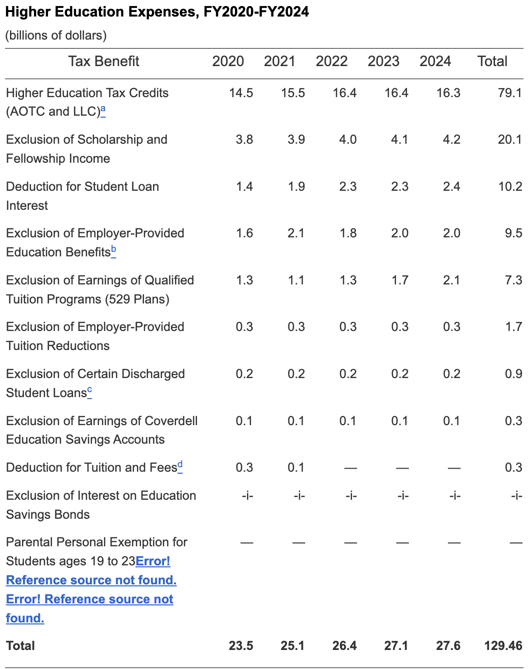

Higher Education Expenses: Costs

Slide 15
Section 104(a)(2)
(a) In general. Except in the case of amounts attributable to (and not in excess of) deductions allowed under section 213 (relating to medical, etc., expenses) for any prior taxable year, gross income does not include—…
(2) the amount of any damages (other than punitive damages) received (whether by suit or agreement and whether as lump sums or as periodic payments) on account of personal physical injuries or physical sickness;
For purposes of paragraph (2), emotional distress shall not be treated as a physical injury or physical sickness. The preceding sentence shall not apply to an amount of damages not in excess of the amount paid for medical care (described in subparagraph (A) or (B) of section 213(d)(1) attributable to emotional distress.
Who benefits from 104(a)(2)? Assume you are a trial attorney, and you are crafting an argument for determining the amount of damages a jury should award if (1) the award is taxable, or (2) it is not taxable.
How is the excludable amount determined in the case of a settlement?
What are the benefits of receiving an annuity versus a lump sum settlement for physical damages?

Slide 16
Section 104(a)(2): Attorney Fees
How should attorney fees be treated, as a basis offset (netted) against the award or separate deduction? See CIR v. Banks, 543 U.S. 426 (2005).
See §62(a)(20) (deduction for attorney fees for unlawful discrimination)
What if the deductible would be limited, for example, as a §212 expense that is treated as a MID under §67 and nondeductible under §67(g)?
Tax consequences of settlement (taxable vs. nontaxable amount): Amos v. Rodman, TC Mem. 2003-329)

