Slide 1
Federal Income Taxation Capital Gains and Losses
Prof. Colon
Spring 2025

Slide 2
Gains and Losses
Analyzing S/X of Property
Realized G/L = amount realized (AR) minus adjusted basis (AB)
Is realized gain recognized and included in GI under §61(a)(3) or does a nonrecognition provision (e.g., §§1031, 1033) apply?
Is realized loss recognized and does it reduce GI under §§62(a)(3) and 165(c)?
What is the character, capital, ordinary or §1231 G/L, of the recognized gains or losses?

Slide 3
Gains and Losses: Overview
If a TP has a net capital gain (NCG), it is taxed at preferential rates under §1(h).🌟
If a TP has a capital loss, it may be limited under §1211(b)
Capital gains and losses generally arise from the S/X of a capital asset. §1222(1)-(4).
Short-term CG/L: asset held from one year or less
Long-term CG/L: asset held for more than one year

Slide 4
Capital Losses
If CLs exceed CGs (Net Capital Loss), under §1211(b), the CLs (ST or LT) are deductible only to the extent of the CGs (ST or LT) plus $3,000.
This deduction is above the line.
Any excess CLs can be carried and used in a subsequent year under §1212(b) or until the TP dies.
Why is there a limitation on the use of CLs?
Consider (1) the realization requirement; and (2) the favorable taxation of NCGs
Section 1212(b) provides rules for the nature of the losses (ST or LT) that can be carried over to subsequent years. Not on the exam.

Slide 5
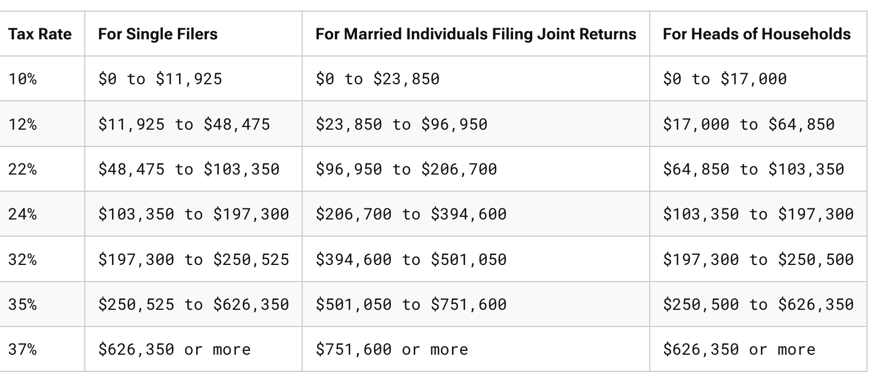
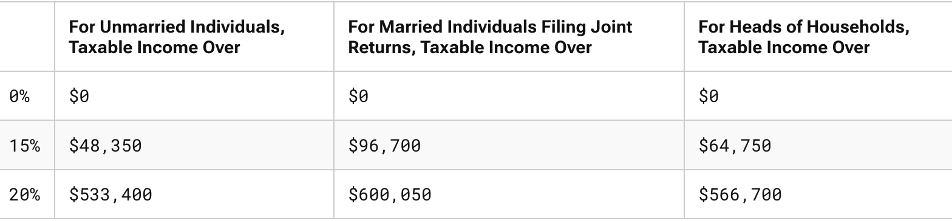
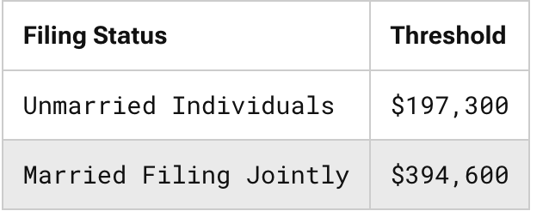
Rates for 2025
199A Threshold

Slide 6
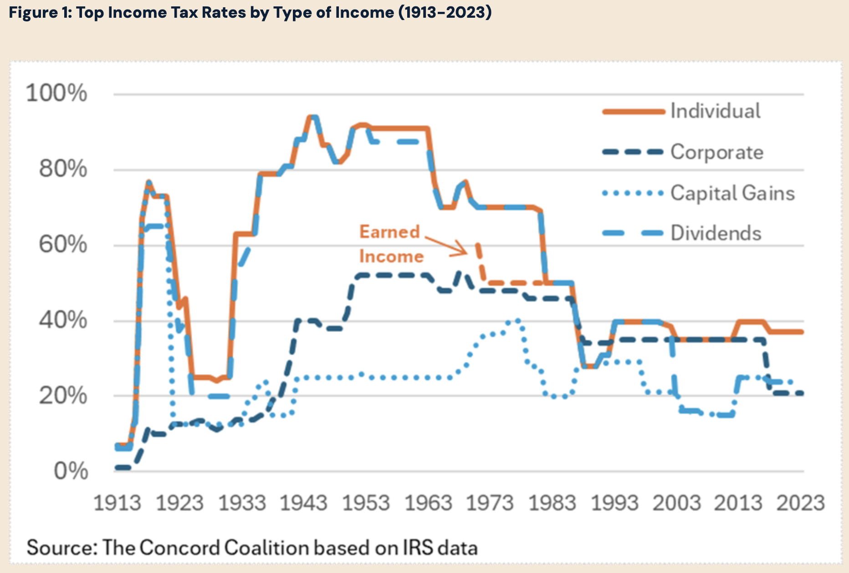
Different Rates by Type of Income

Slide 7
Net Capital Gain
Why are capital gains taxed more lightly than other capital income, e.g., rents, royalties, interest, or labor income?
Notions of trust accounting: income v. corpus
Effect on progressivity?
Double tax argument
Lock-in effect
Inflation gain
Encourage risk taking
Bunching effect

Slide 8
Net Capital Gain: §1(h)
NCG: Excess of NLTCG over NSTCL. §1222(11).
NLTCG: LTCG minus LTCL
NSTCG: STCG minus STCL
First step: Net LT and ST gains and losses
Separately net: (1) LTCGs and LTCLs, and (2) STCGs and STCLs
Results: For (1) NLTCG or NLTCL. If NLTCL, stop.
Results: For (2) NSTCG or NSTCL
2nd Step: Net the nets
If any NLTCG, then net NLTCG and NSTCL (if any)

Slide 9
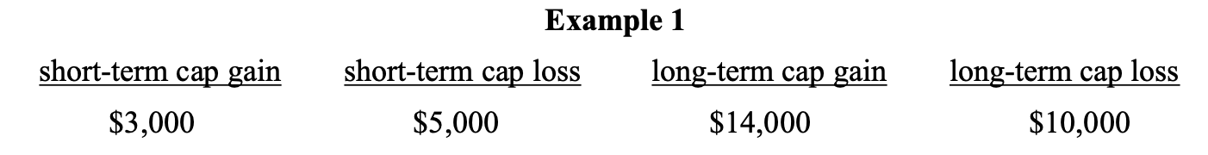
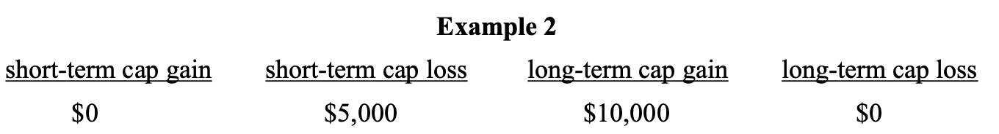
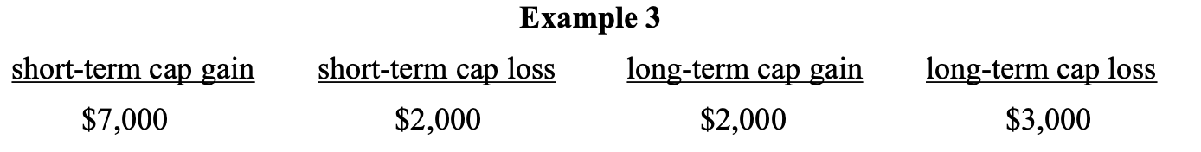
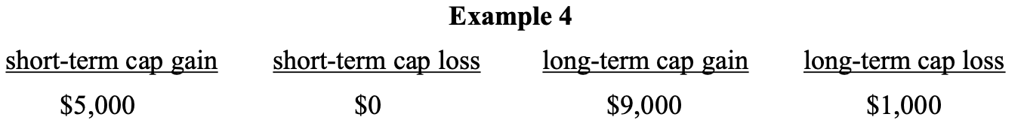
NCGs

Slide 10
Planning to Realize CGs and CLs
Strategy: realize losses to deduct against high-taxed ordinary income (salary) and high-taxed STCGs but avoid realizing losses to offset low-taxed LTCGs
Example: Year end is approaching, and high MTR (32%) TP has 3K of LTCGs and is considering selling stock with a 3K STCL. TP would pay 15% on LTCGs. Should TP sell in Y1 or Y2?
Sale in Y1 consequences?
Sale in Y2 consequences?
Consideration: TVM and sizing

Slide 11
Definition of Capital Asset: §1221(a)(1)-(3)
Any asset EXCEPT:
(a)(1) stock in trade of the taxpayer… which would be included in the inventory of the taxpayer…or property held by the taxpayer primarily for sale to customers in the ordinary course of his trade or business;
(2) [real or depreciable personal] property, used in his trade or business…; [see §1231]
(3) a patent, invention, model or design (whether or not patented), a secret formula or process, a copyright, a literary, musical, or artistic composition, a letter or memorandum, or similar property, held by--
(A) a taxpayer whose personal efforts created such property,
(B) in the case of a letter, memorandum, or similar property, a taxpayer for whom such property was prepared or produced, or
(C) a taxpayer in whose hands the basis of such property is determined, for purposes of determining gain from a sale or exchange, in whole or part by reference to the basis of such property in the hands of a taxpayer described in subparagraph (A) or (B);
But see §1221(b)(3)

Slide 12
Definition of Capital Asset: §1221(a)(4)-(8)
(4) accounts or notes receivable acquired in the ordinary course of trade or business for services rendered or from the sale of property described in paragraph (1);
(5) a publication of the United States Government (including the Congressional Record) which is received from the United States Government or any agency thereof, other than by purchase at the price at which it is offered for sale to the public, and which is held by
(A) a taxpayer who so received such publication, or
(B) a taxpayer in whose hands the basis of such publication is determined, for purposes of determining gain from a sale or exchange, in whole or in part by reference to the basis of such publication in the hands of a taxpayer described in subparagraph (A);
(6) any commodities derivative financial instrument held by a commodities derivatives dealer,…
(7) any hedging transaction which is clearly identified as such before the close of the day on which it was acquired, originated, or entered into…;.or
(8) supplies of a type regularly used or consumed by the taxpayer in the ordinary course of a trade or business of the taxpayer.

Slide 13
Capital Gains/Losses: Sale or Exchange Requirement
Section 1221(1)-(4) requires a S/X
Generally requires that the property survive the transfer and thus doesn’t include transactions in which the property is extinguished or matures
Payment to professor in exchange for giving up tenure rights is not the S/X of a capital asset. Foote v. CIR, 81 T.C. 930 (1983); aff’d 751 F.2d 1257 (5th Cir. 1985).
Many code provisions created a deemed S/X
Liquidation of stock (§331); repayment of debt (§1271); worthless security or debt (§§165(g) and 166(d): loss from failure to exercise option to buy a capital asset deemed to arise on date of expiration (§1234); amount received by lessee in cancellation of lease (§1241)
Arrowsmith (1952):
repayment by SH of judgment against liquidated corporation in subsequent year treated as capital loss and not ordinary
CT: had the corporation paid the liability, the amount of CG realized by SH would have been less; Y2 deduction determined by reference to Y1 inclusion.

Slide 14
Section 1231: Heads I win; Tails I win
Sale of business property would generally be ordinary. §1221(a)(2)
Background
Before 1938, business property generally treated as capital asset.
During great depression, statute amended to treated business property not as capital asset, i.e., ordinary gain/loss.
During WWII, the US expropriated many $0 basis assets, such as ships and submarines, producing significant OI taxed at high rates.
Congress’s response: enactment of §1231, which treats gains from the S/X of §1231 property as CG and losses from the S/X of §1231 property as OL
Section 1231 G/L: G/L from S/X (or condemnation, of depreciable business property held for more than one year, including real property. §1231(b)(1).
Look-back Rule: Net §1231 gain is treated as OI if it doesn’t exceed non-recaptured net §1231 losses
Aggregate net §1231 losses over the last 5 years

Slide 15
Sections 1245 and 1250: Recapture Rules
TP buys depreciable business property for $100 and depreciates $75, lowering the AB to $25. TP sells property for $80 or $110. What is the character of the gain?
If §1245 property is disposed of, the amount by which the lower of the excess of (1) the recomputed basis, or (2) the amount realized exceeds the AB, is ordinary gain. §1245(a)(1).
Recomputed basis: AB plus any depreciation, including §179, allowed or allowable. §1245(a)(2).
§1245 Property: Depreciable property that is
Personal property
Tangible property (not including buildings) used as integral part of manufacturing, production, etc. §1245(a)(3).
§1250: requires recapture of depreciation taken in excess of SL depreciation; since ‘86, RE is generally subject to SL depreciation.

Slide 16
Section 1(h)
NCG under §1222(11) is subject to lower rate than OI: top rate of 20% plus generally 3.8% tax on net investment income.
RE gain is generally LTCG or treated as LTCG under §1231 but is subject to a maximum rate of 25% to the extent that it is unrecaptured §1250 gain, basically the amount of gain that would be ordinary if §1245 had applied. §1(h)(1)(E).
28% rate on collectibles. §1(h)(1)(F).

