Slide 1
Federal Income Taxation Income Shifting in Families
Prof. Colon
Spring 2025

Slide 2

Lucas v. Earl, 281 U.S. 111 (1930)
“that any property either of us now has or may hereafter acquire … in any way, either by earnings (including salaries, fees, etc.), or any rights by contract or otherwise, during the existence of our marriage, or which we or either of us may receive by gift, bequest, devise, or inheritance, and all the proceeds, issues, and profits of any and all such property shall be treated and considered and hereby is declared to be received, held, taken, and owned by us as joint tenants, and not otherwise, with the right of survivorship.”
50% Mr. Earl
50% Mrs. Earl

Slide 3
Lucas v. Earl, 281 U.S. 111 (1930)
What were the Earls trying to achieve?
Assume two tax rates, 10% and 30%, that apply to married and single taxpayers.
The 10% rate applies to the first 10K of income and the 30% rate applies to any income in excess of 10K.
Assume Mr. Earl earns 20K and the contract is effective to split his income with his wife. What are the consequences to the Earls?

Slide 4

Poe v. Seaborn, 282 U.S. 101 (1930)
50% Mr. Seaborn
50% Mrs. Seaborn

Slide 5
Marriage Penalties and Bonuses
Until 1948, couples living in community property states paid less tax than couples living in non-community property states.
Why? By splitting income, couple in community property states were able to use the lower rates two times.
Earls in community property state: 10K * 10% (1K) + 10K * 10% (1K), or 2K total tax
Earls in non-community property state: 10K * 10% (1K) + 10K * 30% (3K) or 4K total tax
In 1948, creation of new rate schedule, married filing jointly
Married couples would pay 2x the tax of a single taxpayer earning one-half of couple’s aggregate income

Slide 6
Unified G&E taxation
G&E Exclusion amounts for 2025:
$13.99MM (S)
$27.98MM (M)
$19K/yr per done
Rates begin at 18% and reach 40%
Gift tax imposed on the donor; estate tax imposed on the transfer of an estate
Gifts do not include direct payments for health and education (§2503(e))
Gifts do not include transfers to spouses (§2523(a))

Slide 7






CIR v. Duberstein, 363 U.S. 278 (1960)
Duberstein (Duberstein Iron)
Berman (Mohawk)
Thanks for sending leads my way. A small token of our appreciation.
Thanks for service as comptroller of our RE sub. Here’s a gratuity of 20K.

Slide 8
Income Taxation of Gifts and Bequests
Gross income doesn’t include property acquired by gift or bequest. §102(a)
The basis of property acquired by gift is generally a carry over basis, except if the basis is greater than the FMV at the time of the gift, for the purposes of determining loss the basis is FMV. §1015(a)
What happens to any unrealized gain at the time of the gift?
The holding period of property acquired by gift includes the period the property was held by the donor. §1223(2)
The basis of property acquired from a decedent by bequest is the FMV of the property at the decedent’s death. §1014(a)(1) and (b)(1).
What happens to any unrealized gain at death?
The holding period of property acquired by bequest is long term. §1223(9)

Slide 9
Income Taxation of Gifts and Bequests
Alternatives:
Include gifts as income
Include bequests as income
Make gifting a realization event
Treat bequests as a realization event

Slide 10
CIR v. Duberstein, 363 U.S. 278 (1960)
What did the court say was the most important consideration?
Did the court follow the common-law definition of gift?
Is the mere absence of a legal or moral obligation sufficient to make a transfer a gift?
How relevant is the donor’s characterization of the transfer?
What was the government’s proposed test?
How are these cases to be decided in the future?
What happened to Duberstein? Stanton?

Slide 11
CIR v. Duberstein, 363 U.S. 278 (1960)
This Court has indicated that a voluntary executed transfer of his property by one to another, without any consideration or compensation therefor, though a common-law gift, is not necessarily a “gift” within the meaning of the statute. For the Court has shown that the mere absence of a legal or moral obligation to make such a payment does not establish that it is a gift. And, importantly, if the payment proceeds primarily from “the constraining force of any moral or legal duty,” or from “the incentive of anticipated benefit” of an economic nature, it is not a gift. And, conversely, “where the payment is in return for services rendered, it is irrelevant that the donor derives no economic benefit from it.” A gift in the statutory sense, on the other hand, proceeds from a “detached and disinterested generosity,” “out of affection, respect, admiration, charity or like impulses.” And in this regard, the most critical consideration, as the Court was agreed in the leading case here, is the transferor’s “intention.”

Slide 12
Consequences of Duberstein
Section 274(b)(1): no deduction under §162 or §212 for gift (under §102) that exceed $25/year.
Excludes items costing less than $4 on which the TP’s name is imprinted, or
Excludes sign, display rack or other promotional materials used on the business premises of recipient.
Section 102(c): amounts transferred from employer to employee can’t be excluded as gifts, unless it constitutes:
(1) an employee achievement award under §74(c), or
(2) an excludible fringe under §132(e)

Slide 13


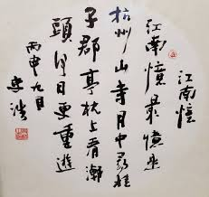
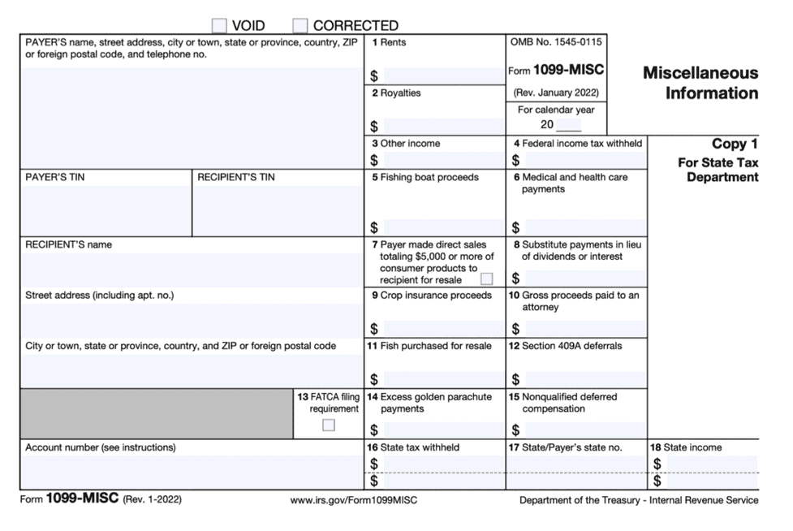

Jue-Ya Yang v. CIR, TC Sum. Op. 2008-156

Slide 14



Olk v. US, 536 F.2d 876 (9th Cir. 1976)

Slide 15
Life Insurance Proceeds
Amounts received under a life insurance contract are exempt from gross income if such amounts are paid by reason of the death of the insured. §101(a)(1).
If a life insurance contract is transferred for valuable consideration, the transferee can exclude only the amounts paid plus any premiums paid by the transferee. §101(a)(2).

