Slide 1
Federal Income Taxation Borrowing and Lending
Prof. Colon
Spring 2025

Slide 2
Borrowing and Lending
Chapter 9: Basic rules of borrowing and lending, including receipt and payment of principal, receipt and payment of interest, identifying principal and interest, and timing of interest and deduction.
Chapter 10: Consequences of not repaying principal or interest
Chapter 11: Applying debt rules in the context of purchase, ownership, and disposition of property.

Slide 3
Benefits and Possible Detriments of Debt
Debt/leverage can magnify both gains and losses
Example:
Amy buys land for 100K in 2025 and sells it one year later for 150K. Her return on her investment of 100K is: (150 – 100)/100 or 50%.
Zandro has 20K and borrows 80K at 10% to buy land for 100K, which he sells one year later for 150K. He repays the bank 88K (80K + 8K of interest), and he has 62K left. His return on his investment of 20K is: (62-20)/20 or 210%

Slide 4
Benefits and Possible Detriments of Debt
Debt/leverage can magnify both gains and losses
Example:
Amy buys land for 100K in 2025 and sells it one year later for 90K. Her return on her investment of 100K is: (90– 100)/100 or -10%.
Zandro has 20K and borrows 80K at 10% to buy land for 100K, which he sells one year later for 90K. He repays the bank 88K (80K + 8K of interest), and he has 2K left. His return on his investment of 20K is: (2-20)/20 or -90%

Slide 5
Debt Basics
Amy borrows 100K from Banker
Accession to wealth under HS for Amy?
Decrease in wealth under HS for banker?
Banker: No current deduction for loan (Reg. 1.263(a)-4(d)(2)(i)(B) and (d)(2)(vi), Ex. 1; cost to create intangible—debt instrument—must be capitalized)
What’s banker’s basis in the loan?
When Amy repays the loan principal, income for Banker?
Amy: What are the result to Amy? Gross income under §61? Why?
When Amy repays the loan principal, deduction for Amy?
Original exclusion for debt proceeds in Y1 depends on estimating future repayment in YX

Slide 6
Debt Basics
Amy borrows 100K and pays 10K of interest to Banker
Decrease in wealth under HS for Amy for interest paid?
Increase in wealth under HS for Banker for interest received?
Banker: Gross income under §61(a)(4)
Amy: Possibly deductible under §163 if it constitutes business interest, investment interest, or qualified residence interest.

Slide 7
Debt Basics: Present Value and Future Value
Future Value: an amount that represents how much an investment made today will grow to in the future over a certain period at a certain rate.
Example: The future value of 100K invested for one year at 10% is 110K.
FV = Invest * (1 + rate)^{T}, where T is the number of periods in the future.
Present Value: the current value today of an amount to be received in the future discounted at a certain rate.
Example: The PV of 110K to be received one year from now invested for one year at 10% is 110K.
PV = FV / (1 + rate) ^{T}

Slide 8
Debt Basics: Using the Loan Exclusion to Play Game
Bank makes a 1-year loan to Amy of 100K. In one year, she’ll have to repay 110K, the original 100K plus interest of 10K.
Should Amy be able to exclude the entire 100K under the borrowing exception?
What is the PV the loan if the discount rate is 10%?
PV = FV / (1 + rate) ^{T}
100K = 110K / (1 + 10%) ¹
Does Amy have an accession to wealth when she receives the 100K in PV terms?

Slide 9
Debt Basics: Using the Loan Exclusion to Play Game
Corp makes a 5-year, no-interest loan to its GEO of 100K.
Should CEO be able to exclude the entire 100K under the borrowing exception?
What is the PV the loan if the discount rate is 10%?
PV = FV / (1 + rate) ^{T}
62K = 100K / (1 + 10%) ⁵
How should the remaining 38K be classified?
Mom makes a no-interest loan to daughter of 200K. Mom’s MTR is 37% and daughter’s is 10%. Mom can request repayment at any time.

Slide 10
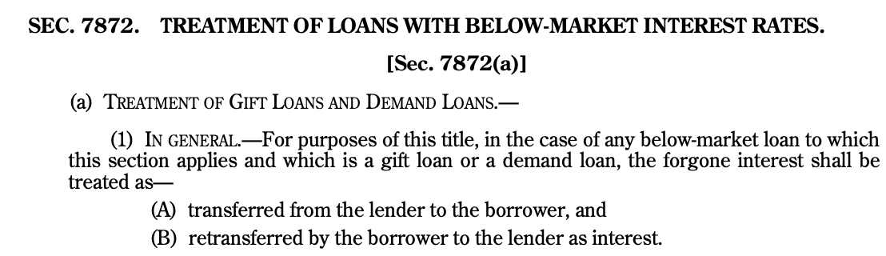
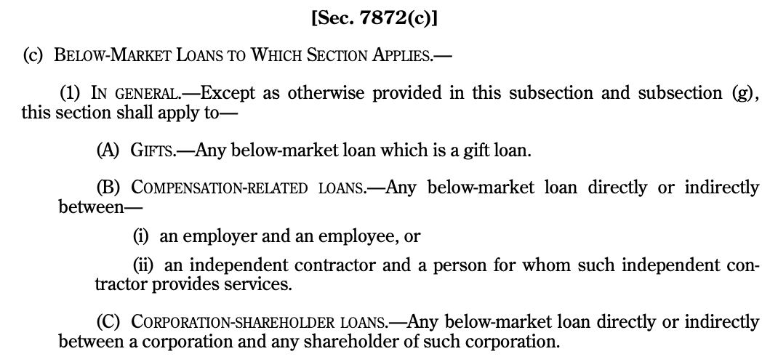
Section 7872

Slide 11
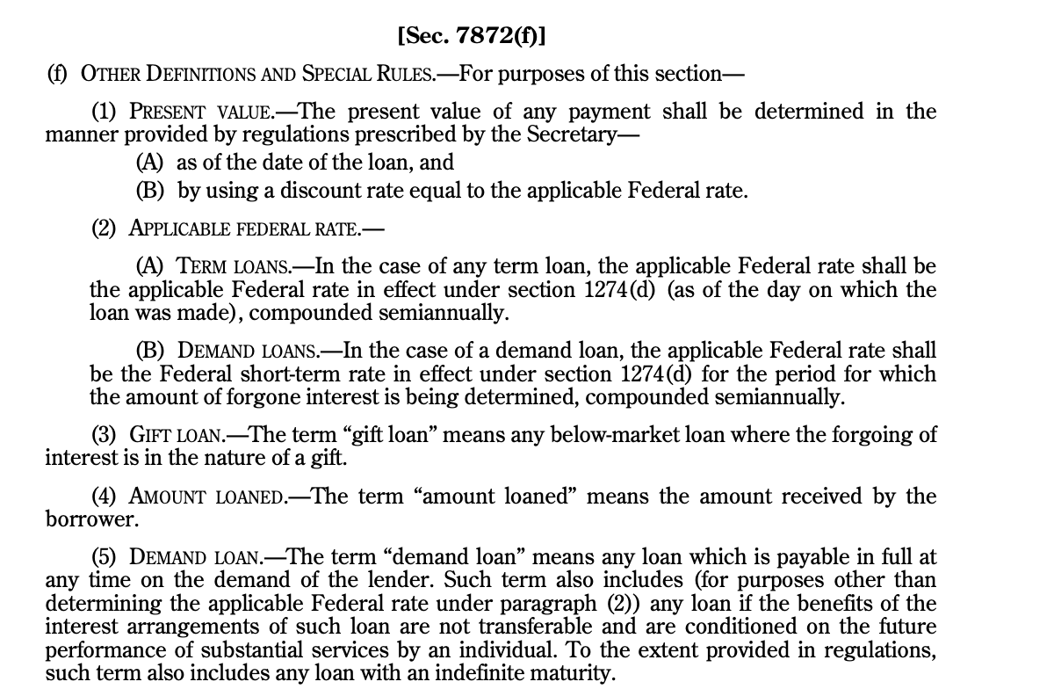
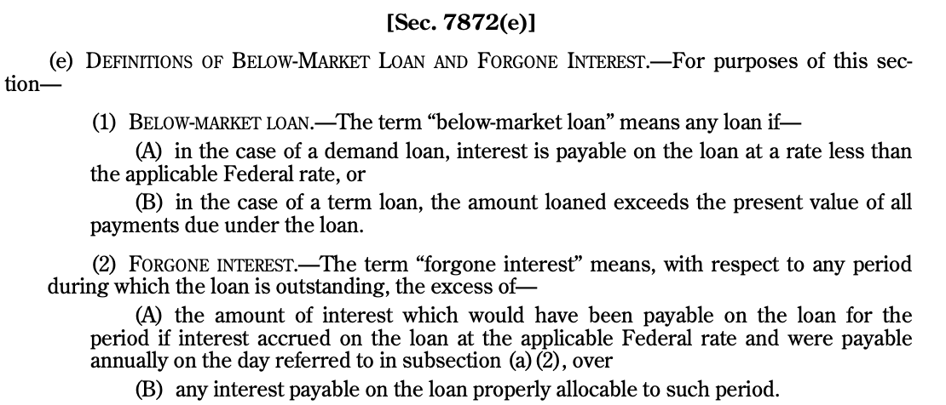
Section 7872

Slide 12
Section 7872
Mom makes a no-interest loan to daughter of 200K. Mom’s MTR is 37% and daughter’s is 10%. Mom can request repayment at any time.
Is the loan subject to §7872?
Yes: It is a below market loan (§7872(e)(1)—no interest is payable) that is a gift loan. §7872(f)(3) and (c)(1)(A).
What are the consequences?
Foregone interest is treated as transferred from mom to daughter and daughter retransfers it as interest to mom on the last day of each year. §7872(a)(1) and (2)
Foregone interest = Short-term AFR

Slide 13
Section 7872
Corporation makes a 1MM, 3-year, no-interest loan to its CEO. If the AFR is 5%, what are the consequences to Corp and CEO?
Possible analysis
Is this loan subject to §7872? Is it a gift, demand, or other below-market loan? §7872(b)(1), (c)(1)(C).
How is it taxed to Corporation and CEO?

Slide 14
Identifying Principal and Interest
For the timing of interest paid and received, we first need to identify in a loan payment how much of the payment is interest and how much is principal.
In a loan transaction that requires interest to be paid annually and the principal to be paid when the term of the loan ends, the interest will be includible/deductible generally when paid. Remember, different rules may apply to below market rate loans. See §7872.
Example: you borrow 50K for 3 years to pay your tuition with an annual interest rate of 10%. At the end of Y1, Y2, and Y3, you will pay 5K of interest, and also, at the end of Y3, you will pay 50K of principal.

Slide 15
Identifying Principal and Interest
You borrow 50K for the student loan, but the payment schedule is 3 annual payments of 20.1K. At the end of 3 years the loan balance will be zero. How much of each payment is interest?
Year | Amount | PV at beginning of Y1
Y1 | 20,106 | 18,278
Y2 | 20,106 | 16,616
Y3 | 20,106 | 15,106
 |  | 50,000
Year | Amount | PV at beginning of Y2
Y2 | 20,106 | 18,278
Y3 | 20,106 | 16,616
 |  | 34,894
Difference = 15,106
Year | Payment | Principal (Loss PV) |  | Interest
Year 1 | 20,106 -- | 15.1K (50K - 34.8K) | = | 5,000
Year 2 | 20,106 -- | 16.6K (34.8K – 18.2K) | = | 3,489
Year 3 | 20,106 -- | 18.2K (18.2K – 0) | = | 1,827
Totals |  | 50,000 |  | 10,316

Slide 16
Original Issue Discount (OID)
Methods of Accounting—affect the timing inclusions/deductible, but not whether an amount is interest, principal, capital expenditure, etc.
Cash method
When paid or received
Accrual method
All events test—right to receive; establish fact of liability
Accrual of interest: include/deduct as times passes under economical accrual of interest

