Slide 1
Int’l Tax Review: U.S. Taxation of Foreign Income
Foreign income is subject to current U.S. tax in the same manner as the U.S. corporation’s U.S. income.
Foreign income includes business income earned through a branch as well as passive income, such as dividends, interest, royalties, etc.
If the foreign income is also subject to foreign tax, the U.S. corporation can credit foreign tax paid under §§901 and 903, subject to the limitations under §904.
Shareholders
Current Tax on WW income
Foreign Tax Credit
US Parent
Foreign Branch Business and Passive Income
US Sub

Slide 2
Int’l Tax Review: U.S. Direct Foreign Tax Credit
A U.S. person can generally credit against its U.S. tax liability foreign income taxes paid under §§901 and 903.
§901 covers foreign income taxes imposed on business income that are similar to U.S. income taxes.
§903 covers foreign income taxes imposed in lieu of income taxes and generally applies to withholding taxes on passive income, such as dividends.
US Corp
US Corp
§901
§903
Foreign Taxes on Branch Operations
Withholding Taxes on Foreign Passive Income

Slide 3
Int’l Tax Review: Indirect FTCs under §902
USP uses Foreign Branch
USP uses Foreign Subsidiary
USP
USP
Dividend = 65
NI = 100
FT = 35
For Op
FC
For Op
NI = 100
FT = 35

Slide 4
Int’l Tax Review: Controlled Foreign Corporations
A FC is a controlled foreign corporation (CFC) if US shareholders (USSHs) own more than 50% of the vote or value of the FC. §957(a).
US shareholders: US persons owning 10% or more of the vote of FC. §951(b).
A CFC’s USSHs are taxed currently on their pro rata share of the CFC’s subpart F income and certain earnings invested in US property under section 956. §951(a)(1)(A)(i) and (B).
A CFC’s business income (earnings that are not subpart F income or included under section 956) is not taxed until remitted as a dividend.
US Parent
Current US Tax
Foreign Tax Credit
No US Tax until remitted
No foreign tax credit until remitted
Foreign Sub
(CFC)
Subpart F
Dividends
Interest
Royalties
Base Company Inc
Earning invested in US
Active Business Income
Foreign Taxes on SubF Inc
Foreign taxes on Business Inc

Slide 5
Theories of Taxation of International Income
If free movement of capital is permitted, investors will allocate capital to where it can receive the highest risk-adjusted return. Where either the residence or source country (or both) imposes taxes on those returns, the movement of capital, national tax revenues, and national welfare can be affected.
Which principles should guide legislators in formulating international tax policy?

Slide 6
Theories of Taxation of International Income
The three traditional principles or theories of taxing international income are:
(1) Capital Export Neutrality (CEN);
(2) Capital Import Neutrality (CIN); and
(3) National Neutrality (NN).
Proponents claim that each best achieves one or more of the following goals: economic efficiency, equity, growth, and simplicity.

Slide 7
Capital Export Neutrality (CEN)
Under CEN, for residents of the same country, income is taxed at the same rate wherever the income is earned.
US international tax system generally reflects CEN:
US taxes US persons on their worldwide income.
A tax credit is given against US taxes for income taxed by the source country
CEN ensures that taxes play no role in the investment decisions of US firms; capital flows to where it receives its highest pre-tax risk-adjusted return.
Relationship between pre-tax and after-tax returns is preserved.
CEN promotes worldwide economic efficiency and equity.

Slide 8
Capital Export Neutrality Example
$1M investment promises 10% return in the US and the UK. UK taxes are 20% and US taxes are 35%. CEN ensures that if pre-tax rates of return are equal, after-tax rates of return will also be equal.
Invest US Invest UK
Income 100k 100k
For. Taxes 0 (20k)
US Taxes (35k) (15k) [35k-20k FTC]
After-tax Inc 65k 65k
After-tax ROR 6.5% 6.5%

Slide 9
Capital Export Neutrality
CEN not entirely reflected in U.S. tax rules:
No credit generally for foreign tax that is greater than the US tax otherwise due on the foreign source income.
Deferral of business income by foreign subsidiaries of US persons.

Slide 10
Capital Import Neutrality (CIN)
Under CIN, capital income arising in one country is taxed at the same rate regardless of the residence of the investor. This is generally achieved by the residence country exempting foreign source income entirely from tax. Such systems are described as territorial tax systems.
Some argue that CIN improves the competitiveness of US multinationals who compete with foreign multinationals from countries whose tax laws reflect CIN principles.
CIN may result in an inefficient allocation of capital.

Slide 11
Capital Import Neutrality Example
$1M investment offers return of 12% in US and 10% in the UK. UK income is taxed at 20% by the UK, but exempt from US tax.
US Investment UK Investment
Income 120k 100k
US Tax (42k) 0
UK Tax 0 (20k)
After-tax Inc. 78k 80k
After-tax ROR 7.8% 8%

Slide 12
US Taxation of USMNs
Shareholders
CEN
US Parent
CIN
Current US Tax
Foreign Tax Credit
No US Tax until remitted
No foreign tax credit until remitted
Foreign Sub
(CFC)
Subpart F
Div
Int
Royal
Base Company Inc
Earning invested in US
Active Business Income
Foreign Taxes on SubF Inc
Foreign taxes on Business Inc

Slide 13
National Neutrality (NN)
Under NN, the residence country does not cede tax jurisdiction over foreign source income to the source country.
The residence country allows a deduction and not a credit for foreign income taxes.
Foreign investment is penalized, since it will only be made if the return after foreign tax (but before US tax) equals or exceeds the before-tax return on US investment.

Slide 14
National Neutrality Example
$1M investment offers a 10% return in the UK, which imposes a 20% tax on the return. US investor will invest in UK only if equivalent US investment offers a pre-tax return less than 8%.
UK Investment US Investment
Income 100k 80k
UK Tax (20k) 0
US Tax (28k) [35%*80] (28k)
After-tax Inc. 52k 52k
After-tax ROR 5.2% 5.2%

Slide 15
Capital Ownership Neutrality
CON is satisfied if tax systems do not distort ownership of assets.
CON maximizes output and efficiency by encouraging the most productive ownership of assets
CON can be achieved if all countries exempt foreign income taxation or tax foreign income (with a foreign tax credit).

Slide 16
Some Pathologies of the U.S. International Tax System
High US statutory corporate tax
Deferral benefits may shift investments offshore
Lockout effect: the choice between repatriation and reinvestment of foreign earnings
Distortions in shareholder payouts
Income shifting
Inversions

Slide 17
OECD Statutory Corporate Tax Rates: 2005-2015

Slide 18
Deferral Benefits
Assume USP earns $100 through its CFC in FC taxed at 0% rate and reinvests earnings in FC for 5 years at 10% p.a. at which time it repatriates the total.
In Y5, USP will have: 100(1.1)^5 – (1-.35)(100(1.1)^5) or $104.68.
Assume USP earns $100 in the US and reinvest the earnings in the US for 5 years at 10% p.a. At the end of 5 years, USP will have:
65(1.065)^5 or $89.06

Slide 19
Lockout Effect and the choice between repatriation and reinvestment of foreigner earnings

Slide 20
Distortions in USP Corporate Payouts
Reinvested foreign earnings may lead to reduced shareholder payouts
Reinvested foreign earnings may lead to higher debt levels and lower US profits

Slide 21
Income Shifting: Principal Model
Intellectual Property
US Parent
?
CFC1
Low Tax
CFC 2
High Tax
Management & control
High value added activities
Higher risk functions
Intellectual Property
Low value added activities
Contract manufacturing
Limited risk distribution functions
Licensing

Slide 22
Inversions
Public
Public
Public
US
Parent
US Parent
NFP
merge
Future Growth
Existing Foreign Subs
US Parent
Existing Foreign Subs
NFP
Existing Foreign Subs
US Merger Sub
US merger sub merges tax-free into US Parent
NFP typically formed in tax haven (Bermuda, Caymans, Barbados)
Potentially use “Inversion” transaction to insert leverage into US group
New growth under NFP
Potential restructuring of US Parent’s Existing Foreign Subs

Slide 23
Inversions:
Actavis/Warner Chilcott (Ireland)
Pentair/Tyco International’s Flow Control Business (Switzerland)
Perrigo/Elan (Ireland)
Applied Materials/Tokyo Electron (Netherlands)
Endo Health/Palladin (Ireland)
Actavis/Forest Laboratories (Ireland)
Horizon Pharma/Vidara Therapeutics (Ireland)
Mylan/Abbott Laboratories subsidiary (Netherlands)
Covidien/Medtronic (Ireland)
Tim Hortons/Burger King (Canada)

Slide 24
Financial Accounting: EPS

Slide 25
Financial Accounting: Book-Tax
Book Income vs. Taxable Income
Temporary and Permanent Book-Tax Differences
Timing differences, e.g., SL depreciation v. accelerated depreciation
Tax-exempt income
Fines
Bad debts
Earnings of foreign subsidiary indefinitely invested abroad
Stock based compensation

Slide 26
Financial Accounting: Permanent v. Temporary

Slide 27
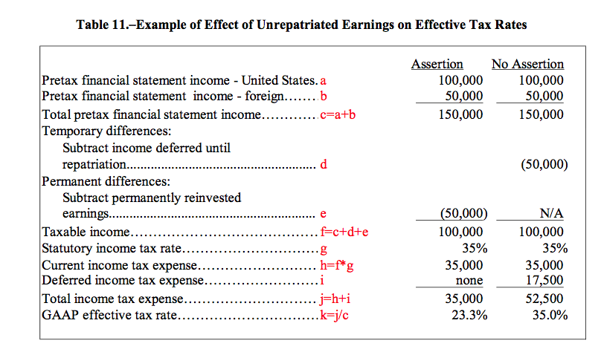
Financial Accounting: Unrepatriated Earnings

Slide 28
Responses: BEPS
OECD, Addressing Base Erosion and Profit Shifting (2013).
it is often the interaction of various principles and the asymmetries among tax regimes of multiple jurisdictions with which a taxpayer has contact that allows base erosion and profit shifting to occur.
Stateless income
Arm’s-length principles and risk shifting
BEPS Final Reports
Action 1: Digital Economy
Action 2: Hybrid Mismatches
Action 3: Strengthen CFC Rules
Action 4: Limit base erosion via interest deduction and other payments
Action 5: Counter harmful practices
Action 6: Prevent treaty abuse
Action 7: Artificial avoidance of PE status
Action 8-10: Aligning Transfer Pricing Outcomes with Value
Action 11: Collection of data on BEPS
Action 12; Disclosure of aggressive tax planning arrangement
Action 13: Re-examine transfer pricing documentation
Action 14: Make dispute resolution more effective
Action 15: Develop multilateral instrument

Slide 29
U.S. Policy Choices
Eliminate Deferral
Reduction in US corporate tax rate
Lower rate on foreign business income
Territorial system for the US
Partial (95%) foreign dividend exemption
Eliminate FTC
Taxing some intangible income earned by CFCs
Minimum tax (19%) on foreign profits
One-time tax on untaxed foreign income
Imputation (SH) credit for corporate taxes paid
Limits on interest deduction by US parent
Special rules for income from intangible property (patent boxes)

