Slide 1
Foreign Tax Credit Limitation: §904(d)
To prevent the double taxation of foreign source income (“FSI”), US persons are permitted a credit for foreign income taxes paid against their US tax liability, subject to the limitations under §904.
Creditable taxes:
Direct income taxes (§901)
In-lieu income taxes (§903)
Deemed paid income taxes (§960(a) and (d))
Excess FTCs: Carryback 1 and forward 10 years, except on GILTI (§ 904(c))
FTC Limitation = US Taxes (pre-credit) x FSTI/WWTI, or
= FSTI x US Tax Rate (§904(a))

Slide 2
Foreign Tax Credit: Revenue Costs
In 2016, the FTCs offset $89B of corporate tax liability, about 25% of the corporate tax revenues.
In 2013, FTCs ate roughly 36% of the corporate tax base in 2013 ($118B out of a total of $329B)

Slide 3
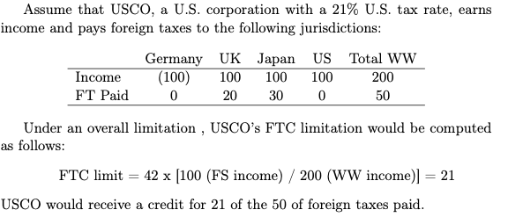
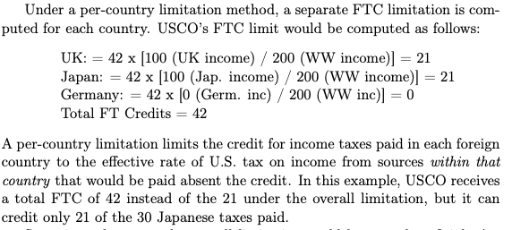
Overall v. Per-Country

Slide 4
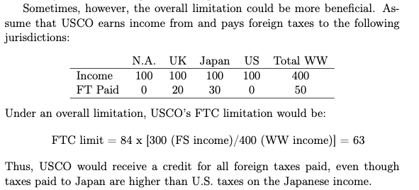
Overall v. Per-Country

Slide 5
Evolution of the Foreign Tax Credit and Limitation
Creditable Taxes
Overall Limitation
Per Country Limitation
Character Based Baskets
Legal Structure Limitations
vs.
1918 - 1921
Source-country
taxes only
1921 - 1932
All foreign income taxes, subject to the FTC limitation
Overall Limitation
1932 - 1954
Overall Limitation
Per Country Limitation
Lesser of the two
1954 - 1960
Per Country Limitation
1960 - 1962
Overall Limitation
Per Country Limitation
Taxpayer election
1962 - 1976
Interest Basket
1976 - 1986
Overall Limitation
1986 - 2004
[8+] Baskets
2004 - 2017
[2+] Baskets
2017 - 2021
Passive Basket
GILTI & Branch
2022 - ????
Proposed nexus rules?
Per Country Limitation?
Passive Basket?
GILTI & Branch/General?

Slide 6
Foreign Tax Credit Limitation: §904(d)
To prevent cross-crediting--averaging low-taxed FSI and high-taxed FSI--US persons must compute a separate 904 limitation for each statutory category or “basket” of income. (§904(d)(1)).
Cross crediting is thus permitted within each basket, but not among the separate baskets.
Exemption for $300 ($600 joint return) of taxes paid with respect to “qualified passive income.” §904(j).

Slide 7
Foreign Tax Credit Limitation: §904(d)
USP earns $100 of FS interest income (passive), subject to $0 foreign taxes, and $100 of FS manufacturing income (general category), subject to $50 foreign taxes, and his US tax rate is 35%.
In the absence of §904(d), his FTC limitation would be:
70, calculated as follows: 70 x (200/200).
Thus, USP could credit all foreign taxes paid.
Under §904(d), however, USP must calculate a separate FTC limitation for each basket. His FTC limitation for each basket would be:
35 [70 x (100/200)] [Passive Basket], and
35 [70 x (100/200)] [General Category Basket]
USP could credit only $35 of the $50 of foreign taxes paid on the GC income.

Slide 8
FTC Limitation: Baskets (pre-’07 tax years)
Passive (d)(1)(A), (2)(A)
FPHCI, PFIC
Lowest priority of all baskets
Excludes export financing interest and high-taxed income.
High withholding tax interest (d)(1)(B), (d)(2)(B)
> or = 5% gross WH tax
Excludes export financing
Financial Services Income (d)(1)(C), (d)(2)(C)
Income of banking, insurance, and financing businesses
Excludes high WH tax interest and export financing
Shipping Income (d)(1)(D), (d)(2)(D)--?

Slide 9
FTC Limitation: Baskets (pre-’07 tax years)
Dividends from 10/50 Corp [Repealed]
Applied on a corp-by-corp basis for pre-2003 tax years
For post-2002 years, dividends from pre-2003 E&Ps of all 10/50 companies aggregated, except for PFICs
For post-2002 dividends from post-2002 E&Ps, look through treatment
[All dividends from 10/50 corps given look through treatment (d)(4)
DISC, FSC, and Foreign Trade Income (d)(1)(F), (H), and (I)
General Limitation (d)(1)(H)
Note: High-taxed [Kickout] Income (d)(2)(F)
Foreign Taxes exceed highest rate in §1 or §11

Slide 10
FTC Limitation: Baskets (post-’06 tax years)
Two baskets:
Passive Income
General Category Income [(d)(2)(A)]
Passive Income
FPHCI, but no Export Financing Interest or High-Taxed Income (d)(2)(B)
DISC, FSC, and Foreign Trade Income (d)(1)(F), (H), and (I)
General Category
Everything except passive
Financial Services Income (d)(2)(C)
Note: High-taxed [Kickout] Income (d)(2)(F)
Foreign Taxes exceed highest rate in §1 or §11

Slide 11
FTC Limitation: Baskets (post-’06 tax years) + post-TCJA
4 Baskets Now:
Passive
General Category
Foreign Branch Income (d)(2)(J)
Profits attributable to a QBU, but NOT including passive income
GILTI (d)(1)(A)

Slide 12
Indirect FTCs: Section 960(a) and (d)
Under §960(a) and (d), US Corporate shareholders of CFCs can credit taxes paid by foreign subsidiaries (CFCs).
Goal: Roughly put USSH in same position as if they had earned income directly.
Rules were formally found in former §902 (indirect tax credit), which allows indirect taxes to be credited when foreign subsidiaries paid dividend to US parent.
Each dividend would bring with it a proportionate amount of foreign taxes paid by the subsidiary.
For foreign taxes deemed paid, a USSH must gross up any inclusion by the amount deemed paid foreign taxes. The FTC limitation is then applied to the grossed-up amount
Subpart F inclusion of 80 and DP FT of 20. The USSH must gross up the 80 of subpart F by the deemed paid taxes, so the total inclusion is 100 with a potential FTC of 20.

Slide 13
Indirect Tax Credit: GILTI §960(d)
GILTI DP FT = 80% ∗ (Inclusion %) ∗ (Aggregate Tested Foreign Taxes)
Inclusion %: GILTI inclusion / Aggregate Tested Income
Example
DC owns 100% of CFC1, which earns 1,000 of gross tested income, incurs 800 expenses, pays 40 of foreign taxes (a 20% rate), and has QBAI of 500.
Assume that DC does not elect the high-taxed exception
The GILTI inclusion is 110 (1,000 - 800 - 40- 50*) [*50 is 10%*500 (QBAI)].
The Inclusion % is GILTI inclusion (110) divided by the tested income (160) or 68.75%
DC’s deemed paid taxes are 22, calculated as follows: 80% * 68.75% * 40 (taxes)
§78 calculated w/out regard to 80% limitation: 68.75% * 40, or 27.5.
Total GILTI Inclusion: 27.5 + 110 = 137.5
But DC entitled to 50% deduction for GILTI under §250, so inclusion is 68.75 (137.5/2)

Slide 14
Indirect Tax Credit: GILTI §960(d)
US tax on the 68.75 GILTI inclusion is 14.44 (21% * 68.75). This would be the maximum amount of the FTC limitation.
Since the deemed paid taxes are 22, no further US taxes are due, but 7.56 (14.44 - 22) are permanently lost and can’t be carried back or forward. §904(c) (last sentence)

Slide 15
FTC Limitation: Look-Through Rules for CFCs (§904(d)(3))
Interest, rents, royalties, SF and GILTI inclusions of USSHs of a CFC are generally treated as passive income to the extent attributable to the passive income of the CFC.
Otherwise, it’s most likely allocated to the general category basket, except if it’s GILTI in which case it’s allocated to the GILTI basket.
Example (SF Inclusion; Reg. 1.904-5(c)(6))
CFC has 30 of FBCSalesInc, 15 of FPHCI, and 70 non-SF income. CFC paid no taxes with respect to any of its income. USSH has SF inclusion of 45, and 15 goes into passive basket, and 30 into the GC basket.
Dividends received from a CFC are treated as passive in the same proportion as the E&Ps of the CFC are attributable to the passive category. Reg.1.904-5(c)(4)(i).
Note, a dividend from a CFC also includes the §78 gross up.).

Slide 16
Source and Allocation of Deductions
FTC: US Tax (pre-credit) x FS Tax Inc/ WW Tax Inc
FS Taxable Income: FS Gross Income less allocable deductions (section 861(b), 862(b), and 863(a))
EC Taxable Inc: ECI less allocable deductions (sections 873(a) and 882(c)(1)(A))
FBC Taxable Inc: Gross income less allocable deductions (954(b)(5))

Slide 17
Source and Allocation of Deductions
Deductions are first “allocated” to a “class” of income, and then “apportioned” within a class between the “statutory groupings” and “residual groupings” of gross income. Reg. 1.861-8(a)(2). Many important expenses, such as interest, state and local taxes, R&D expenses, are subject to specific A&A rules
Expenses are allocated to class of income to which they are “definitely related;” expenses may be related to all of a taxpayer’s income, e.g., general management expenses.
Statutory and Residual Groupings: statutory grouping is gross income that, reduced by deductions, is relevant under an “operative” provision, e.g., foreign source income in a particular basket, gross ECI
Deductions not definitely related to any GI are apportioned ratably among statutory and residual grouping.

Slide 18
Source and Allocation of Deductions
Money is fungible: interest expense related to all income producing activities and assets of taxpayer and thus allocable to all GI of taxpayer. Reg. 1.861-9T(a)
Interest Paid by Individuals:
If individual has at least $5K of FSGI, A&A required:
business interest apportioned to business income;
investment interest to investment income; and
personal interest (i.e., home mortgage interest) to ALL GROSS INCOME. Reg. 1.861-9T(d)(1).

Slide 19
Source and Allocations of Deductions: Example
Andie earns 120k as an associate in a law firm. For 2022, she works abroad for 2 months in Brazil pays tax of 4K (20% of 20K). She owns an apartment in NY and pays 18K in interest expense. She also pays NY state taxes income taxes of 6K, property taxes of 4K, and contributes 2K to charity.
Note, her US MTR is 22%, but her ETR is 14.21%
What’s her FTC limitation?

Slide 20
Source and Allocation of Deductions: Example
120K | WWGI | 20K | FSGI | General Category
(18K) | Mort Interest | (3K) | 16.67% of Mort Int | 1.861-9T(d)(1)(iv)
(6K) | State Tax | (1K) | 16.67% of State Tax | 1.861-6(e)(6)
(4K) | Property Tax | (0.67K) | 16.67% of Prop Tax | 1.861-8(e)(9);(c)(3)
(2K) | Char. Contr. | (.33K) | 16.67% of Ch. Contr. | 1.861-8(e)(9); (c)(3)
90K | WWTI | 15K | FSTI
12.79K | US Tax | 2.13 K | FTC Limit = 12.79 * (15 / 90)

