Slide 1

International Taxation:
Treaty Shopping and Base Erosion

Slide 2
Treaty Shopping
Non-Treaty Owners
Capital
Return
Treaty Co
Capital
Return
USCo

Slide 3
Treaty Shopping: Basic Goals
Lower source country taxes on capital returns of non-treaty resident investors by interposing entity formed in a treaty country and entitled to treaty benefits.
Lower source country taxes on capital returns of treaty resident (TR) by routing investment through a country with a more favorable treaty with the source country so that the total taxes paid are lower than if the TR invested directly in the source country.

Slide 4
Treaty Shopping: Aiken v. CIR
Bahamas
Parent
Interest
Bahamas
Parent
Loan A
Interest
Ecuador
US Sub
US Sub
Honduras
Interest

Slide 5
Treaty Shopping: Northern Indiana v. CIR (7th Cir. 1997)
Northern Indiana, U.S.
Interest (18.25%)
Loan/Remittance of Eurobond Proceeds
Northern Indiana, Neth. Ant.
Interest -1%
(17.25%)
Buy Eurobonds/Loan
Non-Treaty Bond Holders

Slide 6
Treaty Shopping: U.S. Responses
Terminating and renegotiating treaties with tax havens
Requirement of LOB Articles in US Treaties incorporating base erosion and ownership requirements (UK Treaty, Art. 23; §884(e)(4))
Section 7701(l) and conduit financing regulations ( Regs. §1.881-3)
Thin Capitalization (earnings stripping limits) under §163(j) (originally enacted in 1989 and revised in the TCJA)
Denial of Treaty Benefits Paid to Hybrid Entities (§894(c))
Base Erosion and Anti-Abuse Tax (BEAT, §59A)

Slide 7
Conduit Financing Regulations (§7701(l) and Regs. §1.881-3)
When one or more entities act as a conduit in a financing transaction, the IRS can disregard the participation of the conduit entity for US withholding tax purposes.
Financing Arrangement: Advance of capital ($, property, property rights) from one person (financing entity) to another (financed entity) through an intermediate entity, each linked through a financing transaction. Regs. §1.881-3(a)(2)(i).
Financing Transaction: Debt, lease, license, and, in some cases, stock
Stock: Issuer required to redeem or holder has put; issuer has right to redeem and redemption more likely than not to occur; or holder of stock has right to put to party related to issuer. Regs. §1.881-3(a)(2)(ii)(A) and (B).
Conduit Entity: Intermediate entity participating in financing arrangement whose participation may be ignored. Regs. §1.881-3(a)(2)(iii).
Conduit Financing Arrangement: Financing arrangement effected through one or more conduit entities. Regs. §1.881-3(a)(2)(iv).

Slide 8
Conduit Financing Regulations (§7701(l) and Regs. §1.881-3)
An intermediate entity is a conduit entity if:
Participation by the intermediate entity reduces US WH tax;
There is a tax avoidance plan; and
The intermediate entity is related to the financing or financed entity, or
The intermediate entity wouldn‘t have participated in the arrangement but for the fact that the financing entity engaged in the financing transaction with the intermediate entity. Regs. §1.881-3(a)(4)(i).
Tax Avoidance Plan: One of the principal purposes of the plan is to reduce WH tax, determined by examining whether
There has been a significant reduction (absolute or relative) in tax
The intermediate entity had sufficient resources to otherwise make the advance
Time period between financing transactions
Whether financing transaction occurs in the ordinary course of business of integrated T/B. Regs. §1.881-3(b)(1)-(4).

Slide 9
Conduit Financing Regulations (§7701(l) and Regs. §1.881-3)
Ex. 1
Guarantee
FP N
Bank
FS T
DS
Loan
Ex. 2
FP N
1. FP loans $ to DS
FS T
DS
2. FP assigns loan to FS in
exchange for FS note

Slide 10
Conduit Financing Regulations (§7701(l) and Regs. §1.881-3)
Ex. 6
Deposit
SH
FP N
Bank
Co
FS T
DS
Loan
Ex. 9
1. FP loans $ to FS1
FP N
FS1 contributes 99% of loan amount to FS2 and lends 1% to FS2.
FS 1 T
DS
FS 2 T
FS2 loans 100% to DS

Slide 11
Conduit Financing Regulations (§7701(l) and Regs. §1.881-3)
Ex. 11
Interest
Bonds
FP
Interest
Loan
DS
Ex. 12
FP licenses IP to FS for fixed royalty
FP N
FS T
DS
FS licenses IP to DS for contingent royalty

Slide 12
Conduit Financing Regulations (§7701(l) and Regs. §1.881-3)
Ex. 13
2. FP makes non-interest bearing loan to FS
FP N
FS T
DS
1. FS makes interest bearing loan to DS
Ex. 15
FP N
FP contributes $ to FS for perpetual prd stock.
FS T
FS loans $ to FS 1.
FS 1 T
FS 1 loans $ to DS.
DS

Slide 13
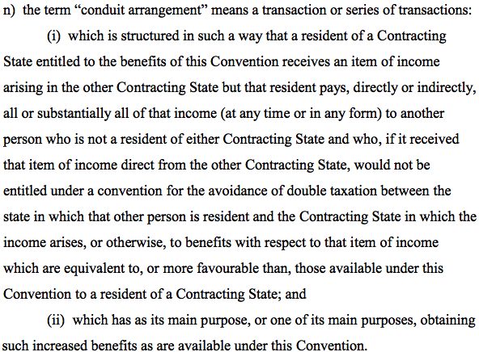
Definition of Conduit: US-UK Treaty
Article 3(1)(n), US-UK Treaty

Slide 14
Conduit Financing: UK Treaty
Article 3, par. 1(n): Conduit Arrangement
Article 10, par. 9 (dividends)
Article 11, par. 7 (interest)
Article 12, par. 5 (royalties)
Technical Explanation Annex (Exchange of Letters)

Slide 15
Treaty Shopping: Conduit Arrangements
X Co
Contract: Pay UK Co issue price of prd stk, receive 3.75% + 20% USCo net profits, and redemption price of stk in 20 yrs.
$$
UK Co
$$
Prd Stk: 4% + 20% net profits
US Co
Example 1, Exchange of Letters, US-UK Treaty, Annex to Technical Explanation

Slide 16
LOB Article: Article 23(2), US-UK Treaty
Limit treaty benefits to qualified persons
A qualified person is treaty resident who is a(n):
Individual
Qualified governmental entity (state, political subdivision, etc.)
Publicly Traded Entities and Subsidiaries
Regularly traded public entity (6% annual turnover (¶7(e)), or
At least 50% of vote and value held by five or fewer publicly traded entities

Slide 17
LOB Article: Article 23(2), US-UK Treaty
Pensions (if >50% of beneficiaries, members, etc., are residents of either US or UK) and Tax-exempts (¶2(e))
Non-individual: Base erosion and base ownership tests (¶2(f))
At least 50% of vote and value owned for at least 1/2 of period by QPs; and
Less than 50% of gross income is paid or accrued as deductible payments to 3rd country residents (arm’s-length payment in ordinary course of business for services or tangible property ignored as well as payments on financial obligations to US and UK banks)

Slide 18
LOB Article (Article 23)
Derivative Benefits: Otherwise non-qualifying company can claim treaty benefits if:
At least 95% of vote and value owned by 7 or fewer persons who are equivalent beneficiaries (“EBs”); and
Less than 50% of GI is paid or accrued in the form of deductible payments to persons who are not EBs. (¶3)
Equivalent Beneficiaries:
Qualified resident of EC, EEA, NAFTA country that would be entitled to claim treaty benefits equivalent to those claimed by company, including US or UK resident individuals, qualified government entities, publicly traded entities, or tax-exempt organizations. (¶7(d) modified by Protocol, Art. IV, and Exchange of Notes).
For dividends, interest, and royalties, the treaty rate of the EB is at least as low as the rate under the UK treaty (¶7(d) modified by Protocol, Art. IV, and Exchange of Notes).

Slide 19
LOB Article (Article 23)
Active Business Income (¶4(a))
Other nonqualified resident can obtain treaty benefits for an item of income if the resident is engaged in the active conduct of a T/B in one country and the income derived in the other country is derived in connection with or is incidental to that T/B.
Disproportionate Ownership and Income Interests (¶5)
Applies if company has class of shares that entitles holder to larger portion of the company’s profit, income, or gain in the other contracting state than the holder would otherwise be entitled to; and
At least 50% of Vote and Value owned by persons who are not EBs.
Common Stock
Tracking Stock: Dividends paid based on US Co’s earnings
UK: Publicly Traded
US Co

Slide 20
LOB Article (Article 23): Examples
Ex. 1: PT Entity
UK: Publicly Traded
UK: Publicly Traded
UK Sub
US
US
Ex. 2: Equivalent Beneficiary
Dutch Co
UK Sub
US

Slide 21
Earnings Stripping and Base Erosion: §163(j)
Out with the Old §163(j)
In with the New §163(j)
No deduction for disqualified interest if US Corp had:
Excess Interest Expense (EIE), and
D/E ratio > 1.5 to 1
EIE: Net Interest Exp > 50% of ATI
ATI: TI computed w/out regard to:
Int income/exp
NOL
Depreciation & amortization
Disqualified interest
Interest paid to related person if no tax imposed on the paid interest
If tax eliminated under treaty, treated as no tax imposed
Disqualified interest disallowed as deduction up to the amount of EIE
Carryover of disallowed amounts
Business interest deduction limited to:
Bus. interest inc + 30% of adjusted taxable income (ATI)
ATI: TI computed w/out regard to
Non-business income, loss, gain, etc.
Bus. Interest exp. and bus. interest inc.
NOL
Pre-2022 TY: depreciation & amortization; after 2021, no add back for depreciation
Any disallowed interest deduction carried over to following year
Small business (aver. gross receipts less than 29MM) excluded
Applies to FC with UST/B
Identity of payor is now irrelevant
Whether treaty applies is now irrelevant
D/E ratio is now irrelevant

Slide 22
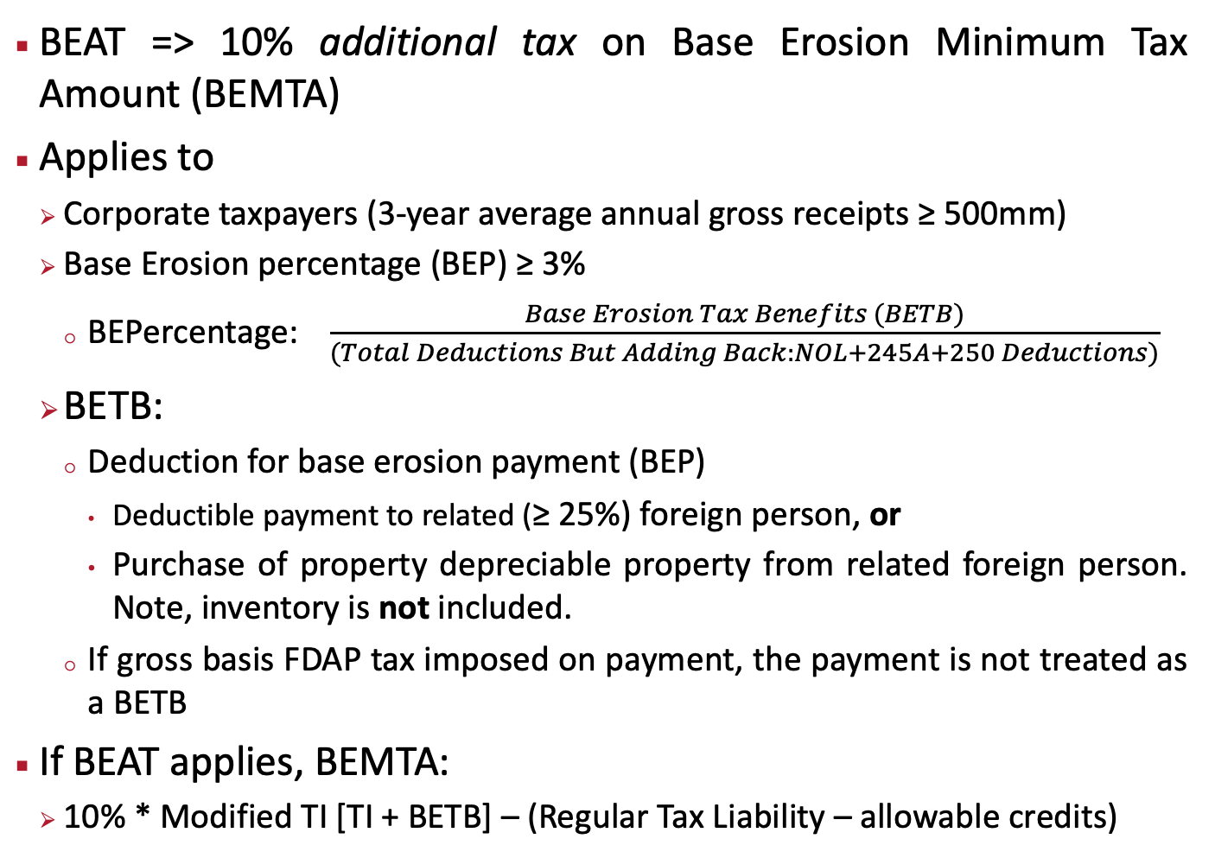
We Got the Beat: Base Erosion and Anti-Abuse Tax (§59A)
BEAT => 10% additional tax on Base Erosion Minimum Tax Amount (BEMTA)
Applies to
Corporate taxpayers (3-year average annual gross receipts ≥ 500mm)
Base Erosion percentage (BEP) ≥ 3%
BEPercentage: $\frac{Base Erosion Tax Benefits (BETB)}{(Total Deductions But Adding Back:NOL+245A+250 Deductions)}$
BETB:
Deduction for base erosion payment (BEP)
Deductible payment to related (≥ 25%) foreign person, or
Purchase of property depreciable property from related foreign person. Note, inventory is not included.
If gross basis FDAP tax imposed on payment, the payment is not treated as a BETB
If BEAT applies, BEMTA:
10% * Modified TI [TI + BETB] – (Regular Tax Liability – allowable credits)

