Slide 1
Controlled Foreign Corporations: CFCs
CFC:
Any FC if more than 50% of the vote or value of the corporation is held by “US Shareholders”. §957
US Shareholder (“USSH”):
A US person owning (directly, indirectly, or constructively) 10% or more of vote or value of a foreign corporation. §951(b)
Consequences of CFC Status:
Once a FC is a CFC at any time during a taxable year, its USSHs are taxed currently on their pro rata share of the CFC’s:
Subpart F Income (§951(a)(1)(A))
Investments in US Property (§951(a)(1)(B))
GILTI (§951A)

Slide 2
CFC: Overview of Subpart F Regime
If a USSH receives a Subpart F inclusion, his basis in the CFC stock increases. §961(a).
When the E&Ps attributable to the SF inclusion are distributed to a USSH, they are treated as a return of capital and its basis in the CFC stock decreases. §§959 and 961(b).
SF inclusions bring with them foreign taxes paid by the CFC. §960.
Gain realized by a USSH when the stock of a CFC is sold is treated as a dividend (not a capital gain) to the extent of untaxed E&Ps. §1248.
Why do corporations not fear? §1248?

Slide 3
Subpart F Income (§ 952, 954)
Insurance Income (§953)
Foreign Personal Holding Company Income (“FPHCI”) (§954(c))
Foreign Base Company Sales Income (“FBCSalI”) (§954(d))
Foreign Base Company Services Income (“FBCSerI”) (§954(e))

Slide 4
Subpart F: Special Rules
If the sum of FBCI is less than the lessor of 5% of GI or 1 million, none of the GI is treated as FBCI (§ 954(b)(3)(A))
If FBCI is greater than 70% of GI, entire GI is FBCI (§ 954(b)(3)(B))
If an item of income is subject to foreign tax at a rate greater than 18.9% (90% of 21%), it is not treated as FBCI (§ 954(b)(4)(A))

Slide 5
FPHCI: §954(c)
Dividends, interest, rents, royalties, and capital gains
Sale of property that doesn’t give rise to any income
Foreign currency gains
Commodities Income
Income from 25% owned loan-out corporations
Swap Income
Substitute Dividends
Aggregate approach for sale of 25%-owned partnerships (§954(c)(4))

Slide 6
Exceptions to FPHCI: §954(c)
Rents and royalties derived in an active business and received from non-related persons. (§ 954(c)(2)(A))
Rents and royalties received from related corp for the privilege of using property within the CFC’s country of formation. (§954(c)(3)(A)(ii))
Dividends and interest received from related corp organized in the same country as the CFC and which has a substantial part of its assets used in its trade or business in the same country. (§954(c)(3)(A)(i))
Income derived in the active conduct of banking, financing, or similar business. (§954(h))
Dividends, interest, rents, royalties from a related CFC to the extent not attributable to SF income. (§954(c)(6)). See Notice 2007-9.
Certain income derived in the active conduct of insurance business (§954(i))

Slide 7
Dover Corp. v. CIR: Check and Sell
6/30/97: Sale of shares of H&C
12/3/98: Request to IRS to file retroactive election for H&C to be treated as DRE effective 6/30/97
Under regs, a DRE election for a corporation is treated as a deemed liquidation.
Under US law, parent-sub liquidations are tax free to both the parent and subsidiary. See sections 332 and 337.
Dover
US
Dover
UK
Shares of H&C
Thyssen
UK
H&C
UK
$
assets

Slide 8
Foreign Base Company Sales Income: §954(d)
FBCSalesI (§954(d))
Income derived in connection with the sale or purchase of property involving a related person (>50%) if
the property is manufactured or produced outside of the CFC’s country of incorporation, and
the property is sold (or purchased) for use or consumption outside the country of incorporation.
Exception: agricultural products not grown in commercially marketable quantities, e.g., coffee, cocoa, tea
CFC2, a Swiss corporation, purchases telephones manufactured by CFC1, a Finnish corporation, and sells them to either an unrelated non-Swiss party or to DC

Slide 9
FBCSalesI: Manufacturing Exception
FBCSalesI does not include income from the sale of property manufactured by the CFC, regardless to whom it is sold.
Purchased property is considered to be manufactured if the CFC substantially transforms the property (e.g., converting wood pulp into paper, steel rods into screws, or tuna fish into canned tuna), or in case of component parts, the CFC’s activities are considered “substantial” and are generally considered to constitute manufacturing, production, or construction. Reg. §1.954-3(a)(4)(i) and (ii).
This test is satisfied if conversion costs are 20% or greater of the total cost of goods sold, provided the activities are not packaging, repackaging, labeling, or minor assembly operations. Reg. §1.954-3(a)(4)(iii).
Packaging, repackaging, labeling, or minor assembly operations will not constitute manufacturing. Id.

Slide 10
FBCSalesI: Manufacturing Exception
If a CFC’s employees substantially contribute to the manufacture or production of the sold personal property, the property sold will be considered to be manufactured or produced by the CFC. Reg. §1.954-3(a)(4)(iv).
Substantial Contribution Through Activities:
Oversight and direction of manufacturing activities or process
Material selection, vendor selection, or control of raw materials, WIP or finished goods
Management of manufacturing costs or capacities
Control of manufacturing logistics
Product design development

Slide 11
Branch Rule: §954(d)(2)
FBCSalesI
Using a Branch
Assume that CFC2, a Cayman corporation, purchases goods manufactured by CFC1, a UK corporation, and sells them in Europe.
The sales income earned by CFC2 would be FBCSalesI because the goods were purchased from a related person (CFC1) and were manufactured and sold for use outside of CFC2’s country of incorporation. 954(d)(1)
Now assume that CFC1 forms a sales branch in the Caymans to sell the same goods in Europe. Also assume that under UK law, the income earned by the branch would not be taxed by the UK.
Under US tax principles, transactions between a corporation and any of its branches have no tax significance. CFC1 would therefore be treated as selling the goods. None of the income would be FBCSalesI because the goods would have been manufactured in the UK and sold by CFC1.
The branch rule of section 954(d)(2) is designed to prevent the use of a branch to avoid the FBCSalesI rules.
CFC1 (UK)
CFC1 (UK)
Goods
Goods
Cayman Branch
Goods
CFC2 (Cayman)
Goods

Slide 12
Branch Rule: §954(d)(2)
If the branch rules apply, the branch is treated as a wholly owned subsidiary of the CFC and the branch is deemed to have sold the property “on behalf of” the “parent” CFC.
Under §954(d)(1), FBCSalesI includes income from the sale of personal property to any person on behalf of a related person.
Consequently, if the sold property is not either manufactured in the branch CFC’s country of incorporation or sold in that country, it will constitute FBCSalesI.

Slide 13
Branch Rule: §954(d)(2); Regs. §1.954-3(b)
The Branch Rule triggered when use of branch has the same “tax effect” as the use of a separate CFC. In the case of a “sales branch”, the branch is treated as having sold the property “on behalf of” the CFC.
Can apply to either sales/purchase or manufacturing branches located outside the CFC’s country of incorporation.
Tax effect
Sales/purchase branch: if income allocated to branch is taxed at less than 90% of and at least 5% points less than effective tax rate of CFC, branch is treated as separate CFC. Reg. §1.954-3(b)(1)(i).
Manufacturing branch: if income allocated to remainder of CFC is taxed at less than 90% of and at least 5% points less than effective tax rate of branch country, branch is treated as separate CFC. Reg. §1.954-3(b)(1)(ii).

Slide 14
Branch Rule: §954(d)(2); Regs. §1.954-3(b)
If the branch rule applies, the branch (B) is treated as a separate subsidiary incorporated in the country where it’s located. Reg. § 1.954-3(b)(2)(i)(a).
Property sold or purchased by sales/purchase B is treated as purchased or sold “on behalf” of the CFC by B. In essence, property is treated as having been transferred tax-free between B and the CFC after purchase and before sale, thereby potentially generating FBCSalesI.
Property sold or purchased by CFC from manufacturing B is treated as made “on behalf” of the manufacturing B by the CFC. In essence, property is treated as having been transferred tax-free between the manufacturing B and the CFC after manufacture and before sale, thereby potentially generating FBCSalesI

Slide 15
Branch Rule: §954(d)(2); Regs. §1.954-3(b)
Example 1: Sales Branch (1.954-3(b)(4), Ex. 1)
CFC (X: 50% TR)
B sells goods in Y and other countries that are manufactured by CFC in X. X does not tax the B income. Because the tax rate in Y is less than 90% and at least 5 percentage points less than the rate that would apply if X taxed the income of B, B is treated as a separate corporation. Income derived by B from the sale of property outside of Y is treated as income from the sale of property produced in X and sold for use outside of Y, thereby generating FBCSalI. CFC does not generate any FBCSalI because it manufactures the goods.
B (Y: 10% TR)
Example 2: Sales Branch (1.954-3T(b)(4), Ex. 3)
CFC (X: 40% TR)
CFC purchases goods produced in X from related party and sells through B for use outside of X. Because of the tax rate disparity between X and Y, B is treated as a separate corporation. Income derived by B from the purchase from a related person of property manufactured outside of Y and sold for use outside of Y is FBCSalI.
If the property were purchased from an unrelated person, and B were treated as a separate corporation, none of the income would be FBCSalI because it would be treated as purchasing from and selling to unrelated persons.
B (Y: 5% TR)

Slide 16
Branch Rule: §954(d)(2); Regs. §1.954-3(b)
Example 3: Manufacturing Branch (1.954-3(b)(4), Example 2)
CFC (X: 0% TR)
CFC sells goods manufactured by B inside and outside of X; B manufactures the goods in Y, which taxes only the manufacturing profits (30%) and not sales profits. X imposes no tax on the sales profits, but if CFC were incorporated under the laws of Y, its income would be subject to a 30% tax. Because of the rate disparity, B is treated as a separate corporation. B derives no FBCSalI because it manufactures the sold products, but income from the remainder of CFC is treated as income from the sale of property for use outside of X produced in Y on behalf of B, a related person is thus FBCSalI.
B (Y: 30% TR)
Example 4: Multiple Sales Branches (1.954-3(b)(4), Example 4)
CFC manufactures goods in X and sells through BB (Y) and through BC (Z). Each country only taxes income arising in that country. Each branch is tested separately. Because of the tax rate disparity between X & Y and X & Z on the income tax rate that would apply if the income of Y and Z were derived by X, BB and BC are treated as separate corporations. The income of BB and BC is treated as income from the sale of personal property “on behalf of” CFC and will be FBCSalI. CFC doesn’t derive any FBCSalI because it manufactures the sold articles.
CFC (X: 50% TR)
BB (Y: 20% TR)
BC (Z: 20% TR)

Slide 17
Branch Rule: §954(d)(2); Regs. §1.954-3(b); Rev. Rul. 75-7 (contract manufacturing)
FC received conversion fee for processing
Product remained sole property of CFC during processing
Quality control vested in CFC
Negotiation and sale of final product responsibility of CFC
Holdings:
(1) Performance of processing operations by FC is performance by CFC, and thus substantial transformation; and
(2) FC is considered to be a manufacturing branch but the branch rules don’t apply since the tax rate in X is higher than in Y.
USP
Metal Ore
Metal Ore
CFC X (46%)
FC Y (38.5%)
Ferroalloy

Slide 18
Ashland Oil v. CIR, 95 TC 348 (1990)
IRS argues that Tensia is “branch or similar establishment”
TC disagrees, stating that a branch does not encompass an unrelated corporation operating under an arm's-length contractual arrangement, and a “similar establishment” refers to an establishment that has the typical characteristics of a branch yet goes by another name.
IRS Response to Ashland: Rev. Rul. 97-48, which revoked Rev. Rul. 75-7.
Drew Chem (US)
Ameroid transfers know how and manufacturing intangibles. Tensia manufactures products using IP and charges Ameroid cost plus fixed fee.
Drew Ameroid (Lib)
Tensia (Belg)
Ameroid sells Tensia products to 3rd parties outside of Liberia
Tensia owned raw materials and finished products until delivery to Ameriod.

Slide 19
Branch Rule Issues
Expansion of manufacturing branches because of the substantial contribution rules.
If more than one branch satisfies the manufacturing test, the branch with the lowest effective rate is the manufacturing location for purposes of the branch rules. Reg. §1.954-3T(b)(1)(ii)(c)(3)(iii)
What’s a branch? How much activity is necessary to constitute a sales branch?
CTB Rules
Foreign tax rate—fiscal incentives

Slide 20
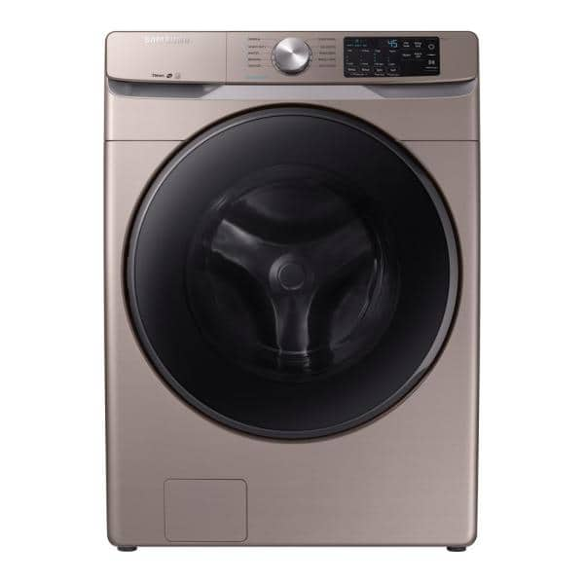
Whirlpool v. CIR (6th Cir 2021)
Whirlpool US
Whirlpool Mex
Arcos
Industrias

Slide 21
Whirlpool v. CIR (6th Cir 2021)
Manufacturing supply agreement
Whirlpool US
Whirlpool Overseas (Lux)
Whirlpool Mex
Sale of machinery, equipment, WIP
Manufacturing agreement
Lux paid WIN for manufacturing
Lux owed raw mat, WIP, and goods
Whirlpool Intl (WIN) Mex (DRE)
Commercial Arcos
Industrias Arcos
Employees subcontracted
Sale of tools to manufacture
Lease of RE of factories

Slide 22
Foreign Base Company Services Income (FBCSerI): §954(e)
Income from performing services, such as technical, managerial, engineering, architectural, scientific, skilled, industrial, or commercial, for or on behalf of a related person outside the CFC’s country of incorporation.
DC
DC pays CFC1, a Swiss corporation, to install or maintain computers in Germany sold by DC
DC assigns to CFC1 a contract to build a dam in India
DC sells computers for a lower price if purchaser agrees to have CFC1 service them
CFC1

Slide 23
FBCServiceInc: Notice 2007-13
Substantial assistance furnished by related US person(s)
Objective cost test
Assistance: direction, supervisions, services, know-how, financial assistance, equipment, material, or supplies provided directly or indirectly by a related US person to a CFC
Cost to CFC of services furnished by related US person equals or exceeds 80% of total cost to CFC of performing services

Slide 24
US Taxation of USMNs: Before 2018
Shareholders
CEN
US Parent
CIN
Current US Tax
Foreign Tax Credit
No US Tax until remitted
No foreign tax credit until remitted
Remittances would bring FTCs with them
Foreign Sub
(CFC)
Subpart F
Div
Int
Royal
Base Company Inc
Earning invested in US
Active Business Income
Foreign Taxes on SubF Inc
Foreign taxes on Business Inc

Slide 25
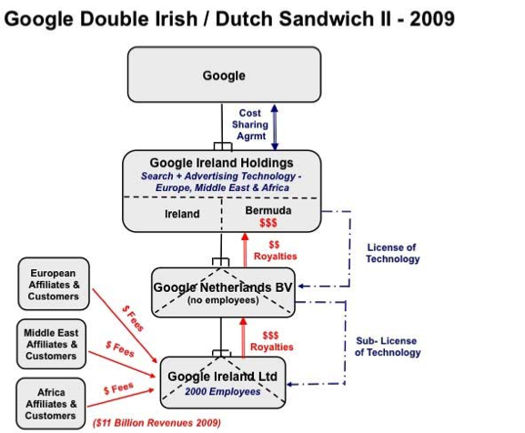
Stateless Income: Google Double Dutch/Irish Sandwich

Slide 26
Where are we now, post-2017?
Shareholders
US Parent
Current US Tax
Subpart F: 21%
GILTI 10.5%
Foreign Tax Credit
General limits
80% for GILTI
No US Tax
No FTC
No Expenses
Foreign Sub
(CFC)
Subpart F
Passive Inc
Base Company Inc
Earning invested in US
GILTI
Non-GILTI, non-Subpart F Income (high taxed income and NDTIR)
Foreign Taxes on SubF Inc & GILTI
Foreign taxes on Non-GILTI, non-Subpart F inc

Slide 27
Overview of Global Low-Taxed Intangible Income (GILTI): §951(A)
Enacted in the TCJA, the GILTI regime moves the United State towards a global minimum tax on the worldwide income of its multinationals.
GILTI applies to income not subject to subpart F. (§951A(c)(2)(A)(i)(II))
USSHs are entitled to a 10% cost of capital exclusion with respect to each CFC’s tangible assets. (§951A(b)(2)(A))
GILTI is basically the income in excess of this “normal” return
Corporate USSHs of CFCs are subject to a 10.5% rate on GILTI (§250(a)(1)(B))
This rate is schedule to increase to 13.125% in 2026 (§250(a)(3)(B))
Corporate USSHs are entitled to a deemed paid credit for foreign taxes paid on GILTI, but the credit is limited (20% haircut). (§960(d))

Slide 28
GILTI: Some Gory Details
GILTI: Net tested income over Net deemed tangible income return (Net DTIR) (§951A(b)(1) and (2))]
Net Tested Income:
Excess of Sum of Tested Income of each CFC over
Sum of Tested Loss of each CFC (§951A(c)(1))
Compare Subpart F
Tested Income & Loss:
Income: Excess of gross inc minus (subpart F, high-taxed income related party dividends, ECI) minus allocable expenses, including taxes
Loss: Excess of expenses, including taxes, over gross inc minus (subpart F, high-taxed income, related party dividends, ECI) (§951A(c)(2))

Slide 29
GILTI: Some More Gory Details
Net DTIR
10% * Qualified Business Asset investment (QBAI) of each CFC minus specified interest expense (§951A(b)(2)(A) and (B))
QBAI: AB of tangible depreciable property used to produce tested income (§951A(d)(1) and (2))
Dual use property: allocated based on gross income.
Specified interest expense
Aggregate tested interest expense less tested interest income

Slide 30
GILTI Done Graphically
GILTI
Net CFC Tested Inc
Net DTIR
=
Aggregate Tested Inc
Aggregate Tested Loss
10% QBAI
Specified Int Exp
Aggregate Tested Int Exp
Aggregate Tested Int Inc

Slide 31
GILTI: Separate Computations and Inclusions
UPS
(USSH)
GILTI
Net CFC Tested Inc
Net DTIR
Specified Interest Exp
USSH
CFCs
Tested Inc
Tested Loss
QBAI
Tested Int Exp
Tested Int Inc
CFC1
CFC2
CFC3

Slide 32
GILTI: Some more rules
GILTI is included in income similarly to subpart F. §951A(e)(1)
Amount proportionate to the amount that would be received by the shareholder in a year-end hypothetical distribution of all the CFC’s current-year earnings relative to all current year earnings.
US tax principles used to calculate tested inc/loss, e.g, §163(j), depreciation, E&Ps, etc.
Only a tested income CFC can have QBAI; a tested loss CFC cannot have QBAI. Regs. §1.951A-3(b)

Slide 33
GILTI: Specified Interest Expense: Regs. §§1.951A-1(a)(c)(iii) and 1.951A-4
Specified interest expense (shareholder level item)
Excess of tested interest expense over tested interest income
Tested Int Expense: interest expense allocated to gross income
Tested Int Income: interest income included in gross income
Roughly: interest can be deducted only to the extent of interest income
Special rules apply to securities dealers, banking, and insurance companies.
Specified interest expense includes interest expense of ALL CFCs, including CFCs with a tested loss, but for a loss CFC, the interest expense is reduced by 10% * QBAI of the test loss CFC.

Slide 34
GILTI Example
Example
USP owns 4 CFCs, some of which either manufacture or make substantial contributions to manufacturing, develop and license IP, and provide services to unrelated parties
All the amounts are in millions
There is no tested interest income
None of the CFCs have any subpart F, high-taxed income, or ECI
Item | CFC1 | CFC2 | CFC3 | CFC4
Gross Test Inc/<Loss> | 700 | 150 | 400 | 0
Tangible Property | 100 | 600 | 0 | 800
Allocable Deductions | 200 | 50 | 100 | 300
Tested Interest Exp | 0 | 30 | 10 | 100

Slide 35
GILTI Example Continued: Calculation of Net Tested Income
The USP’s net CFC tested income: Sum of CFC tested inc minus CFC tested loss
Net equals 600
Item | CFC1 | CFC2 | CFC3 | CFC4
Gross Tested Inc/<Loss> | 700 | 150 | 400 | 0
< ECI, subpart F, high-taxed> | 0 | 0 | 0 | 0
Gross Tested Income | 700 | 150 | 400 | 0
Allocable Deductions | <200> | <50> | <100> | <300>
CFC Tested Income/<Loss> | 500 | 100 | 300 | <300>

Slide 36
GILTI Example Continued: Calculation of Net DTIR
Item | CFC1 | CFC2 | CFC3 | CFC4 | Total
Share of QBAI | 100 | 600 | 0 | 0 | 700
Share of Specified Int Exp | 0 | 30 | 10 | 20 | 60
CFC4 has a tested net loss so QBAI = 0
Since CFC4 has a tested net loss, its interest is reduced by the tested loss QBAI amount: 10% of the QBAI assuming CFC4 was a net income CFC
10% * 80 = 80
100 int exp – 80 = 20
Net DTIR = (10% * QBAI) minus specified interest
70 – 60 = 10

Slide 37
GILTI Example Continued: Allocation of GILTI Inclusion among CFCs
GILTI = Net CFC Tested Income – NDTIR
600 – 10 = 590
But we’re not done yet….
The total GILTI inclusion is allocated among the CFCs in order to track PTI/PTEP, FTCs, basis adjustments
GILTI is allocated only among tested income CFCs in proportion to the amount of tested income. Tested loss CFCs are not allocated any GILTI
CFC1 = 590 * 500/900 = 328
CFC2 = 590 * 100/900 = 65
CFC3 = 590 * 300/900 = 197
CFC4 = 590 * 0/900 = 0

Slide 38
GILTI: High-Tax Exception and High-Tax Regulatory Exception
Under §951A(c)(2)(A)(i)(III), GILTI doesn’t include any income that would otherwise be subpart F if it is taxed at a rate > 18.9%
Regulations extended this treatment to any item of income (not only subpart F) that is subject to tax at a rate > 18.9%. Reg. §1.951-2(c)(7)
The US controlling parent must make an election to apply the high-tax exception. Reg. §1.951-2(c)(7)(viii)

Slide 39
Participation Exemption: §245A
The TCJA enacted a participation exemption/territorial system for E&Ps of certain foreign corporations distributed to U.S corporations in §245A.
§245A allows a 100% DRD for dividends received by a U.S. corporation (not individual) for the foreign source portion of the dividend from a specified 10% owned foreign corporation (SFC). §245A(a).
SFC: any foreign corporation in which a U.S. corporation owns 10% or more of the vote or value but excluding passive foreign investment companies (PFICs). §245A(b).
No FTC is allowed with respect to any amount deducted or for any hybrid dividend (a dividend that is deductible in the foreign country). §245A(d) and (e).
Regulations limit the 100% DRD in certain abusive situations that effectively eliminate from tax amounts included under subpart F/GILTI. See Reg. §1.245A-5.

Slide 40
Investment in US Property: §956
A USH is taxed on its pro rata share of subpart F income and on its pro rata share of the 956 amount, i.e., any increases in investment of earnings in “US property.” §§951(a)(1)(B); 956.
US Property (§ 959(c)(1), (2)):
Tangible property located in US, except export property
Stock of domestic corporation, except stock of USCO that is not a USSH or USCO that is 25% owned by USSHs
Obligation of US person, except US debt, deposits in US banks, debt of USCO that is not a USSH or USCO that is 25% owned by USSHs
Right to use in US certain IP of CFC acquired or developed for use in the US
CFC treated as owning obligation of USP that CFC guarantees or secures with a pledge of its property (§ 956(d)); pledge of >2/3 of CFC stock treated as pledge of CFC’s assets

Slide 41
Investment in US Property: §956
With the enactment of the participation exemption, the need for §956 has been greatly reduced. Why?
Recognizing that an actual dividend of non-subpart F/GILTI paid to a USSH would be eligible for the 100% DRD, Treasury has basically eliminated §956 for US corporate shareholders.
Under Reg. §1.956-1(a)(2), any 956 amount for a corporate shareholder is reduced by any amount allowed under §245A.

Slide 42
PTEP (PTI):
If an amount is included in a USSH’s income as an investment in U.S. property, subpart F, or GILTI, when the E&Ps attributable to the previously taxed income (“PTEP”) are actually distributed, they are not taxed again. (§959(a)).
This same rule applies to investments in U.S. property, subpart F, and GILTI distributed from lower-tier subsidiaries through a chain of upper-tier subsidiaries. (§959(b)).
Ordering of Distributions of PTEP (§ 959(c)(2), (3))
Current PTI
Accumulated PTI
Current non-PTI E&Ps
Accumulated non-PTI E&Ps

Slide 43
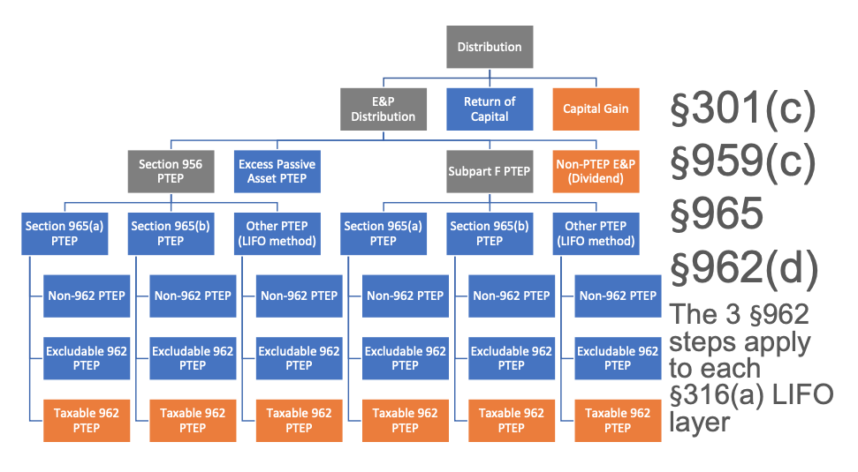
PTEP (PTI): Notice 2019-1

Slide 44
Section 1248
Original purpose of §1248:
Prevent repatriation of untaxed E&Ps of CFCs at capital gains rates.
Section 1248:
US person sells or exchanges (redeems or liquidates) stock of FC
US person is a 10% shareholder of FC while FC was a CFC at any time during last five years
Gain to the extent of non-PTEP, post-’62 E&Ps accumulated while the US person was a shareholder of FC while FC was a CFC is treated as a dividend
Notice 2004-70: §1248 dividends eligible for capital gains rate for qualified dividends
Any amount treated as a dividend and received by a U.S. corporation is treated as a dividend for purposes of §245A. §1248(j).

Slide 45
Passive foreign investment companies (PFICs)
Enacted in 1986, the PFIC provisions are intended to plug the gaps in the CFC regime (and formerly the FPHC regime) by eliminating the benefits of deferral for US persons owning stock in any foreign corporation earning substantial amounts of passive income or owning substantial amounts of passive assets. (§§1291-1298)

Slide 46
PFICs
Definition of PFIC:
Any foreign corporation if:
75% or more of its GI is passive income (§ 954(c)) or
the average percentage of its passive income producing assets is 50% or more (§1297(a))
Holding Company Rule:
If a FC owns 25% or more of another corporation, FC is treated as holding and earning its proportionate share of the other corporation’s assets and income (§1297(c))

Slide 47
PFICs: Special rules
Once a PFIC, always a PFIC (§1298(b)(1))
If PFIC and CFC, treated only as CFC for US shareholders (§1297(d))
Exceptions for start-up years and changing businesses (§1298(b)(2), (3))

Slide 48
PFICs: The 3 Different Paths
1291 Regime:
Any “excess distribution,” including gain from the sale of PFIC stock, is allocated ratably across the SH’s holding period.
Amounts allocated to the current year and pre-PFIC years are included as OI.
The SH’s taxes are also increased by the amounts allocated to the remaining years times the highest tax rate in effect for those years.
Finally, interest is charged on the increased taxes. (§1291(a)(1) and (2), (c))
QEF Regime:
Each SH of a QEF includes as OI his pro rata share of the QEF’s ordinary earnings and as CG his pro rata share of the QEF’s NCG. (§1293(a)).
Basis and PTEP adjustments similar to CFC regime.
Mark-to-Market Regime:
Marketable PFIC stock is MTM at year end;
Gain is included as OI income and losses are treated as ordinary and deductible to the extent of “unreversed inclusions.” (§1296(a), (c))

Slide 49
PFICs
PFIC Example
USSH purchases stock of FC on Dec. 31, 2019, for $100 and sells it on Dec. 31, 2024, for $200. FC owns only passive assets and earns $5 per year, none of which is distributed. FC increases in value $20 per year.

