Slide 1

Transfer Pricing
Transfer Pricing: Refers to prices related parties charge each other for goods, services, and capital. Left unchecked, abusive transfer pricing could substantially threaten corporate tax revenues.
Example
Toyota Japan sells cars it produces in Japan for 10K to its US distributor for 14k, which in turn sells them in the US market for 15k, leaving 1k of US profit and 4k of Japanese profit. Assume now that an unrelated distributor would require a profit margin of 20% of the sales price. The price thus paid by Toyota US is 2k too high resulting in an understatement of its US income and an overstatement of its Japanese income. The total profit of 5, however, remains within the Toyota consolidated group.
Toy JP
Toy US

Slide 2
Transfer Pricing: 482
In any case of two or more organizations, trades, or businesses (whether or not incorporated, whether or not organized in the United States, and whether or not affiliated) owned or controlled directly or indirectly by the same interests, the Secretary may distribute, apportion, or allocate gross income, deductions, credits, or allowances between or among such organizations, trades, or businesses, if he determines that such distribution, apportionment, or allocation is necessary in order to prevent evasion of taxes or clearly to reflect the income of any of such organizations, trades, or businesses. In the case of any transfer (or license) of intangible property (within the meaning of section 367(d)(4)), the income with respect to such transfer or license shall be commensurate with the income attributable to the intangible.

Slide 3
Transfer Pricing: 482 Regulations
1968: Set out arm’s-length standard for loans, services, use and sale of tangible property, and transfer of intangible property
1986: Added the CWI standard in section 482 for intangibles
1988: Treasury White Paper
1994: Final Section 482 Regs
2005: New Proposed Cost-Sharing Regs
2006: New Controlled Services Regs
2008-9: New Temporary Cost-Sharing Regs
Dec. 16, 2011: Final Cost-Sharing Regs

Slide 4
Transfer Pricing: 482 Regulations
In determining the true taxable income of a controlled taxpayer, the standard to be applied in every case is that of a taxpayer dealing at arm’s length with an uncontrolled taxpayer. A controlled transaction meets the arm’s length standard if the results of the transaction are consistent with the results that would have been realized if uncontrolled taxpayers had engaged in the same transaction under the same circumstances (arm’s length result). However, because identical transactions can rarely be located, whether a transaction produces an arm’s length result generally will be determined by reference to the results of comparable transactions under comparable circumstances. (-1(b)(1))

Slide 5
Transfer Pricing: 482 Regulations
The arm’s length result of a controlled transaction must be determined under the method that, under the facts and circumstances, provides the most reliable measure of an arm’s length result. (-1(c)(1))
Transactions between unrelated parties provide the most objective basis for determining whether the results of a controlled transaction are arm’s length. (-1(c)(2))
Comparability
Economic Functions: R&D, Product design, manufacturing, purchasing, marketing, transportation, management services
Contract Terms: volume, warranties, duration of licenses, credit terms
Risks: market risks, financial risks (FX, interest rate), product liability risk
Economic Conditions: relative size of markets, market shares, location-specific costs
Arm’s length Range (-1(e))

Slide 6
Transfer Pricing Methods: Transaction Based and Profit Based
Tangible Property
CUP, RPM, CP+
Comparable Profits
Profit Split
Intangible Property
CUT
Comparable Profits
Profit Split

Slide 7
Transfer Pricing: Transaction Methods
Comparable Uncontrolled Price (CUP) (tangible property)
Compares amount charged in a controlled transaction by reference to amount charged in a comparable uncontrolled transaction (-3(b)(2)
Comparable? Effect of TMs, etc.
Comparable Uncontrolled Transactions (CUT) (intangibles) (-4)
Comparable IP must have same profit potential –NPV of benefits to be realized (based on prospective profits or costs) (-4(c)(2)(iii)(B)(1)
CWI adjustments, but not if, inter alia, IP transferred to uncontrolled taxpayer in a CUT transaction under substantially the same circumstances as those of the controlled transaction (-4(f))

Slide 8
Transfer Pricing: Transaction Methods
Resale Price (tangible property)
Sales between related parties are analyzed from the POV of a buyer that resells the goods to an unrelated person and is used in cases where the reseller (distributor) does not add substantial value to the goods by physically altering them before resale (-4(c))
Not ordinarily used where the controlled party uses its IP to add substantial value.
Similarity of functions, risks borne, and contractual terms are especially important
Cost Plus (tangible property)
Compares gross profit markups of comparable controlled and uncontrolled transactions. Focuses on POV of producer, manufacturer. (-4(d))

Slide 9
Transfer Pricing: Profit-Based Methods
Profit Split
Allocate P&L based on relative value of each controlled taxpayer’s contribution to combined P&L based on functions performed, risks assumed, and capital employed by each party. (-6(b))
Comparable Profit Split (-6(c)(2))
Difficult to find uncontrolled parties dealing at arm’s length in similar transactions and enough information about their combined P&Ls
Examine operating profit margin relative to financial metric
Residual Profit Split (-6(c)(3))
Operating income allocated to each party to provide market return for “routine” contributions to activity—contributions of tangible and IP, services that are generally owned by uncontrolled TP engaged in similar activities.
Residual profit divided among the controlled parties based on relative value of their contributions of IP to the relevant business activity
External market benchmarks that reflect the FMV of the IP,
Capitalized cost of developing the IP, or
The amount of actual expenditures

Slide 10
Intellectual Property and Section 482
…In the case of any transfer (or license) of intangible property (within the meaning of section 367(d)(4)), the income with respect to such transfer or license shall be commensurate with the income attributable to the intangible.
US Parent
IP License
Royalties: CWI Standard
Foreign Sub
(CFC)
Royalties from unrelated persons are active business income if:
CFC develops or adds substantial value to the IP
CFC makes license as part of its marketing functions and is substantial in relation to royalties

Slide 11
Cost Sharing Arrangements (-7T)
Reasons for CSAs and transfer pricing concerns
CSA: arrangement by which controlled participants share the costs and risks of developing cost shared intangibles in proportion to their reasonably anticipated benefits (RAB) shares.
Xilinx v. CIR, 598 F.3d 1191 (9th Cir. 2010) (stock option expenses not shared cost); Altera Corp v. CIR, 926 F.3d 1061 (2019) (SBC required to be shared in cost-sharing)
If there is a valid CSA, each participant is considered to be an owner of the IP and therefore no royalty is imputed.
Buy-in payments (platform contribution costs)
Veritas v. CIR, 133 T.C. 297 (2010)

Slide 12
IP, Section 482, and Cost Sharing
CSA: arrangement by which controlled participants share the costs and risks of developing cost shared intangibles in proportion to their reasonably anticipated benefits (RAB) shares.
US Parent
CSA
No imputed royalty
Foreign Sub
(CFC)
If there is a valid CSA, each participant is considered to be an owner of the IP and therefore no royalty is imputed.
CFC buy-in payments (platform contribution costs)
Where does the $ come from?

Slide 13
Amazon v. CIR (148 TC No. 8, (2017)); aff’d 934 F.3d 976 (2019)
Ownership Structure
Transaction
In ‘05-’06, AMZ transferred to AEHT
Web SW
Marketing Intangibles
Euro. customer lists
Issues:
AEHT’s buy-in payment
AMZ: 254mm
IRS: 3.458bi
Amount of intangible development cost (IDC)
Stock-based compensation
AMZ (US)
AEHT (Lux)

Slide 14
Recent 482 Cases
Coca Cola v. CIR, 155 T.C. 145 (2020)
Rare IRS victory in 482 case
Upheld $10 billion in adjustments for 2007-2020 Tys
CC licensed TMs, product names, logos, patents, secret formulas, and proprietary manufacturing processes to foreign affiliates (supply points) to produce concentrate sold to unrelated bottlers.
CC used formulary apportionment method previously agreed with IRS in earlier settlement
IRS: used comparable profits method (CPM) that used CC’s unrelated bottlers as comparable parties. CPM can limit subsidiary’s profit to a routine return.
Medtronic v. CIR, 900 F.3d 610 (8th Cir. 2018), vacating and remanding TC Memo 2016-112. Coming any day.
Issue: Best TP methods: CPM or CUT

Slide 15
Transfer Pricing
BOP: 482 determinations sustained absent showing of abuse of discretion—allocations are arbitrary, capricious, or unreasonable.
Enforcement/Penalty Provisions:
1059A
6038A; and
6662(e) and 6662(e)(B)
Substantial valuation misstatement: price/value > 200% (or 50% less) than correct amount or net 482 adjustment exceeds the lessor of $5mm or 10% of gross receipts
Gross valuation misstatement: same as above but 400% (or 25%) or net 482 adjustment exceeds the lessor of $20mm or 20% of gross receipts
APAs and Arbitrations
Uni, Bi, and Multilateral (183 applications filed in 2022)
Income Tax Treaties
Art. 9(2)
Country by Country Reporting:
Ultimate parent entity of US MNE Group with $850mm of revenue must file Form 8975. Reg 1.6038-4

Slide 16
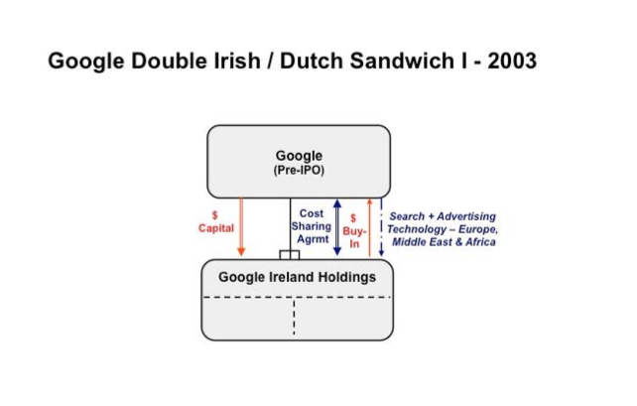
Google Double Irish/Dutch Sandwich I-2003

Slide 17
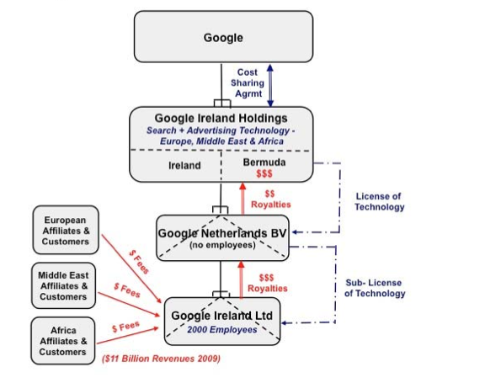
Google Double Irish/Dutch Sandwich II-2003

Slide 18
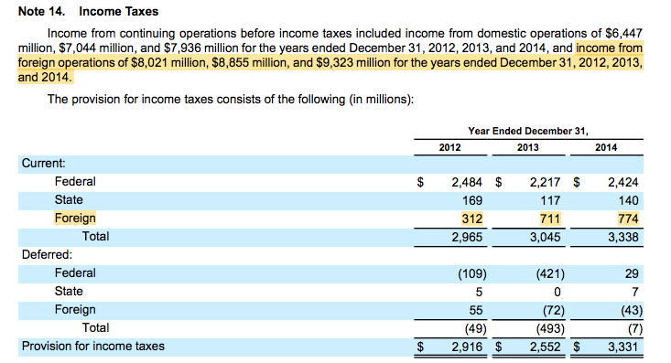
Google’s Effective Tax Rate

Slide 19
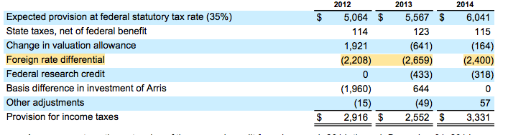
Google’s Effective Tax Rate: Reconciliation
We have not provided U.S. income taxes and foreign withholding taxes on the undistributed earnings of foreign subsidiaries as of December 31, 2014 because we intend to permanently reinvest such earnings outside the U.S. If these foreign earnings were to be repatriated in the future, the related U.S. tax liability may be reduced by any foreign income taxes previously paid on these earnings. As of December 31, 2014, the cumulative amount of earnings upon. which U.S. income taxes have not been provided is approximately $47.4 billion. Determination of the amount of unrecognized deferred tax liability related to these earnings is not practicable

Slide 20
BEPS Initiative: 15 Action Points
Address the tax challenges of the digital economy
Neutralize the effects of hybrid mismatch arrangements
Strengthen CFC rules
Limit base erosion via interest deductions and other financial payments
Counter harmful tax practices more effectively, taking into account transparency and substance
Prevent treaty abuse
Prevent the artificial avoidance of Permanent Establishment (PE) status
Aligning transfer pricing outcomes with value creation: intangibles
Aligning transfer pricing outcomes with value creation: risks and capital
Aligning transfer pricing outcomes with value creation: other high-risk transactions
Measuring and monitoring BEPS
Require taxpayers to disclose their aggressive tax planning arrangements
Re-examine transfer pricing documentation
Make dispute resolution mechanisms more effective
Develop a multilateral instrument

Slide 21
Repairing the Cracks in the International Tax System
Pre-2017
Post-2017
Global--BEPS
Stateless income
Treaty abuse
Double non-tax
United States
High corporate tax rate (35%)
Treatment of foreign income
Deferral
Where to tax income from IP
Run away plants
Solutions?
Eliminate deferral
Territoriality
Modified deferral
Cash flow taxes
BEPS
Pillar One (reallocating tax jurisdiction over residual profit) to where goods/services are used or consumed
MNEs > Eur20 billion & 10% profit margin
25% of profit about 10% profit margin (Amt A) subject to reallocation
Pillar Two (global minimum 15% tax)
United States
21% corporate tax rate
Expansion of anti-deferral regime (GILTI)
Creation of participation exemption
Tax benefit for export income (FDII)
Minimum tax on corporations making base erosion payments to foreign related parties (BEAT)
Limits on interest deductions
15% minimum tax on adjusted book income

Slide 22
Pillar Two: Anti Global Base Erosion/GLoBE Rules (oecd.org)
Initial Public Consultation (Oct. 9, 2019)
Blueprint (Oct. 12, 2021)
Rules released (Dec. 20, 2021)
Commentary on Pillar Two GLoBE model Rules (Mar. 14, 2022)
Release of Technical Guidance on implementing Pillar Two (Feb. 2, 2023)
Aim: Global Minimum Tax at 15% rate for MNEs with more than Eur 750mm consolidated revenue

Slide 23
Pillar Two – Four measures for global minimum taxation
PILLAR ONE
PILLAR TWO
Focuses on achieving a minimum income taxation for MNEs in each jurisdiction where the MNE has a taxable presence
Mix of 4 measures
Subject-to Tax Rule
Income Inclusion Rule
Undertaxed Payments Rule
Switch-over Rule

Slide 24
Pillar Two – Four measures for global minimum taxation
2
3
Income Inclusion Rule (IIR)
Undertaxed Payments Rule (UTPR)
Domestic
legislation
Tax treaties
Inclusion of the income of a low-taxed constituent entity in the tax base of the ultimate parent entity if that income is not taxed at the minimum 15% ETR.
Secondary rule which is meant as a backstop in case the minimum taxation is not achieved through the IIR. The UTPR is applied by the jurisdiction of the payer.
1
Switch-over Rule (SOR)
Subject to Tax Rule (STTR)
Ensuring proper application IIR by allowing a switch from the exemption method to the credit method.
Additional source taxation (withholding) and deny treaty benefits for “mobile payments” (interest, royalties, etc.) not sufficiently taxed in the recipient’s jurisdiction (<9% nominal rate).
Parent/Residence jurisdiction
Source jurisdiction
Summary: The proposal works as worldwide minimum corporate taxation with either the source or the parent/residence jurisdiction picking up the tax if the other does not.

Slide 25
Proposed Alignment with OECD’s Pillar Two
Would repeal and replace the base erosion and anti-abuse tax (BEAT) with an undertaxed profits rule (UTPR) that mirrors Pillar Two’s UTPR
The proposed UTPR targets foreign-parented multinationals operating in low-tax jurisdictions
UTPR would disallow some deductions for US corporations (or US branches of FCs) to the extent foreign members of the same “financial reporting group” have low-taxed income that is not subject to a Pillar Two-compliant IIR
There are two components of Pillar Two:
Income Inclusion Rule (IIR) — Imposes a top-up tax on a parent entity with respect to the low-taxed income of a member of its financial reporting group
Applies to income taxed below a 15% effective tax rate threshold
Implementation planned for 2023
UTPR — Denies deductions or requires an equivalent adjustment to tax liability to the extent that the low-taxed income of a member of the group is not subject to an IIR
Implementation planned for 2024
FY2024 Treasury Greenbook, pp. 32-36

Slide 26
Proposed UTPR Aimed at Protecting U.S. Revenue
Would apply only to financial reporting groups with at least $850 million in global annual revenue in at least two of the last four years (with certain de minimis exclusions)
Would deny deductions to domestic group members to the extent necessary to effect a 15% tax rate in each foreign jurisdiction in which the group has profits
The disallowance would apply pro rata to all otherwise allowable deductions and after all other deduction disallowance provisions in the Code are applied
Excess amount of UTPR disallowance would be carried forward indefinitely
Would not apply to income subject to an IIR that satisfies OECD rules
Including income subject to the GILTI regime
Would also adopt a domestic minimum top-up tax that would apply when another jurisdiction adopts a UTPR
Would be effective for taxable years beginning after December 31, 2023
FY2023 Treasury Greenbook, pp. 4-8

Slide 27
BBBA Baseline Assumed for GILTI and FDII
The minimum tax rate used for purposes of Pillar Two’s Income Inclusion Rule and Undertaxed Profits Rule will be 15%
The GILTI regime is intended to be a qualifying IIR under Pillar Two
The FY2023 Treasury Greenbook assumes the BBBA as a baseline, indicating the retention of the §250 deduction for FDII and reducing its percentage
 | Current Law | Build Back Better Act (H.R. 5376) | FY2023 Treasury Greenbook
§250 Deduction GILTI | 50% | 28.5% | 28.5%*
Corporate Tax Rate | 21% | 21% | 28%**
GILTI Effective Rate | 10.5% | 15% | 20%
*The FY2023 Treasury Greenbook retains the BBBA’s reduced IRC §250 deduction percentage for GILTI **The increased corporate tax rate would be effective for taxable years beginning after December 31, 2022
FY2023 Treasury Greenbook, pp. 2-3. Export Tax Incentives; Build Back Better Act, §128121.

