Slide 1
International Taxation
Professor Jeffrey M. Colón
Fordham University School of Law
Spring 2023

Slide 2
Introduction
Code, Treaty, & Text
Code & Regulations
UK Treaty and Technical Explanation
International Taxation (ITT) (draft text), includes cases, administrative guidance, and comments
Class Page
https://jmc877.github.io/International-Tax/index.html

Slide 3
Course Overview
U.S. Persons vs. Them (Foreign Persons)
Residence
Foreign Persons: Source basis taxation
Investment Income (Dividends, Interest, Royalties, and Rents)
Business Income, including U.S. real estate
U.S. Persons: Residence basis taxation
World-wide income taxation
Fiscal conflicts of sovereigns (the clash of residence and source taxation)
Foreign tax credit (source trumps residence)
Deferral and Anti-deferral regimes: Subpart F/Controlled Foreign Corporations (CFCs), Passive Foreign Investment Companies (PFICs), and Global Intangible Low-Taxed Income (GILTI)
Transfer Pricing
Bi-lateral Treaties: Resolving fiscal conflicts of sovereigns: residence trumps source
OECD BEPS (Base Erosion Profit Shifting) Initiatives: Pillars 1 & 2

Slide 4
Promulgating, Interpreting, and Administering U.S. Tax Law
Executive Branch
Judicial Branch
Legislative Branch

Slide 5
Legislative Branch
Bill Introduced in the House of Representatives and Senate
Bill Referred to and Public Hearings by House Committee on Ways and Means and Senate Finance Committee
Executive Branch
Executive Sessions of Ways and Means and Senate Finance
Bill Referred to House and Senate Floors
Reconciliation Conference
Bill Returned to Full House and Senate

Slide 6
Executive Branch
President
Treasury
Legislative
Proposals
Assist. Sec. for Tax Policy
IRS
Regulations
Revenue Rulings
Priv. Letter Rul.
Tech. Adv. Mem.
Chief Coun. Adv.
Audit
30-Day Letter
90-Day Letter
Tax Court

Slide 7
Judicial Branch
Refund Suits
90 day
Letter
Tax Court
Claims Court
District Court
Appellate Courts
Supreme Court

Slide 8
Internal Revenue Code and Regulations
IRC: Title 26 of the U.S. Code
Subtitles (A-K)
A (Income Taxes) and (B) Estate and Gift Taxes
Chapters and Subchapters
Chapter 1 (Normal Taxes) [§§1-1400L]
Subchapter C: Corporate Distributions and Adjustments [§§301-385]
Subchapter K: Partners and Partnerships [§§701-777]
Subchapter N: Tax based on U.S. and foreign source income [§§861-999]
Parts [I], Sections [61], Subsections [c], Paragraphs [1], Subparagraphs [A], Clauses [i], and Subclauses [II]
Treasury Regulations: Title 26 of the CFR
Chapter, Parts, Sections [§§ 1.1 and 301.7701], Subsections [-1], Paragraphs[-1(d)]; Subparagraphs [-1(d)(1)]; and Subdivisions [-1(d)(1)(ii)]

Slide 9
Treaties and Taxes
Income Tax Treaties
Gift and Estate Tax Treaties
Exchange of Tax Information Agreements
Social Security Totalization Agreements
GATT/WTO

Slide 10
Basic Function of Treaties
“The United States of America and Canada, desiring to conclude a Convention for the avoidance of double taxation and the prevention of fiscal evasion with respect to taxes on income and on capital (…)”

Slide 11
How is Double Tax Eliminated?
Reduction or elimination of source basis taxation
Treaty definitions of source
Tie-breaker test for dual residents
Requiring one country to grant a credit for taxes paid to other country (or an exemption on income taxed by the other country)
Mutual Agreement Procedures
Exchange of tax information

Slide 12
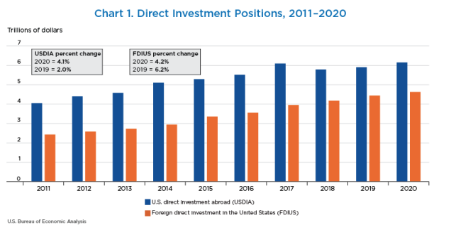
Direct Investment: 2011-2020 (Historical Cost)

Slide 13
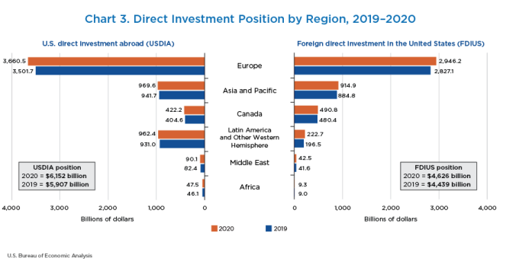
U.S. Outward and Inward Direct Investment by Region (2019-2020)

Slide 14
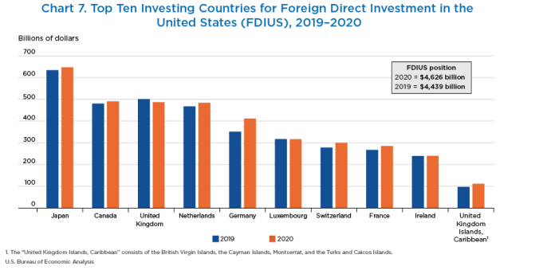
Foreign Direct Investment in the United States (Top Ten Investing Countries)

Slide 15
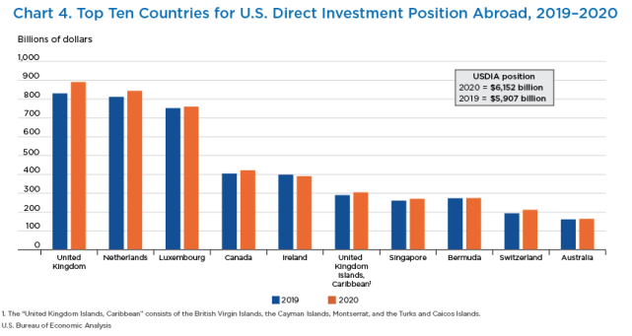
U.S. Direct Investment Abroad (Top Ten Countries)

Slide 16
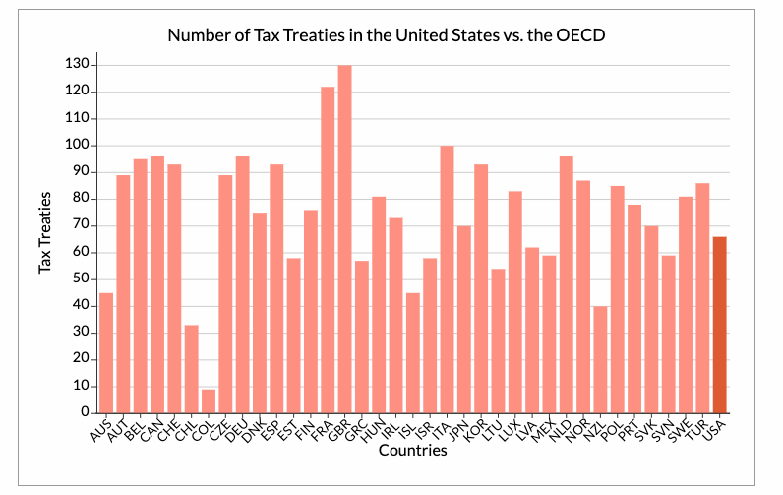
World-wide Bilateral Treaty Network
Total number of treaties: 3,000+ (2021)

Slide 17
Origins of Model Tax Treaties
Resolving conflicts between source and residence basis tax jurisdiction:
Deduction (credit) of foreign (source) taxes by country of residence
Exemption of income earned by foreign investors by the source country
Adjustment of tax rates by both source and residence countries
Apportionment of income between the source and residence countries

Slide 18
Origins of Model Tax Treaties
Mexico (1943) and London (1946) Model Tax Conventions [LoN]
Organization for European Economic Co-operation (OEEC) Reports (1958-1961)
OECD Model Double Tax Conventions and Commentary:
1963, 1977, and 1992+
US Model Treaties and Technical Explanations
1981, 1996, 2006, and 2016 (issued with Preamble on Feb. 17, 2016)
United Nations Model Double Taxation Convention between Developed and Developing Countries (1980 and 2001, updated 2011 & 2017)
OECD (2014+): Base Erosion & Profit Shifting (BEPS)
Digital economy, hybrid mismatch, strengthen CFC rules, limit base erosion, treaty abuse, transfer pricing, PE status, minimum tax
Pillar One—modifies traditional tax nexus rules; allows tax on portion of profit where goods are sold or services are consumed
Pillar Two—minimum country-by-country 15% corporate tax; intended to discourage race to the bottom tax policies

Slide 19
Negotiating and Concluding Treaties
Article II, Section 2, of the U.S. Constitution grants the Executive Branch the power to make treaties:
[The President] shall have Power, by and with the Advice and Consent of the Senate, to make Treaties, provided 2/3 of the Senators present concur
Note, however, that Article I - Section 7, gives the House of representatives the lead role in domestic tax matters:
“All Bills for raising Revenue shall originate in the House of Representatives”
Actual negotiation done by either State Department or Treasury Department in the case of tax treaties
After negotiations are concluded, the treaty is presented to the President for his signature and then forwarded to the Senate (the Foreign Relations Committee)
Revenue measures are generally under the jurisdiction of the Senate Committee on Finance

Slide 20
Senate Advice and Consent
“Advice”: In considering a treaty, the Senate may amend the treaty and enter “reservations” with respect to specific provisions, which have the effect of preventing the provision from having legal effect
The Senate may also issue understandings that clarify treaty provisions

Slide 21
Ratification and Entry into Force
The President ratifies a treaty by signing an instrument of ratification
The parties thereafter exchange or deposit instruments of ratification
Presidential proclamation
ARTICLE 29 of the US-UK Treaty
Entry into Force
This Convention shall be subject to ratification in accordance with the applicable procedures of each Contracting State and instruments of ratification shall be exchanged as soon as possible
This Convention shall enter into force upon the exchange of instruments of ratification and its provisions shall have effect:
a) in the United States:
(i) in respect of taxes withheld at source, for amounts paid or credited on or after the first day of the second month next following the date on which this Convention enters into force(…)

Slide 22
Treaty Elements
Treaty or Convention
Entry into Force
Termination
Protocol
Memorandum of Understanding
Exchange of Notes
Technical Explanation

Slide 23
International Tax Matrix
 | Foreign Persons |  | US Persons
 | USI | FSI | USI | FSI
Investment Income | Flat 30%* | 0% | Net Tax | Net Tax with FTC^
Business Income | Net Tax on ECI** | 0%*** | Net Tax | Net Tax with FTC
*Most CGs and interest are exempt, and treaties reduce or eliminate source basis taxation. (§§871 and 881)
**Net tax on ECI --> Income effectively connected with US trade/business taxed at graduated rates (0 – 37%) with deductions for the cost of earning the income. Most treaties require a U.S. permanent establishment before US can tax business income. (§§864, 871(b) and 882)
*** Very limited categories of FSI are subject to US tax. (§864(c)(4), (5)).
^Net Tax with FTC = Net tax with a credit for foreign taxes on foreign source income. For individuals, LTCG and qualified dividends taxed up to 23.8%. (§§1, 11, 901, and 1411)

Slide 24
Repairing the Cracks in the International Tax System
Pre-2017
Post-2017
Global--BEPS
Stateless income
Treaty abuse
Double non-tax
United States
High corporate tax rate (35%)
Treatment of foreign income
Deferral
Where to tax income from IP
Run away plants
Solutions?
Eliminate deferral
Territoriality
Modified deferral
Cash flow taxes
United States
21% corporate tax rate
New for ‘23: 15% min tax on accounting income
Expansion of anti-deferral regime (GILTI)
Creation of participation exemption
Tax benefit for export income (FDII)
Minimum tax on corporations making base erosion payments to foreign related parties (BEAT)
Limits on interest deductions
More changes coming!
BEPS
Pillar One (reallocating tax jurisdiction over residual profit) to where goods/services are used or consumed
Pillar Two (global minimum 15% tax)
EU adopted directive implementing Pillar Two, which requires national adoption by Dec. 2023

Slide 25
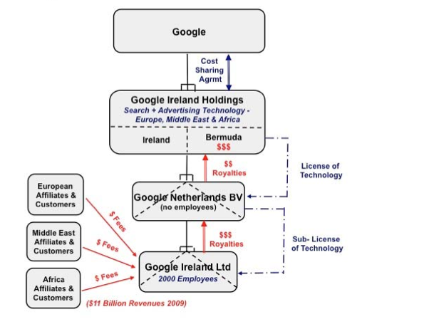
Google Double Irish/Dutch Sandwich II-2003

Slide 26
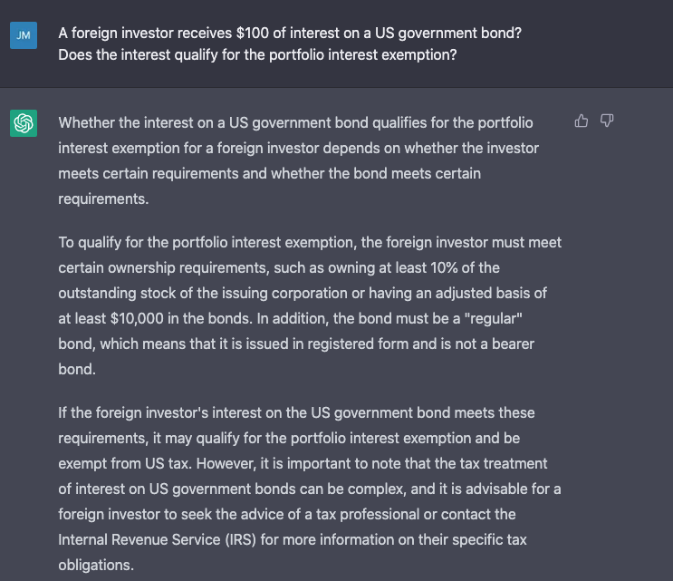
ChatGPT: Not quite ready for prime time tax
Really, really, wrong!

