Slide 1
Inversion Transactions and Section 7874

Slide 2
Inversions: McDermott (1980’s)
Public
Public
Public
McDermott
McDermott
McDermott
“Hook” stock (stock in McD Foreign still held by McD US)
US
US
Foreign
McDermott
merge
McDermott
McDermott
Foreign
Foreign
US
US Merger
Sub
McDermott Foreign corp tenders for McDermott US stock in exchange for McDermott Foreign stock
McD Foreign no longer a “CFC”
Congress enacted sec. 1248(i) that requires former US parent (like McD US) to include in income all the earnings of the former foreign subsidiary (like McD Foreign)
US merger sub merges into McD US with MCD US surviving; tax free reorganization to public shareholders
McD US stock converted into McD Foreign stock and US Merger Sub stock converted into McD US stock

Slide 3
Inversions: Helen of Troy
Public
Public
Public
US
Parent
US Parent
NFP
merge
Future Growth
Existing Foreign Subs
US Parent
Existing Foreign Subs
NFP
Existing Foreign Subs
Taxpayers responded to new law by not using an existing foreign sub (like McD Foreign in prior slide), but instead using a newly formed foreign sub with no earnings as NFP
Avoids “hook” stock issue
US Merger Sub
Potentially use “Inversion” transaction to insert leverage into US group
New growth under NFP
Potential restructuring of US Parent’s Existing Foreign Subs
US merger sub merges tax-free into US Parent
NFP typically formed in tax haven (Bermuda, Caymans, Barbados)

Slide 4
Inversions: The Empire Strikes Back: 367(a) Regs
Regulations under section 367 require shareholders recognize gain in an otherwise tax-free transaction when US shareholders own >50% of the transferee foreign corporation. Reg. 1.367(a)-3(c).
Self-inversions taxable
Combinations taxable when US acquirer was larger than foreign target
In some situations, however, SH-level tax acceptable if low BIG, tax-exempt SHs, etc.

Slide 5
Inversions: The Empire Strikes Back: Section 7874
7874(a)
If (i) foreign corporation acquires substantially all of US corporation’s assets, and (ii) resulting foreign entity does not have substantial business activities (“SBA”) in the place of its reincorporation, and (iii) shareholders receive 60% or more (but less than 80%) of resulting foreign corporation by reason of holding US stock then certain tax attributes limited and excise tax imposed.
7874(b)
All of the above but shareholders receive 80% or more then resulting foreign corporation is a US corp (regardless of place of incorporation).

Slide 6
Inversions: Section 7874
These transactions fail section 7874 tests
Typically 100% continuity so 80% test met.
Little or no business activities (assets, employees, revenue) in tax haven so fail the SBA Test.
Consequently, NFP treated as US Corp all US tax purposes.
Public
Public
US Parent
NFP
Bermuda, Caymans or Barbados
Existing Foreign Subs
US Parent
Existing Foreign Subs

Slide 7
Inversions after Section 7874
2013 +
2005-2012
Actavis/Warner Chilcott (Ireland)
Pentair/Tyco International’s Flow Control Business (Switzerland)
Perrigo/Elan (Ireland)
Applied Materials/Tokyo Electron (Netherlands)
Endo Health/Palladin (Ireland)
Actavis/Forest Laboratories (Ireland)
Horizon Pharma/Vidara Therapeutics (Ireland)
Mylan/Abbott Laboratories subsidiary (Netherlands)
Covidien/Medtronic (Ireland)
Tim Hortons/Burger King (Canada)
2005 – Luna Gold (Canada)
2007 – Fluid Media Networks (Canada)
2008 – Patch International (Canada)
2009 – Tim Hortons (Canada), Ensco International (U.K.)
2010 – Plastinum Polymer (Netherlands)
2012 – Rowan (U.K.), Aon (U.K.), DE Master Blenders (Netherlands)

Slide 8
Inversions after Section 7874
Public
Public
NFP not formed in a “tax haven” but in a country where the overall group, tested after the transaction, can satisfy the SBA Test (here the UK)
Still flunks the continuity test (generally 100% continuity in these cases) but focus on the SBA Test to comply with the section 7874 rules
US Parent
NFP
UK
US Parent
UK (etc.)
operations
ROW
operations
Do the same inversion transaction (NFP, US merger Sub, etc.) but with NFP formed in a jurisdiction in which the corporate group had a meaningful presence.
UK (etc.)
operations
ROW
operations

Slide 9
SBA Test
2006 Regulations
a safe harbor (10% of relevant factors – sales, property, employees, and payroll – in NFP’s jurisdiction of incorporation); and
facts and circumstances test.
2009 Regulations
Dropped the safe harbor.
2012 Regulations
Dropped the facts and circumstances test in favor of a very stringent “bright line” 25% test (25% of each of gross income from sales, property, employees, and payroll in NFP’s jurisdiction of incorporation).
Possible for corporate group not to have SBA in the U.S. and for 7874 to still apply.
Possible for a corporate group not to have SBA in any country
2015 Regulations
Maintain bright-line 25% test

Slide 10
Inversions
US Parent Public
Foreign Parent Public
Public
Public
<80%
>20%
NFP
US Parent
FMV
$4X
Foreign
Target
FMV
>$X
US Parent
Foreign
Target
Existing Foreign Operations
Foreign Operations
Existing Foreign Operations
Foreign
Operations
Combination transactions ignore the SBA test and focus instead only on the continuity test
Focus is on a Foreign Target that is worth more than 25% of US Parent
Combination complies with inversion rules because Foreign Target shareholders, collectively, receive more than 20% of NFP (80% continuity test is not met).
The SBA Test is irrelevant because NFP is out of the rules under the continuity test, so NFP can be formed anywhere
Still taxable to the former US shareholders of US Parent because of the 50% continuity rule.

Slide 11
Anti-Inversion Guidance
Notice 2014-52
Rules regarding non-ordinary course distributions of the domestic entity
Certain stock issues to the foreign target SHs can be disregarded (inflates US company % interest)
Loans by foreign sub CFC to foreign target or NFP treated as deemed dividend to US target
Notice 2015-79
NFP must be subject to residence basis tax for SBA purposes
Expand definition of “inversion gain”
All exchanging SHs must recognize all gain upon exchange of CFC stock regardless of the CFC’s undistributed E&Ps if the CFC is no longer a CFC

Slide 12
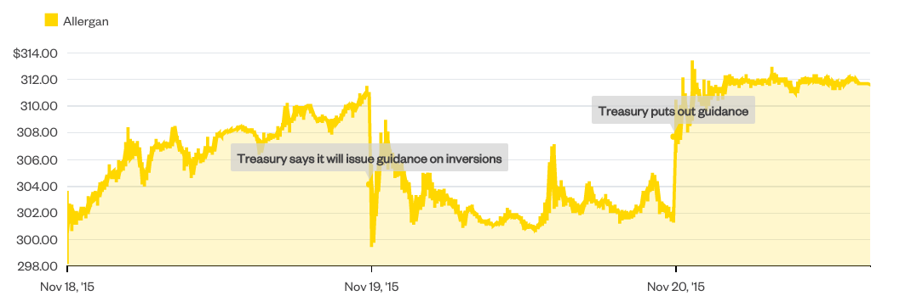
Anti-Inversion Guidance

