Slide 1
An Overview of U.S. International Tax Policy

Slide 2
Overview of issues in International Tax Policy
How should foreign income, including the income of foreign subsidiaries, of U.S. persons be taxed?
Same as U.S. income?
Less than U.S. income?
Not at all?
Should we distinguish among the different types of foreign income, e.g., capital gains, interest, operating income?
Concerns:
Economic efficiency
Competitiveness vis a vis foreign MNs
National interest concerns
Equity
Administration

Slide 3
Overview of Theories of Taxing International Income
If free movement of capital is permitted, investors will allocate capital to where it can receive the highest risk-adjusted return.
Where either the residence or source country (or both) imposes taxes on those returns, the movement of capital, national tax revenues, and national welfare can be affected.
Which principles should guide legislators in formulating international tax policy?

Slide 4
Taxing international Income
The three traditional principles or theories of taxing international income are:
(1) Capital Export Neutrality (CEN)
(2) Capital Import Neutrality (CIN) and
(3) National Neutrality (NN).
Proponents claim that each best achieves one or more of the following goals:
economic efficiency
equity
growth and
simplicity

Slide 5
Capital Export Neutrality
Under CEN, for residents of the same country, income is taxed at the same rate wherever the income is earned, and a credit is given for foreign taxes.
This is referred to as residence basis taxation.
CEN ensures that taxes play no role in the investment decisions of US firms; capital flows to where it receives its highest pre-tax risk-adjusted return.
Relationship between pre-tax and after-tax returns is preserved.
CEN promotes worldwide economic efficiency and equity.

Slide 6
Capital Export Neutrality
$1M investment promises 10% return in the US and Hungary. Hungarian taxes are 9% and US taxes are 21%. CEN ensures that if pre-tax rates of return are equal, after-tax rates of return will also be equal.
Invest US Invest Hungary
Income 100k 100k
For. Taxes 0 (9k)
US Taxes (21k) (12k) [21k-9k FTC]
After-tax Inc 79k 79k
After-tax ROR 7.9% 7.9%

Slide 7
Capital Import Neutrality (CIN)
Under CIN, capital income arising in one country is taxed at the same rate regardless of the residence of the investor. This is generally achieved by the residence country exempting foreign source income entirely from tax.
Some argue that CIN improves the competitiveness of US multinationals who compete with foreign multinationals from countries whose tax laws reflect CIN principles.
CIN may result in an inefficient allocation of capital.

Slide 8
Capital Import Neutrality
$1M investment offers return of 11% in US and 10% in Hungary. Hungarian income is taxed at 9% by Hungary, but it is exempt from US tax.
US Investment Hungary Investment
Income 110k 100k
US Tax (23.1k) 0
For Tax 0 (9k)
After-tax Inc. 86.9k 91k
After-tax ROR 8.69% 9.1%

Slide 9
National Neutrality
Under NN, the residence country does not cede tax jurisdiction over foreign source income to the source country.
The residence country allows a deduction and not a credit for foreign income taxes.
Foreign investment is penalized, since it will only be made if the return after foreign tax (but before US tax) equals or exceeds the before-tax return on US investment.

Slide 10
National Neutrality Example
$1M investment offers a 10% return in Hungary, which imposes a 9% tax on the return. US investor will invest in Hungary only if equivalent US investment offers a pre-tax return less than 9.1%.
Hungary Investment US Investment
Income 100k 91k
For Tax (9k) 0
US Tax (19.11k) [21%*91] (19.1k)
After-tax Inc. 71.89k 71.89k
After-tax ROR 7.19% 7.19%

Slide 11
Capital Ownership Neutrality
CON is satisfied if tax systems do not distort ownership of assets.
CON maximizes output and efficiency by encouraging the most productive ownership of assets
CON can be achieved if all countries exempt foreign income taxation or tax foreign income (with a foreign tax credit).

Slide 12
Where are we now?
Shareholders
For direct investments, US int’l tax system generally reflects CEN
WW taxation at same rate on all income…but
FDII (§250)
§911
FTC
Lots of limitations
US Parent
Foreign Branch Business & Passive Income
US Sub

Slide 13
Foreign Income of Foreign Subsidiaries: Before TCJA
Shareholders
US Parent
Current US Tax
Foreign Tax Credit
No US Tax until remitted
Indirect FTC (dividends would bring FTCs with them)
Foreign Sub
(CFC)
Subpart F
Passive income
Base Company Inc
Earning invested in US
Active Business Income
Foreign Taxes on SubF Inc
Foreign taxes on Business Inc

Slide 14
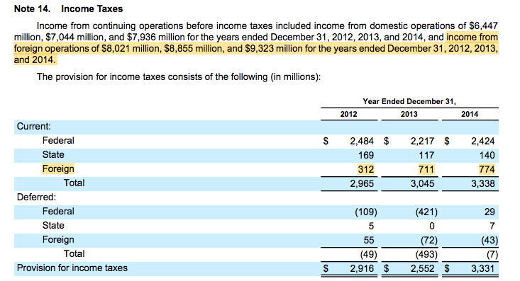
Google’s ETR (Pre-TCJA)

Slide 15
Where are we now?
Shareholders
US Parent
Current US Tax
Subpart F: 21%
GILTI 10.5%
Foreign Tax Credit
Limits
80% for GILTI
No US Tax
No FTC
No Expenses
Foreign Sub
(CFC)
Subpart F
Passive Inc
Base Company Inc
Earning invested in US
GILTI
Non-GILTI, non-Subpart F Income
Foreign Taxes on SubF Inc & GILTI
Foreign taxes on Non-GILTI, non-Subpart F inc

Slide 16
Section 911: Foreign Earned Income and Housing Cost Exclusion
A qualified individual can exclude
Up to $120,000 (2023) for foreign earned income, and
Housing cost amount. §911(a)(1) and (2)
Who’s qualified?
US citizen bona fide resident of foreign country for entire year, or
US citizen or RA who’s present in a FC for 330 days/12 consecutive months. §911(d)(1)
Individual must have a foreign tax home
Foreign earned income (§911b)
Salaries, fees, compensation for personal services
For a T/B in which capital & personal services are material income-producing factors, up to 30% of net profit can be earned income
Income from sale of artistic works that are the result of personal effort
Royalties by writer for property in writer’s product
Lawsuit proceeds from discrimination suit
No gambling proceeds

Slide 17
Housing Cost Amount
HCA (§911(c)):
The excess of
(a) an individual’s housing expenses, over
(b) 16% of the exclusion amount (19.2K = 16% *120K)
But limited to 30% of the exclusion amount (36K = 30% * 120K)
So maximum HCA would be 16.8k [36k – 19.2k]
But IRS can provide by regulations an adjustment to 30% exclusion:
Notice 2023-26
Geneva: 98.3K
Moscow: 108K
If the employer doesn’t provide the HCA, it can be deducted up to the foreign earned income amount.

Slide 18
Expatriates: §877A
If you have a lot of movable capital, would you rather be taxed on a residence or source basis?
Covered Expatriates subject to MTM taxation
Exemption amount: $821,000
Election to defer tax
Covered Expatriate
Average net income (5 years) > $190,000
Net Worth > $2mm
Exceptions
Dual citizens from birth and (1) citizenship relinquished before 18.5 yrs and not a RA for more than 10 yrs before expatriation, or (2) RA for not more than 10/last 15 years. (§877A(g)(1)(B))
Expatriate
US citizen giving up citizenship
Long-term RA (8 out of the last 15 years) becoming a NRA (§877A(g)(2))
Gift and Estate tax consequences (§2801)

Slide 19
Foreign Derived Intangible Income (FDII): §250
Tax Policy Goals
Maintain intangible property in the US
Maintain production destined for foreign markets in the US
Under §250, US corporation can deduct:
37.5% of FDII (ETR = 13.125%)
50% of GILTI (ETR = 10.5%)

Slide 20
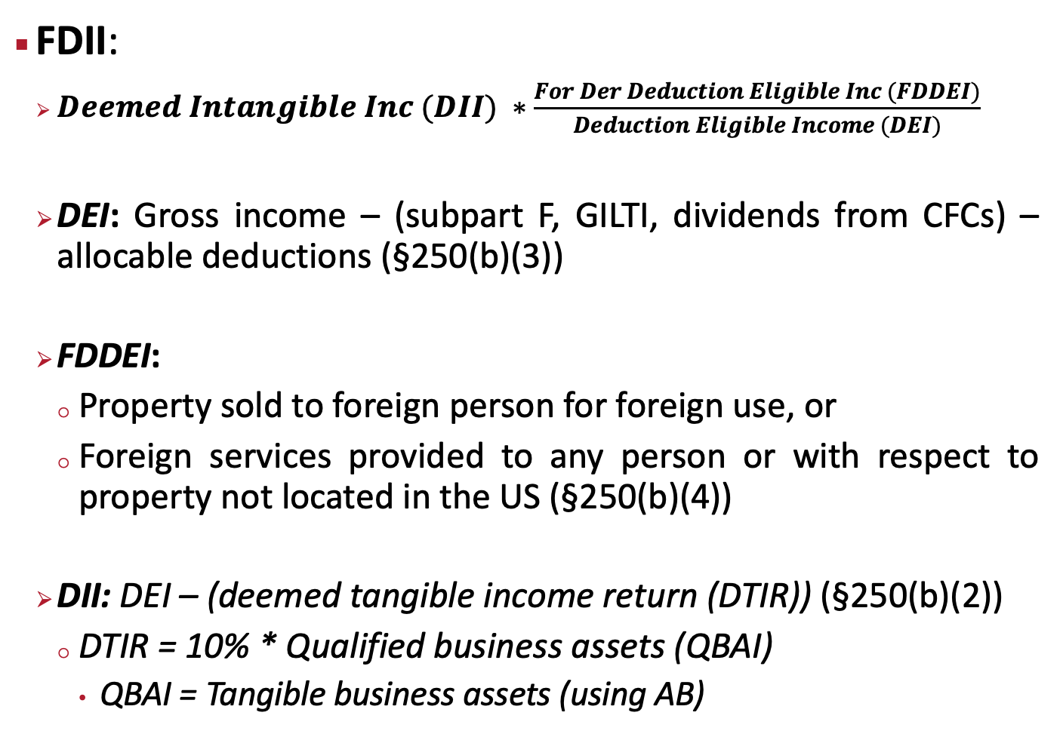
Foreign Derived Intangible Income (FDII): §250
FDII:
$Deemed Intangible Inc (DII) ∗\frac{For Der Deduction Eligible Inc (FDDEI)}{Deduction Eligible Income (DEI)}$
DEI: Gross income – (subpart F, GILTI, dividends from CFCs) – allocable deductions (§250(b)(3))
FDDEI:
Property sold to foreign person for foreign use, or
Foreign services provided to any person or with respect to property not located in the US (§250(b)(4))
DII: DEI – (deemed tangible income return (DTIR)) (§250(b)(2))
DTIR = 10% * Qualified business assets (QBAI)
QBAI = Tangible business assets (using AB)

Slide 21
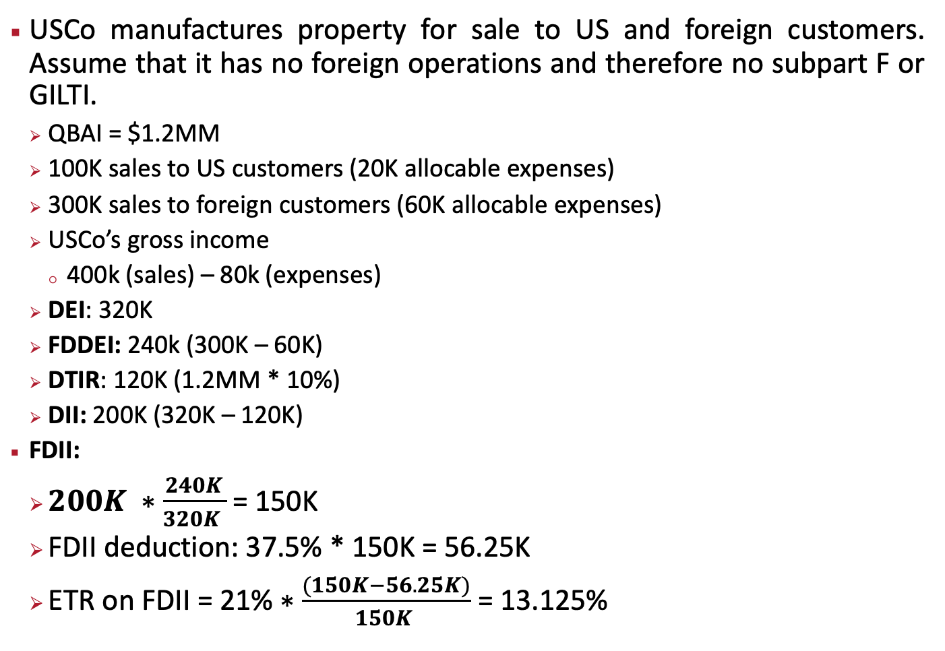
FDII Example
USCo manufactures property for sale to US and foreign customers. Assume that it has no foreign operations and therefore no subpart F or GILTI.
QBAI = $1.2MM
100K sales to US customers (20K allocable expenses)
300K sales to foreign customers (60K allocable expenses)
USCo’s gross income
400k (sales) – 80k (expenses)
DEI: 320K
FDDEI: 240k (300K – 60K)
DTIR: 120K (1.2MM * 10%)
DII: 200K (320K – 120K)
FDII:
$200K ∗\frac{240K}{320K }$ = 150K
FDII deduction: 37.5% * 150K = 56.25K
ETR on FDII = 21%$∗\frac{(150K−56.25K)}{150K }$ = 13.125%

