Slide 1
Partnership Taxation Choice of Entity
Prof. Colon
Spring 2025

Slide 2
LLC
C Corp
?
PSH
S Corp

Slide 3
Choice of Business Entity
Sole Proprietorship/Branch/Division
Partnership
GP, LP, LLP, and LLLP
LLC
Corporation
Association
Business Trust
Analysis:
Is there a separate entity for federal tax purposes?
Is the entity a SP/B/D, PSH, or Corp?

Slide 4
C Corp vs. Pass-through
Rate Comparison
C Corp:
21% Corporate rate + 23.8% (20% NCGs or qualified dividends + 3.8% NII)
New (post-2022 tax years): 15% Corporate Minimum Tax on large corporations based on financial statement income
Pass-through:
37% for operating income, but 29.6% for QBI (note, this rate doesn’t apply to CGs)
3.8% for NII
20% for qualified dividends and NCGs
Other considerations
Step-up basis for property held at death
Investment of passive earnings by C Corp or SH
Use of losses

Slide 5
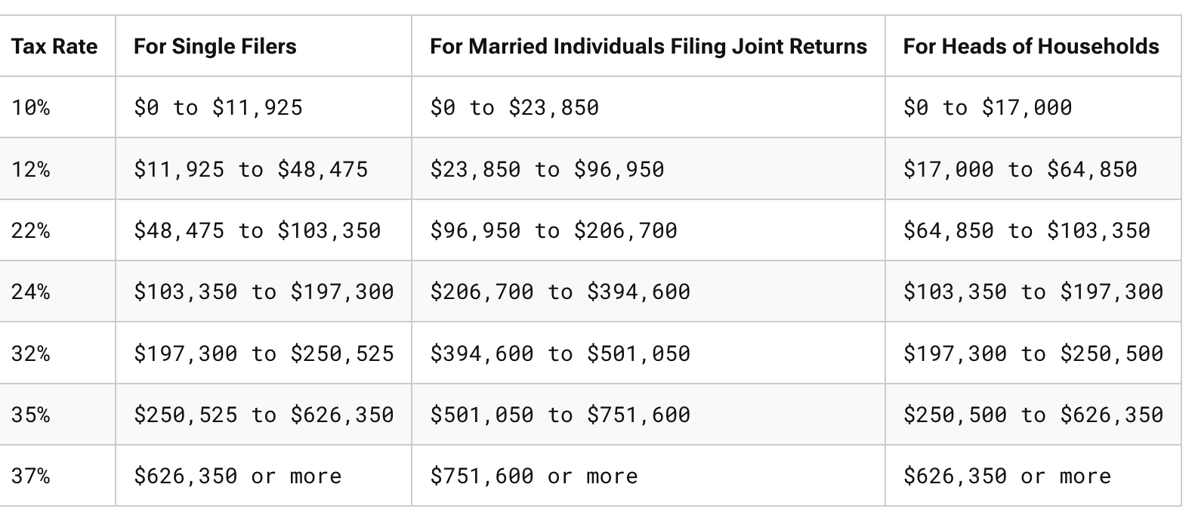
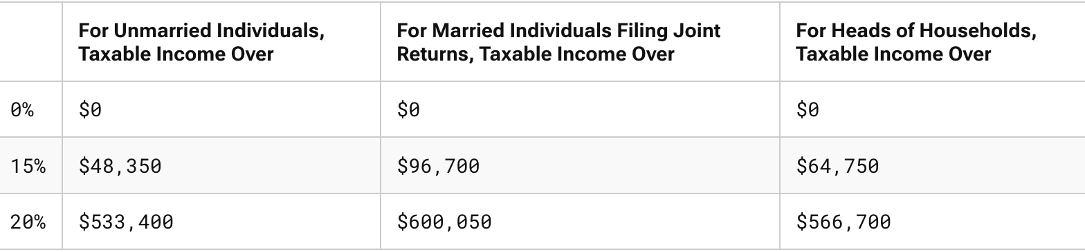
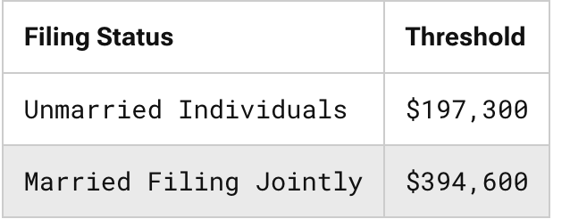
Rates for 2025
Capital Gains Rates
199A Threshold
Source: Tax Foundation

Slide 6
Tax Differences: C, S, and K
 | C Corporations | S Corporations | Partnerships (GPs, LPs, LLCs)
Entity’s Income | Taxed to entity (21% max. rate) | Taxed to owners with basis adjustment (37% max rate; 29.6% if QBI) | Taxed to owners with basis adjustment (37% max rate; 29.6% if QBI)
Entity’s Losses | Deductible against corporate income; NOLs can offset 80% of TI and be carried forward indefinitely | Deductible by owners, limited by basis in stock; individual excess business loss subject to 250k/yr limitation | Deductible by owners; limited by basis in PSH; excess business loss subject to 250k/yr limitation
Distributions of $ | Taxed to SHs to extent of E&Ps, return of basis, and then gain; Qualified dividends taxed at 20% max + 3.8% NII | No taxation; reduction of basis and then gain | No taxation; reduction of basis and then gain
Distributions of Property | Gain but not loss recognized; taxed to SHs as dividend to extent of FMV | Gain but not loss recognized | No G/L to PSH; CO basis to Ps
Transfer of Equity Interests | Capital G/L | Capital G/L | Capital G/L with look-through to extent of OI assets; can elect to adjust basis of PSH property
Source: JCT-71-15

Slide 7
Tax Differences: C, S, and K
 | C Corporations | S Corporations | Partnerships (GPs, LPs, LLCs)
Mergers with Corporations | Tax-free | Tax-free | Can’t undertake tax-free reorg with corporation
Classes of Equity Interests and Maximum # of Owners | No limitation; no maximum | One class of stock; 100 maximum | No limitation; no max, but minimum of 2
Foreign Owners | Eligible | Not Eligible | Eligible
Tax-exempt Owners | Eligible; dividends not subject to UBIT | Generally not eligible except charitable organizations and retirement plans; income is UBIT | Eligible, but subject to UBIT
Source: JCT-71-15

Slide 8
Comparison of AT-Returns for C Corporation and PSH
 |  | Choice of Entity Examples Assumptions
Ret PSH | 10% |  | Tax SH/P OI | 37.0%
Ret Corp | 10% |  | Tax SH/P Div | 23.8%
Tax Corp | 21% |  | Tax SH/P CG | 23.8%
Amount Invested | 10,000 |  | Tax SH/P 199A | 29.6%
 | Pass-through vs. C Corporation: One Period
 |  |  |  | C Corporation | PSH/S Corp w/ 199A | PSH/ S Corp w/out 199A
1 | Pre-Tax Income |  |  | 1,000.00 | 1,000.00 | 1,000.00
2 | Corp/P Tax |  |  | (210.00) | (296.00) | (370.00)
3 | After-Tax Income |  |  | 790.00 | 704.00 | 630.00
4 | Tax on Distribution of AT Earnings |  |  | (188.02) | 0.00 | 0.00
5 | Net Amount to C or P: [1+2+4] |  |  | 601.98 | 704.00 | 630.00
6 | Effective Tax Rate [(PT Inc - AT Inc) / PT Inc] |  |  | 39.80% | 29.60% | 37.00%
https://bit.ly/2F2KsbX

Slide 9
Partnership vs. Corporation
If T_{C}=T_{P} and T_{CG}=0, neither dominates
If T_{C}=T_{P} and T_{CG}>0, PSH dominates
If T_{C}<T_{P} and T_{CG}=0, Corporation dominates
If T_{C}<T_{P} and T_{CG}>0, no clear preference

Slide 10
Comparison of AT-Returns for C Corporation and PSH: The Benefits of Deferral
Pass-through vs. C Corporation: Benefits of Deferral (AT Returns are Reinvested and then Liquidated)
 |  |  | C Corporation | PSH w/ 199A | PSH w/out 199A
 |  | 5 | 13,525 | 14,052 | 13,573
 |  | 10 | 18,679 | 19,745 | 18,422
 | Year of | 15 | 26,218 | 27,745 | 25,003
 | Liquidation | 25 | 53,371 | 54,784 | 46,061
 |  | 35 | 111,450 | 108,172 | 84,852
 |  | 45 | 235,683 | 213,587 | 156,314
 |  | 50 | 343,594 | 300,127 | 212,160
https://bit.ly/2F2KsbX

Slide 11
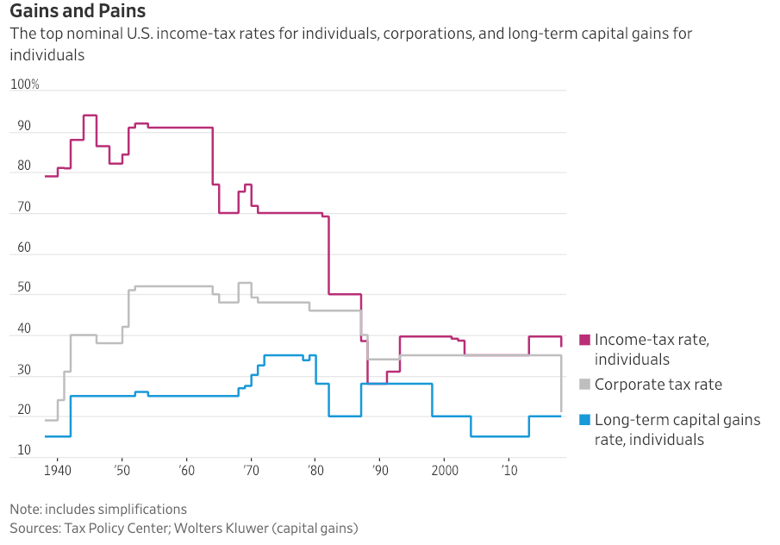
Marginal Tax Rates

Slide 12
Section 199A: Ugh
20% deduction of a non-corporate taxpayer’s Qualified Business Income Amount (QBIA)
QBIA: the lesser of:
(A) 20% of QBI with respect to the QT/B, or
the greater of
(B)(i) 50% of the W-2 wages of the QT/B, or
(B)(ii) Sum of 25% W-2 wages PLUS 2.5% of the unadjusted basis immediately after acquisition of all qualified property. §199A(b)(2).
The (B) limit doesn’t apply if the taxpayer’s income is less than $197,300 ($394,600) (inflation adjusted limits for 2025)
QT/B: Any business except the T/B of being an employee, and: health, law, accounting, actuarial science, performing arts, consulting, athletics, financial service, brokerage services, or any T/b where the principal assets of the T/B is the reputation or skill of 1 or more of its employees;
Scope of “principal assets of the T/B is the reputation or skill…”? See Reg. §1.199A-5(b)(2)(xiv)
Exception for specified service business: If the taxpayer’s income is less than $197,300 ($394,600) (2025), a specified service, e.g., law, will be treated as a QT/B. §199A(d)(3)(A).

Slide 13
Partnership v. Proprietorship
Definition of PSH:
JV etc., through which “any business, financial operation, or venture is carried on…” §§761 and 7701(a)(2).
Rigas v. U.S. (2011)
What’s at stake for the parties?
What was the economic deal between the parties?
How did the Court apply the following Luna factors?
Agreement of the parties
Contributions by the parties to the venture?
Interest in P&L? (Important)
What’s a clawback provision?
Responsibilities of the parties?
Parties’ right to control over income and capital?
Representations to 3rd parties

Slide 14
The New Kid in Town: Cross Refined Coal, LLC v. CIR (D.C. Cir 2022)
Purported PSH formed to produce refined coal, which generated significant refined-coal tax credits, found to be a PSH for federal tax purposes even though the PSH was only profitable after taking into account refined-coal tax credits
IRS:
Argued that PSH did not pursue business to obtain a pre-tax profit
One P, Fidelity, was partially protected against losses under liquidated-damages provision
CT:
PSH: must be undertaken for legitimate non-tax business purpose and Ps must intend to share in P/L or both.
PSH pursuit of after-tax profit can be legitimate business activity
If main P had operated the PSH business directly, it would have had a legitimate business purpose; no reason Ps cannot validly pursue the same objective
Note: Under the IRA of 2022, many business tax credits have been increased, e.g., clean hydrogen, advanced manufacturing, nuclear power (good!), clean energy production,…

Slide 15
Partnership v. Other Relationships
PSH v. Co-tenancy
Rev. Proc. 2002-22 (requirements for requesting ruling that real estate held by T-I-C is NOT a PSH for federal tax purposes)
Why is it beneficial not to be a PSH in some circumstances?
Elections: Depreciation, etc.
Is it possible to do a like-kind exchange of a PSH interest? See §1031(a)(1)
Lessor-lessee
Debtor-Creditor
Employer-Employee/Independent Contractor
Common law (substance over form)
Anti-abuse regulations (Reg. §1.701-2)

Slide 16
CTB: Business Entity
Any entity recognized for federal tax purposes (including a SME) that is not a trust or subject to special treatment under the IRC
BE with 2 or more members
Corporation, or
Partnership
BE with 1 member (SME)
Disregarded Entity (“tax nothing”), or
Corporation. Reg. §301.7701-2(a).

Slide 17
CTB: Corporation Defined
Federal law controls, but legal relations governed by state law
Entity organized pursuant to state corporate statutes
Certain foreign entities are per se corporations, e.g., Sociedad Anónima, Societe Anonyme; Public Limited Company; Aktiengesellschaft; Gufen Youxian Gongsi; and Societas Europaea (Reg. §301.7701-2(b)(8))
Insurance companies
Associations. §7701(a)(3); Reg. §301.7701-2(b)

Slide 18
CTB: Eligible Entity
Business entity not classified as a corporation—an Eligible Entity (“EE”)—can choose its tax status √
EE with two or more members is either an association or PSH
EE with one member (“SME”) is either association or disregarded entity (sole proprietorship, branch, division) (Reg. §301.7701-2(a))
Default classification for domestic EE:
PSH if 2 or more members
Disregarded entity if single owner (Reg. §301.7701-3(b))

Slide 19
CTB: Elections
EE can elect (√ ) alternate tax status:
EE with 2 or more members can elect to be taxed as an association (corporation)
SME can elect to be taxed as an association
Form 8832 (Reg. §301.7701-3(c))

Slide 20
CTB: Foreign Eligible Entities
Default Classifications
PSH if two or more members and at least one member doesn’t have limited liability
Association if all members have limited liability
DRE if single owner who does not have limited liability
Liability determined under foreign law or organizational documents (Reg. §301.7701-3(b)(2))

Slide 21
CTB Election
Effective date: dated listed on Form 8832 or filing date, but
Not more than 75 days prior to filing date, or
Not more than 12 months after filing date. (Reg. §301.7701-3(c)(1)(iii))
Relief for Late Filing: Rev. Proc. 2002-59
New entity can request relief for late filing if election filed by return due date
An EE that changes its classification cannot change its classification again during the next 60 months, except if there is a >50% change in ownership and CIR consents.
An initial election is not considered a change. (Reg. §301.7701-3(c)(1)(iv))

Slide 22
CTB: Classification Changes
PHS->Assoc.: PSH contributes A&L to Assoc. in exchange for stock and the PSH liquidates
Assoc.->PSH: Assoc. distributes assets to SHs, and SHs contribute A&L to new PSH
Assoc.->DRE: Assoc. liquidates and distributes A&L to single owner
DRE->Assoc.: Owner of DRE contributes all A&L to the Assoc. in exchange for stock (Reg. §301.7701-3(g))
Rev. Rul. 2004-59: Conversion of PSH into Corp pursuant to state law not requiring transfer of A&L—formless conversion—treated as contribution of assets to new Corp, liquidation of PSH, and distribution of stock to Ps.
Change in Number of Members (Reg. §301.7701-3(f))
PSH->DRE: Rev. Rul. 99-6
DRE->PSH: Rev. Rul. 99-5

Slide 23
CTB: Rev. Rul. 99-6 (Sit 1)
Before
After
10k
A
B
B
50%
LLC
LLC
Assets
Assets

Slide 24
CTB: Rev. Rul. 99-6 (Sit 2)
Before
After
E
E
50%
50%
10k
10k
C
D
LLC
LLC
Assets
Assets

Slide 25
Entities
Corp
Corp
DRE
Branch
LLC
Hybrid
PSH
Reverse
Hybrid
Hybrid: Passthrough under US law; corp under foreign law
Reverse Hybrid: Corp under US law; passthrough under foreign law

Slide 26
Election out of SubK
Investment purposes only (not conduct of a T/B);
Securities dealer for underwriting/distributing securities; or
Joint production, extraction, or use of property (but not for selling services or property produced or extracted),
if the income of the members can be determined without the computation of PSH TI. §761(a)(1)-(3)
When could such an election be beneficial?
New §761 regulations (Nov. 2024): allow certain unincorporated organizations (LLCs, PSHs) owned in whole or in part by certain “applicable entities” (tax exempts) to elect to be excluded from the application of the PSH tax rules

Slide 27
Publicly Traded Partnerships (PTPs/MLPs)
Some publicly traded Corporations switched to PSH status in the early ‘80s.
Why? See Historical marginal tax rate chart.
After 2017, how does the analysis change?
What was the concern of Congress?
Under §7704, PTPs generally taxed as corporations (§7704(a))
Publicly Traded Partnership:
Traded on established securities market
Readily tradable on a secondary market (or substantial equivalent)
Various Exceptions (Safe harbors)
Private transfers (family transfers, death)
Certain redemptions/repurchases
Private placements. Reg. §1.7704-1

Slide 28
Publicly Traded Partnerships (PTPs/MLPs)
Passive Income Exception
PTP not taxed as Corp if ≥ 90% of its gross income is “qualifying income”, such as
Dividends, Interest, Gains from Stock and Bond Sales, Swap Income (NPC)
Real Property Rents and Gains (§7704(d)(1)(C) and (D))
Income from the production, exploration, mining, refining of natural resources (§7704(d)(1)(E))
Interest derived from conduct of financial or insurance business excluded (§7704(d)(2))
QI does NOT include income from services
QI exception does not apply to any PSH that would be subject to the ‘40 Act if it were a corporation (§7704(c)(3))
A list of current MLPs
Why are some MLPs converting to C Corps after the TCJA? See article on class web site.

Slide 29
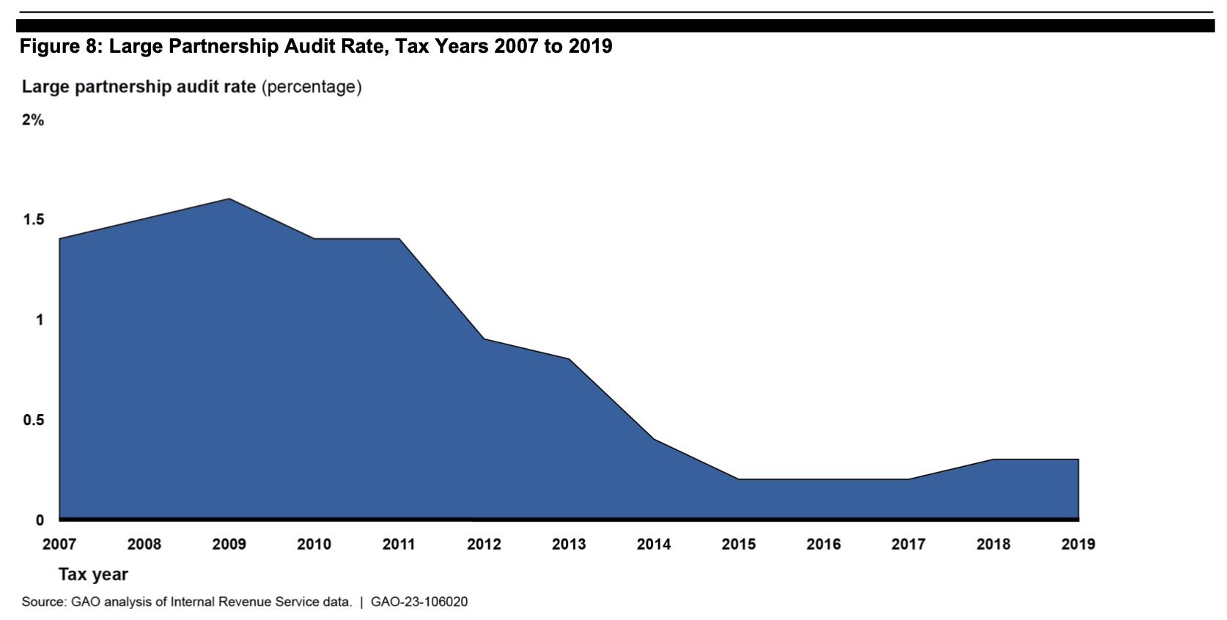
Audit Rate for Large Partnerships (>100MM assets and >100 total partners)
Source: GAO, GAO-23-106020

Slide 30
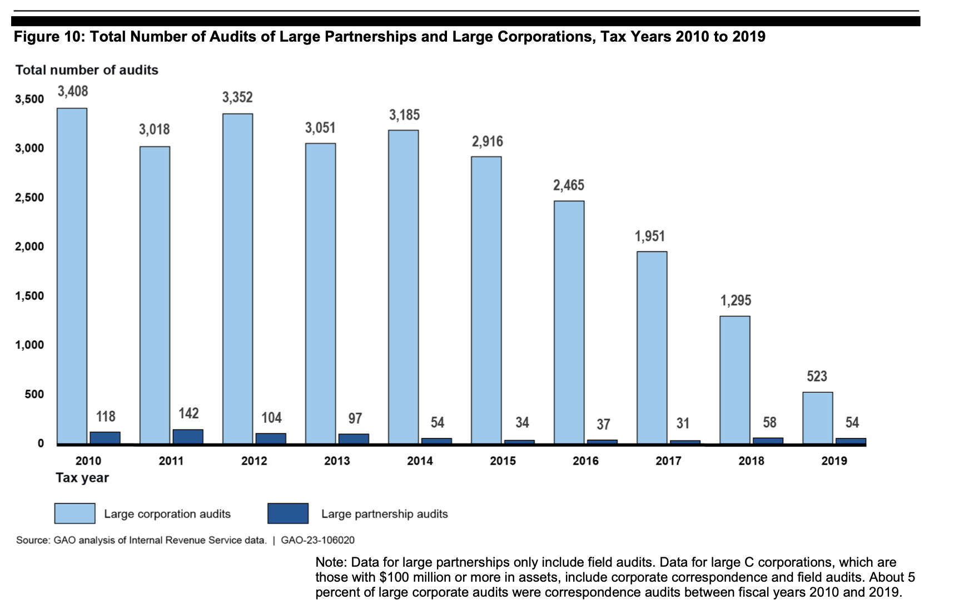
Audits of Large Partnerships and Large Corporations
Source: GAO, GAO-23-106020

Slide 31
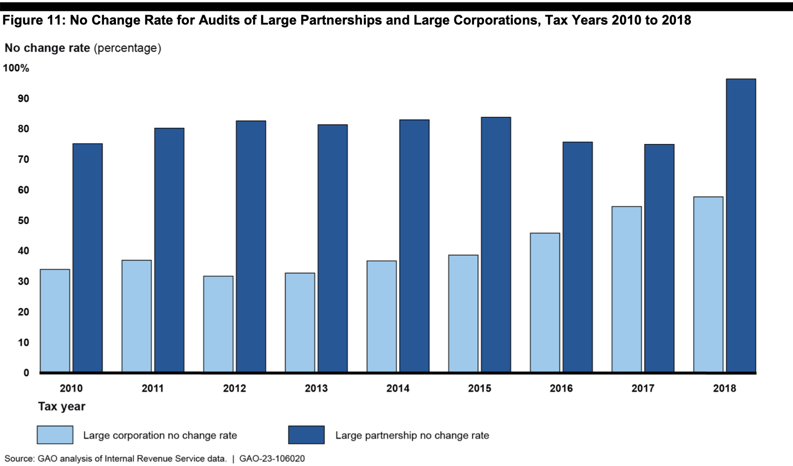
No Change Rates for Audits of Large Partnerships and Large Corporations
Source: GAO, GAO-23-106020

