Slide 1
Partnership Taxation: Nonrecourse Deductions
Prof. Colon
Spring 2025

Slide 2
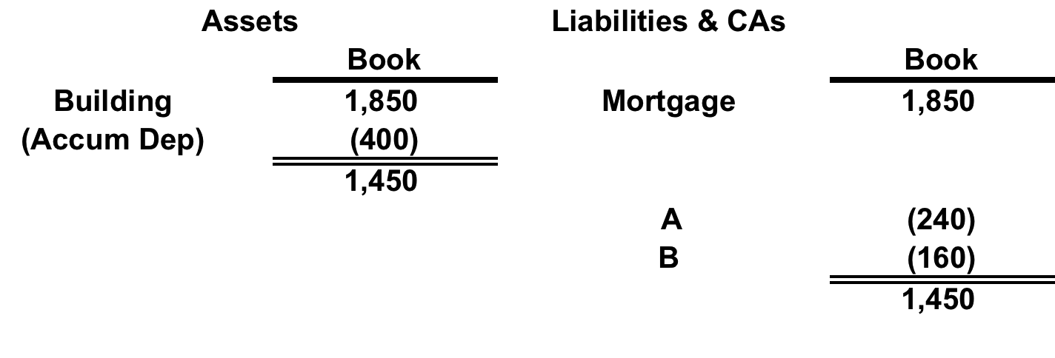
CIR v. Tufts
A and B form AB GP to build and operate building with 100% financing. All PSH items are allocated 60-40. Assume the building rental income equals all other expenses except for annual depreciation of 100. At the end of Y4, the AB balance sheet is as follows:
If mortgage was recourse and the building was transferred to the lender by deed in lieu of foreclosure at the end of Y4, what are the tax consequences if the property was worth its book value?
If the mortgage was nonrecourse, what are the tax consequences if the property was worth its book value?

Slide 3
Allocation of NR Deductions: Safe Harbor
PSH must satisfy the SEE safe harbor or alternate test for economic effect, including CA adjustments;
NR deductions have to be allocated “in a manner that is reasonably consistent with allocations that have SEE of some other significant PSH item attributable to the property securing the NR liabilities;” and
The PSH agreement must contain a “minimum gain chargeback” provision. Reg. §1.704-2(e).
The Ps who have been allocated NR deductions must be allocated (charged back) a corresponding amount of gain when the PSH sells the property

Slide 4
NR Deductions: Definitions
PSH Minimum Gain (PMG): Gain PSH would realize (using book value) if property subject to NR liability was disposed of for the amount of the liability (and no other consideration). Reg. §1.704-2(d)(1).
Excess of loan amount over AB (or book value if different from AB)
NR Deductions: Amount of yearly net increase in PMG, reduced by the distributions made during the year of the proceeds of NR liabilities allocable to an increase in PMG (nonrecourse distributions).
NR Deductions consist of:
Depreciation
Pro-rata share of other PSH losses, deductions and §705(a)(2)(B) expenditures
Excess NR deductions are carried over to the following year. Reg. §1.704-2(c).
If there is no secondary financing, there will be sufficient depreciation deductions.

Slide 5
P’s Share of PMG
A P’s share of PMG at the end of any PSH year equals:
(1) NR deductions allocated to him (and to any predecessor), plus
(2) NR distributions made to him, minus
(3) the P’s share of net decreases in PMG, minus
(4) the P’s share of decreases in PMG resulting from revaluations.
A P’s share of PMG is added to the amount of any deficit balance in the P’s CA that the P is obligated to restore.
Thus, a CA can go negative at least to the extent of PMG
The PSH must keep track each P’s share of PSH PMG. Reg. §1.704-2(g)(1)(i) and (ii).

Slide 6
Minimum Gain Chargeback
If there is a decrease in PMG, each P must be allocated items of PSH income and gain equal to that P’s share of the net decrease in PMG. Reg. §1.704-2(f)(1).
Any MGCB consists first of gains from disposition of property subject to NR liability and then a pro rata portion of other income and gain. Any excess carries over. Reg. §1.704-2(f)(6)
Exceptions:
NR debt recharacterized as Partner nonrecourse debt
Capital contributions that are used to repay the NR liability or used to increase the basis of the property subject to the NR liability
Revaluations
Waiver. Reg. §1.704-2(f)(2)-(4); -2(d)(4).

Slide 7
NR Deductions: Example
G & L form GL, a limited PSH, with G contributing 40 and L 360. GL borrows on a nonrecourse basis 1,600 and purchases a building for 2,000.
GL contains a MGCB provision
Allocations and Distributions
All losses, including NR deductions, allocated 90-10 to L and G; all income allocated 90-10 until income allocations equal previous loss allocations; thereafter all items allocated 50-50;
Non-liquidating cash distributions distributed 90-10 until Capital Contributions restored, thereafter 50-50
GL satisfies the alternate test for economic effect (G has DRO, L doesn’t, but there is a QIO)
Assume that the PSH breaks even except for annual depreciation of 400.
[1] Compute each P’s CA and share of PMG for Y1-4 assuming GL sells the property on Jan. 1 of Y4 for 2,400 (assume no depreciation adjustment for Y4)
[2] Assume that instead of selling the building, GL borrows another 500 (nonrecourse) securing it with a 2nd mortgage on the property and distributes the 500. What are the Ps’ CAs and share of PMG at the end of Y4?

Slide 8
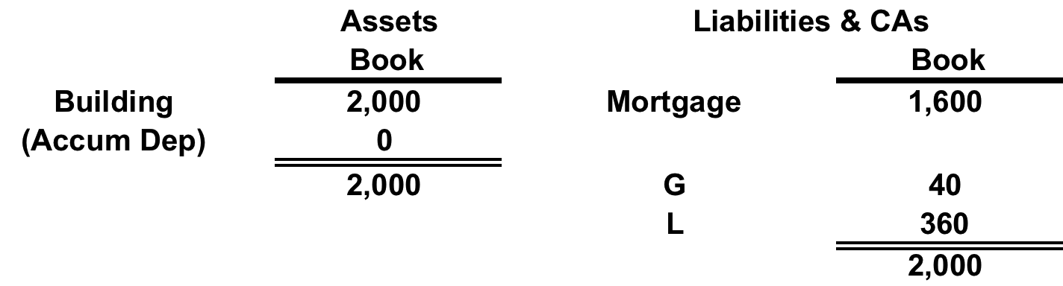
NR Deductions: Example
BS at Formation
BS at the End of Y1

Slide 9
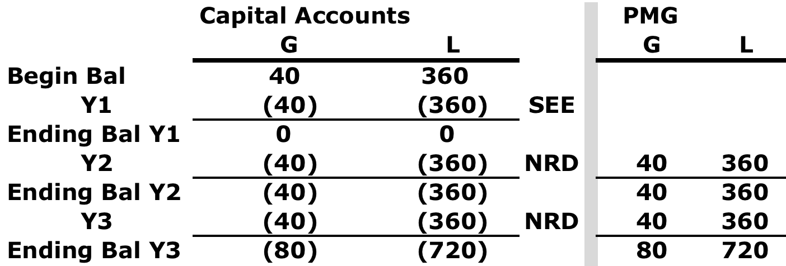
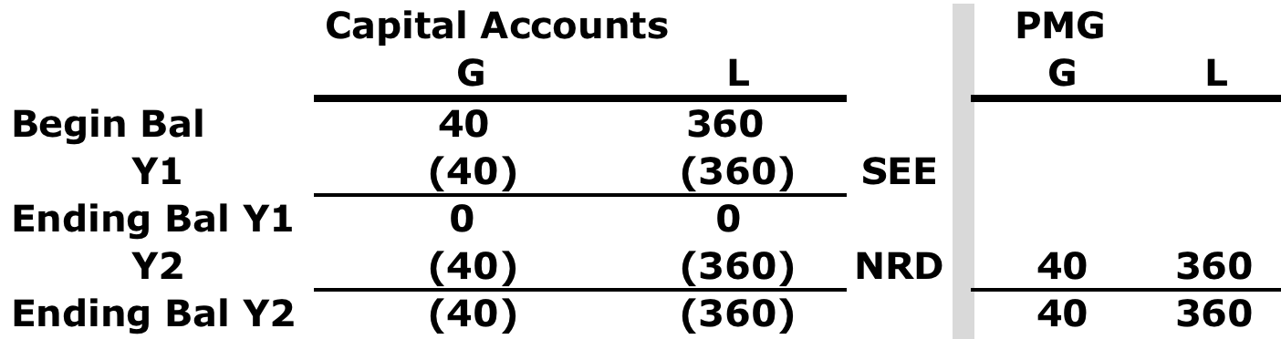
NR Deductions: Example
BS at the End of Y2
BS at the End of Y3

Slide 10
NR Deductions: Example

Slide 11
NR Deductions: Example

