Slide 1
Partnership Taxation: Property Contributions: Section 704(c)
Prof. Colon
Fall 2023

Slide 2
Allocations with Respect to Contributed Property: §704(c)
“…income, gain, loss, and deduction with respect to property contributed to the partnership by a partner shall be shared among the partners so as to take account of the variation between the basis of the property to the partnership and its fair market value at the time of contribution…” §704(c)(1)(A)
“if any property so contributed has a built-in loss—such built-in loss shall be taken into account only in determining the amount of items allocated to the contributing partner,…” §704(c)(1)(C)
When property is contributed to a PSH, what’s the PSH’s basis in the property?
What credit does a P get in his CA for contributed property?
When and where else do book-tax disparities arise?

Slide 3
Section 704(c)
A and B form AB (GPSH), a 50-50 PSH; B contributes nondepreciable property (AB=14k; FMV=20k) and A contributes cash (20k)

Slide 4
Section 704(c)
3 Allocation Methods under §704(c):
Traditional Method (Reg. §1.704-3(b))
Traditional Method with Curative Allocations (Reg. §1.704-3(c))
Remedial Method (Reg. §1.704-3(d))
Operating Rules:
§704(c) applies on a property-by-property basis (no aggregation of G/L)
Can use different methods on different property, subject to methods being “reasonable”
§704(c) can be disregarded if there is a “small disparity” between book and tax (<15% and <20k). Reg. §1.704-3(a)(2); -3(e)

Slide 5
Section 704(c): Traditional Method
A and B form AB (GPSH), a 50-50 PSH; B contributes nondepreciable property (AB=14k; FMV=20k) and A contributes cash (20k)
AB sells property for: (1) 20k; or (2) 24k. Reg. §1.704-1(b)(4)(i); -3(b)(1)
Tax consequences?
Book consequences?
(1) Calculate book and tax items; (2) allocate book first; (3) then for noncontributing Ps match tax and book; and (4) any remaining tax items to contributing P

Slide 6
Section 704(c): The Traditional Method and the Ceiling Rule
Same fact as previous example, but the property is sold for 18k Reg. §1.704-3(b)(1)
“the total income, gain, loss, or deduction allocated to the Ps for a TY with respect to a property cannot exceed the total PSH income, gain, loss, or deduction with respect to that property for the TY (the ceiling rule).”
Why is the resulting book/tax disparity a problem? Is it permanent?

Slide 7
The Traditional Method, the Ceiling Rule, and BIL Property
§704(c)(1)(C):
C) if any property so contributed has a built-in loss—
(i) such built-in loss shall be taken into account only in determining the amount of items allocated to the contributing partner, and
(ii) …in determining the amount of items allocated to other partners, the basis of the contributed property in the hands of the partnership shall be treated as being equal to its fair market value at the time of contribution.
As a result of §704(c)(1)(C), it is no longer possible to shift BILs to noncontributing Ps.
Under Prop. Reg. §1.704-3, the P contributing BIL property has a 704(c)(1)(C) basis adjustment with respect to the property equal to the BIL.
When the BIL property is sold, the PSH computes G/L using FMV basis at the time of contribution and allocates the G/L under the PSH agreement.
The contributing P’s G/L from the sale of the BIL property will be its share of G/L under the PSH agreement (using FMV basis) minus the §704(c)(1)(C) adjustment.
Assume A contributes 20K and B contributes BIL property (AB=24k; FMV=20k), and the property is sold by AB for 22k.
Tax and Book Consequences?

Slide 8
Section 704(c): The Traditional Method with Curative Allocations
AB sells property for 18k and also has 4k of capital gains from the sale of stock. Review the ceiling rule.
How could the tax gain from the sale of stock be allocated to eliminate book/tax disparity caused by the ceiling rule? Reg. §1.704-3(c)(1)
Curative allocation: allocation of a PSH item for tax purposes that is different than for book purposes. Must be reasonable and of the same type that was subject to the ceiling rule. Reg. §1.704-3(c)(3)

Slide 9
Section 704(c): The Remedial Method
AB sells the property (but not the stock) for 18k.
If equal amounts of tax G/L could be created, how much should be created and how should it be allocated to eliminate the book/tax disparity caused by the ceiling rule? Reg. §1.704-3(d)(1); -3(d)(7), Ex. 2.

Slide 10
Section 704(c): Depreciable Property and the Traditional Method:
A contributes depreciable property worth 100 (AB 60) and B contributes 100 to AB, a 50-50 PSH. For tax purposes, the property has 4 years remaining to be depreciated.
Tax Depreciation: 15/yr (60/4)
Book Depreciation: 25/yr (100/4) (Reg. §1.704-1(b)(2)(iv)(g)(3))
What if instead B (noncontributing) were allocated tax depreciation equal to book depreciation (12.5/yr) and the remainder (2.5/yr) were allocated to A (contributing)? Reg. §1.704–3(b)(1), -3(b)(2), Ex. 1(ii).

Slide 11
Section 704(c): Depreciable Property and the Traditional Method
PSH Depreciation of Contributed Property:
PSH recovers remaining basis over the same period as P. §168(i)(7).
PSH recovers the same proportion of basis for book as it does for tax. Reg. §1.704-1(b)(2)(iv)(g)(3).
Conceptually, each noncontributing P is treated as if he had purchased an undivided interest in the contributed property for $.
Determine book and tax depreciation
Allocate book depreciation following PSH agreement
Allocate tax depreciation to noncontributing P to match book
Allocate any remainder to contributing P.

Slide 12
Depreciable Property and the Traditional Method: The Dreaded Ceiling Rule
A contributes depreciable property worth 100 (AB 40) and B contributes 100 to AB, a 50-50 PSH. For tax purposes, the property has 4 years remaining to be depreciated.
Each year, the total tax depreciation is 10 and book is 25.
Issue: PSH’s tax basis is less than noncontributor’s (B’s) share of book basis—the PSH can’t match B’s tax and book depreciation.
 |  | Capital Accounts
 | A |  |  | B
 | Tax | Book |  | Tax | Book
BB | 40 | 100 |  | 100 | 100
Y1 Dep | 0 | (12.5) |  | (10) | (12.5)
Y2 Dep | 0 | (12.5) |  | (10) | (12.5)
Y3 Dep | 0 | (12.5) |  | (10) | (12.5)
Y4 Dep | 0 | (12.5) |  | (10) | (12.5)
 | 40 | 50 |  | 60 | 50

Slide 13
Depreciable Property: Traditional Method with Curative Allocations
Same facts as above, except AB also earns each year 20 of ordinary income.

Slide 14
Depreciable Property and Remedial Allocations
PSH must use a special rule to determine book items:
Treat contributed property as if contributing P had sold property to the PSH on a deferred basis for its FMV:
To the extent of the property’s (tax) AB, PSH steps into shoes of contributing P for book and tax
Excess of FMV over AB is treated for book as if the PSH had purchased the property for this amount. PSH can use any cost recovery method allowed for such property
PSH then uses traditional method to allocate tax items
Tax follows book for noncontributing;
Remainder to contributing
If the ceiling rule prevents noncontributing P from receiving tax allocation equal to book, the PSH can make a remedial allocation to both the contributing and noncontributing P. Reg. §1.704-3(d)(2).
Remember: remedial items don’t affect a PSH’s taxable income or the AB of its property. Reg. §1.704-3(d)(4).

Slide 15
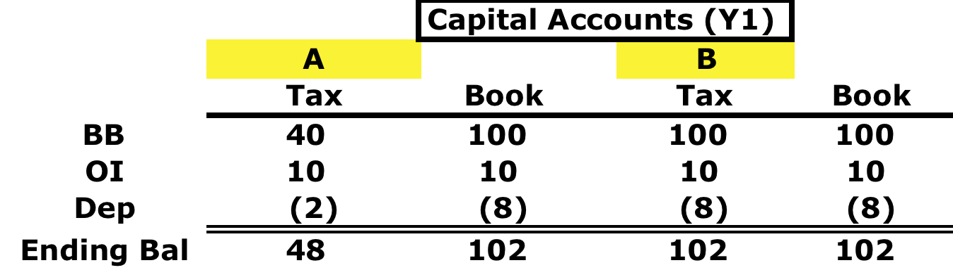
Depreciable Property and Remedial Allocations
A contributes depreciable property worth 100 (AB 40) and B contributes 100 to AB, a 50-50 PSH. For tax purposes, the property has 4 years remaining to be depreciated.
AB elects to depreciate the excess of the value of its property over its AB (60) over 10 yrs on a SL basis (6/yr).
Annual Book depreciation for Y1-4 → 16 (10 + 6)
Annual Book depreciation for Y5-10 → 6
Annual Tax depreciation for Y1-4 → 10

Slide 16

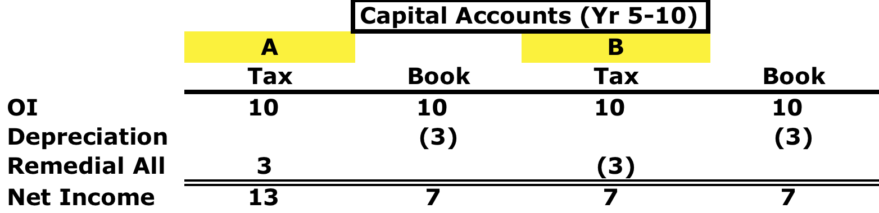
Depreciable Property and Remedial Allocations
Capital accounts after 4 years:
Capital account yearly adjustments for each Y5-10:

Slide 17
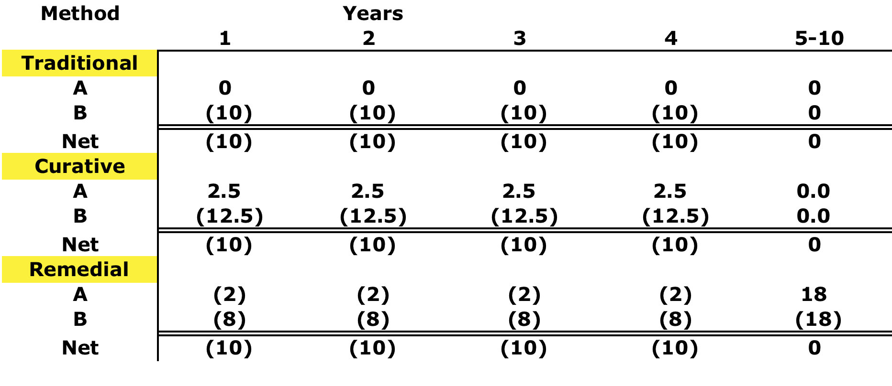
Choice of Methods
A contributes depreciable property worth 100 (AB 40) and B contributes 100 to AB, a 50-50 PSH. For tax purposes, the property has 4 years remaining to be depreciated.

Slide 18
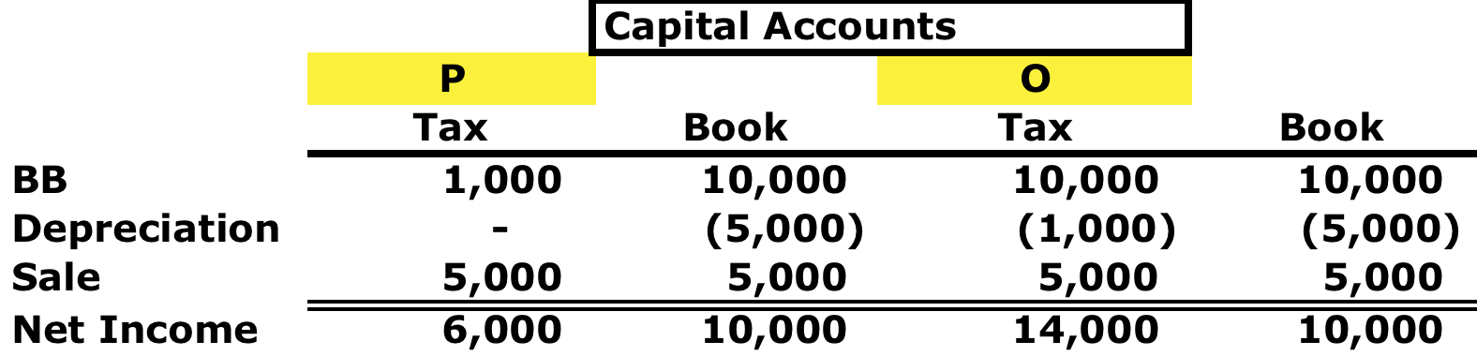
Choice of Methods: Anti-abuse Rules
Reg. §1.704-3(b)(2), Ex. 2 (traditional method); FAA 20204201F
Reg. §1.704-3(c)(4), Ex. 3 (traditional w/ curative)

Slide 19
Review: Character of G/L on Contributed Property
Any G/L recognized by PSH wrt contributed Unrealized receivable is OI/L
Any G/L recognized by PSH wrt inventory item w/in 5 years of contribution is OI/L
If Capital Asset with BIL contributed to PSH, any loss recognized w/in 5 years of contribution is CL to the extent of the BIL. §724

Slide 20
Reverse §704(c) Allocations
A and B form AB (GPSH); B contributes property (AB=14k; FMV=20k) and A contributes cash (20k). When building is worth 40k, C enters as an equal P

Slide 21
Sen. Wyden Partnership Proposals (Sept. 10, 2021)
In general, property can move into and out of partnerships tax free under sections 721 and 731. Section 704(c) attempts to prevent the shifting of gain or loss between partners by requiring that the tax items of contributed property be shared between the partners to take into account the built-in gain or loss at the time of contribution (i.e., the variation between the value and basis at the time of contribution). However, current rules provide significant flexibility for partnerships in choosing how to take into account that variation. Notwithstanding the intent to prevent it, the current rules still allow for gain to be shifted between partners. The regulations provide several “reasonable” methods for accounting for the variation, but only one – the “remedial method” fully prevents shifting of built-in gain between partners in all cases. While Subchapter K has attempted to allow for partners to deal with this issue flexibly, it is no longer sustainable.
The provision would require that all partnerships use the remedial method for section 704(c) allocations (described in Treas. reg. sec. 1.704-3(d)). This would cure the so-called “ceiling rule” problem in all instances.

