Slide 1
Partnership Taxation: Partner-Partnership Transactions
Prof. Colon
Spring 2025

Slide 2
Partner-PSH Transactions
3 Categories of P-PSH Transactions
P is acting in his capacity as a P and compensation is determined with reference to the PSH’s income.
Under §704(b), these payments are treated as distributive shares.
P is acting at arm’s length with the PSH and not in his capacity as a P.
Under §707(a), these transactions are treated the same as transactions between third parties, e.g., compensation, rent, interest.
P is acting in his capacity as a P and receives a fixed or guaranteed payments--not determined by reference to the PSH’s income--for services or use of capital.
Under §707(c), for purposes of §§61 (OI), 162 (deduction), and 263 (capitalization), the payment is treated as if the P were a third party; for all other purposes, it’s treated as a distributive share.

Slide 3
Summary of Partner-PSH Transactions
Tax Treatment of Partner-Partnership Transactions
 | Character | Accounting Method | Subject to 263 | 199A
707(a) | Ordinary /Capital | P’s; 267(a) and (e) | Yes | No
707(c) | Ordinary | PSH’s; 706(a) | Yes | No
704(b) | Flow Through | PSH’s; 706(a) | No | Yes

Slide 4
Acting in Capacity as a Partner
Pratt v. CIR (1970): GP of real estate LPSH received 5% of gross rental income for managerial services (§707(a) timing play)
Not guaranteed payment because computed as a % of gross rental income
Services performed in capacity as P
Rev. Rul. 81-300: Payments to P for RE management services of 5% of gross rentals are guaranteed payments. Factors:
Reasonableness of payments
Same method of payment used to compensate 3rd parties.
Legislative History to §707(a)(2)(A): Transaction described in Rev. Rul. 81-300 should be treated under §707(a)

Slide 5
Guaranteed Payments: Reg. §1.707-1(c), Exs. (1)-(3)
P, a 10% partner, is entitled to a 10K guaranteed payment for services plus 10% of PSH income after deducting the GPay. PSH income after deducting the 10K GPay is 50K.
Result for P?
P is entitled to 30% of PSH income before any GPay but not less than 10K. PSH income is alternatively: [1] 60K; [2] 20K.
Result in [1]?:
Result in [2]?:
Result under Prop. Reg. §1.707-1(c), Ex. 2?
P is entitled to receive 10K for services plus 30% of PSH income/loss. After deducting the GPay, the PSH has a loss of <9K>.
Result for P?

Slide 6
Section 707(a)(2)(A)
If a P performs services for a PSH,
there is a related direct or indirect allocation and distribution to the P, and
the performance of such services and the allocation and distribution, when viewed together, are properly characterized as a transaction occurring between the PSH and P acting in a nonpartner capacity, the transaction will be treated as a §707(a) transaction.

Slide 7
Section 707(a)(2)(A): Disguised Capital Expenditures
A PSH hires A, a general contractor, to renovate the PSH’s office. Instead of hiring A directly, the PSH makes A a P in exchange for a contribution of cash. The PSH specially allocates 50k of gross income/yr for 2 years to A—A’s fee would normally be 100k—and buys out A’s PSH interest at the beginning of Y3. Prop. Reg. §1.707-2(d), Ex. 1.

Slide 8
Section 707(a)(2)(A): Proposed Regulations on Disguised Payments for Services
Factors to determine if P acting in a partner capacity:
Significant Entrepreneurial Risk**
Capped allocations of PSH income
Allocation for 1 or more years if reasonably certain
Allocation of gross income
Allocation fixed in amount or designed to assure that Net Profits likely to be available (e.g., NI from a specific transaction)
Arrangement in which a service provider waives its right to receive payment for the future performance of services in a manner that is non-binding or fails to timely notify the partnership and its partners of the waiver and its terms.
Transitory P Status
Timing of the Allocation/Distribution (similar to non-P service provider)
Tax Motivation to become P
Relative Size of the Payment compared to P’s interest in PSH profits
**Different allocations for different services received. Prop. Reg. §1.707-2(c)(1)-(6).

Slide 9
Section 707(a)(2)(A): Prop. Reg. §1.707-2(d)
A PSH hires A, a general contractor, to renovate the PSH’s office. Instead of hiring A directly, the PSH makes A a P in exchange for a contribution of cash. The PSH specially allocates 50k of gross income/yr for 2 years to A—A’s fee would normally be 100k—and buys out A’s PSH interest at the beginning of Y3. Ex. 1
A, a stock broker, agrees to effect trades for PSH ABC without the normal commissions. A contributes 51% of PSH capital in X for a 51% PSH interest. A also receives a special allocation of gross income computed in a manner approximating its foregone commissions. The special allocation to A is computed by means of a formula similar to a normal brokerage fee and varies with the value and amount of services rendered rather than with the income of the PSH. It is reasonably expected that the PSH will have sufficient gross income to make this allocation. Ex. 2.

Slide 10
PSH Interest Received For Services
Capital Interest vs. Profits Interest
Section 721 applies to transfers of property in exchange for a PSH interest.
Query: What about the exchange of a PSH interest for services to the PSH or to a P?
“To the extent that any of the partners gives up any part of his right to be repaid his contributions (as distinguished from a share in partnership profits) in favor of another partner as compensation for services . . ., §721 does not apply. The value of an interest in such partnership . . . constitutes income to the partner under §61.” (Reg. §1.721-1(b))

Slide 11
Capital and Profits Interests
Capital Interest: an interest that gives the holder a share of the proceeds if the PSH's assets were sold at FMV and then the proceeds were distributed in a complete liquidation of the PSH. This determination generally is made at the time of receipt of the PSH interest.
Profits Interest: a PSH interest other than a capital interest. Rev. Proc. 93-27.

Slide 12
Capital Interest Received For Services
P Consequences
Ordinary income in the year of receipt unless not transferable and subject to substantial risk of forfeiture (not vested). §83(a).
Even if the interest is not transferable and subject to substantial risk of forfeiture, an election can be made to include the FMV of the interest in income in year of receipt. §83(b).
PSH Consequences
Deduction (or capitalization) in year in which included in income by P. §83(h).
If the PSH holds appreciated property, does the transfer cause a taxable disposition of a portion of PSH property? Cf. Reg. §1.83-6(b).

Slide 13
Diamond v. CIR (1971)
In exchange for obtaining a 1.1M mortgage for Kargman, D receives a 60% profits interest
K puts up all capital
In event of sale, K recovers all funds advanced and then 40% of profits
D sells PSH interest for 40K shortly after closing. Uses STCG to offset other STCLs.
Why does Diamond want §721 treatment?
Diamond
Kargman
PSH

Slide 14

Campbell v. CIR (1990)
In exchange for $150 and prior services, Campbell receives LP interest and is to be allocated 1% P&L.
LPs contribute 3.49M and allocated 97% of P&L.
C’s distributive share of ‘80 loss: 11.7K
LPSH expected to incur taxable losses of 1.17M/year over next 10 years
Losses arise from consulting and management fees, interest and depreciation
Realty
GP
Campbell
LPs
Grand LPSH

Slide 15

McDougal v. CIR
McDougal: If you (McClanahan) train my horse so that he can race again, I’ll give you a 1/2 interest
McClanahan
McDougal
MM LPSH
“When on the formation of a joint venture a party contributing appreciated assets satisfies an obligation by granting his obligee a capital interest in the venture, he is deemed first to have transferred to the obligee an undivided interest in the assets contributed, equal in value to the amount of the obligation so satisfied. He and the obligee are deemed thereafter and in concert to have contributed those assets to the joint venture.”

Slide 16
Rev. Proc. 93-27
Capital Interest: an interest that gives the holder a share of the proceeds if the PSH's assets were sold at FMV and then the proceeds were distributed in a complete liquidation of the PSH. This determination generally is made at the time of receipt of the PSH interest.
Profits Interest: a PSH interest other than a capital interest.
Receipt of profits interest received in exchange for services not currently taxable if received for services to or for the benefit of a PSH in a partner capacity or in anticipation of being a partner
Exceptions:
Profits interest relates to substantially, predictable stream of income from PSH assets
P sells interest w/in 2 years, or
Profits interest is LP interest of a PTP

Slide 17
Rev. Proc. 2001-43
Where a PSH grants a profits interest to a service provider in a transaction meeting the requirements of this revenue procedure and Rev. Proc. 93-27, the IRS will not treat the grant of the interest or the event that causes the interest to become substantially vested as a taxable event for the partner or the partnership.
The partnership and the service provider treat the service provider as the owner of the PSH interest from the date of its grant.
Upon the grant of the interest or at the time that the interest becomes substantially vested, neither the PSH nor any of the partners deducts any amount (as wages, compensation, or otherwise) for the fair market value of the interest.

Slide 18
Proposed Regulations (5/24/05)
A transfer of all PSH interests in exchange for services is subject to §83. Prop. Reg. §1.83-3(e); Prop. Reg. §1.721-1(b)(1).
In general, receipt of property for services is currently taxable as OI to service provider if property is vested (transferable or not subject to a substantial risk of forfeiture)
PSH deduction: §83(h); Prop. Reg. §1.83-6.
§83(b) election: even if property not vested, taxpayer can elect to take value of property into income upon receipt. If §83(b) election made, TP is treated as P, even if property not vested. Prop. Reg. §1.761-1(b).

Slide 19
Proposed Regulations (5/24/05)
Service provider’s Capital Account increased by amount taken into income under §83. In essence, PSH is deemed to transfer cash to P, who, in turn, transfers it back to PSH in exchange for its capital account.
Valuation: Prop. Regs. permit service provider to value PSH interest received on a liquidation basis.
Amount of cash service provider would receive if PSH sold of all of its assets for their FMV, allocated G/L, satisfied liabilities, and liquidated. Prop. Reg. §1.83-3(l).
PSH generally will NOT recognize G/L upon transfer of PSH interest, even if PSH holds only appreciated property. Prop. Reg. §1.721-1(b)(2). But not if PSH created by transfer. See McDougal.

Slide 20
Proposed Regulations (Example)
AB PSH wants to make C an immediate 10% P because of his past hard work on behalf of AB PSH.
BEFORE
AFTER

Slide 21

Funds
GP
LPs
20% Profits
(Carried Interest)
1% Capital
99% Capital
Fund
80% Profits
LLC
Management Services
Management Fee
(1% manage fee)
Securities

Slide 22
Funds and Fee Waivers
GP
LPs
21% Profits
(20% Carried Interest
+ 1% additional interest)
1% Capital
99% Capital
Fund
79% Profits
LLC
Management Services
Management Fee
Securities

Slide 23
Funds: Carried Interest
Assume Fund earns $100 of CGs. See Rigas v. US
Structure | Manager | Investor
Incentive Fee | 20 OI | 100 CG; (20) Ord Ded
Carried Interest | 20 CG | 80 CG (100 CG- 20 CL)
Difference | OI into CG | OD into CL

Slide 24
Carried Interest: Section 1061
3-year holding period requirement for gains with respect to applicable partnership interests
APSHI: interest in a partnership which, directly or indirectly, is transferred to (or is held by) the taxpayer in connection with the performance of substantial services by the taxpayer, or any other related person, in any applicable trade or business
AT/B: raising or returning capital, and either investing in (or disposing of) specified assets (or identifying specified assets for such investing or disposition), or developing specified assets
Specified Assets: securities, commodities, real estate held for rental or investment, cash or cash equivalents, options or derivative contracts.
Exceptions:
PSH interest held by corporation. What about S Corporations? See Notice 2018-18. Nope!
Capital interest that provides the right to share in PSH capital commensurate with the capital contributed or the value of the interest subject to tax under §83 upon vesting.

Slide 25
Funds: Fee Waivers
Management Fees (1% or 2%)
OI to fund manager
Deduction by fund Ps, but:
Tax-exempt (pension, foreign) Ps
Taxable Individuals: Limitations under sections 212, 67/68, AMT
Fee waiver: manager waives management fee in exchange for an increased interest in the fund’s profits (profits interest).
Priority allocation of $ of any PSH gain (even before LPs) equal to waived fees
Can be paid out of quarterly income
Can be paid out of Gross Income
“Net Profits” are calculated without regard to losses
No clawbacks

Slide 26
Fee Waivers: Prop. Reg. §1.707-2, Ex. 3
New PSH ABC will invest in non-publicly traded assets. M will perform services for no fee, will contribute 500K for 1% of ABC’s capital and profits, and will be entitled to a priority allocation of net gain in 12-month period in which partnership has overall net gain to approximate foregone fee. A controls M and directs operations of ABC as its GP, including timing of distributions to M. A has 10% interest in overall net profits of ABC subject to clawback obligation that A could and would pay. M’s allocations highly likely to be available and reasonably determinable because A controls timing of asset dispositions.
A’s arrangement not treated as payment for services
M’s arrangement is payment for services (priority allocation of net profit from any 12-month period, timing of sales by A)
Same result if ABC can fund priority allocation from revaluations

Slide 27
Fee Waivers: Prop. Reg. §1.707-2, Ex. 5
A is GP of ABC and delegates management to M. M takes 1% of capital as management fee instead of typical 2%. A will receive typical 20% share of profits over life of partnership and an additional interest (AI), the PV of which is estimated to equal the waived 1% fee. Amounts allocated under the AI is neither highly likely to be available nor reasonably determinable. A also is subject to a clawback that the parties anticipate A would comply with.
Arrangement does not constitute payment for services.

Slide 28
Modification of Rev. Proc. 93-27
The preamble states that Rev. Proc. 93-27 will not apply to transactions in which a management company waives its fees and another party receives an interest in future PSH profits, the value of which approximates the waived fee.
Rev. Proc. 93-27 will not apply to a profits interest issued in conjunction with a partner forgoing payment of an amount that is substantially fixed (including a substantially fixed amount determined by formula, such as a fee based on a percentage of partner capital commitments) for the performance of services, including a guaranteed payment under §707(c) or a payment in a non-partner capacity under §707(a).

Slide 29
Rev. Proc. 93-27
Sec. 4.01 Other than as provided below, if a person receives a profits interest for the provision of services to or for the benefit of a partnership in a partner capacity or in anticipation of being a partner, the Internal Revenue Service will not treat the receipt of such an interest as a taxable event for the partner or the partnership.

Slide 30
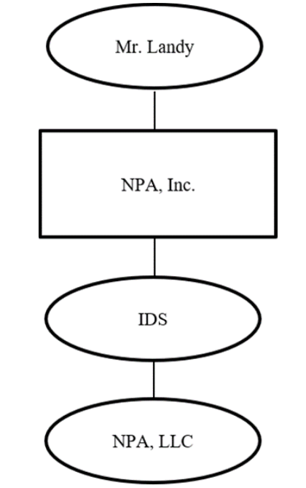
ES NPA Holding LLC v. CIR (T.C. Mem. 2023-55)
Landy owned consumer loan businesses through various wholly owned entities:
NPA, Inc., Community Credit Services, Inc., National Opportunities Unlimited, Inc., and American Consumer Credit, LLC
On 9/27/11 NPA, Inc. formed two LLCs: IDS and NPA, LLC.
IDS had two classes of membership units: B and C
NPA, LLC had three classes of units: A, B, and C
IDS LLC agreement: class B and class C units in IDS track the class B and class C units in NPA, LLC--owner of IDS class B (class C) units was entitled to 100% of the payments received by IDS because of its ownership of NPA, LLC class B (class C) units
On 10/13/11, NPA, Inc. contributed substantially all of its business assets to NPA, LLC in exchange for all three classes of units (classes A, B, and C) in NPA, LLC. NPA, Inc. then contributed all three classes of units (classes A, B, and C) in NPA, LLC to IDS as a capital contribution to IDS.

Slide 31
ES NPA Holding LLC v. CIR (T.C. Mem. 2023-55)
October 14, 2011, NPA, LLC entered into revenue-sharing agreements with the consumer loan businesses, CCS, NOU, and ACC.
NPA Investors, LP (NPA Investors) purchased all of NPA, LLC’s class A units from IDS for $14,502,436.
ES NPA exercised a call option granted by NPA, Inc., acquired all of the IDS class C units in exchange for ES NPA’s payment to NPA, Inc. of $100,000 and services provided or to be provided.
ES NPA agreed to provide the following services to NPA, Inc. for the option to pay $100,000 to NPA, Inc. to acquire all of the class C units in IDS (which reflected an indirect interest in the class C units of NPA, LLC): “strategic advice for the purpose of enhancing the performance of [NPA Inc.’s] business and to assemble an investor group that would purchase 40 [sic] percent of [NPA Inc.’s] business for approximately $21 million.” The call option agreement also provides that ES NPA is hereby given “an option . . . to purchase all of the Class C Units . . . from [IDS]” and is dated October 14, 2011.

Slide 32
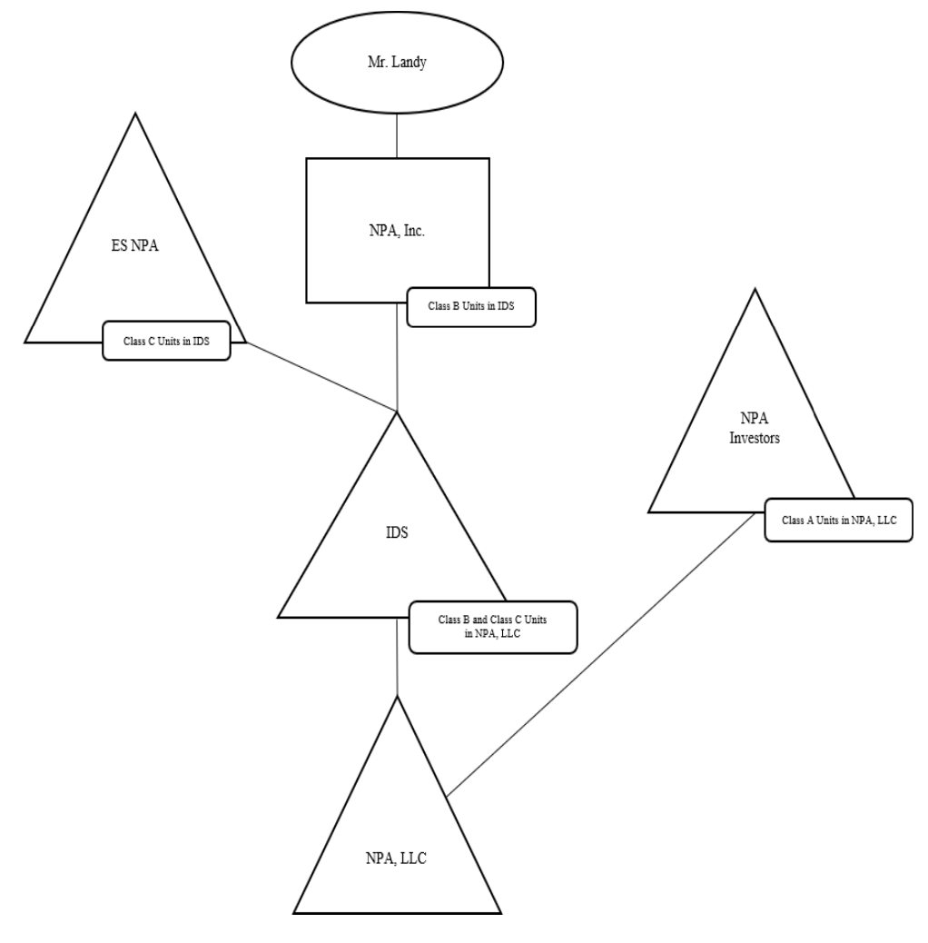
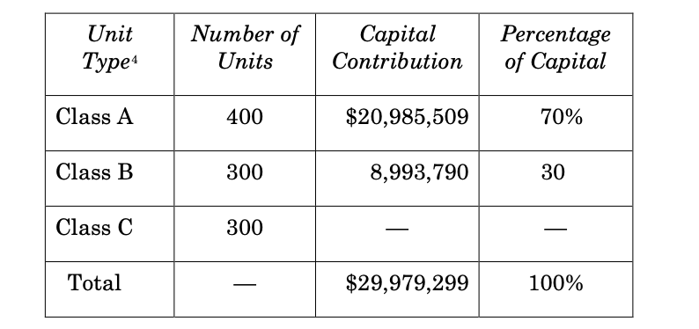
ES NPA Holding LLC v. CIR (T.C. Mem. 2023-55)

Slide 33
ES NPA Holding LLC v. CIR (T.C. Mem. 2023-55)
Issue: does ES NPA’s indirect receipt of the class C units in NPA, LLC qualify as a profits interest in Rev. Proc. 93-27?
IRS:
Rev. Proc. 93-27 doesn’t apply because ES NPA didn’t provide services to IDS.
ES NPA received a capital interest in IDS w/ a FMV of 12MM.
CT:
ES NPA provided services to NPA, Inc. in X for class C IDS units, which were identical to class C units in NPA, LLC.
Evidence that ES NPA provided services to or for the benefit of NPA LLC…It is of no material consequence that ES NPA’s interest in NPA, LLC is held indirectly through IDS, which is a mere conduit since the liquidation rights in the class C units in both IDS and NPA, LLC are identical.
Class C IDS unit was not a capital interest? Why not?

Slide 34
Employer/Employee Employment Taxes
Federal Income:
Compensation is generally taxed as ordinary income, but see §199A
Investment income: 3.8% tax on investment income, e.g., dividends, interest, rents, royalties for income: > $200,000 (single), $250,000 (joint). §1411.
Note: doesn’t apply to T/B of trading in financial instruments. §1411(c)(2)(B).
Social Security Taxes on Wages:
7.65% [6.2% (OASDI) + 1.45% (Medicare)] to $176,100 (2025) (employers & employees, each). §§3101(a) and (b)(1); 3111(a) and (b).
1.45% (employer & employee) on earned income > $176,100 (2025). §§3101(b)(1) and 3111(b).
0.9% Additional Medicare tax (employee) on earned income > $200,000 (single); 250,000 (joint). §3101(b)(2)
Total: 15.3% up to 176.2K; 2.9% > 176.1K to 200K/250K; 3.8% > 200K/250K

Slide 35
P’s Distributive Share of PSH Income and SE Taxes
If PSH is engaged in a T/B, a P’s distributive share of the PSH’s business income will be treated as self-employment income. §1402(a).
SE Rate = 12.4%, plus
2.9% hospital insurance/Medicare tax, plus
0.9% additional Medicare tax for SE income > 250K for joint returns (200K for single). §1401(a) and (b).
In computing SE taxes, a taxpayer can subtract ½ of the SE taxes (except the 0.9% tax); effectively 92.35% of a taxpayer’s SE income is subject to SE tax (or an ETR of 14.13%). §1402(a)(12).
In computing taxable income, a taxpayer can deduct ½ of the SE taxes (except the 0.9% tax). §164(f)
Exceptions: rental income, interest income, S/X of capital assets
Guaranteed payments for services are also subject to SE tax. Reg. §1.1402(a)-1(b)
NII Tax (3.8%) doesn’t apply to items subject to Medicare SE tax. §1411(c)(6)

Slide 36
Limited Partner Exception: Lots of disputes
An LP’s distributive share of PSH income is not subject to SE tax. §1402(a)(13).
Enacted in 1977 before LLCs and when being an LP that took part in controlling the PSH would entail losing limited liability. Goal: prevent LPs from obtaining social security benefits on passive income.
What is an LP? How should Ps of LLPs be treated? Members of LLCs?
Proposed 1997 regulations
Renkemeyer, Campbell & Weaver, LLP v. CIR, 136 T.C. No. 137 (2011): Ps of GP law firm operating as LLP not LPs for SE taxes; functional analysis, which was followed in Soroban (TC 2023).
Big LP case in the pipeline: Point72 and Sirius Solutions (5th Cir.)
Issue: Is manager subject to SE tax on allocations attributable to LP interest? Potential tax liability in Point72: $344MM over 2 years!
Denham Capital (TC Mem. Dec. 2024) (reaffirmed 2023 TC holding in Soroban, finding Ps active and fundamental contributors to PSH)

Slide 37
Limits on Benefits for Self-Employed
Ps aren’t considered employees for accident and health plans. If PSH pays P’s health insurance, such premiums are treated as guar. payments and are deductible by PSH but includable by the Ps.
P should be able to deduct above the line under §162(l).
Alternative: distribute amounts to Ps under §731 and have Ps pay.
Cafeteria Plans (employee can choose between taxable and nontaxable benefits) don’t apply to Ps because they are not employees.
Fringe benefits: most treated as guaranteed payments, but some are not, e.g., dependent care assistance, no additional cost, employee discount.
A partner is treated an employee for qualified plan purposes only if he is a “self-employed individual” as defined in §401(c)(1), with “earned income” for the taxable year as defined in §401(c)(2).
Owner of a DRE treated as P and not employee for fringe benefit purposes, therefore subject to self-employment tax and treated as P for fringe benefit purpose. Reg. §301.7701-2T.

