Slide 1
Disguised Sales
Example
A contributes property (B=18K; FMV=65K) to AB
P/L shared equally, except for 65k of loan proceeds
B contributed “ability to get financing for AB through good credit”
AB takes out recourse loan for 870K and distributes 65K to A.
Tax Consequences
What are the tax consequences of the exchange? (§721)
What are the tax consequences of the loan? (§752(a))
What are the tax consequences of distribution? (§731(a) and §733(1))
Otey v. CIR, 70 T.C. 312, aff’d 634 F.2d 1046 (6th Cir. 1980)

Slide 2
Disguised Sales: Mixing Bowl Transactions
A contributes appreciated land to AB (AB=10; FMV=100)
B contributes appreciated nonmarketable securities to AB (AB=10; FMV=100)
AB liquidates, distributing the land to B and the securities to A
In the absence of any special rules, what are the hoped-for results?
A
B
AB
Land
Sec

Slide 3
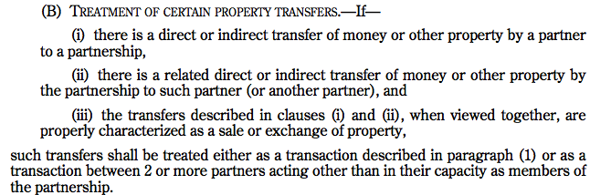

Disguised Sales: Sec. 707(a)(2)(B)

Slide 4

Disguised Sales
Transfers of property to a PSH linked with transfers of property (including assumption of liabilities) by the PSH to the P are treated as sales in whole or in part under 707(a)(2)(B) if:
The transfer by the PSH would not have been made but for the transfer of property; and
If the transfers are not simultaneous, the subsequent transfer is not subject to the entrepreneurial risk of the PSH. Reg. §1.707-3(b)(1).
If a transfer is treated as a sale in whole or in part under 707(a)(2)(B), the sale is deemed to occur on the date of the contribution; but if the PSH transfer occurs after the transfer of property to the PSH, the PSH is treated as transferring an obligation to transfer $ or other property to the P. Reg. §1.707-3(a)(2).

Slide 5
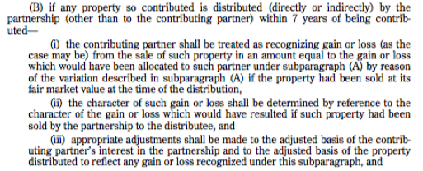
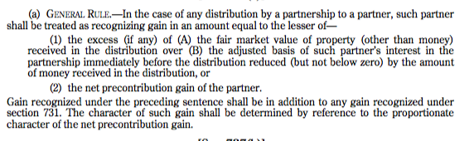
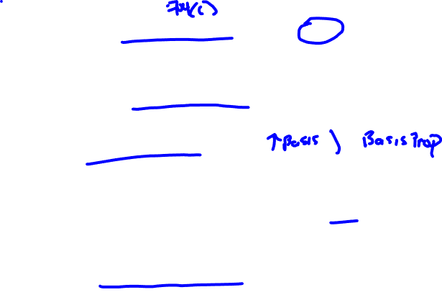
Mixing Bowl Transactions: 704(c)(1)(B) and 737

Slide 6

Disguised Sales
Sale presumption for transfers between P and PSH occurring within two years of the transfer of property by P. Reg. §1.707-3(c)(1)
(10) Facts and Circumstances, e.g.,
Certainty and Timing of 2nd transfer.
Legally enforceable right to 2nd transfer.
2nd transfer secured.
PSH has incurred debt to enable it to make the 2nd transfer.
PSH has excess liquid assets that are expected to be available for the second transfer.
Transfer large in proportion to P’s continuing interest in PSH profits.
P has no obligation to return $ to the PSH. Reg. §1.707-3(b)(2).

Slide 7
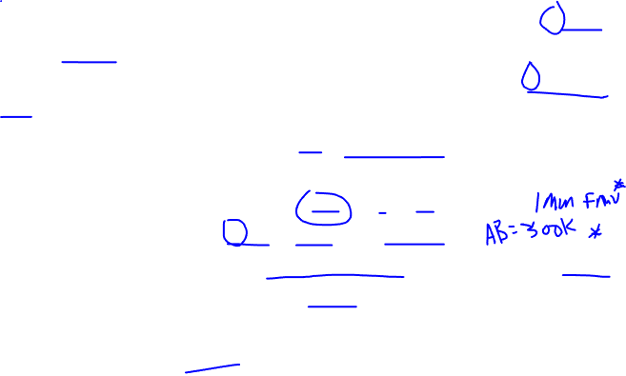
Disguised Sales: Reg. 1.707-3(f), Ex. 1
A transfers Blackacre to ABCD (FMV=4MM; AB=1.2MM), and B, C, and D each transfer 1MM. Immediately after the transfer, ABCD transfers 3MM to A to equalize CAs.
A is treated as having sold ¾ (3MM/4MM) of Blackacre for 3MM.
The basis of the portion sold is 900k (3/4*1.2MM)
The gain recognized is 3MM – 900k, or 2.1MM
A is treated as having contributed property worth 1MM (4MM-3MM) with an AB of 300k (1.2MM – 900k) to the PSH.
ABCD takes a 3MM basis in the purchased portion of Blackacre and a 300k basis in the contributed portion for a total basis of 3.3MM.

Slide 8
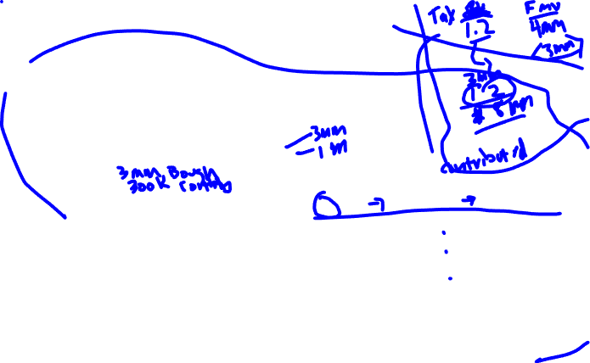
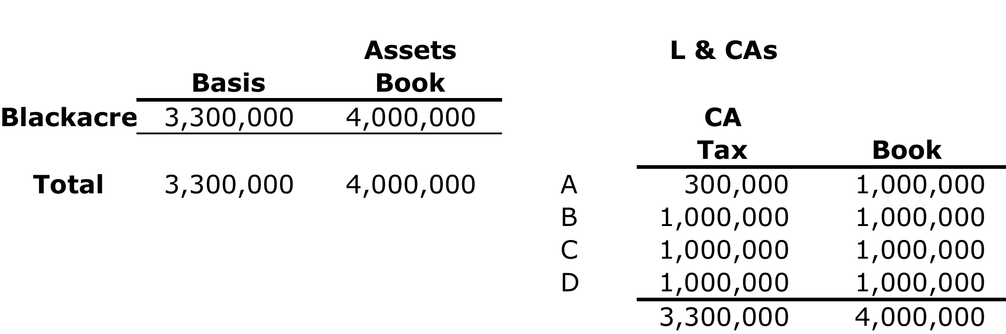
Disguised Sales
Immediately after the transfers, ABCD’s balance sheet is as follows:

Slide 9
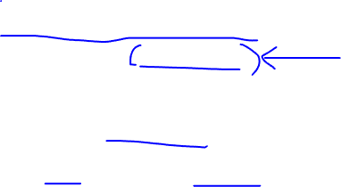
Exceptions for Normal Distributions: Reg. §1.707-4
Reasonable guaranteed payments for use of a P’s capital (707(c))
Reasonable preferred returns (preferential distribution of PSH CF with respect to contributed capital that will be matched, to the extent available, by an allocation of income or gain).
Reasonable amount safe harbor for GPs and Pfrd Returns:
P’s capital *150%*applicable federal rate. Reg. §1.707-4(a)(3)(ii)
Distributions out of operating CF:
Not GP, not reasonable prfd returns, or distributions to P acting other than as a P, and don’t exceed:
Net CF *P’s interest in PSH profit (or lesser of P’s interest for year or over life of PSH).
NCF = TI/L + TE interest + depreciation – (debt repayment + capital exp.). Reg. §1.707-4(b).

Slide 10
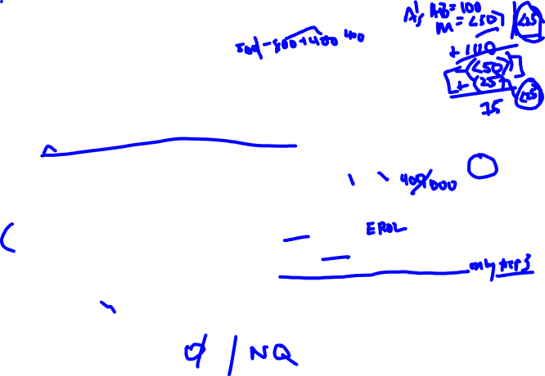
Liabilities: Reg. §1.707-5
A transfers property (FMV=1000; AB=500) subject to a recourse mortgage of 800 to a 50-50 PSH.
What is A’s basis in the PSH?
If P transfers property subject to a nonqualified liability to a PSH, the PSH is treated as transferring consideration to the P to the extent the amount of the liability exceeds the P’s share of the liability immediately after the transfer. Reg. §1.707-5(a)(1).
In above example: A is treated as receiving 400 (800-400) and selling 40% of property (see below for complete consequences)
Determining share of recourse & nonrecourse liabilities:
Recourse: as determined under Reg. §1.752-1(a)(1)
Nonrecourse: as determined under Reg. §1.752-3(a)(3) applying the same % used to determine the P’s shares of excess nonrecourse liabilities
Note: This approach disregards any portion of the liability allocable under Tier 1 (share of PSH MG) and Tier 2 (share of 704(c) MG) and doesn’t permit the use of alternative methods for allocating excess NRLs. Reg. §1.752-3(a).

Slide 11
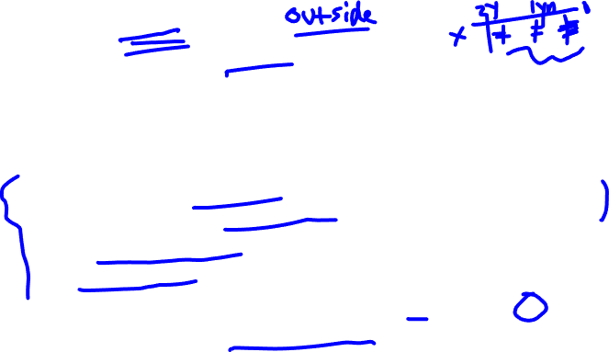
Qualified Liabilities: Reg. §1.707-5(a)(5)
Qualified Liability:
Incurred more than 2 years before transfer of property
If a liability is incurred within two years of transfer, it is presumed to be in anticipation of the transfer; but it will still be a qualified liability if the liability:
is allocable to capital expenditures with respect to the property (proceeds used to acquire or improve the property);
was not incurred in anticipation of the transfer (must be established by TP); or
was incurred in the ordinary course of business and all assets of the trade or business are transferred. Reg. §1.707-5(a)(6), (a)(7).

Slide 12
Liabilities: Reg. §1.707-5(f), Ex. 1
A transfers 500k to AB and B transfers building (AB=400k; FMV=1MM) subject to 500k NR liability, which was incurred 12 months earlier to finance acquisition of other property.
A and B agree to allocate all PSH items 50-50, including excess NR deductions.
B is treated as receiving a distribution of 250k (500k-250k) and treated as selling 250k (or ¼) of the FMV of the office building.
B has gain of 250k – 100k ( ¼ * 400k), or 150k. Reg. §1.707-5(f), Ex. 1.

Slide 13
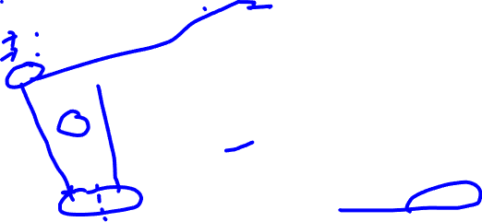
Liabilities: Reg. §1.707-5(f), Ex. 1

Slide 14
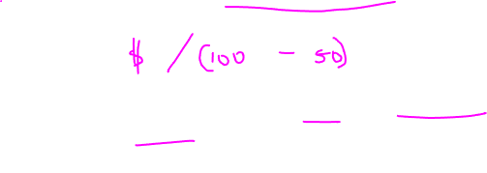
Special Rule for Qualified Liabilities: Reg. §1.707-5(a)(5)
A transfers property subject to a qualified liability to PSH and A receives some $ from the PSH--that is, the transfer is a partial sale w/out regard to the qualified liability
If a property transfer is treated as a partial sale (without regard to the PSH’s assumption of a qualified liability), a portion of a qualified liability is treated as additional consideration in amount equal to the lesser of:
The amount of the liability that would have been treated as consideration if the liability had not been qualified; or
The product of the partner’s “net equity percentage” times the amount of the liability.
P’s NE Percentage:
Consideration from PSH/(FMV Property - Qualified Liability)
Rationale: If a P has cashed out of his equity, he is treated as selling a corresponding portion of the property

Slide 15
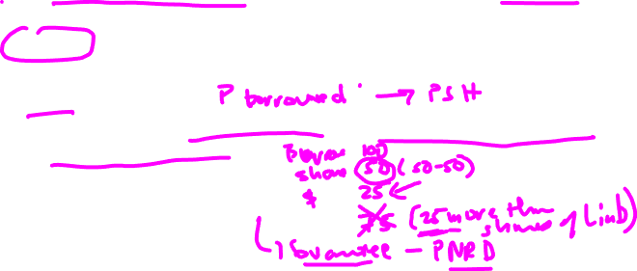
Distribution of Loan Proceeds: Reg. 1.707-5(b)(1)
If a P transfers property to a PSH, and the PSH incurs a liability and distributes all (or some) of the loan proceeds to the P within 90 days of incurring the loan, the transfer is taken into account only to the extent that is exceeds the P’s allocable share of the liability.
Allocable share: P’s share of liability * (amt distributed traceable to the liability/total amt of liability)
For debt that is otherwise nonrecourse, how does a P increase its share of the liability under section 752?
See Canal v. CIR

Slide 16
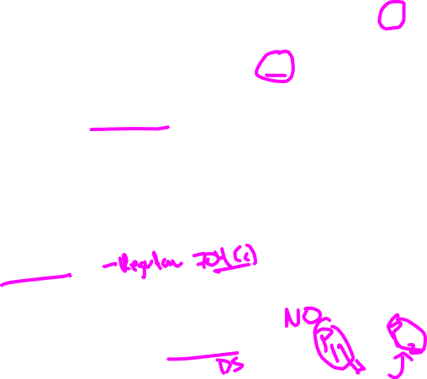
Mixing Bowl: Distribution of Property with BIG or BIL: 704(c)(1)(B)
If 704(c) property is distributed w/in 7 years of contribution other than to the contributing P, the contributing P recognizes any BIG or BIL that he would have recognized if the property had been sold for its FMV when distributed. §704(c)(1)(B)(i).
Remember: depreciation deductions, if applicable, and application of methods for allocating G/L and deprecation under section 704(c) (e.g., remedial)
Effect of proposed BIL regulations
Why is this rule need as a backstop to section 704(c)(1)(A)?
Does a PSH or P generally recognize any G/L on the distribution of property? See §§731 and 732(a).
Why doesn’t section 707(a)(2)(B) apply?

Slide 17
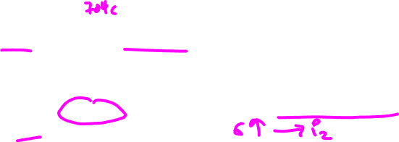
Mixing Bowl Transactions: Distribution of Property with BIG or BIL: 704(c)(1)(B)
Character: the same as if the property had been sold by the PSH to the distributee P. See 707(b)(2) and Reg. §1.704-4(b)(1).
Contributing P’s basis in the PSH is increased by the gain recognized. Reg. §1.704-4(e)(1).
In the case of BIL property, contributing P is entitled to his 704(c)(1)(C) adjustment.
PSH’s basis in the distributed property increased immediately before the distribution by the G/L recognized. Reg. §1.704-4(e)(1).
Distribution of “like-kind” property to contributing P (section 704(c)(2)):
P treated as having contributed the distributed like-kind property
Any gain or loss recognized under 704(c)(1)(B) is reduced by any BIG/BIL in the distributed property. Reg. §1.704-4(d)(3).

Slide 18

Distribution of Property to P: Section 737
If a P has contributed BIG property to a PSH, and P receives a distribution of other property, the contributing P recognizes gain equal to the lesser of:
FMV – P’s AB in PSH (reduced by any $ received), or
P’s net precontribution gain (NPG).
NPG: gain P would have been recognized under 704(c)(1)(B) if all property contributed to PSH by P w/in last 7 years and still held by PSH had been distributed to another P. §737(a) and (b).
Basis: P’s basis in PSH increased by gain recognized (deemed to occur immediately before distribution) and PSH’s basis in contributed property is increased by the same amount. §737(c)(1) and (2).

Slide 19
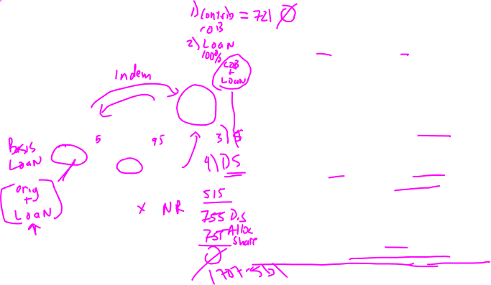
Canal Corporation v. CIR
WISCO (775MM) and GP (376.4MM) contribute tissue assets to GP LLC
GP has 95% interest; WISCO, 5%
GP LLC borrows 755.2MM at closing and distributes it to WISCO/Chesapeake
GP guaranteed loan
WISCO indemnified GP for any principal payments GP would have to make under the loan
WISCO has 157MM of assets (21% of maximum liability under indemnity)
GP LLC refinanced the loan in two parts, both with a GP sub (GP Finance). Refinanced loan had similar terms to BOA loan.
Transaction treated as taxable for fin. acc’t purposes but tax-free for tax purposes.
WISCO bought out 1 year later for 41MM (gain of 21MM) and also received 196MM from GP to compensate for loss of deferral
WISCO has gain of 524MM under 752
Chesapeake
WISCO
GP
tissue assets
755MM
GP Tissue LLC
tissue assets
Assets: 1.151bi
Liabilities: 0.7552bi

