Slide 1
Partnership Taxation
Prof. Colon
Spring 2021

Slide 2
Administrative Details
Class web page: Teams
Textbook & Code
Cunningham & Cunningham, The Logic of Subchapter K (6th 2020)
Cunningham & Cunningham, Logic Problems (2020)
Code & Regs (any version with the 2018 changes)
New fantastic free database of federal tax materials: Tax Analysts
Exam: Yes; Type = Short answer
Recording: Yes

Slide 3
Course Goals
Understand and be able to apply to problems the fundamental provisions of the US tax rules applicable US partnerships and their partners:
Subchapter K of the IRC and accompanying Treasury Regulations
IRS administrative guidance (revenue rulings, revenue procedures, notices, and PLRs)
Judicial decisions interpreting the Code and Regs, and especially the application of common law and statutory substance-over-form principles
Be able to do competently undertake basic partnership tax research

Slide 4
Legislative Branch
Bill Introduced in the House of Representatives and Senate
Bill Referred to and Public Hearings by House Committee on Ways and Means and Senate Committee on Finance
Executive Branch
Executive Sessions of Ways and Means and Senate Finance
Bill Referred to House and Senate Floors
Reconciliation Conference
Bill Returned to Full House and Senate

Slide 5
Legislative History Example: New Section 163(j)
Conference Committee Report (H.R. CONF. REP. NO. 115-466)
House Bill
The deduction for business interest is limited to the sum of (1) business interest income; (2) 30% of the adjusted taxable income of the taxpayer for the taxable year; … The amount of any business interest not allowed as a deduction for any taxable year may be carried forward for up to five years beyond the year in which the business interest was paid or accrued, treating business interest as allowed as a deduction on a first-in, first-out basis…
Adjusted taxable income means the taxable income of the taxpayer computed without regard to (1) any item of income, gain, deduction, or loss which is not properly allocable to a trade or business; (2) any business interest or business interest income; (3) the amount of any net operating loss deduction; and (4) any deduction allowable for depreciation, amortization, or depletion….
Senate Amendment
The Senate amendment makes several changes to the definition of adjusted taxable income. Specifically, the Senate amendment does not add back deductions allowable for depreciation, amortization, or depletion, but does add back any deduction under section 199, and any deduction under section 199A with respect to qualified business income of a passthrough entity….
The Senate amendment permits interest deductions to be carried forward indefinitely, subject to certain restrictions applicable to partnership….
Conference Agreement
The conference agreement generally follows the Senate amendment, with the following modifications. Under the conference agreement, for taxable years beginning after December 31, 2017 and before January 1, 2022, adjusted taxable income is computed without regard to deductions allowable for depreciation, amortization, or depletion….

Slide 6
Executive Branch
President
Treasury
Legislative
Proposals
Assistant Secretary for Tax Policy
IRS
Regulations
Revenue Rulings
Priv. Letter Rul.
Tech. Adv. Mem.
Gen Legal Advice Mem. (GLAMs)
Audit
30-Day Letter
90-Day Letter
Tax Court

Slide 7
Judicial Branch
Refund Suits
90 day
Letter
Tax Court
Claims Court
District Court
Appellate Courts
Supreme Court

Slide 8
Internal Revenue Code and Regulations
IRC: Title 26 of the U.S. Code
Subtitles (A-K)
A (Income Taxes) and (B) Estate and Gift Taxes
Chapters and Subchapters
Chapter 1 (Normal Taxes) [§§1-1400L]
Subchapter C: Corporate Distributions and Adjustments [§§301-385]
Subchapter K: Partners and Partnerships [§§ 701-777]
Subchapter S: S Corporations and Their Shareholders [§§1361-1379]
Parts [I], Sections [61], Subsections [c], Paragraphs [1], Subparagraphs [A], Clauses [i], and Subclauses [II]
Treasury Regulations: Title 26 of the CFR
Chapter, Parts, Sections [§§1.1 and 301.7701], Subsections [-1], Paragraphs[-1(d)]; Subparagraphs [-1(d)(1)]; and Subdivisions [-1(d)(1)(ii)]

Slide 9
Overview
Entities
Corporations: S and C
Partnerships, including LLCs, GPs, LPs, LLPs, and LLLPs
Special Taxpayers
Foreigners (nonresident aliens and foreign corporations)
Tax-exempt (charities, non-profits)
RICs (mutual funds) and REITs
Trusts
Taxation
Federal and State Income Taxes
Franchise Taxes (Ex. Del: 75<x<180K)
Employment Taxes

Slide 10
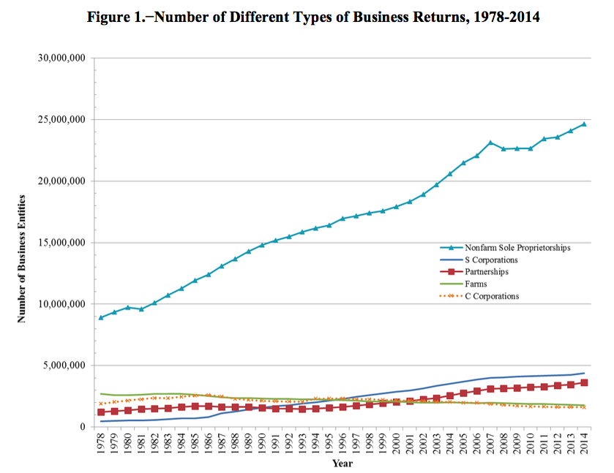
Different Business Returns
Source: JCX-42-17

Slide 11
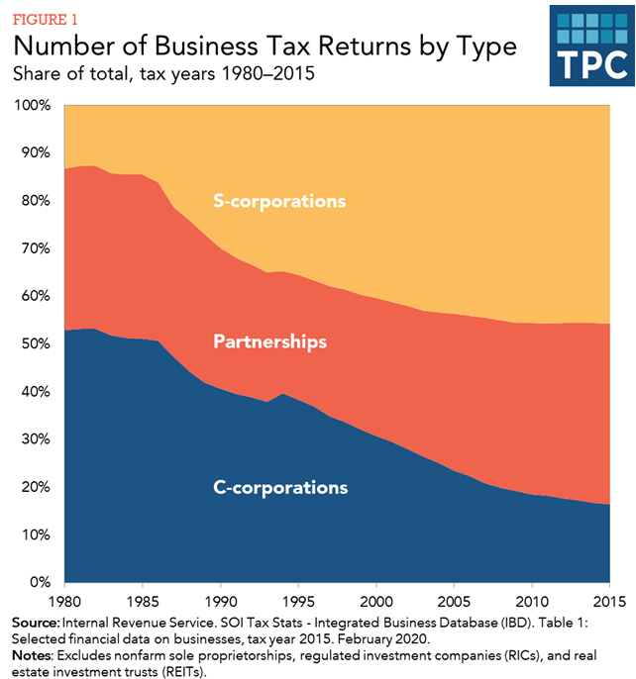
Number of Business Tax Returns by Type
Source: TPC, Key Elements of US Tax System

Slide 12
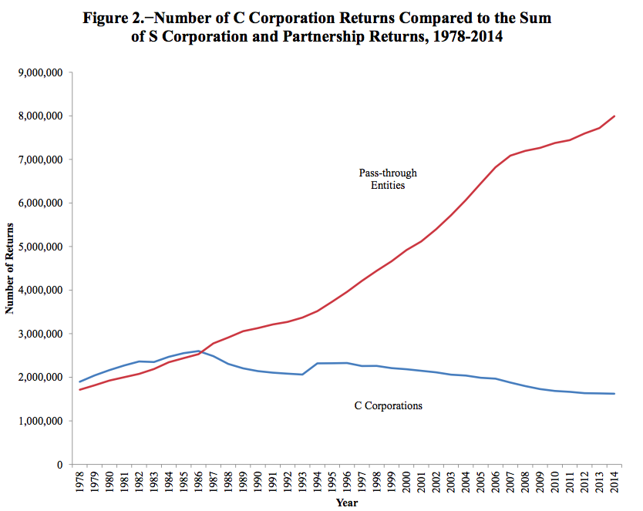
Passthrough vs. C Corporation
Source: JCX-42-17

Slide 13
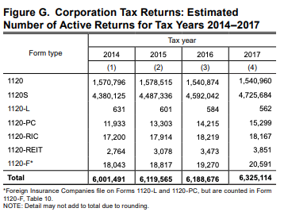
Number and Types of Corporate Returns
Source: IRS, SOI, Corp Inc. Tax Ret (2017)

Slide 14
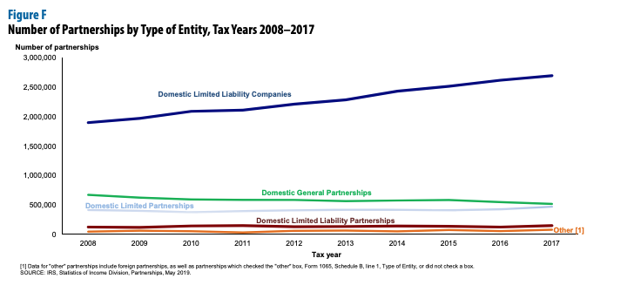
Partnership Returns by Type of Entity
Source: IRS, SOI, Fall 2019, Partnership Returns, 2017

Slide 15
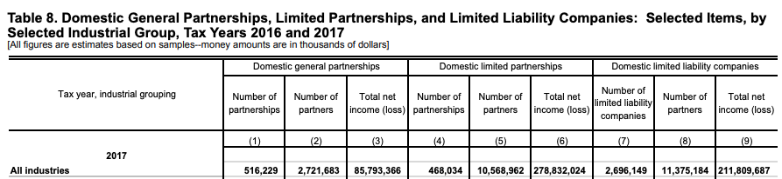
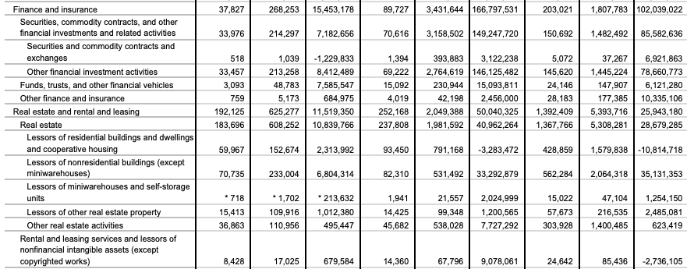
Number of Partnership Returns and Partners
Source: IRS, SOI, Fall 2019, Partnership Returns, 2017

Slide 16
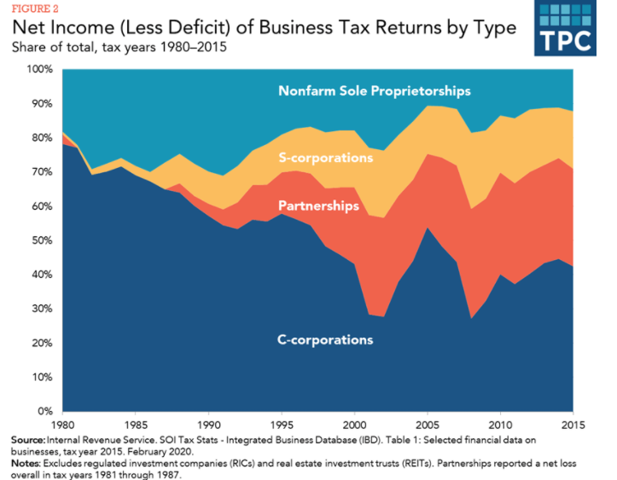
Net Income of Business Tax Returns by Types by Percent of Total (1980-2015)
Source: TPC, Key Elements of US Tax System

Slide 17
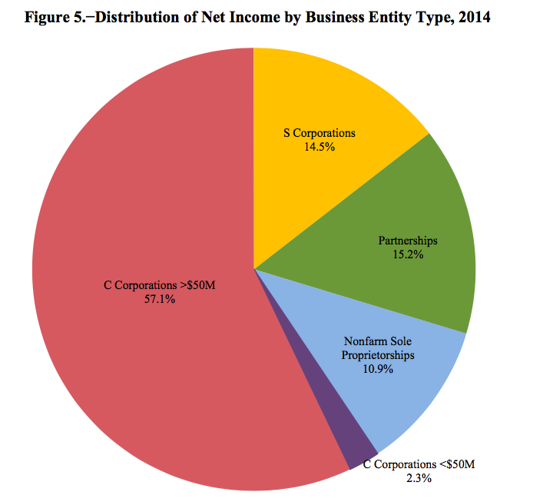
Income by Business Entity
Source: JCX-42-17

Slide 18
Overview of Federal Income Taxation
Separate Owner and Entity Taxation [Sub. C] (aka: double taxation)
Income Earned by Entity Taxed Separately from Owners’ Income
Income Earned by Entity Taxed Again to Owners when Distributed
Passthrough Taxation [Sub. K and Sub. S]
Income Earned by Entity is Taxed Directly to Entity’s Owners (whether or not actually received)
Income Earned by Entity not Taxed Again to Owners When Actually Received

Slide 19
Overview of Subchapter K
Existence of a partnership
Partnership or ….
Identities of Ps
Contributions of property to a partnership
Neither PSH nor Ps generally recognize gain or loss on the contribution of property to a PSH (§701)
PSH takes a carryover basis in the property and the Ps take a carryover basis in the PSH interest
Facilitate formations of partnership vs. shifting of pre-contribution g/l among partners
Partnership operations
A PSH not subject to tax on its income (§701), but PSH items of income, losses, etc. passed through to Ps. (§702(a))
Aggregate v. entity approach
Flexibility in allocating income, gains, losses among partners (§704(a))
Capital accounts
Special rules for nonrecourse deductions

Slide 20
Overview of Subchapter K (cont.)
Contributions of property with BIG and BIL (§704(c))
Liabilities
Ps get basis in PSH interest for PSH liabilities (§752)
Recourse and nonrecourse liabilities
Partner/Partnership Transactions (§707)
Sales of partnership interests
Gain or loss from transfer of PSH interest is generally capital (§741), except to the extent the PSH owns unrealized receivables or inventory items (§751).
Effect on the selling and the new partner
Distributions
Distributions are generally tax-free to Ps, except to the extent that any $ distributed exceeds a P’s basis in the PSH. (§731(a)(1))
Ps recognize losses only in complete liquidations. (§731(a)(2)).
Distributed property generally has the same basis in the hands of a P as it had in the hands of the PSH. (§732(a)(1)).
Effect on distributee and remaining partners
Disguised sales (§707(a)(2)(B))

Slide 21
Partnership Taxation
Application of “regular” tax rules
Aggregate v. entity treatment
Substance over form (common law)
Partnership anti-abuse rules (§1.701-2)
SubK must be applied in a manner consistent with intent of SubK
Economic substance doctrine (§7701(o))
Transaction has ES only if it changes in a meaningful way (excluding income tax effects) TP’s economic position and TP has substantial purpose (excluding income tax effects) for entering into transaction

