Slide 1
BULKLOADING USING GREENPLUM’s ANALYTIC ENGINE
Alex Infanzon
Notes:
Data delayed is insight lost. One challenge of large scale, multi-terabyte data warehouses and analytical environments is getting large amounts of data loaded within a given maintenance window. Greenplum’s analytic engine enables you to gain insight and value from your data by providing fast loading and agile deep in-database analytics.
This presentation concentrates primarily on how to load large data sets in a timely manner by combining the power of Greenplum's scatter-gather (gpfdist) and SAS® bulk loading. It also points out how to reap the benefits of Greenplum’s massive parallel architecture by leveraging SAS in-database processing capabilities. An example on how to configure and test bulk loading using SAS and Greenplum is presented.

Slide 2

Agenda
Industry trends
Scatter-gather approach
Connecting to Greenplum from SAS
Using gpfdist and SAS BULKLOAD to load data
In-database processing
Conclusions and Questions
Notes:
Brief review of the key Industry trends
Scatter-Gather Streaming™ is a new approach to loading data. It leverages the parallel-everything architecture of Greenplum and can achieve loading rates greater than 10TB per hour per rack. It provides support for both large-batch and continuous real-time loading strategies. It also enables complex data transformations “in-flight” and transparent interfaces to loading via support files, application and services.
SAS/ACCESS for Greenplum is an out-of-the-box solution that provide enterprise data access and integration between SAS and the Greeplum Analytic Engine. It provides fast and efficient access to the data sets in Greenplum
One of the coolest features that Greenplum offers as far as Extraction Transformation and Load (ETL) is concerned, is the combination of external tables with gpfdist. gpfdist is Greenplum's parallel file distribution server, it can be used in combination with the SAS BULKLOAD loading capability to provide the fastest way to insert large data volumes into Greenplum from a SAS program.
In addition to provide fast load capabilities. The Greenplum analytical engine allows you to use other techniques to further improve performance. SAS In-Database processing is a flexible, cost-effective way to manage increasing amounts of data by embedding SAS technology into databases. The result: improved accuracy, reduced data movement and streamlined analytic processes. For decision makers, this means faster access to analytical results and more agile and accurate decisions that comply with governance requirements.

Slide 3

Industry Trends
We've Pushed Past the Capacity
Handling a Huge Bag of Mixed Information
Providing Extended Features
Timeliness of data is Required
Notes:
We've Pushed Past the Capacity - Data is bursting at the seams. We have pushed past the capacity of traditional information management systems. Incremental improvements will and do help, but information growth is fast outpacing those improvements. The impact can be seen across the commodity infrastructure stack; transactional data stores, search engines, and data warehouses are simply unable to manage massive information sets while still providing the service levels customers have come to expect. A MPP architecture is the right approach to address this issue.
Handling a Huge Bag of Mixed Information - Customers are working with many different types of information from raw text and precise tables to complex de-normalized structures. Big data solutions need to support whatever mix of information a customer throws at it and allow flexible use of this information. When dealing with massive data sets, rigid schemas that force one to rebuild a database in order to provide a slightly different or extended view are not feasible to manage.
Providing Extended Features - The more information that is put into a big data store, the more users want to utilize the information in one place. It is simply too painful to move and sync massive data sets between specialized systems. Greenplum’s goal is to provide a single system that can handle processing, search, and analytics across their entire data set by embedding sub-systems that provide a different way to work with today's information (Hadoop, EDI, virtualization and collaboration environments Chorus)
Timeliness of data is Required - As big data solutions move from back office analytics to customer-facing production systems it is no longer acceptable to wait hours, or days, for an update to be available and usable across the information management infrastructure. Much of what is interesting about big data is the ability to understand what is happening right now. Whether providing trending topics for Twitter, price momentum for stocks, or fraud detection for financial transactions, management and processing of massive data sets in real time is required. This means that big data systems need to be able to ingest new information and make it available to end users fast.

Slide 4

Time to insight
Insight lost
Data delayed
Notes:
Generally speaking there are five phases to deploy your analytical applications and perform your analysis.
Modeling - In this phase you define your SAS Data Sets and create the corresponding tables that will host them in the Greenplum. You can also create analytical models using tools like SAS Enterprise Miner.
Data Preparation - In the data preparation phase data sources are identified and data is extracted. Normalizing, cleansing and transforming the data occurs during this phase.
Loading - In the loading phase the results of the data preparation phase are inserted into Greenplum. Extraction, Transformation and Loading can be viewed as the combination of Data Preparation and Loading phases. Extraction, Transformation and Loading are the phases that take most time – according to some studies it can be up to 80%.
Insert, update, select and delete are typical operations that occur during the query and analysis phase. In some cases the analytical models are executed inside the database and this time will be also considered part of the query and analysis phase.
In the interpretation phase queries and analytical model results analyzed by analysts and decision makers. A critical success factor is to have as much time as possible to
This is an iterative model, and each phase is refined or tuned to reduce the amount of time needed to go to market with your application.

Slide 5
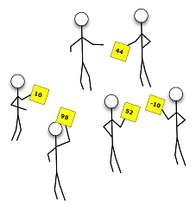
Greenplum’s Scatter-Gather Technique
Notes:
Greenplum supports fast, parallel data loading with its external tables feature. An external table could be a flat file, the output of an application or service. Combining external tables and gpfdist enables full parallelism by utilizing the resources of all Greenplum when loading or unloading data.
External tables can also be accessed in ‘single row error isolation’ mode, allowing administrators to filter out bad rows during a load operation into a separate error table, while still loading properly formatted rows. Administrators can control the acceptable error threshold for a load operation, giving them control over the quality and flow of data into the database.
By using external tables in conjunction with Greenplum Database’s parallel file server (gpfdist), administrators can achieve maximum parallelism and load bandwidth from their Greenplum Database system. Greenplum has demonstrated load rates in excess of 10 TB an hour.

Slide 6
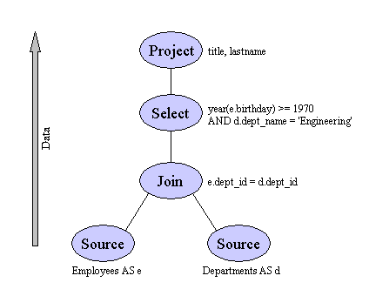

Greenplum MPP Architecture
Master Servers
Query planning & dispatch
...
...
Network
Interconnect
Segment Servers
Query processing & data storage
...
...
External Sources
Loading, streaming, etc.
Notes:
Greenplum Database is a massively parallel processing (MPP) analytical server based on PostgreSQL open-source technology. MPP (also known as a shared nothing architecture) refers to systems with two or more processors which cooperate to carry out an operation - each processor with its own memory, operating system and disks. Greenplum leverages this high-performance system architecture to distribute the load of multi-terabyte data warehouses, and is able to use all of a system’s resources in parallel to process a query.
Greenplum is essentially several PostgreSQL database instances acting together as one cohesive system. It is based on PostgreSQL 8.2.14, and in most cases is very similar to PostgreSQL with regards to SQL support, features, configuration options, and end-user functionality. Users interact with Greenplum as they would a regular PostgreSQL DBMS. The internals of PostgreSQL have been modified or supplemented to support the parallel structure of Greenplum. For example the system catalog, query planner, optimizer, query executor, and transaction manager components have been modified and enhanced to be able to execute queries in parallel across all of the PostgreSQL database instances at once. The Greenplum interconnect (the networking layer) enables communication between the distinct PostgreSQL instances and allows the system to behave as one logical system.
Greenplum also includes features designed to optimize PostgreSQL for business intelligence (BI) workloads. For example, Greenplum has added parallel data loading (external tables), resource management, query optimizations and storage enhancements which are not found in regular PostgreSQL. Many features and optimizations developed by Greenplum do make their way back into the PostgreSQL community. For example, table partitioning is a feature developed by Greenplum which is now in standard PostgreSQL.

Slide 7
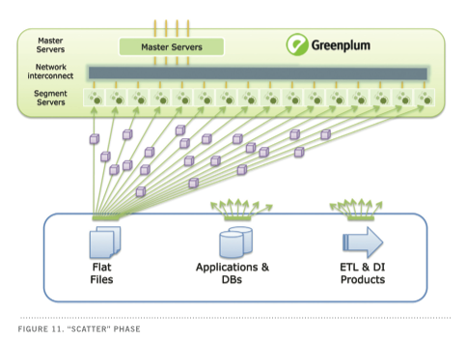
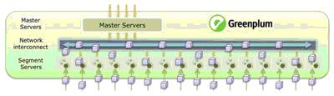
Greenplum’s Scatter-Gather Technique
Notes:
The Scatter-Gather Streaming technology takes advantage of all the segment servers in the Greenplum database. Data is streamed from either flat files, applications, other databases, ETL and/or Data Integration tools.
Data is distributed across all the segments using a hash key, one or more table columns can be used as the distribution key for the table. The distribution key is used by a hashing algorithm to assign each row to a particular segment. Keys of the same value will always hash to the same segment. Choosing a unique distribution key, such as a primary key, will ensure the most even data distribution. Hash distribution is the default distribution policy for a table. If a DISTRIBUTED clause is not supplied, then either the PRIMARY KEY (if the table has one) or the first column of the table will be used as the table distribution key. Rows of data are read from the source and are sent to the segment servers in a round robin fashion.
When a segment server receives a row it checks the distribution key to determine if the row needs to be inserted in the local database. If the row does not belong to the segment node it is shipped to the right segment server through the to the network interconnect.

Slide 8
Multiple Network Interface Cards
CREATE EXTERNAL TABLE ext_expenses ( name text, date date, amount float4, category text, desc text )
LOCATION ('gpfdist://etlhost-1:8081/*',
'gpfdist://etlhost-2:8081/*')
FORMAT 'TEXT' (DELIMITER ',');
8081
Notes:
If your ETL machine is configured with multiple network interface cards (NICs), run one instance of gpfdist on your ETL host and then define your external table definition so that the host name of each NIC is declared in the LOCATION clause. This allows network traffic between your Greenplum segment hosts and your ETL host to use all NICs simultaneously. Use the CREATE EXTERNAL TABLE command to define the external table and specify the location and format of the external table data files.
For example, if using a single Greenplum file server (gpfdist) instance on a machine with multiple NICs
CREATE EXTERNAL TABLE ext_expenses ( name text, date date, amount float4, category text, desc text )
LOCATION ( 'gpfdist://etlhost-1:8081/*',
'gpfdist://etlhost-2:8081/*')
FORMAT 'TEXT' (DELIMITER ',');

Slide 9
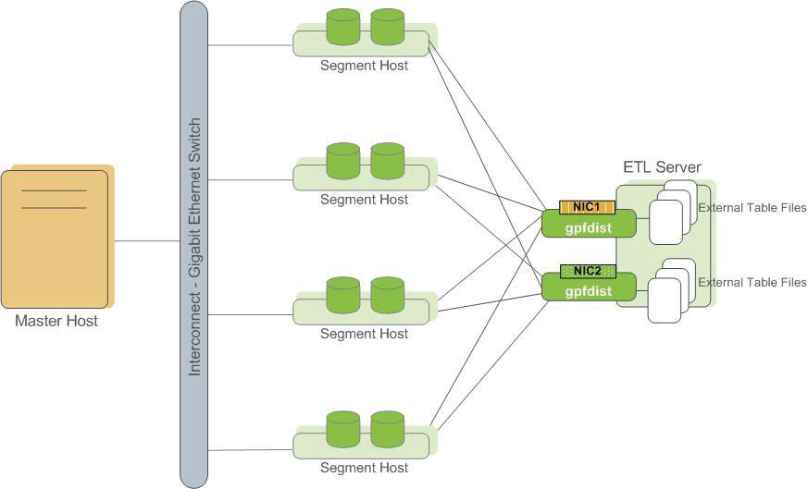
Multiple gpfdist Instances
CREATE EXTERNAL TABLE ext_expenses ( name text, date date, amount float4, category text, desc text )
LOCATION ('gpfdist://etlhost-1:8081/*',
'gpfdist://etlhost-2:8082/*')
FORMAT 'TEXT' (DELIMITER ',');
8081
8082
Notes:
Run multiple gpfdist instances on your ETL host and divide your external data files equally between each instance. For example, if you have an ETL system with two network interface cards (NICs), then you could run two gpfdist instances on that machine to maximize your load performance. You would then divide the external table data files evenly between the two gpfdist programs.
For example, if using multiple Greenplum file server (gpfdist) instances
CREATE EXTERNAL TABLE ext_expenses ( name text, date date, amount float4, category text, desc text )
LOCATION ( 'gpfdist://etlhost-1:8081/*',
'gpfdist://etlhost-2:8082/*')
FORMAT 'TEXT' (DELIMITER ',');

Slide 10

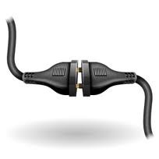

Connecting to Greenplum
Notes:
SAS Access interfaces enable SAS solutions to read, write and update data regardless of its native database or platform. Connectivity between SAS and Greenplum is established through the SAS Access for Greenplum interface.

Slide 11





SAS/Access for Greenplum
libname gpadmin greenplm uid=gpadmin pwd=gpadmin dsn=ddGP;
data gpadmin.emp;
set new;
run;
proc print data=gpadmin.emp;
var fn ln;
title 'This is a header message';
run;
SAS/Access
engine
LIBNAME
Statement
ODBC Driver Manager
Pass-Through Facility
ODBC Driver
GPDB
proc sql;
select a.LNAME, a.FNAME, b.SALARY
format=dollar10.2
from mydblib.STAFF a, mydblib.PAYROLL b
where (a.IDNUM eq b.IDNUM) and
(b.SALARY gt 40000);
quit;
SAS/ACCESS
ODBC
Greenplum
Notes:
Access to a RDBMS requires sending database commands from the client to be executed by the server. SAS Data Integration tools key features are:
• Data integration – allows you to treat data as a resource to be viewed and used in SAS® programs regardless of format
• SQL support – LIBNAME and Pass-Trough are the basic means of data integration.
• Bulk-loading – for moving data from SAS® into third party data stores
• Temporary table support – to create tables that can be accessed by multiple SAS® processes
• Metadata integration – for maintaining the RDBMS metadata within the SAS Metadata Repository
• Data integrity and security – enables encoding of RDBMS passwords and log-in and authentication.
In general it is usually easier to use SAS/ACCESS® ODBC to access a RDBMS. Before you can use the product you have to set up an ODBC data source that points to the database. The user needs to install the correct driver, for example, the DataDirect® ODBC driver for GPDB, and then configure the ODBC data source name (DSN). This only needs to be done once for each client workstation, after which the GPDB will be accessible.

Slide 12
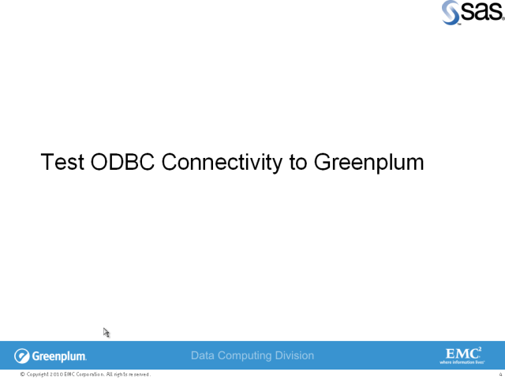
SAS Connectivity to Greenplum
Notes:
Click on the Test ODBC Connectivity to Greenplum title to view the demo

Slide 13

Loading Data – SAS BULKLOAD
Notes:
The purpose of bulk loading is to provide the highest possible load performance utilizing native DBMS load utilities. The ability to exploit native load utilities has huge performance implications when loading a large data set. The SAS/ACCESS libname engines allow you to easily invoke these native load extensions via libname and/or dataset options.

Slide 14
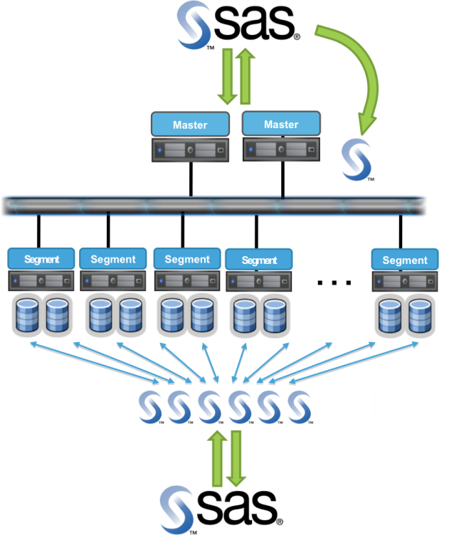
Loading Data Using SAS tools
Notes:
There are different ways to load data into Greenplum.
Using the SQL INSERT statement to add new rows into a table. One can insert one or more rows specified by value expressions, or zero or more rows resulting from a query. When using this approach the SAS application/program communicates with the Greenplum Master Server. The incoming rows are sent to the segment servers based on the hash distribution key. Use this approach for small volumes of SAS observations
SAS bulk loading capability is one of the fastest ways to insert large data volumes into a relational database. Combine SAS bulk load with Greenplum Scatter-Gather streaming technology to fully use all the segment servers in the database.

Slide 15




Putting it all together
libname mydblib greenplm dsn=ddGP user=gpadmin password=gpadmin;
proc sql;
create table mydblib.flights98
(bulkload=YES
bl_host='137.69.6.166'
bl_port='8082‘
bl_protocol='gpfdist')
as select * from Sasuser.Tours;
quit;
SAS/Access
RedHat Linux
For Greenplum
SAS for Windows
Driver
Manager
ODBC
Driver
GP Master
Server
GP Segment
Server
GP Segment
Server
gpfdist
GP Segment
Server
Notes:
:The Environmet
A Windows XP client connecting to a Greenplum Engine in a RedHat Linux Virtual Machine. The gpfdist loader is installed in the Windows XP client machine.
Create your loading proc in Base SAS
Connect to the Greenplum engine using SAS/ACCESS for Greenplum
PROC SQL is executed. The flights98 table as well as the external table based on the tours data set layout in the SASUSER library
Data is made available to gpfdist
gpfdist loads the data in parallel using all the segment servers

Slide 16
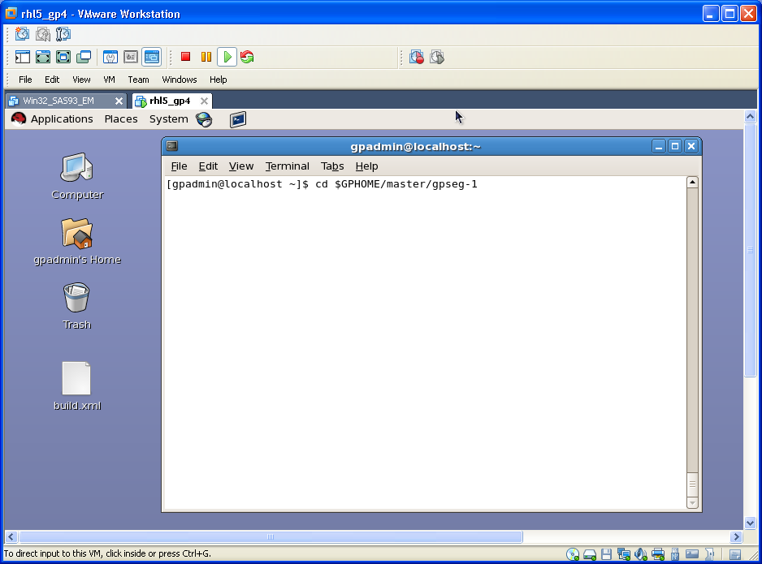
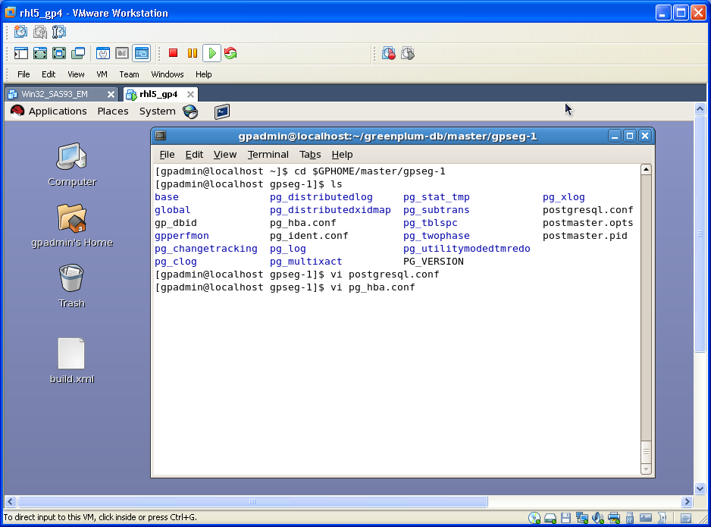
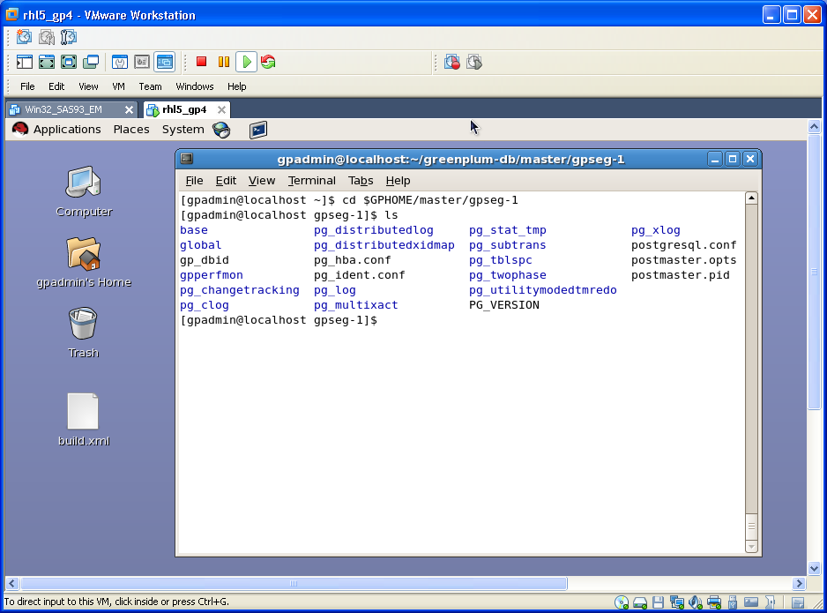
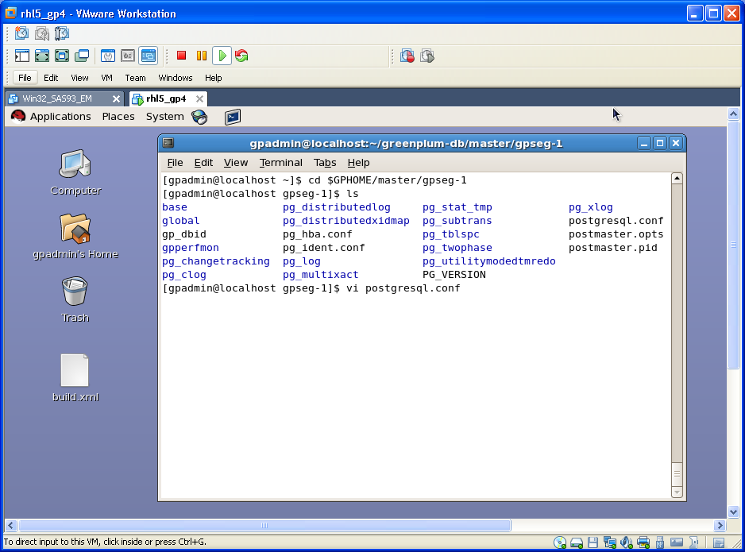
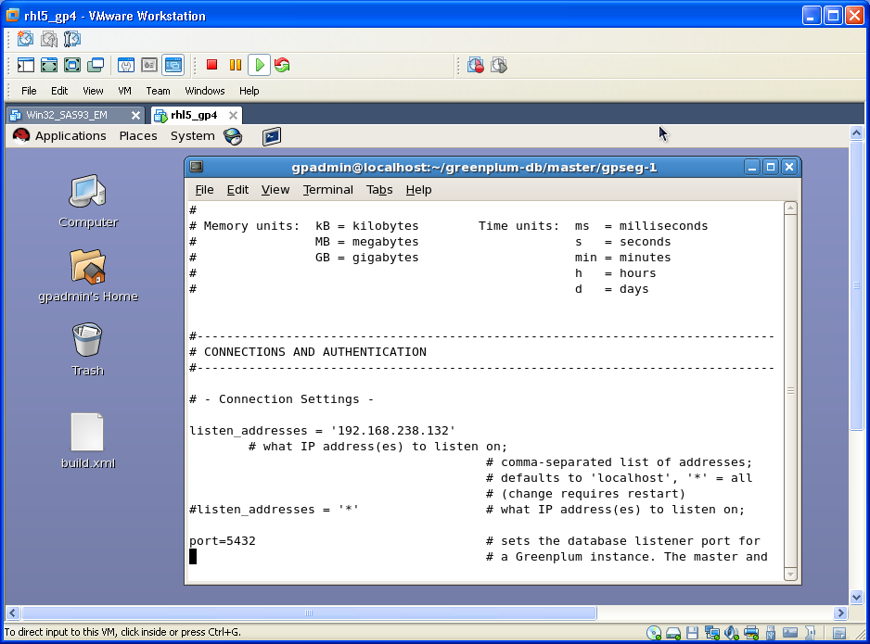
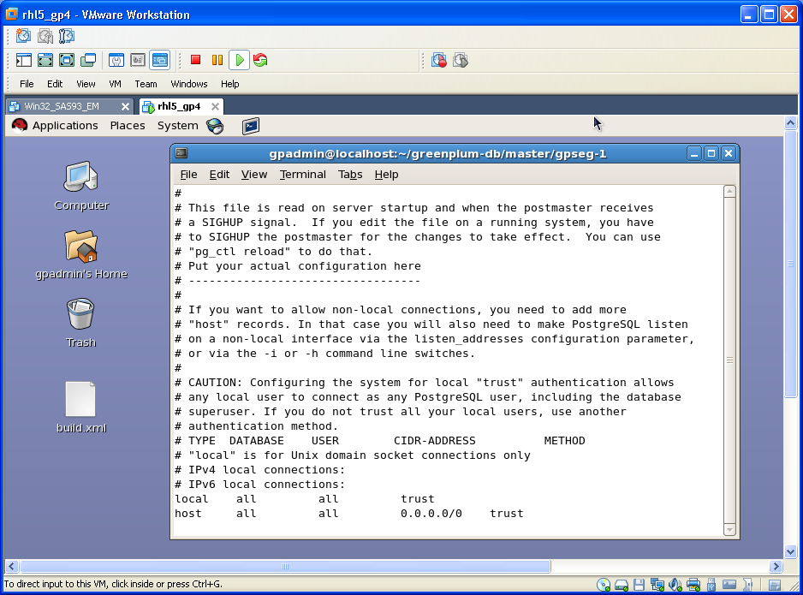
Configuring gpfdist
Notes:
In order for Greenplum Database to be able to accept remote client connections, you must configure your Greenplum Database master so that connections are allowed from the client hosts and database users that will be connecting to Greenplum Database.
To enable remote client connections
1. Edit the postgresql.conf file of the Greenplum master instance and modify the listen_addresses setting to include the TCP/IP addresses or hostnames of the remote clients. The special entry * corresponds to all hosts. For example:
listen_addresses = 'localhost', 'remotehost1', 'remotehost2'
listen_addresses = '*‘
2. Next, make sure that the pg_hba.conf file of the Greenplum master is correctly configured to allow connections from the users to the database(s) using the authentication method you want.
3. Restart Greenplum after making these configuration changes.
4. Also make sure that the databases and roles you are using to connect exist in the system and that the roles have the correct privileges to the database objects.

Slide 17
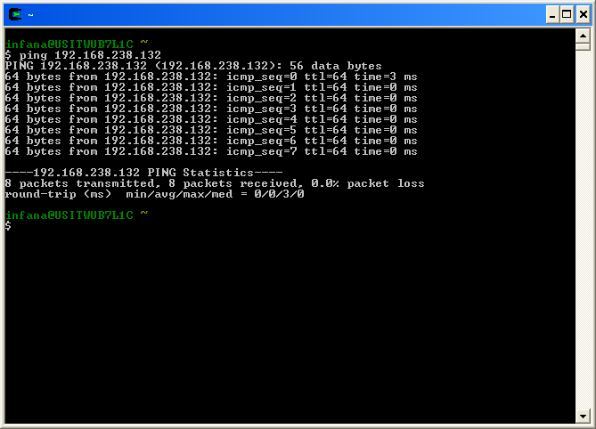
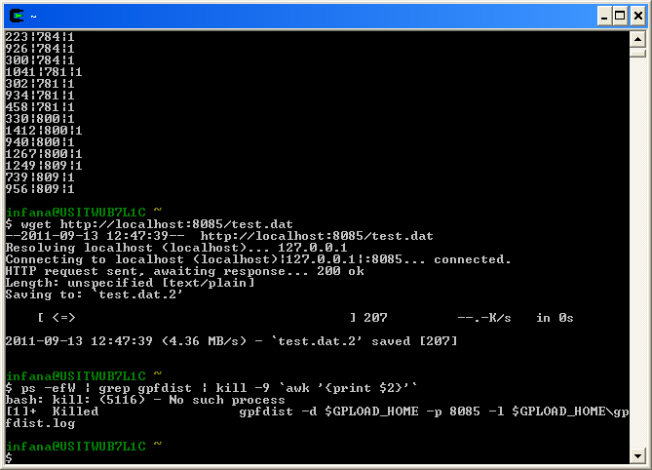
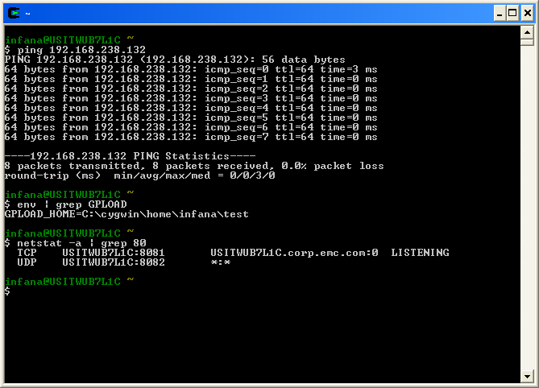
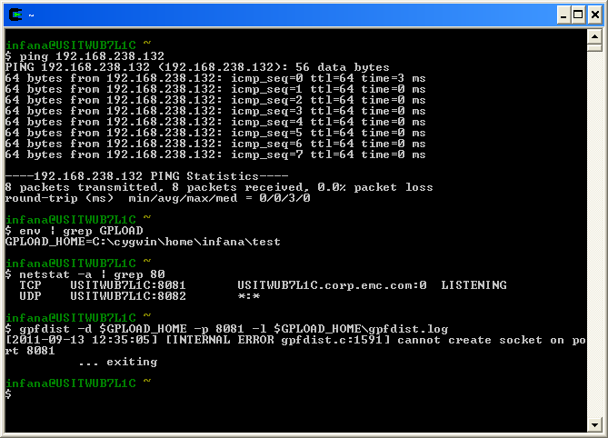
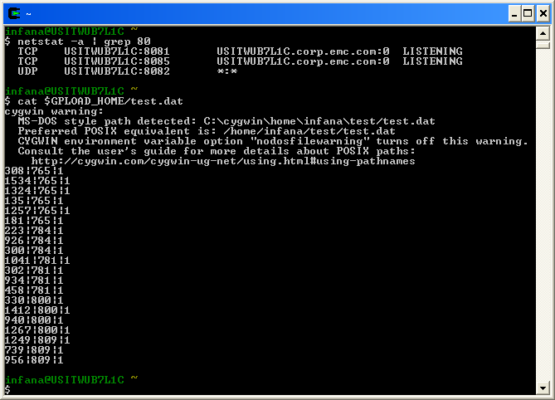
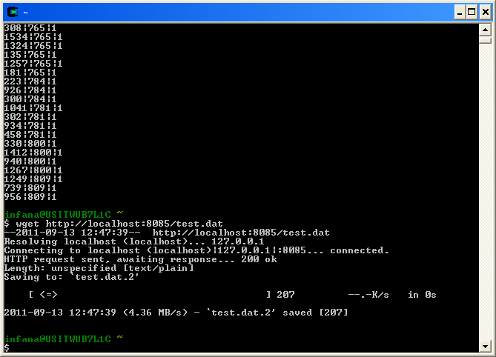
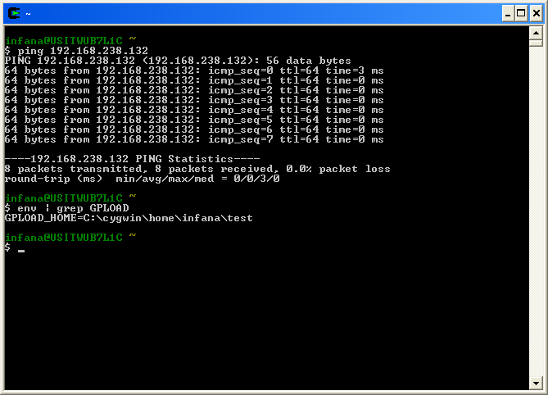
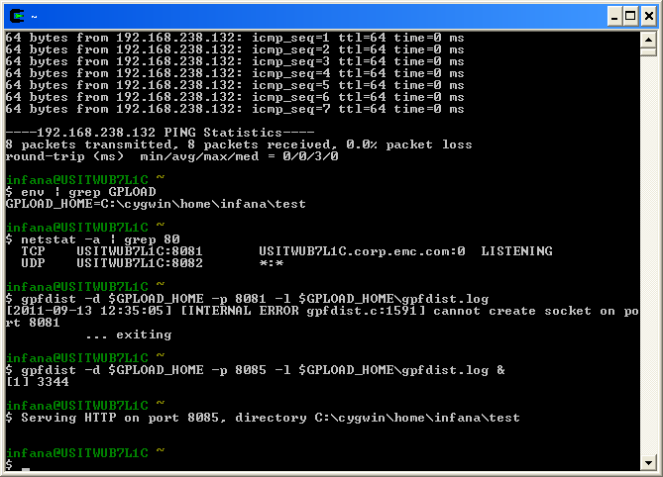
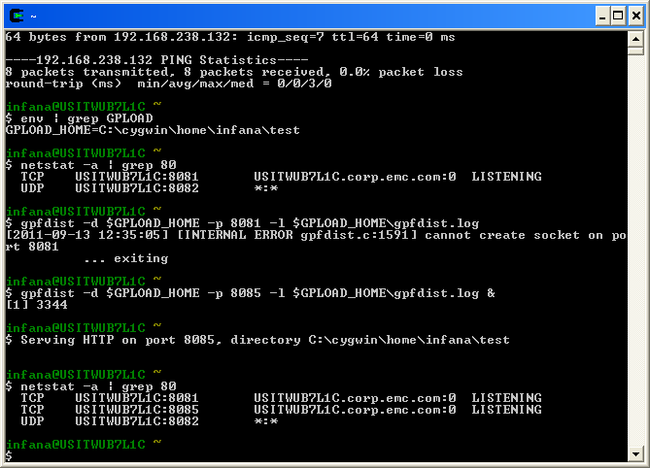
Start and Test gpfdist
Notes:
Follow this steps to test gpfdist is working properly:
Make sure you can ping the server where the Greenplum engine is installed
Verify that the GPLOAD_HOME variable is set
Check availability of the ports you intend to use for gpfdist; if the port is already in use an error will be displayed
Execute gpfdist in the background
Verify that gpfdist is listening in the right port
Create a small sample file
Test connectivity between an instance of gpfdist and a Greenplum database segment.
Use the kill command to terminate execution of gpfdist

Slide 18
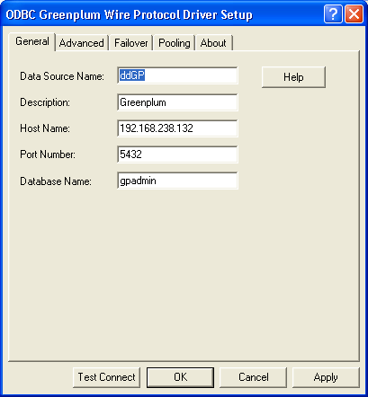
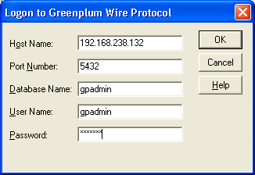
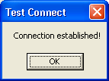
Test DSN Connection
Notes:
To test the DSN connectivity follow these steps:
Click Test Connect
Provide logon to Greenplum information and click OK
Connectioin message is displayed

Slide 19
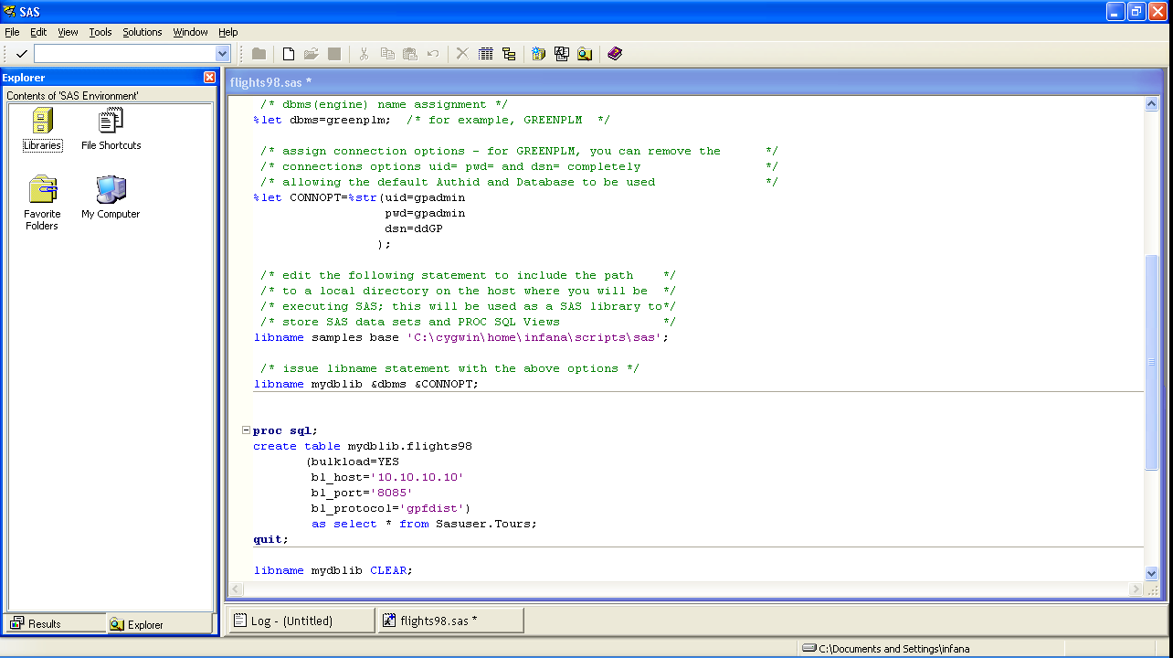
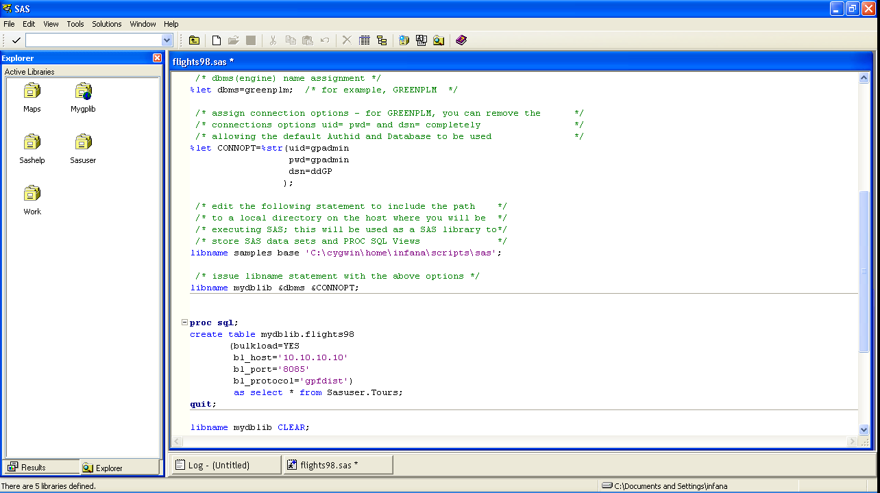
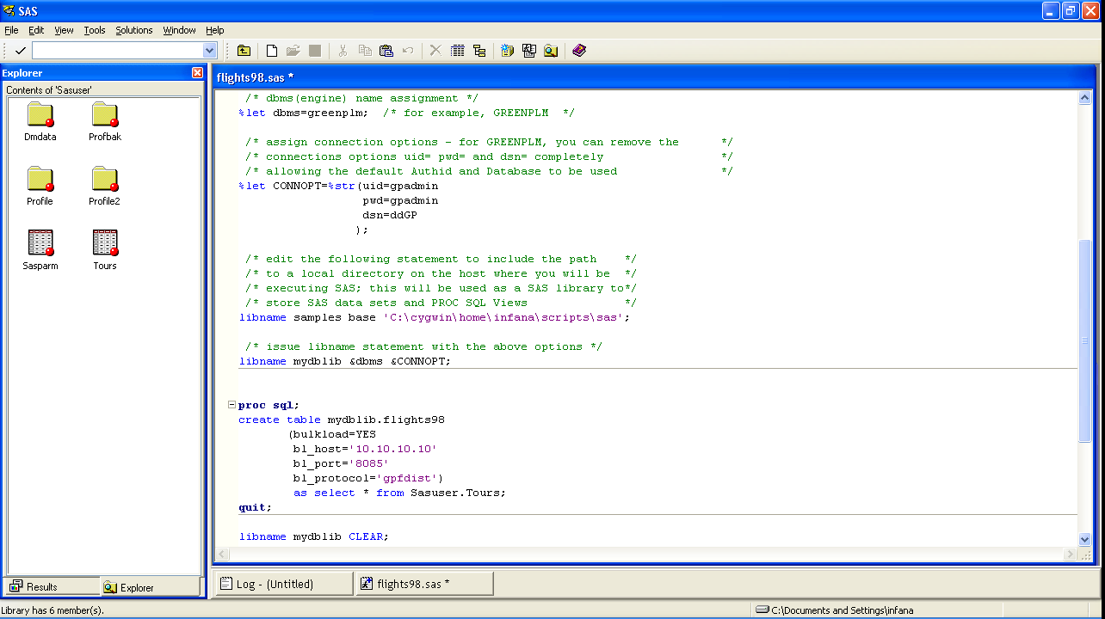
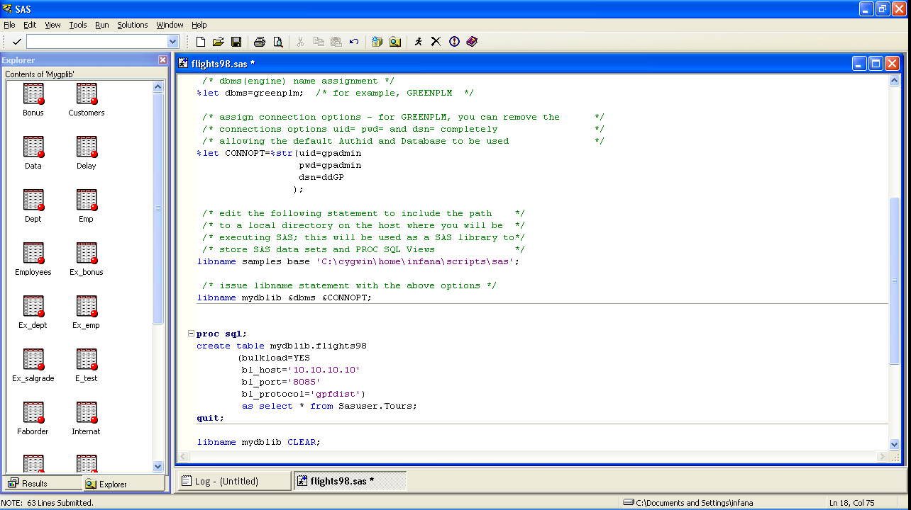
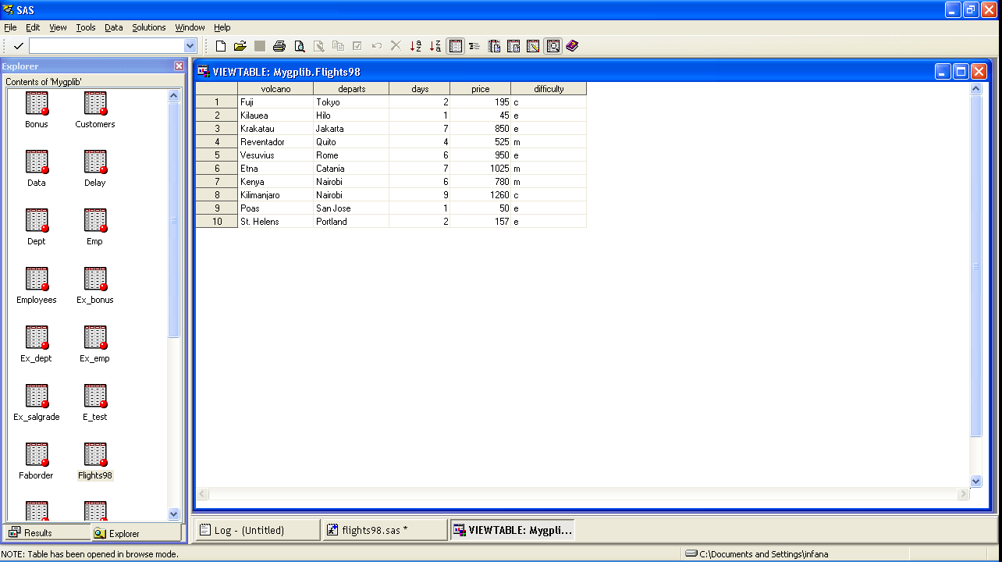
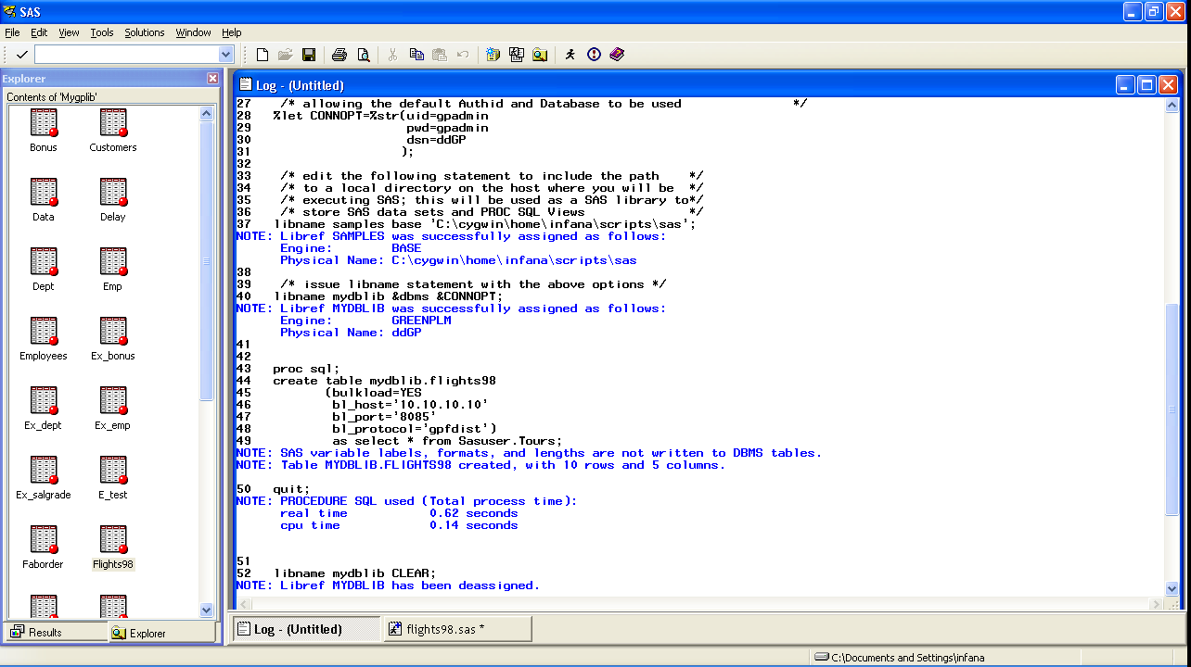
Execute Test Program in SAS for Windows
Notes:
Execute a simple Base SAS program
Check the SAS libraries available
Validate the Tours data set exits in the SASUSER library
Click backspace to return to the Active Libraries pane
Check the tables in the Greenplum library and make sure the flights98 data set does NOT exists
Execute the program and review the log for errors
Double click on the flight98 data set to display the observations that were loaded

Slide 20
Time to insight
BEFORE
Insight gained
AFTER
Timely data
Notes:
1. Humans are pretty bad at getting things right the first time, but very good at improving. By reducing the time devoted to loading and querying data, GP supports organizational learning. That is, with GP, more proportionally more time can be devoted to those organizationally distinctive activities of modeling and interpretation.
2. It is not uncommon for project teams to neglect plannning for success. When BI and analytical applications are seen organizationally as successful, the natural respone is a huge increase in demand for more. By reducing the cost to the organization in loading and querying data, the implementation team is helping position the organization for success.

Slide 21

in-database Processing
Notes:
“In-database processing is crucial to improving organizations' responsiveness in today's complex environments," said Dan Vesset, Program Vice President for Business Analytics Research at IDC. "SAS is stating its commitment to making in-database analytics more pervasive, enabling any customer to leverage SAS Business Analytics to improve the speed and accuracy of decision making throughout the organization."
SAS In-Database processing is a flexible, efficient way to leverage increasing amounts of data by integrating select SAS technology into databases or data warehouses. It utilizes the massively parallel processing (MPP) architecture of the database or data warehouse for scalability and better performance. Moving relevant data management, analytics and reporting tasks to where the data resides is beneficial in terms of speed, reducing unnecessary data movement and promoting better data governance. For decision makers, this means faster access to analytical results and more agile and accurate decisions.

Slide 22








SAS In-Database Processing
Data Mining Client
Publishing Client
Client Application
SAS
SAS
Model Publishing
Macro
Model Publishing
Macro
Score Code
Export Node
SAS/ACCESS
Interface
Scoring Functions
Deployed Component for In-Database Processing
score.sas
GPDB
score.xml
Format Catalog
Install Script
Notes:
1 Install the components that are necessary for in-database processing in the Greenplum database. This is a one-time installation process.
2 Use SAS Enterprise Miner to create a scoring model, and use the Score Code Export node to export files that are used to create the scoring functions to a score output directory.
3 Start SAS and run the SAS publishing macros.
4 After the scoring functions are created, they are available to use in any SQL expression in the same way that Greenplum built-in functions are used.

Slide 23
Time to insight
BEFORE
Insight gained
AFTER
Timely data
Notes:
Using in-database processing for operational analytics significantly reduces bottlenecks resulting from moving data over a network. For decision makers, this means faster access to analytical results they need to compete effectively.

Slide 24

Conclusion
SAS and Greenplum enable customers to gain timely insight and value from their data by providing fast loading and in-database processing capabilities.
Timely data is insight gained

Slide 25
CONTACT INFORMATION
Alex Infanzon
EMC Greenplum
Alejandro.infanzonmunoz@emc.com

