Slide 1

iSurvey
Survey Management System
John McCann ID:20086617
Hdip in Computer Science
01/06/2021

Slide 2
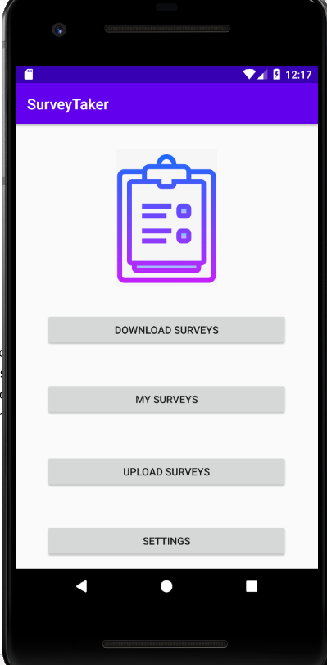
What is iSurvey?
iSurvey is a backoffice to mobile application designed to aid local authorities with public consultations and enable staff to get public opinion.
This app enables staff to gain easy, dynamic and important public feedback with relative ease to the end user.
Historically, previous applications were third party systems that didn’t give the flexibility and control that iSurvey will.

Slide 3

Demo

Slide 4
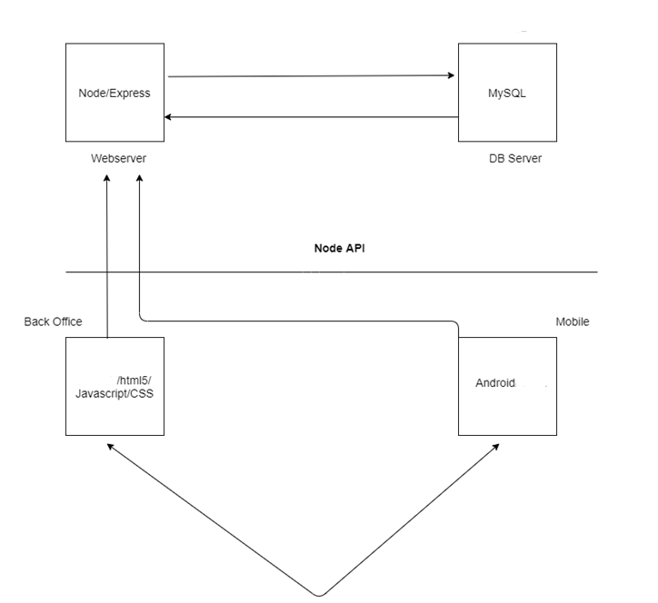
Project Aims
How iSurvey works!
A survey is created in the back office and saved in a database.
Staff then connect via a mobile app to the database to download the survey.
They then run the survey on the application, save and upload answers when completed.

Slide 5
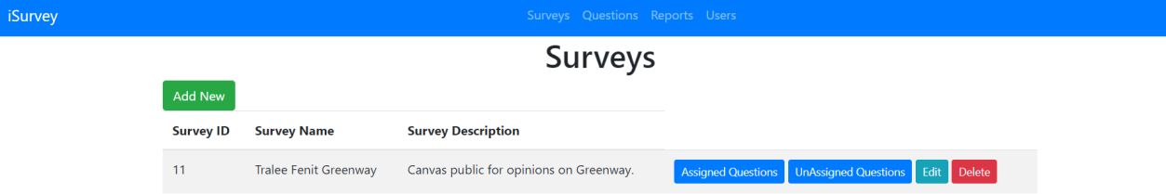
Project Aims
Back Office Functionality
Create Survey
Create Questions
Assign Questions to Survey
Assign Survey to User
Process Survey Answers

Slide 6
Project Aims
Mobile Functionality
Download Surveys
List Surveys
Gather Answers
Upload Completed Survey
Settings

Slide 7
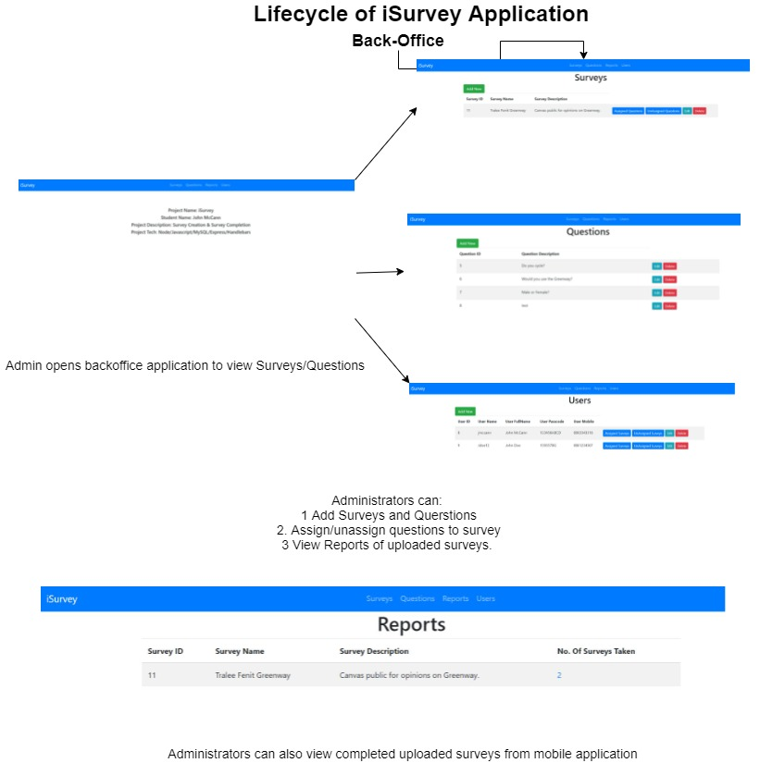
Lifecycle of iSurvey Application
Back office
Users open back office application and can do the following :
Add Surveys and Questions
Assign/Unassign questions to surveys
Assign/Unassign surveys to users
View Reports of uploaded surveys

Slide 8
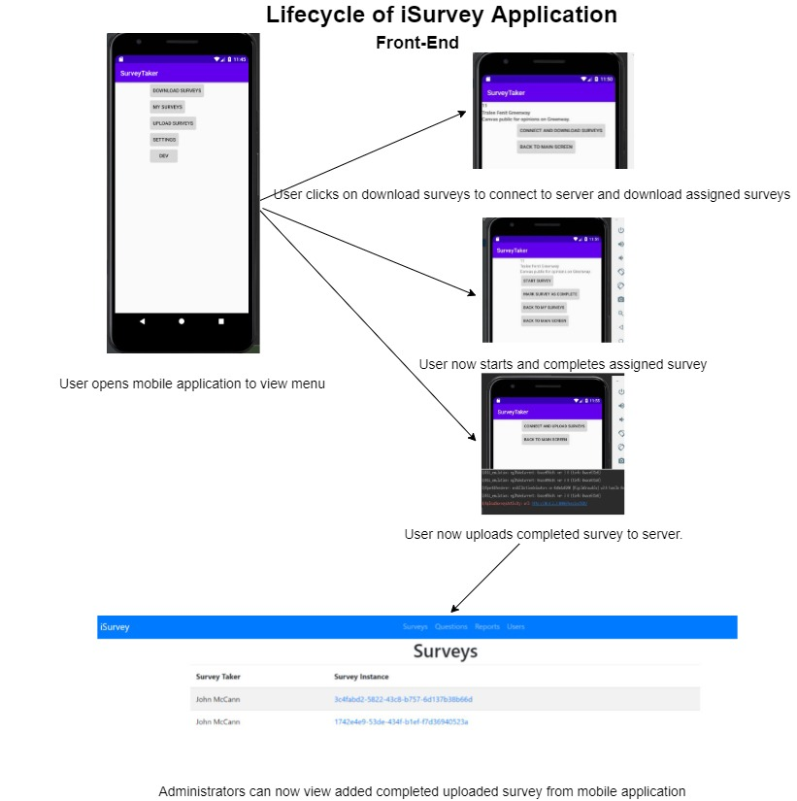
Lifecycle of iSurvey Application
Mobile Application
Users open mobile application and can do the following :
View Menu
Connect and download associated surveys
Start and complete assigned survey
Upload completed survey to server
View added completed survey from mobile app

Slide 9






Technologies
Visual Studio Code
enriched built-in support for Node.js development
great tooling for web technologies such as JSX, HTML, CSS, and JSON, all of which are evident within the project
Node.js
scalability, ease of use and reputation as a well tested tool ensured that node.js would be included in the development of this project.
Android Studio
easy to use interface, along with highly efficient testing tools makes Android Studio the perfect mobile development tool
MySQL
Familiarity, expertise and ease of use through my work on the Databases module of Semester Two ensured MySQL’s place in this project
Handlebars
This templating engine with powerful features was the perfect tool in UI development

Slide 10
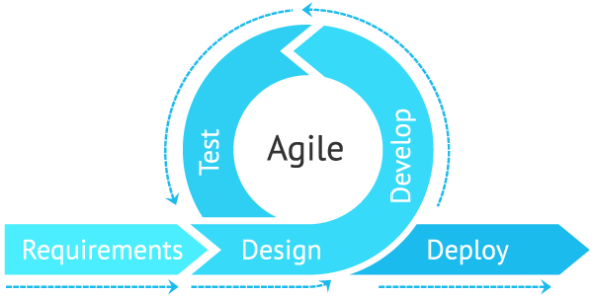
Methodology
Agile Development
By breaking the product into cycles, the Agile model enabled me to deliver a working product.
Initial set up
Backend development
Mobile development - initial stages emphasis on functionality
UI of the mobile application was improved to a more aesthetically pleasing and easy to use app
After rigorous testing, application was ready for submission.

Slide 11
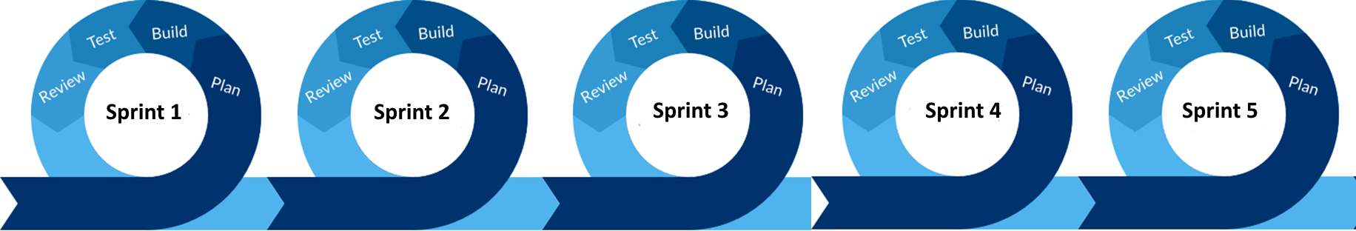
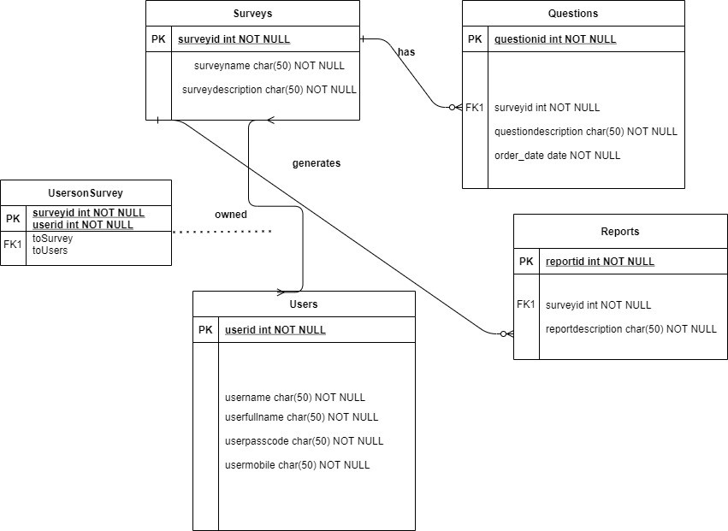
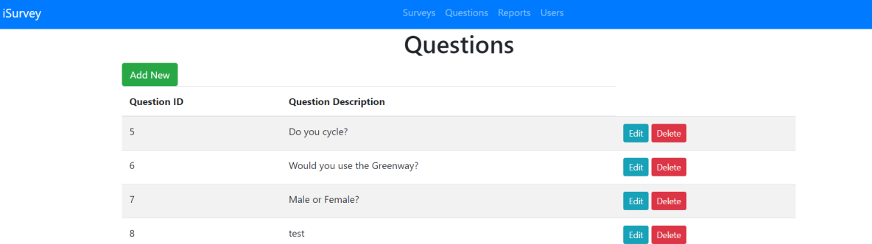
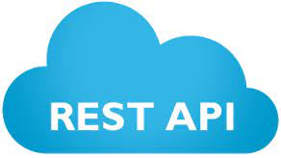
Implementation
Initial Software Installation
Creation of tables & api
Frontend Development
Mobile Backend Development
Mobile Frontend Development

Slide 12
Implementation
Agile Development
Initial Software Installation
Creation of tables & api
Frontend Development
Mobile Backend Development
Mobile Frontend Development
Installation of software for the back office development of the project.
Creation of tables and API in the second step of back office development
Building html pages with handlebars, CSS and bootstrap
Building of a mobile app including activities within android studio and the use of SQLite.
Building of a REST API to be called from Java on mobile device

Slide 13

Project Outcomes
Success ✓
Back office functional requirements achieved:
Creating both Surveys and Questions
Assigning Questions to Surveys and Surveys to a User
Processing Survey Answers
Mobile Functionality requirements achieved:
Downloading and Listing Surveys
Gathering answers
Uploading the completed surveys
Changing setting features as required

Slide 14

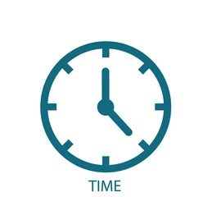

Lessons Learned
Sourcetree was a “source” of constant frustration as it often crashed midway through some important commits which did not leave this developer best pleased!!
Android Studio on a Windows machine with insufficient RAM was not the best idea as the constant crashing of the emulator and slow Gradle building was often the cause of aggravation!
As usual time constraints dictated a lot of the application capabilities. Given more time this app would be more polished looking and capable of a lot more functionality

Slide 15




Next Release
Hosting
Security
Login
Data Validation
Hosting this application would be the obvious next step as this project demonstrates it’s working locally
With limited security included in this app, further security is essential to ensure this application is completely secure.
Adding a splash screen or login screen would have made the application more aesthetically pleasing
Data Validation in the back office and mobile device is also an obvious requirement

Slide 16
Personal Reflection
This project began as a personal project but now has potential to be utilized within the organization that I work (Kerry County Council) which is an undoubted bonus.
A mention has to go to my extremely supportive and patient family, my wife Daire and children Ellie and Luke who have had to endure the challenges that come with the HDip and have always been there with love and support!
Thanks also to Rosanne Birney, whose advice and guidance was always sound and helped me focus on what was required and was of great help throughout the whole process.
To my friend Brendan Hayes, whose knowledge, expertise and love of Android Studio helped me no end in getting to the finish line and for that I am eternally grateful!
Overall both this final project (and indeed the HDIP in general) have challenged and rewarded me in equal high measures and hopefully this project is a proper indication of the hard work and interest shown for the duration of the course.

Slide 17

Any Questions?

Slide 18


