Slide 1

Who’s at home?
Project Proposal: To develop a smart home IOT application that records the coming and goings of family members from home using Bluetooth technology in conjunction with the raspberry pi. This data is then stored and used for informational purposes and exported to a database and can be used at a later date to chart various trends etc with the view to further enhancement using cloud platform technologies to send notifications upon clock in/out.

Slide 2
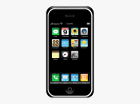
Using Bluetooth technologies and having run a script to identify the Bluetooth of my wife Daire’s and my phone , we can use this to register when each of us enter or leave the family home.

Slide 3

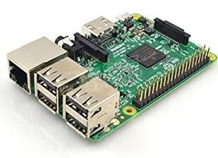
Using Bluetooth technology the pi will recognize the mobile phone (and it’s owner) upon entering and leaving the house and will display this information on the sensehat as will as printing it on the pi.

Slide 4

I will then create a database on Mysql and send the data from the pi and store in the database for further analysis.

Slide 5

The data is then sent to a webserver where it can be viewed on a website and checked for particular patterns/trends etc.

Slide 6



Further enhancement may be explored using
IOT platforms to send sms messages/tweets
to family members letting them know they are
home….and to bring some milk!!

