Slide 1

ONC Annual Meeting: MU Training Day Utilizing the popHealth Tool to Support Quality Measure Analysis
Rob McCready
November 18, 2011

Slide 2
Learning Objectives
Upon completion of this training, you will be able to:
Understand the execution of the Meaningful Use Clinical Quality Measures
Understand the Meaningful Use business rules as they relate to reporting Clinical Quality Measures
Use the popHealth web application to explore and understand the Clinical Quality Measure results of a patient population

Slide 3


popHealth Project Background
A not-for-profit organization chartered to work in the public interest

Slide 4
Clinical Quality Measures (CQMs)
Measures of the healthcare provider's:
Processes
Experience
Outcomes
Observations
Treatments
… as they relate to healthcare quality
http://www.ama-assn.org/ama1/pub/upload/mm/399/ehr-clinical-quality-measures.pdf

Slide 5
Clinical Quality Measures (CQMs)
All CQMs include:
Initial Patient Population
Filters patients down based on demographics
Ie. Age/Gender
Denominator
Query logic applied to the Initial Patient Population
Filters patients down based on clinical and provider encounter attributes;
Diagnosis/Condition
Lab Result
Encounter
Etc.
Numerator
Applied to the Denominator, and measures the
Filters patients down based on quality metrics;
Medications/Vaccination
Procedures/Imagery/Labs/Exams/Physical Exam
Cessation/Intervention/Counseling
Etc.
Exclusion
Removes a patient from the denominator based on clinical attribute

Slide 6
Clinical Quality Measures (CQMs)
CQMs Report at a Simple Performance Rate as a Fraction
Numerator
Denominator
Consider
Initial Patient Population: 1000 Adults
Denominator: 500 Hypertensive Adults
Numerator: 400 With BP in the Past Year
400
500
= 80%

Slide 7
Meaningful Use Process Logic
There are 44 Meaningful Use CQMs
At a minimum, an eligible provider should select a total of 6 CQMs to report out on Meaningful Use
For Stage 1, eligible providers should initially select from the 3 Core Measures
If any of the Core Measures result in a “0” numerator, for whatever reason, choose a replacement from the Core Alternate Measures
Additionally, select 3 from the Optional set of the remaining 38 CQMs

Slide 8
popHealth
An Open Source, Reference Implementation, Clinical Quality Measure Reporting Tool
Empowers healthcare providers to perform Meaningful Use Clinical Quality Measure reporting
Promotes easier submission of Clinical Quality Measure to public health organizations
Key Features
Healthcare provider-friendly user interface
Reflects Meaningful Use Process Logic
Includes support for all 44 of Meaningful Use Stage 1 Outpatient Clinical Quality Measures
Integrates with Electronic Health Record systems via nationally recognized data standards

Slide 9
popHealth
Leverages Standards-Based Data Inputs
Integrates with certified EHR continuity of care data standards for patient inputs
HITSP C32 XML Standard
ASTM CCR XML Standard
Produces a single XML reporting artifact as output
PQRI XML Standard
Deployed within a Healthcare Provider’s Firewall
Identifiable Patient Data Remains in the Provider’s Practice
Addresses security and privacy issues

Slide 10
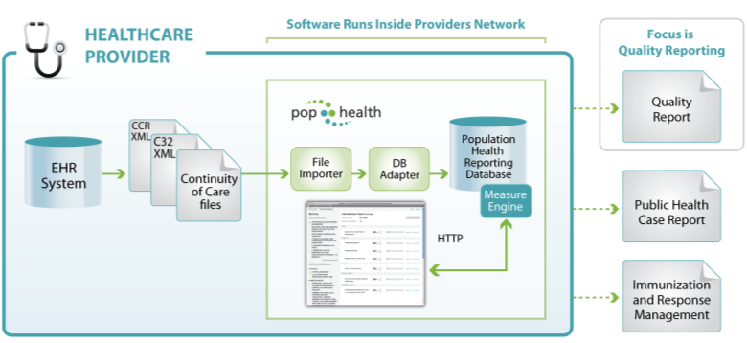
popHealth ConOps

Slide 11
Exercise: Analysis of Meaningful Use (MU) Stage 1 Clinical Quality Measures (CQM) via popHealth

Slide 12
Exercise: Analysis of MU CQM Results via popHealth
Description:
Use of the popHealth web analysis tool to understand the MU CQM results of a patient population
Mode of Participation:
Web-based interaction with a publicly available popHealth demonstration server
Time Allotted:
15 minutes: Moderator Demonstration of popHealth
30 minutes: Interactive Demonstration using popHealth
15 minutes: Exercise Brief Out
Directions:
Review the scenario, and work together to develop a report for your notional eligible provider’s CQM results
Each participant will explain her/his results during the brief out

Slide 13

Session Wrap Up/Summary
In this session, we reviewed:
The Meaningful Use Stage 1 Clinical Quality Measures
The Meaningful Use business rules as they relate to reporting on Clinical Quality Measures
Use of the open source popHealth reference implementation software for analysis and reporting the MU CQM results against a patient population

Slide 14
Backup

Slide 15
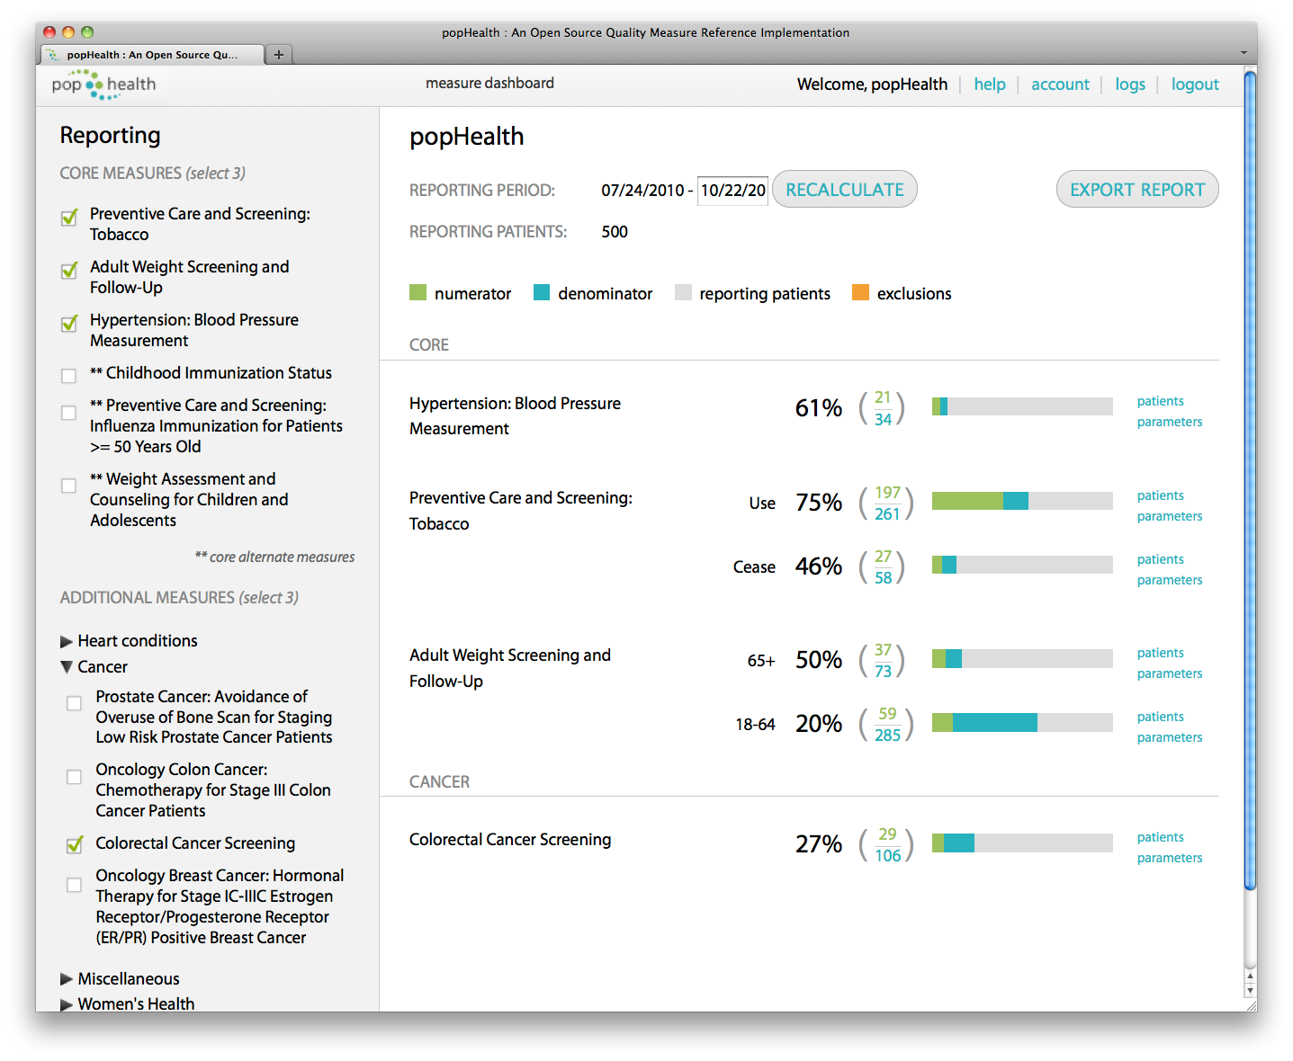
popHealth Dashboard

Slide 16
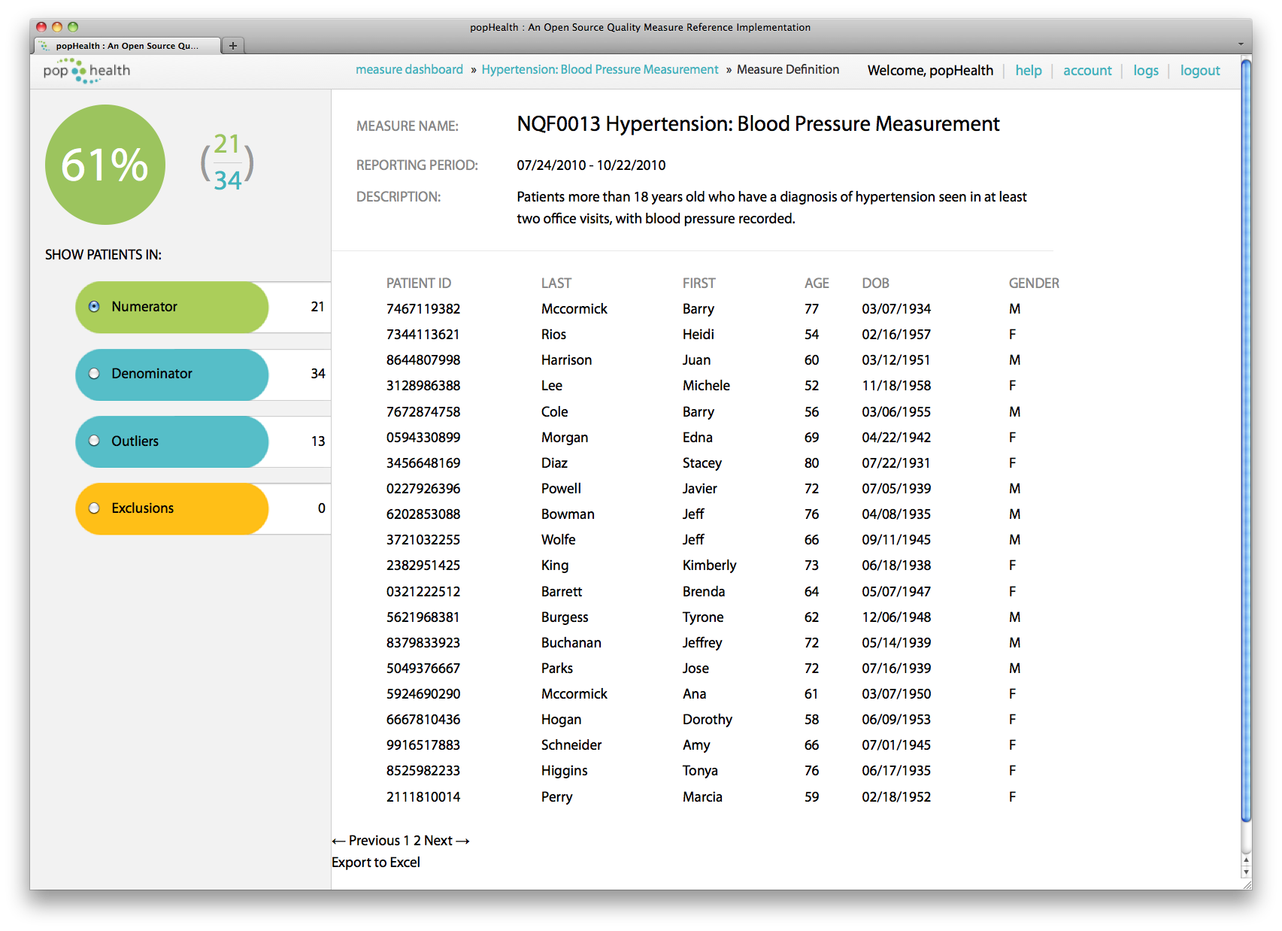
popHealth Patient Results View

Slide 17
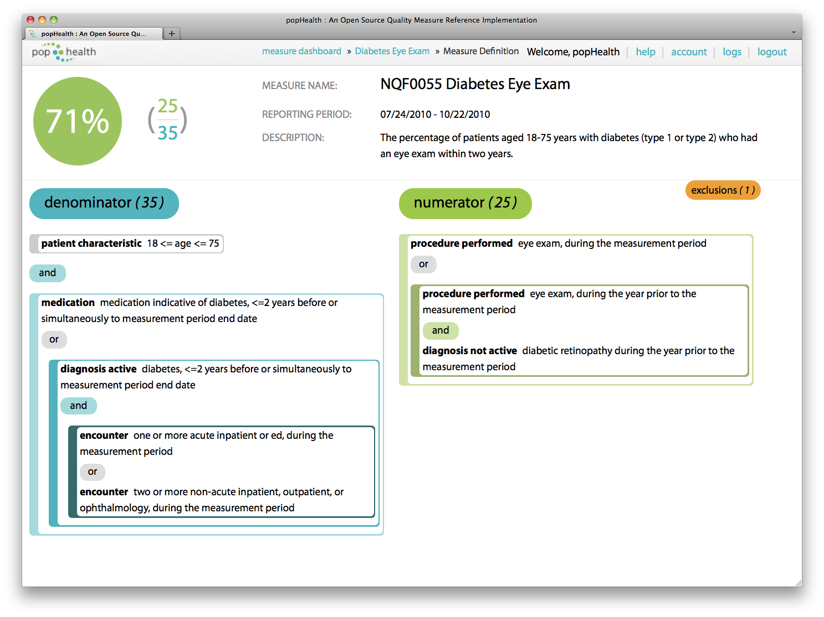
popHealth Quality Measure View

